Slide 1
Princeton Initiative: Bubbles
Markus Brunnermeier
Princeton University
TexPoint fonts used in EMF.
Read the TexPoint manual before you delete this box.: AAAAAA

Slide 2
Systemic risk – a broad definition
Systemic risk build-up during (credit) bubble
… and materializes in a crisis
  “Volatility Paradox” contemp. measures inappropriate
Spillovers/contagion – externalities
  Direct contractual: domino effect (interconnectedness)
  Indirect: price effect (fire-sale externalities)
  credit crunch, liquidity spirals
  Adverse GE response amplification, persistence
preventive
Fire
sales
crisis management
Shock to
capital
Loss of
net worth
Precaution
+ tighter
margins
volatility
price

Slide 3
Bubbles and Crashes
Dilip Abreu and Markus Brunnermeier
Princeton University
TexPoint fonts used in EMF.
Read the TexPoint manual before you delete this box.: AAAAAA

Slide 4
Story of a typical technology stock
Company X introduced a revolutionary wireless communication technology.
It not only provided support for such a technology but also provided the informational content itself.
It’s IPO price was $1.50 per share. Six years later it was traded at $ 85.50 and in the seventh year it hit $ 114.00.
The P/E ratio got as high as 73.
The company never paid dividends.
Notes:
About RCA: read Bernheim et al (1935) “The Seucrity market” Findings and Recommendations of a special staff of the 20th century fund – p. 475 and following

Slide 5
Story of RCA - 1920’s
Company: Radio Corporation of America (RCA)
Technolgy: Radio
Year: 1920’s
  It peaked at $ 397 in Feb. 1929, down to $ 2.62 in May 1932,

Slide 6
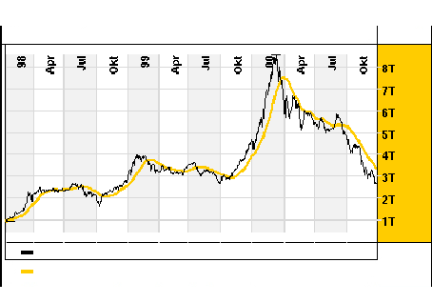
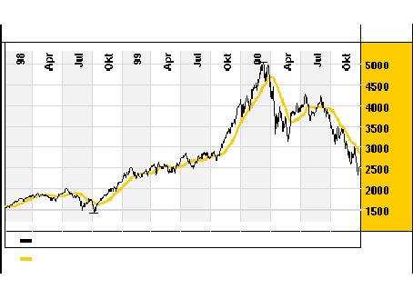
Internet bubble - 1990’s
Why do bubbles persist?
Do professional traders ride the bubble or attack the bubble (go short)?
What happened in March 2000?
Loss of ca. 60 %
from high of $ 5,132
Loss of ca. 85 %
from high of Euro 8,583

Slide 7
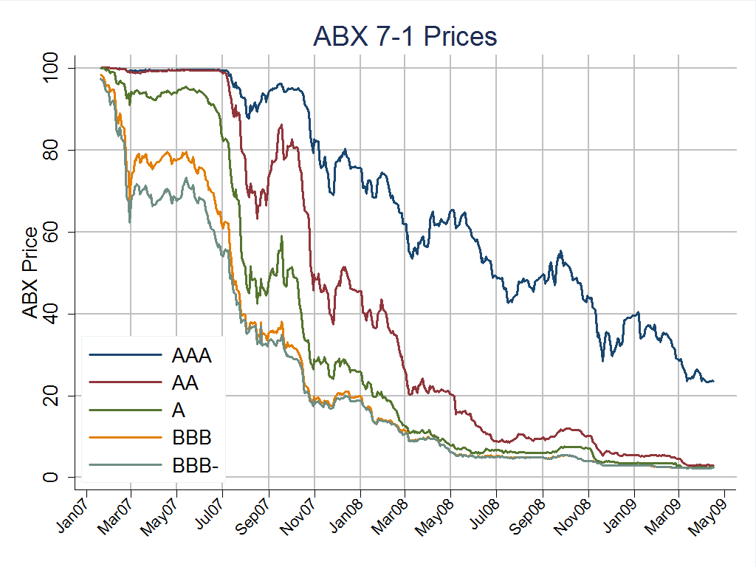
Credit bubble 2004-2006

Slide 8
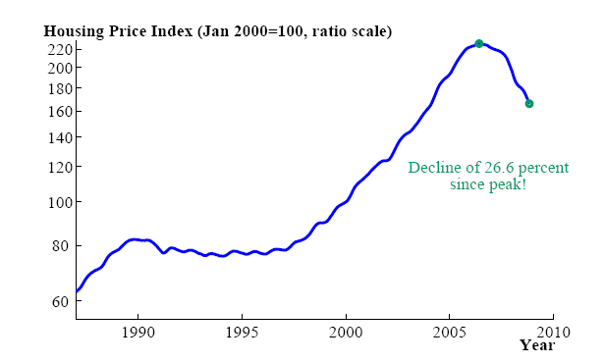
US House price index – Case-Shiller

Slide 9
Housing Bubble

Slide 10
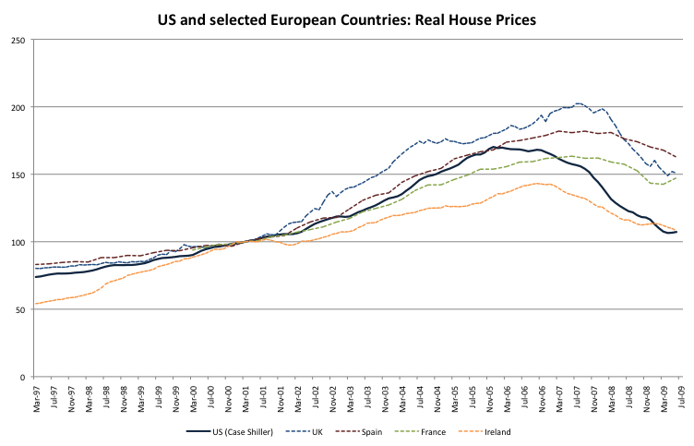
Housing bubble

Slide 11
Do (rational) professionals ride the bubble?
South Sea Bubble (1710-1720)
  Issac Newton
    04/20/1720 sold shares at £ 7,000 profiting £3,500
    Re-entered the market later – ending up losing £20,000
    “I can calculate the motions of the heavenly bodies, but not the madness of people”
Internet Bubble (1992 – 2000)
  Druckenmiller of Soros’ Quantum Fund didn’t think that he party would end so quickly.
    “We thought it was the eighth inning, and it was the ninth.”
  Julian Robertson of Tiger Fund refused internet stocks.
Housing bubble (2007)
  Chuck Prince “Dance as long as the music is playing”

Slide 12
Pros’ dilemma
“The moral of this story is that irrational market can kill you …
Julian said ‘This is irrational and I won’t play’ and they carried him out feet first.
Druckenmiller said ‘This is irrational and I will play’ and they carried him out feet first.”
Quote of a financial analyst, New York Times
April, 29 2000

Slide 13
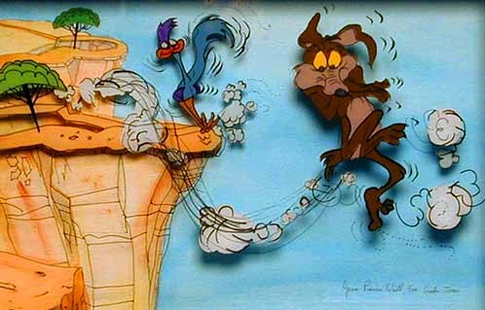
Minsky moment – Wile E. Coyote Effect

Slide 14
Stylized facts
Initial innovation justifies some price increase
Momentum leads to price overshooting
  Extrapolative expectations
Many market participants seem to be aware that the “price is too high” but keep on holding the asset
  “Play as long as the music is playing”
Resell-option is crucial for speculative bubbles
Credit bubbles lead to extra amplification effects in downturn (since they can impair financial sector)
  subprime borrowing was only 4% of US mortgage market
  Amplification focus of next lecture

Slide 15
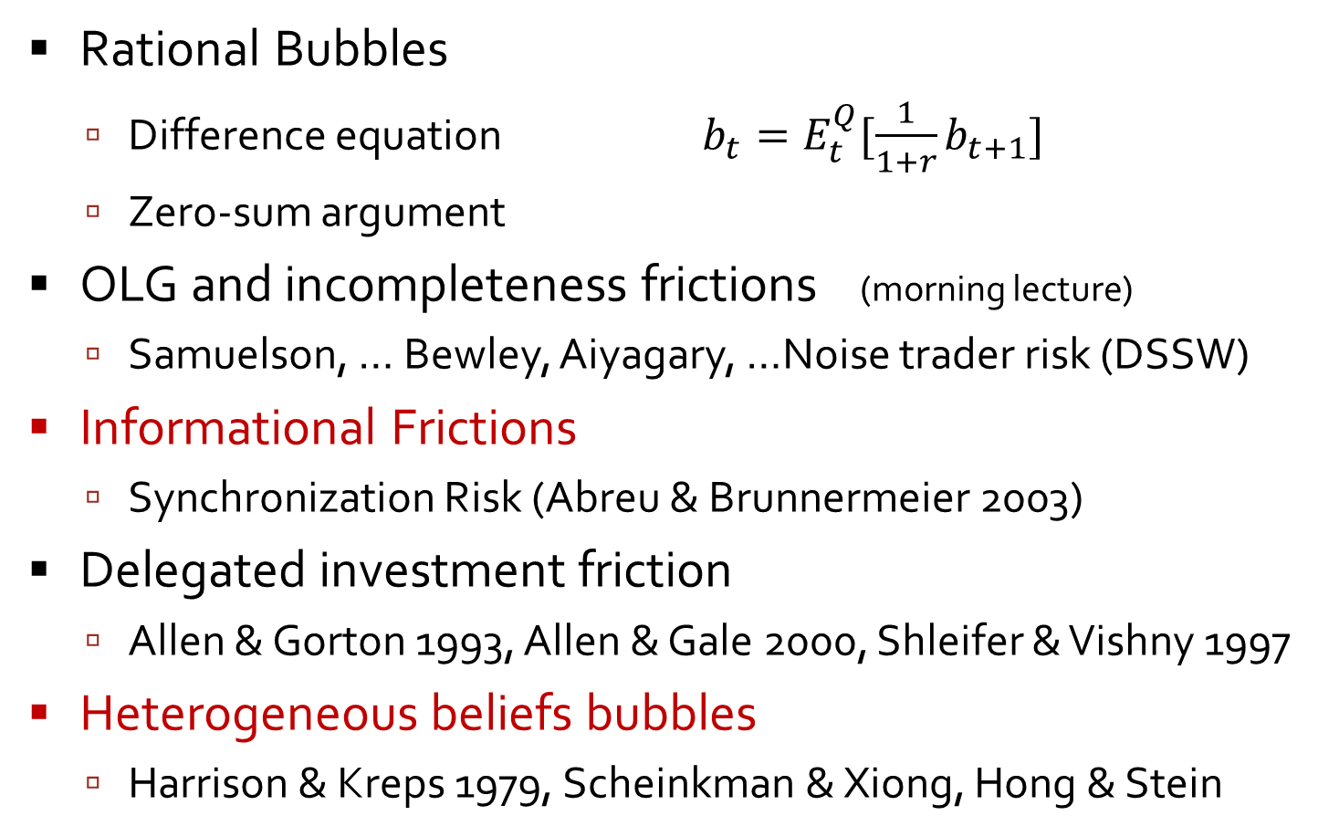
Bubble literature overview
Rational Bubbles
  Difference equation $b_{t}=E_{t}^{Q}[\frac{1}{1+r}b_{t+1}]$
  Zero-sum argument
OLG and incompleteness frictions (morning lecture)
  Samuelson, … Bewley, Aiyagary, …Noise trader risk (DSSW)
Informational Frictions
  Synchronization Risk (Abreu & Brunnermeier 2003)
Delegated investment friction
  Allen & Gorton 1993, Allen & Gale 2000, Shleifer & Vishny 1997
Heterogeneous beliefs bubbles
  Harrison & Kreps 1979, Scheinkman & Xiong, Hong & Stein

Slide 16
On Market Efficiency
Keynes (1936) ) bubble can emerge
  “It might have been supposed that competition between expert professionals, possessing judgment and knowledge beyond that of the average private investor, would correct the vagaries of the ignorant individual left to himself.”
Friedman (1953), Fama (1965)
Efficient Market Hypothesis ) no bubble emerges
  “If there are many sophisticated traders in the market, they may cause these “bubbles” to burst before they really get under way.”

Slide 17
Limits to Arbitrage
Fundamental risk (Campell & Kyle 1993)
  Risk that fundamental overturns mispricing
Noise trader risk (DSSW)
  Risk that irrational traders drive price even further from fundamentals
Synchronization risk
  One trader alone cannot correct mispricing
  (can sustain a trade only for a limited time)
  Risk that other rational traders do not act against mispricing (in sufficiently close time)
  Relatively unimportant news can serve as synchronization device and trigger a large price correction

Slide 18
Timing Game - Synchronization
(When) will behavioral traders be overwhelmed by rational arbitrageurs?
Collective selling pressure of arbitrageurs more than suffices to burst the bubble.
Rational arbitrageurs understand that an eventual collapse is inevitable.
But when?
Delicate, difficult, dangerous TIMING GAME !

Slide 19
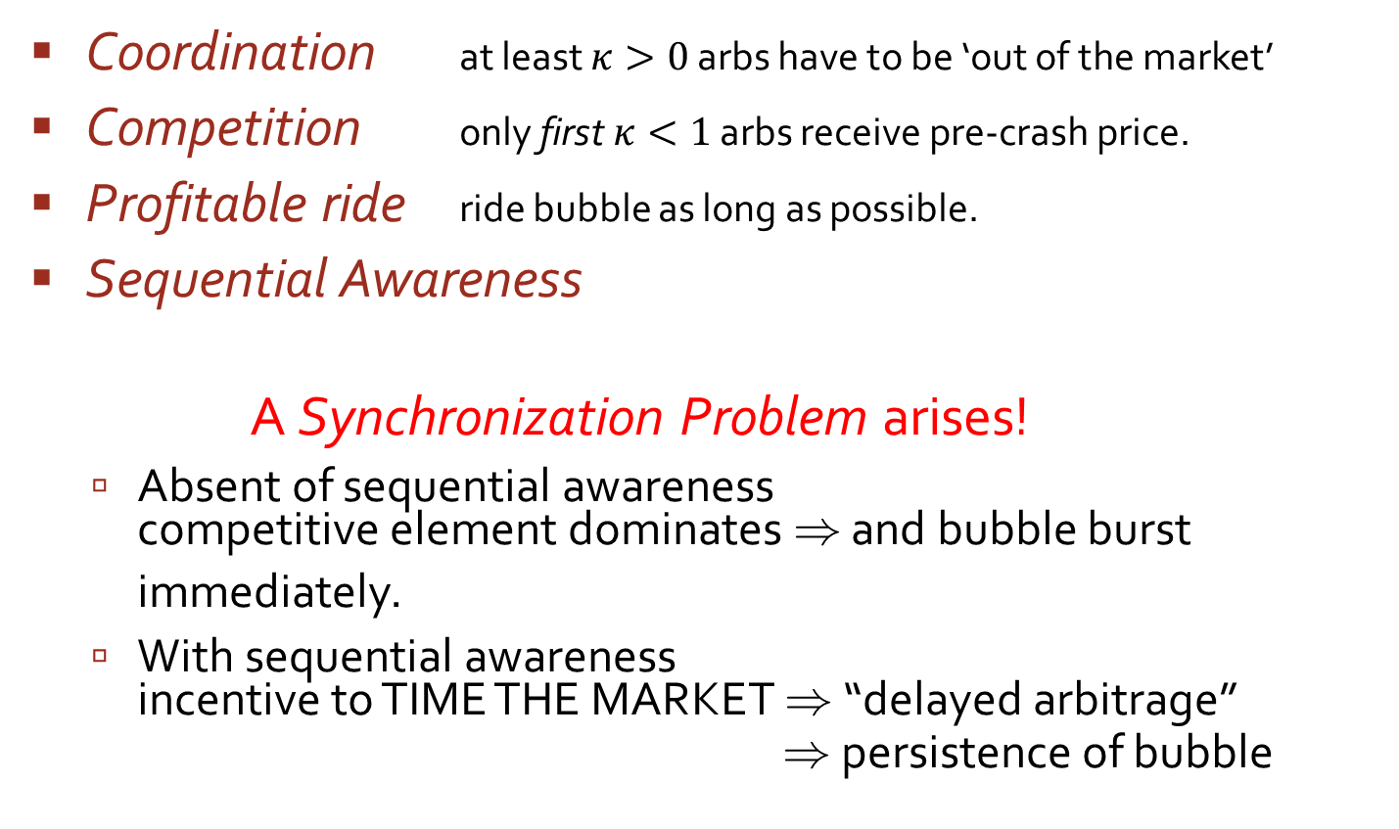
Elements of the Timing Game
Coordination at least $κ>0$ arbs have to be ‘out of the market’
Competition only first $κ<1$ arbs receive pre-crash price.
Profitable ride ride bubble as long as possible.
Sequential Awareness
A Synchronization Problem arises!
  Absent of sequential awareness
  competitive element dominates ) and bubble burst immediately.
  With sequential awareness
  incentive to TIME THE MARKET ) “delayed arbitrage”
  ) persistence of bubble

Slide 20
Overview
Introduction
Model setup
Preliminary analysis
Persistence of bubbles
Public events
Price cascades and rebounds
Empirical evidence & Hedge funds
  Brunnermeier & Nagel (2004)

Slide 21






Common action of $κ$ arbs
Sequential awareness
  Random $t_{0}$ with $F\left(t_{0}\right)=1−e^{−λt_{0}}$
$$p_{t}=e^{gt}$$
$$\overline{β}p_{t}$$
$$\left(1−β\left(⋅\right)\right)p_{t}$$
1
1/η
0
paradigm shift
- internet 90’s
- railways
- etc.
$$t_{0}+\overline{τ}$$
t
t₀
t₀ + ηκ
t₀+ η
t₀+ τ
random
starting
point
κ traders
are aware of
the bubble
all traders
are aware of
the bubble
bubble bursts
for exogenous
reasons
maximum life-span of the bubble $\overline{τ}$
21

Slide 22
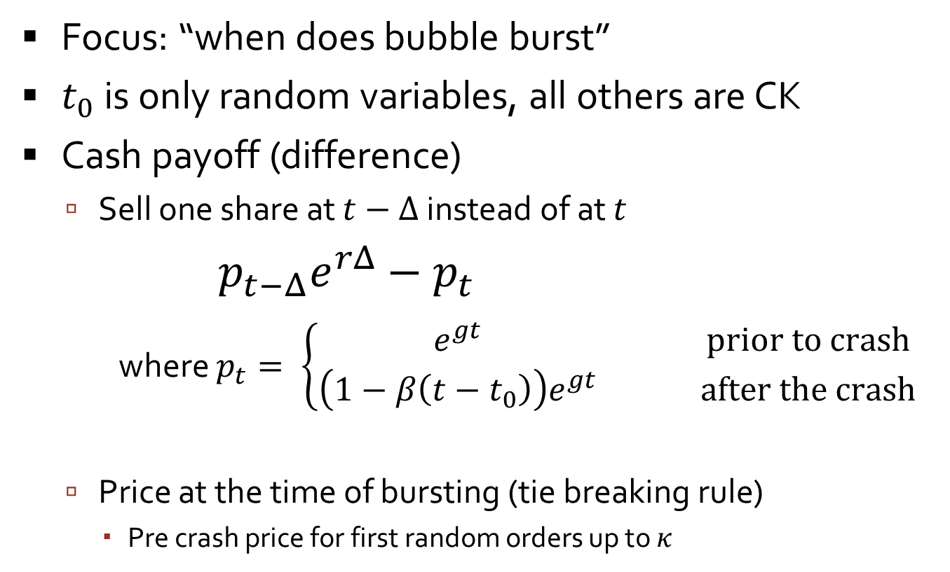
Payoff structure
Focus: “when does bubble burst”
$t_{0}$ is only random variables, all others are CK
Cash payoff (difference)
  Sell one share at $t−Δ$ instead of at $t$
  $p_{t−Δ}e^{rΔ}−p_{t}$
  where $p_{t}= \left\{\begin{matrix}e^{gt} & & \text{prior} \text{to} \text{crash} \\ \left(1−β\left(t−t_{0}\right)\right)e^{gt} & & \text{after} \text{the} \text{crash}\end{matrix}\right.$
  Price at the time of bursting (tie breaking rule)
    Pre crash price for first random orders up to $κ$

Slide 23
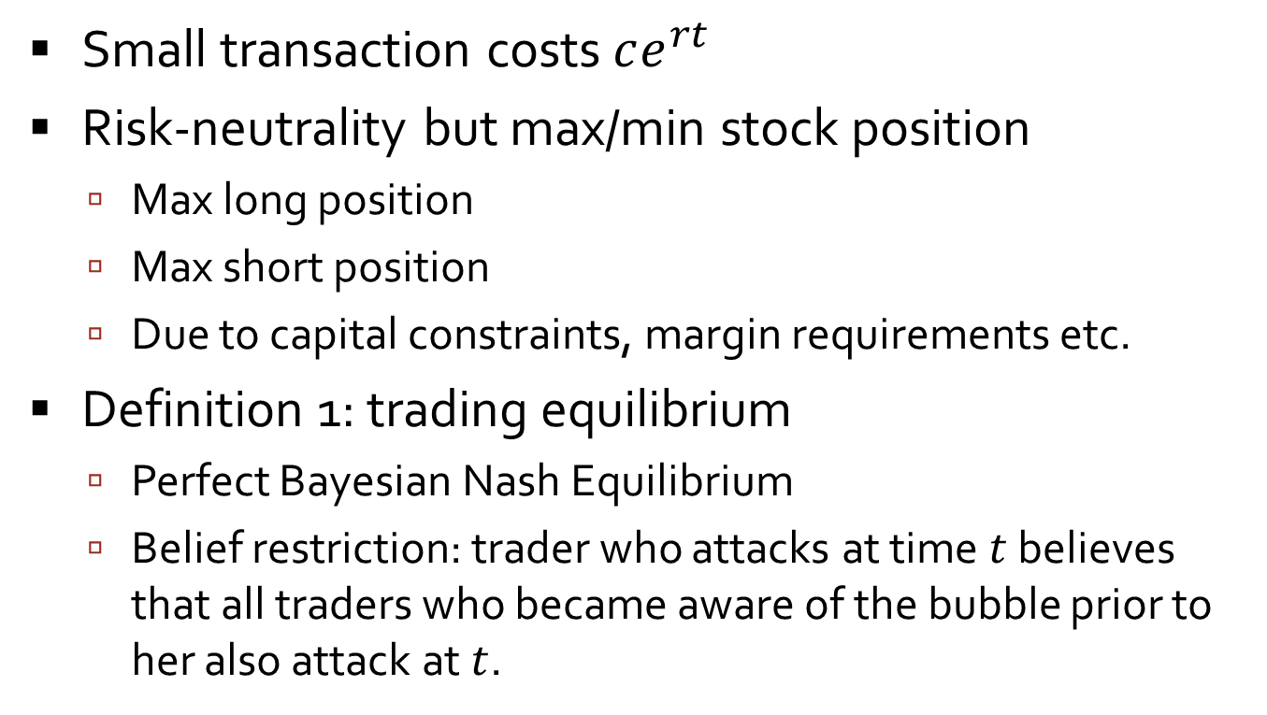
Payoff structure, Trading
Small transaction costs $ce^{rt}$
Risk-neutrality but max/min stock position
  Max long position
  Max short position
  Due to capital constraints, margin requirements etc.
Definition 1: trading equilibrium
  Perfect Bayesian Nash Equilibrium
  Belief restriction: trader who attacks at time $t$ believes that all traders who became aware of the bubble prior to her also attack at $t$.

Slide 24
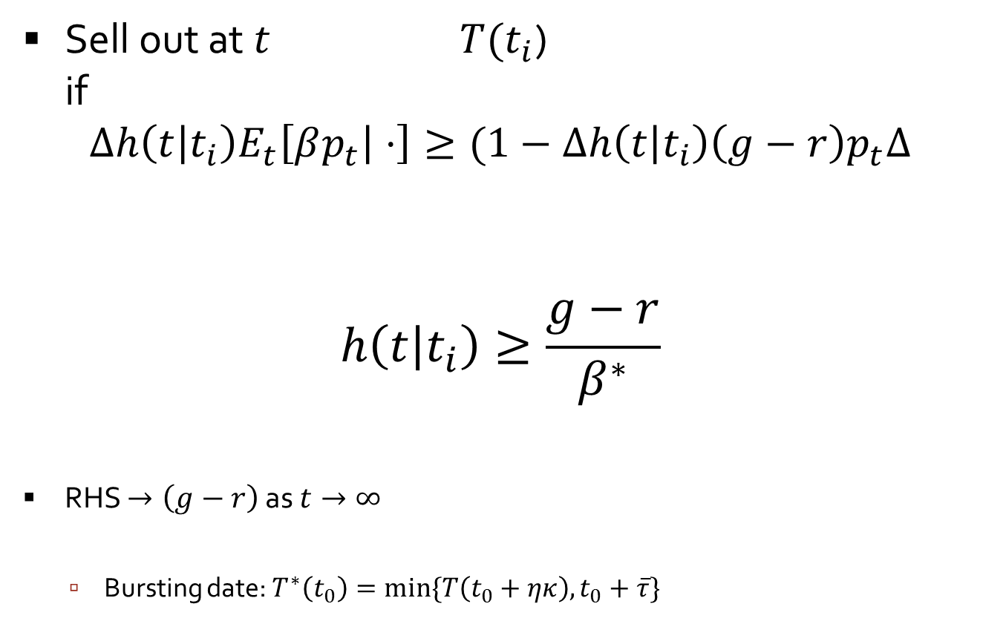

Sell out condition for $Δ→0$ periods
Sell out at $t$ $T(t_{i}$)
if
$$Δh\left(t | t_{i}\right)E_{t}\left[βp_{t} | ⋅\right]≥(1−Δh\left(t | t_{i}\right)\left(g−r\right)p_{t}Δ$$
$$h\left(t | t_{i}\right)≥\frac{g−r}{β^{∗}}$$
RHS $→\left(g−r\right)$ as $t→∞$
  Bursting date: $T^{∗}\left(t_{0}\right)=min⁡\{T\left(t_{0}+ηκ\right), t_{0}+\overline{τ}\}$
appreciation rate
benefit of attacking
cost of attacking

Slide 25
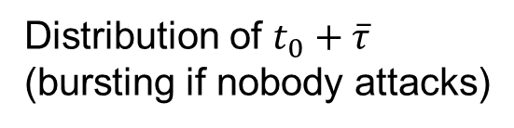



Sequential awareness
Distribution of $t_{0}$
Distribution of $t_{0}+\overline{τ}$
(bursting if nobody attacks)
trader t_{i}
t_{i} - η
t_{i}
t
since t_{i} · t₀ + η
since t_{i} ¸ t₀
$$t_{0}$$
$t_{0}+\overline{τ}$

Slide 26
Sequential awareness
Distribution of $t_{0}$
Distribution of $t_{0}+\overline{τ}$
(bursting if nobody attacks)
trader t_{i}
t_{i} - η
t_{i}
t
since t_{i} · t₀ + η
since t_{i} ¸ t₀
trader t_{j}
t_{j} - η
t_{j}
t
$$t_{0}$$
$t_{0}+\overline{τ}$

Slide 27

Sequential awareness
Distribution of $t_{0}$
Distribution of $t_{0}+\overline{τ}$
(bursting if nobody attacks)
trader t_{i}
t_{i} - η
t_{i}
t
since t_{i} · t₀ + η
since t_{i} ¸ t₀
trader t_{j}
t_{j} - η
t_{j}
t
trader t_{k}
$t_{0}+\overline{τ}$
t
$$t_{0}$$
$$t_{k}$$

Slide 28
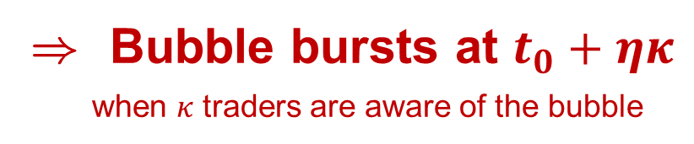
Conjecture 1: Immediate attack
) Bubble bursts at $t_{0}+ηκ$
when $κ$ traders are aware of the bubble
t_{i} - η
t_{i}
t

Slide 29
Conjecture 1: Immediate attack
) Bubble bursts at $t_{0}+ηκ$
when $κ$ traders are aware of the bubble
t_{i} - η
t_{i} - ηκ
t_{i}
t
If t₀< t_{i} - ηκ , the bubble
would have burst already.

Slide 30
Conjecture 1: Immediate attack
) Bubble bursts at $t_{0}+ηκ$
when $κ$ traders are aware of the bubble
Distribution of t₀
Distribution of t₀ + ηκ
λ/(1-e^{-ληκ})
t_{i} - η
t_{i} - ηκ
t_{i}
t_{i} + ηκ
t
If t₀< t_{i} - ηκ , the bubble
would have burst already.

Slide 31
Conjecture 1: Immediate attack
) Bubble bursts at $t_{0}+ηκ$
when $κ$ traders are aware of the bubble
Distribution of t₀
λ/(1-e^{-ληκ})
t_{i} - η
t_{i} - ηκ
t_{i}
t_{i} + ηκ
t

Slide 32
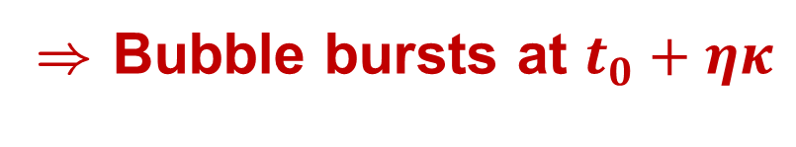
Conjecture 1: Immediate attack
) Bubble bursts at $t_{0}+ηκ$
Distribution of t₀
λ/(1-e^{-ληκ})
t_{i} - η
t_{i} - ηκ
t_{i}
t_{i} + ηκ
t
Bubble bursts
for sure

Slide 33
Conjecture 1: Immediate attack
) Bubble bursts at $t_{0}+ηκ$
Distribution of t₀
λ/(1-e^{-ληκ})
t_{i} - η
t_{i} - ηκ
t_{i}
t_{i} + ηκ
t
Bubble bursts
for sure

Slide 34
Conjecture 1: Immediate attack
) Bubble bursts at $t_{0}+ηκ$
Distribution of t₀
λ/(1-e^{-ληκ})
t_{i} - η
t_{i} - ηκ
t_{i}
t_{i} + ηκ
t
Bubble bursts
for sure

Slide 35
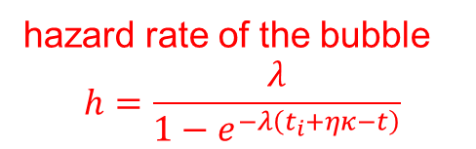

Conjecture 1: Immediate attack
) Bubble bursts at $t_{0}+ηκ$
hazard rate of the bubble
$$h=\frac{λ}{1−e^{−λ\left(t_{i}+ηκ−t\right)}}$$
Distribution of t₀
$$\frac{λ}{1−e^{ληκ}}$$
t_{i} - η
t_{i} - ηκ
t_{i}
t_{i} + ηκ
t

Slide 36
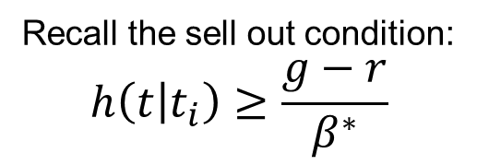
Conjecture 1: Immediate attack
Recall the sell out condition:
$$h\left(t | t_{i}\right)≥\frac{g−r}{β^{∗}}$$
) Bubble bursts at $t_{0}+ηκ$
hazard rate of the bubble
$$h=\frac{λ}{1−e^{−λ\left(t_{i}+ηκ−t\right)}}$$
Distribution of t₀
$$\frac{λ}{1−e^{ληκ}}$$
t_{i} - η
t_{i} - ηκ
t_{i}
t_{i} + ηκ
t

Slide 37

Conjecture 1: Immediate attack
Recall the sell out condition:
$$h\left(t | t_{i}\right)≥\frac{g−r}{β^{∗}}$$
) Bubble bursts at $t_{0}+ηκ$
hazard rate of the bubble
$$h=\frac{λ}{1−e^{−λ\left(t_{i}+ηκ−t\right)}}$$
bubble appreciation / bubble size
Distribution of t₀
lower bound:$\left(g−r\right) \overline{β}>\frac{λ}{1−e^{ληκ}}$
$$\frac{λ}{1−e^{ληκ}}$$
t_{i} - η
t_{i} - ηκ
t_{i}
t_{i} + ηκ
t
optimal time
to attack t_{i}+τ_{i}
) “delayed attack is optimal”

Slide 38
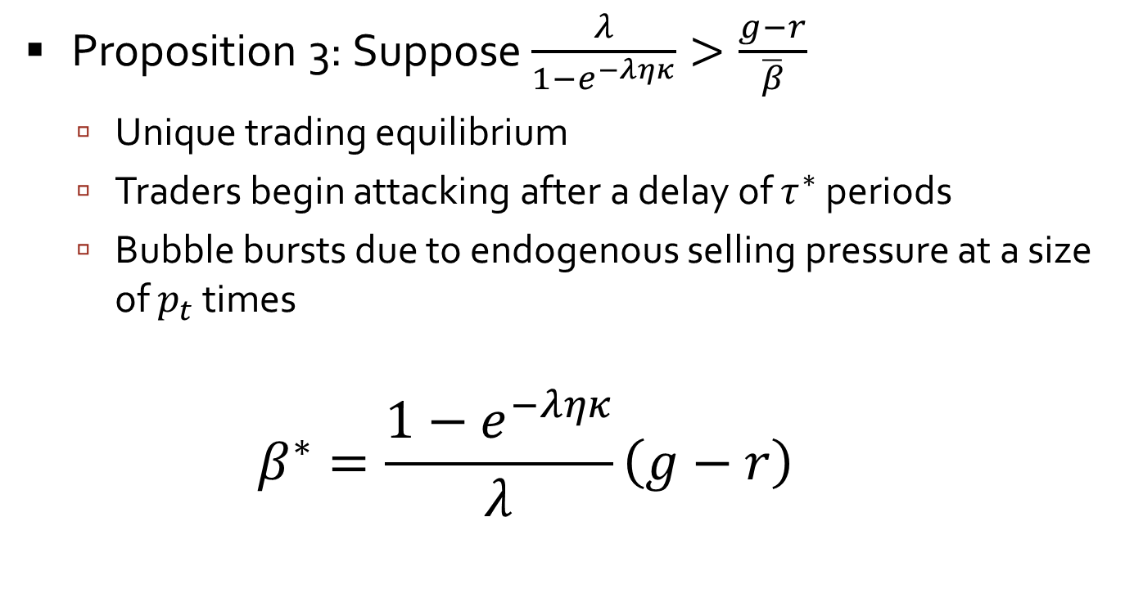
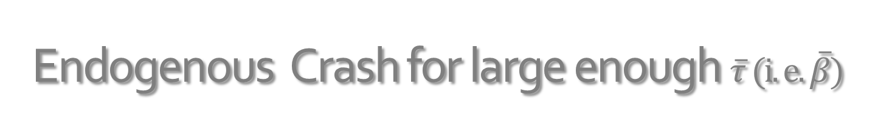
Endogenous Crash for large enough $\overline{τ} (i.e. \overline{β})$
Proposition 3: Suppose $\frac{λ}{1−e^{−ληκ}}>\frac{g−r}{\overline{β}}$
  Unique trading equilibrium
  Traders begin attacking after a delay of $τ^{∗}$ periods
  Bubble bursts due to endogenous selling pressure at a size of $p_{t}$ times
  $$β^{∗}=\frac{1−e^{−ληκ}}{λ}\left(g−r\right)$$

Slide 39
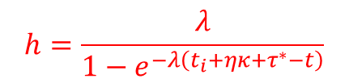
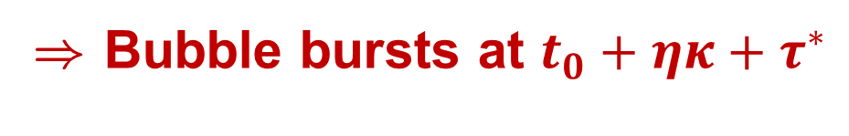

Endogenous crash
) Bubble bursts at $t_{0}+ηκ+τ^{∗}$
$$h=\frac{λ}{1−e^{−λ\left(t_{i}+ηκ+τ^{∗}−t\right)}}$$
bubble appreciation
bubble size
lower bound:$\frac{g−r}{\overline{β}}>\frac{λ}{1−e^{ληκ}}$
t_{i} - η
t_{i} - ηκ
t_{i}
t_{i} - η + ηκ +τ*
t_{i} +τ*
t_{i} + ηκ +τ*
t
conjectured
attack
optimal

Slide 40
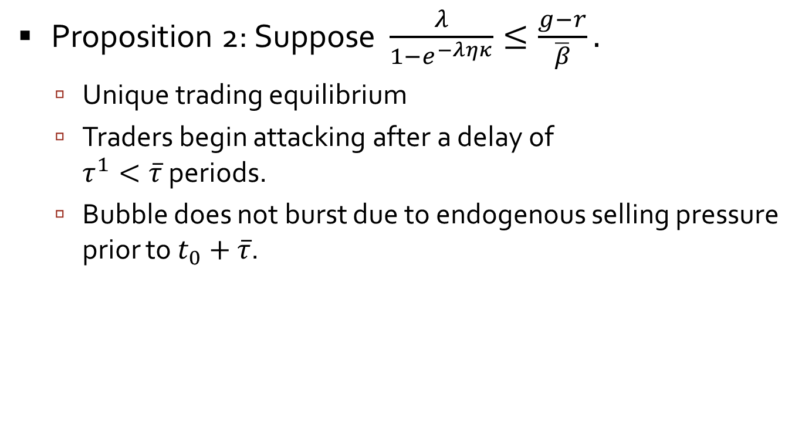
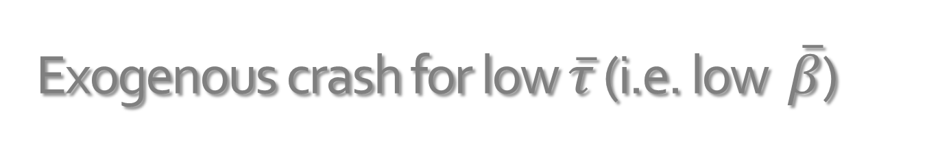
Exogenous crash for low $\overline{τ}$ (i.e. low $\overline{β}$)
Proposition 2: Suppose $\frac{λ}{1−e^{−ληκ}}≤\frac{g−r}{\overline{β}}.$
  Unique trading equilibrium
  Traders begin attacking after a delay of
  $τ^{1}<\overline{τ}$ periods.
  Bubble does not burst due to endogenous selling pressure prior to $t_{0}+\overline{τ}$.

Slide 41


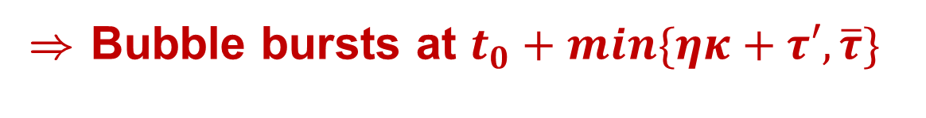


Delayed attack by $τ′$
) Bubble bursts at $t_{0}+min\{ηκ+τ′, \overline{τ}\}$
hazard rate of $t_{0}+ηκ+τ′$
$$h=\frac{λ}{1−e^{−λ\left(t_{i}+ηκ+τ′−t\right)}}$$
bubble appreciation
bubble size
lower bound:$\frac{g−r}{\overline{β}}>\frac{λ}{1−e^{ληκ}}$
$$\frac{λ}{1−e^{ληκ}}$$
t_{i} - η
t_{i}
t_{i} +τ’
t_{i} + ηκ +τ’
t
t_{i} +τ’

Slide 42


Delayed attack by $τ′$
) Bubble bursts at $t_{0}+min\{ηκ+τ′, \overline{τ}\}$
hazard rate of $t_{0}+ηκ+τ′$
$$h=\frac{λ}{1−e^{−λ\left(t_{i}+ηκ+\overline{τ}−t\right)}}$$
bubble appreciation
bubble size
lower bound:$\frac{g−r}{\overline{β}}>\frac{λ}{1−e^{ληκ}}$
t_{i} - η
t_{i}
t_{i} +τ’
t_{i} + ηκ +τ’
t
t_{i} +τ’
attack
$$t_{i}+\overline{τ}$$

Slide 43
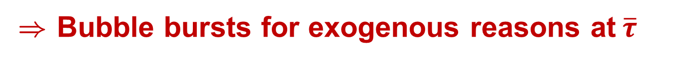
Delayed attack by $τ′$
) Bubble bursts at $t_{0}+min\{ηκ+τ′, \overline{τ}\}$
hazard rate of $t_{0}+ηκ+τ′$
$$h=\frac{λ}{1−e^{−λ\left(t_{i}+ηκ+\overline{τ}−t\right)}}$$
bubble appreciation
bubble size
lower bound:$\frac{g−r}{\overline{β}}>\frac{λ}{1−e^{ληκ}}$
t_{i} - η
t_{i}
t_{i} +τ’
t_{i} + ηκ +τ’
t
t_{i} +τ’
attack
$$t_{i}+\overline{τ}$$
) Bubble bursts for exogenous reasons at$\overline{τ}$

Slide 44

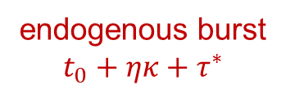
Lack of common knowledge
) standard backwards induction can’t be applied
endogenous burst
$$t_{0}+ηκ+τ^{∗}$$
t₀ + ηκ
t₀
t₀ + η
t₀ + 2η
t₀ + 3η
…
$$t_{0}+\overline{τ}$$
everybody
knows of the
the bubble
everybody knows that
everybody knows of the
bubble
everybody knows that
everybody knows that
everybody knows of
the bubble
…
κ traders
know of
the bubble
(same reasoning applies for κ traders)

Slide 45
Role of synchronizing events
News may have an impact disproportionate to any intrinsic informational (fundamental) content
  News can serve as a synchronization device
Fads & fashion in information
  Which news should traders coordinate on?
When “synchronized attach” fails, then the bubble is temporarily strengthened

Slide 46
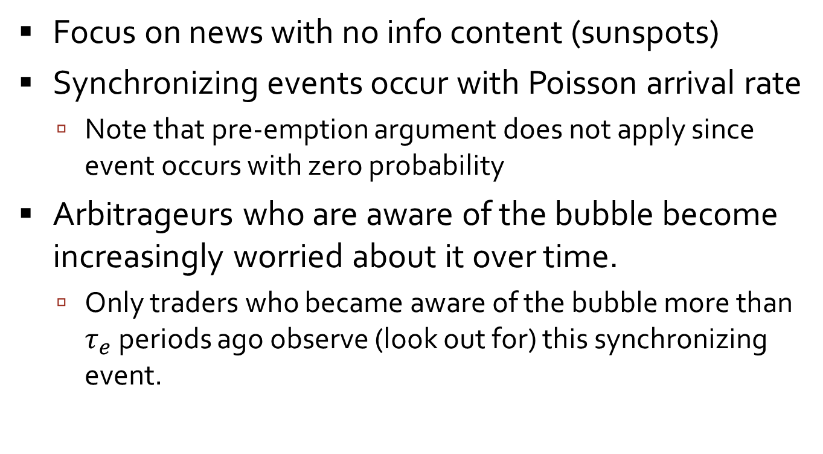
Setting with synchronizing events
Focus on news with no info content (sunspots)
Synchronizing events occur with Poisson arrival rate
  Note that pre-emption argument does not apply since event occurs with zero probability
Arbitrageurs who are aware of the bubble become increasingly worried about it over time.
  Only traders who became aware of the bubble more than $τ_{e}$ periods ago observe (look out for) this synchronizing event.

Slide 47
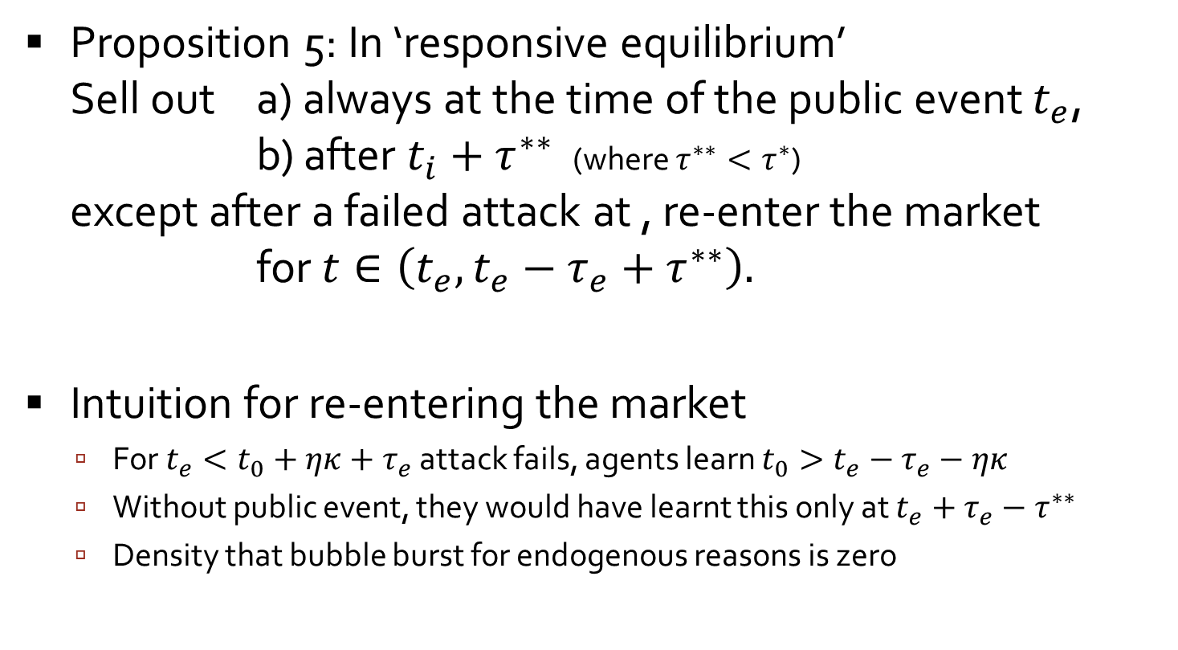
Synchronizing events – market rebounds
Proposition 5: In ‘responsive equilibrium’
Sell out a) always at the time of the public event $t_{e}$,
b) after $t_{i}+τ^{∗∗}$ (where $τ^{∗∗}<τ^{∗}$)
except after a failed attack at , re-enter the market
for $t∈\left(t_{e},t_{e}−τ_{e}+τ^{∗∗}\right).$
Intuition for re-entering the market
  For $t_{e}<t_{0}+ηκ+τ_{e}$ attack fails, agents learn $t_{0}>t_{e}−τ_{e}−ηκ$
  Without public event, they would have learnt this only at $t_{e}+τ_{e}−τ^{∗∗}$
  Density that bubble burst for endogenous reasons is zero

Slide 48
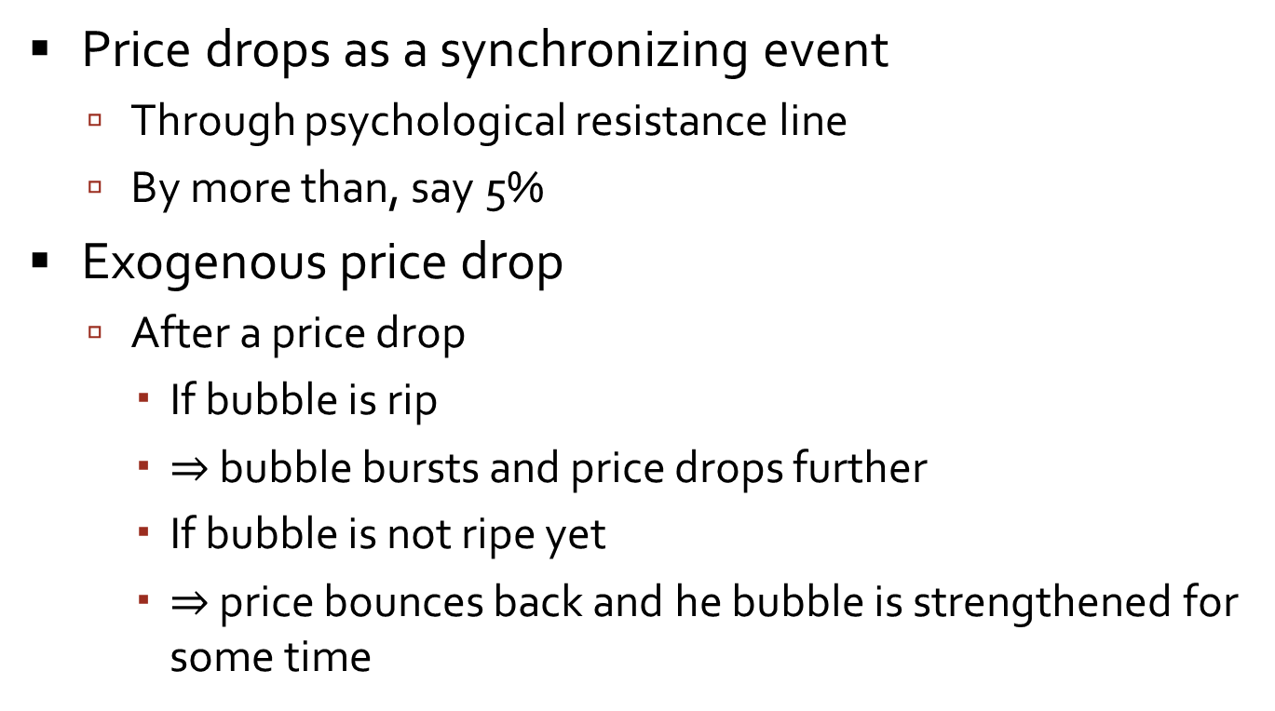
Price cascades and rebounds
Price drops as a synchronizing event
  Through psychological resistance line
  By more than, say 5%
Exogenous price drop
  After a price drop
    If bubble is rip
    $⇒$ bubble bursts and price drops further
    If bubble is not ripe yet
    $⇒$ price bounces back and he bubble is strengthened for some time

Slide 49
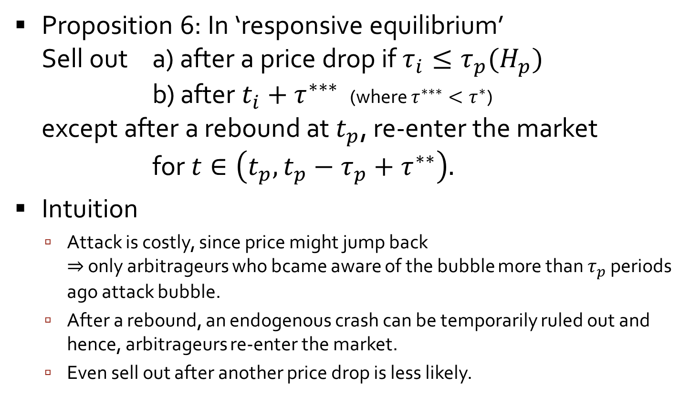
Price cascades and rebounds
Proposition 6: In ‘responsive equilibrium’
Sell out a) after a price drop if $τ_{i}≤τ_{p}(H_{p})$
b) after $t_{i}+τ^{∗∗∗}$ (where $τ^{∗∗∗}<τ^{∗}$)
except after a rebound at $t_{p}$, re-enter the market
for $t∈\left(t_{p},t_{p}−τ_{p}+τ^{∗∗}\right).$
Intuition
  Attack is costly, since price might jump back
  $⇒$ only arbitrageurs who bcame aware of the bubble more than $τ_{p}$ periods ago attack bubble.
  After a rebound, an endogenous crash can be temporarily ruled out and hence, arbitrageurs re-enter the market.
  Even sell out after another price drop is less likely.

Slide 50
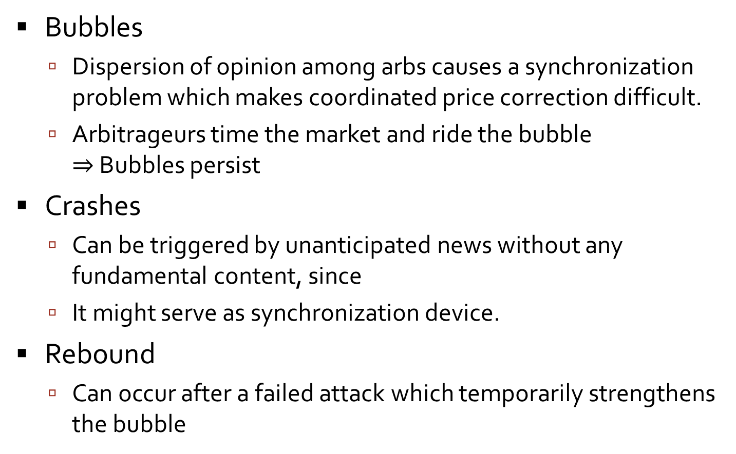
Conclusion of Bubbles and Crashes
Bubbles
  Dispersion of opinion among arbs causes a synchronization problem which makes coordinated price correction difficult.
  Arbitrageurs time the market and ride the bubble
  $⇒$ Bubbles persist
Crashes
  Can be triggered by unanticipated news without any fundamental content, since
  It might serve as synchronization device.
Rebound
  Can occur after a failed attack which temporarily strengthens the bubble

Slide 51
Hedge Funds & the Technolgy Bubble
Markus Brunnermeier and Stefan nagel
Princeton University and Stanford University
TexPoint fonts used in EMF.
Read the TexPoint manual before you delete this box.: AAAAAA

Slide 52
Hedge Funds and the Technology Bubble
With Stefan Nagel
  Quarterly 13F filings to SEC
  Mandatory for all institutional investors
    With holdings in U.S. stocks of more than $ 100 million
    Domestic and foreign
    At manager level
  Caveat: No short positions
53 managers with CDA/Spectrum data
  Excludes 18 managers b/c mutual business dominates
  Incl. Soros, Tiger, Tudor, D.E. Shaw etc.
Hedge fund performance data
  HFR hedge fund style indexes

Slide 53
Did hedge funds ride the bubble?

Slide 54
Did Soros ride the bubble?
Fig. 4a: Weight of technology stocks in hedge fund portfolios versus weight in market portfolio

Slide 55
Fund in- and outflows

Slide 56
Did hedge funds time stocks?
Figure 5. Average share of outstanding equity held by hedge funds around price peaks of individual stocks

Slide 57
Did hedge funds’ timing pay off?
Figure 6: Performance of a copycat fund that replicates hedge fund holdings in the NASDAQ high P/S segment

Slide 58
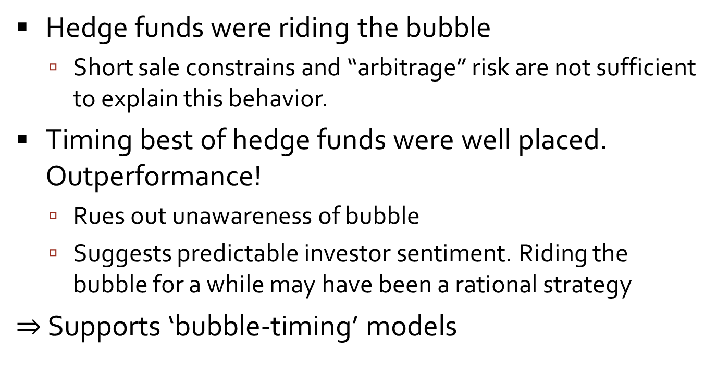
Conclusion
Hedge funds were riding the bubble
  Short sale constrains and “arbitrage” risk are not sufficient to explain this behavior.
Timing best of hedge funds were well placed. Outperformance!
  Rues out unawareness of bubble
  Suggests predictable investor sentiment. Riding the bubble for a while may have been a rational strategy
$⇒$ Supports ‘bubble-timing’ models

Slide 60
Heterogeneous Beliefs Bubbles
Harrison and Kreps, Scheinkman and Xiong
TexPoint fonts used in EMF.
Read the TexPoint manual before you delete this box.: AAAAAA

Slide 61
Bubbles with Trading Cost – simplified example
Two risk-neutral agents: A and B.
  An asset with fixed supply, 1 unit equally divided bw A & B.
  Heterogeneous beliefs; short-sales prohibited.
  Harrison and Kreps (1978), Morris (1996), Scheinkman and Xiong (2003).
$$E_{u}^{A}\left[\tilde{R}\right]=90,$$
$$E_{u}^{B}\left[\tilde{R}\right]=75$$
$$p_{u}=90$$
$$p_{0}=57.5$$
$$E_{0}^{A}\left[\tilde{R}\right]=50 \\ E_{0}^{B}\left[\tilde{R}\right]=50$$
$$E_{d}^{A}\left[\tilde{R}\right]=10,$$
$$E_{d}^{B}\left[\tilde{R}\right]=25$$
$$p_{d}=25$$
t=0
t=1
t=2

Slide 62
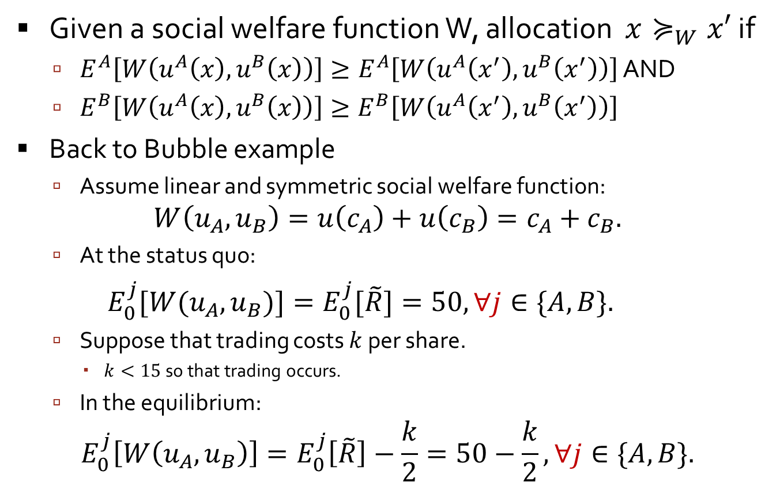
Welfare criterions heterogeneous beliefs
Brunnermeier & Xiong 2011
Given a social welfare function W, allocation $x≽_{W}x′$ if
  $E^{A}\left[W\left(u^{A}\left(x\right),u^{B}\left(x\right)\right)\right]≥E^{A}\left[W\left(u^{A}\left(x^{′}\right),u^{B}\left(x^{′}\right)\right)\right]$ AND
  $E^{B}\left[W\left(u^{A}\left(x\right),u^{B}\left(x\right)\right)\right]≥E^{B}\left[W\left(u^{A}\left(x^{′}\right),u^{B}\left(x^{′}\right)\right)\right]$
Back to Bubble example
  Assume linear and symmetric social welfare function:
$$W\left(u_{A},u_{B}\right)=u\left(c_{A}\right)+u\left(c_{B}\right)=c_{A}+c_{B}.$$
  At the status quo:
$E_{0}^{j}[W(u_{A},u_{B})]=E_{0}^{j}[\tilde{R}]=50, ∀j∈\{A,B\}.$
  Suppose that trading costs $k$ per share.
    $k<15$ so that trading occurs.
  In the equilibrium:
$$E_{0}^{j}\left[W\left(u_{A},u_{B}\right)\right]=E_{0}^{j}\left[\tilde{R}\right]−\frac{k}{2}=50−\frac{k}{2}, ∀j∈\{A,B\}.$$

