Slide 1
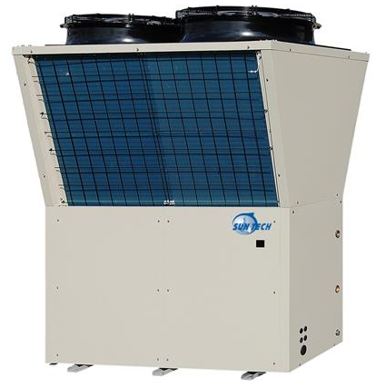
Prospect of CO2 heat pump applications in China
Youhua Tian
Peking University
圣艾蒙环保科技
Notes:
carbon dioxide |daɪ'ɒksaɪd|
Thanks for the invitation of peichao the present haochen that I become a member of the CEG.
I am very glad that all you studies abroad still cares much about China and its most important parts energy.

Slide 2
ROAD MAP
BACKGROUND
PRINCIPLE OF THE CO2 HEAT PUMP
ADVANTAGES OF CO2 HEAT PUMP
APPLICATIONS OF CO2 HEAT PUMP IN NORTHERN CHINA
Notes:
背景
机器和技术
技术的优势
应用

Slide 3
ⅠBACKGROUND
OUR ENTREPRENEUR GROUP
Professor Zhang (CTO, Expert at Heat Pump, Inventor of the ultra-low CO2 air source heat pump)
Youhua Tian (“CIO”,Urban and Environmental Sciences, PKU)
Zhenguo Zhang(CEO, Former General Manager of Xuyue--河北旭跃实业集团有限公司)
Bo Hu(CFO)
Notes:
Entrepreneurship Competition last year at PKU

Slide 4
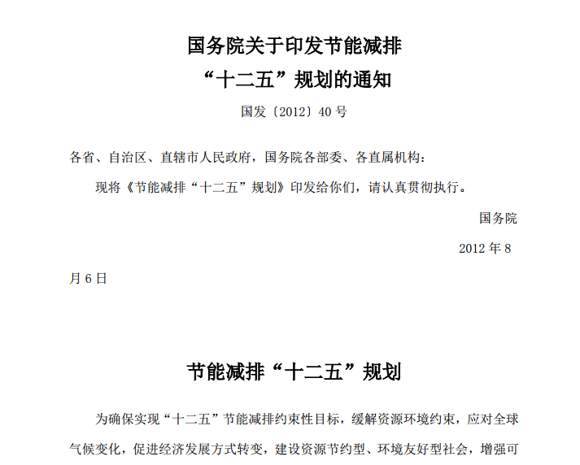
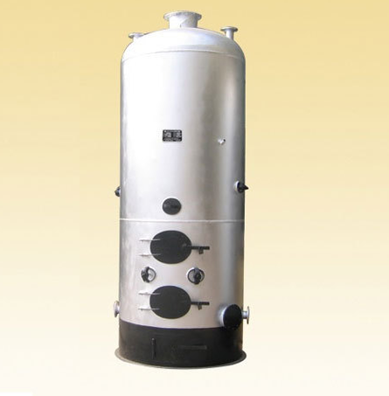
ⅠBACKGROUND
Why Heat-pump?
Zhenguo Zhang:
河北旭跃实业集团
Coal transportation &trading company
Bo Hu:
Who’s father-in-law
is a boiler maker
coal-fired boilers
Notes:
日本 和 欧洲
Co-founders共同创建人
团队介绍
专利
公司简介

Slide 5
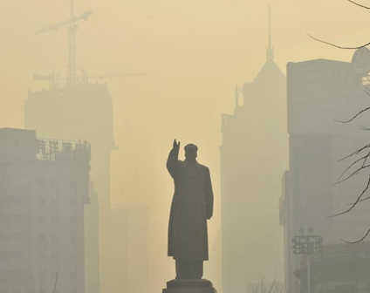
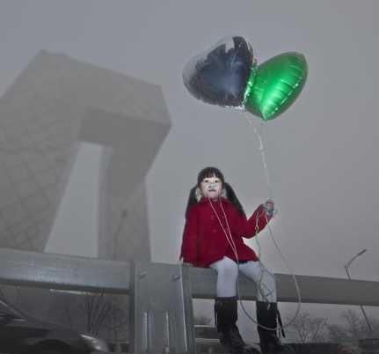
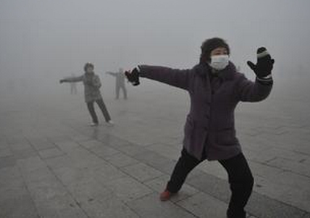
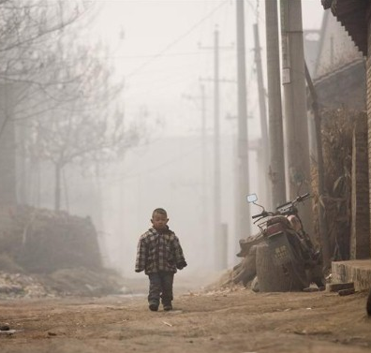
ⅠBACKGROUND
Hazy weather in winter
When PM2.5 over 400, all companies making smog are forced to STOP PRODUCTION
Notes:
Hazy 'heɪzɪ
Market demand is very huge

Slide 6
At the very beginning, we intend to replace coal-fired boilers with heat pump to reduce smog.
What is the contribution of coal-fired gas to total carbon emissions?

Slide 7
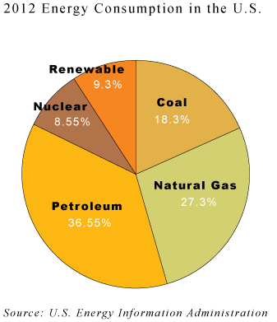
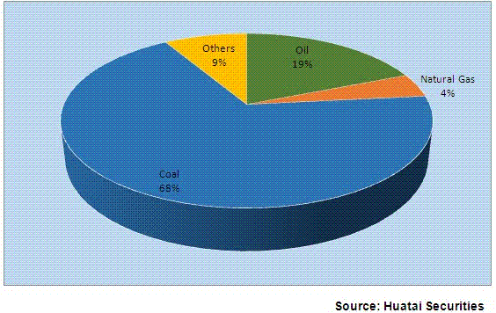
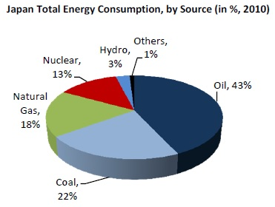
ⅠBACKGROUND
Energy Consumption Structure in China, 2013
Notes:
How huge is the market?

Slide 8
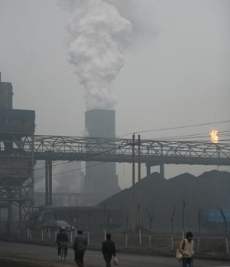
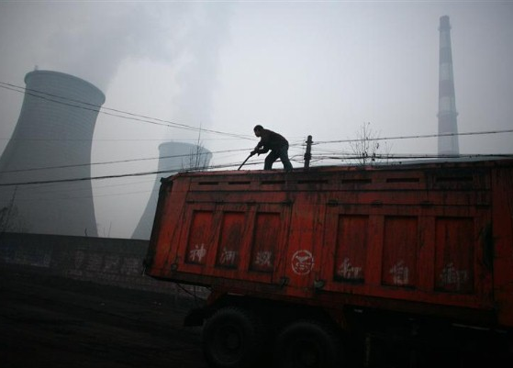
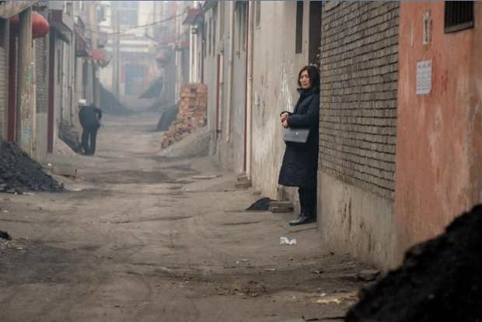
ⅠBACKGROUND
Some of the pollutants responsible are sulfur dioxide and nitrogen oxide emitted by coal combustion, which provides 70% of China’s energy and 80% of its electricity, and is primarily used by coal power plants, heavy industry such as iron and steel and cement factories, and for residential heating in the winter.
Flue gas produced by factories and residential heating is discharged directly into the atmosphere without any treatment.
Notes:
combustion [kəm'bʌstʃ(ə)n]
Cleaned the air before emission
If hazy weather is caused mainly by coal, then the coal fired by factories and residential heating is the most important inducement.

Slide 9
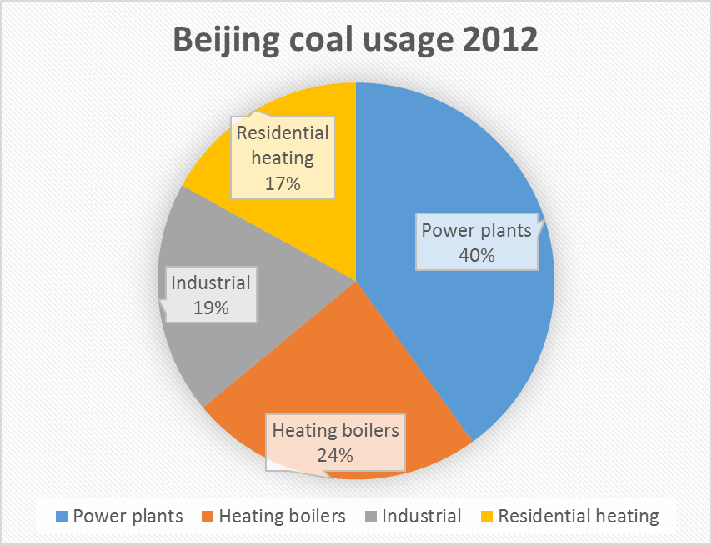
ⅠBACKGROUND
Beijing requires over 20 million tons of coal each year.
Notes:
If those part of the coal consumption is zero, then the air quality could be much better.

Slide 10
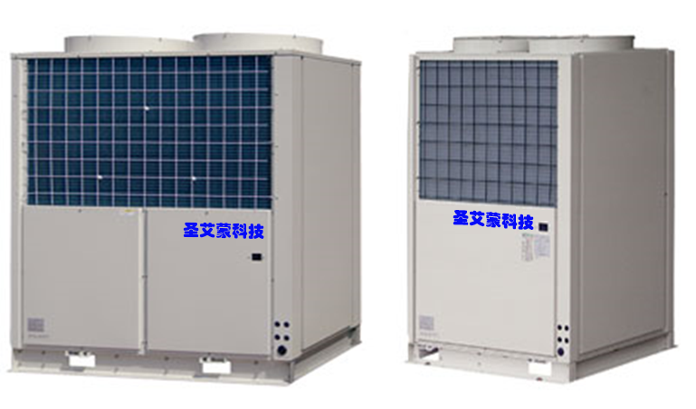
What is CO2-heat pump looks like?
1.8 m
2m
1.2 m
The first generation of our product
Notes:
Coal fired Power plants Cleane the air before emission
So the damage caused by power plants is much lighter than residential heating and factory using
generation efficiency of coal thermal power is about 40%

Slide 11
Ⅱ PRINCIPLE OF THE CO2 HEAT PUMP
Notes:
inducement

Slide 12
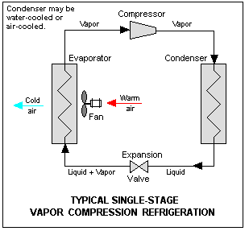
Vapor-compression refrigeration Carnot Cycle
Notes:
Compressor 压缩机
Condenser 聚光器
Expansion 扩张
Evaporator 蒸发器
Absorb 吸收
Emit 发出
Normal pressure co2 was compressed to high-temperature high-pressure gas by compressor, and then through a heat exchanger you get heat from the refrigerating fluid. Then you get normal-temperature high pressure refrigerate. The refrigerant liquid is then entering the evaporator, where is heat transfer media that help the refrigerant liquid gets heat to become a a low-temperature low-pressure gas .

Slide 13
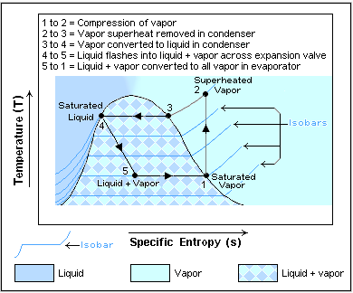
Reverse Carnot cycle
Notes:
临界状态
critical state
Appropriate pressure
heat exchange

Slide 14
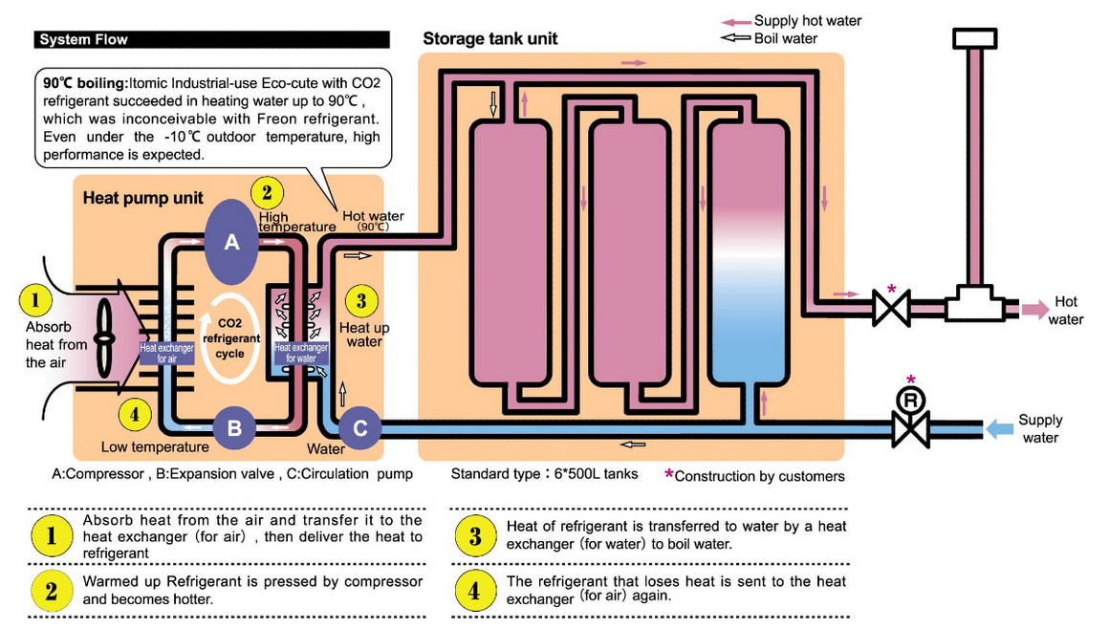
Principle :
Notes:
Normal pressure air was compressed to high-temperature high-pressure gas by compressor, and then through a heat exchanger you get heat from the refrigerating fluid. Then you get normal-temperature high pressure refrigerate. The refrigerant liquid is then entering the evaporator, where is heat transfer media that help the refrigerant liquid gets heat to become a a low-temperature low-pressure gas .
make the co2 stay in Critical state there in no liquid at all

Slide 15
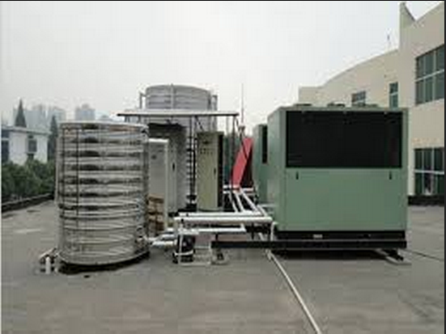
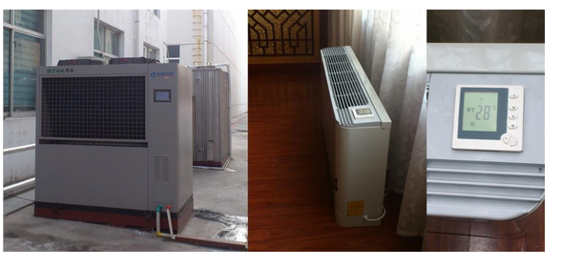
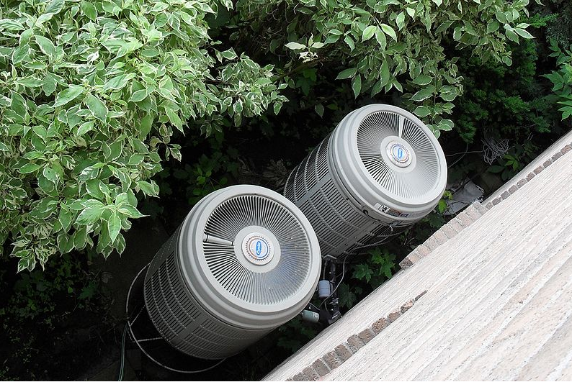
R22
R22
R410A or R134A
制冷剂：Refrigerant
Outside components (Evaporator) of a residential air-source heat pump
Notes:
Bath
room heating
R22 Freon ['friːɒn]氟里昂
is a part of the Montreal protocol signed by a great number of countries.
In EU and the USA virgin R22 cannot be used from the 1st of January 2010. In the rest of the world the phase out date is different from country to country. Below you can find the links with the information regarding phase out in different regions.
最新一代熱泵熱水機利用由大氣中補捉來的天然冷媒CO2 ( R744 ) , 造成地球 溫室效應指數 ( GWP )為 1 , 只有傳統冷媒的 1 / 1700 , 臭氧層破壞指數 ( ODP ) 為 0 , 加上二氧化碳 的高熱傳效應可大大的提昇能源使用效率 , 平均 COP > 3.8 .

Slide 16
Ⅲ ADVANTAGES OF CO2 HEAT-PUMP
Notes:
inducement

Slide 17
1. Lower operation costs
Notes:
There are other ways of getting heat, like gas oil boiler but I tell you that our heat pump is the most economical choice.
Higher front cost

Slide 18
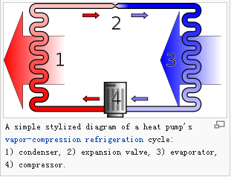
WHY THE COST IS SO CHEAP?
Because the COP(coefficient of performance) of heat pump is about 4.0 (2.8~7.0)
4 Joule
1 Joule
4~5 Joule of heat from heat sources (air, water …)
Notes:
Joule [dʒuːl]

Slide 19
Produce 60℃ hot water from 15℃ （Standard Condition）
 | CO2 heat-pump | Non-CO2 heat-pump | Solar water heaters | Gas boiler | Oil boiler | Electric heater | Coal boilers
Initial investment (Ten thousand RMB/TON) | 1 | 1 | 1.8 | 0.3 | 0.2 | 0.2 | 0.1
Costs of entire heating season | 13 RMB/m2 | 20 RMB/m2 | ? RMB/m2 | 26 RMB/m2 | 42 RMB/m2 | 55 RMB/m2 | 13 RMB/m2 17~27 RMB government charge
Operating Environment | -15℃--43℃ | 10℃—43℃ | 受天气变化大 | 不受外界温度影响 | 不受外界温度影响 | 不受外界温度影响 | 不受外界温度影响
The maximum water temperature of the product | 95℃ | 55℃ | 受天气变化大 | 100℃ | 100℃ | 100℃ | 100℃
Stabality | 出水稳定，55—95℃可调 | 出水稳定，30-55℃可调 | 受天气变化大 | 产水慢，时间长 | 产水慢，时间长 | 产水量小 | 产水慢，时间长
安装 | 不受安装空间限制 | 不受安装空间限制 | 必须安装在阳光下，局限性大 | 设置专门的锅炉房 | 设置专门的锅炉房 | 不受安装空间限制 | 设置专门的锅炉房
优点 | 后期费用低，无需专人管理 | 后期费用低，无需专人管理 | 后期费用低，无需专人管理 | 前期投资小 | 前期投资小 | 前期投资小 | 前期投资小，后期费用低
缺点 | 前期投资高 | 前期投资高 | 前期投资高 | 后期费用高，需专人管理 | 后期费用高，需专人管理 | 后期费用高，需专人管理 | 需专人管理
安全性 | 冷媒R744，安全环保 | 冷媒氟或氨，不安全不环保 | 安全环保 | 有漏气、火灾、爆炸等安全隐患，不环保 | 有漏油、火灾、爆炸等安全隐患、不环保 | 有漏电、电热管老化等安全隐患、环保 | 有火灾、爆炸等安全隐患、不环保
燃料+冷媒 | 电+R744(二氧化碳) | 氟或氨 | 太阳能+电 | 管道燃气 | 柴油 | 电 | 煤
理论燃值 | 860kcal/kwh | 860kcal/kwh | 860kcal/kwh | 8500kcal/ m³ | 9800kcal/kg | 860kcal/kwh | 5000kcal/kg
热效率 | 以COP计： | 以COP计： |  | 85% | 80% | 95% | 55%
 | 夏季5.0 | 夏季4.2
 | 春秋季节4.5 | 春秋季节3.8 | 240天免费
 | 冬季2.5-3.6 | 冬季2.0以下 | 120天0.95
 | -15℃以上可正常运行 | （10℃以下运行费用高或不可运行）
燃料单价 | 1RMB/kwh | 1RMB/kwh | 1RMB/kwh | 4RMB/m3 | 7.3RMB/kg | 1RMB/kwh | 0.5RMB/kg
1ton热水能耗 | 12.87kwh | 16.33kwh | 18.36kwh | 6.23m³ | 5.74kg | 55.08kwh | 16.36kg
（45度温差）
Price of produce 1 ton of 60℃ water | 12.87RMB | 16.33RMB | 18.36RMB | 24.92RMB | 41.9RMB | 55.08RMB | 8.18RMB
Notes:
resources shortages

Slide 20
2. Safe to the Environment and Operator
Notes:
When I say our machine is safe, not only because of it does not produce any smog but also the Refrigerant it used is safe to the environment.

Slide 21
Refrigerants
Refrigerants |  | Ozone depletion potential | Global warming potential | safety
HCFC | R22 | 0.055 | 1700 | A1
HFC | R134a | 0 | 1300 | A1
 | R404A | 0 | 3850 | A1
 | R407C | 0 | 1370 | A1
 | R410A | 0 | 1370 | A1
 | R507A | 0 | 3900 | A1
Natural | R717（氨） | 0 | <1 | B2
 | NH₃
 | R290（丙烷） | 0 | 3 | A3
 | C₃H₈
 | R600a | 0 | 3 | A3
 | C₄H₁₀
 | R744 | 0 | 1 | A1
 | CO₂
There are over 300 kinds of refrigerants.
For heat-pump
Notes:
HCFC: hydrochlorofluorocarbon氟氯烃化合物
environment friendly
depletion [dɪ'pliːʃn]
R22 is a part of the Montreal protocol signed by a great number of countries.
In EU and the USA virgin R22 cannot be used from the 1st of January 2010. In the rest of the world the phase out date is different from country to country. Below you can find the links with the information regarding phase out in different regions.
最新一代熱泵熱水機利用由大氣中補捉來的天然冷媒CO2 ( R744 ) , 造成地球 溫室效應指數 ( GWP )為 1 , 只有傳統冷媒的 1 / 1700 , 臭氧層破壞指數 ( ODP ) 為 0 , 加上二氧化碳 的高熱傳效應可大大的提昇能源使用效率 , 平均 COP > 3.8 .

Slide 22
3. Produces high-temperature (97℃) water within 1 minute
Notes:
Automatic 全自动

Slide 23
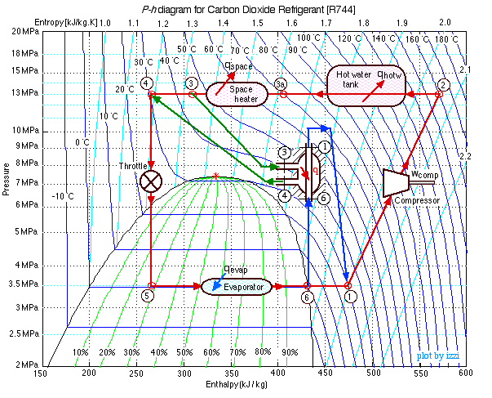
Principle

Slide 24
4. Works at -20℃ (Environmental temperature)
Notes:
In theory, the machine can work in an environment of minus forty degrees
We already test it in the lab

Slide 25
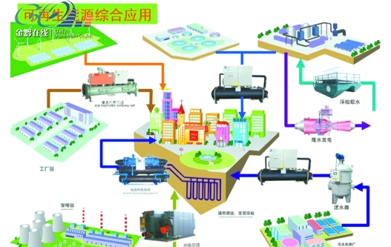
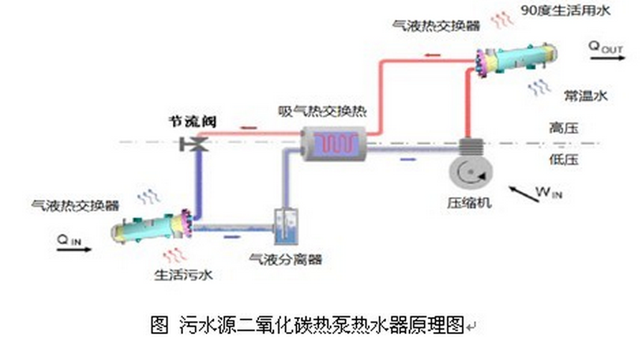
Three types of heat pumps
Exhaust air heat pump(EAHP)
Extracts heat from the exhaust air of a building,
Water source heat pumps (WSHP)
Uses flowing water as source or sink for heat
Hybrid (HHP)
Uses twin source for heat
Notes:
municipal sewage mjʊ‘nɪsɪp(ə)l ‘suːɪdʒ 市政污水
Big river
Under ground water

Slide 26
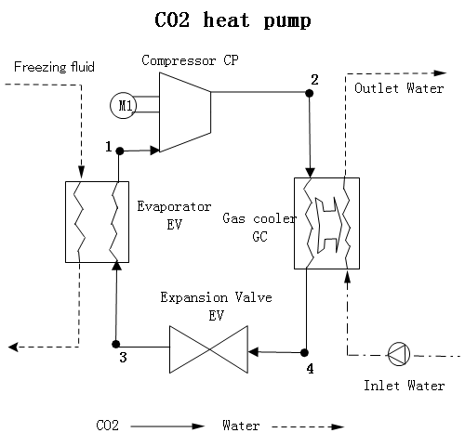
Core technology we can produce heat and cool energy at the same time
heat
Hot Water/air
cold
water
Cold air or liquid
Notes:
core technology

Slide 27
Ⅳ APPLICATIONS OF CO2 HEAT-PUMP IN NORTHERN CHINA

Slide 28
1. Winter heating & Summer cooling
12 RMS/m2 in Zhengzhou for the entire heating season
Notes:
Advantages

Slide 29
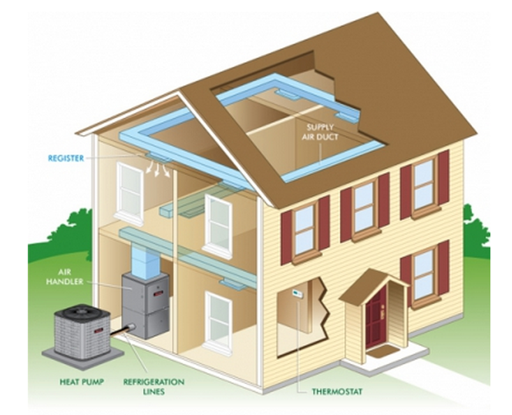
1. Winter heating & Summer cooling
fan coil air-conditioning system
Notes:
风机盘管fan coil air-conditioning system
They are not using co2
Considering the cost, we use 7 degrees Celsius cold water. So we can only use the fan coil air-conditioning system

Slide 30
2. Industry
Widely used in factories which need heating and cooling at the same time, especially high-temperature water (>70℃) and low-temperature air/liquid (<-20℃)
When PM2.5 over 400, all companies making smog are forced to STOP PRODUCTION

Slide 31
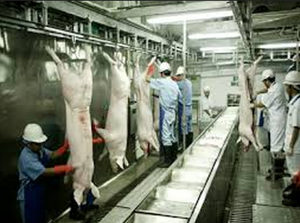
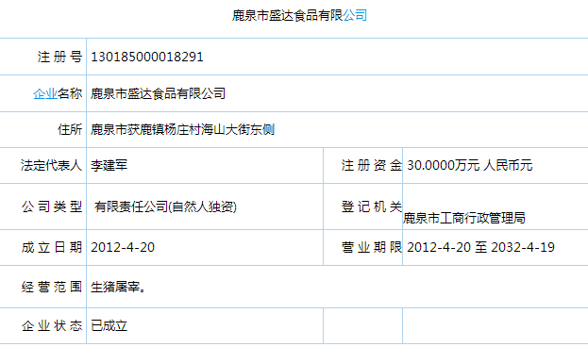
Slaughterhouse
Needs 65℃ hot water for washing and 0℃ cold air for keeping fresh meat
They used coal-fired boilers (prohibited now) to get hot water and air refrigerator to get cold air
Saving 1 million RMB each year
Notes:
'slɔːtəhaʊs
Fine罚款
Laying of pipelines yourself
Open a port 开一个端口
county town

Slide 32
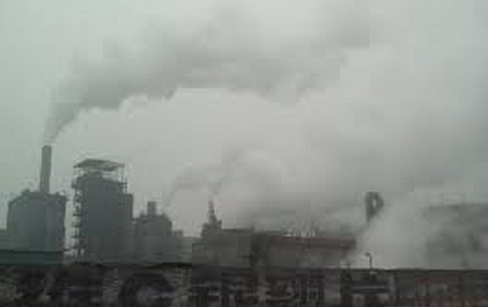
Chemical Plants
Each production line needs 100T 90℃ hot-water to accelerate chemical reactions and 400T 40℃ cold-water to prevent explosion. Also needs 200T -20 ℃ cold liquid to keep products.
Saving them 6-8 million RMB each year
Notes:
Production Line
Reform 改造

Slide 33
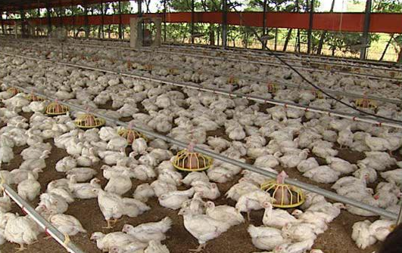
Farms
Slaughterhouse
Keep fresh meat
Keep the Coop, Piggery cool
Notes:
listed company
Slaughterhouse
Keep fresh meat
Keep the Coop Piggery cool

Slide 34
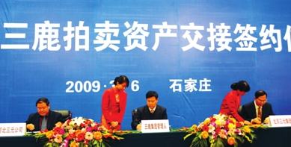
Dairies
Pasteurization 60~90℃ hot water
Milk & Yogurt refrigerate 4℃
Produce ice cream

Slide 35
Others
Supermarkets( keep warm, needs cold for meat and milk )
Food Factory (hot water to produce, cold environment to keep food)
Hotel (hot-water)
Schools
…

Slide 36
THANK YOU !

Slide 37
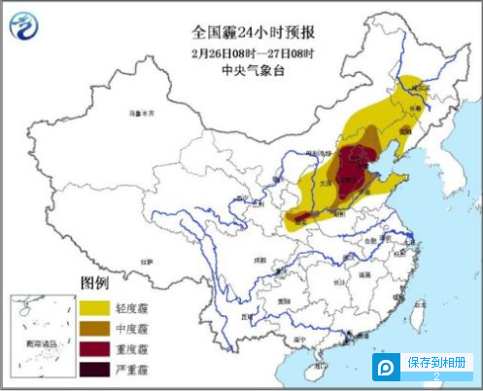
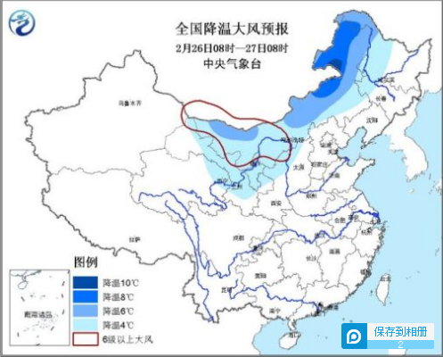
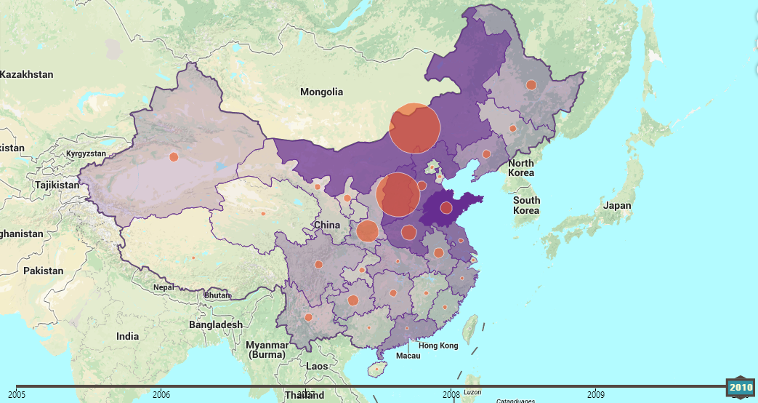
ⅠBACKGROUND
Notes:
Cooling and wind

Slide 38
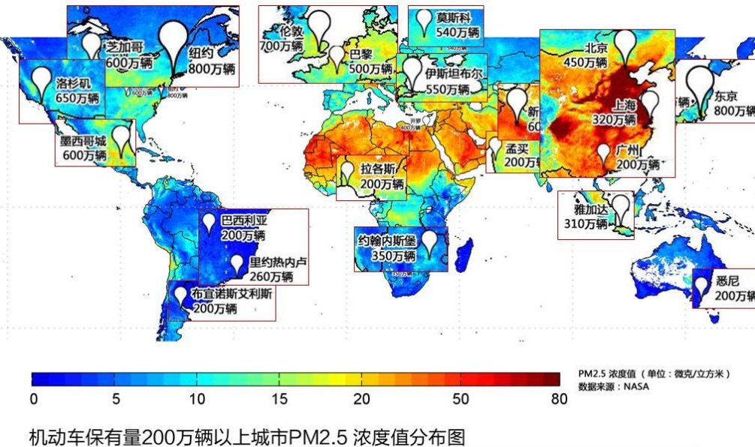
BACKGROUND
PM2.5 of cities owing cars over 2 millions

