Slide 1
Daily Person Trips in New Jersey: A Synthesis
Alain L. Kornhauser
Professor, Operations Research & Financial Engineering
Director, Transportation Research Program
Princeton University
Presented at Technix Conference, Univ. of Maryland, CATT
January 21, 2012

Slide 2
Most every day…
Almost 9 Million NJ residents
0.25 Million of out of state commuters
Make 30+ Million trips
Throughout the 8,700 sq miles of NJ
Where/when do they start?
Where do they go?
Does anyone know???
I certainly don’t
Not to sufficient precision for credible analysis

Slide 3
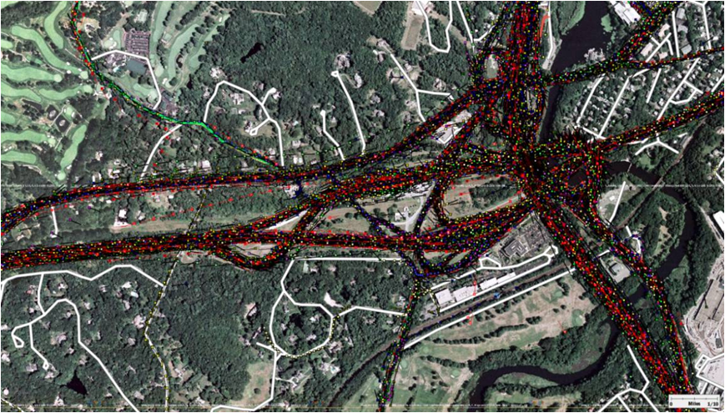
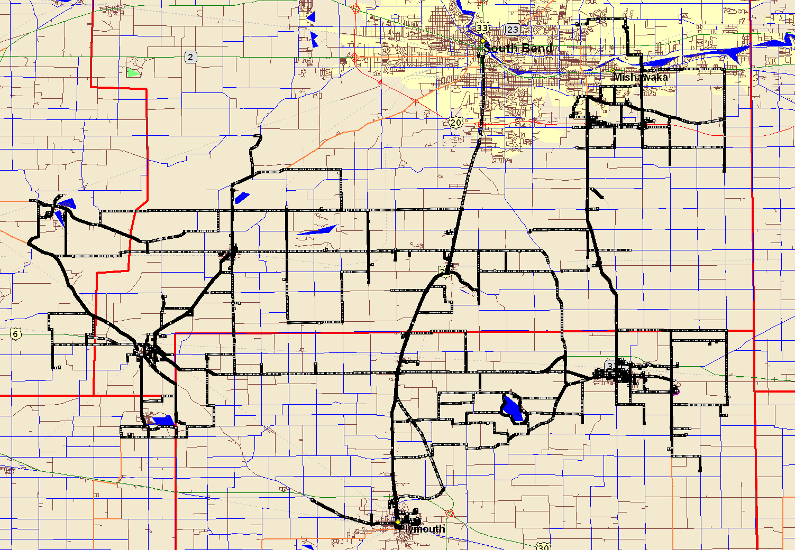
I’ve Tried…
I’ve harvested one of the largest troves of GPS tracks
Literally billions of individual trips,
Unfortunately, they are spread throughout the western world, throughout the last decade.
Consequently, I have only a very small ad hoc sample of what happens in NJ on a typical day.

Slide 4
Why do I want to know every trip?
Academic Curiosity
If offered an alternative, which ones would likely “buy it” and what are the implications.
More specifically:
If an alternative transport system were available, which trips would be diverted to it and what operational requirements would those trip impose on the new system?
In the end…
a transport system serves individual decision makers. It’s patronage is an ensemble of individuals,
I would prefer analyzing each individual trip patronage opportunity.

Slide 5
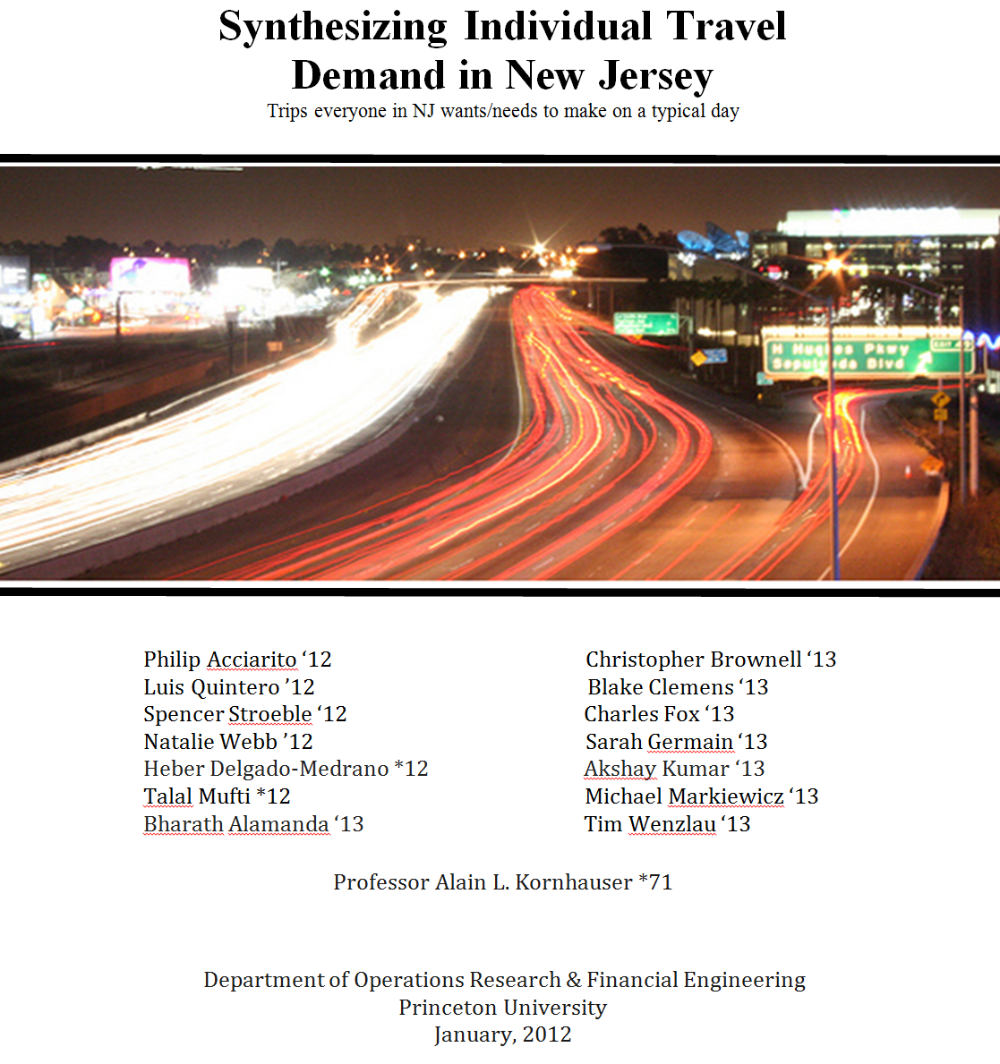

Slide 6
Synthesize from publically available data:
“every” NJ Traveler on a typical day NJ_Resident file
Containing appropriate demographic and spatial characteristics that reflect trip making
“every” trip that each Traveler is likely to make on a typical day. NJ_PersonTrip file
Containing appropriate spatial and temporal characteristics for each trip

Slide 7
Creating the NJ_Resident file
for “every” NJ Traveler on a typical day
NJ_Resident file
Start with Publically available data:

Slide 8
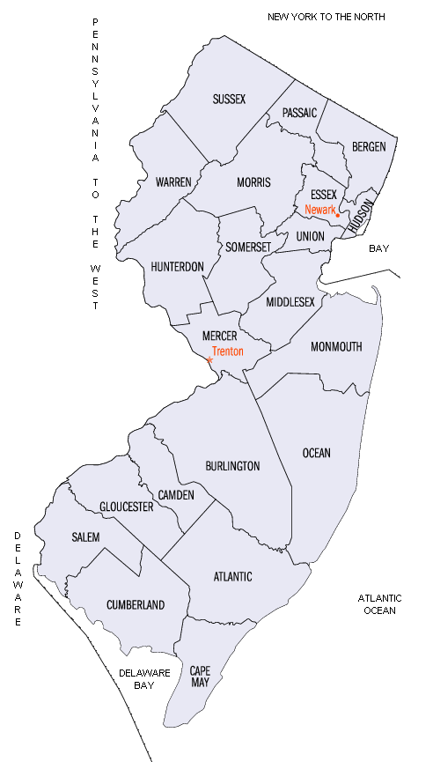
2010 Population census @Block Level
8,791,894 individuals distributed 118,654 Blocks.
County | Population | Census Blocks | Median Pop/ Block | Average Pop/Block
ATL | 274,549 | 5,941 | 26 | 46
BER | 905,116 | 11,171 | 58 | 81
BUR | 448,734 | 7,097 | 41 | 63
CAM | 513,657 | 7,707 | 47 | 67
CAP | 97,265 | 3,610 | 15 | 27
CUM | 156,898 | 2,733 | 34 | 57
ESS | 783,969 | 6,820 | 77 | 115
GLO | 288,288 | 4,567 | 40 | 63
HUD | 634,266 | 3,031 | 176 | 209
HUN | 128,349 | 2,277 | 31 | 56
MER | 366,513 | 4,611 | 51 | 79
MID | 809,858 | 9,845 | 50 | 82
MON | 630,380 | 10,067 | 39 | 63
MOR | 492,276 | 6,543 | 45 | 75
OCE | 576,567 | 10,457 | 31 | 55
PAS | 501,226 | 4,966 | 65 | 101
SAL | 66,083 | 1,665 | 26 | 40
SOM | 323,444 | 3,836 | 51 | 84
SUS | 149,265 | 2,998 | 28 | 50
UNI | 536,499 | 6,139 | 61 | 87
WAR | 108,692 | 2,573 | 23 | 42
Total | 8,791,894 | 118,654 |  | 74.1

Slide 9
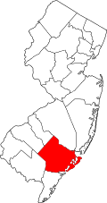
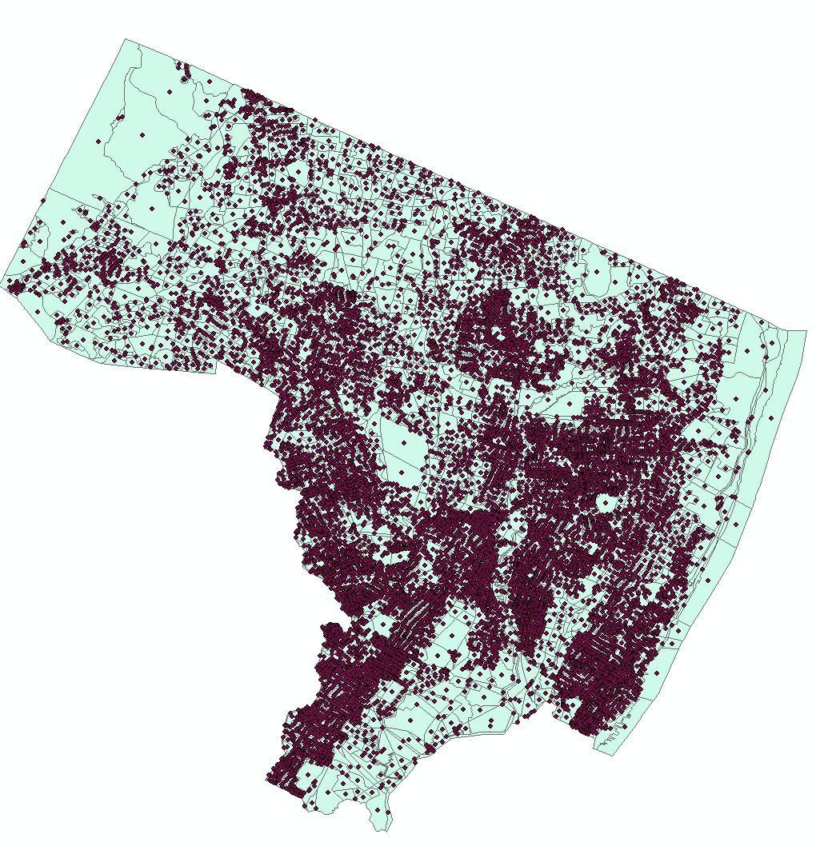
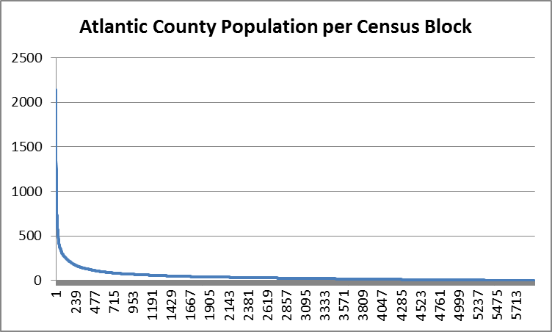
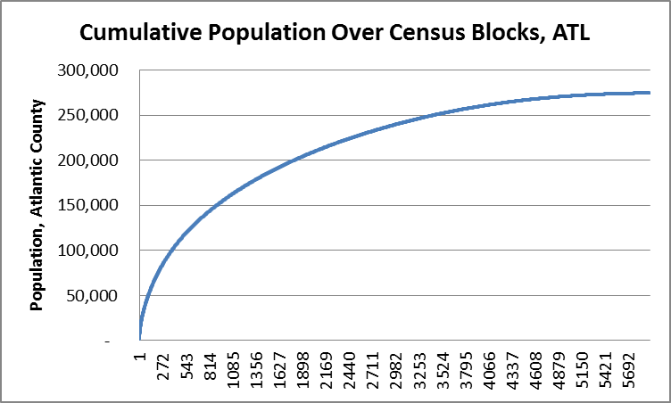
Atlantic County@Block Level
County | Population | Census Blocks | Median Pop/ Block | Average Pop/Block
ATL | 274,549 | 5,941 | 26 | 46

Slide 10
Publically available data:
Distributions of Demographic Characteristics
Age
Gender
Household size
Name (Last, First)
Ages (varying linearly over interval): | input: | output:
[0,49] | 67.5% | 67.5%
[50,64] | 18.0% | 17.9%
[65,79] | 12.0% | 12.1%
[80,100] | 2.5% | 2.5%
Household: | Size: | Probability: | cdf: | Expectation:
couple | 2 | 0.30 | 0.300 | 0.6
couple + 1 | 3 | 0.08 | 0.380 | 0.24
couple + 2 | 4 | 0.06 | 0.440 | 0.24
couple + 3 | 5 | 0.04 | 0.480 | 0.2
couple + 4 | 6 | 0.04 | 0.520 | 0.24
couple + grandparent: | 3 | 0.01 | 0.525 | 0.015
single woman | 1 | 0.16 | 0.685 | 0.16
single mom + 1 | 2 | 0.07 | 0.755 | 0.14
single mom + 2 | 3 | 0.05 | 0.805 | 0.15
single mom + 3 | 4 | 0.03 | 0.835 | 0.12
single mom + 4 | 5 | 0.03 | 0.865 | 0.15
single man | 1 | 0.12 | 0.985 | 0.12
single dad + 1 | 2 | 0.01 | 0.990 | 0.01
single dad + 2 | 3 | 0.005 | 0.995 | 0.015
single dad + 3 | 4 | 0.005 | 1.000 | 0.02
 |  |  |  | 2.42
Gender: | Input: | Output:
female | 51.3% | 51.3%

Slide 11
Beginnings of NJ_Resident file
County | Person Index | Household Index | Last Name | First Name | Middle Initial | Age | Gender | Worker Index | Worker Type | Home Latitude | Home Longitude
0 | 1 | 1 | PREVILLE | RICHARD | G. | 24 | FALSE | 5 | worker | 39.43937 | -74.495087
0 | 2 | 1 | PREVILLE | JACK | J. | 7 | FALSE | 0 | grade School | 39.43937 | -74.495087
0 | 3 | 1 | PREVILLE | CHARLES | X. | 1 | FALSE | 7 | under 5 | 39.43937 | -74.495087
0 | 4 | 2 | DEVEREUX | SUE | B. | 24 | TRUE | 6 | at-home-worker | 39.43937 | -74.495087
0 | 5 | 2 | DEVEREUX | ANTON | P. | 2 | FALSE | 7 | under 5 | 39.43937 | -74.495087
0 | 6 | 2 | DEVEREUX | KATIE | S. | 6 | TRUE | 0 | grade School | 39.43937 | -74.495087
0 | 7 | 3 | WHEDBEE | LINDA | C. | 26 | TRUE | 6 | at-home-worker | 39.43937 | -74.495087
0 | 8 | 4 | CARVER | ROBERT | Z. | 24 | FALSE | 5 | worker | 39.43937 | -74.495087
0 | 9 | 4 | CARVER | JENNIFER | P. | 25 | TRUE | 6 | at-home-worker | 39.43937 | -74.495087
0 | 10 | 5 | TINSLEY | ELLEN | U. | 23 | TRUE | 4 | college on campus: | 40.85646 | -74.197833
County
Task 1
2010 Census
# People,
Lat, Lon,
WorkerType Index | WorkerType String: | Distribution:
0 | grade school | 100% ages [6,10]
1 | middle school | 100% ages [11,14]
2 | high school | 100% ages [15,18]
3 | college: commute | Sate-wide distribution
4 | college: on campus | Sate-wide distribution
5 | worker | Drawn to match J2W Stats by County
6 | at-home worker and retired | Remainder + 100% ages [65,79]
7 | nursing home and under 5 | 100% ages [0,5] and 100% ages [80,100]
For each person
Vital Stats
RandomDraw:
Age, M/F, WorkerType,

Slide 12
Using Census Journey-to-Work (J2W) Tabulations to assign Employer County
Home
County
Task 2
C2C
Journey2Work
WorkCounty Destination RandomDraw:
Journey2Work
Home State | Home County | County Name | Work State | Work County | County Name | Workers
34 | 1 | Atlantic Co. NJ | 6 | 59 | Orange Co. CA | 12
34 | 1 | Atlantic Co. NJ | 6 | 85 | Santa Clara Co. CA | 9
34 | 1 | Atlantic Co. NJ | 10 | 3 | New Castle Co. DE | 175
34 | 1 | Atlantic Co. NJ | 10 | 5 | Sussex Co. DE | 9
6 | 37 | L. A. Co. CA | 34 | 1 | Atlantic Co. NJ | 33
6 | 65 | Riverside Co. CA | 34 | 1 | Atlantic Co. NJ | 7
9 | 3 | Hartford Co. CT | 34 | 1 | Atlantic Co. NJ | 5
9 | 5 | Litchfield Co. CT | 34 | 1 | Atlantic Co. NJ | 4
Work
County
http://www.census.gov/population/www/cen2000/commuting/files/2KRESCO_NJ.xls
http://www.census.gov/population/www/cen2000/commuting/files/2KWRKCO_NJ.xls
County | Person Index | Household Index | Last Name | First Name | Middle Initial | Age | Gender | Worker Index | Worker Type | Home Latitude | Home Longitude | Employer County
0 | 1 | 1 | PREVILLE | RICHARD | G. | 24 | FALSE | 5 | worker | 39.43937 | -74.495087 | 22
0 | 2 | 1 | PREVILLE | JACK | J. | 7 | FALSE | 0 | grade School | 39.43937 | -74.495087
0 | 3 | 1 | PREVILLE | CHARLES | X. | 1 | FALSE | 7 | under 5 | 39.43937 | -74.495087
0 | 4 | 2 | DEVEREUX | SUE | B. | 24 | TRUE | 6 | at-home-worker | 39.43937 | -74.495087
0 | 5 | 2 | DEVEREUX | ANTON | P. | 2 | FALSE | 7 | under 5 | 39.43937 | -74.495087
0 | 6 | 2 | DEVEREUX | KATIE | S. | 6 | TRUE | 0 | grade School | 39.43937 | -74.495087
0 | 7 | 3 | WHEDBEE | LINDA | C. | 26 | TRUE | 6 | at-home-worker | 39.43937 | -74.495087
0 | 8 | 4 | CARVER | ROBERT | Z. | 24 | FALSE | 5 | worker | 39.43937 | -74.495087 | 0
0 | 9 | 4 | CARVER | JENNIFER | P. | 25 | TRUE | 6 | at-home-worker | 39.43937 | -74.495087
0 | 10 | 5 | TINSLEY | ELLEN | U. | 23 | TRUE | 4 | college on c ampus: | 40.85646 | -74.197833

Slide 13
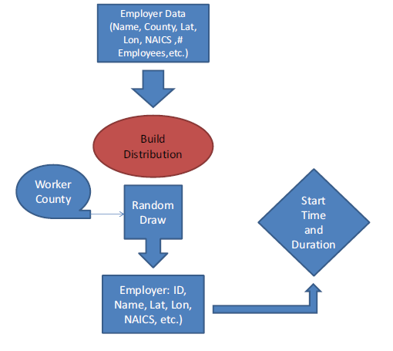
Using Employer Data to assign a Workplace Characteristics
Name | County | NAICS Code | NAICS Description | Employment | Latitude | Longitude
1 VIP SKINDEEP | Atlantic | 81219915 | Other Personal Care | 2 | 39.401104 | -74.514228
10 Acres Motel | Atlantic | 72111002 | Hotels & Motels Ex Casino | 2 | 39.437305 | -74.485488
1001 Grand Street Investors | Atlantic | 52399903 | Misc Financial Inves | 3 | 39.619732 | -74.786654
1006 S Main St LLC | Atlantic | 53111004 | Lessors Of Res Buildg | 5 | 39.382399 | -74.530785
11th Floor Creative Group | Atlantic | 51211008 | Motion Picture Prod | 2 | 39.359014 | -74.430151
123 Cab Co | Atlantic | 48531002 | Taxi Svc | 2 | 39.391600 | -74.521715
123 Junk Car Removal | Atlantic | 45331021 | Used Merch Stores | 2 | 39.361705 | -74.435779
1400 Bar | Atlantic | 72241001 | Drinking Places | 4 | 39.411266 | -74.570083
1-800-Got-Junk? | Atlantic | 56221910 | Other Non-Haz Waste Disp | 4 | 39.423954 | -74.557892
Employment-Weighted
Random Draw

Slide 14
Using School Data to Assign School Characteristics

Slide 15
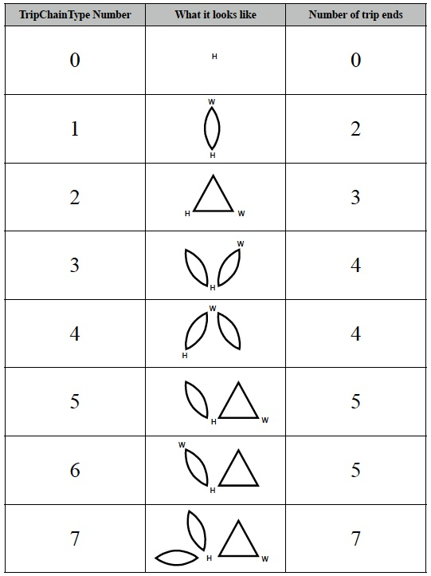
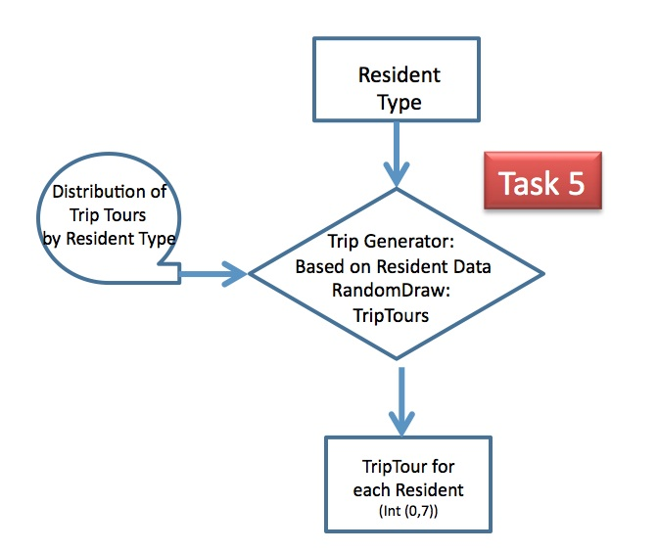
Assigning a Daily Activity (Trip) Tour to Each Person

Slide 16
Final NJ_Resident file
Home County
Person Index
Household Index
Full Name
Age
Gender
Worker Type Index
Worker Type String
Home lat, lon
Work or School lat,lon
Work County
Work or School Index
NAICS code
Work or School start/end time
ATL | 274,549
BER | 905,116
BUR | 448,734
CAM | 513,657
CAP | 97,265
CUM | 156,898
ESS | 783,969
GLO | 288,288
HUD | 634,266
HUN | 128,349
MER | 366,513
MID | 809,858
MON | 630,380
MOR | 492,276
OCE | 576,567
PAS | 501,226
SAL | 66,083
SOM | 323,444
SUS | 149,265
UNI | 536,499
WAR | 108,692
NYC | 86,418
PHL | 18,586
BUC | 99,865
SOU | 13,772
NOR | 5,046
WES | 6,531
ROC | 32,737
Total: | 9,054,849

Slide 17
Creating the NJ_PersonTrip file
“every” trip that each Traveler is likely to make on a typical day. NJ_PersonTrip file
Containing appropriate spatial and temporal characteristics for each trip
Start with
NJ_ResidentTrip file
NJ_Employment file
Readily assign trips between Home and Work/School
Trip Activity -> Stop Sequence
Home, Work, School characteristics synthesized in NJ_Resident file

Slide 18
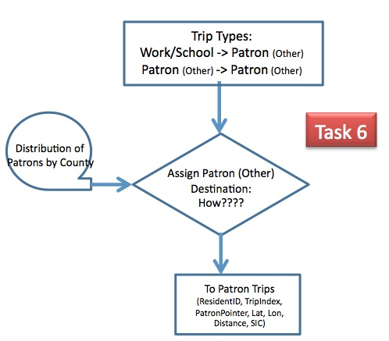
Assigning “Other” Locations
1. Select Other County Using:
Attractiveness-Weighted
Random Draw
Attractiveness (i)= (Patrons (I)/AllPatrons)/{D(i,j)² + D(j,k)²};
Where i is destination county; j is current county; k is home county
2. Select “Other” Business using:
Patronage-Weighted Random Draw within selected county

Slide 19
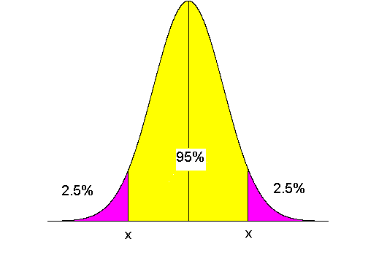
Assigning Trip Departure Times
Task 8
Trip Type; SIC
Distribution of
Arrival/Departure
Times
Time Generator:
RandomDraw:
Time Distribution
Trip Departure time
(SeconsFromMidnight)
For: H->W; H->School; W->Other
Work backwards from Desired Arrival Time using
Distance and normally distributed Speed distribution, and
Non-symmetric early late probabilities
Else, Use Stop Duration with non-symmetric early late probabilities based on SIC Cod

Slide 20
NJ_PersonTrip file
 | All Trips
Home County | Trips | TripMiles | AverageTM
 | # | Miles | Miles
ATL | 936,585 | 27,723,931 | 29.6
BER | 3,075,434 | 40,006,145 | 13.0
BUC | 250,006 | 9,725,080 | 38.9
BUR | 1,525,713 | 37,274,682 | 24.4
CAM | 1,746,906 | 27,523,679 | 15.8
CAP | 333,690 | 11,026,874 | 33.0
CUM | 532,897 | 18,766,986 | 35.2
ESS | 2,663,517 | 29,307,439 | 11.0
GLO | 980,302 | 23,790,798 | 24.3
HUD | 2,153,677 | 18,580,585 | 8.6
HUN | 437,598 | 13,044,440 | 29.8
MER | 1,248,183 | 22,410,297 | 18.0
MID | 2,753,142 | 47,579,551 | 17.3
MON | 2,144,477 | 50,862,651 | 23.7
MOR | 1,677,161 | 33,746,360 | 20.1
NOR | 12,534 | 900,434 | 71.8
NYC | 215,915 | 4,131,764 | 19.1
OCE | 1,964,014 | 63,174,466 | 32.2
PAS | 1,704,184 | 22,641,201 | 13.3
PHL | 46,468 | 1,367,405 | 29.4
ROC | 81,740 | 2,163,311 | 26.5
SAL | 225,725 | 8,239,593 | 36.5
SOM | 1,099,927 | 21,799,647 | 19.8
SOU | 34,493 | 2,468,016 | 71.6
SUS | 508,674 | 16,572,792 | 32.6
UNI | 1,824,093 | 21,860,031 | 12.0
WAR | 371,169 | 13,012,489 | 35.1
WES | 16,304 | 477,950 | 29.3
Total | 30,564,528 | 590,178,597 | 19.3
9,054,849 records
One for each person in NJ_Resident file
Specifying 30,564,528 Daily Person Trips
Each characterized by a precise
Origination, Destination and Departure Time

