Slide 1

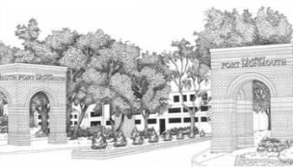
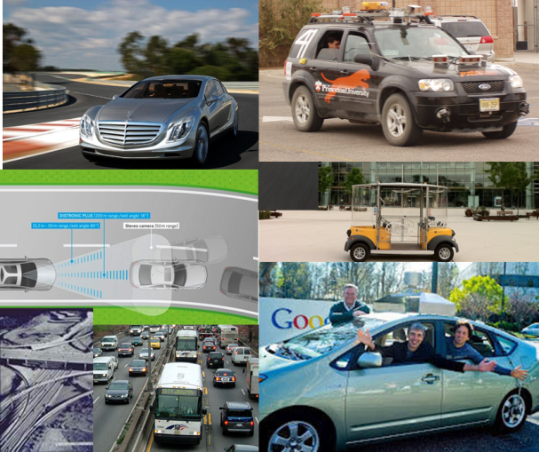
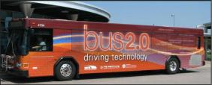

Appropriate Modelling of Travel Demand in a SmartDrivingCar World
Ride-Sharing
by
Alain L. Kornhauser, PhD
Professor, Operations Research & Financial Engineering
Director, Program in Transportation
Faculty Chair, PAVE (Princeton Autonomous Vehicle Engineering)
Princeton University
Presented at
Orf 467
Nov. 7, 2016

Slide 2

SAE Levels of Automation
What the Levels Deliver:
Levels 1 & 2 (AEB): Increased Safety, Comfort & Convenience
Primarily an Insurance Discount Play
Levels 3, 4 (Self-Driving): Increased Pleasure, Safety, Comfort & Convenience
An Enormous Consumer Play
Level 5 (Driverless Repositioning) : Pleasure, Mobility, Efficiency, Equity
Revolutionizes “Mass Transit” by Greatly Extending the Trips that can be served @ “zero” cost of Labor.
(That was always the biggest “value” of PRT; zero labor cost for even zero-occupant trips)
A Corporate Utility/Fleet Play

Slide 3
What about Level 4 Implications on
Energy, Congestion, Environment?
Assuming PLANNERS continue to PLAN as they do now.
  How will people “get around”?
Assuming this new way of “getting around” offers different opportunities and constraints for PLANNERS to improve “Quality of Life”.
  How will Zoning/Land-Use Change?
  How will people “get around”?

Slide 4
What about Level 4 Implications on
Energy, Congestion, Environment?
Assuming Planners Don’t Change
Land-Use hasn’t changed
  Trip ends don’t change!
Assume Trip Distribution Doesn’t Change
  Then it is only Mode Split.
  Do I:
    Walk?
    Ride alone?
    Ride with someone?
All about Ride-sharing

Slide 5
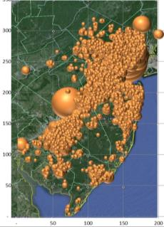
Kinds of RideSharing
“AVO < 1” RideSharing
  “Daddy, take me to school.” (Lots today)
“Organized” RideSharing
  Corporate commuter carpools (Very few today)
“Tag-along” RideSharing
  One person decides: “I’m going to the store. Wanna come along”. Other: “Sure”. (Lots today)
    There exists a personal correlation between ride-sharers
“Casual” RideSharing
  Chance meeting of a strange that wants to go in my direction at the time I want to go
    “Slug”, “Hitch hiker”

Slide 6
aTaxis and RideSharing
“AVO < 1” RideSharing
  Eliminate the “Empty Back-haul”; AVO Plus
“Organized” RideSharing
  Diverted to aTaxis
“Tag-along” RideSharing
  Only Primary trip maker modeled, “Tag-alongs” are assumed same after as before.
“Casual” RideSharing
  This is the opportunity of aTaxis
  How much spatial and temporal aggregation is required to create significant casual ride-sharing opportunities.

Slide 7
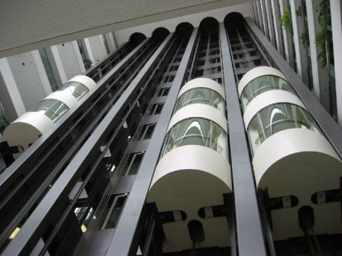
Spatial Aggregation
By walking to a station/aTaxiStand
  At what point does a walk distance makes the aTaxi trip unattractive relative to one’s personal car?
  ¼ mile ( 5 minute) max
Like using an Elevator!
Elevator

Slide 8
What about Level 4 Implications on
Energy, Congestion, Environment?
Assuming Planners Don’t Change
No Change in Today’s Walking, Bicycling and Rail trips
Today’s Automobile trips become aTaxi or aTaxi+Rail trips with hopefully LOTS of Ride-sharing opportunities

Slide 9
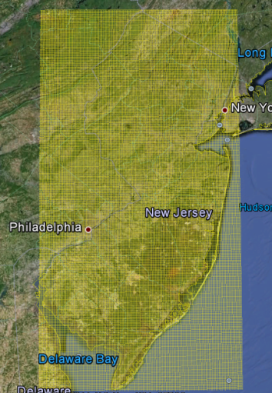
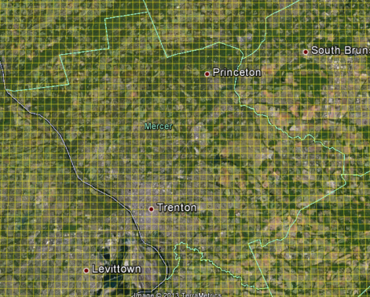
Pixelation of New Jersey
Zoomed-In Grid of Mercer
NJ State Grid

Slide 10
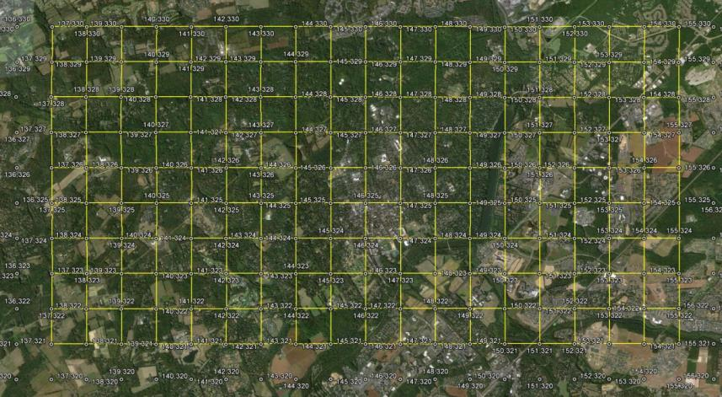
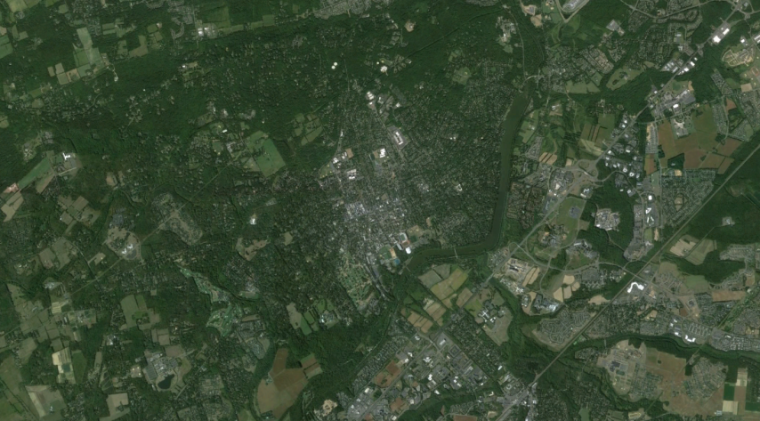
Pixelating the State
with half-mile Pixels
xPixel = floor{108.907 * (longitude + 75.6)}
yPixel = floor{138.2 * (latitude – 38.9))

Slide 11
An aTaxiTrip
{oYpixel, oXpixel, oTime (Hr:Min:Sec) , }
An aTaxiTrip
{oYpixel, oXpixel, oTime (Hr:Min:Sec) ,dYpixel, dXpixel, Exected: dTime}
a PersonTrip
{oLat, oLon, oTime (Hr:Min:Sec) ,dLat, dLon, Exected: dTime}
P₁
D
O
O

Slide 12
Common Destination (CD)
CD=1p: Pixel -> Pixel (p->p) Ride-sharing
P₁
O
TripMiles = L
TripMiles = 2L
TripMiles = 3L

Slide 13
P₁
O
PersonMiles = 3L
PersonMiles = 3L
aTaxiMiles = L
AVO = PersonMiles/aTaxiMiles = 3

Slide 14
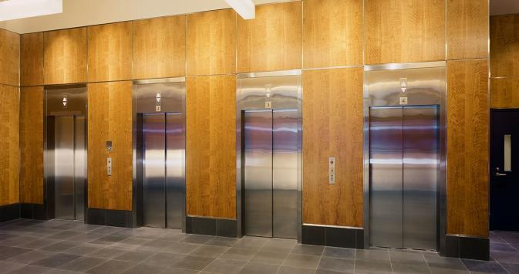
Elevator Analogy of an aTaxi Stand
Temporal Aggregation
Departure Delay: DD = 300 Seconds
Kornhauser
Obrien
Johnson
40 sec
Henderson
Lin
1:34
Popkin
3:47

Slide 15
Elevator Analogy of an aTaxi Stand
60 seconds later
Henderson
Lin
Young
0:34
Christie
Maddow
4:12
Samuels
4:50
Popkin
2:17

Slide 16
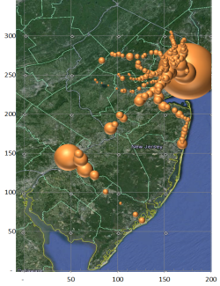
Spatial Aggregation
By walking to a station/aTaxiStand
  A what point does a walk distance makes the aTaxi trip unattractive relative to one’s personal car?
  ¼ mile ( 5 minute) max
By using the rail system for some trips
  Trips with at least one trip-end within a short walk to a train station.
  Trips to/from NYC or PHL

Slide 17
a PersonTrip from NYC
(or PHL or any Pixel containing a Train station)
An aTaxiTrip
{oYpixel, oXpixel, TrainArrivalTime, dYpixel, dXpixel, Exected: dTime}
NYC
NJ Transit Rail Line to NYC, next Departure
D
O
aTaxiTrip
Princeton Train Station

Slide 18
Spatial Aggregation
By walking to a station/aTaxiStand
  A what point does a walk distance makes the aTaxi trip unattractive relative to one’s personal car?
  ¼ mile ( 5 minute) max
By using the rail system for some trips
  Trips with at least one trip end within a short walk to a train station.
  Trips to/from NYC or PHL
By sharing rides with others that are basically going in my direction
  No trip has more than 20% circuity added to its trip time.

Slide 19

CD= 3p: Pixel ->3Pixels Ride-sharing
P₁
O
P₂

Slide 20
CD= 3p: Pixel ->3Pixels Ride-sharing
P₅
P₁
O
P₃

Slide 21
What about Level 4 Implications on
Energy, Congestion, Environment?
  I just need a Trip File for some Local
    {Precise O, Precise oTime, Precise D}
    For All Trips!
  “Precise” Location: Within a Very Short Walk
    ~ Parking Space -> Front Door
    (Properly account for accessibility differences: conventionalAuto v aTaxi)
  “Precise” oTime : “to the second”
    (Properly account for how long one must wait around to ride with someone else)

Slide 22
Project Overview
Trip Synthesizer (Activity-Based)
Motivation –
Publicly available TRAVEL Data do NOT contain:
  Spatial precision
    Where are people leaving from?
    Where are people going?
  Temporal precision
    At what time are they travelling?
Notes:
There is no data telling us when people are leaving their house, when they are coming back, where they are going in between

Slide 23
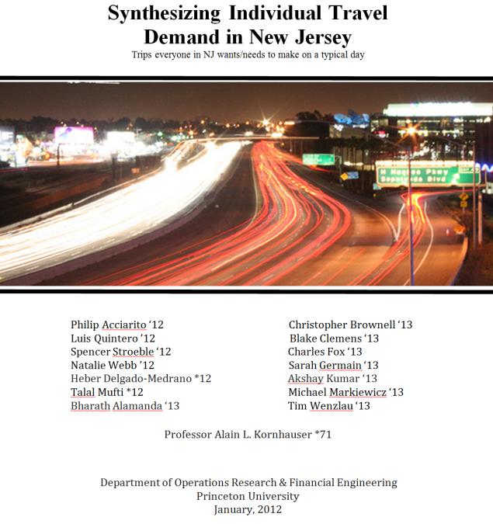

Slide 24
Synthesize from available data:
“every” NJ Traveler on a typical day NJ_Resident file
  Containing appropriate demographic and spatial characteristics that reflect trip making
“every” trip that each Traveler is likely to make on a typical day. NJ_PersonTrip file
  Containing appropriate spatial and temporal characteristics for each trip

Slide 25



Creating the NJ_Resident file
for “every” NJ Traveler on a typical day
  NJ_Resident file
  Start with Publically available data:

Slide 26
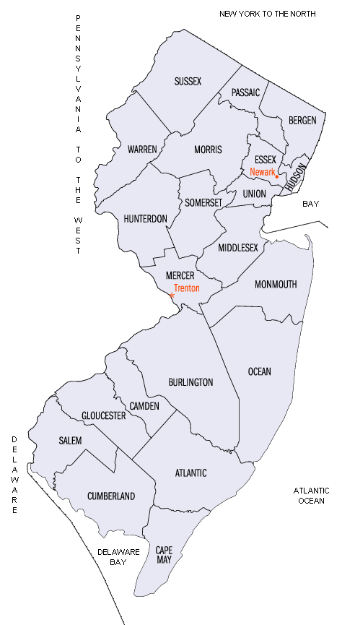
2010 Population census @Block Level
  8,791,894 individuals distributed 118,654 Blocks.
County | Population | Census Blocks | Median Pop/ Block | Average Pop/Block
ATL | 274,549 | 5,941 | 26 | 46
BER | 905,116 | 11,171 | 58 | 81
BUR | 448,734 | 7,097 | 41 | 63
CAM | 513,657 | 7,707 | 47 | 67
CAP | 97,265 | 3,610 | 15 | 27
CUM | 156,898 | 2,733 | 34 | 57
ESS | 783,969 | 6,820 | 77 | 115
GLO | 288,288 | 4,567 | 40 | 63
HUD | 634,266 | 3,031 | 176 | 209
HUN | 128,349 | 2,277 | 31 | 56
MER | 366,513 | 4,611 | 51 | 79
MID | 809,858 | 9,845 | 50 | 82
MON | 630,380 | 10,067 | 39 | 63
MOR | 492,276 | 6,543 | 45 | 75
OCE | 576,567 | 10,457 | 31 | 55
PAS | 501,226 | 4,966 | 65 | 101
SAL | 66,083 | 1,665 | 26 | 40
SOM | 323,444 | 3,836 | 51 | 84
SUS | 149,265 | 2,998 | 28 | 50
UNI | 536,499 | 6,139 | 61 | 87
WAR | 108,692 | 2,573 | 23 | 42
Total | 8,791,894 | 118,654 |  | 74.1

Slide 27
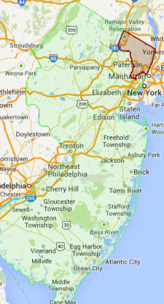
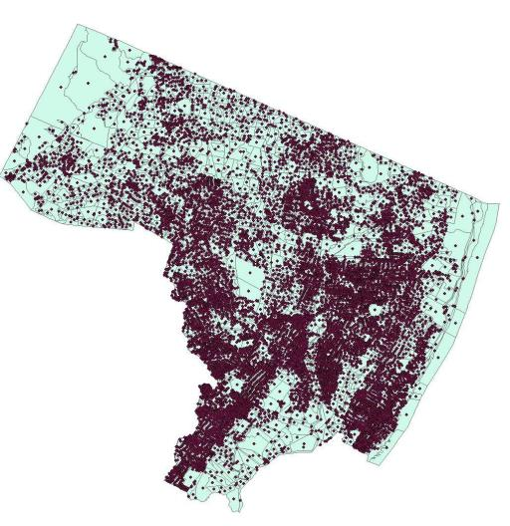
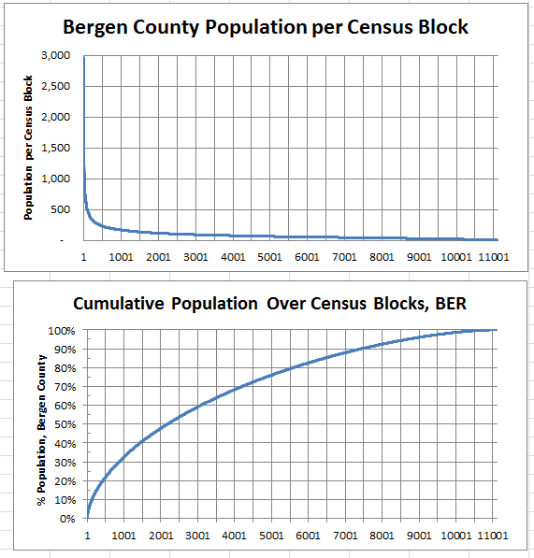
Bergen County @ Block Level
County | Population | Census Blocks | Median Pop/ Block | Average Pop/Block
BER | 907,128 | 11,116 | 58 | 81.6

Slide 28
Publically available data:
Distributions of Demographic Characteristics
  Age
  Gender
  Household size
  Name (Last, First)
Ages (varying linearly over interval): | input: | output:
[0,49] | 67.5% | 67.5%
[50,64] | 18.0% | 17.9%
[65,79] | 12.0% | 12.1%
[80,100] | 2.5% | 2.5%
Household: | Size: | Probability: | cdf: | Expectation:
couple | 2 | 0.30 | 0.300 | 0.6
couple + 1 | 3 | 0.08 | 0.380 | 0.24
couple + 2 | 4 | 0.06 | 0.440 | 0.24
couple + 3 | 5 | 0.04 | 0.480 | 0.2
couple + 4 | 6 | 0.04 | 0.520 | 0.24
couple + grandparent: | 3 | 0.01 | 0.525 | 0.015
single woman | 1 | 0.16 | 0.685 | 0.16
single mom + 1 | 2 | 0.07 | 0.755 | 0.14
single mom + 2 | 3 | 0.05 | 0.805 | 0.15
single mom + 3 | 4 | 0.03 | 0.835 | 0.12
single mom + 4 | 5 | 0.03 | 0.865 | 0.15
single man | 1 | 0.12 | 0.985 | 0.12
single dad + 1 | 2 | 0.01 | 0.990 | 0.01
single dad + 2 | 3 | 0.005 | 0.995 | 0.015
single dad + 3 | 4 | 0.005 | 1.000 | 0.02
 |  |  |  | 2.42
Gender: | Input: | Output:
female | 51.3% | 51.3%

Slide 29
  Beginnings of NJ_Resident file
County | Person Index | Household Index | Last Name | First Name | Middle Initial | Age | Gender | Worker Index | Worker Type | Home Latitude | Home Longitude
0 | 1 | 1 | PREVILLE | RICHARD | G. | 24 | FALSE | 5 | worker | 39.43937 | -74.495087
0 | 2 | 1 | PREVILLE | JACK | J. | 7 | FALSE | 0 | grade School | 39.43937 | -74.495087
0 | 3 | 1 | PREVILLE | CHARLES | X. | 1 | FALSE | 7 | under 5 | 39.43937 | -74.495087
0 | 4 | 2 | DEVEREUX | SUE | B. | 24 | TRUE | 6 | at-home-worker | 39.43937 | -74.495087
0 | 5 | 2 | DEVEREUX | ANTON | P. | 2 | FALSE | 7 | under 5 | 39.43937 | -74.495087
0 | 6 | 2 | DEVEREUX | KATIE | S. | 6 | TRUE | 0 | grade School | 39.43937 | -74.495087
0 | 7 | 3 | WHEDBEE | LINDA | C. | 26 | TRUE | 6 | at-home-worker | 39.43937 | -74.495087
0 | 8 | 4 | CARVER | ROBERT | Z. | 24 | FALSE | 5 | worker | 39.43937 | -74.495087
0 | 9 | 4 | CARVER | JENNIFER | P. | 25 | TRUE | 6 | at-home-worker | 39.43937 | -74.495087
0 | 10 | 5 | TINSLEY | ELLEN | U. | 23 | TRUE | 4 | college on campus: | 40.85646 | -74.197833
County
Task 1
2010 Census
# People,
Lat, Lon,
WorkerType Index | WorkerType String: | Distribution:
0 | grade school | 100% ages [6,10]
1 | middle school | 100% ages [11,14]
2 | high school | 100% ages [15,18]
3 | college: commute | Sate-wide distribution
4 | college: on campus | Sate-wide distribution
5 | worker | Drawn to match J2W Stats by County
6 | at-home worker and retired | Remainder + 100% ages [65,79]
7 | nursing home and under 5 | 100% ages [0,5] and 100% ages [80,100]
For each person
Vital Stats
RandomDraw:
Age, M/F, WorkerType,

Slide 30
  Using Census Journey-to-Work (J2W) Tabulations to assign Employer County
Home
County
Task 2
C2C
Journey2Work
WorkCounty Destination RandomDraw:
Journey2Work
Home State | Home County | County Name | Work State | Work County | County Name | Workers
34 | 1 | Atlantic Co. NJ | 6 | 59 | Orange Co. CA | 12
34 | 1 | Atlantic Co. NJ | 6 | 85 | Santa Clara Co. CA | 9
34 | 1 | Atlantic Co. NJ | 10 | 3 | New Castle Co. DE | 175
34 | 1 | Atlantic Co. NJ | 10 | 5 | Sussex Co. DE | 9
6 | 37 | L. A. Co. CA | 34 | 1 | Atlantic Co. NJ | 33
6 | 65 | Riverside Co. CA | 34 | 1 | Atlantic Co. NJ | 7
9 | 3 | Hartford Co. CT | 34 | 1 | Atlantic Co. NJ | 5
9 | 5 | Litchfield Co. CT | 34 | 1 | Atlantic Co. NJ | 4
Work
County
http://www.census.gov/population/www/cen2000/commuting/files/2KRESCO_NJ.xls
http://www.census.gov/population/www/cen2000/commuting/files/2KWRKCO_NJ.xls
County | Person Index | Household Index | Last Name | First Name | Middle Initial | Age | Gender | Worker Index | Worker Type | Home Latitude | Home Longitude | Employer County
0 | 1 | 1 | PREVILLE | RICHARD | G. | 24 | FALSE | 5 | worker | 39.43937 | -74.495087 | 22
0 | 2 | 1 | PREVILLE | JACK | J. | 7 | FALSE | 0 | grade School | 39.43937 | -74.495087
0 | 3 | 1 | PREVILLE | CHARLES | X. | 1 | FALSE | 7 | under 5 | 39.43937 | -74.495087
0 | 4 | 2 | DEVEREUX | SUE | B. | 24 | TRUE | 6 | at-home-worker | 39.43937 | -74.495087
0 | 5 | 2 | DEVEREUX | ANTON | P. | 2 | FALSE | 7 | under 5 | 39.43937 | -74.495087
0 | 6 | 2 | DEVEREUX | KATIE | S. | 6 | TRUE | 0 | grade School | 39.43937 | -74.495087
0 | 7 | 3 | WHEDBEE | LINDA | C. | 26 | TRUE | 6 | at-home-worker | 39.43937 | -74.495087
0 | 8 | 4 | CARVER | ROBERT | Z. | 24 | FALSE | 5 | worker | 39.43937 | -74.495087 | 0
0 | 9 | 4 | CARVER | JENNIFER | P. | 25 | TRUE | 6 | at-home-worker | 39.43937 | -74.495087
0 | 10 | 5 | TINSLEY | ELLEN | U. | 23 | TRUE | 4 | college on c ampus: | 40.85646 | -74.197833

Slide 31
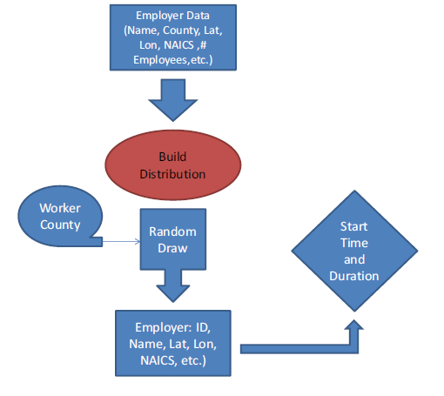
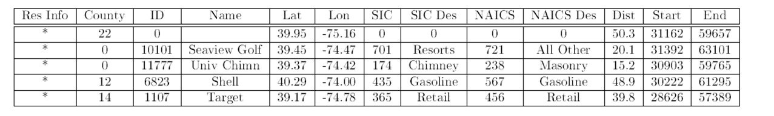
  Using Employer Data to assign a Workplace Characteristics
Name | County | NAICS Code | NAICS Description | Employment | Latitude | Longitude
1 VIP SKINDEEP | Atlantic | 81219915 | Other Personal Care | 2 | 39.401104 | -74.514228
10 Acres Motel | Atlantic | 72111002 | Hotels & Motels Ex Casino | 2 | 39.437305 | -74.485488
1001 Grand Street Investors | Atlantic | 52399903 | Misc Financial Inves | 3 | 39.619732 | -74.786654
1006 S Main St LLC | Atlantic | 53111004 | Lessors Of Res Buildg | 5 | 39.382399 | -74.530785
11th Floor Creative Group | Atlantic | 51211008 | Motion Picture Prod | 2 | 39.359014 | -74.430151
123 Cab Co | Atlantic | 48531002 | Taxi Svc | 2 | 39.391600 | -74.521715
123 Junk Car Removal | Atlantic | 45331021 | Used Merch Stores | 2 | 39.361705 | -74.435779
1400 Bar | Atlantic | 72241001 | Drinking Places | 4 | 39.411266 | -74.570083
1-800-Got-Junk? | Atlantic | 56221910 | Other Non-Haz Waste Disp | 4 | 39.423954 | -74.557892
Employment-Weighted
Random Draw

Slide 32
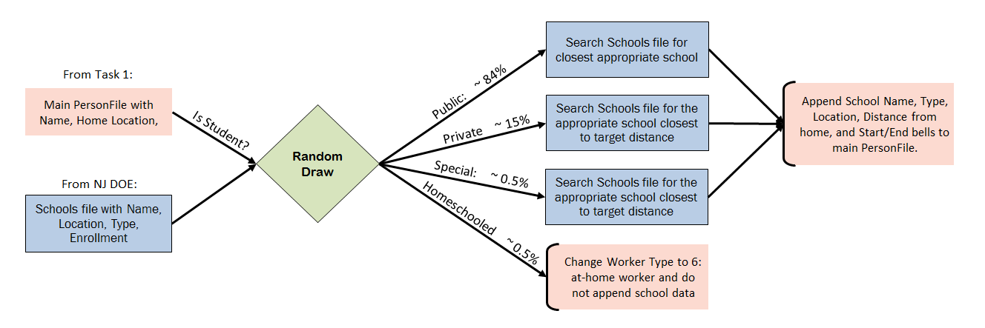
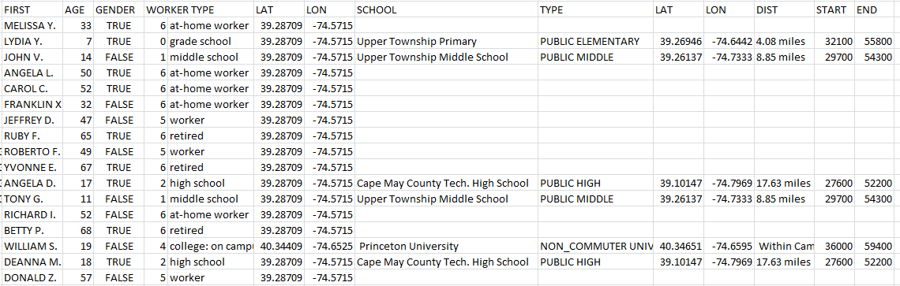
  Using School Data to Assign School Characteristics

Slide 33
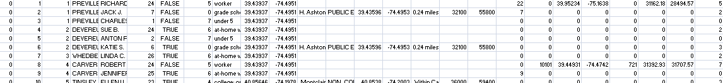
  Final NJ_Resident file
Home County
Person Index
Household Index
Full Name
Age
Gender
Worker Type Index
Worker Type String
Home lat, lon
Work or School lat,lon
Work County
Work or School Index
NAICS code
Work or School start/end time
ATL | 274,549
BER | 905,116
BUR | 448,734
CAM | 513,657
CAP | 97,265
CUM | 156,898
ESS | 783,969
GLO | 288,288
HUD | 634,266
HUN | 128,349
MER | 366,513
MID | 809,858
MON | 630,380
MOR | 492,276
OCE | 576,567
PAS | 501,226
SAL | 66,083
SOM | 323,444
SUS | 149,265
UNI | 536,499
WAR | 108,692
NYC | 86,418
PHL | 18,586
BUC | 99,865
SOU | 13,772
NOR | 5,046
WES | 6,531
ROC | 32,737
Total: | 9,054,849

Slide 34
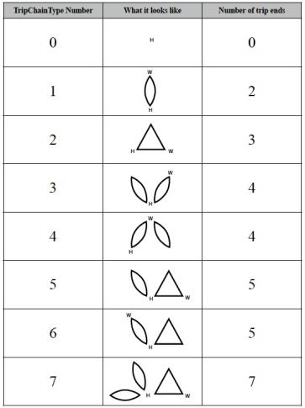
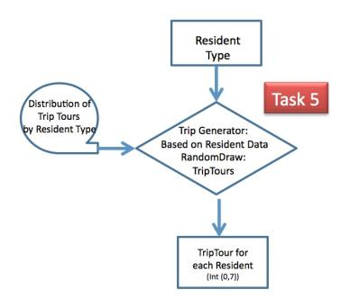
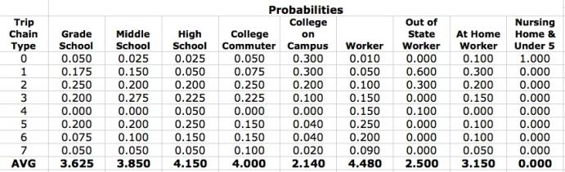
  Assigning a Daily Activity (Trip) Tour to Each Person

Slide 35
Creating the NJ_PersonTrip file
“every” trip that each Traveler is likely to make on a typical day. NJ_PersonTrip file
  Containing appropriate spatial and temporal characteristics for each trip
Start with
  NJ_ResidentTrip file
  NJ_Employment file
Readily assign trips between Home and Work/School
  Trip Activity -> Stop Sequence
    Home, Work, School characteristics synthesized in NJ_Resident file

Slide 36
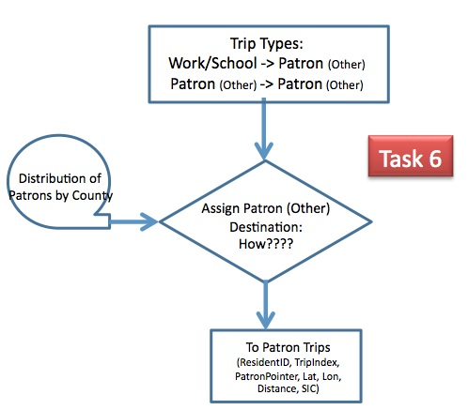
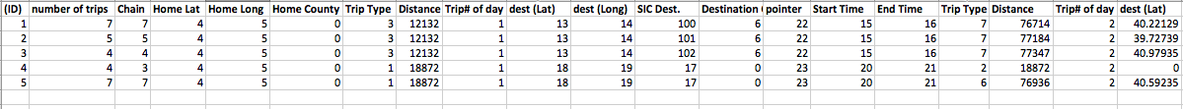
Assigning “Other” Locations
1. Select Other County Using:
Attractiveness-Weighted
Random Draw
Attractiveness (i)= (Patrons (I)/AllPatrons)/{D(i,j)² + D(j,k)²};
Where i is destination county; j is current county; k is home county
2. Select “Other” Business using:
Patronage-Weighted Random Draw within selected county

Slide 37
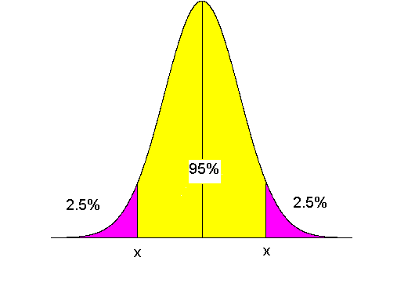
Assigning Trip Departure Times
Task 8
Trip Type; SIC
Distribution of
Arrival/Departure
Times
Time Generator:
RandomDraw:
Time Distribution
Trip Departure time
(SeconsFromMidnight)
  For: H->W; H->School; W->Other
Work backwards from Desired Arrival Time using
  Distance and normally distributed Speed distribution, and
  Non-symmetric early late probabilities
Else, Use Stop Duration with non-symmetric early late probabilities based on SIC Cod

Slide 38
NJ_PersonTrip file
 | All Trips
Home County | Trips | TripMiles | AverageTM
 | # | Miles | Miles
ATL | 936,585 | 27,723,931 | 29.6
BER | 3,075,434 | 40,006,145 | 13.0
BUC | 250,006 | 9,725,080 | 38.9
BUR | 1,525,713 | 37,274,682 | 24.4
CAM | 1,746,906 | 27,523,679 | 15.8
CAP | 333,690 | 11,026,874 | 33.0
CUM | 532,897 | 18,766,986 | 35.2
ESS | 2,663,517 | 29,307,439 | 11.0
GLO | 980,302 | 23,790,798 | 24.3
HUD | 2,153,677 | 18,580,585 | 8.6
HUN | 437,598 | 13,044,440 | 29.8
MER | 1,248,183 | 22,410,297 | 18.0
MID | 2,753,142 | 47,579,551 | 17.3
MON | 2,144,477 | 50,862,651 | 23.7
MOR | 1,677,161 | 33,746,360 | 20.1
NOR | 12,534 | 900,434 | 71.8
NYC | 215,915 | 4,131,764 | 19.1
OCE | 1,964,014 | 63,174,466 | 32.2
PAS | 1,704,184 | 22,641,201 | 13.3
PHL | 46,468 | 1,367,405 | 29.4
ROC | 81,740 | 2,163,311 | 26.5
SAL | 225,725 | 8,239,593 | 36.5
SOM | 1,099,927 | 21,799,647 | 19.8
SOU | 34,493 | 2,468,016 | 71.6
SUS | 508,674 | 16,572,792 | 32.6
UNI | 1,824,093 | 21,860,031 | 12.0
WAR | 371,169 | 13,012,489 | 35.1
WES | 16,304 | 477,950 | 29.3
Total | 32,862,668 | 590,178,597 | 19.3
9,054,849 records
  One for each person in NJ_Resident file
Specifying 32,862,668 Daily Person Trips
  Each characterized by a precise
    {oLat, oLon, oTime, dLat, dLon, Est_dTime}

Slide 39
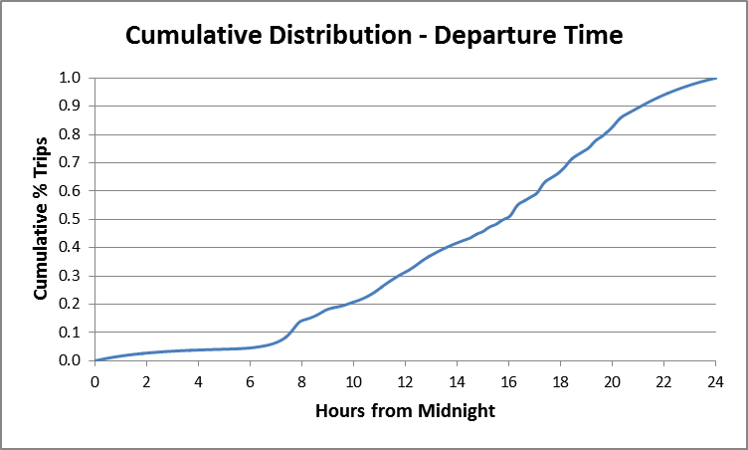
NJ_PersonTrip file

Slide 40
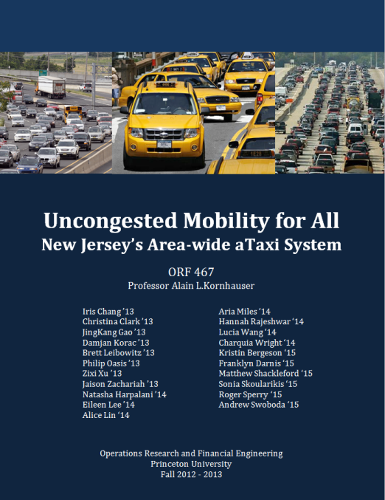

Slide 41
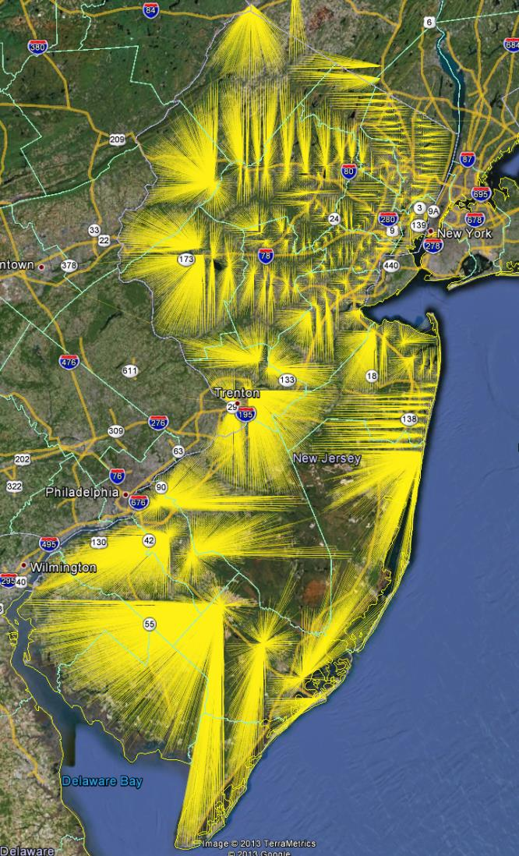
NJ Transit
Train Station
“Consumer-shed”

Slide 42
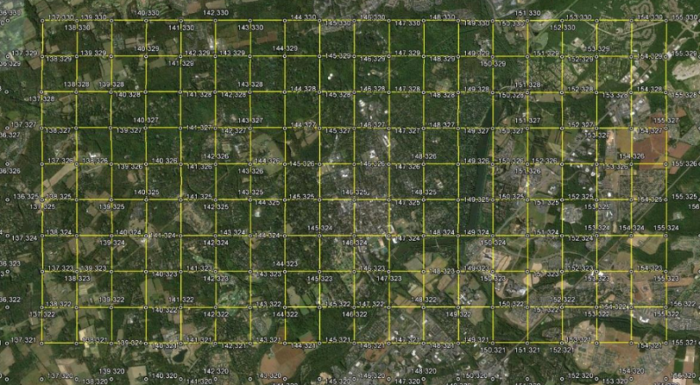
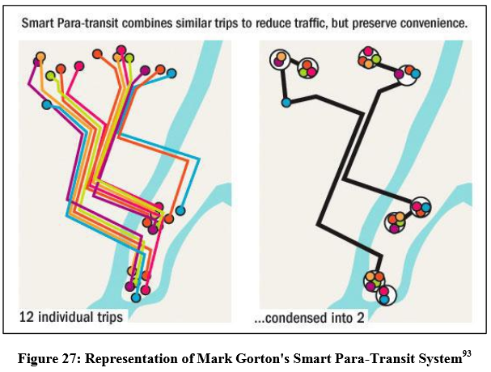
“Pixelated” New Jersey
(“1/2 mile square; 0.25mi²)
aTaxi Concept – (PRT) Model
Personal Rapid Transit Model
aTaxi Concept – SPT Model
Smart Para Transit Transit Model
Ref: http://orfe.princeton.edu/~alaink/Theses/2013/Brownell,%20Chris%20Final%20Thesis.pdf

Slide 43
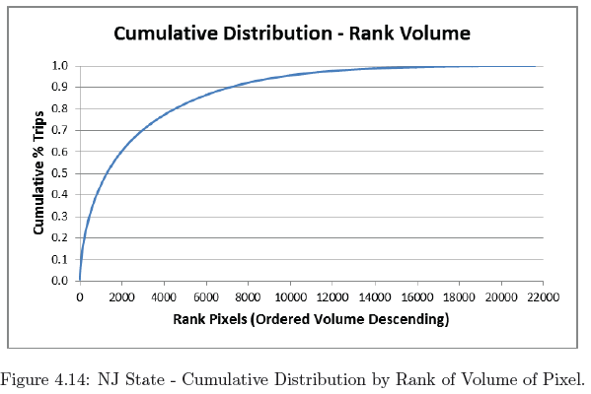
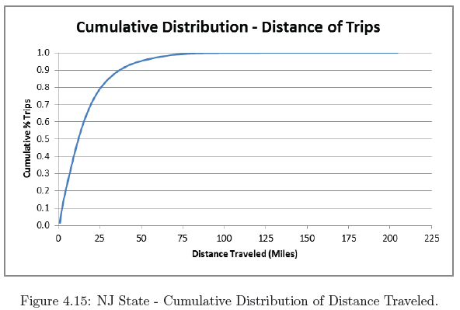
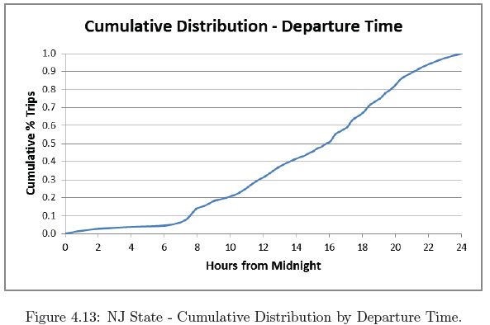
New Jersey Summary Data
Item | Value
Area (mi²) | 8,061
# of Pixels Generating at Least One O_Trip | 21,643
Area of Pixels (mi²) | 5,411
% of Open Space | 32.9%
# of Pixels Generating 95% of O_Trips | 9,519
# of Pixels Generating 50% of O_Trips | 1,310
# of Intra-Pixel Trips | 447,102
# of O_Walk Trips | 1,943,803
# of All O_Trips | 32,862,668
Avg. All O_TripLength (miles) | 19.6
# of O_aTaxi Trips | 30,471,763
Avg. O_aTaxiTripLength (miles) | 20.7
Median O_aTaxiTripLength (miles) | 12.5
95% O_aTaxiTripLength (miles) | 38.0

Slide 44
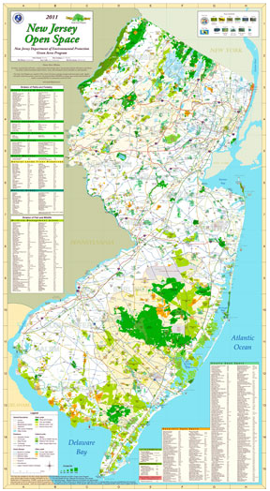
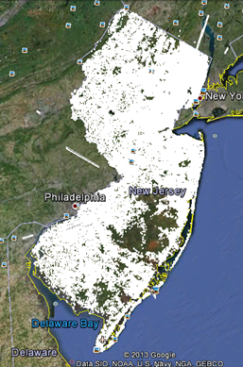

Slide 45
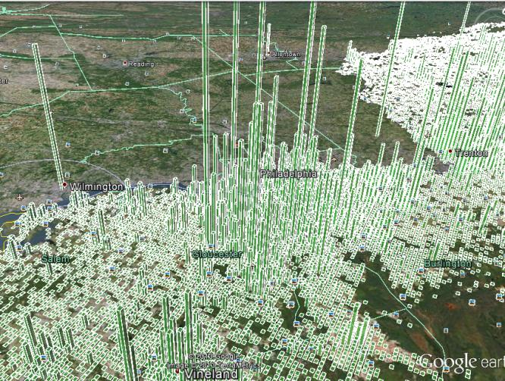
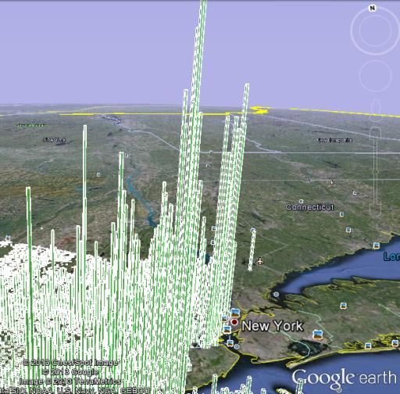
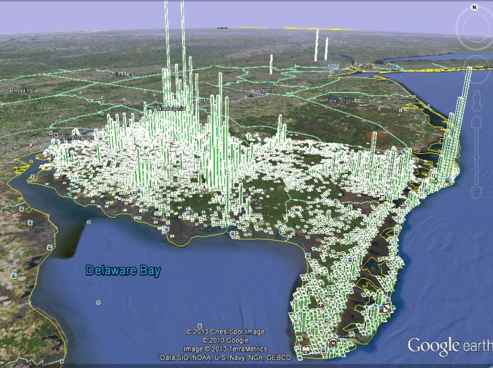

Slide 46
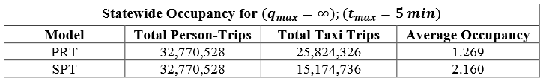
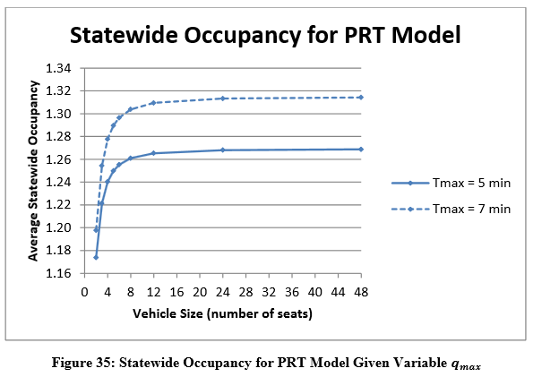
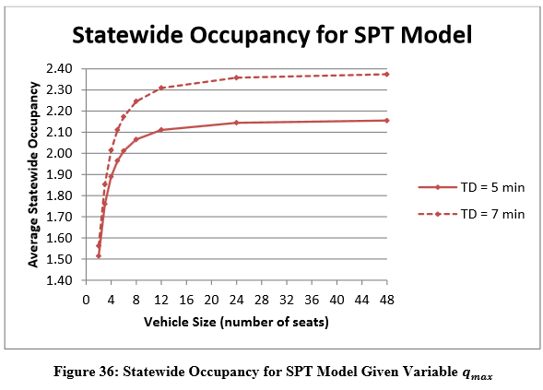
State-wide automatedTaxi (aTaxi)
Serves essentially all NJ travel demand (32M trips/day)
Shared ridership potential:
Slide 98

Slide 47
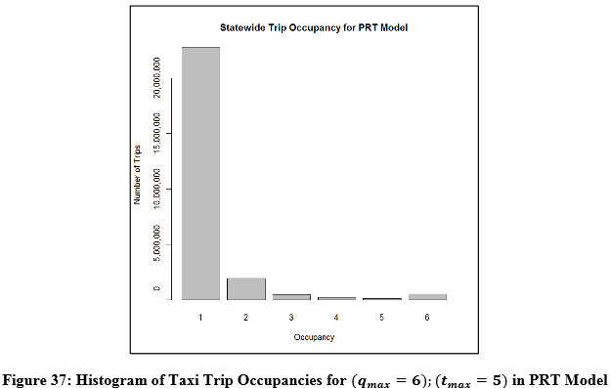
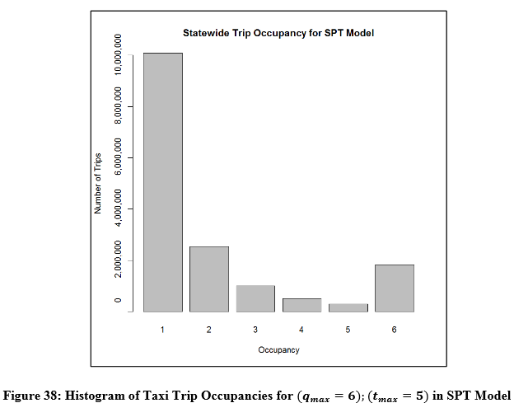
State-wide automatedTaxi (aTaxi)
Serves essentially all NJ travel demand (32M trips/day)
Shared ridership potential:

Slide 48
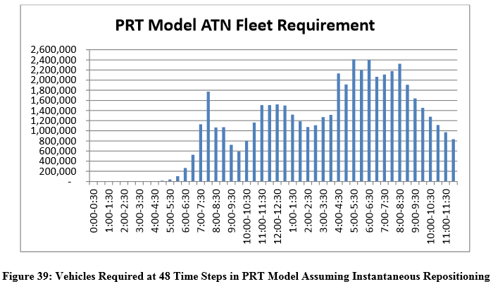
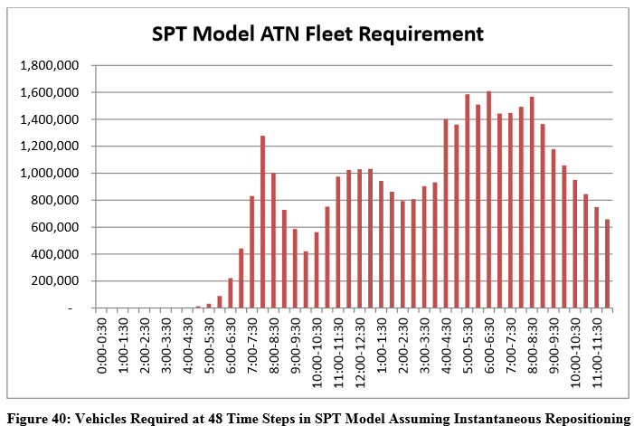
State-wide automatedTaxi (aTaxi)
Fleet size (Instantaneous Repositioning)

Slide 49
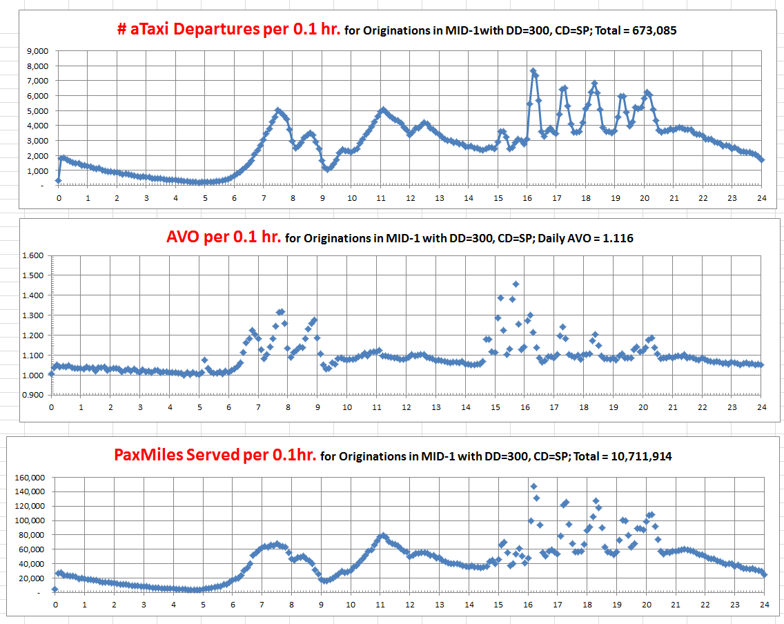
c
http://orfe.princeton.edu/~alaink/NJ_aTaxiOrf467F13/Orf467F13_NJ_TripFiles/MID-1_aTaxiDepAnalysis_300,SP.xlsx

Slide 50
Results

Slide 51
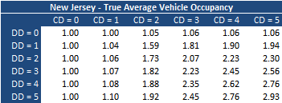
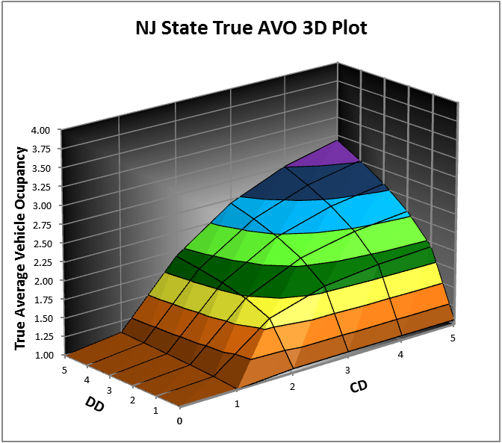
Results

Slide 52

What about the whole country?

Slide 53

Public Schools in the US

Slide 54
Nation-Wide Businesses
Rank | State | Sales Volume | No. Businesses
1 | California | $1,889 | 1,579,342
2 | Texas | $2,115 | 999,331
3 | Florida | $1,702 | 895,586
4 | New York | $1,822 | 837,773
5 | Pennsylvania | $2,134 | 550,678
9 | New Jersey | $1,919 | 428,596
45 | Washington DC | $1,317 | 49,488
47 | Rhode Island | $1,814 | 46,503
48 | North Dakota | $1,978 | 44,518
49 | Delaware | $2,108 | 41,296
50 | Vermont | $1,554 | 39,230
51 | Wyoming | $1,679 | 35,881
13.6 Million Businesses
{Name, address, Sales, #employees}
Notes:
US Businesses: 13.6Million
US Employees: 240 Million (with Luke's 50M students, 12% Unemployment)
US Patrons: 330 Million (!!!)
US Sales Volume: 30Billion

Slide 55
US_PersonTrip file will have..
308,745,538 records
  One for each person in US_Resident file
Specifying 1,009,332,835 Daily Person Trips
  Each characterized by a precise
    {oLat, oLon, oTime, dLat, dLon, Est_dTime}
Will Perform Nationwide aTaxi AVO analysis
Results ????

Slide 56


Slide 57


Slide 58


Slide 59


Slide 60
Trip Files are Available
If You want to Play

Slide 61
Discussion!
Thank You
alaink@princeton.edu
www.SmartDrivingCar.com

