Slide 1
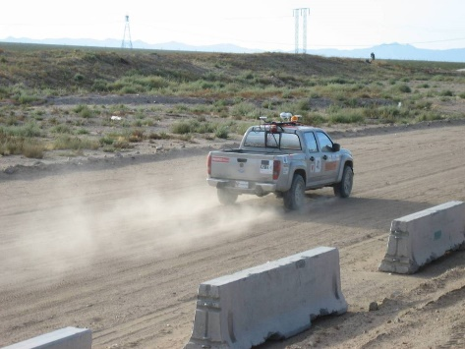

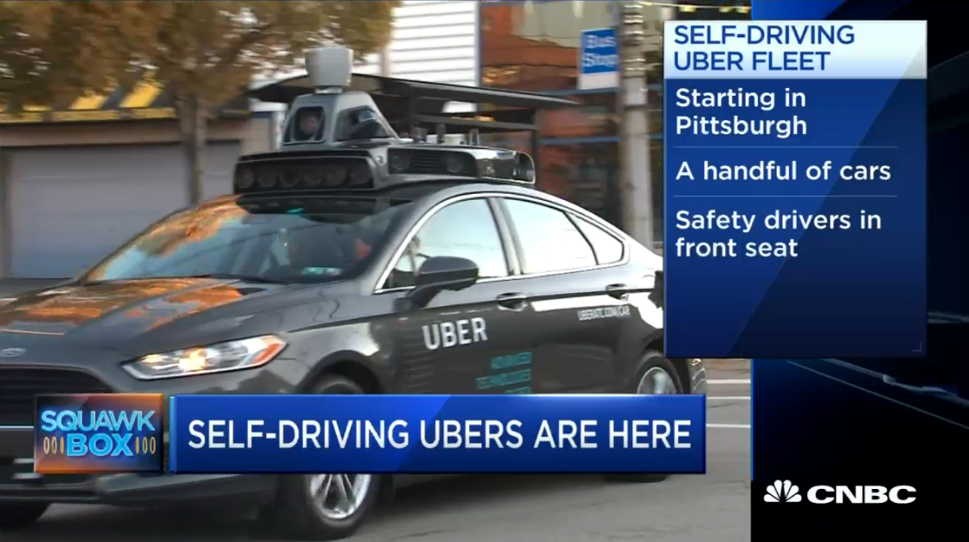
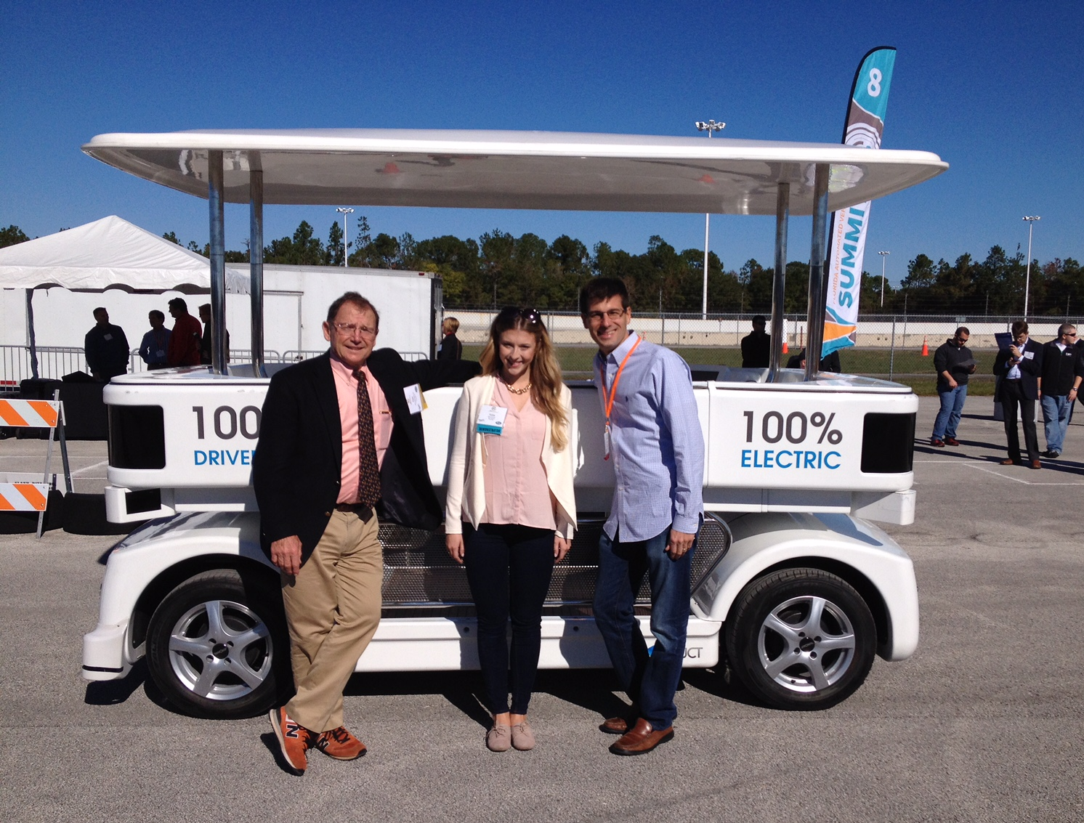
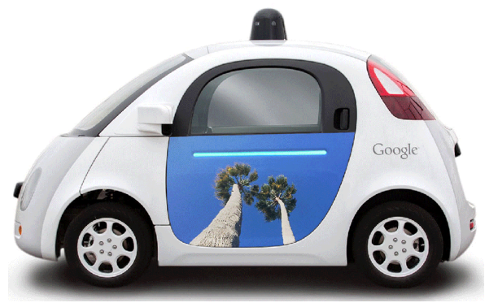

Making Sure We’re on the Same Page…
by
Alain L. Kornhauser, PhD
Professor, ORFE
(Operations Research & Financial Engineering)
Director, CARTS
(Consortium for Automated Road Transportation Safety)
Faculty Chair, PAVE
(Princeton Autonomous Vehicle Engineering)
Princeton University
Presented at
November 14, 2017
Knoxville, TN

Slide 2
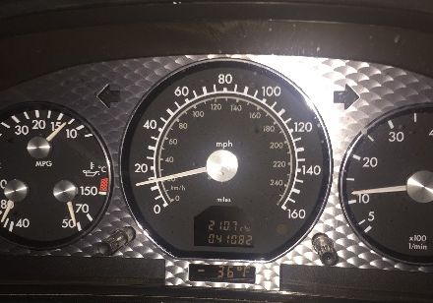
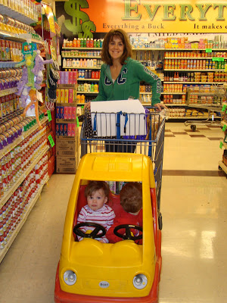
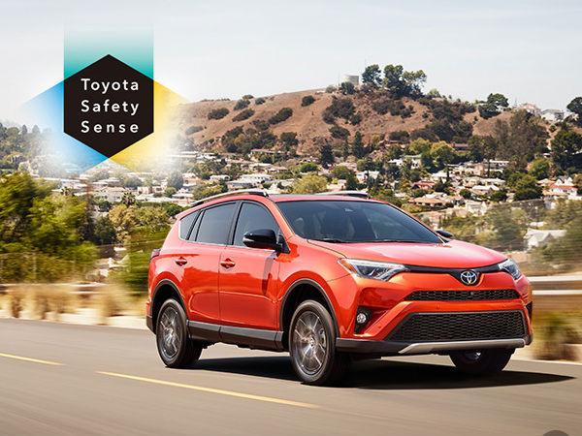
Making Sure We Are Using the Same Terminology…
Lots of confusion… ‘Connected’; ‘Autonomous’, ‘Automated’, ‘4 NHTSA Levels’ ‘5 SAE Levels’…
Only 3 kinds: Classified by their Business Case, Not Technology
  ‘Safe-Driving Cars… (Trucks or Buses)’
    Don’t Crash, Stay in their lane and keep us from mis-behaving
    Always on Automated Emergency Braking, Lane Centering & and Speed Limiting
    Delivers: Safety
      Insurance Can/Should Promote Wide-spread Adoption w/o Government Mandate
Lexus and Toyota Will Make Automated Braking Standard on Nearly Every Model and Trim Level by End of 2017

Slide 3
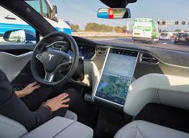
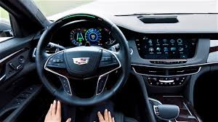
Making Sure We Are Using the Same Terminology…
Lots of confusion… ‘Connected’; ‘Autonomous’, ‘Automated’, ‘4 NHTSA Levels’ ‘5 SAE Levels’…
Only 3 kinds:
  ‘Safe-Driving Cars… (Trucks or Buses)’
    Always on Automated Emergency Braking, Lane Centering & Speed Limiting
    Delivers: Safety
      Needs Insurance to Promote Wide-spread Adoption w/o Government Mandate
  ‘Self-Driving Cars… (Trucks or Buses)’
    Safe-Driving + Ability to take Hands-Off Wheel and/or Feet-Off Pedals
      On Some Stretches of Some Roads and Some Times
    Delivers: User Convenience + some Environmental Benefits
      New ‘Chrome & Fins”. Auto companies & Car dealers know how to sell these
  https://electrek.co/2017/06/12/first-drive-tesla-autopilot-2-0-autopark/

Slide 4
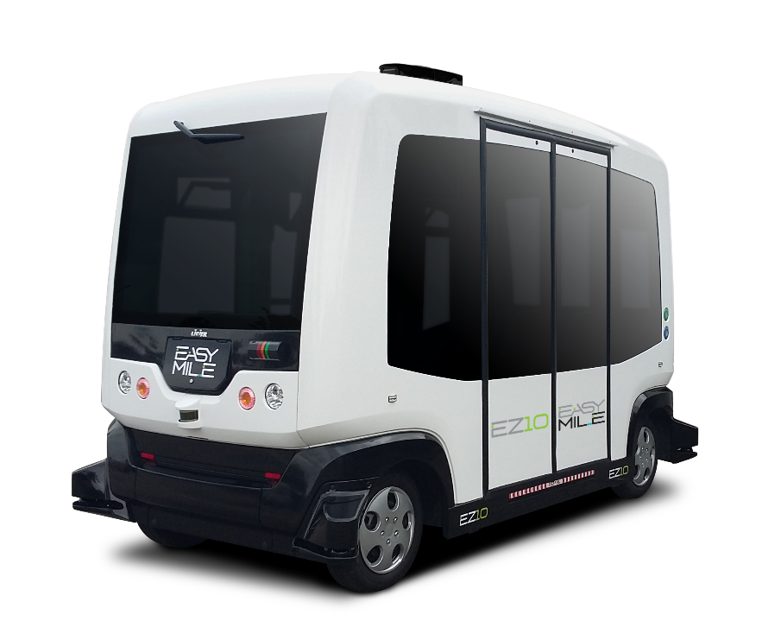
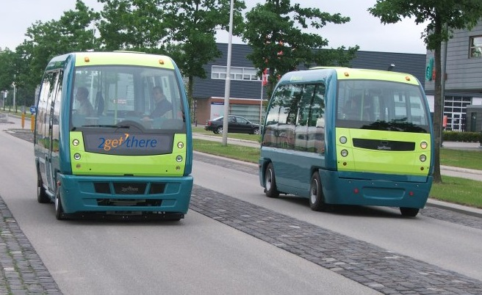
Making Sure We Are Using the Same Terminology…
Lots of confusion… ‘Connected’; ‘Autonomous’, ‘Automated’, ‘4 NHTSA Levels’ ‘5 SAE Levels’…
Only 3 kinds:
  ‘Safe-Driving Cars… (Trucks or Buses)’
    Always on Automated Emergency Braking & Lane Centering
    Delivers: Safety
      Needs Insurance to Promote Wide-spread Adoption w/o Government Mandate
  ‘Self-Driving Cars… (Trucks or Buses)’
    Safe-Driving + Ability to take Hands-Off Wheel and/or Feet-Off Pedals
      On Some stretches of Some Roads and Some Times
    Delivers: User Convenience + some Environmental Benefits
  ‘Driverless Cars … (Cars, Trucks or Buses)
    Safe-Driving + Always: Hands-Off, Feet-Off; No Steering Wheel or Pedals
      Sharing Some Streets at Some Times with Conventionally-driven vehicles
    Delivers: Mobility for All + Substantial Environmental Benefits
Waymo will now put self-driving vans on public roads with nobody at the wheel

Slide 5
Big-time Implications…Safe-Driving Cars
Safety!
  You don’t need to take your hands off the wheel or feet off the pedals or be chauffeured to achieve safety.
    Insurance
      Either results in or be a result of
      Today Auto Casualty does NOT give you a discount if your car has SafeDriving Technology.
        That will change! Hopefully very soon
    Health Care system
      Emergency rooms, Ambulances, Organ donor, Social Security (fewer die younger)
    Body shops, replacement parts (availability & production)
    Police & courts
      Technology will probably not enable you to speed run red lights, …
When: Soon with New Cars and accelerated with After-market.

Slide 6
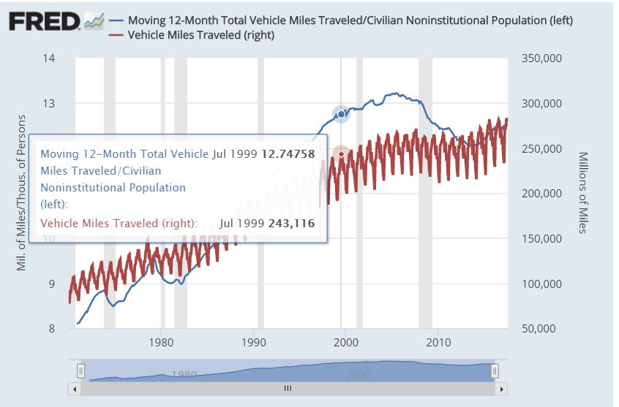
Big-time Implications…Self-Driving Cars
1st and Foremost: provides Comfort & Convenience To the Driver
  VMT (Vehicle Miles Travelled) goes through the roof
  Land ...Far away & cheap becomes more attractive
    Acceleration of sprawl
  Driving as an occupation becomes much more attractive
  Traditional auto companies sell more cars at higher profit
    BMW becomes the ‘Ultimate Riding Machine”
      And throw monkey wrenches into Driverless Cars
When: Will begin to happen soon with those most interested in taking advantage of far away cheap land will be first buyers.

Slide 7
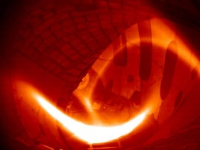
Big-time Implications…Driverless Cars
Affordable High-quality LoS Mobility for All
  VMT (Vehicle Miles Travelled) goes through the roof
    More people able to travel More I order to take advantage of More.
    Unless there is Substantial Ride-sharing.
    Average Vehicle Occupancy must at least Double (2x AVO)
  Zoning Regulations Change
    Moderate density becomes very attractive (a la: Transit Area Development)
    Removal of parking requirement makes housing more affordable.
When: 4 years ago Google said “in 4 years”
  Is it like “Cheap energy from Nuclear Fusion”?
  We still have 2 months to go
Affordable Package Delivery
  “Easy” in wee hours (midnight->5am)
    “No one else” using the roads
When: “God-send” to Amazon.
  Who could make it happen in “4 years”
Why Nuclear Fusion Is Always 30 Years Away

Slide 8
Discussion!
Thank You
alaink@princeton.edu
www.SmartDrivingCar.com

