Slide 1

Congratulations
Class of 2015!
Notes:
REMARKS
Good afternoon. We’re here to honor the Class of 2008, x of whom are majors in the Department. I’m Hal Foster, chair of the department, and it is my pleasure to welcome parents, family members, friends, and--not least--our graduating seniors to this Class Day celebration. We’re almost as proud of the seniors as you are, and we thank you for sharing them with us these last four years.
First, let me introduce the A&A faculty (who are present). [CHECK] In alphabetical order we have (please stand):
Patricia Fortini Brown: Italian Renaissance art
William Childs: Classical art & archaeology
Slobodan Curcic: Byzantine and Medieval art & architecture
Rachael DeLue: American art
Thomas Kaufmann: Renaissance & Baroque art
Anne McCauley: modern art & photography
John Pinto: Renaissance & Baroque architecture
T. Leslie Shear: classical art & archaeology
Yoshiaki Shimizu: Japanese art
Nino Zchomeldise: Medieval art
John Wilmerding: American art [J officially retires this June after 19 years of extraordinary leadership at Princeton--he truly is the dean of American art studies; please join me in a final round of applause as a gesture of our great gratitude]
And from the Princeton Art Museum: ??
Laura Giles, curator of prints & drawings
John Pohl, curator of pre-Columbian art
Betsy Rosasco, curator of later Western art
Joel Smith, curator of photography
I also want to thank our terrific office for help with this celebration (& much more): Susan Lehre, Lisa Ball, Diane Schulte & Trish Dobcyznski.
This is an ending, but (as the cliché goes) it’s also a beginning. I won’t go into the diverse plans of our seniors; suffice it to say they’re extremely varied & very adventurous. They depart with many memories, of course, & one of the most vivid, good & bad, is the senior thesis. Many universities have an honors thesis, but Princeton is unusual in that every student is required to complete a thesis. This is the most substantial piece of work that our students do at Princeton. Although each has an advisor, they are largely on their own to select the topic, research the literature, and write the text--or, in the case of our Program 2 studio art concentrators, to create an art project. Each thesis is evaluated by two readers, one of whom is the advisor, and the highest grades determine the departmental prizes (a description of which is in your program).
As usual the seniors have fanned out widely. To give you a sense of the range, we’ll look briefly at each thesis, in chronological order, & hear a few comments from the faculty reports as we go…

Slide 2
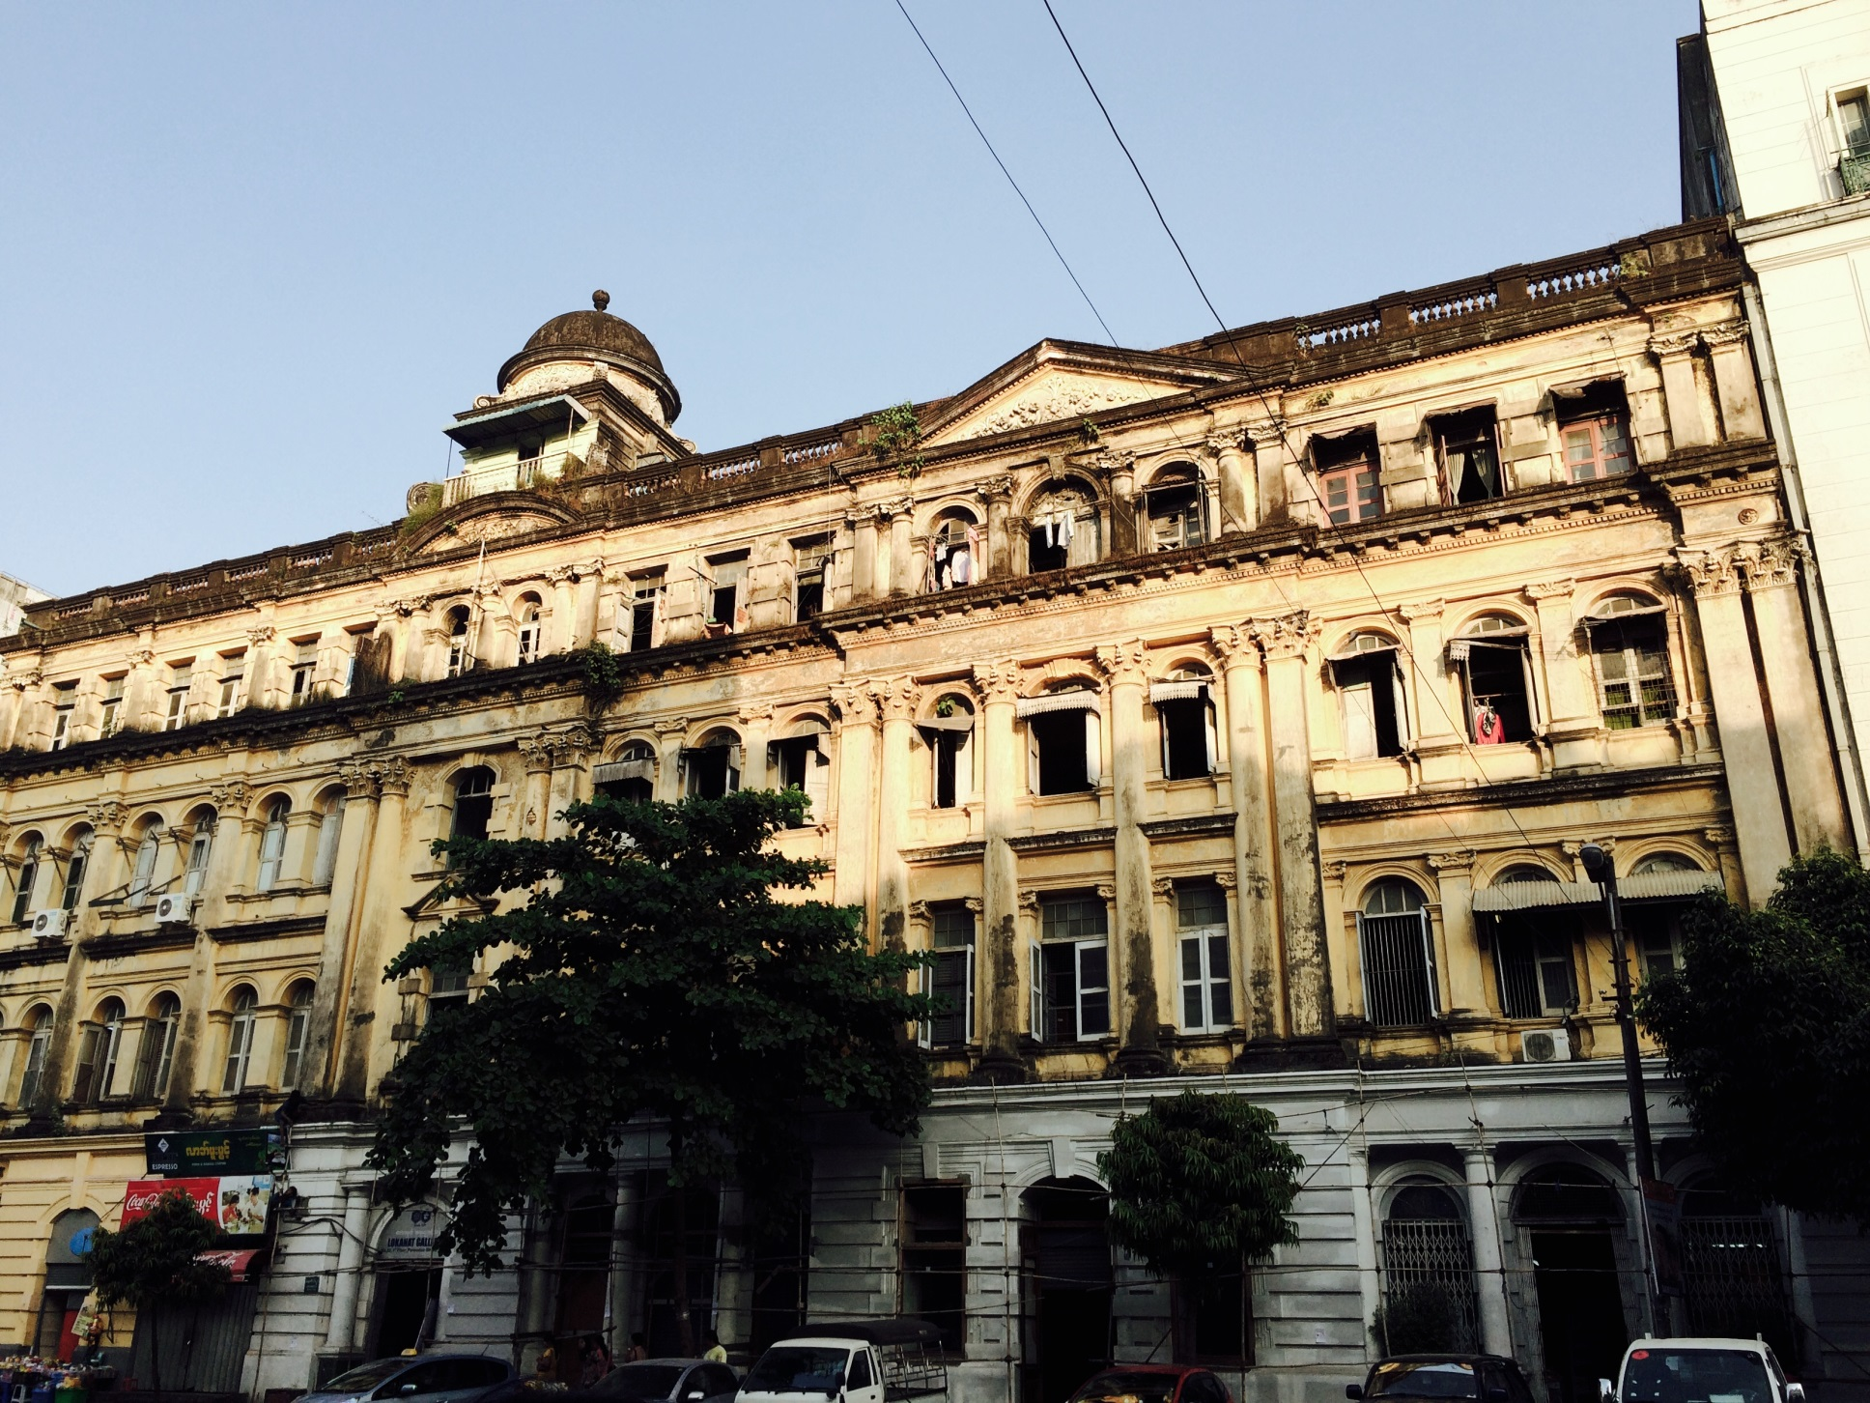
Phway Su Aye,
“Yangon’s Heritage: Between Nostalgia and Critique”
Notes:
[NAME/TITLE]

Slide 3

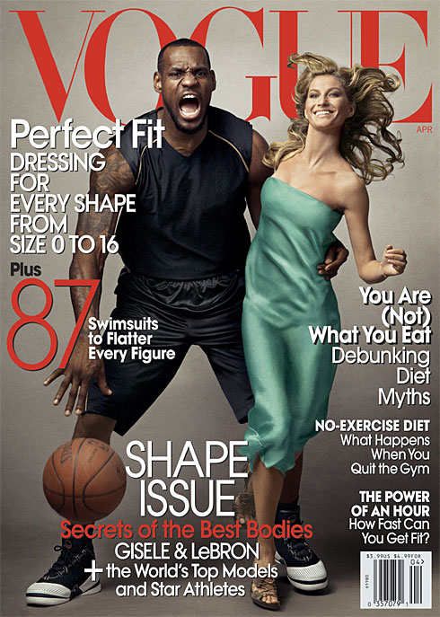
Joseph Thomas Bonura, “War Posters: The Definition, Evolution, and Modernization of American Visual Propaganda”
Notes:
[NAME/TITLE]

Slide 4
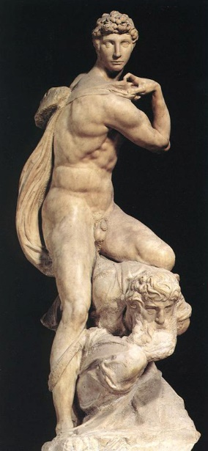
Suhryoung Christine Chun,
“The Context and Legacy of Michelangelo’s Genius of Victory”
Notes:
[NAME/TITLE]

Slide 5
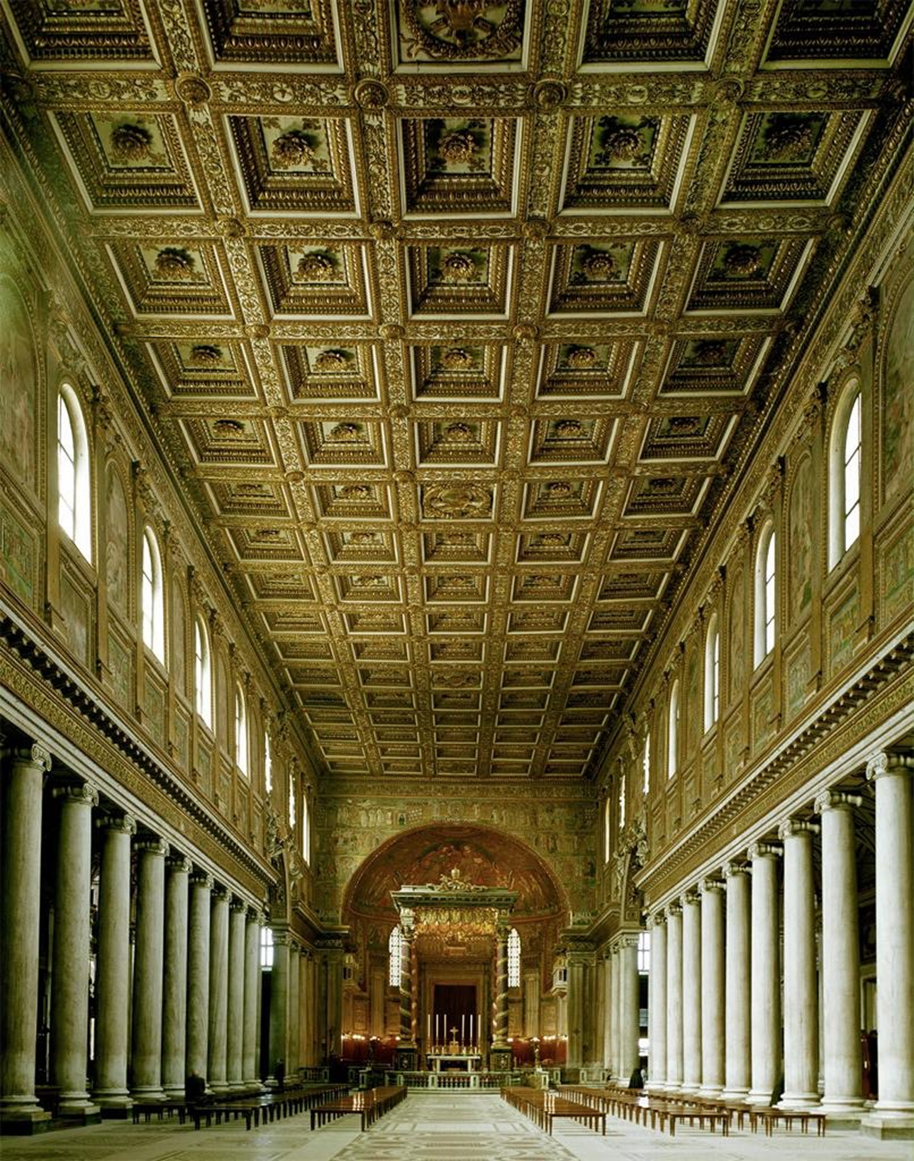
Stephen T. Coulton,
“An Architecture of Relations: Typology and Narrative in Early Christian Rome”
Notes:
[NAME/TITLE]

Slide 6
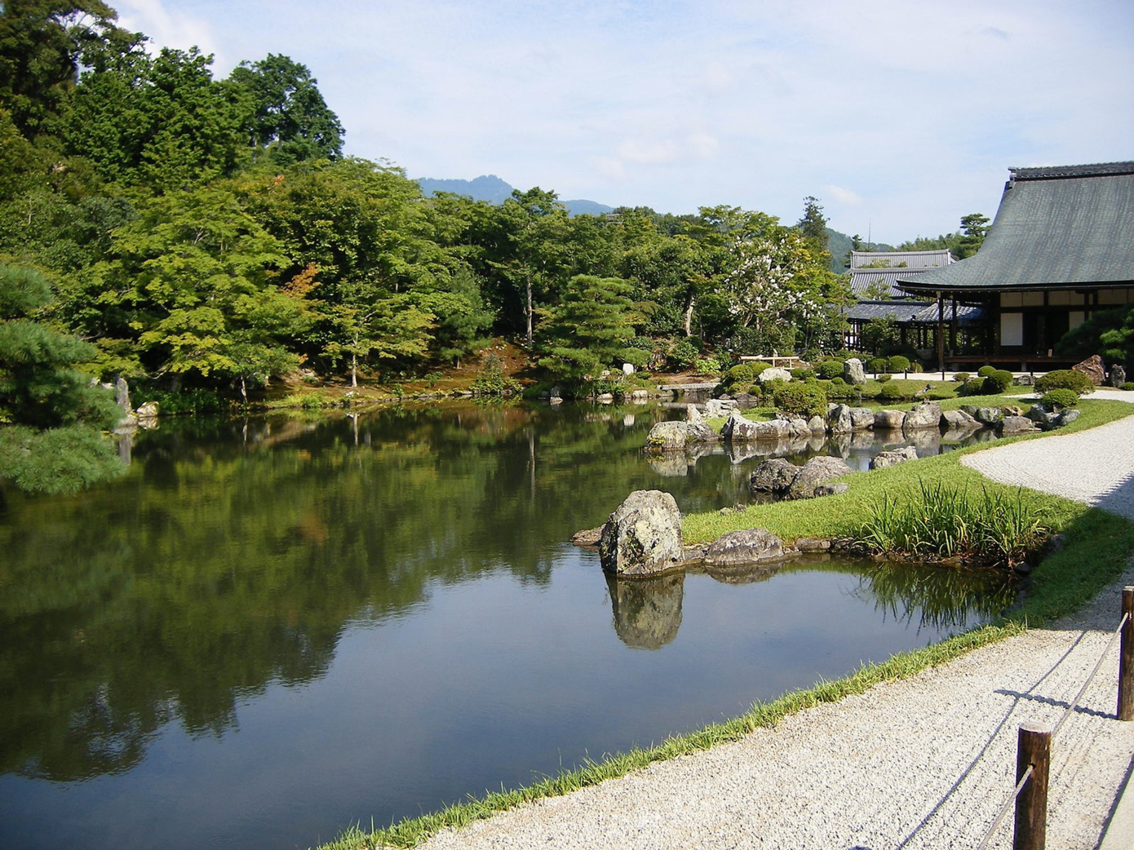
Alison Kay Itzkowitz,
“Nature and Artifice in the Arts of Japan”
Notes:
[NAME/TITLE].”

Slide 7
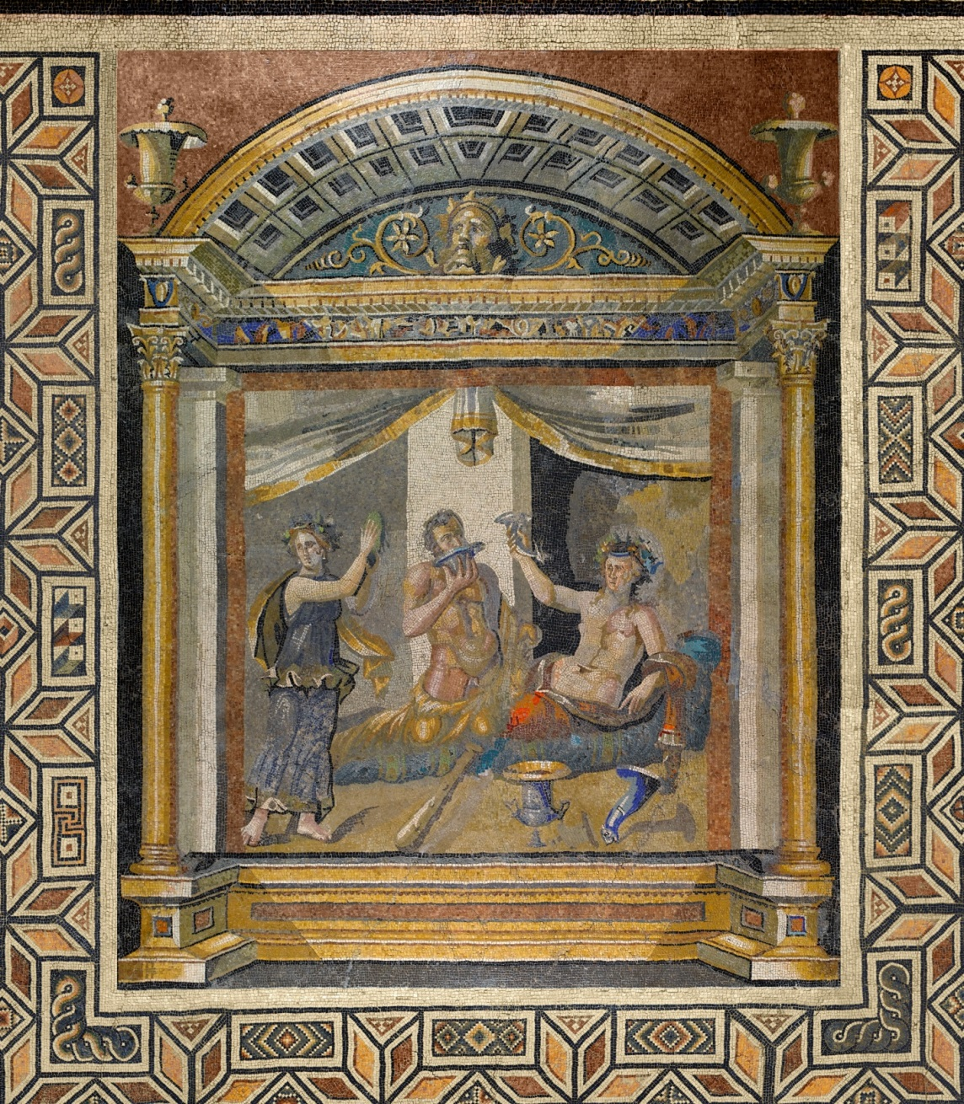
Annie Dolan McLaughlin,
“If Boiseries Could Talk: A Comparative Study and Museological Debate of the Contemporary Period Room Display Through the Lens of
18th-Century French Decorative Interiors”
Notes:
[NAME/TITLE]

Slide 8
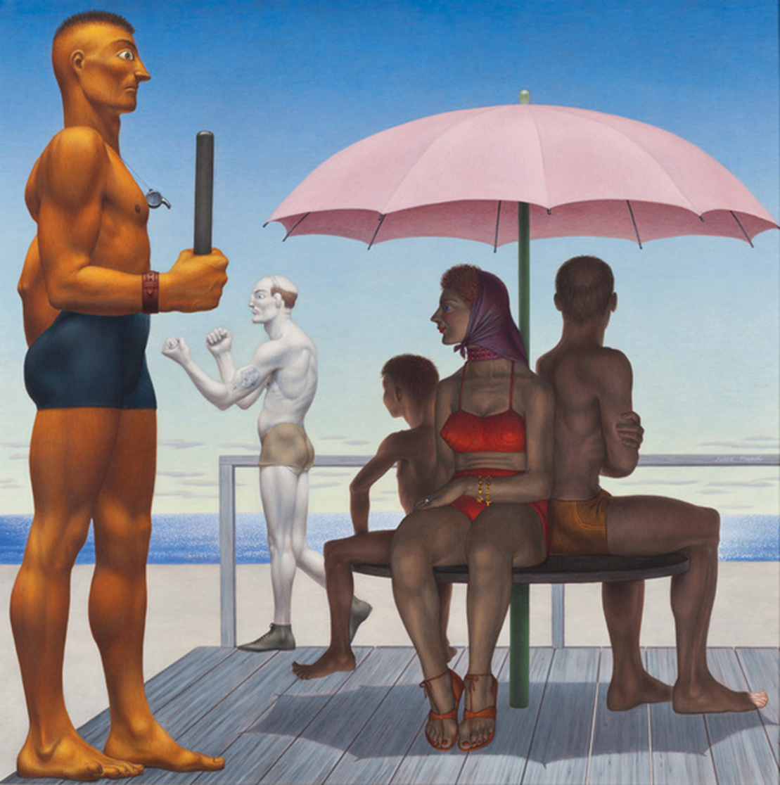
Elizabeth Hall Rise,
“Social Surrealism in the 1930s and 1940s:
Locating Atypical Bodies in the American Scene”
Notes:
[NAME/TITLE]

Slide 9
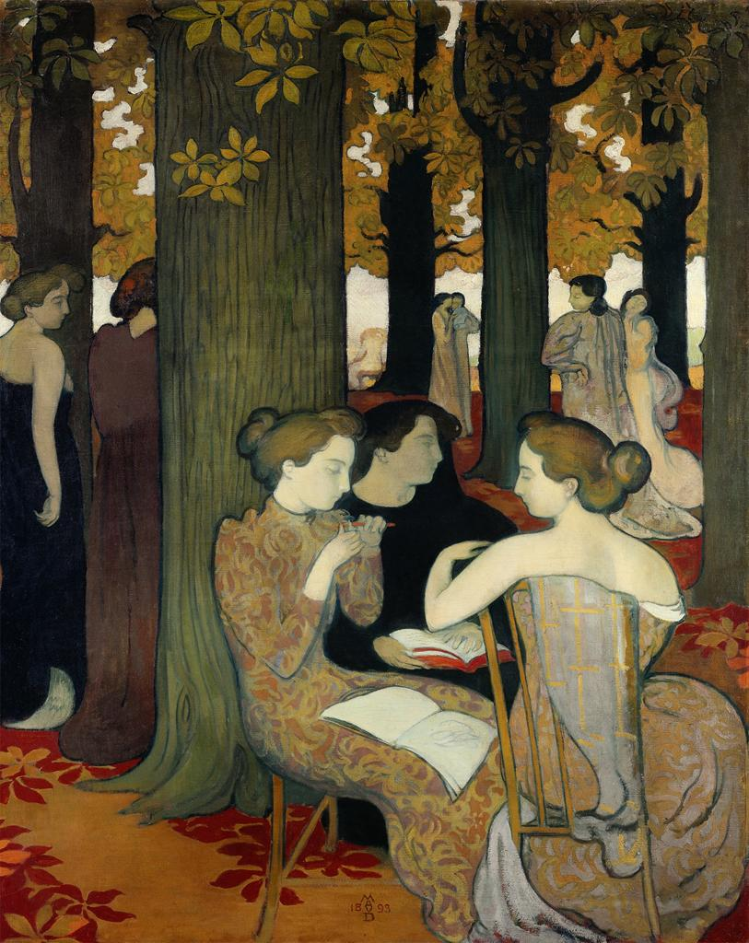
Yael Wollstein, “Maurice Denis: Mythology and Modernity”
Notes:
[NAME/TITLE]

Slide 10
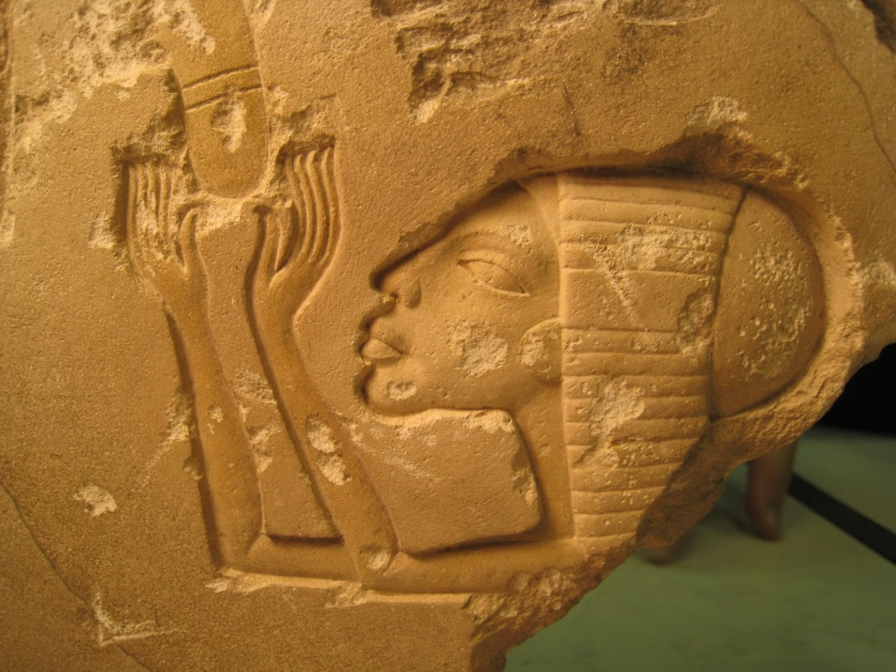
Hoi Lam Helen Wong,
“Akhenaten and Two Daughters:
A Fragment of an Amarna Period Column in the Princeton University Art Museum”
Notes:
[NAME/TITLE]

Slide 11
Program 2
Notes:
We now move to our “Program 2” students, our designation for majors who do a special concentration in the practice of the visual arts (they receive a certificate from the Visual Arts Program too). In lieu of a written thesis they undertake the no-less-difficult task of a year-end exhibition (or screening) of their work. This year we have x majors in Program 2 (the titles on the screen are those of their project as a whole)…

Slide 12
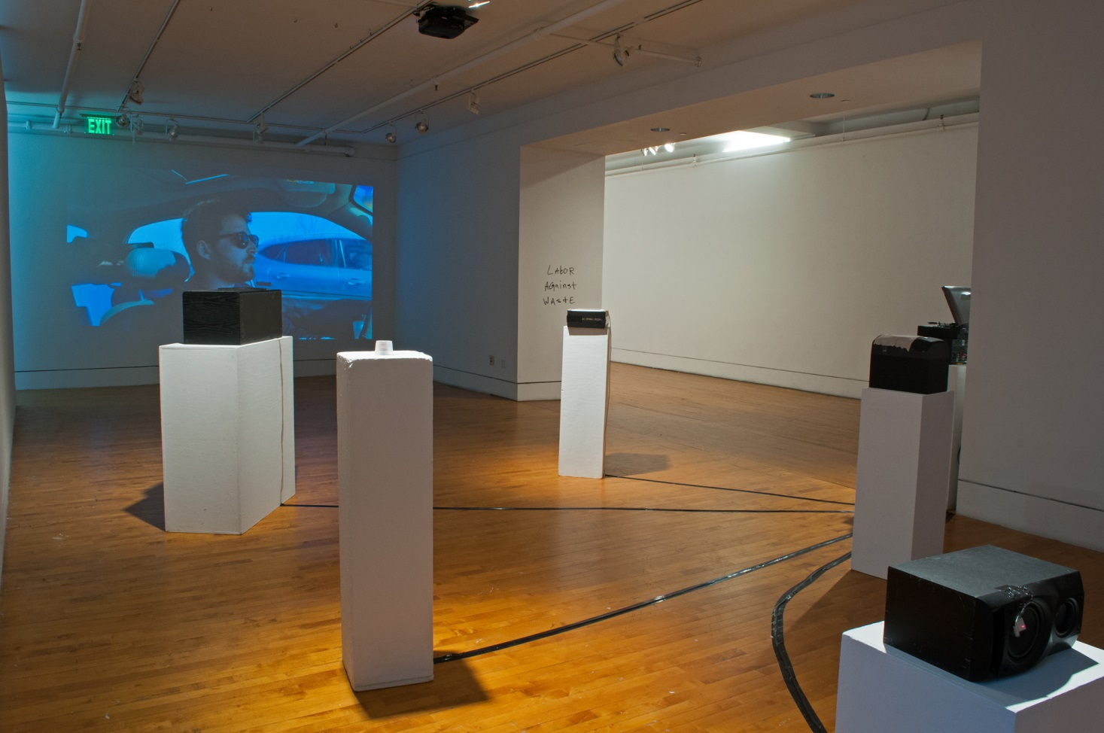
Margaret Ann Craycraft, “Labor Against Waste”
Notes:
[NAME/TITLE]

Slide 13
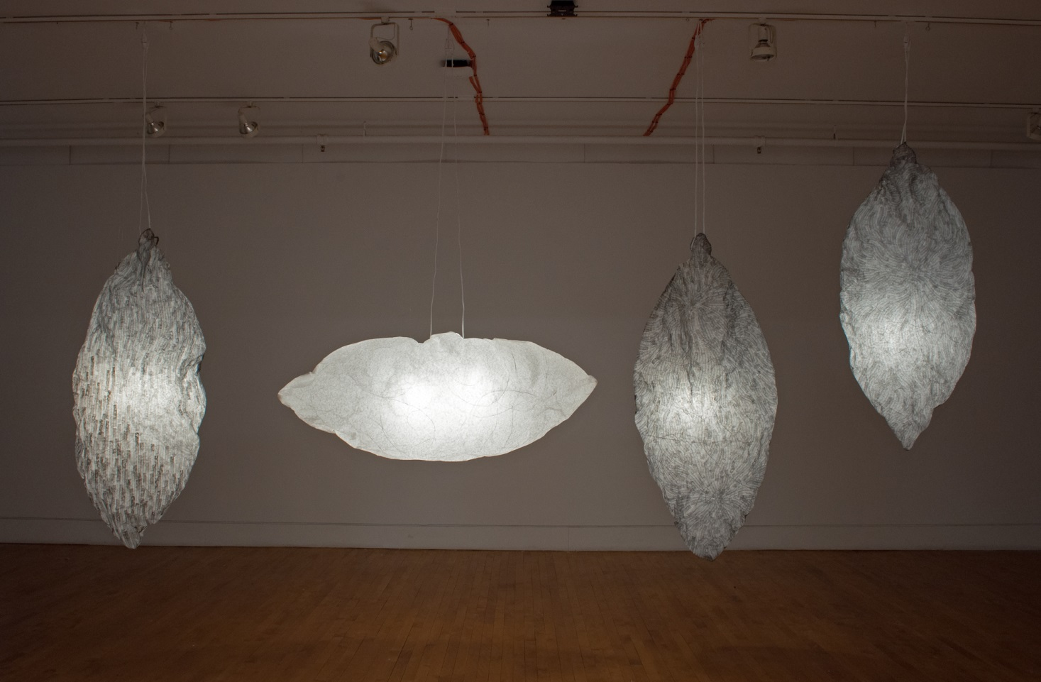
April S. Lee, “an exhibition”
Notes:
[NAME/TITLE]

Slide 14
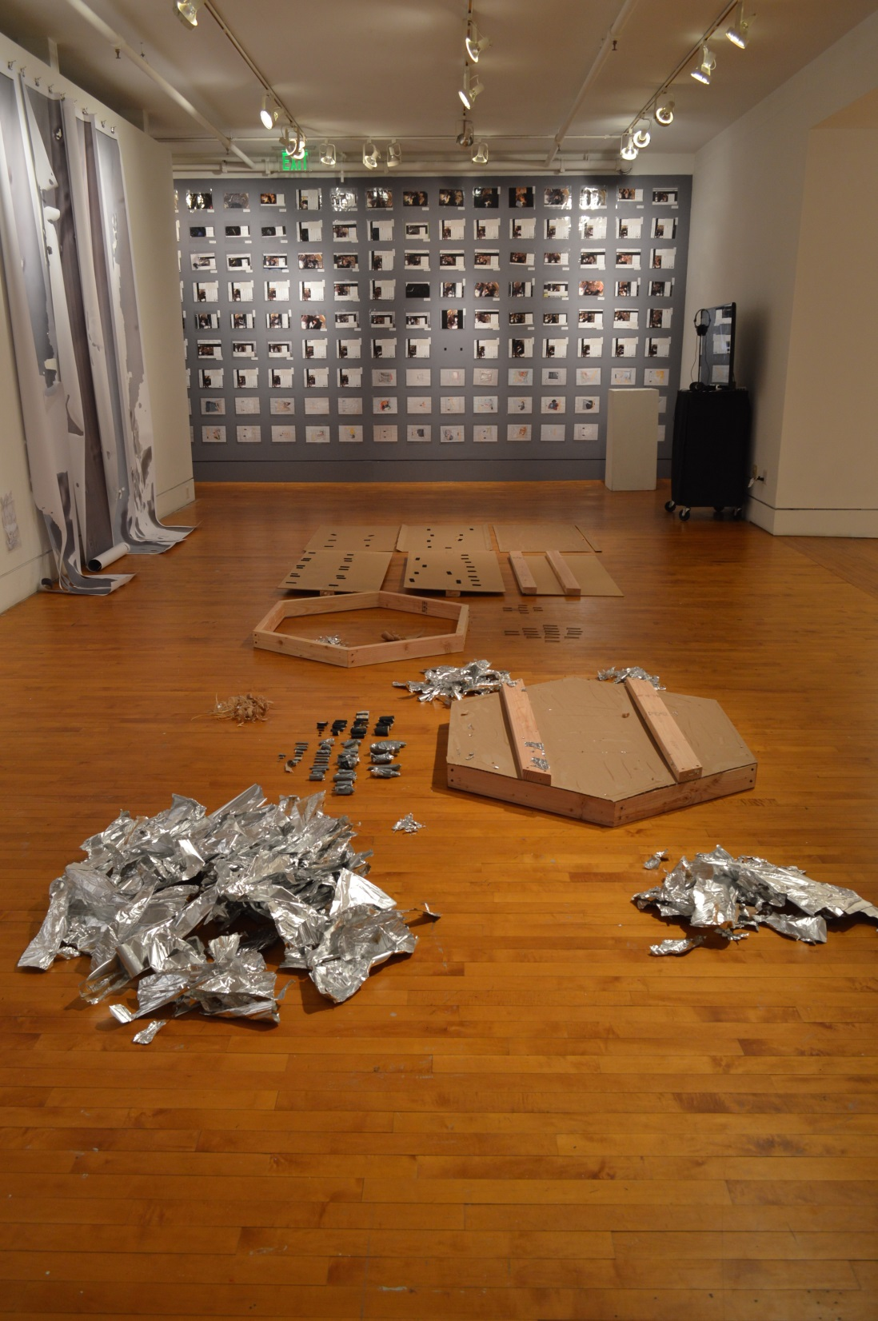
Kemy Chuxia Lin, “Disorientations”

Slide 15
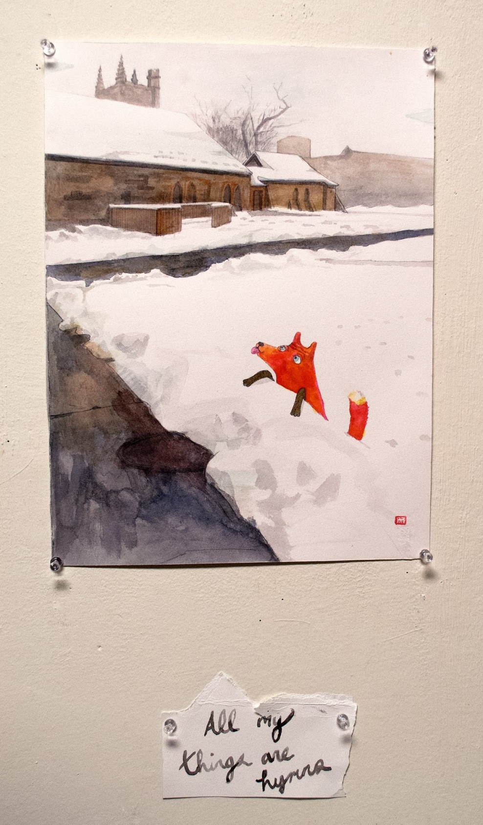
Kai Alexander Song-Nichols,
“All My Things are Hymns”

Slide 16
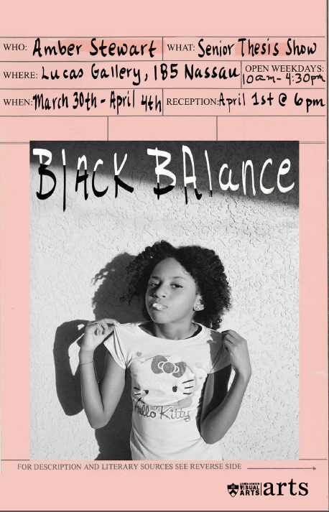
Amber Symone Stewart, “Black Balance”

Slide 17
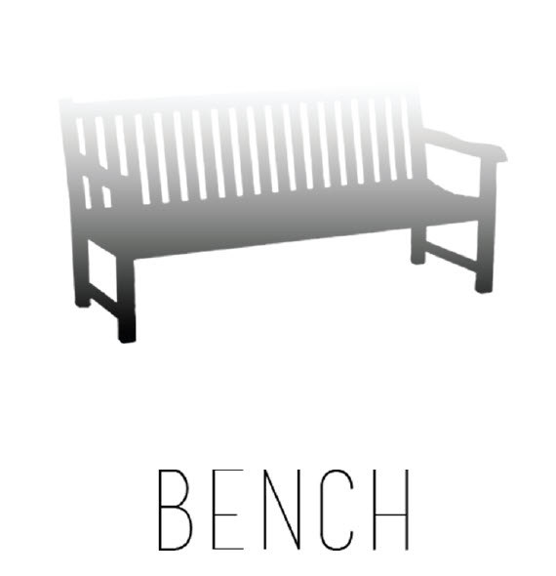
Christopher Bogle Webb St. John, “BENCH”

Slide 18
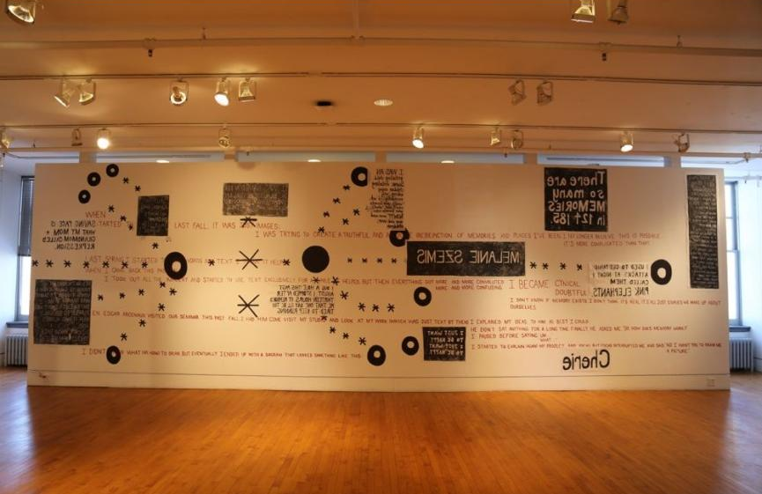
Melanie Cherie Szemis, “I’m Not Sure How I Got Here”

Slide 19
Certificates in Other
Departments & Programs
Notes:
Now we want to recognize our students who earned CERTIFICATES IN OTHER PROGRAMS (besides Visual Arts). These are given to students who complete a required courses in various interdisciplinary programs. The following seniors have earned certificates (there are quite a few, I’m happy to say; please stand--hold your applause until the end):
Scott Mardy in American Studies.
Derek Whitworth in Chinese Language.
Katherine Holmgren, Christina McMillan, & Lauren Racusin in European Cultural Studies.
Elizabeth Ingrassia and Colleen O’Boyle in French Language and Culture.
Christian Sahner in both Medieval Studies & Hellenic Studies.
Katie Kratsios in Hellenic Studies.
Lauren Racusin again in Judaic Studies.
Lauren Hooten in Latin American Studies.
Lauren Hooten, Christine Dobrosky, Winston Smith, and Laura Trimble in Spanish & Portugese Languages & Cultures.
Laura Wieschaus in Women & Gender Studies.
Congratulations to you all for enriching your art history experience with the exploration of these other disciplines…

Slide 20
Awards, Prizes,
and Certificates
Notes:
And now, awards, prizes, and certificates.
First, I’d like to invite Eve Aschheim, Director of the Visual Arts Program, to present the prizes for Visual Arts thesis projects. It is our custom to award departmental prize-winners books published by faculty members over this academic year (a shameless way to nudge up our own sales), so please come up when called to take yours away…

Slide 21
The
Herbert L. Lucas
Award in Visual Arts
Notes:
[Established in 1998 by Hebert L. Lucas, Class of 1950, this prize is awarded annually to two graduating seniors who are Program 2 students or Certificate students in Visual Arts.]…

Slide 22
Amber Symone Stewart, “Black Balance”

Slide 23
April S. Lee, “an exhibition”
Notes:
[NAME/TITLE]

Slide 24
The
Grace May Tilton
Prize in Fine Arts
Notes:
Thanks, Eve. We now have a few extra-departmental prizes to announce. The Grace May Tilton Prize in Fine Arts (given by Robert Schirmer, Class of 1921, in memory of his mother) is awarded for an outstanding thesis by a senior in any of the twelve departments associated with the American Studies Program. The thesis must deal wholly or principally with some aspect of the arts or crafts, past or present, within the territory embraced by the United States or elsewhere in the Americas.
This year the prize goes to no less than 4 of our seniors (please stand so we can recognize you)…

Slide 25
Elizabeth Hall Rise,
“Social Surrealism in the 1930s and 1940s:
Locating Atypical Bodies in the American Scene”
Notes:
[NAME/TITLE]

Slide 26
The Stella and
Rensselaer W. Lee
Prize
Notes:
Next is the Frederick Barnard White Prize in Art & Archaeology for an outstanding thesis within the department (no subject specified); this year the prize goes to…

Slide 27
Alison Kay Itzkowitz,
“Nature and Artifice in the Arts of Japan”
Notes:
[NAME/TITLE].”

Slide 28
The Irma S. Seitz Prize
in the Field of Modern Art
Notes:
Next is the Frederick Barnard White Prize in Art & Archaeology for an outstanding thesis within the department (no subject specified); this year the prize goes to…

Slide 29
Yael Wollstein, “Maurice Denis: Mythology and Modernity”
Notes:
[NAME/TITLE]

Slide 30
The
Frederick Barnard White
Prize in Architecture
Notes:
Next is the Frederick Barnard White Prize in Art & Archaeology for an outstanding thesis within the department (no subject specified); this year the prize goes to…

Slide 31
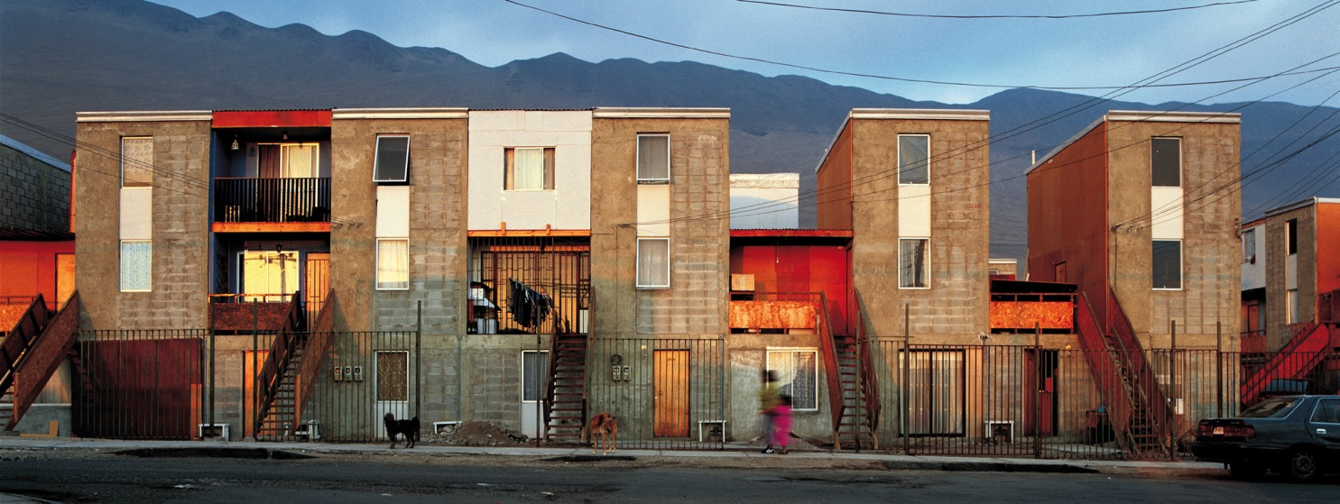
Misha Semenov,
“Playing by the Rules: Examining the Interactions of Rules, Built Form,
and Social Behavior in American Residential Communities”
Notes:
[NAME/TITLE].”

Slide 32
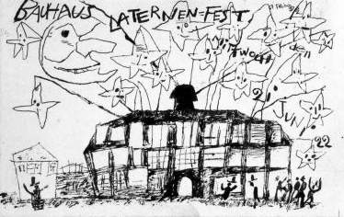
Dalma Földesi,
“From Stage to Screen:
The Bauhaus Apparatus between Theater and Cinema”
Notes:
[NAME/TITLE].”

Slide 33
The Frederick Barnard White
Prize in Art & Archaeology
Notes:
Next is the Frederick Barnard White Prize in Art & Archaeology for an outstanding thesis within the department (no subject specified); this year the prize goes to…

Slide 34
Elizabeth Hall Rise,
“Social Surrealism in the 1930s and 1940s:
Locating Atypical Bodies in the American Scene”
Notes:
[NAME/TITLE]

Slide 35
The Department of
Art & Archaeology
Senior Thesis Prize
Notes:
Finally, we come to the Department of Art & Archaeology Senior Thesis Prize. Established by the Irvine Foundation, it is awarded annually for the senior thesis deemed the most outstanding in the department. Here again we had two superb candidates, and decided to aware the prize to each. First…

Slide 36
Phway Su Aye,
“Yangon’s Heritage: Between Nostalgia and Critique”
Notes:
[NAME/TITLE]

Slide 37
Departmental Honors
Notes:
We come to our final category (I promise): DEPARTMENTAL HONORS:
Honors are awarded to students who have earned the highest combined marks in department grades, the junior and senior independent work, and the senior comprehensive examination. Will the students please stand when called, and the audience hold its applause until the end of each category:
Honors (cum laude):
Caitlin Horn
Eleanor Oakes
Lauren Hooten
Congratulations to you all.
High Honors (magna cum laude):
Susannah Cramer-Greenbaum
Christine Dobrosky
Colleen O’Boyle
Leah Tharpe
Michael Jorgensen. Congratulations to you all.
Highest Honors (summa cum laude):
Christian Sahner
Christina McMillan
Katherine Holmgren. Congratulations to you all.
We’ve arrived at the end of our Class Day celebration. Will all our graduating seniors please stand? Please join me in saluting them once more. It has been our great pleasure to have you with us for the last four years, and we wish you all the best in the years ahead.

