Slide 1
Hybrid Codes and the
Point-to-Point Channel
Paul Cuff
Curt Schieler

Slide 2
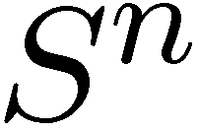
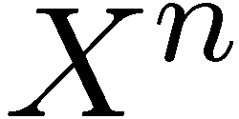
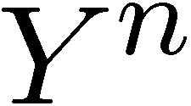
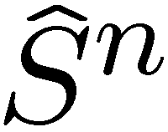
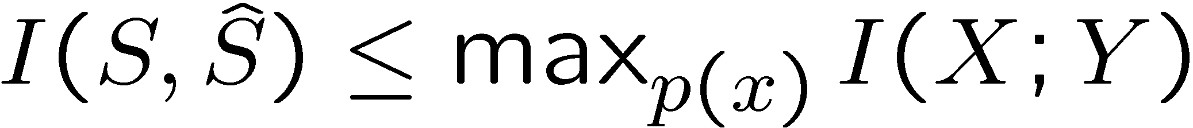
Source-Channel Coding
p(y|x)
f
g
Correlation between S and Ŝ:
Achieved with separately designed encoder and decoder.
Notes:
This is an anti-source-channel-separation talk. We’re looking at what can be gained by considering source coding and channel coding jointly in the point-to-point memoryless channel. This may sound like a solved problem, and it is for the most part, unless you tweak it a little bit.
(click)
The familiar question for this communication setting is “how much can we correlate the reconstruction ‘S hat’ with the source S?,” usually measured by a distortion function. And the known result is that mutual information between S and ‘S hat’ must be less than the channel capacity.
(click)
And to our delight, this can be achieved by connecting two components---a lossy compressor that uses a rate less than capacity to describe the source, and a channel coder that achieves capacity. The data from the lossy compressor is simply fed into the channel coder. I will refer to this as the “separation method.”
We know that the separation method results in a transmission that looks independent of the source. When I say “looks independent” I mean that the first order statistics or empirical distribution of the source and transmission sequences are uncorrelated. Of course, as a block they are not independent. First-order statistics is what, for example, a distortion constraint would capture.
What if we wanted the tranmitted signal to be correlated with the source.

Slide 3
Video Transmission (example)
f
p(y|x)
Notes:
For example, consider a video broadcast that might be received by an analog receiver or a digital receiver. The analog receiver uses simple circuitry to do limited processing on the received signal (the channel output Y), and the digital receiver is not limited in its processing.
We could split the bandwidth or power into two parts---one for an analog transmission and one for a digital transmission. And it’s well known that the digital part can use the analog signal as side information, along the lines of Wyner-Ziv coding. But splitting the transmission into these two parts may not be the optimal use of the bandwidth or power. It is possible to embed the digital information into the analog signal itself.
(click)
The relationship between this and the point-to-point communication setting from the last slide is that Y represents that analog signal and ‘S hat’ represents the digital signal. We’d like to minimize the distortion of each of them with the source.

Slide 4
Systematic Transmission (example)
Transmission
Relay
Transmission
Analog
Digital
Hybrid
Notes:
Consider another example which is a motivating example for digital communication itself.

Slide 5

Copy-Robust Documents (example)
A document gets printed with redundancy .
Photocopy noise removed by photocopier.
Notes:
Imagine a printed document that looks exactly the same after being photocopied. The printer inserts redundancy into the document so that the “smart” photocopier can remove noise caused by printing and scanning. No degradation.

Slide 6


Connection to General Point-to-Point Channel Setting
p(y|x)
f
g

Slide 7
Digital Watermark (example)
Media is modified to include extra information
Scoundrel may try to delete the watermark
  Channel input (X) is modified media
  Ŝ is additional information (digital tag)

Slide 8
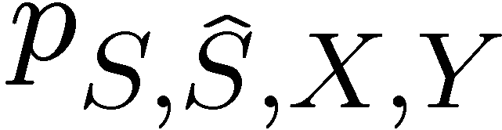
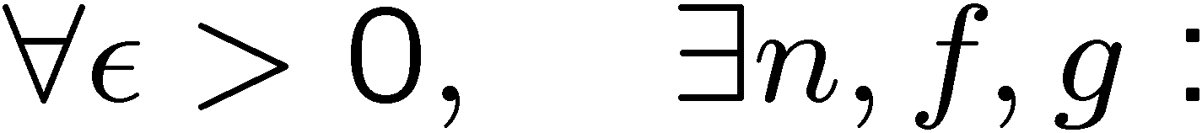
Define Empirical Coordination
p(y|x)
f
g
Empirical distribution:
is achievable if:

Slide 9
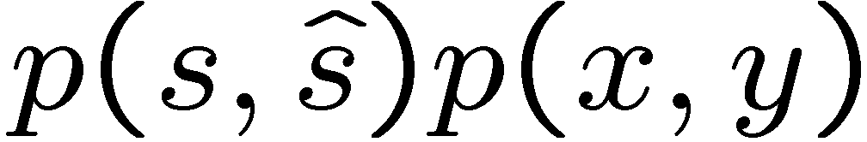
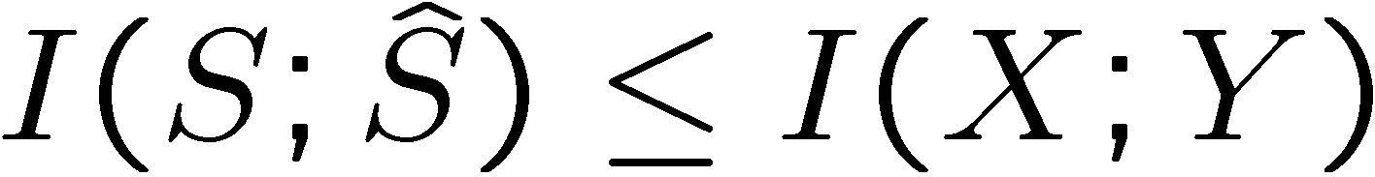
Separation Method
Channel
Index
Achieves product distributions:
such that

Slide 10

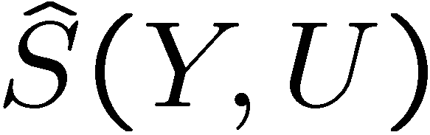
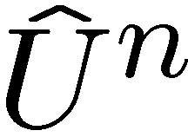
A Better Idea (Hybrid Codes)
Channel

Slide 11
Hybrid Codes
Digital
  Source is compressed and coded in blocks
Analog
  Channel input and reconstruction depend letter-by-letter on the source and channel output
Hybrid Codes take advantage of correlation in network setting (i.e. interference channel)
  [Minero, Lim, Kim – Allerton 2010, ISIT 2011]

Slide 12

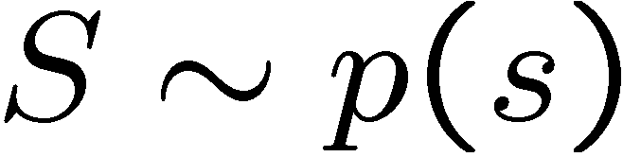
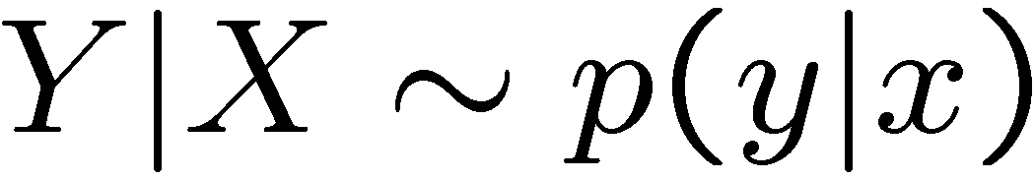
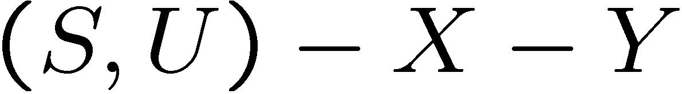
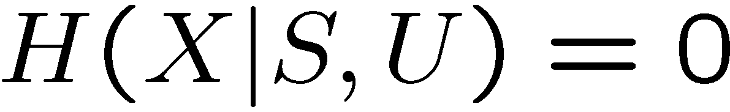
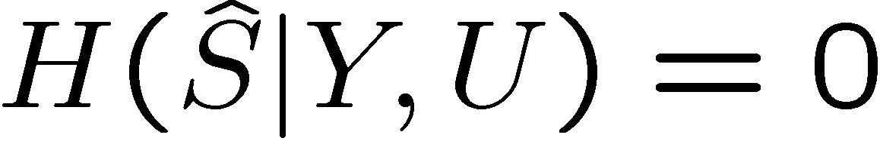
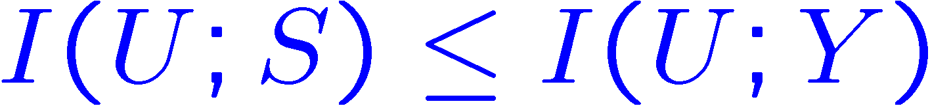
Achievable Inner Bound
is achievable if
Source
Channel
Markov Chain
Function (analog encoding)
Function( analog decoding)
Digital Decoding

Slide 13
Binary Example
Source is Bern(p)
Binary symmetric channel (Ɛ)
Require reconstruction to equal channel input
  i.e. X = Ŝ (systematic transmission)
Minimize Hamming distortion
If p= .5: D = Ɛ (Optimal)
If p>0 and Ɛ>0 : D > 0 (Suboptimal)
Notes:
Consider a binary source and BSC. How much is lost if we require systematic transmission, that is we require that X=‘S hat’. It turns out that if the source is Bernoulli half, nothing is lost. You achieve D=e, which is the smallest distortion that can be achieved even without systematic transmission. However, if p \neq ½, systematic transmission has a cost. This is illustrated by considering that for all p>0 and e>0 we must have D>0. However, without systematic transmission, we can have D=0 whenever h(p)+h(e)<1.
(Note: Systematic transmission is a case where hybrid codes are optimal. Thus, we can evaluate this example numerically to find the optimal D.)

Slide 14
State Amplification
Channel State is known to the encoder
Two objectives
  Transmit a message
  Help decoder estimate state
No loss of generality
p(y|x,s)
f
g
[Kim, Sutivong, Cover – ‘08]
[Choudhuri, Kim, Mitra – ‘10, ‘11]

Slide 15
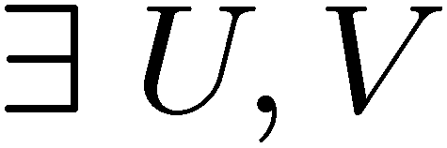
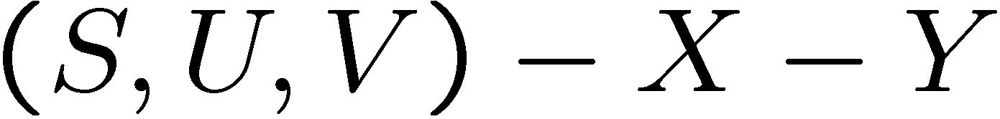

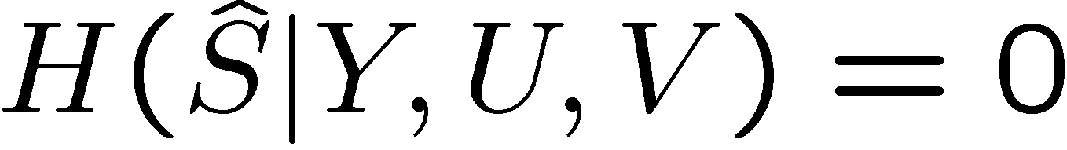
Causal Achievable Region
is achievable iff
Source
Channel
Markov Chain
Function (analog encoding)
Function( analog decoding)
Digital Decoding

Slide 16

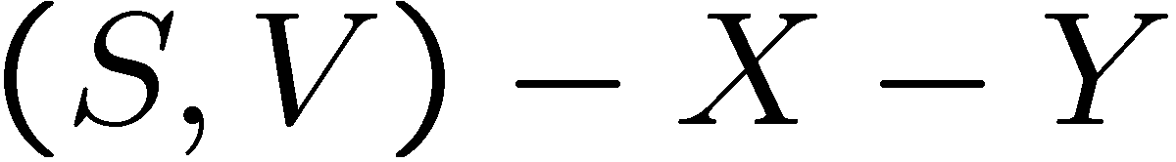

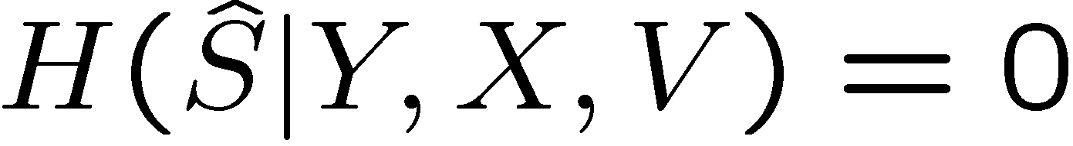
Strictly-Causal Achievable Region
is achievable iff
Source
Channel
Markov Chain
Function (analog encoding)
Function( analog decoding)
Digital Decoding

