Slide 1

Information Theory for
Secrecy and Control
Paul Cuff
Electrical Engineering
Princeton University

Slide 2
Two Parts
Secrecy for competitive settings
  Historic Results
  New Metric for Secrecy
Embedding information in analog signals
  Background of watermarking
  Theoretical limit

Slide 3
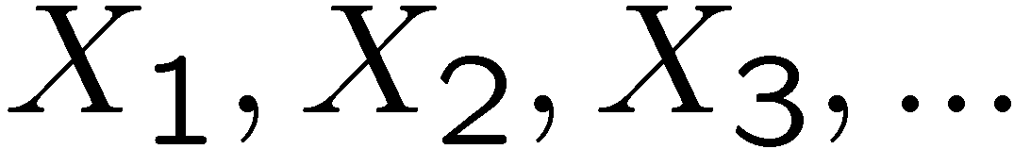
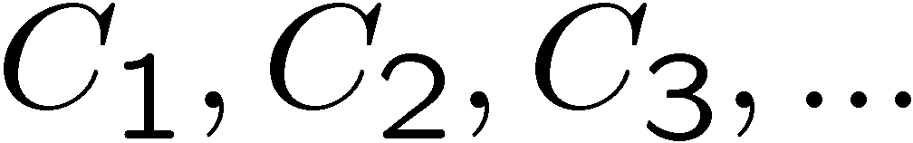
Cipher
Plaintext: Source of information:
  Example: English text: Mountain West Conference
Ciphertext: Encrypted sequence:
  Example: Non-sense text: boohoo2u4tcubsu
Key
Key
Plaintext
Encipherer
Ciphertext
Decipherer
Plaintext

Slide 4
Example: Substitution Cipher
Simple Substitution
  Example:
    Plaintext: …D IT CAME TO P…
    Ciphertext: …A TM SFUR MZ I…
Caesar Cipher
Alphabet | A B C D E …
Mixed Alphabet | F Q S A R …
Alphabet | A B C D E …
Mixed Alphabet | D E F G H …
Notes:
Julius Caesar used this cipher, with a shift of 3. His nephew, Augustus, used a shift of 1.

Slide 5

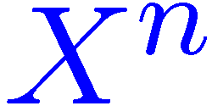
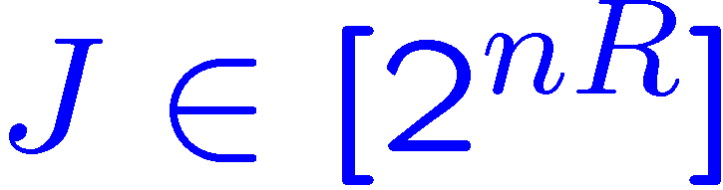
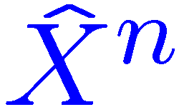

Shannon Model
Schematic
Assumption
  Enemy knows everything about the system except the key
Requirement
  The decipherer accurately reconstructs the information
Key
Key
Plaintext
Encipherer
Ciphertext
Decipherer
Plaintext
Adversary
For simple substitution:
Notes:
26! Is about 4 x 10^26 (the number of atoms in my chair). 88.4 bits
Redundancy of English is about 3.75 5bits per letter. (without spaces it’s 3.7)
About 25 letters needed to decode

Slide 6
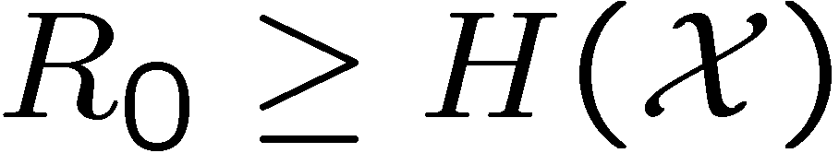
Shannon Analysis
Perfect Secrecy
  Adversary learns nothing about the information
  Only possible if the key is larger than the information

Slide 7
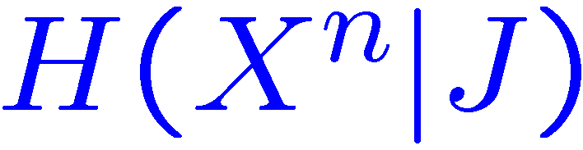

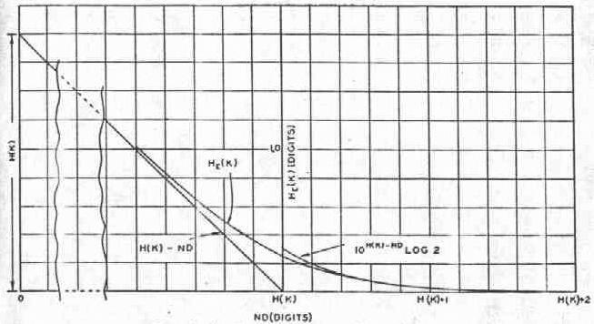
Shannon Analysis
Equivocation vs Redundancy
  Equivocation is conditional entropy:
  Redundancy is lack of entropy of the source:
  Equivocation reduces with redundancy:

Slide 8
Computational Secrecy
Some imperfect secrecy is difficult to crack
Public Key Encryption
  Trapdoor Functions
Difficulty not proven
  Often “cat and mouse” game
Vulnerable to quantum computer attack
X
2147483647
1125897758 834 689
524287

Slide 9
Information Theoretic Secrecy
Achieve secrecy from randomness (key or channel), not from computational limit of adversary.
  Physical layer secrecy
    Wyner’s Wiretap Channel [Wyner 1975]
  Partial Secrecy
    Typically measured by “equivocation:”
    Other approaches:
      Error exponent for guessing eavesdropper [Merhav 2003]
      Cost inflicted by adversary [this talk]
Notes:
A couple of aspects have been integrated in the study of information theoretic secrecy. One observation is that channel noise can be used, as the key is, to hide the information from an eavesdropper. The other development has been the study of partial secrecy.
Insert a diagram if I have time.

Slide 10
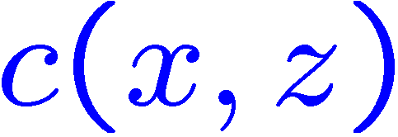


Partial Secrecy for Dynamic Systems
An adversary tries to interfere with a system
Cost inflicted by adversary
Objectives
  Reliable transition
  Minimize cost
Key
Source
Encipherer
Message
Decipherer
Reconstruction
Adversary
Interference
Notes:
Jam a communication channel; break into a network, counter a military attack; overload a power grid.

Slide 11
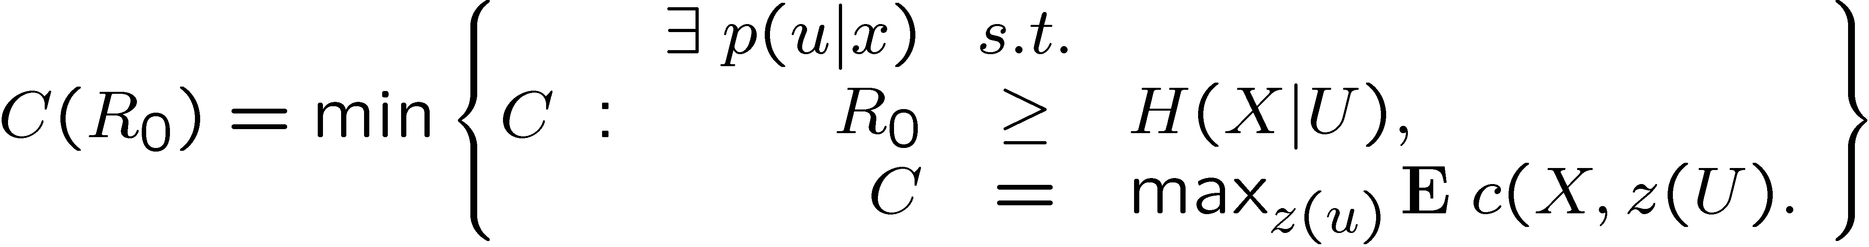
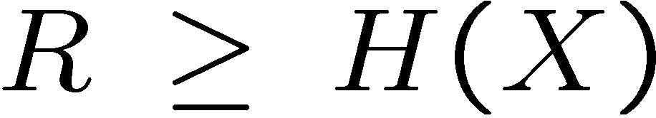

Cost-Rate Function
Minimum achievable average cost
Method: First reveal a correlated sequence without encryption
Theorem:
Also required:

Slide 12
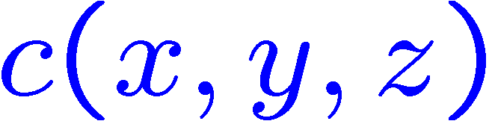
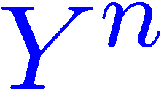
Partial Secrecy (Generalized)
More flexibility at the receiver
Cost imposed by adversary
Objectives
  Minimize cost
Key
Source
Encipherer
Message
Decipherer
Reconstruction
Adversary
Interference
Notes:
Jam a communication channel; break into a network, counter a military attack; overload a power grid.

Slide 13
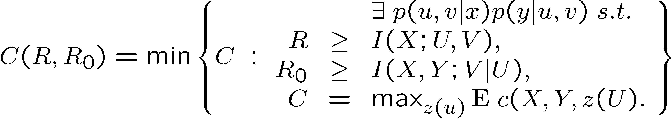
Cost-Rate Function (Generalized)
Minimum achievable average cost
Complex Relationship between the two rates.
Just beginning to explore this
Theorem:

Slide 14
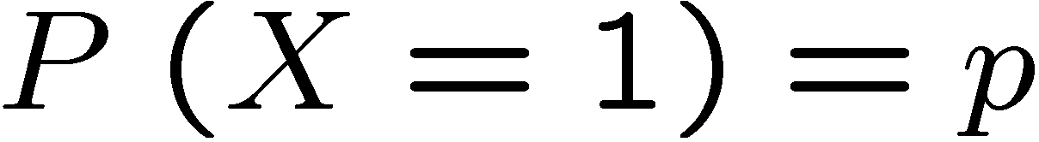



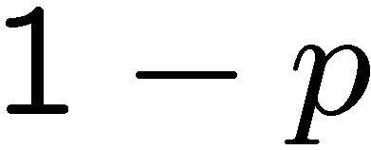
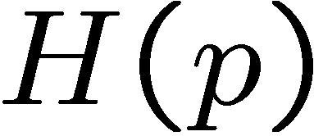


Binary-Hamming Case
Binary Source:
Cost equals 1 unit if
Naïve approach
  Random hashing or time-sharing
Optimal approach
  Reveal excess 0’s or 1’s to condition the hidden bits
(black line)`
(orange line)
Source
0 | 1 | 0 | 0 | 1 | 0 | 0 | 0 | 0 | 1
* | * | 0 | 0 | * | * | 0 | * | 0 | *
Public message

Slide 15
Control (Embedding Digital in Analog)
Correlate signals by embedding information
  Digital Watermarking
  Steganography
  New Results

Slide 16
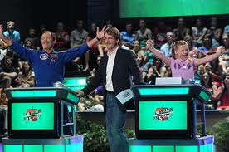
Alice and Bob Game
Binary Answers
Alice is Given Answers Ahead
Score by Both Guessing Correct
They Collude

Slide 17
Coordination in Distributed Systems
Alice and Bob:
  Dilemma: communication vs. optimal action
Watermarking and Steganography
  Information requires distortion
Digital Information in Analog Control Signals
  Embedded information is related to the control signal

Slide 18

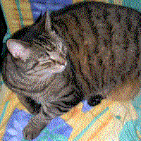
Steganography Example
Hide information in least significant bits
Host Image
Hidden image in 2 LSB

Slide 19
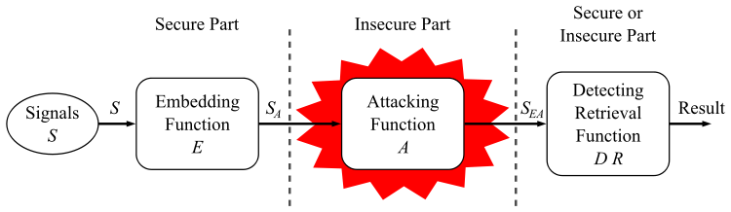
Watermark Model
Embedded information should be robust

Slide 20
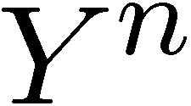
Coordination of Sequences
Three sequences
  First is random
  Second processed from first
  Third processed from second
Sequence
  Carries information
  Important control sequence
Source
Processor
Control 1
Processor
Control 2
Notes:
Can think of the processors as an encoder and a decoder.

Slide 21
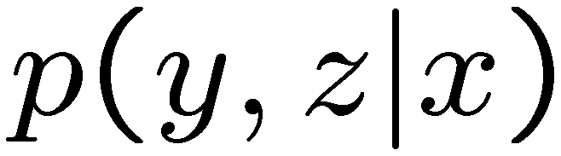
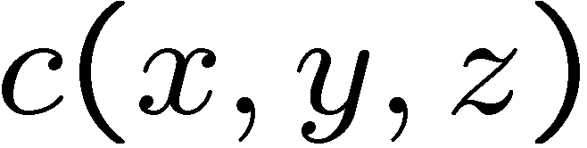
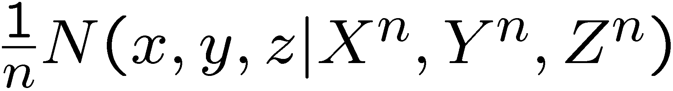
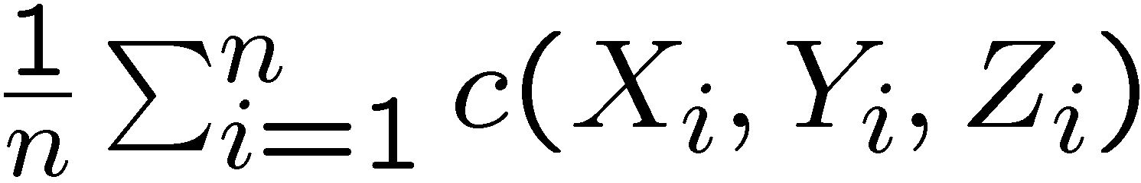
Definition of Coordination
Achieve a distribution
Minimize average cost
Desire distribution
Empirical distribution
Cost function
Average cost
Notes:
The Alice and Bob game defined an objective function.

Slide 22
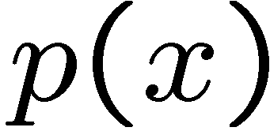

Results
Achievable Distributions
Left side: information carrying content
Right side: signal correlation
Theorem:
Given , the distribution must satisfy,

Slide 23
Causality
Second processor is causal
Left side: information carrying content
Right side: signal correlation
Theorem:
Given , the distribution must satisfy,

Slide 24
Example: Communication Channels
Three frequency channels
Random hopping schedule

Slide 25
Summary
Framework for Encryption
  Average cost inflicted by eavesdropper
  Move away from “equivocation”
Embedding information in control signals
  Related to watermarking
  Many unexplored questions

