Slide 1
Toward a Secure Data-Rate Theorem
Paul Cuff

Slide 2
Control Setting
System (Plant)
Sensors
Controller
U_{i}
X_{i}
Y_{i}
Rate R
Encoder

Slide 3
Data Rate Theorem
x_{i+1} = A x_{i} + B u_{i} + v_{i}
y_{i} = C x_{i} + w_{i}
Rate R encoder and decoder
M_{i}(y^{i}) 2 2^{R}
u_{i}(M^{i})

Slide 4
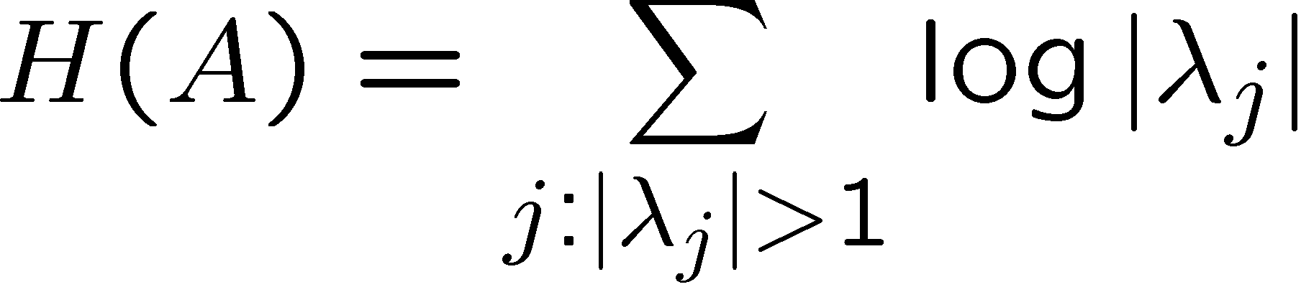
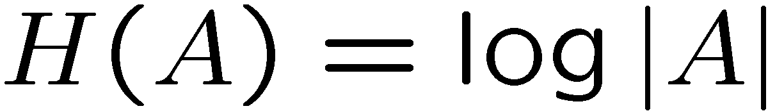
Intrinsic Entropy
If all modes are unstable,

Slide 5
Data Rate Theorem
R > H(A) is necessary and sufficient to stabilize the system.
Many different assumptions about noise and definitions of stability, but this threshold is the same in all cases.
[Tatikonda, Mitter 04], [Baillieul 99, 02], [Nair et. al. 05, 07, 09], [Wong, Brockett 99]

Slide 6
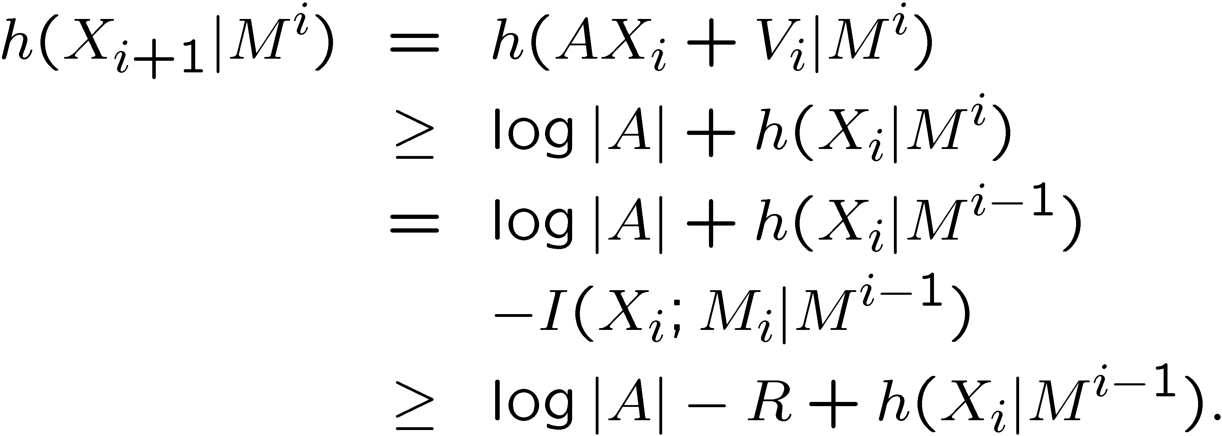
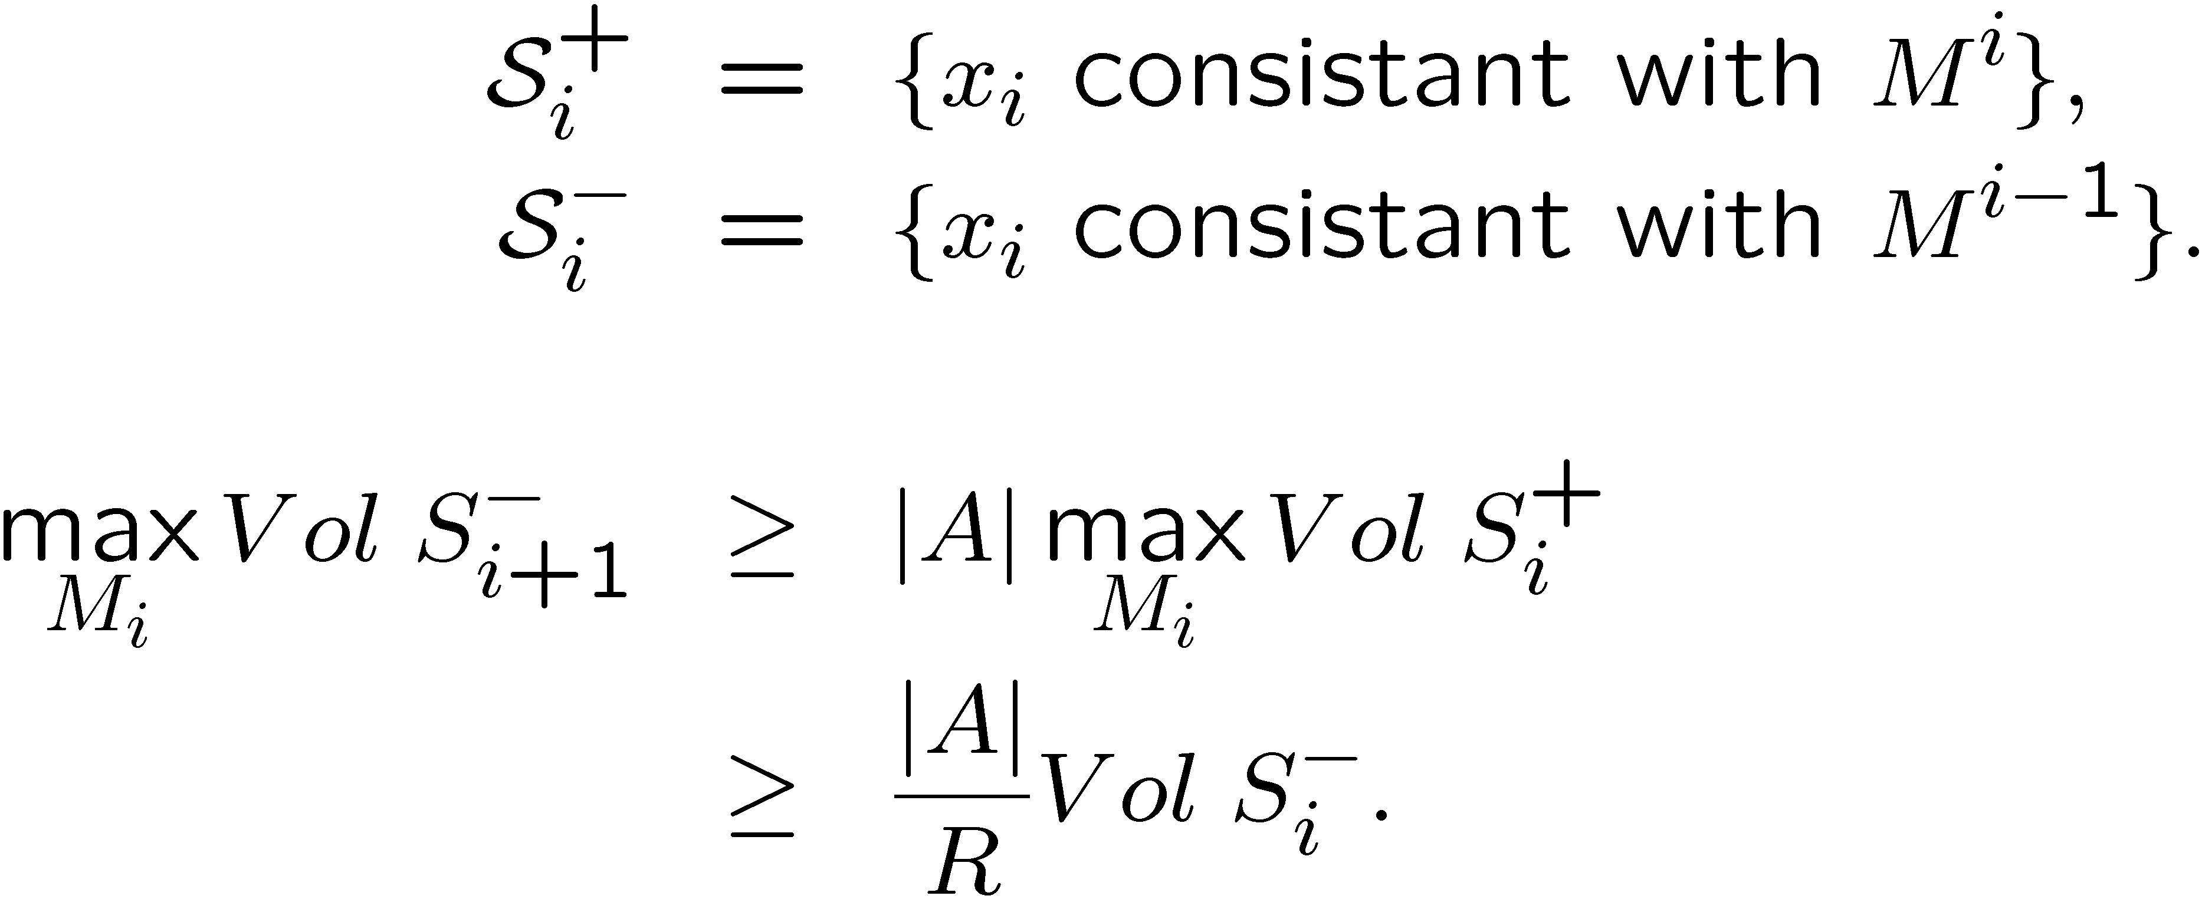
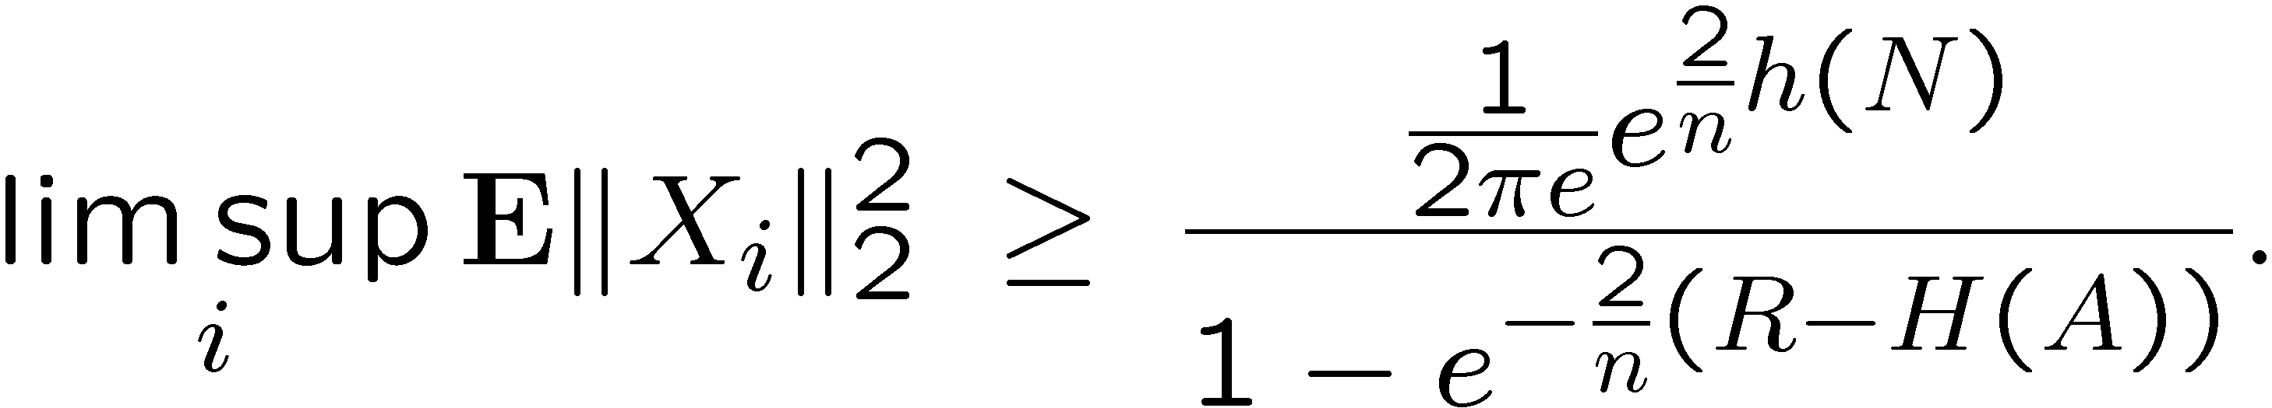
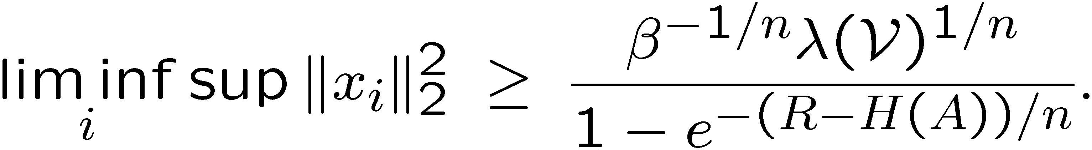
Data Rate Theorem Converse
Probabilistic Analysis
Uncertainty Set Evolution
Using EPI
Using Brunn-Minkowski Inequality

Slide 7
Scalar Achievability
For simplicity, consider a noiseless system.
x_{i+1} = a x_{i} + u_{i}
Quantize to odd integers.
If x₀ is in [-1,1], then the error never gets larger than 1.
-3
-1
1
3
Starting set

Slide 8
Block coding tools
What if we use rate distortion theory to create an AWGN channel?
This ignores the effect of delays. Here LQR can be used to analyze the performance.

Slide 9
Control Setting
System (Plant)
Sensors
Controller
U_{i}
X_{i}
Y_{i}
Rate R
Encoder

Slide 10
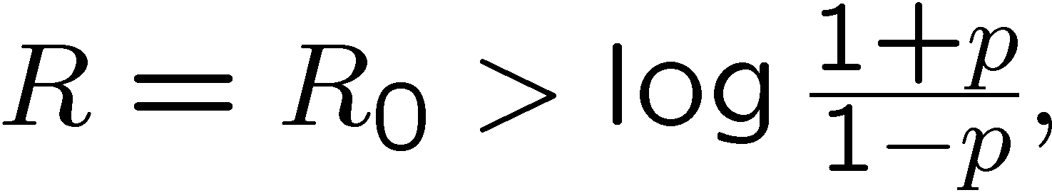
Synthesize a Channel
With an adversary present, we can synthesize a channel using common randomness.
[Bennett, Shor et. al., 02], [C., 08]
Example: yields perfect secrecy
[Liu, Chen 11] [C. 10, Allerton]

Slide 11
Control Setting
System (Plant)
Sensors
Controller
U_{i}
X_{i}
Y_{i}
Rate R
Encoder

Slide 12
Simple Idea for no Delay
Quantize evens or odds depending on 1 bit of secret key.
-3
-1
1
3
2
0
2
4

Slide 13
Key Aspects of a Secure DRT Problem
Must use probabilistic analysis with averages.
  Worst case bounded noise sequences can be controlled. No need to understand information known to the adversary.
Probably need to look at other aspects of performance such as LQR performance.
  Data-rate threshold will likely not change
  Consider bounded control power, etc.

Slide 14
Combined Control and Communication
System (Plant)
Sensors
Controller
U_{i}
X_{i}
Y_{i}
Rate R
Encoder

Slide 15
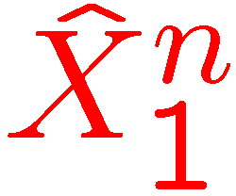
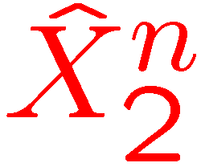
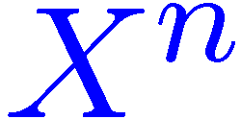


No Rate – No Channel
No explicit communication channel
Signal “A” serves an analog and information role.
  Analog: symbol-by-symbol relationship
  (Digital): uses complex structure to carry information.
Source
Processor 1
Processor 2
Actuator 1
Actuator 2

Slide 16
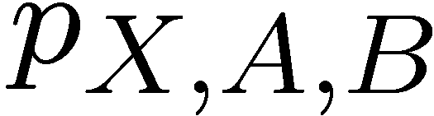
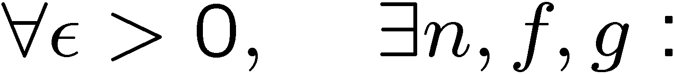
Define Empirical Coordination
Source
Processor 1
Processor 2
Empirical distribution:
is achievable if:

Slide 17
Coordination Region
The coordination region
gives us all results concerning average distortion.
Source
Processor 1
Processor 2

Slide 18
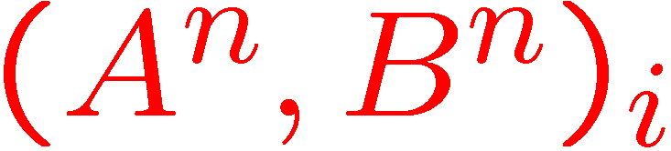
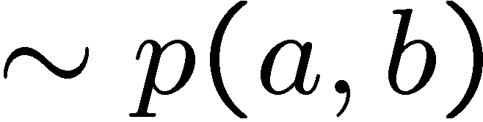
Result – No constraints
Source
Processor 1
Processor 2
Achievability: Make a codebook of (A^{n} , B^{n} ) pairs

Slide 19

Related Work
“Witsenhausen Counterexample”
  [Witsenhausen 68]
  [Grover-Wagner-Sahai 10]
Digital Watermarking and “Information Hiding”
  [Moullin O’Sullivan 00], [Chen-Wornell 01], [Cohen-Lapidoth 02], [Wu-Hwang 07]

Slide 20

Example – Collision Avoidance
Flocking
Frequency Hopping (avoid interference)
Writing to Scattered Memory Locations

Slide 21
Example - Games
Partner games (example: bridge)
Penny Matching
  [Gossner-Hernandez-Neyman 03]

Slide 22
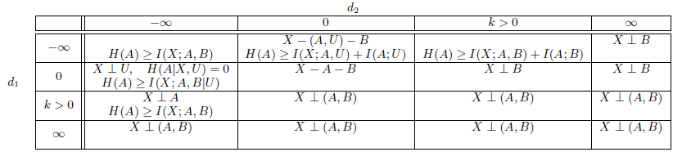
General Results
Variety of causality constraints (delay)
Finite Look-ahead
Source
Processor 1
Processor 2

Slide 23
Alice and Bob Game
Alice and Bob want to cooperatively score points by both correctly guessing a sequence of random binary numbers (one point if they both guess correctly).
Alice gets entire sequence ahead of time
Bob only sees that past binary numbers and guesses of Alice.
What is the optimal score in the game?
Notes:
I used to call this the Alice and Bob game, but I used different lets here, and besides, Alice and Bob are used for cryptography.
Let them think for a while about this question.

Slide 24
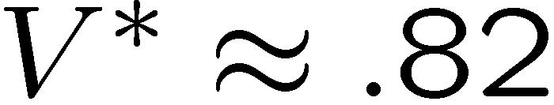
Alice and Bob Game (answer)
Online Matching Pennies
  [Gossner, Hernandez, Neyman, 2003]
  “Online Communication”
Solution
Notes:
This is a variation of the first-order statistics question

Slide 25
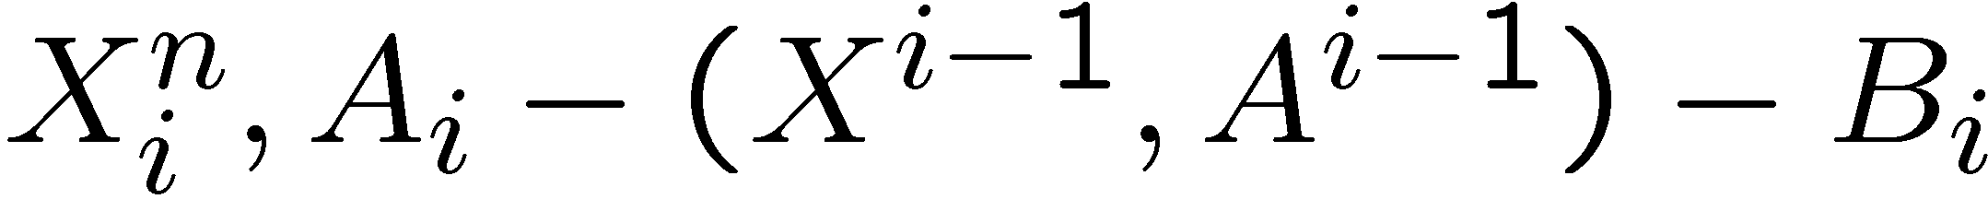
Alice and Bob Game (connection)
Score in Alice and Bob Game is a first-order statistic
Markov structure is different (strictly causal):
First Surprise: Bob doesn’t need to see the past of the sequence.

Slide 26
General (causal) solution
Achievable empirical distributions
  (Processor 2 is strictly causal)
Notes:
For the Yanis and Zeus game, you let X be Bernoulli half and find the distribution that satisfied the above inequality and has the highest probability of X=Y=Z. You get the answer from the previous page.

Slide 27
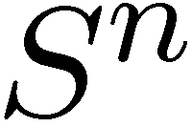
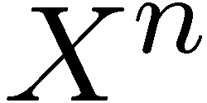
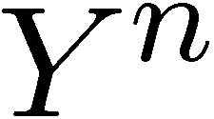
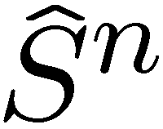
Noise in the system
[C.-Schieler, Allerton 11]
So called “hybrid analog-digital codes” are useful.
f
p(y|x)
g

Slide 28
Thank you
System (Plant)
Sensors
Controller
U_{i}
X_{i}
Y_{i}
Rate R
Encoder

