Slide 1

Causal Secrecy:
An Informed Eavesdropper
Paul Cuff
Electrical Engineering
Princeton University

Slide 2



Main Idea
Secrecy for distributed systems
  Limit the adversaries “useful” information
Distributed System
Action
Message
Node B
Information
Node A
Adversary
Attack
Notes:
Special Cases: rate-distortion theory (no adversary); lossless (Globecom); unlimited secret key; unlimited communication; seperability of nodes B and C.

Slide 3
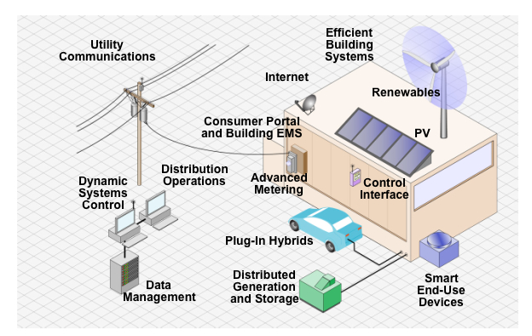
Communication in Distributed Systems
“Smart Grid”
Image from http://www.solarshop.com.au

Slide 4
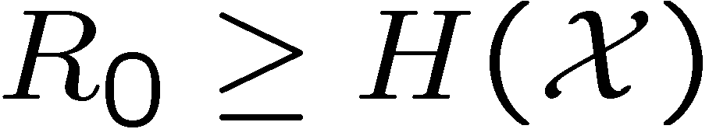
Perfectly Private Communication
Vernam Cipher (1917)
  Key Sequence: 001011…
  Information: 101100…
One Time Pad
  Random Secret Key [Mauborgne]
Shannon [1949 paper]
  One time pad is necessary and sufficient for perfect secrecy.
XOR
100111…

Slide 5
Obtaining Secret Key
Secret Key Generation
  Key extracted from correlated observations and public communication.
  [Gacs-Korner 73, Maurer 93, Ahlswede-Csiszar 93]
Quantum Key Distribution
  Key exchanged using entangled photos. Secrecy verifiable.
  [Bennett-Brassard 84]
Public Key Distribution
  Key obtained by public communication is intractable to compute by a third party. [Diffie-Hellman, Merkle 76]

Slide 6
Creating Secure Channels
Physical Layer Security
  Use Channel Noise to Create Private Channel
  Wyner’s Wiretap Channel [Wyner 75]

Slide 7
Focus of Talk
What do we do with Secrecy Resources?

Slide 8
Example: Communication Limited Control
Communication
Signal (sensor)
Signal (control)
00101110010010111
Attack Signal
Adversary

Slide 9
Example: Feedback Stabilization
“Data Rate Theorem” [Wong-Brockett 99, Baillieul 99]
Controller
Dynamic System
Adversary
Sensor
Decoder
Encoder
10010011011010101101010100101101011
Feedback

Slide 10
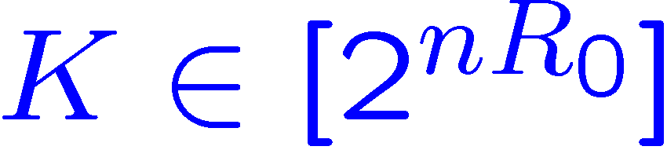
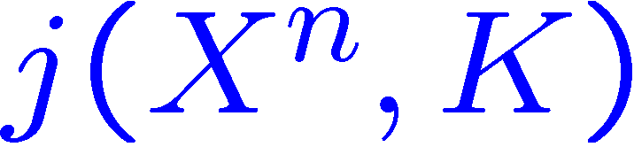
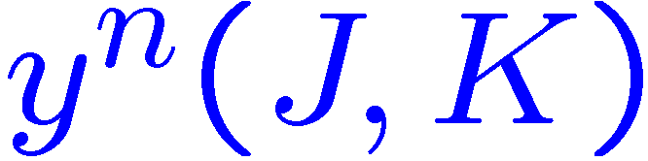
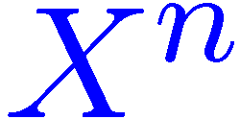
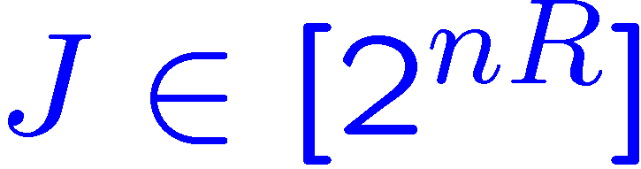
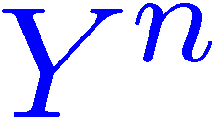
Isolate Communication Component
Schematic
Assumption
  Adversary knows everything about the system except the key
Requirement
  The decipherer accurately reconstructs the information
Key
Key
Source Signal
Public Channel
Output Signal
Adversary
Notes:
26! Is about 4 x 10^26 (the number of atoms in my chair). 88.4 bits
Redundancy of English is about 3.75 5bits per letter. (without spaces it’s 3.7)
About 25 letters needed to decode

Slide 11
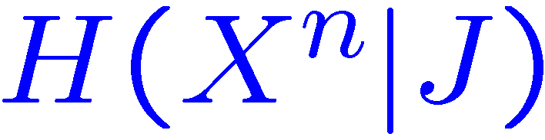
Equivocation
Equivocation:
Not an operationally defined quantity
Bounds:
  List decoding
  Additional information needed for decryption
Not concerned with structure

Slide 12
Coordination
Don’t want Adversary to Coordinate
  Many ways to define this.
Establish a Pay-off function
  Min-max game between communication system and adversary.

Slide 13
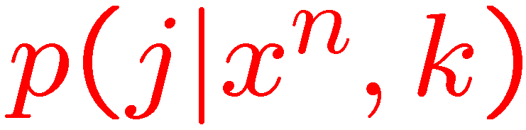

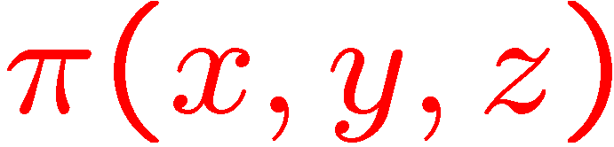
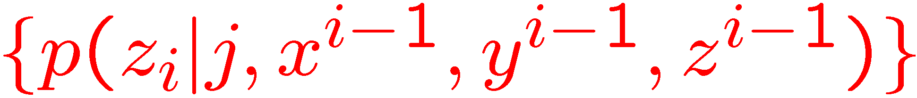
Competitive Distributed System
Decoder:
Encoder:
Key
Information
Node A
Message
Node B
Action
Adversary
Attack
System payoff: .
Adversary:
Notes:
Jam a communication channel; break into a network, counter a military attack; overload a power grid.

Slide 14
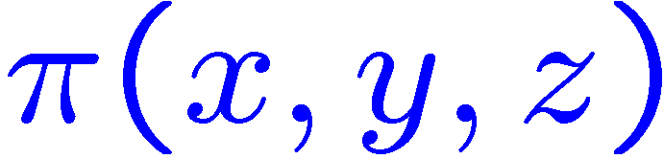
Zero-Sum Game
Value obtained by system:
Objective
  Maximize payoff
Key
Information
Node A
Message
Node B
Action
Adversary
Attack
Notes:
Jam a communication channel; break into a network, counter a military attack; overload a power grid.

Slide 15
Secrecy-Distortion Literature
[Yamamoto 97]:
  Cause an eavesdropper to have high reconstruction distortion
    Replace payoff (π) with distortion
[Yamamoto 88]:
  No secret key
  Lossy compression

Slide 16
Secrecy is Too Easy
Consider a binary, uniform, memoryless source
  (i.e. random bits)
Use a “one-bit pad”
Adversary can narrow the source sequence to two complementary sequences
  “Perfect Secrecy:” No good reconstruction

Slide 17
Theoretical Results
Information Theoretic Rate Regions
Provable Secrecy

Slide 18
Two Categories of Results
Lossless Transmission
General Reward Function
Simplex interpretation
  Linear program
Hamming Distortion
Common Information
  Secret Key
Notes:
Lossless is a special case of the general setting

Slide 19
General Payoff Function
Any payoff function π(x,y,z)
Any source distribution (i.i.d.)
No requirement for lossless transmission.
Adversary:

Slide 20
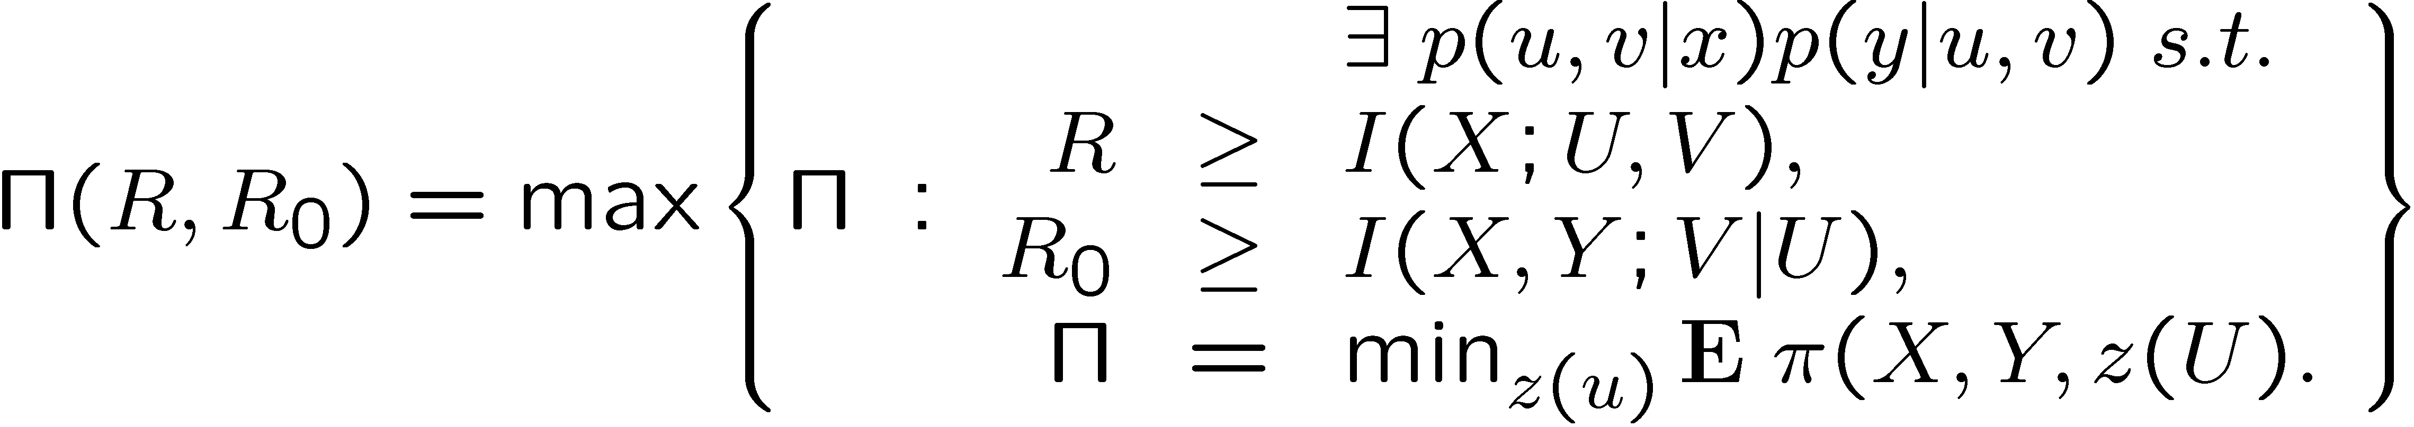
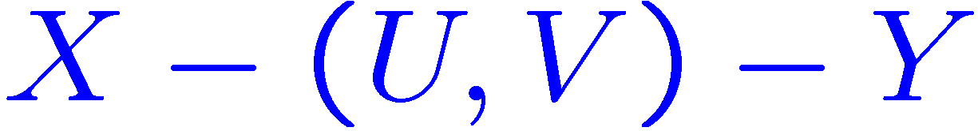
Payoff-Rate Function
Maximum achievable average payoff
Markov relationship:
Theorem:

Slide 21
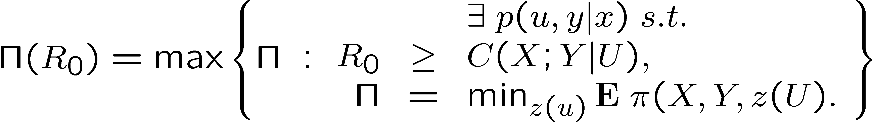
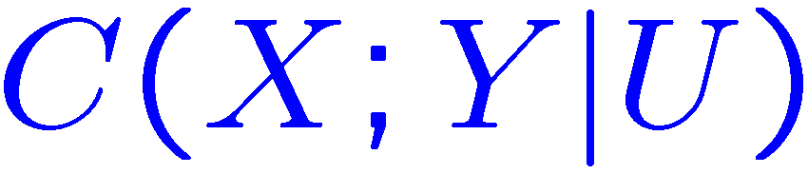
Unlimited Public Communication
Maximum achievable average payoff
Conditional common information:
Theorem (R=∞):

Slide 22
Competitive Distributed System
Decoder:
Encoder:
Key
Information
Node A
Message
Node B
Action
Adversary
Attack
System payoff: .
Adversary:
Notes:
Jam a communication channel; break into a network, counter a military attack; overload a power grid.

Slide 23
Zero-Sum Game
Value obtained by system:
Objective
  Maximize payoff
Key
Information
Node A
Message
Node B
Action
Adversary
Attack
Notes:
Jam a communication channel; break into a network, counter a military attack; overload a power grid.

Slide 24
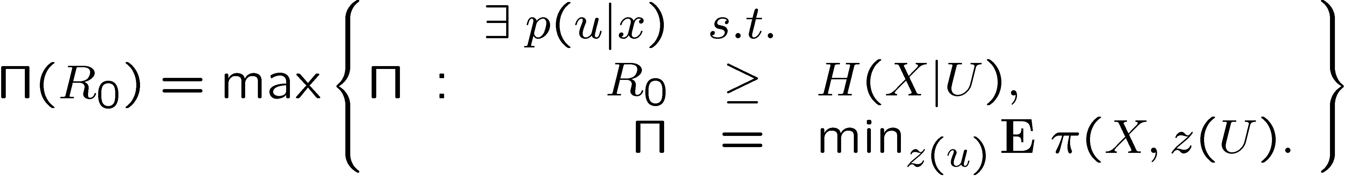
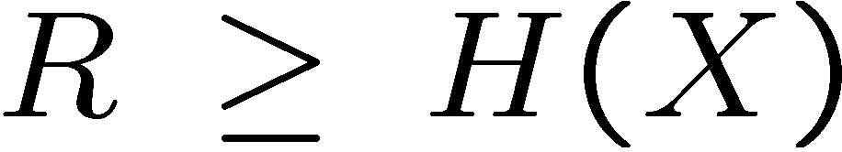
Lossless Case
Require Y=X
  Assume a payoff function
Related to Yamamoto’s work [97]
  Difference: Adversary is more capable with more information
Theorem:
[Cuff 10]
Also required:

Slide 25
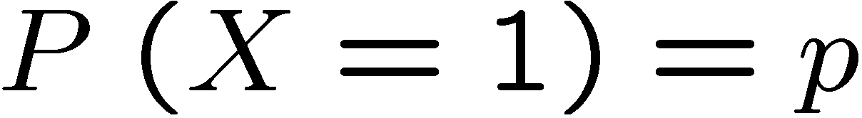



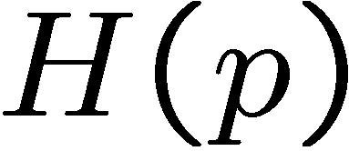
Binary-Hamming Case
Binary Source:
Hamming Distortion
Naïve approach
  Random hashing or time-sharing
Optimal approach
  Reveal excess 0’s or 1’s to condition the hidden bits
(black line)
(orange line)
Source
0 | 1 | 0 | 0 | 1 | 0 | 0 | 0 | 0 | 1
* | * | 0 | 0 | * | * | 0 | * | 0 | *
Public message

Slide 26
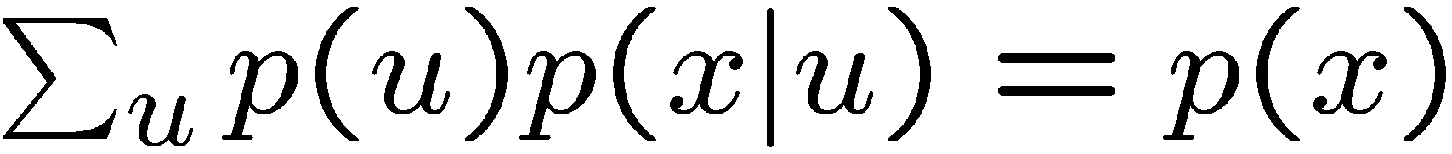
Linear Program on the Simplex
Constraint:
Minimize:
Maximize:
U will only have mass at a small subset of points (extreme points)

Slide 27


Linear Program on the Simplex

Slide 28
Summary
Information available to Adversary is key consideration
  No use of “equivocation”
  Coordination ability extracted by considering competitive game.

