Slide 1
Log-Optimal Utility Functions
Paul Cuff

Slide 2
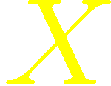

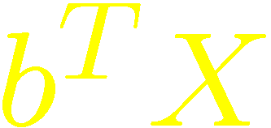

Investment Optimization
is a vector of price-relative returns for a list of investments
      A random vector with known distribution
is a portfolio
      A vector in the simplex
is the price-relative return of the portfolio
Find the best

Slide 3
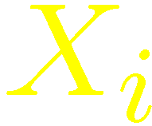

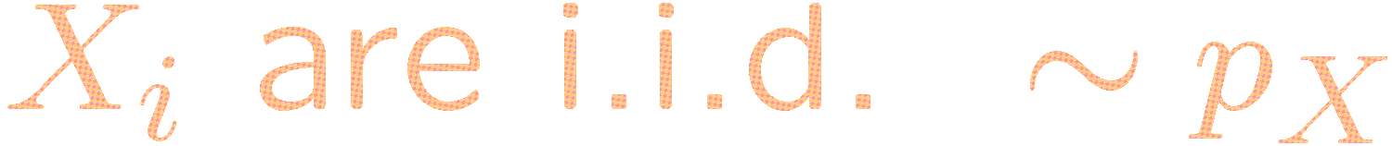

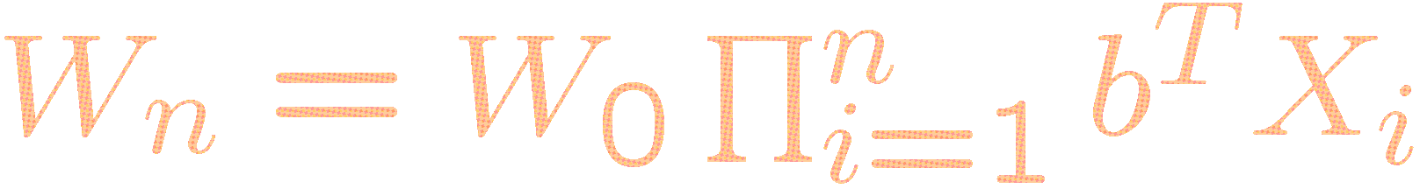
Compounding Growth
is the price-relative return for time-period
The wealth after time is

Slide 4
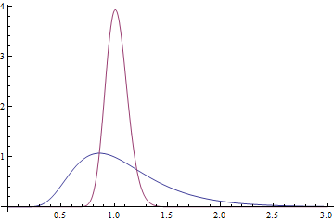
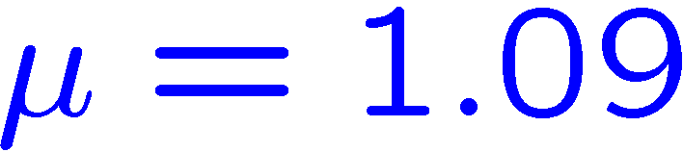
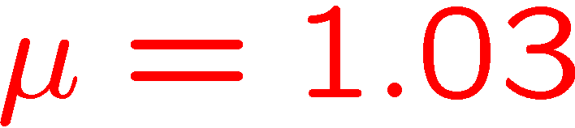
Comparing Random Variable
Markowitz “efficient frontier”
  Select based on mean and variance
  Still heavily analyzes [Elton Gruber 11]
Utility Function (discussed next)
Example:

Slide 5


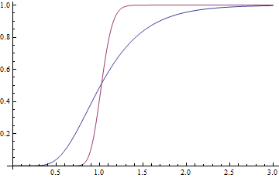
Stochastic Dominance
Stochastic dominance gives an objective best choice.
dominates if
PDF
CDF
No stochastic dominance here

Slide 6

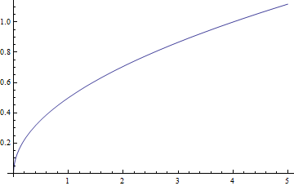
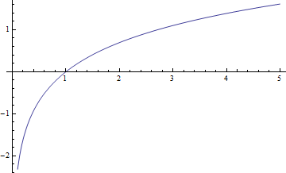
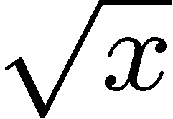
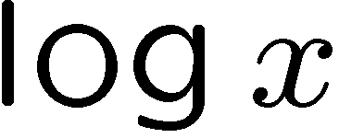
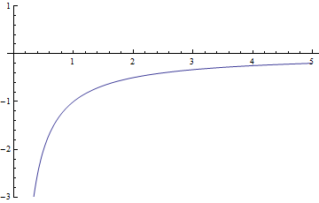
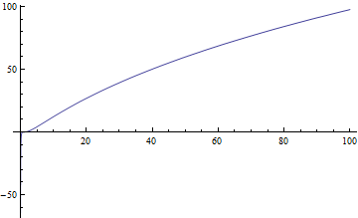
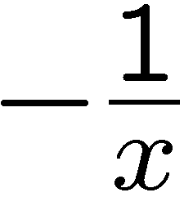
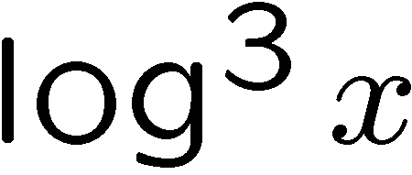
Utility Theory
Von Neumann-Morgenstern
  Requires four consistency axioms.
All preferences can be summed up by a utility function
“Isoelastic”
(power law)
Notes:
Power utility functions are called “isoelastic” or “constant relative risk aversion”

Slide 7
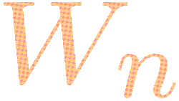



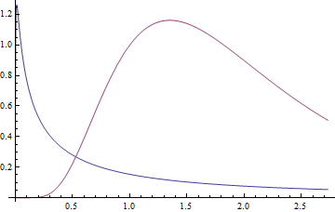
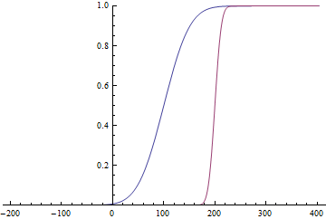
Near Stochastic Dominance
(after compounding)
What happens to as increases?
PDF
CDF
Log-wealth

Slide 8
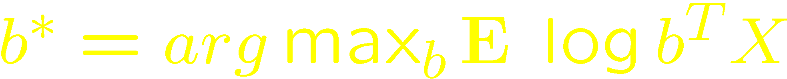


Log-Optimal Portfolio
Kelly, Breiman, Thorp, Bell, Cover
maximizes
beats any other portfolio with probability at least half
is game theoretically optimal if payoff depends on ratio

Slide 9
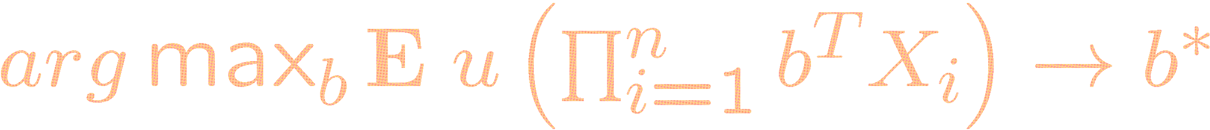
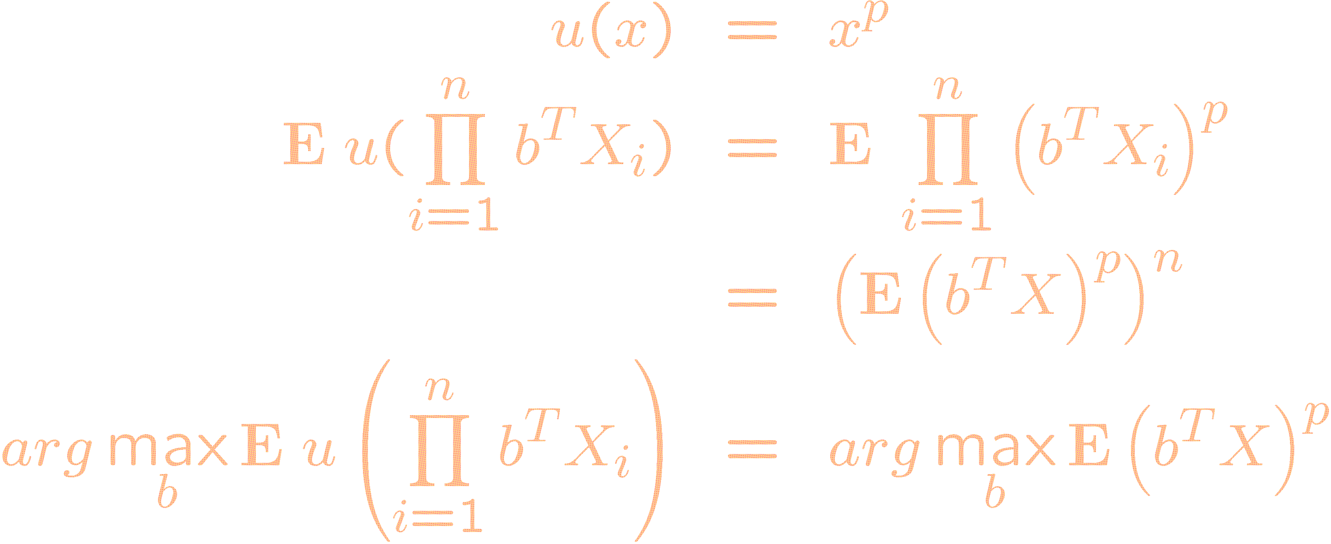
Is Log-Optimal Utility-Optimal?
Question: ?
Answer: Not true for all
Example:
Notes:
Even in the long horizon limit, the optimal portfolio doesn’t converge to log-optimal

Slide 10

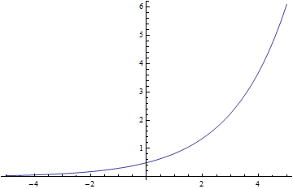

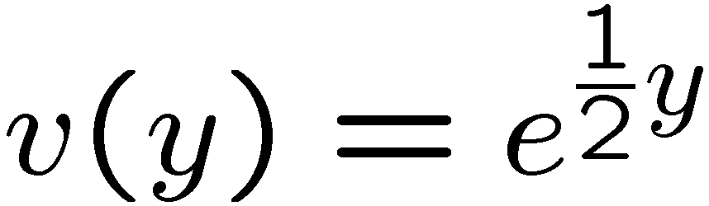
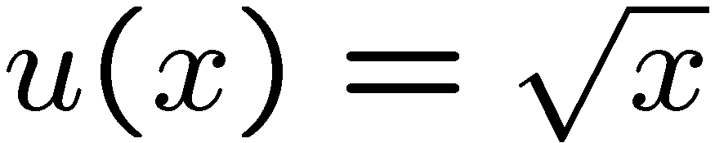
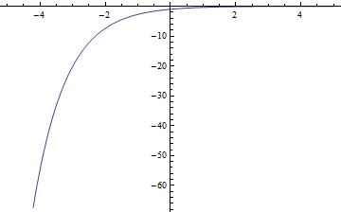
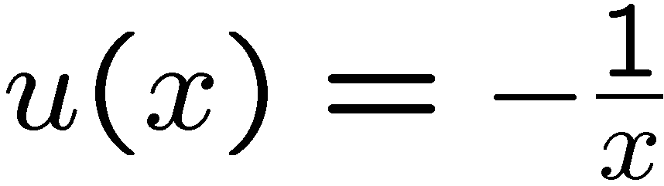
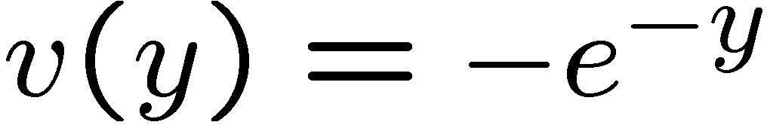
The problem is in the tails
Analysis is more natural in the log domain:
Power laws are exponential in the log domain.
  Consequently, all of the emphasis is on the tails of the distribution
Examples:
Change domain: ( )

Slide 11
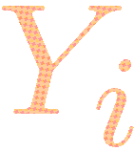

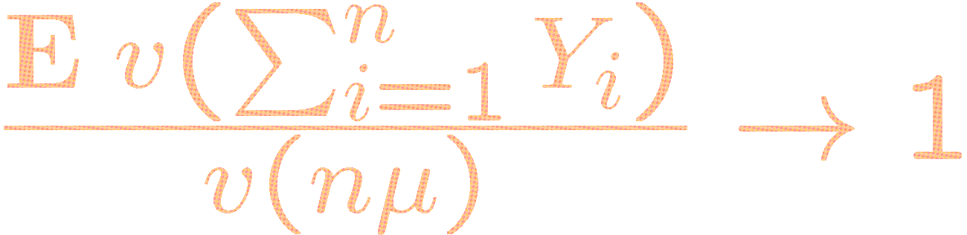
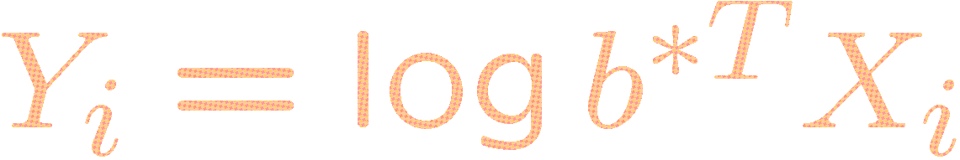
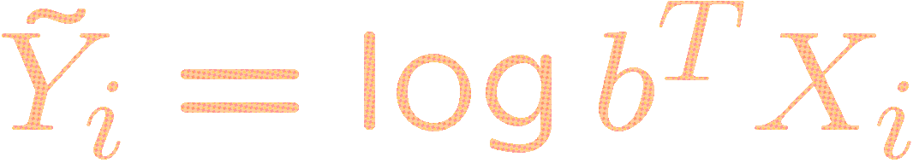
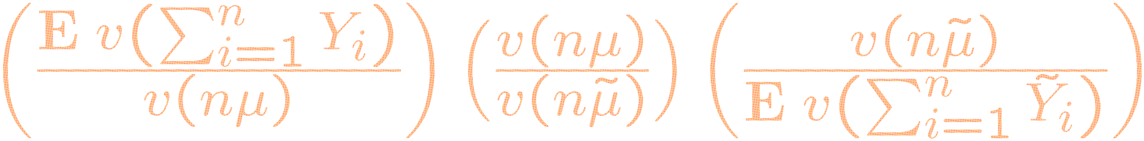
Method of Attack
Find conditions on the log-utility function such that for all i.i.d. sequences with mean and finite variance,
Show that beats portfolio by analyzing:

Slide 12
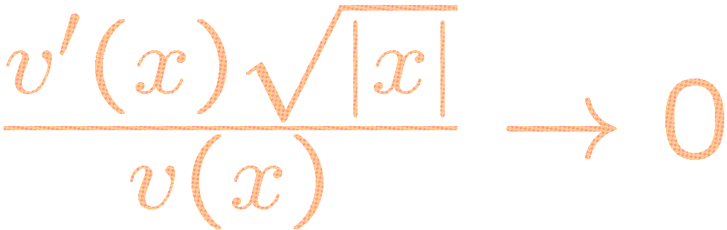


Main Result
All log-utility functions satisfying
as x goes to plus or minus infinity, and growing at least fast enough that
for all
are log-optimal utility functions.

Slide 13
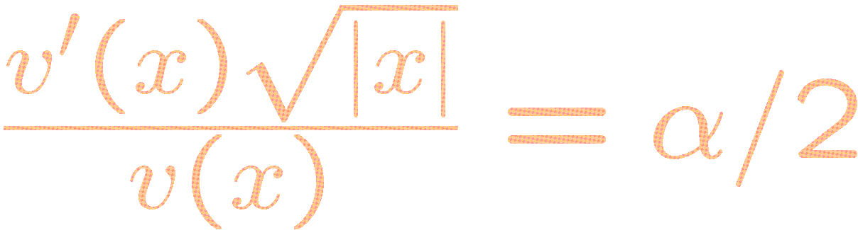
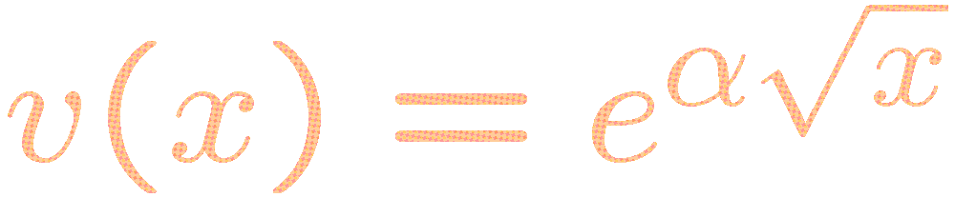
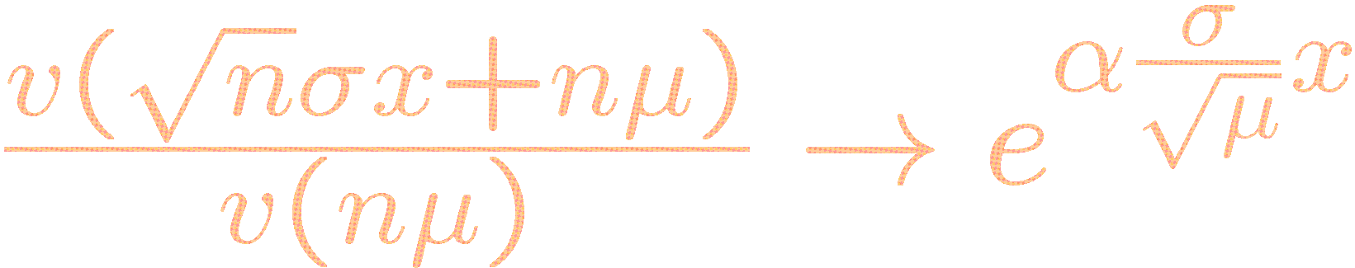
Boundary Case
Consider the boundary case
This yields
Notice that

Slide 14
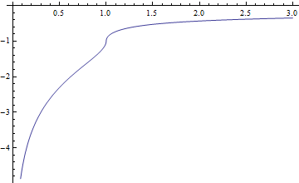
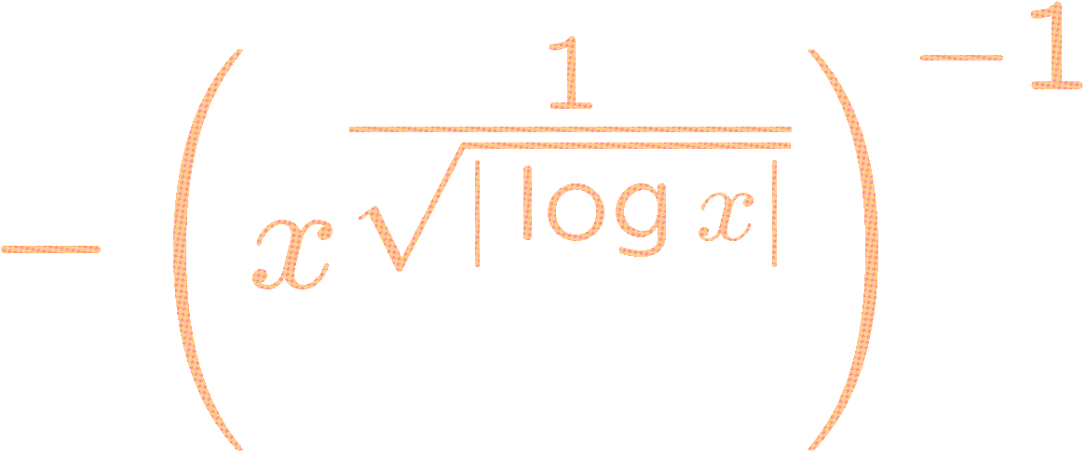
Summary
Log-optimal portfolio is nearly stochastically dominant in the limit
Utility functions with well behaved tails will point to the log-optimal portfolio in the limit.
Even functions that look like the popular ones (for example, bounded above and unbounded below) can be found in the set of log-optimal utility functions.

