Slide 1
Equivocation
A Special Case of Distortion-based Characterization

Slide 2
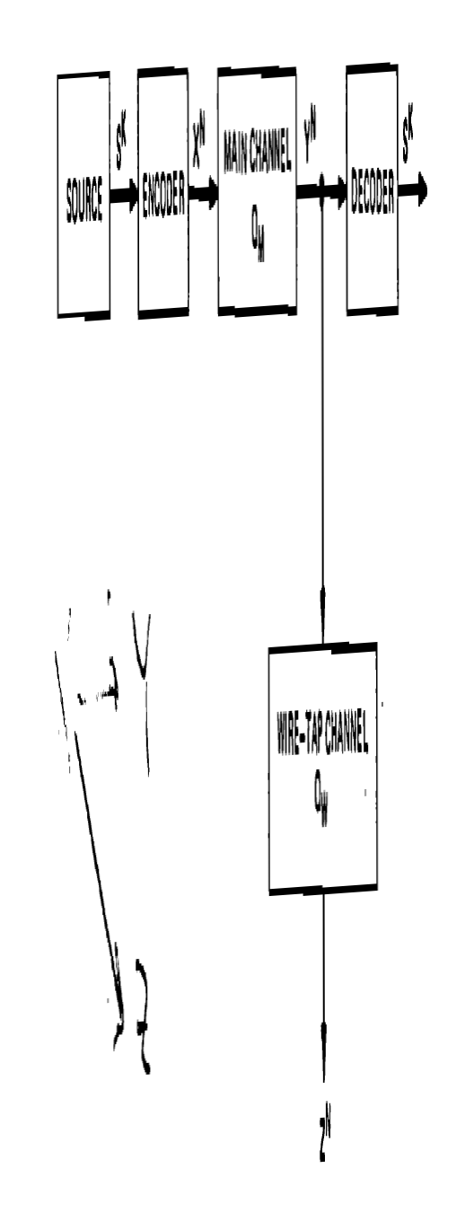
Wiretap Channel [Wyner 75]

Slide 3
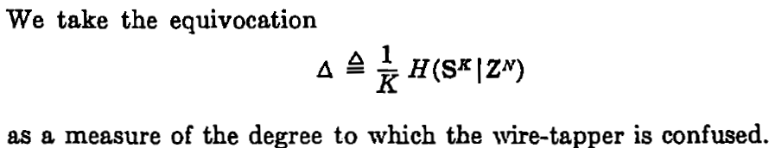
Wiretap Channel [Wyner 75]

Slide 4
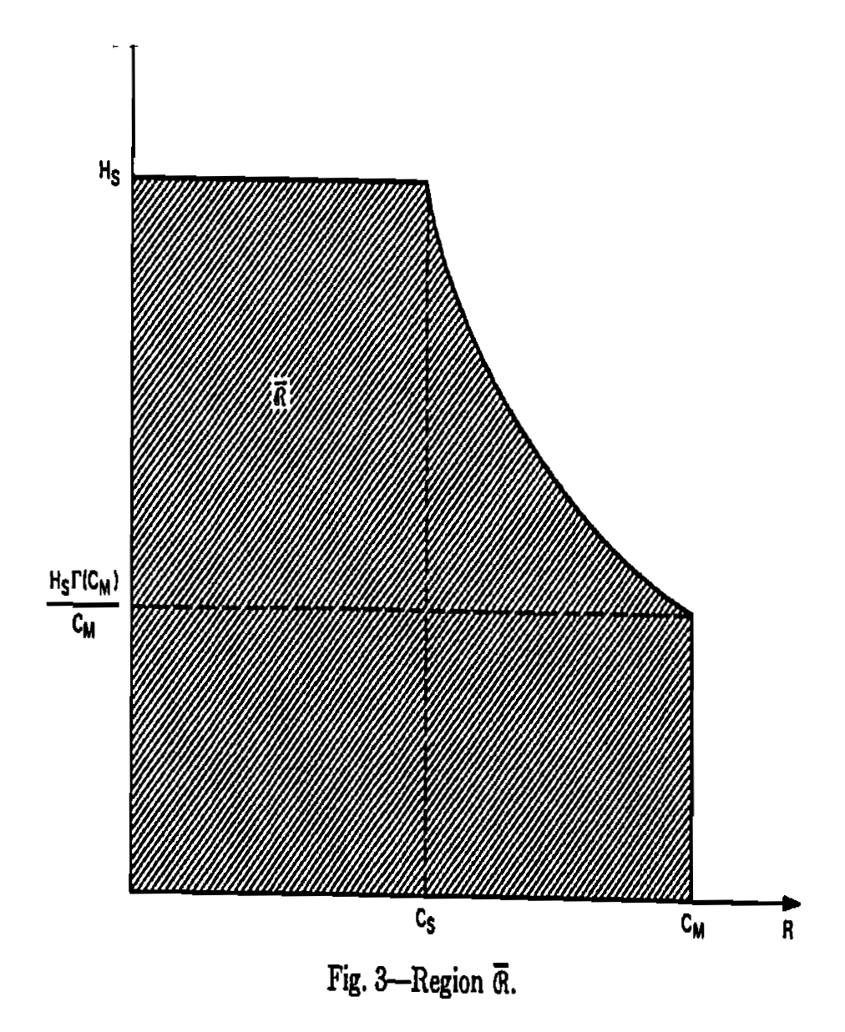
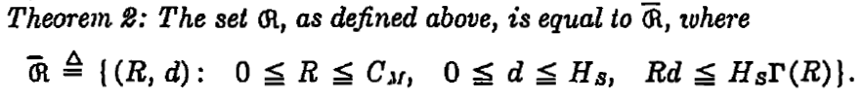
Wiretap Channel [Wyner 75]

Slide 5
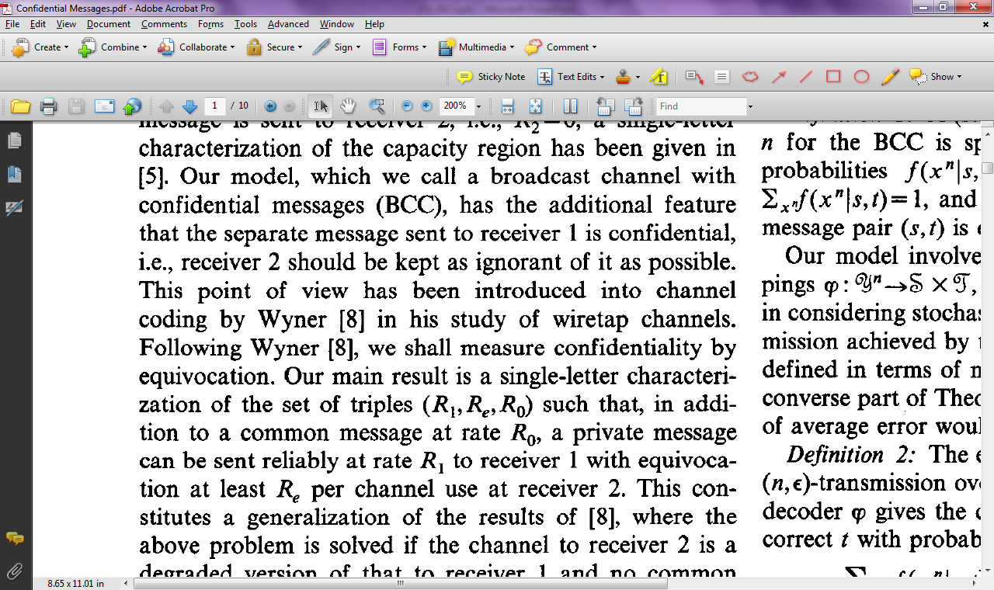
Confidential Messages [Csiszar, Korner 78]

Slide 6
Confidential Messages [Csiszar, Korner 78]

Slide 7
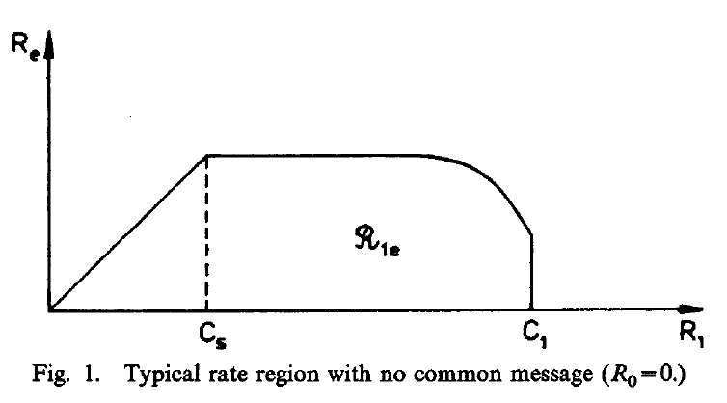
Confidential Messages [Csiszar, Korner 78]

Slide 8
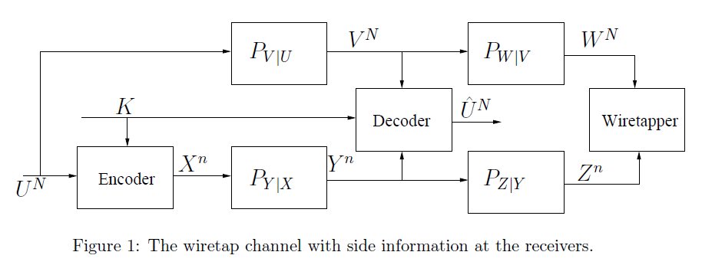
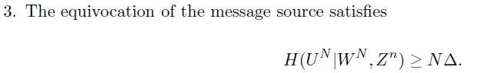
Merhav 2008

Slide 9
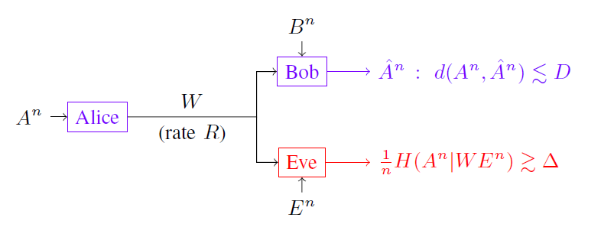
Villard-Piantanida 2010

Slide 10
Other Examples of rate-equivocation
Gunduz-Erkip-Poor 2008
Lia-H. El-Gamal 2008
Tandon-Ulukus-Ramchandran 2009
…

Slide 11
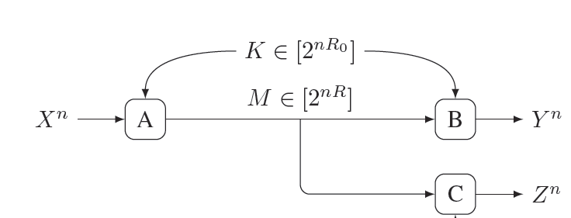
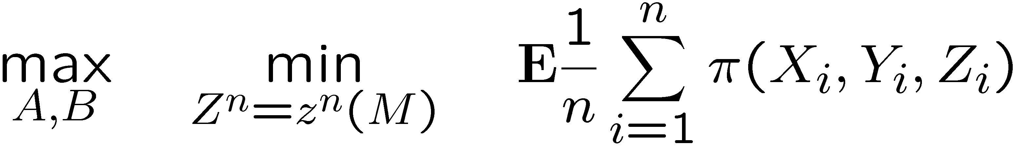
Another Approach

Slide 12
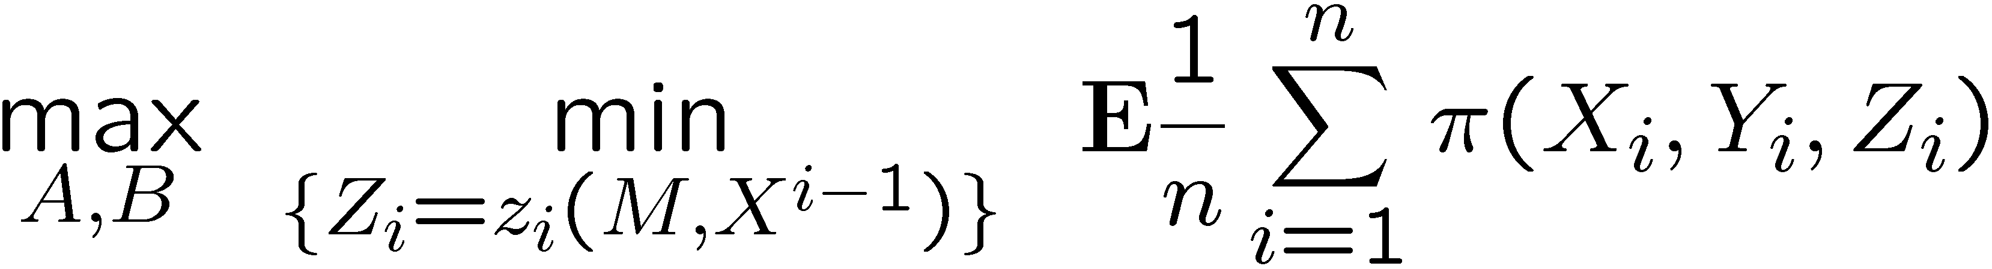
Causal Disclosure (case 1)

Slide 13

Causal Disclosure (case 2)

Slide 14
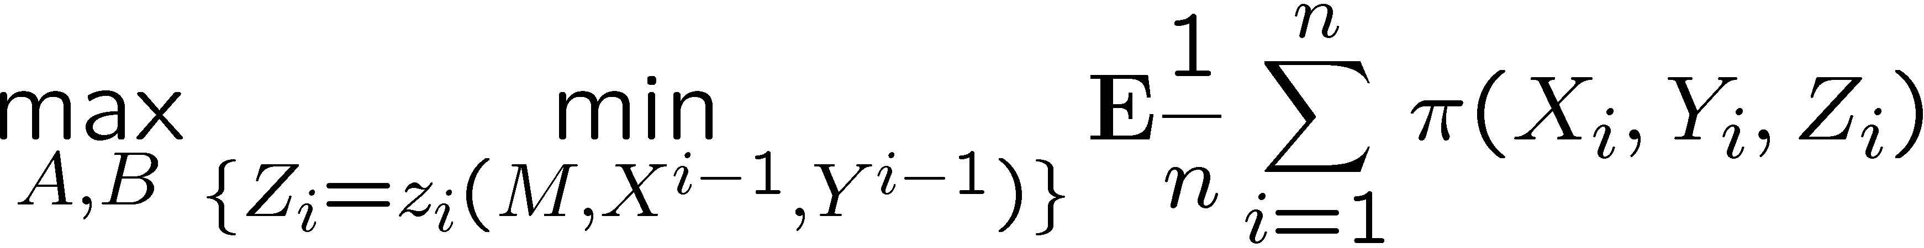
Causal Disclosure (case 3)

Slide 15
What if lossy compression were defined with respect to information measures?
H(X^n|M)
Not as interesting as R(D)
R

Slide 16
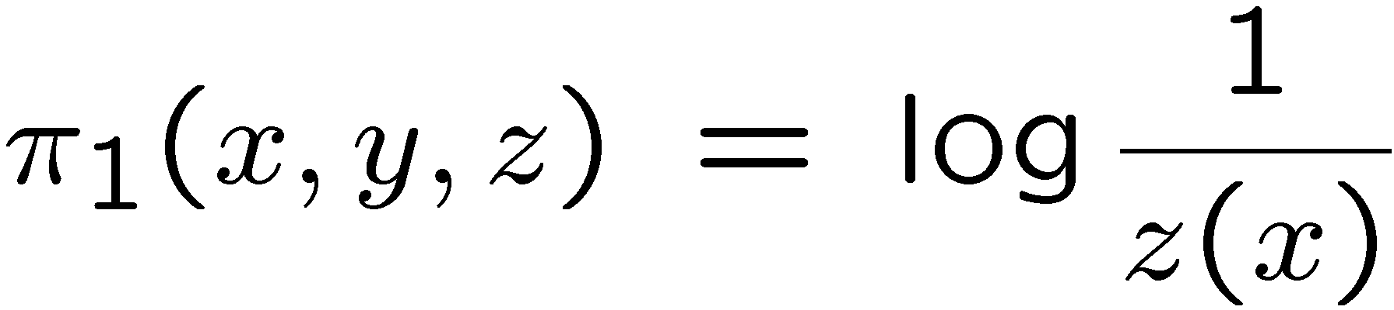
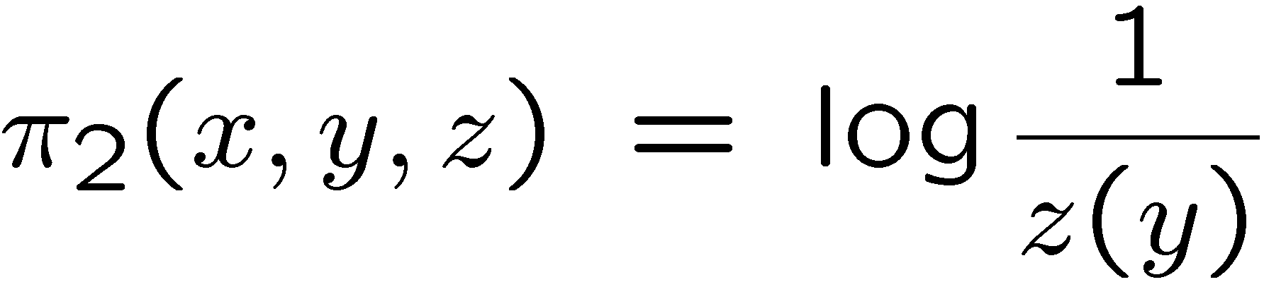
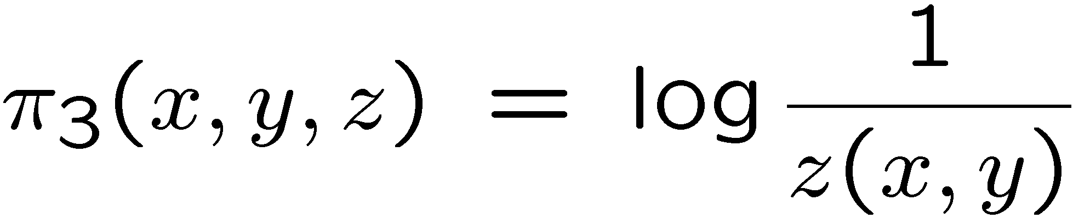
Log-loss Distortion
Reconstruction space of Z is the set of distributions.

Slide 17
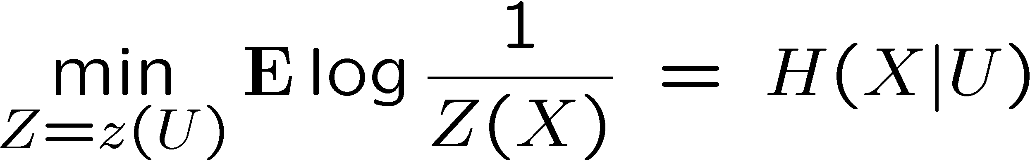
Best Reconstruction Yields Entropy

Slide 18
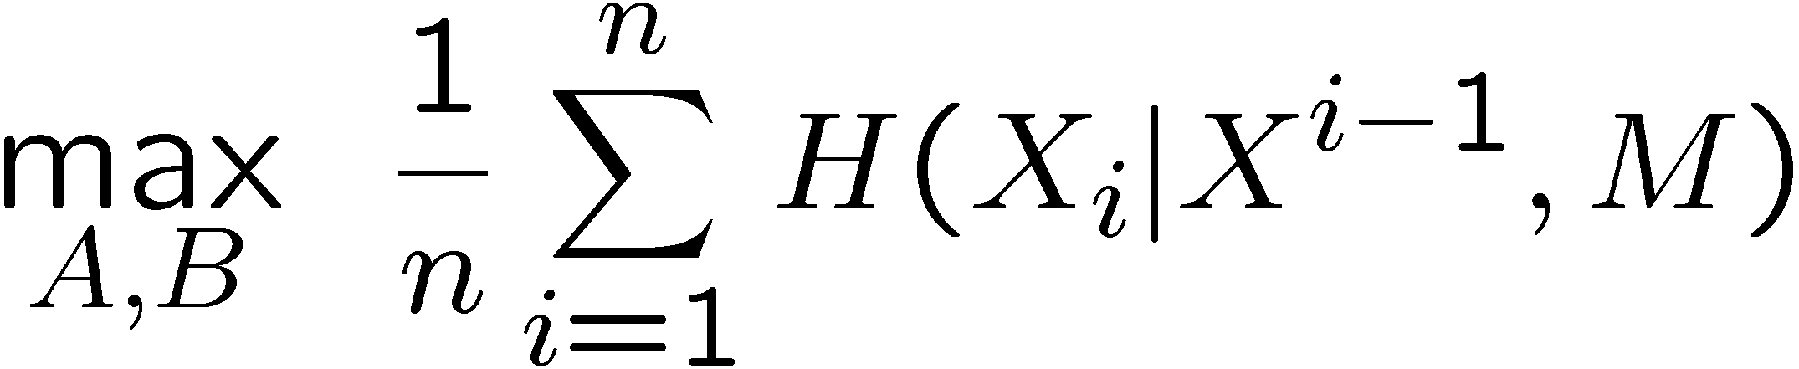
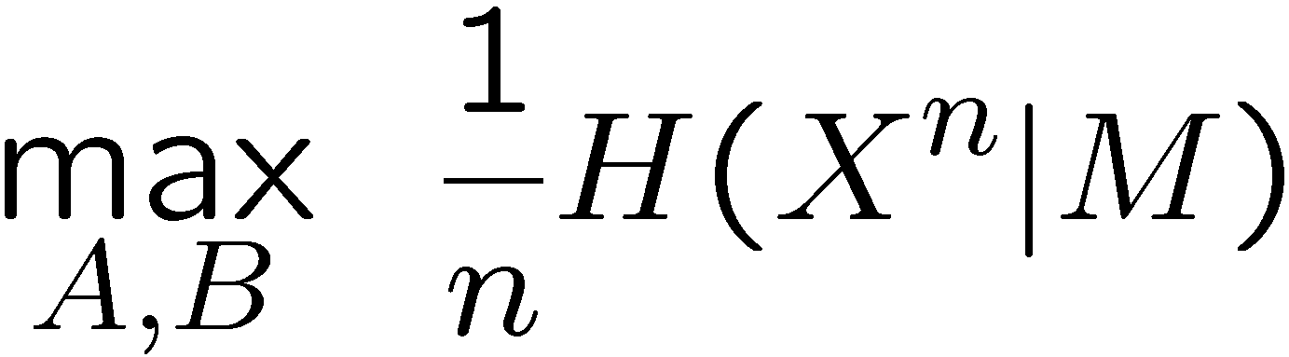

Log-loss $π_{1}$ (case 1)

Slide 19
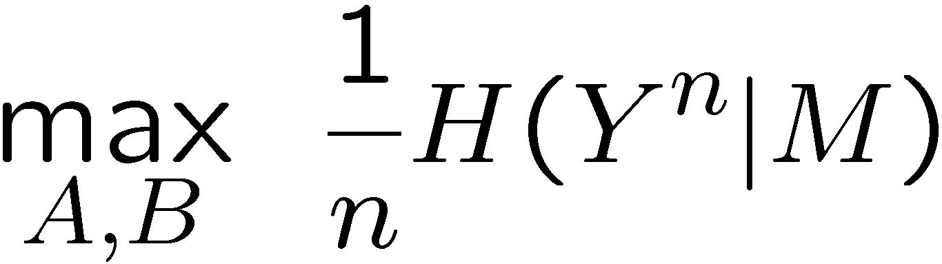

Log-loss $π_{2}$ (case 2)

Slide 20
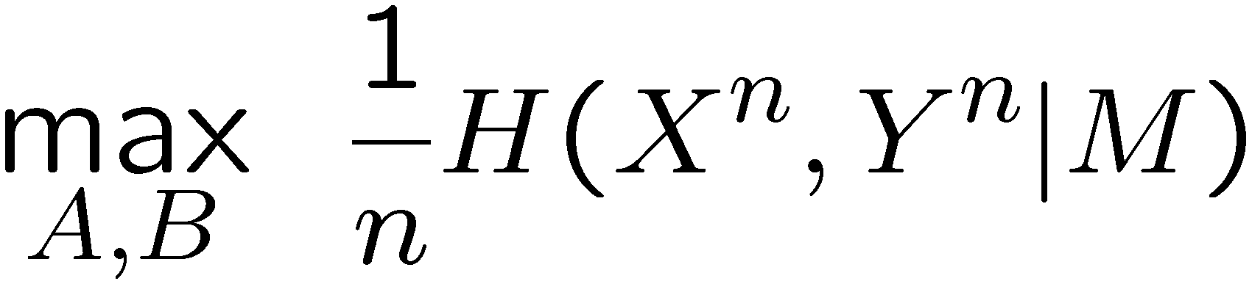

Log-loss $π_{3}$ (case 3)

Slide 21
Result 1 from Secrecy R-D Theory

Slide 22
Result 2 from Secrecy R-D Theory

Slide 23
Result 3 from Secrecy R-D Theory

Slide 24
Equivocation is a blunt special case
General optimal secrecy performance requires a specific encoding scheme.
These equivocation bounds can be achieved with:
Random binning
Time-sharing
Almost any reasonable method

Slide 25
Summary
Equivocation in secrecy is in general a special case of rate-distortion theory for secrecy systems with causal disclosure.
The equivocation special case does not shed light on good coding structures in general.

