Slide 1
The Source Coding Side of Secrecy
Paul Cuff
TexPoint fonts used in EMF.
Read the TexPoint manual before you delete this box.: AA

Slide 2
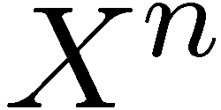
Game Theoretic Secrecy
Motivating Problem
Mixed Strategy
  Non-deterministic
Requires random
  decoder
  Dual to wiretap channel
Player 1
Communication
leakage
Encoder
Zero-sum
Repeated
Game
State
Eavesdropping
Player 2
Notes:
This talk focusses on a proof technique instead of a particular problem. There are actually a number of specific questions to ask about this type of setting: how would one best use secret key or a noisy broadcast channel?, Suppose player two has different quality of leaked information, etc. This talk is called the “source coding” side of secrecy because even without brining noisy channels into the picture, the problems generally call for an encoder/decoder pair that has much different characteristics than those used in standard information theory problems.

Slide 3
Main Topics of this Talk
Achievability Proof Techniques:
  Pose problems in terms of existence of joint distributions
  Relax Requirements to “close in total variation”
  Main Tool --- Reverse Channel Encoder
  Easy Analysis of Optimal Adversary

Slide 4
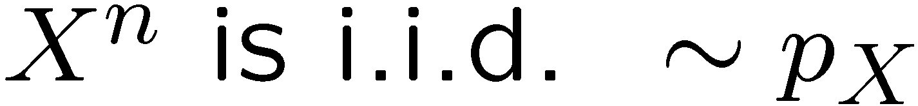
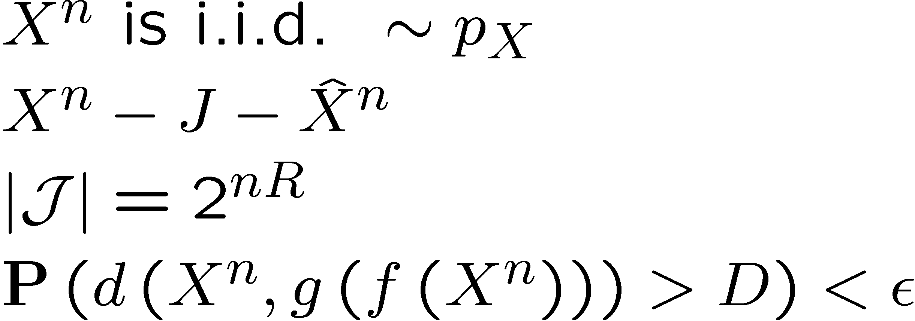
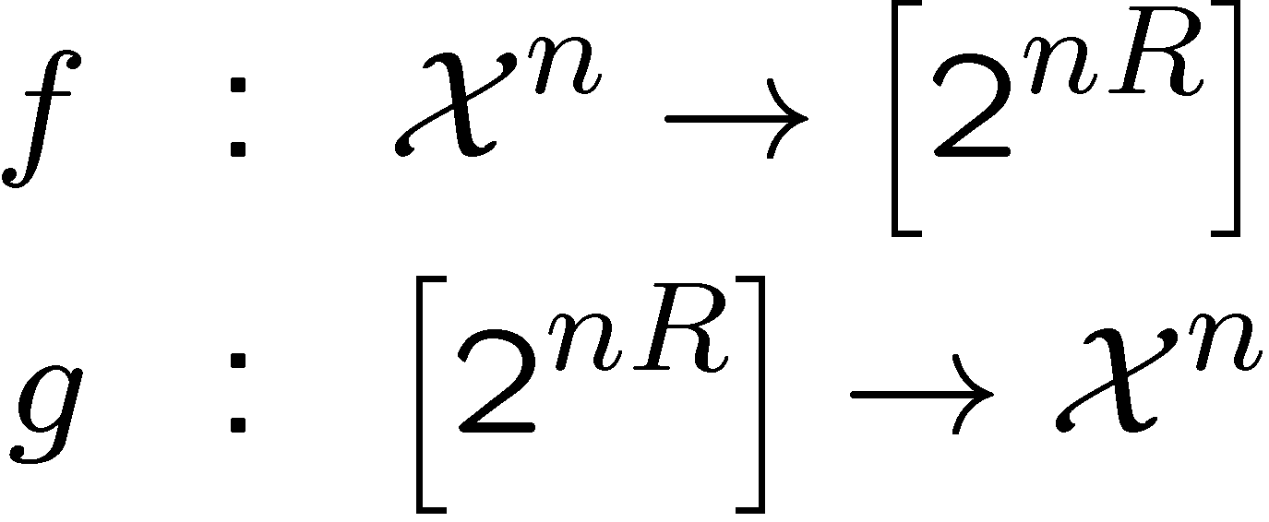
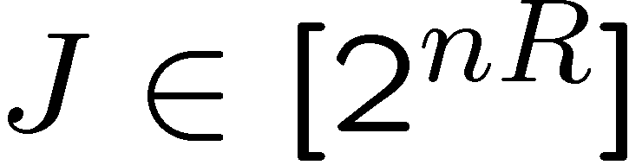
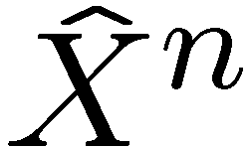
Restate Problem---Example 1 (RD Theory)
Standard
Existence of Distributions
Can we design:
such that
Does there exists a distribution:
f
g

Slide 5
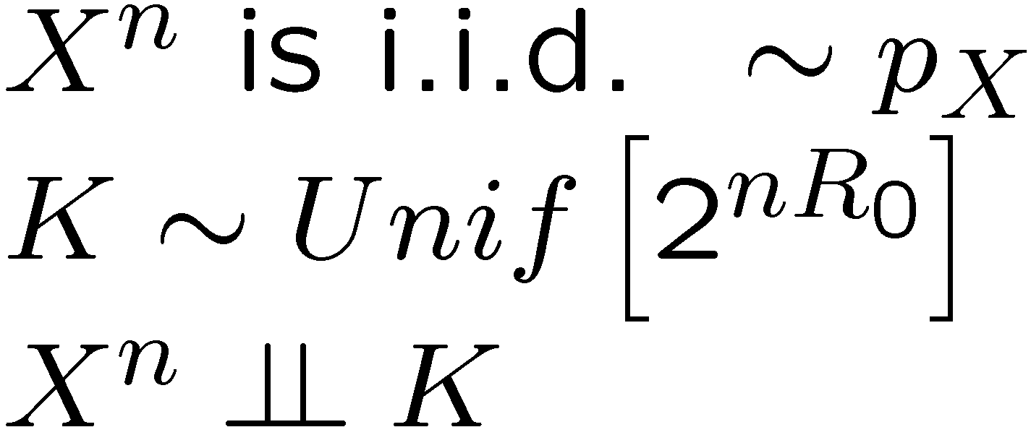
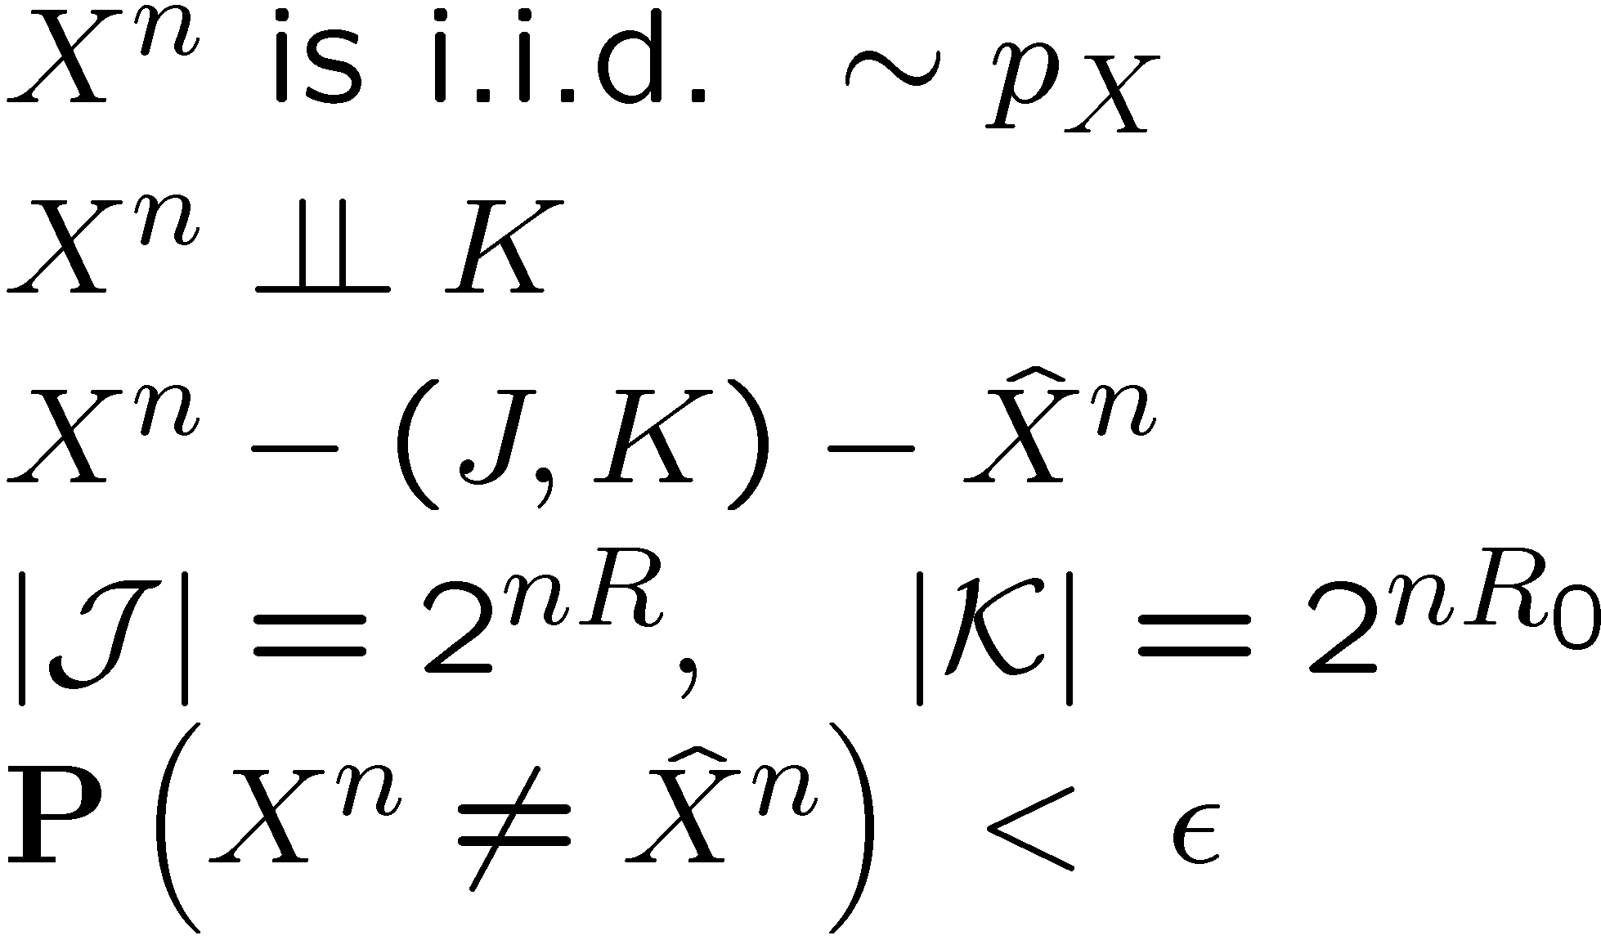
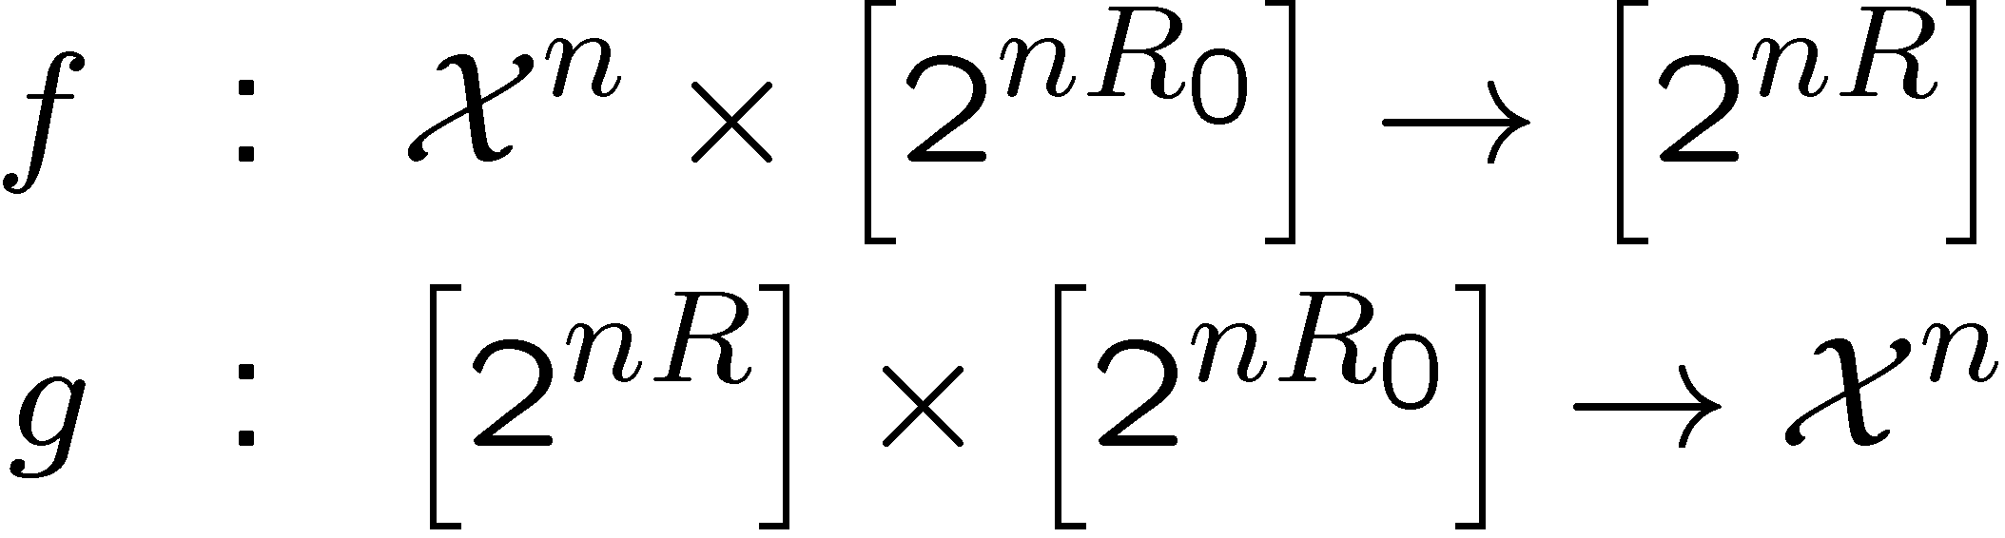
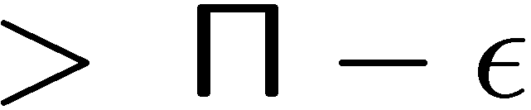
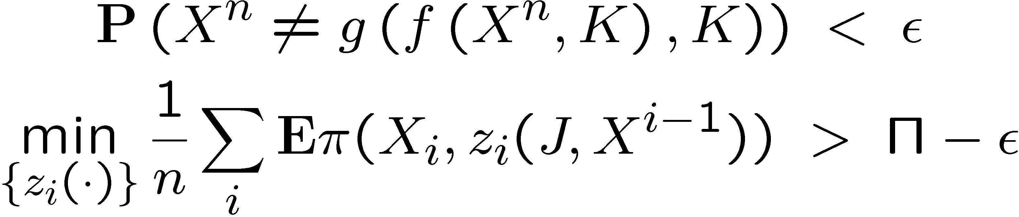

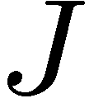
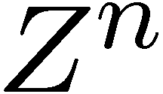
Restate Problem---Example 2 (Secrecy)
Standard
Existence of Distributions
Can we design:
such that
Does there exists a distribution:
Score
f
g
Eve
[Cuff 10]

Slide 6
Tricks with Total Variation
Technique
  Find a distribution p₁ that is easy to analyze and satisfies the relaxed constraints.
  Construct p₂ to satisfy the hard constraints while maintaining small total variation distance to p₁.
How?
Property 1:

Slide 7
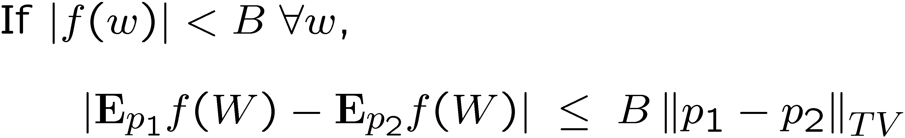
Tricks with Total Variation
Technique
  Find a distribution p₁ that is easy to analyze and satisfies the relaxed constraints.
  Construct p₂ to satisfy the hard constraints while maintaining small total variation distance to p₁.
Why?
Property 2 (bounded functions):

Slide 8
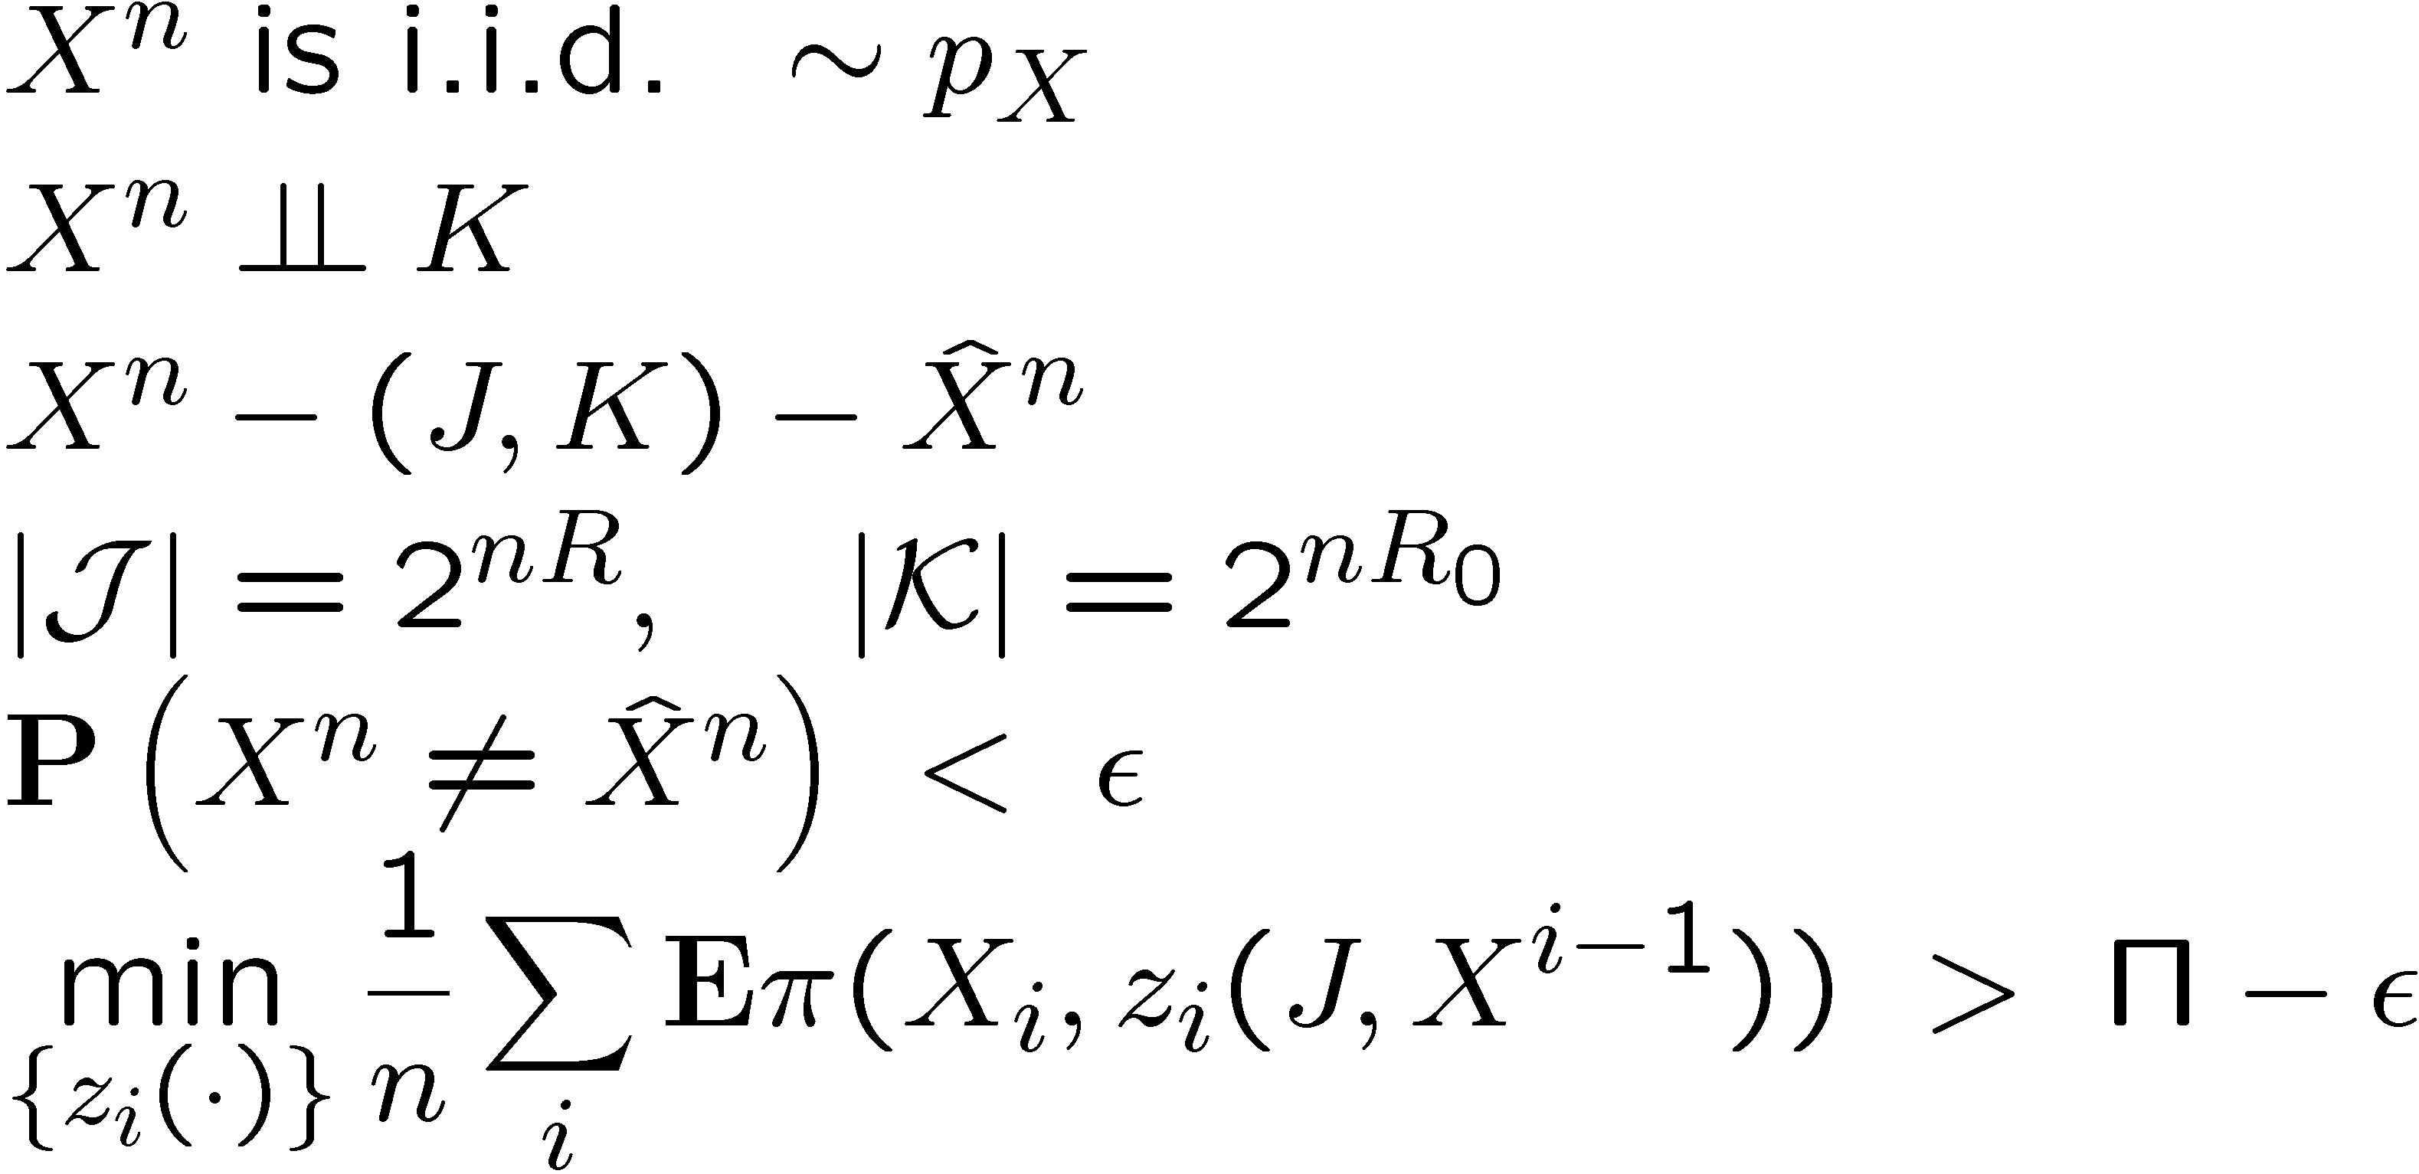
Summary
Achievability Proof Techniques:
  Pose problems in terms of existence of joint distributions
  Relax Requirements to “close in total variation”
  Main Tool --- Reverse Channel Encoder
  Easy Analysis of Optimal Adversary
Secrecy Example: For arbitrary ², does there exist a distribution satisfying:

Slide 9
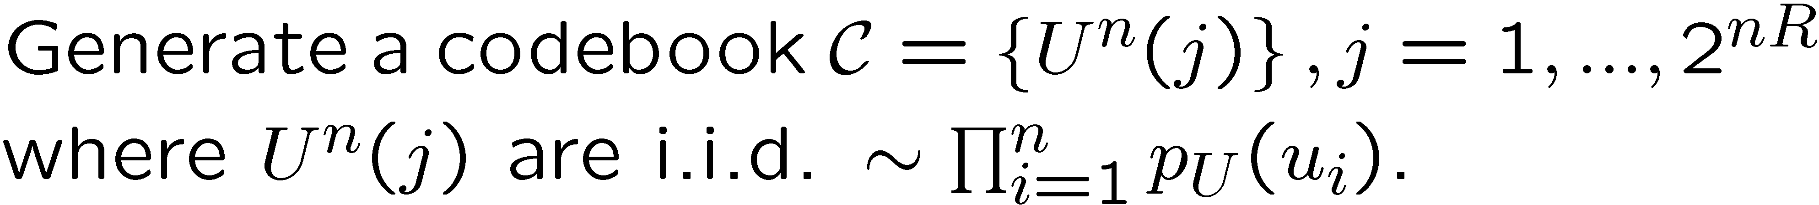
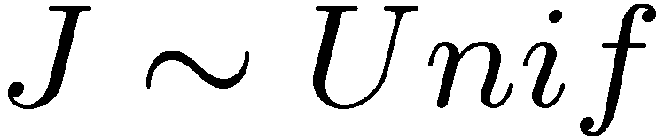
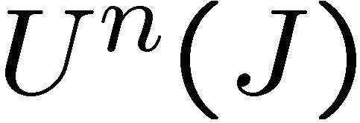

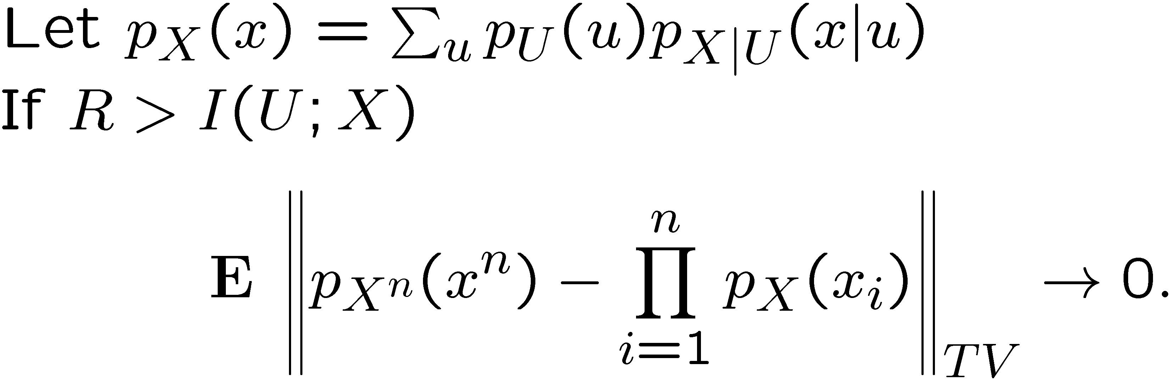
Cloud Overlap Lemma
Previous Encounters
  Wyner, 75 --- used divergence
  Han-Verdú, 93 --- general channels, used total variation
  Cuff 08, 09, 10, 11 --- provide simple proof and utilize for secrecy encoding
Memoryless Channel
P_{X|U}(x|u)

Slide 10
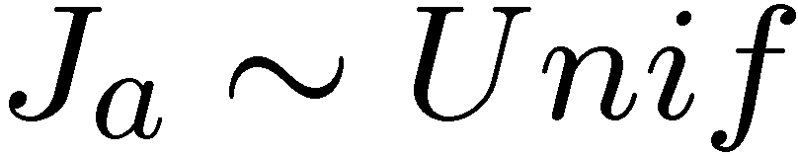
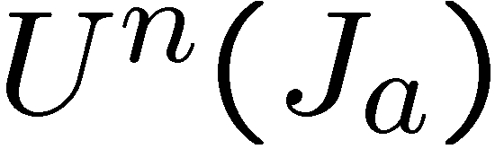
Reverse Channel Encoder
For simplicity, ignore the key K, and consider J_{a} to be the part of the message that the adversary obtains. (i.e. J = (J_{a}, J_{s}), and ignore J_{s} for now)
Construct a joint distribution between the source X^{n} and the information J_{a} (revealed to the Adversary) using a memoryless channel.
Memoryless Channel
P_{X|U}(x|u)

Slide 11
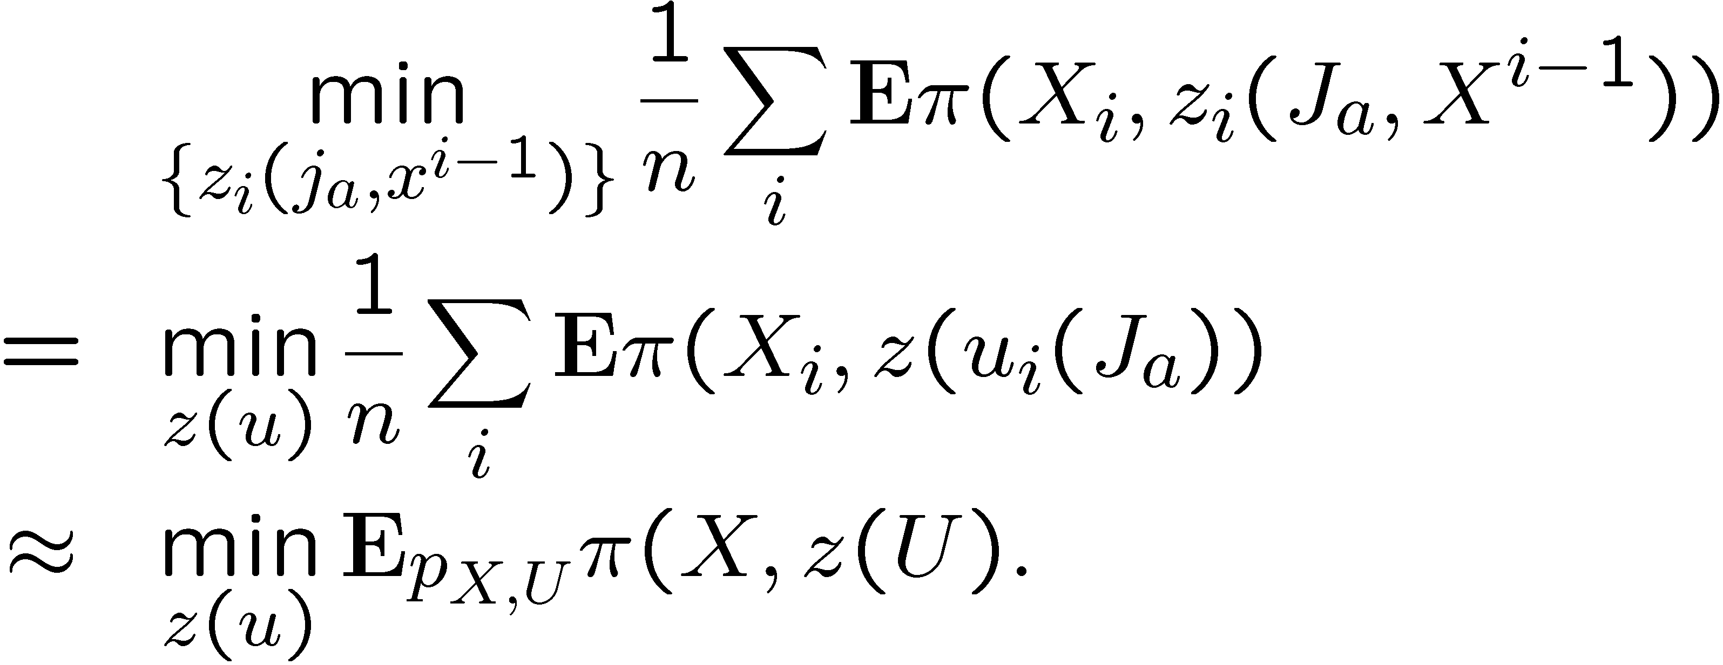
Simple Analysis
This encoder yields a very simple analysis and convenient properties
  If |J_{a}| is large enough, then X^{n} will be nearly i.i.d. in total variation
  Performance:
Memoryless Channel
P_{X|U}(x|u)
Notes:
Notice that this simplifies to a single letter expression.

Slide 12
Summary
Achievability Proof Techniques:
  Pose problems in terms of existence of joint distributions
  Relax Requirements to “close in total variation”
  Main Tool --- Reverse Channel Encoder
  Easy Analysis of Optimal Adversary
Notes:
I’ve outlines tools and techniques for designing optimal encoders for source coding for game theoretic secrecy. The main ideas were to pose the operational question in terms of existence of a joint distribution. Then we show that most hard constraints can be relaxed. This was important for removing the causal nature of the problem statement. Then we constructed a joint distribution using a memoryless channel and the cloud overlap lemma which was very easy to analyze for the worst-case adversary. The resulting “reverse channel encoder” behaves somewhat like a rate-distortion encoder but is random.

