Slide 1

Secure Communication for Distributed Systems
Paul Cuff
Electrical Engineering
Princeton University

Slide 2



Main Idea
Secrecy for distributed systems
Design encryption specifically for a system objective
Distributed System
Action
Message
Node B
Information
Node A
Adversary
Attack
Notes:
Special Cases: rate-distortion theory (no adversary); lossless (Globecom); unlimited secret key; unlimited communication; seperability of nodes B and C.

Slide 3
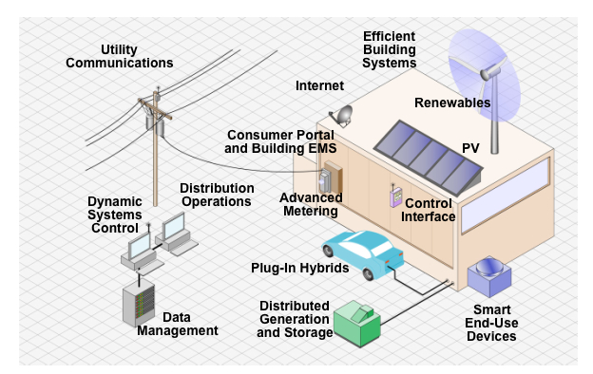
Communication in Distributed Systems
“Smart Grid”
Image from http://www.solarshop.com.au

Slide 4
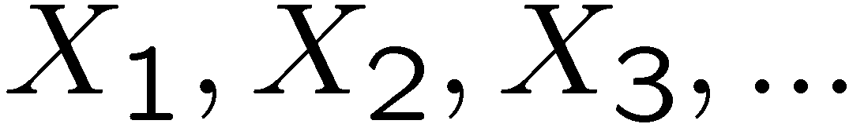
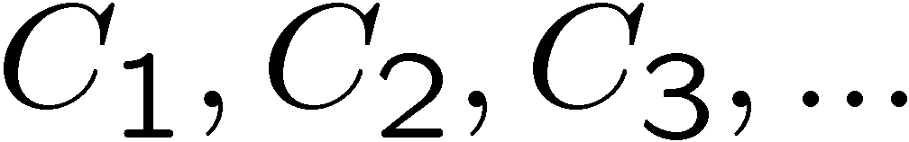
Cipher
Plaintext: Source of information:
Example: English text: Information Theory
Ciphertext: Encrypted sequence:
Example: Non-sense text: cu@sp4isit
Key
Key
Plaintext
Encipherer
Ciphertext
Decipherer
Plaintext

Slide 5
Example: Substitution Cipher
Simple Substitution
Example:
Plaintext: …RANDOMLY GENERATED CODEB…
Ciphertext: …DFLAUIPV WRLRDFNRA SXARQ…
Caesar Cipher
Alphabet | A B C D E …
Mixed Alphabet | F Q S A R …
Alphabet | A B C D E …
Mixed Alphabet | D E F G H …
Notes:
Julius Caesar used this cipher, with a shift of 3. His nephew, Augustus, used a shift of 1.

Slide 6

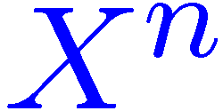
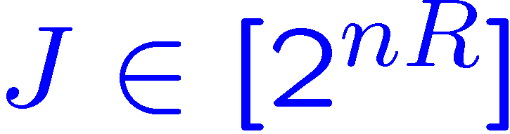
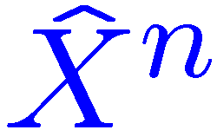
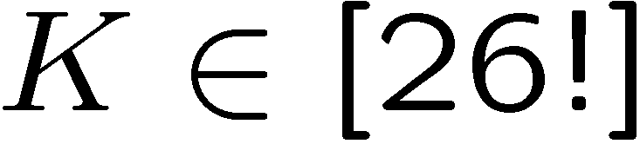
Shannon Model
Schematic
Assumption
Enemy knows everything about the system except the key
Requirement
The decipherer accurately reconstructs the information
Key
Key
Plaintext
Encipherer
Ciphertext
Decipherer
Plaintext
Adversary
For simple substitution:
Notes:
26! Is about 4 x 10^26 (the number of atoms in my chair). 88.4 bits
Redundancy of English is about 3.75 5bits per letter. (without spaces it’s 3.7)
About 25 letters needed to decode

Slide 7
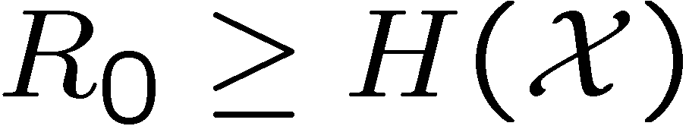
Shannon Analysis
Perfect Secrecy
Adversary learns nothing about the information
Only possible if the key is larger than the information

Slide 8
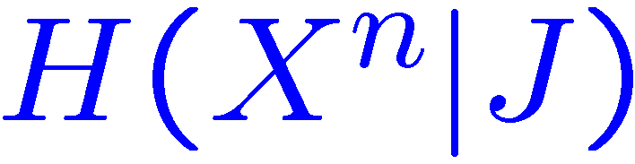

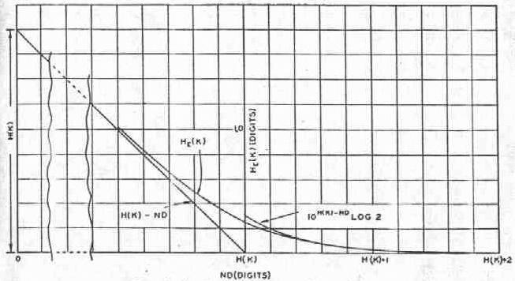
Shannon Analysis
Equivocation vs Redundancy
Equivocation is conditional entropy:
Redundancy is lack of entropy of the source:
Equivocation reduces with redundancy:

Slide 9
Computational Secrecy
Assume limited computation resources
Public Key Encryption
Trapdoor Functions
Difficulty not proven
Often “cat and mouse” game
Vulnerable to quantum computer attack
X
2147483647
1125897758 834 689
524287

Slide 10
Information Theoretic Secrecy
Achieve secrecy from randomness (key or channel), not from computational limit of adversary.
Physical layer secrecy
Wyner’s Wiretap Channel [Wyner 1975]
Partial Secrecy
Typically measured by “equivocation:”
Other approaches:
Error exponent for guessing eavesdropper [Merhav 2003]
Cost inflicted by adversary [this talk]
Notes:
A couple of aspects have been integrated in the study of information theoretic secrecy. One observation is that channel noise can be used, as the key is, to hide the information from an eavesdropper. The other development has been the study of partial secrecy.
Insert a diagram if I have time.

Slide 11
Shannon Analysis
Equivocation vs Redundancy
Equivocation is conditional entropy:
Redundancy is lack of entropy of the source:
Equivocation reduces with redundancy:

Slide 12
Equivocation
Not an operationally defined quantity
Bounds:
List decoding
Additional information needed for decryption
Not concerned with structure

Slide 13
Guessing Eavesdropper
[Merhav 03]:
Prob. of correct guess

Slide 14
Guessing Eavesdropper
[Merhav 03]:
Prob. of correct guess

Slide 15
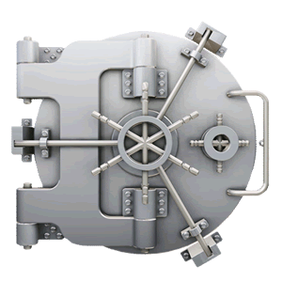


Traditional View of Encryption
Information inside

Slide 16



Proposed View of Encryption
Information obscured
Images from albo.co.uk

Slide 17
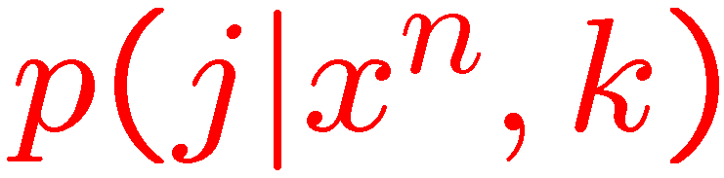
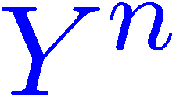

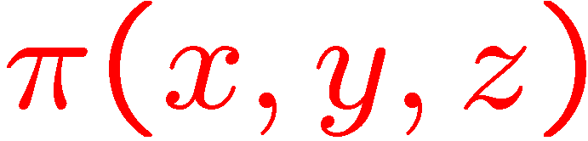
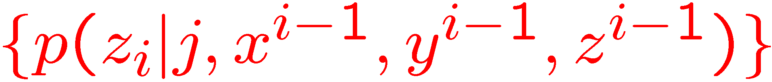
Competitive Distributed System
Decoder:
Encoder:
Key
Information
Node A
Message
Node B
Action
Adversary
Attack
System payoff: .
Adversary:
Notes:
Jam a communication channel; break into a network, counter a military attack; overload a power grid.

Slide 18
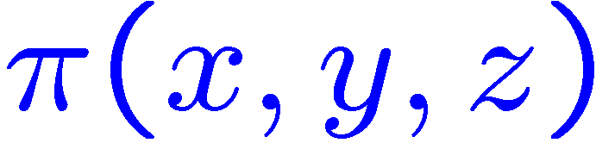
Zero-Sum Game
Value obtained by system:
Objective
Maximize payoff
Key
Information
Node A
Message
Node B
Action
Adversary
Attack
Notes:
Jam a communication channel; break into a network, counter a military attack; overload a power grid.

Slide 19
Secrecy-Distortion Literature
[Yamamoto 97]:
Cause an eavesdropper to have high reconstruction distortion
Replace payoff (π) with distortion
[Yamamoto 88]:
No secret key
Lossy compression

Slide 20
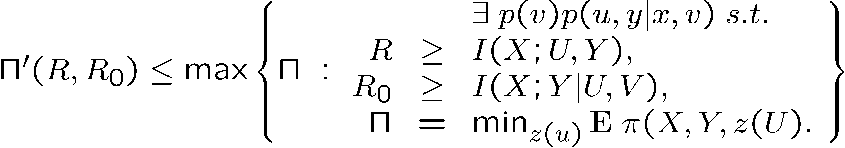
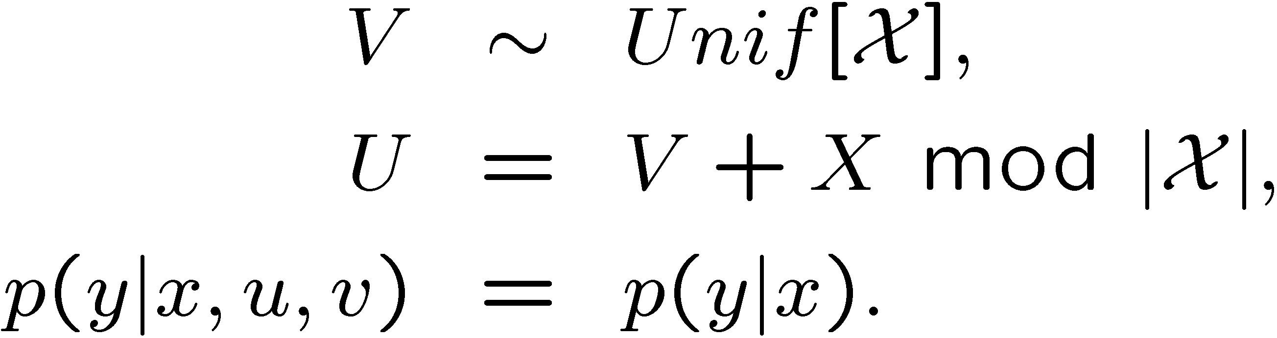
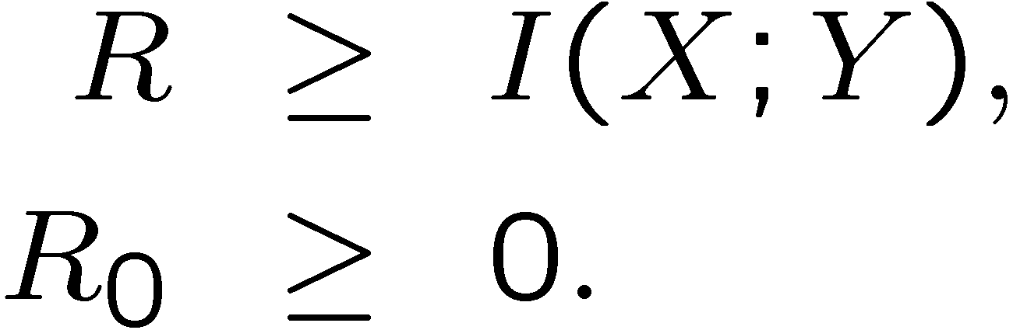
Secrecy-Distortion Literature
[Theorem 3, Yamamoto 97]:
Theorem:
Choose
Yields

Slide 21
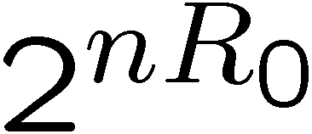
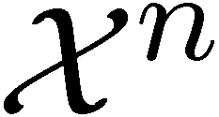
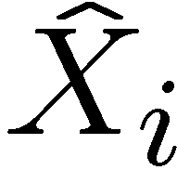
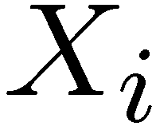
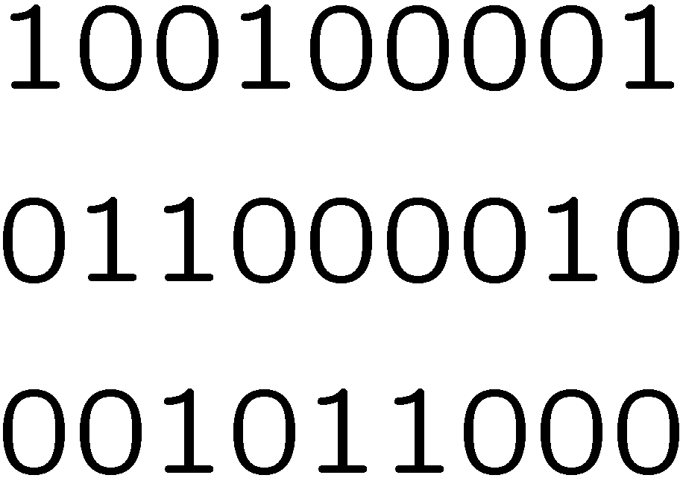
How to Force High Distortion
Randomly assign bins
Size of each bin is
Adversary only knows bin
Reconstruction of only depends on the marginal posterior distribution of
Example:

Slide 22
Theoretical Results
Information Theoretic Rate Regions
Provable Secrecy

Slide 23
Two Categories of Results
Lossless Transmission
General Reward Function
Simplex interpretation
Linear program
Hamming Distortion
Common Information
Secret Key
Notes:
Lossless is a special case of the general setting

Slide 24
Competitive Distributed System
Decoder:
Encoder:
Key
Information
Node A
Message
Node B
Action
Adversary
Attack
System payoff: .
Adversary:
Notes:
Jam a communication channel; break into a network, counter a military attack; overload a power grid.

Slide 25
Zero-Sum Game
Value obtained by system:
Objective
Maximize payoff
Key
Information
Node A
Message
Node B
Action
Adversary
Attack
Notes:
Jam a communication channel; break into a network, counter a military attack; overload a power grid.

Slide 26
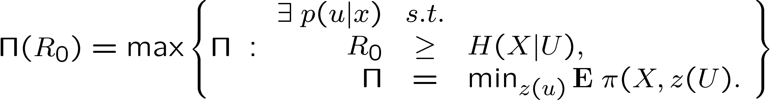
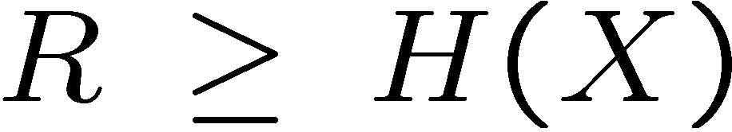
Lossless Case
Require Y=X
Assume a payoff function
Related to Yamamoto’s work [97]
Difference: Adversary is more capable with more information
Theorem:
[Cuff 10]
Also required:

Slide 27
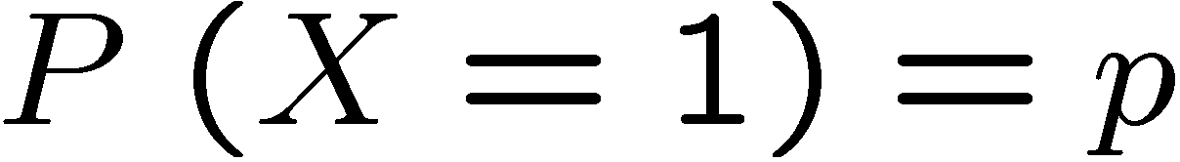



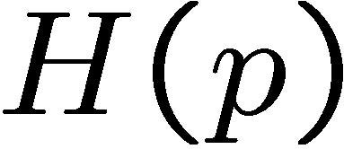
Binary-Hamming Case
Binary Source:
Hamming Distortion
Naïve approach
Random hashing or time-sharing
Optimal approach
Reveal excess 0’s or 1’s to condition the hidden bits
(black line)
(orange line)
Source
0 | 1 | 0 | 0 | 1 | 0 | 0 | 0 | 0 | 1
* | * | 0 | 0 | * | * | 0 | * | 0 | *
Public message

Slide 28
Linear Program on the Simplex

Slide 29
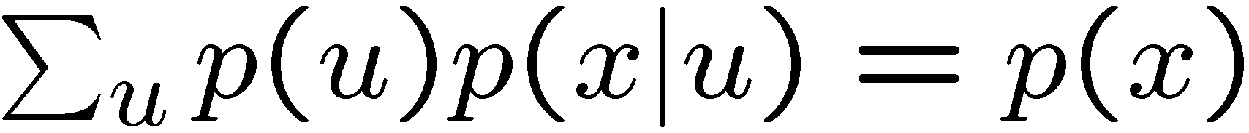
Linear Program on the Simplex
Constraint:
Minimize:
Maximize:
U will only have mass at a small subset of points (extreme points)

Slide 30
Hamming Distortion – Low Key Rate
Arbitrary i.i.d. source (on finite alphabet)
Hamming Distortion
Small Key Rate
Confuse with sets of size two
Either reveal X or reveal that X is in {0,1} during each instance
∏ = R0/2

Slide 31
General Payoff Function
Any payoff function π(x,y,z)
Any source distribution (i.i.d.)
No requirement for lossless transmission.
Adversary:

Slide 32
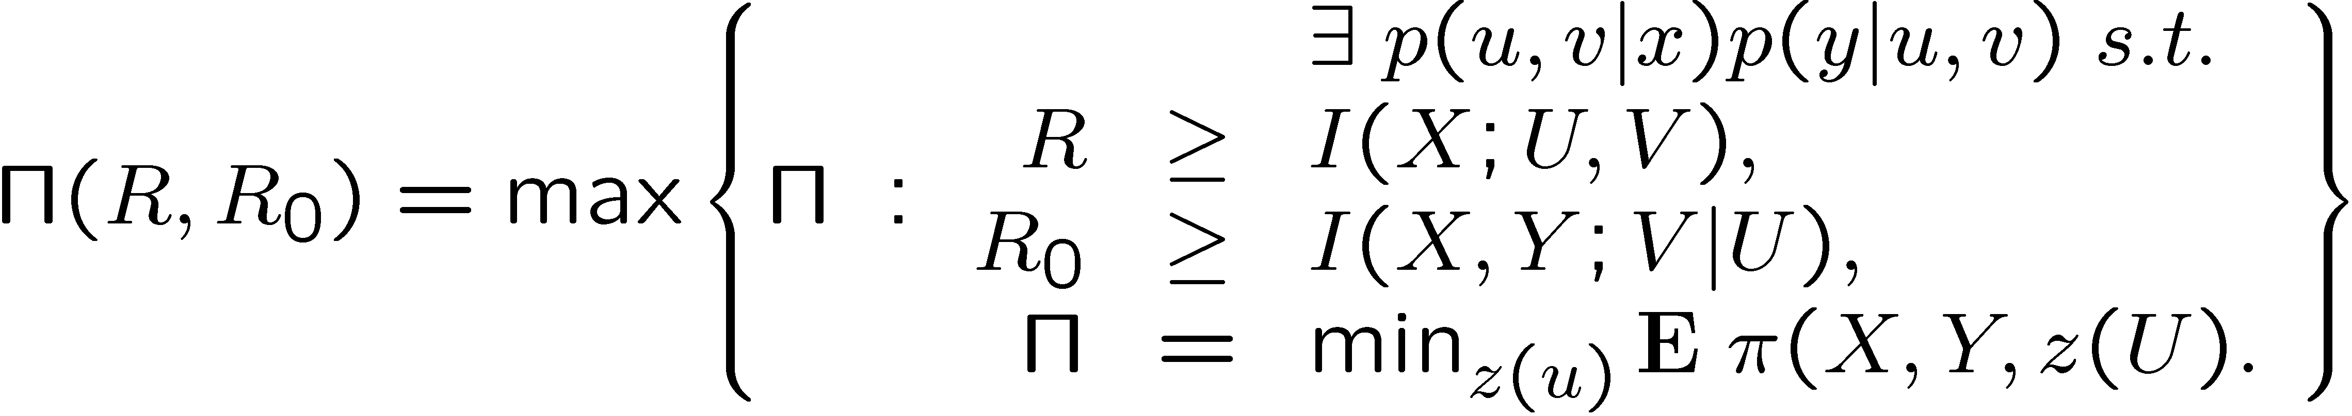
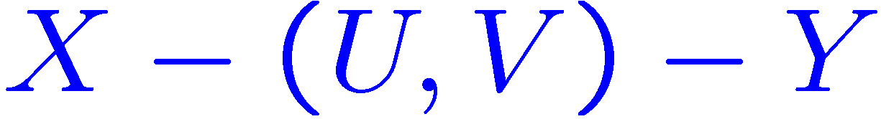
Payoff-Rate Function
Maximum achievable average payoff
Markov relationship:
Theorem:

Slide 33
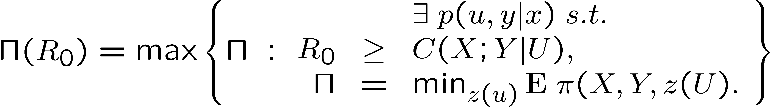

Unlimited Public Communication
Maximum achievable average payoff
Conditional common information:
Theorem (R=∞):

Slide 34
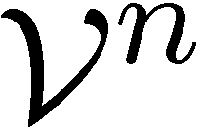
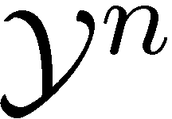
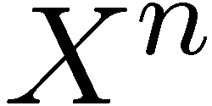
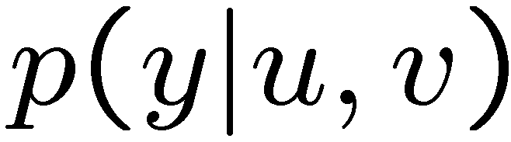
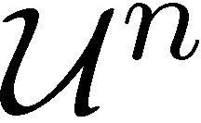
Encoding Scheme
K
Coordination Strategies [Cuff-Permuter-Cover 10]
Empirical coordination for U
Strong coordination for Y

Slide 35
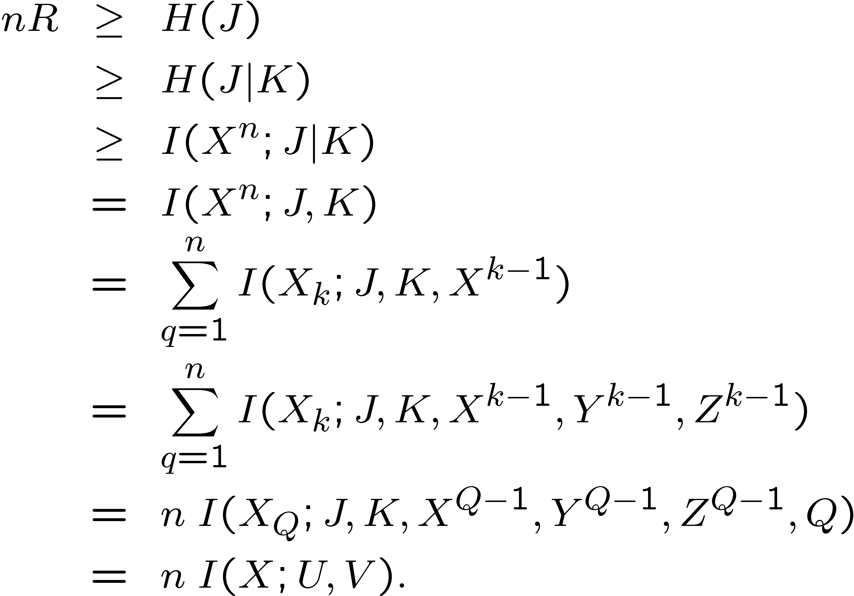
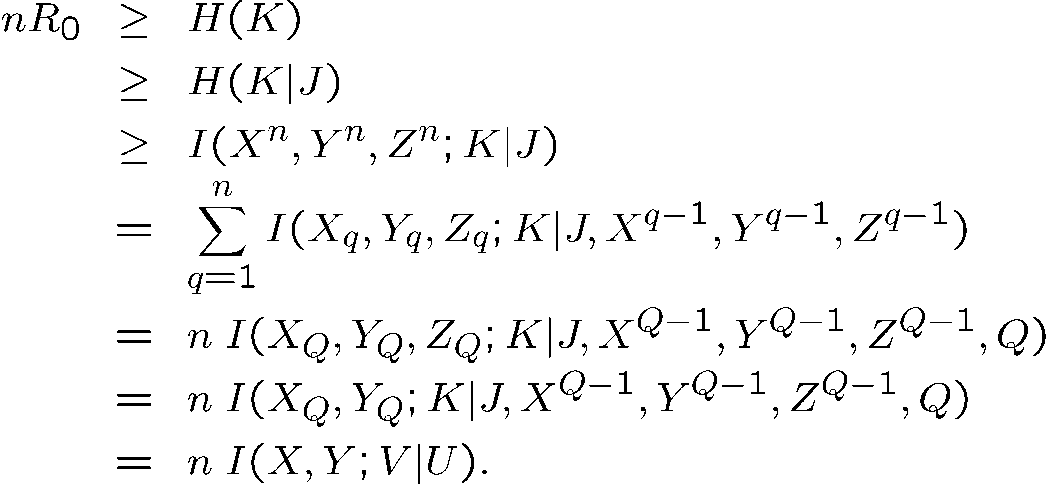
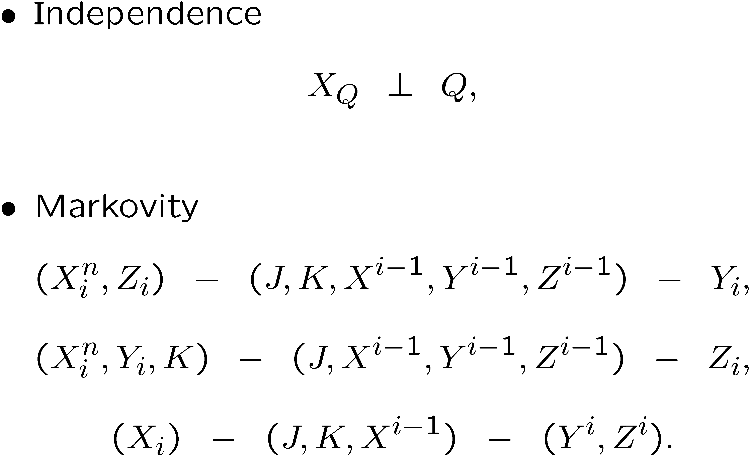
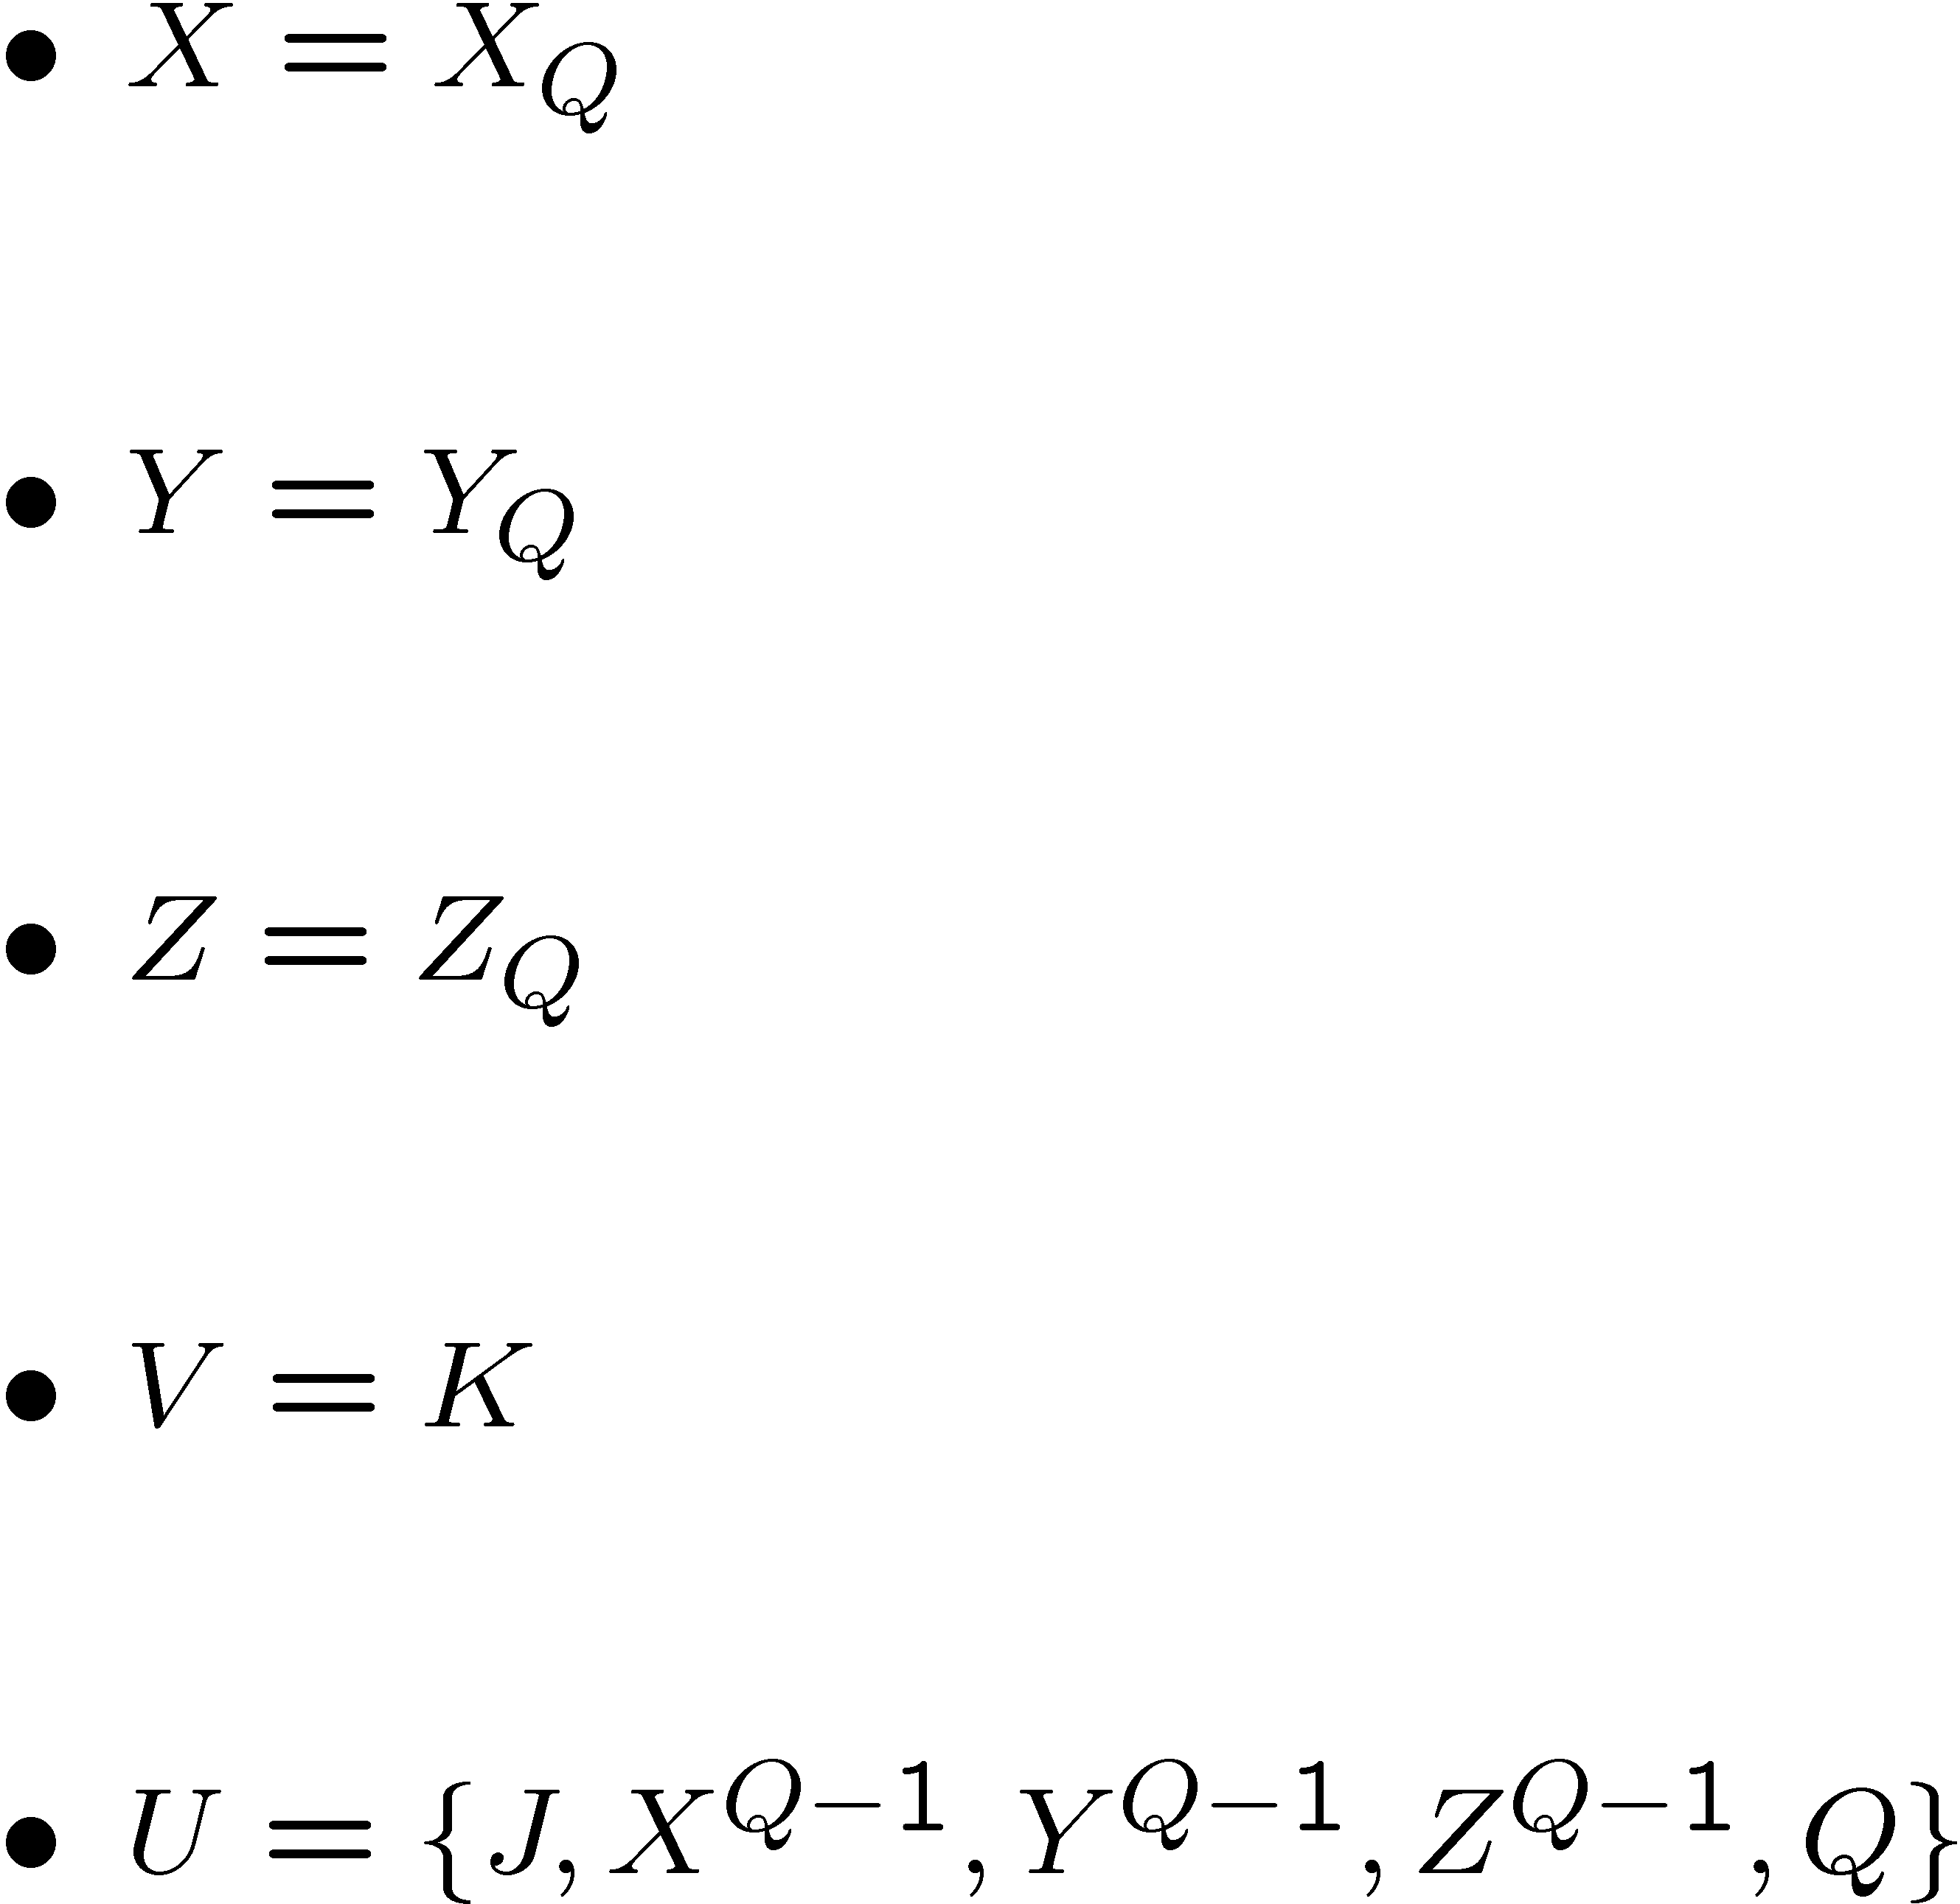
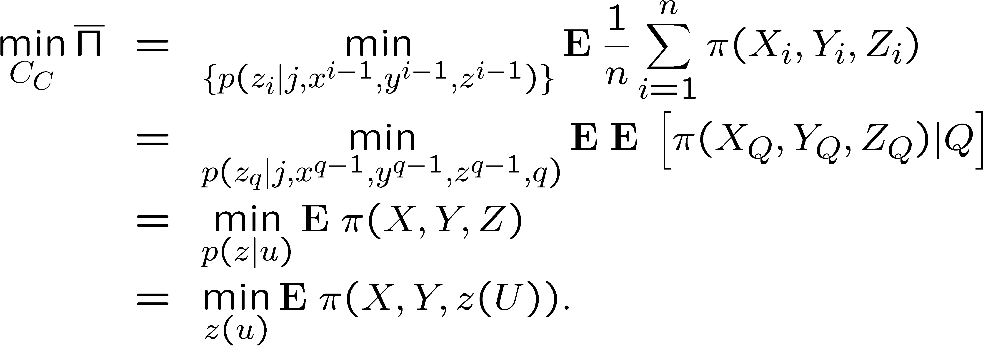
Converse

Slide 36
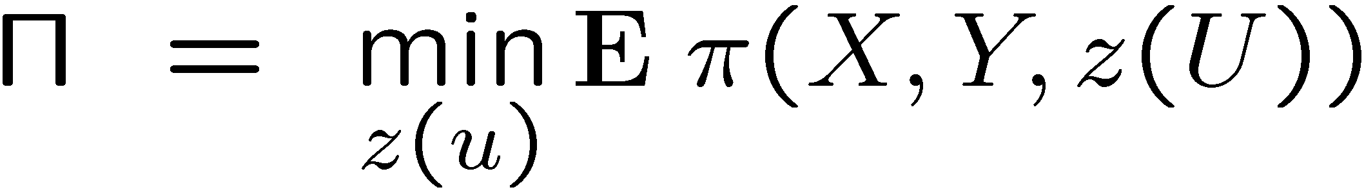
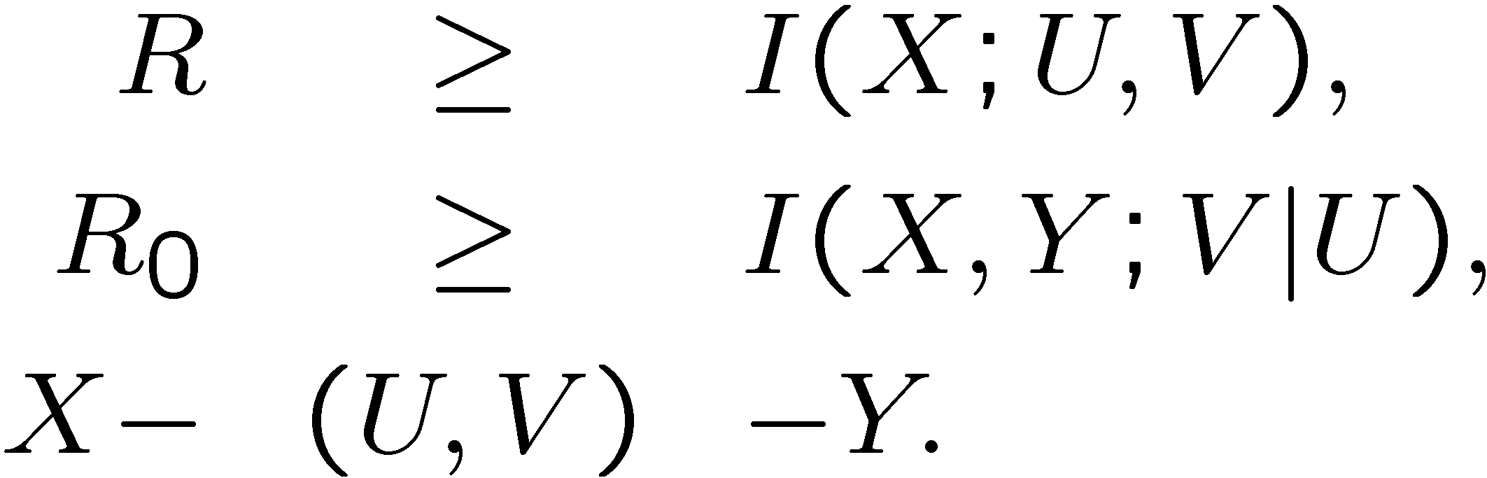
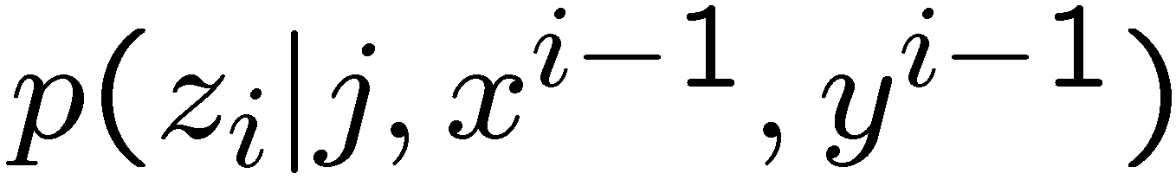
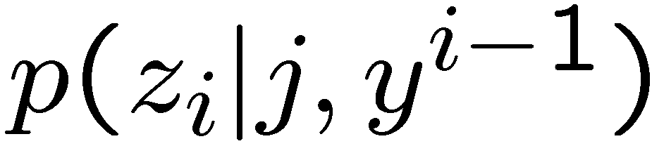
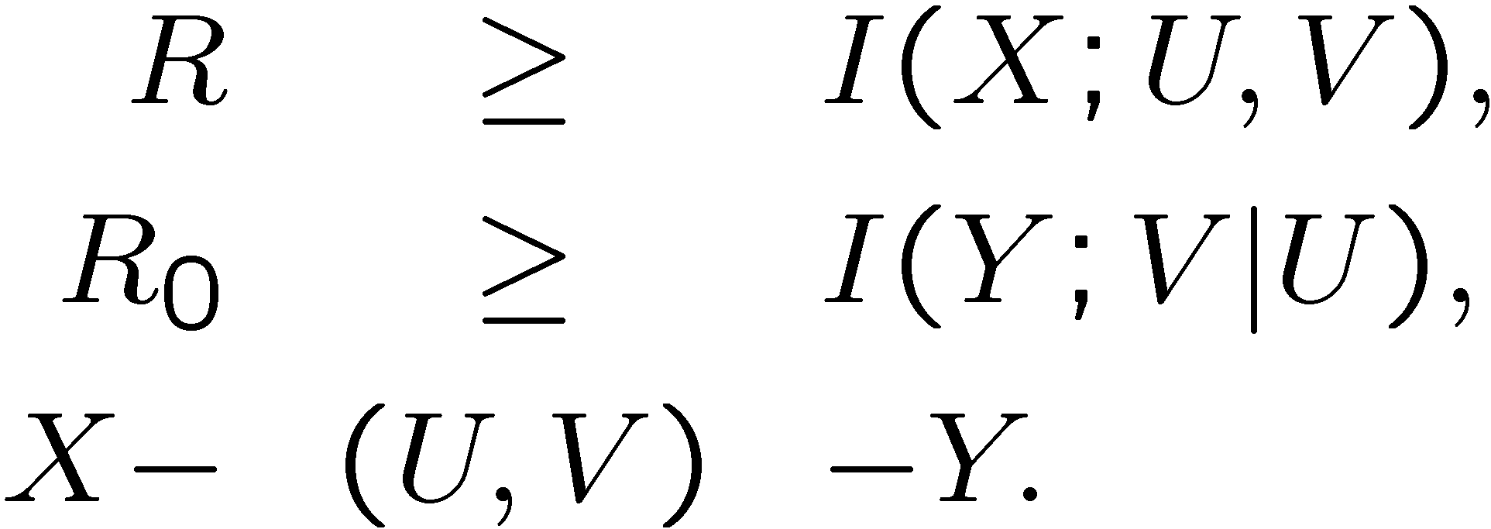
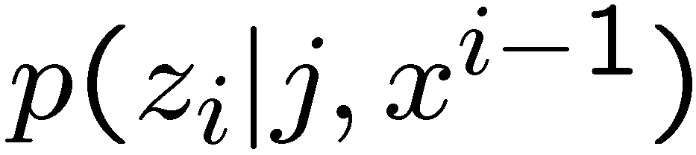
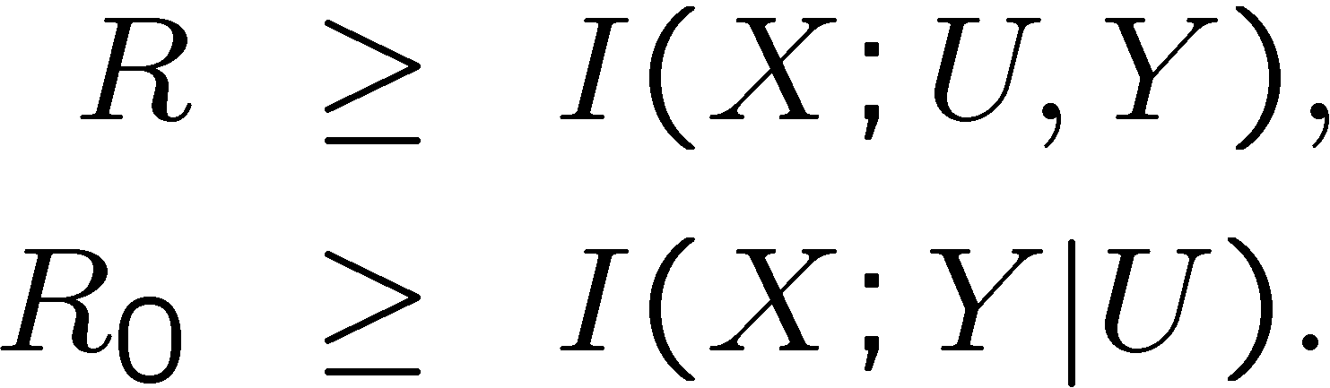
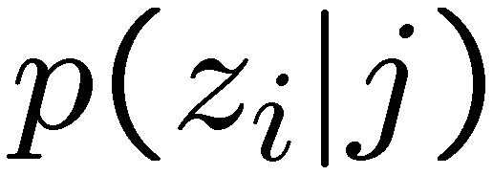


What the Adversary doesn’t know can hurt him.
Knowledge of Adversary:
[Yamamoto 97]
[Yamamoto 88]:

Slide 37
Summary
Framework for Encryption
Average cost inflicted by adversary
Dynamic settings where information is available causally
No use of “equivocation”
Optimal performance uses both “strong” and “empirical” coordination.

