Slide 1
Part 1: Information Theory
Statistics of Sequences
Curt Schieler
Sreechakra Goparaju

Slide 2
Three Sequences
X1 X2 X3 X4 X5 X6 … Xn
Y1 Y2 Y3 Y4 Y5 Y6 … Yn
Z1 Z2 Z3 Z4 Z5 Z6 … Zn
Empirical Distribution
Notes:
A question about statistics of sequences.

Slide 3
Example
1 0 1 1 0 0 0 1
0 1 1 0 1 0 1 1
1 1 0 1 0 0 1 0
000
001
010
011
100
101
110
111

Slide 4
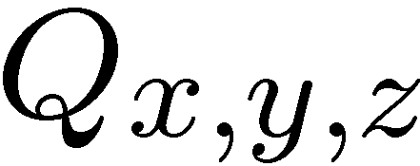
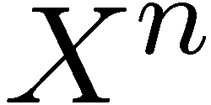
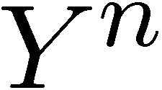
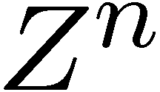
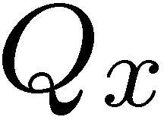
Question
Given , can you construct sequences , , so that the statistics match ?
Constraints:
is an i.i.d. sequence according to
As sequences, - - forms a Markov chain
i.e. Z is conditionally independent of X given the entire sequence
Notes:
Q might not have a Markov structure. We see that this is possible, even in a simple example. Let Q be the uniform distribution on permutations of (1,2,3). This does not have a Markov structure. But it is achievable with a simple scheme. Let Y = X+1 (mod 3) and Z = Y+1 (mod 3) on even times. Let Y = X-1 (mod 3) and Z = Y-1 (mod 3) on odd times.

Slide 5
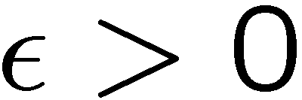
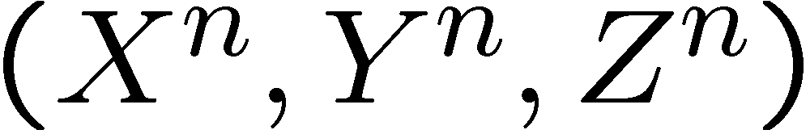
When is Close Close Enough?
For any , choose n and design the distribution of so that

Slide 6
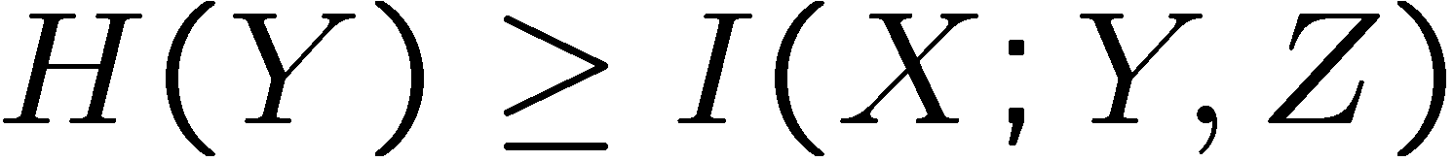
Necessary and Sufficient

Slide 7
Why do we care?
Curiosity---When do first order statics imply that things are actually correlated?
This is equivalent to a source coding question about embedding information in signals.
Digital Watermarking; Steganography
Imagine a black and white printer that inserts extra information so that when it is scanned, color can be added.
Frequency hopping while avoiding interference
Notes:
How much distortion must be incurred to allow coordination.

Slide 8
Yuri and Zeus Game
Yuri and Zeus want to cooperatively score points by both correctly guessing a sequence of random binary numbers (one point if they both guess correctly).
Yuri gets entire sequence ahead of time
Zeus only sees that past binary numbers and guesses of Yuri.
What is the optimal score in the game?
Notes:
I used to call this the Alice and Bob game, but I used different lets here, and besides, Alice and Bob are used for cryptography.
Let them think for a while about this question.

Slide 9
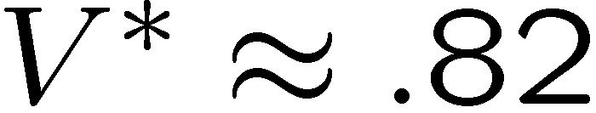
Yuri and Zeus Game (answer)
Online Matching Pennies
[Gossner, Hernandez, Neyman, 2003]
“Online Communication”
Solution
Notes:
This is a variation of the first-order statistics question

Slide 10
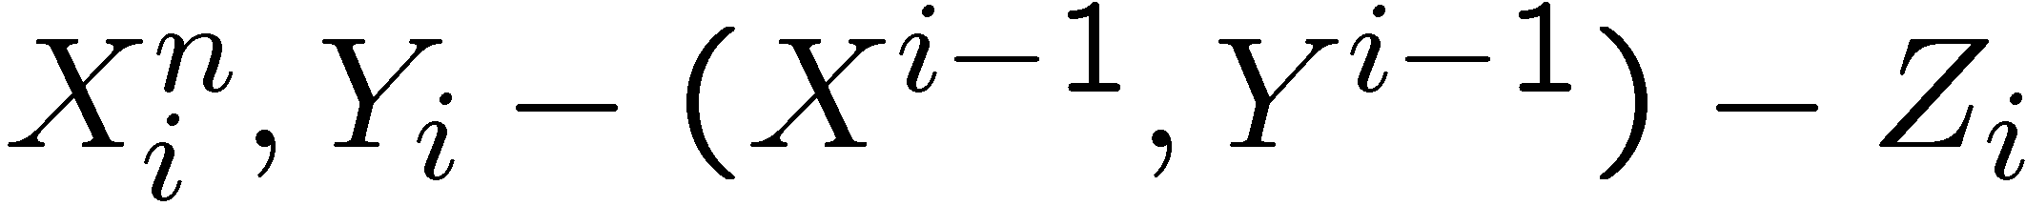
Yuri and Zeus Game (connection)
Score in Yuri and Zeus Game is a first-order statistic
Markov structure is different:
First Surprise: Zeus doesn’t need to see the past of the sequence.

Slide 11
General (causal) solution
Achievable empirical distributions
(Z depends on past of Y)
Notes:
For the Yanis and Zeus game, you let X be Bernoulli half and find the distribution that satisfied the above inequality and has the highest probability of X=Y=Z. You get the answer from the previous page.

Slide 12
Part 2: Aggregating Information
Ranking/Voting
Effect of Message Passing in Networks

Slide 13
Mutual information scheduling for ranking algorithms
Students:
Nevin Raj
Hamza Aftab
Shang Shang
Mark Wang
Faculty:
Sanjeev Kulkarni
Adam Finkelstein

Slide 14
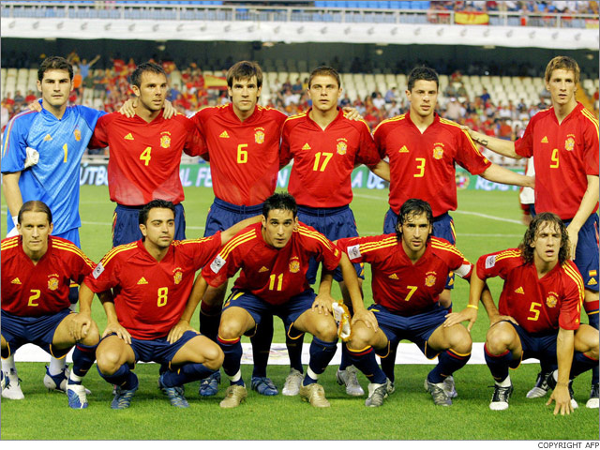




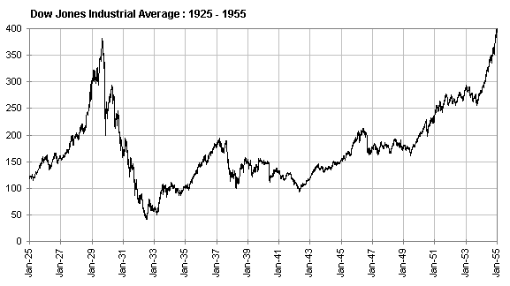
Applications and Motivation
http://www.disneydreaming.com/wp-content/uploads/2010/01/Netflix.jpg
http://www.google.com/
http://www.soccerstat.net/worldcup/images/squads/Spain.jpg
http://www.sscnet.ucla.edu/history/hunt/classes/1c/images/1929%20chart.gif
http://recessinreallife.files.wordpress.com/2009/03/billboard1.jpg
http://www.freewebs.com/get-yo-info/halo2.jpg
Notes:
This particular project looked at ranking based on paired comparisons. The innovation wasn’t the method of ranking (Bradley-Terry model). The innovation was the method of scheduling new comparisons.

Slide 15
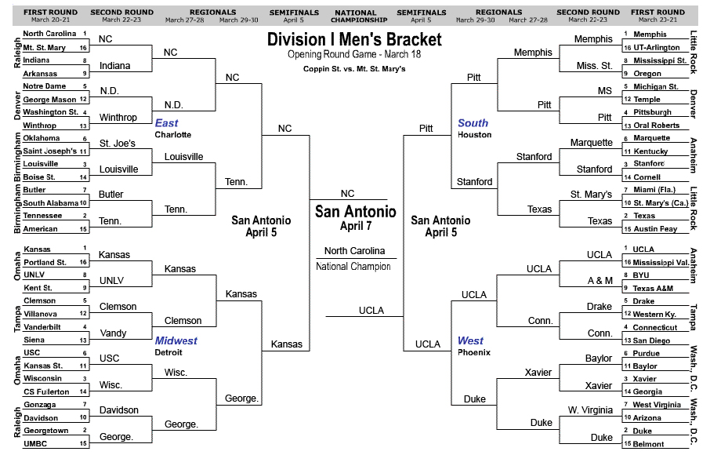
Background
What is ranking?
Challenges:
Data collection
Modeling
Approach:
Scheduling
http://blogs.suntimes.com/sweet/BarackNCAABracket.jpg

Slide 16
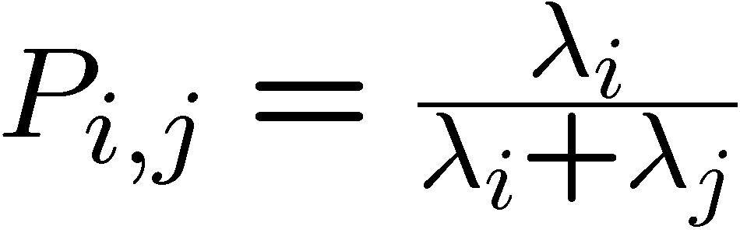
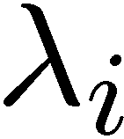
Ranking Based on Pair-wise Comparisons
Bradley Terry Model:
Examples:
A hockey team scores Poisson- goals in a game
Two cities compete to have the tallest person
is the population

Slide 17
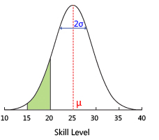
Actual Model Used
Performance is normally distributed around skill level
Linear Model
2. Use ML to estimate parameters
http://research.microsoft.com/en-us/projects/trueskill/skilldia.jpg

Slide 18
Visualizing the Algorithm
Outcomes
Player | A | B | C | D
A | 0 | 2 | 3 | 3
B | 0 | 0 | 7 | 2
C | 0 | 2 | 0 | 5
D | 1 | 2 | 2 | 0
Scheduling
Player | A | B | C | D
A | 0 | 0.031 | 0.025 | 0.024
B | 0.031 | 0 | 0.023 | 0.033
C | 0.025 | 0.023 | 0 | 0.030
D | 0.024 | 0.033 | 0.030 | 0
A
B
?
C
D

Slide 19
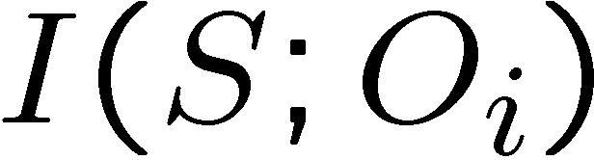
Innovation
Schedule each match to maximize
Greedy
Flexible
S is any parameter of interest
(skill levels; best candidate; etc.)
Notes:
A good idea is to choose the match you are most uncertain about. This is the same as MI in some models. However, MI takes into account other factors (measures how much uncertainty will be reduced).

Slide 20
Numerical Techniques
Calculate mutual information
Importance sampling
Convex Optimization (tracking of ML estimate)

Slide 21
Results
(for a 10 player tournament and100 experiments)

Slide 22
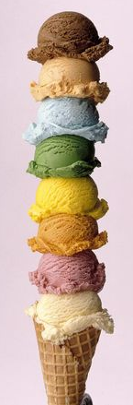
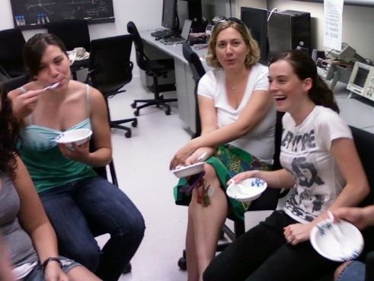
Case Study: Ice Cream
The Problem: 5 flavors of ice cream, but we can only order 3
The Approach:
Survey with all possible paired comparisons
The Answer:
Cookies and cream, vanilla, and mint chocolate chip!
The Significance:
Partial information to obtain true preferences
http://www.rainbowskill.com/canteen/ice-cream-art.php

Slide 23
Grade Inflation
We would like a simple comparison of student performance (currently GPA)
Employers want this
Grad schools want this
We base awards off this

Slide 24


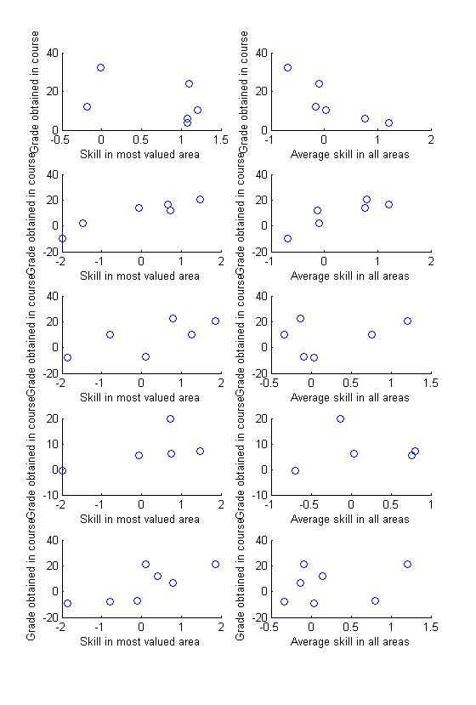
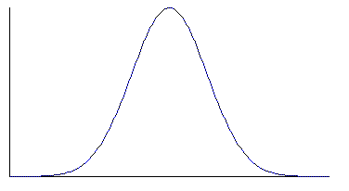

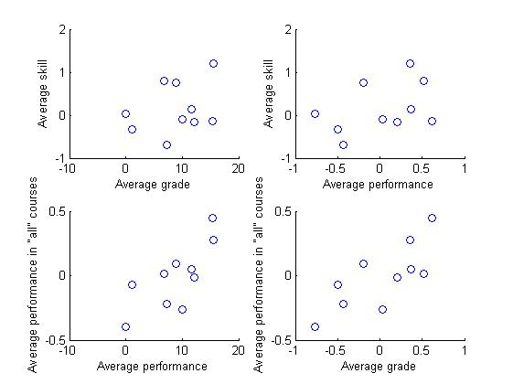
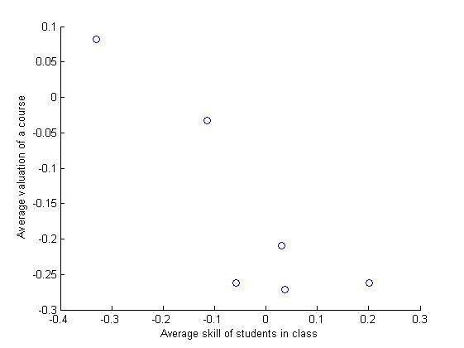
Predicting Performance from Past Grades
Hamza Aftab
Prof. Paul Cuff
Background
Algorithm
Conclusions
Traditional method of obtaining aggregate information from student grades (e.g GPA) has its limitations, such as rigid assumption of how better an ‘A’ is than ‘B’ and not allowing for the observable fact that a student might consistently outperform another in some courses and the other might outperform in certain others (regardless of GPA). We looked for ways to derive information about the student’s range of skills, a course’s “inflatedness” and its ability to accurately predict performance without making too many assumptions.
1)
Grades Performance
2)
Matrix Completion
3) SVD x
Noise breakdown : Noise ~ N (0 , σ_{student} + σ_{course})
- A better way of predicting grades?
What does “inflation” mean now?
Better students = Harder class ?
A |  | A- | B
 | B+ |  | B
A- |  | C-
 | B |  | A-
0.67 |  | 0.67 | -0.43
 | 0.67 |  | -0.43
-0.67 |  | -0.67
 | -0.67 |  | 0.97
RMS=22
RMS=12
We compare the ability of average skill of students and their skill in the area most valued by the course in predicting who will perform better. Since the latter performs better, we have a better and a course specific way of predicting performance, which we could not in a GPA like system.
0.67 |  | 0.67 | 0.43
 | 0.67 |  | 0.43
-0.67 |  | -0.67
 | -0.67 |  | 0.97
0.67 | -0.13 | 0.67 | -0.43
-0.28 | 0.67 | -0.28 | -0.43
-0.67 | 0.21 | -0.67 | 0.35
-0.34 | -0.67 | -0.34 | 0.97
RMS=8
RMS=13
A New Model
RMS=20
RMS=27
Performance = x +
Student’s skill Course’s valuation Noise
C
B
B+
A
-1.28 | 0.05
0.47 | -1.29
1.18 | -0.46
0.85 | 1.44
-0.52 | 0.13
0.06 | -0.50
-0.52 | 0.13
0.35 | 0.46
T
0.67 | -0.13 | 0.67 | -0.43
-0.28 | 0.67 | -0.28 | -0.43
-0.67 | 0.21 | -0.67 | 0.35
-0.34 | -0.67 | -0.34 | 0.97
RMS=12
RMS=15
Students’ skills
Courses’ valuation
RMS=20
RMS=31
Performance in Class
0.273
0.383
0.624
0.661
0.686
0.705
0.719
0.78
0.797
0.882
Sample Results
Better the students in a course, the lower its average values. This makes sense since in a more competitive class, a standard student is expected to perform worse relative to other students in class.
RMS=1.7
RMS=1.6
Average performance seems to be a better measure of students’ overall rank than the average of their different skills. This is because not all skills are valued equally overall.
(e.g more humanities classes than math)
RMS=0.5
RMS=0.5

Slide 25
Voting Theory
No universal best way to combine votes
Arrow’s Impossibility Theorem
Condercet Method
If one candidate beats everyone pair-wise, they win.
(Condercet winner)
Can we identify unique properties (robustness, convergence in dynamic models)

Slide 26
Vote Message-Passing
What happens when local information is shared and aggregated?
Example: Voters share their votes with 10 random people and summarize what they have available with a single vote.

Slide 27
Convergence to Good Aggregate

Slide 28
Simulations for random aggregation

