Slide 1

Secure Communication for Signals
Paul Cuff
Electrical Engineering
Princeton University

Slide 2
Information Theory
Channel Coding
Source Coding
Secrecy
Secrecy
Channel
Source

Slide 3



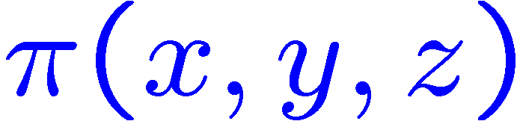
Main Idea
Secrecy for signals in distributed systems
Want low distortion for the receiver and high distortion for the eavesdropper.
More generally, want to maximize a function
Distributed System
Action
Information
Signal
Message
Node B
Node A
Adversary
Attack
Notes:
Special Cases: rate-distortion theory (no adversary); lossless (Globecom); unlimited secret key; unlimited communication; seperability of nodes B and C.

Slide 4
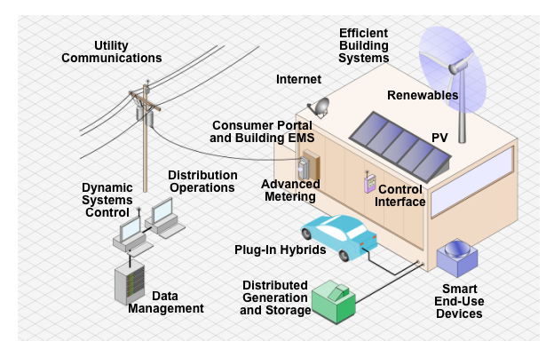
Communication in Distributed Systems
“Smart Grid”
Image from http://www.solarshop.com.au

Slide 5
Example: Rate-Limited Control
Communication
Signal (sensor)
Signal (control)
00101110010010111
Attack Signal
Adversary

Slide 6
Example: Feedback Stabilization
Data-rate Theorem [Baillieul, Brockett , Mitter, Nair, Tatikonda, Wong]
Controller
Dynamic System
Adversary
Sensor
Decoder
Encoder
10010011011010101101010100101101011
Feedback

Slide 7
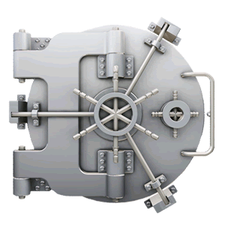


Traditional View of Encryption
Information inside

Slide 8
A Brief History of Crypto
Substitution Cipher to Shannon and Hellman

Slide 9
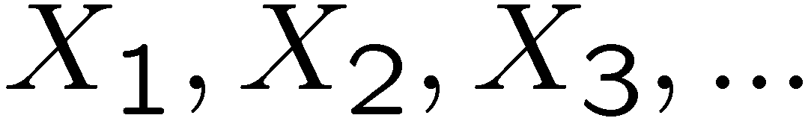
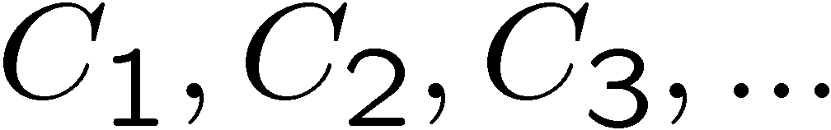
Cipher
Plaintext: Source of information:
Example: English text: Information Theory
Ciphertext: Encrypted sequence:
Example: Non-sense text: cu@ist.tr4isit13
Key
Key
Plaintext
Encipherer
Ciphertext
Decipherer
Plaintext

Slide 10
Example: Substitution Cipher
Simple Substitution
Example:
Plaintext: …RANDOMLY GENERATED CODEB…
Ciphertext: …DFLAUIPV WRLRDFNRA SXARQ…
Caesar Cipher
Alphabet | A B C D E …
Mixed Alphabet | F Q S A R …
Alphabet | A B C D E …
Mixed Alphabet | D E F G H …
Notes:
Julius Caesar used this cipher, with a shift of 3. His nephew, Augustus, used a shift of 1.

Slide 11
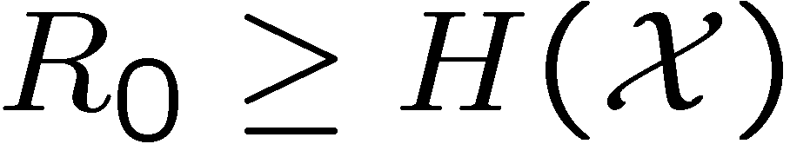
Shannon Analysis
1948
Channel Capacity
Lossless Source Coding
Lossy Compression
1949 - Perfect Secrecy
Adversary learns nothing about the information
Only possible if the key is larger than the information

Slide 12
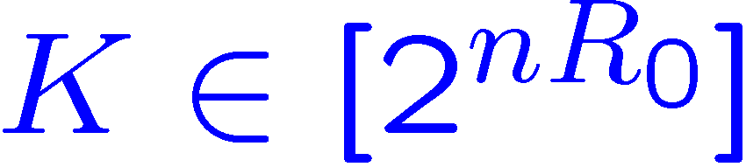
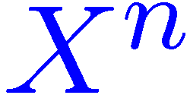
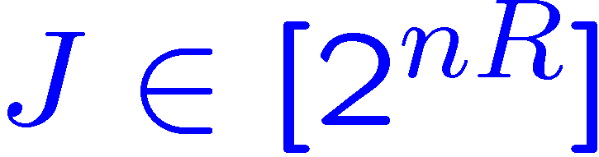
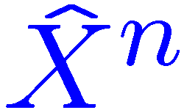
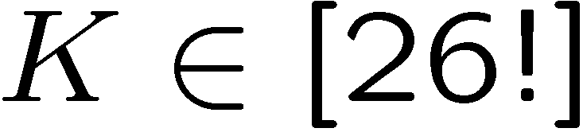
Shannon Model
Schematic
Assumption
Enemy knows everything about the system except the key
Requirement
The decipherer accurately reconstructs the information
Key
Key
Plaintext
Encipherer
Ciphertext
Decipherer
Plaintext
Adversary
For simple substitution:
Notes:
26! Is about 4 x 10^26 (the number of atoms in my chair). 88.4 bits
Redundancy of English is about 3.75 5bits per letter. (without spaces it’s 3.7)
About 25 letters needed to decode

Slide 13
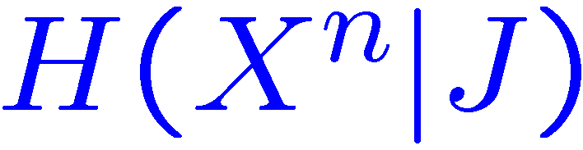

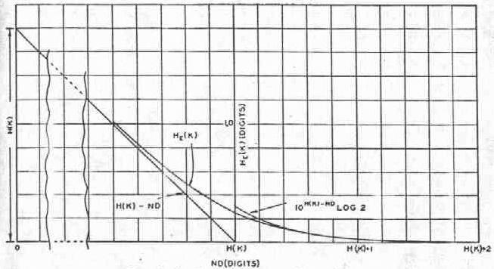
Shannon Analysis
Equivocation vs Redundancy
Equivocation is conditional entropy:
Redundancy is lack of entropy of the source:
Equivocation reduces with redundancy:

Slide 14
Computational Secrecy
Assume limited computation resources
Public Key Encryption
Trapdoor Functions
Difficulty not proven
Can become a “cat and mouse” game
Vulnerable to quantum computer attack
X
2 147 483 647
1 125 897 758 834 689
524 287

Slide 15
Information Theoretic Secrecy
Achieve secrecy from randomness (key or channel), not from computational limit of adversary.
Physical layer secrecy (Channel)
Wyner’s Wiretap Channel [Wyner 1975]
Partial Secrecy
Typically measured by “equivocation:”
Other approaches:
Error exponent for guessing eavesdropper [Merhav 2003]
Cost inflicted by adversary [this talk]
Notes:
A couple of aspects have been integrated in the study of information theoretic secrecy. One observation is that channel noise can be used, as the key is, to hide the information from an eavesdropper. The other development has been the study of partial secrecy.
Insert a diagram if I have time.

Slide 16
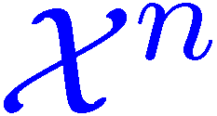
Equivocation
Not an operationally defined quantity
Bounds:
List decoding
Additional information needed for decryption
Not concerned with structure

Slide 17
Source Coding side of Secrecy
Partial secrecy tailored to the signal

Slide 18
Our Framework
Assume secrecy resources are available (secret key, private channel, etc.)
How do we encode information optimally?
Game Theoretic Interpretation
Eavesdropper is the adversary
System performance (for example, stability) is the payoff
Bayesian games
Information structure
Notes:
Jam a communication channel; break into a network, counter a military attack; overload a power grid.

Slide 19
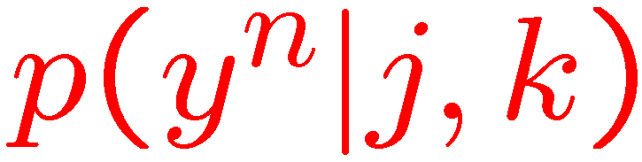
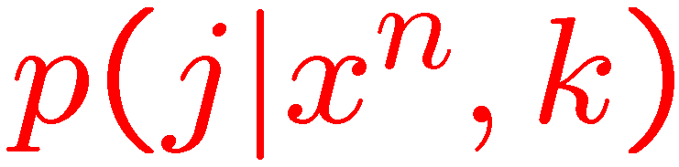
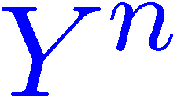

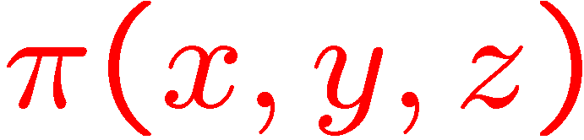

First Attempt to Specify the Problem
Decoder:
Encoder:
Key
Information
Node A
Message
Node B
Action
Adversary
Attack
System payoff: .
Adversary:
Notes:
Jam a communication channel; break into a network, counter a military attack; overload a power grid.

Slide 20
Secrecy-Distortion Literature
[Yamamoto 97]:
Proposed to cause an eavesdropper to have high reconstruction distortion
[Schieler-Cuff 12]:
Result: Any positive secret key rate greater than zero gives perfect secrecy.
Perhaps too optimistic!
Unsatisfying disconnect between equivocation and distortion.

Slide 21
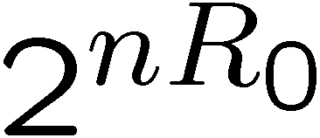
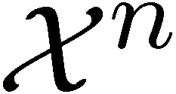
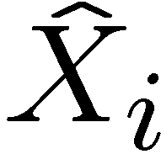
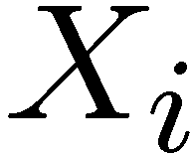
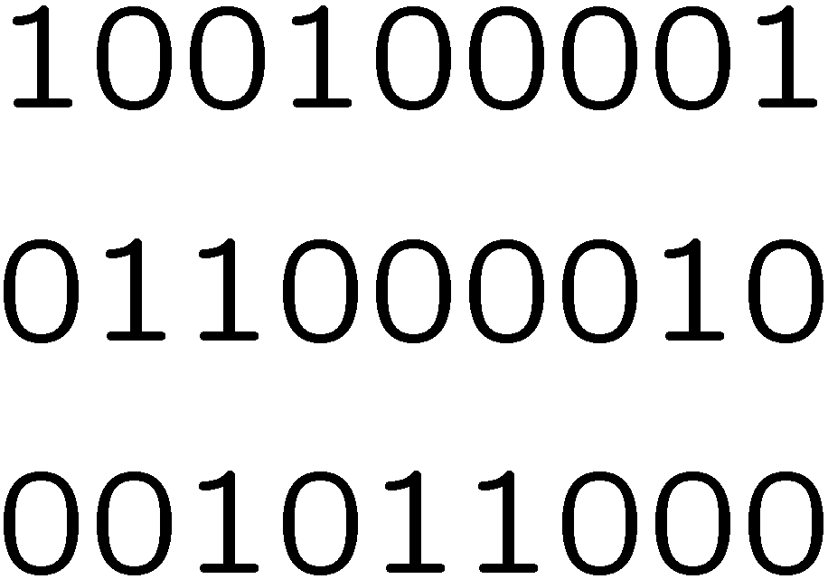
How to Force High Distortion
Randomly assign bins
Size of each bin is
Adversary only knows bin
Reconstruction of only depends on the marginal posterior distribution of
Example (Bern(1/3)):

Slide 22
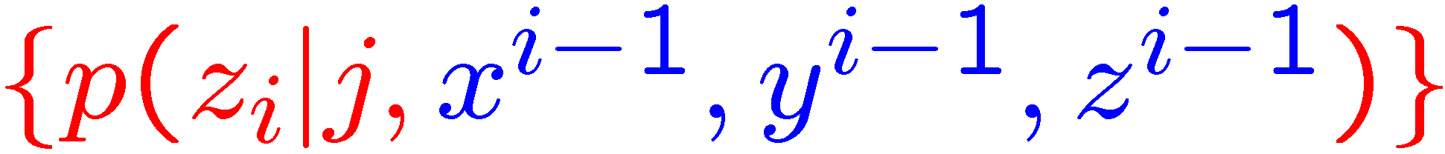
Competitive Secrecy
Decoder:
Encoder:
Key
Information
Node A
Message
Node B
Action
Adversary
Attack
System payoff: .
Adversary:
Notes:
Jam a communication channel; break into a network, counter a military attack; overload a power grid.

Slide 23
Performance Metric
Value obtained by system:
Objective
Maximize payoff
Key
Information
Node A
Message
Node B
Action
Adversary
Attack
Notes:
Jam a communication channel; break into a network, counter a military attack; overload a power grid.

Slide 24
Distributed Channel Synthesis
An encoding tool for competitive secrecy

Slide 25
Actions Independent of Past
The system performance benefits if X^{n} and Y^{n} are memoryless.

Slide 26
Channel Synthesis
Q(y|x)
Black box acts like a memoryless channel
X and Y are an i.i.d. multisource
Communication Resources
Source
Output

Slide 27
Channel Synthesis for Secrecy
Channel Synthesis
Information
Node A
Node B
Action
Adversary
Attack
Not optimal use of resources!

Slide 28
Channel Synthesis for Secrecy
Channel Synthesis
Information
Node A
Node B
Action
U^{n}
Adversary
Attack
Reveal auxiliary U^{n} “in the clear”

Slide 29
Point-to-point Coordination
Synthetic Channel Q(y|x)
Related to:
Reverse Shannon Theorem [Bennett et. al.]
Quantum Measurements [Winter]
Communication Complexity [Harsha et. al.]
Strong Coordination [C.-Permuter-Cover]
Generating Correlated R.V. [Anantharam, Gohari, et. al.]
Common Randomness
Source
Node A
Message
Node B
Output

Slide 30
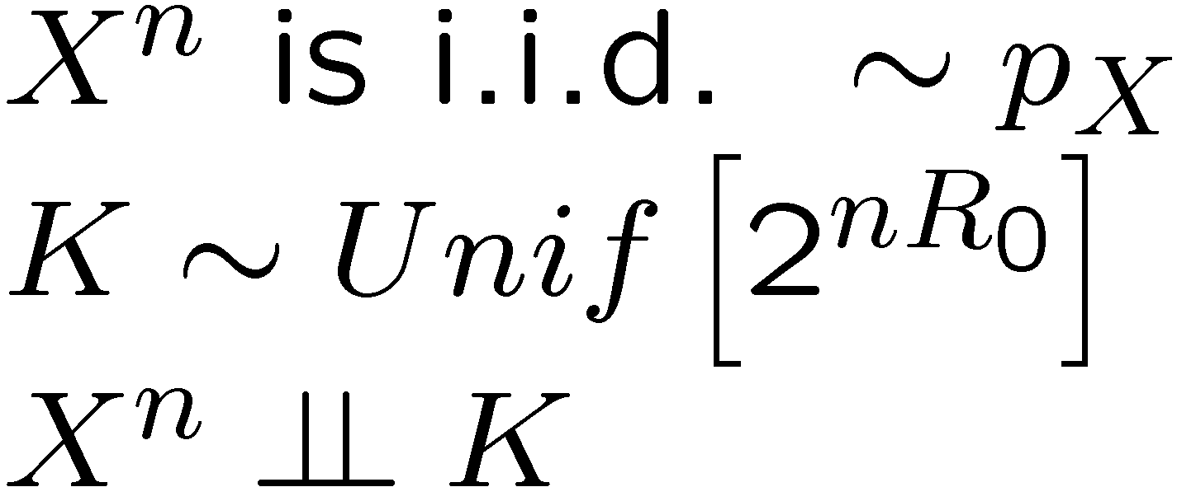
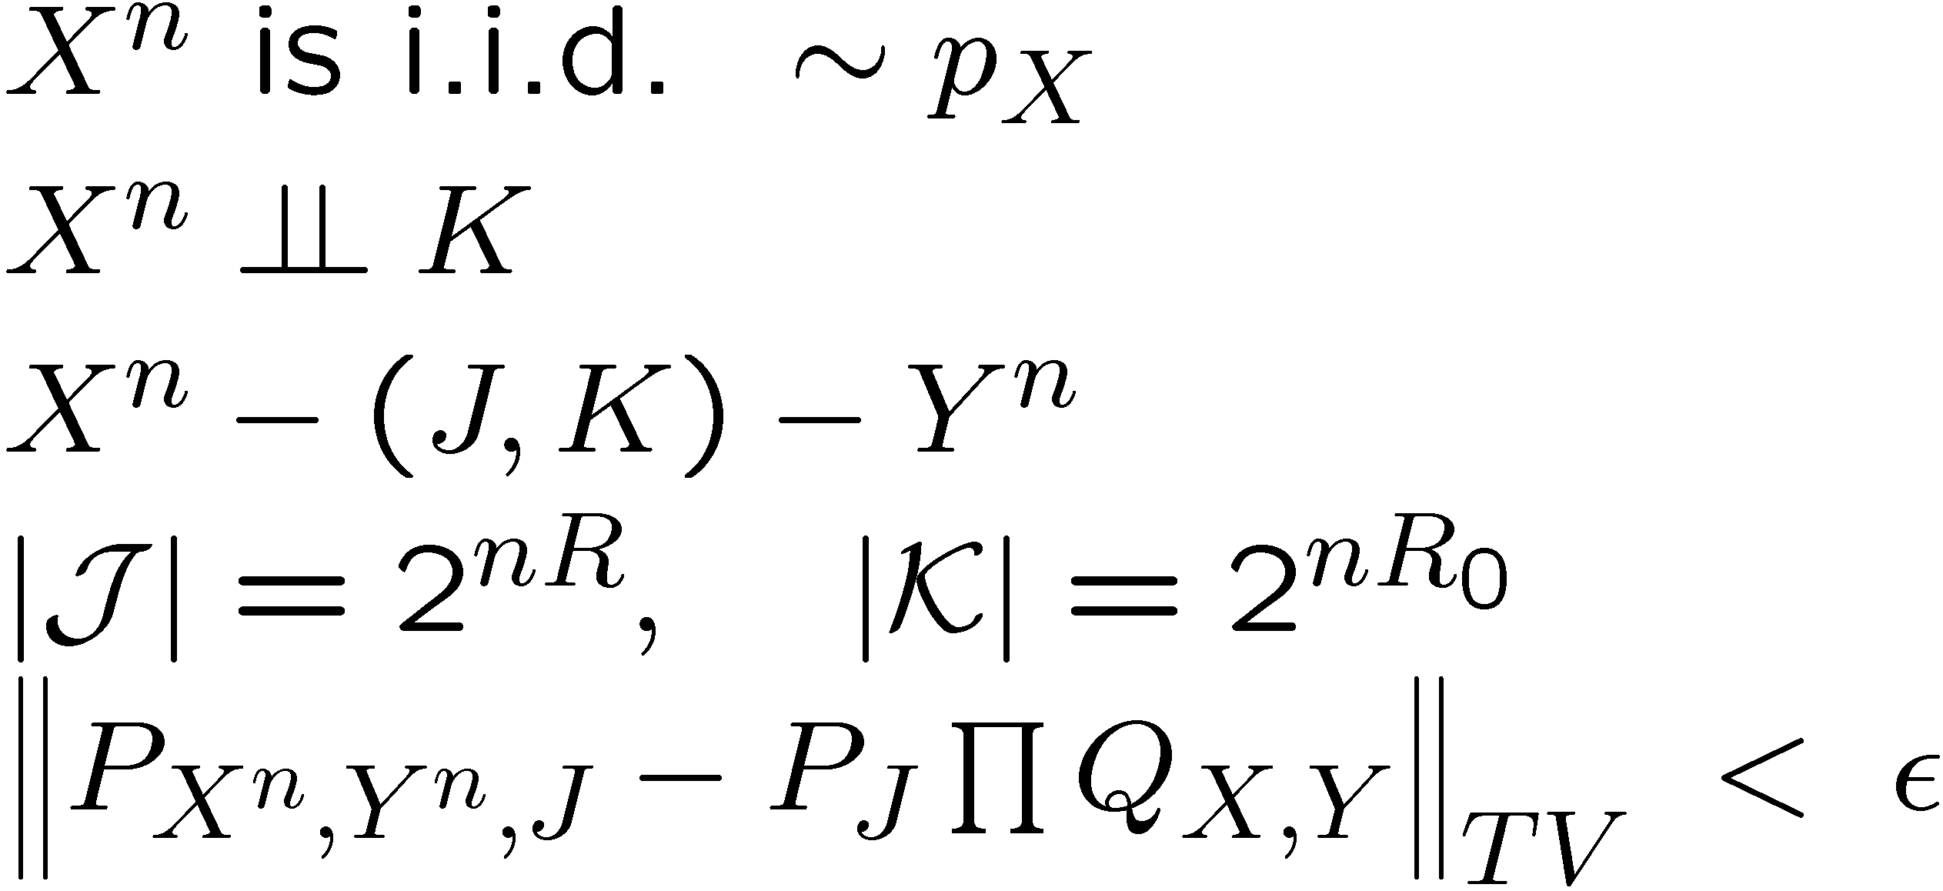
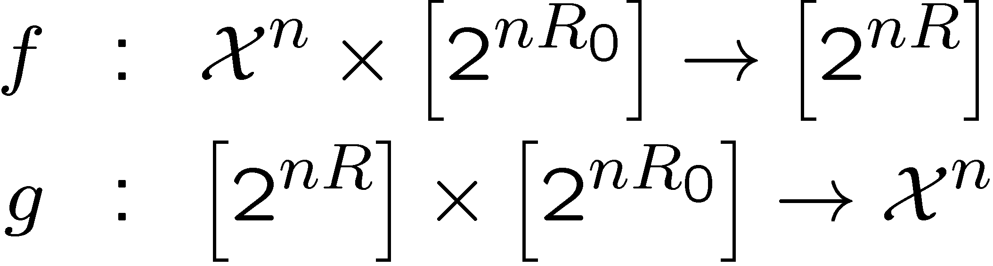
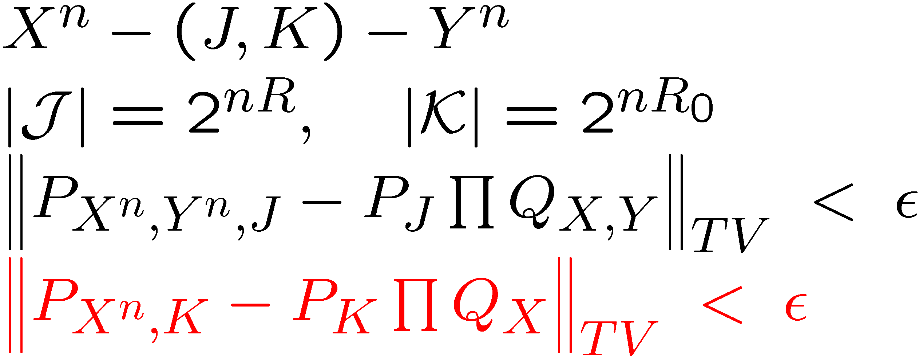
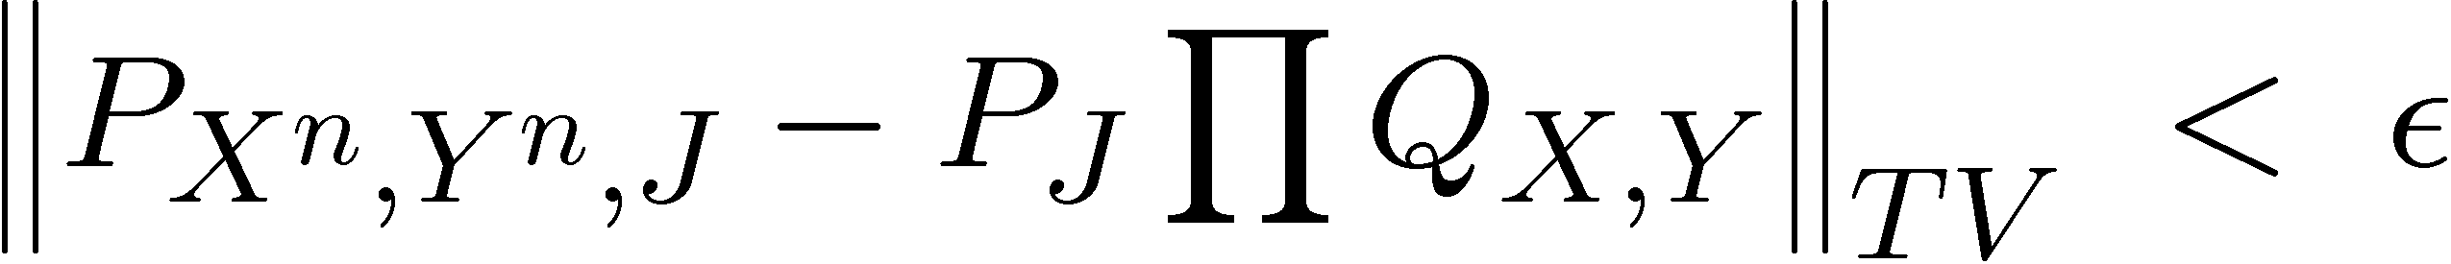

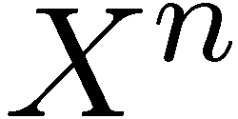

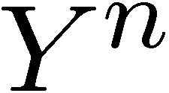
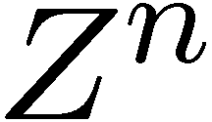
Problem Statement
Canonical Form
Alternative Form
Can we design:
such that
Does there exists a distribution:
f
g

Slide 31
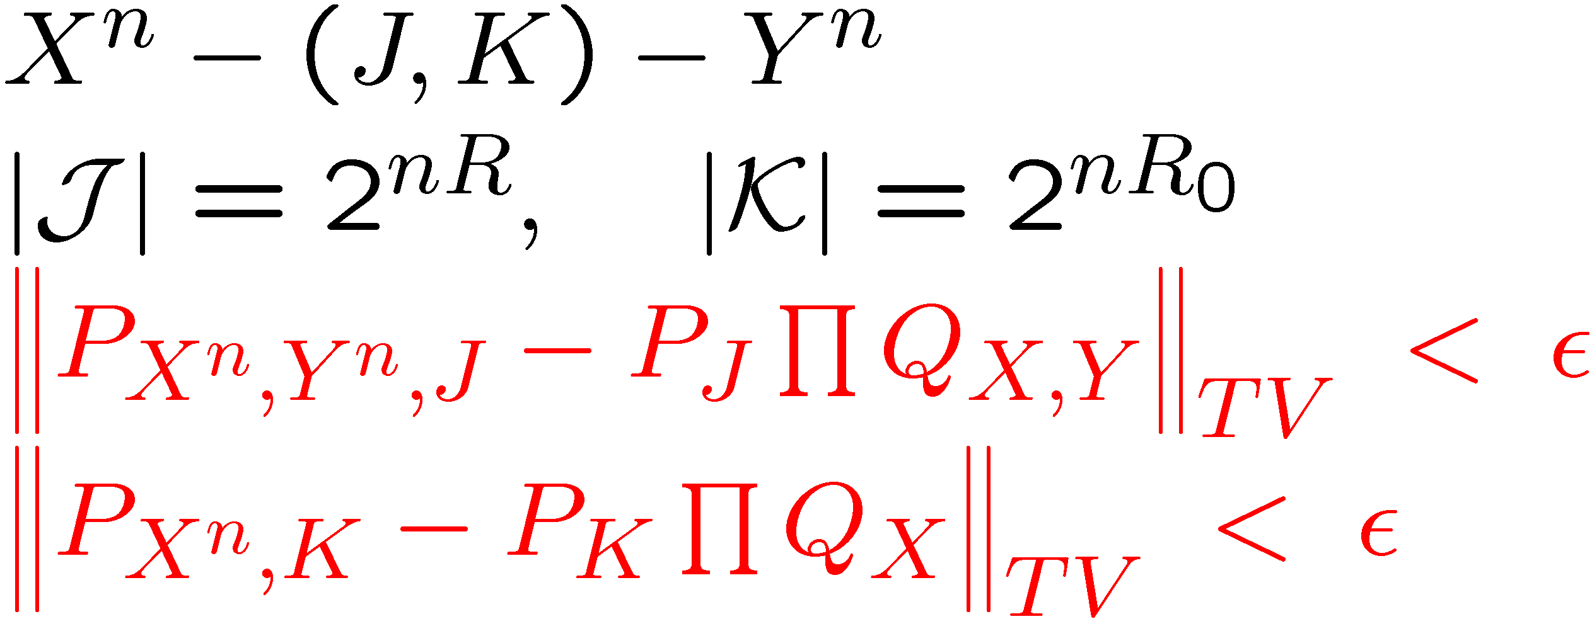
Construction
Choose U such that P_{X,Y|U} = P_{X|U} P_{Y|U}
Choose a random codebook
J
U^{n}
P_{X|U}
X^{n}
C
K
Y^{n}
P_{Y|U}
Cloud Mixing Lemma
[Wyner], [Han-Verdu, “resolvability”]

Slide 32
Theoretical Results
Information Theoretic Rate Regions
Provable Secrecy

Slide 33
Reminder of Secrecy Problem
Value obtained by system:
Objective
Maximize payoff
Key
Information
Node A
Message
Node B
Action
Adversary
Attack
Notes:
Jam a communication channel; break into a network, counter a military attack; overload a power grid.

Slide 34
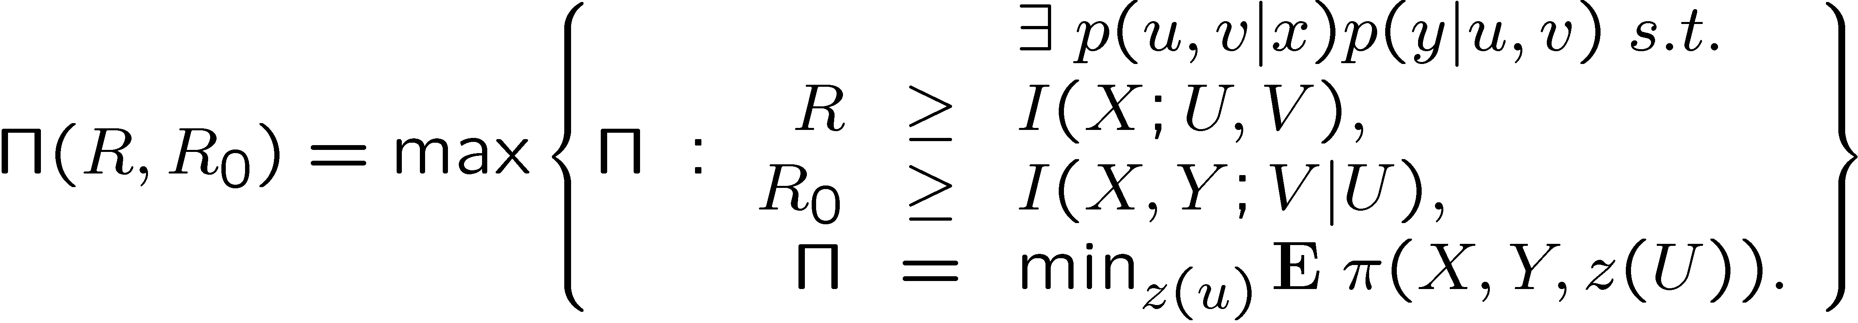
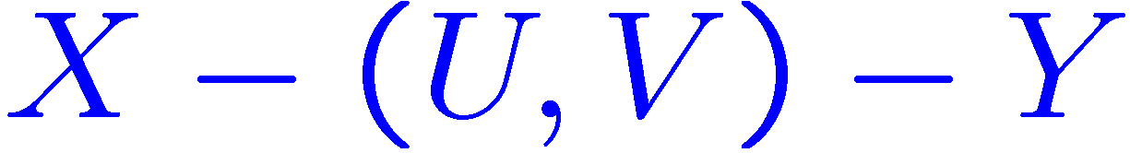
Payoff-Rate Function
Maximum achievable average payoff
Markov relationship:
Theorem:

Slide 35
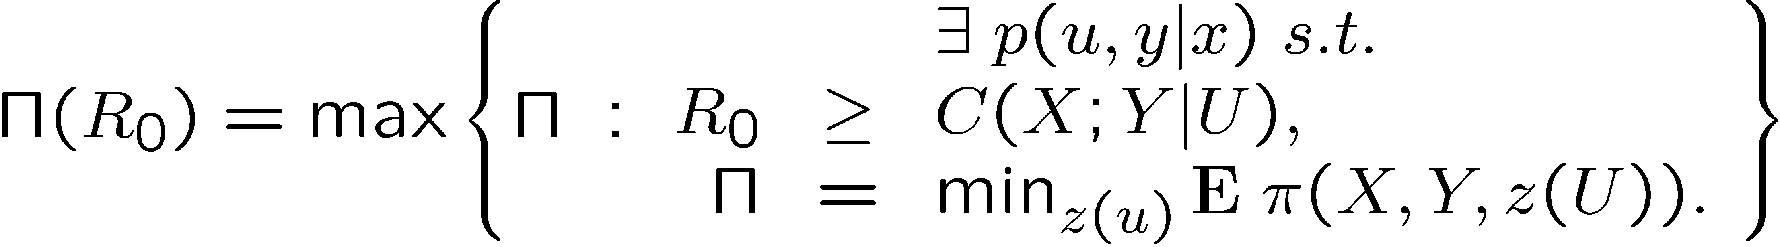
Unlimited Public Communication
Maximum achievable average payoff
Conditional common information:
Theorem (R=∞):

Slide 36
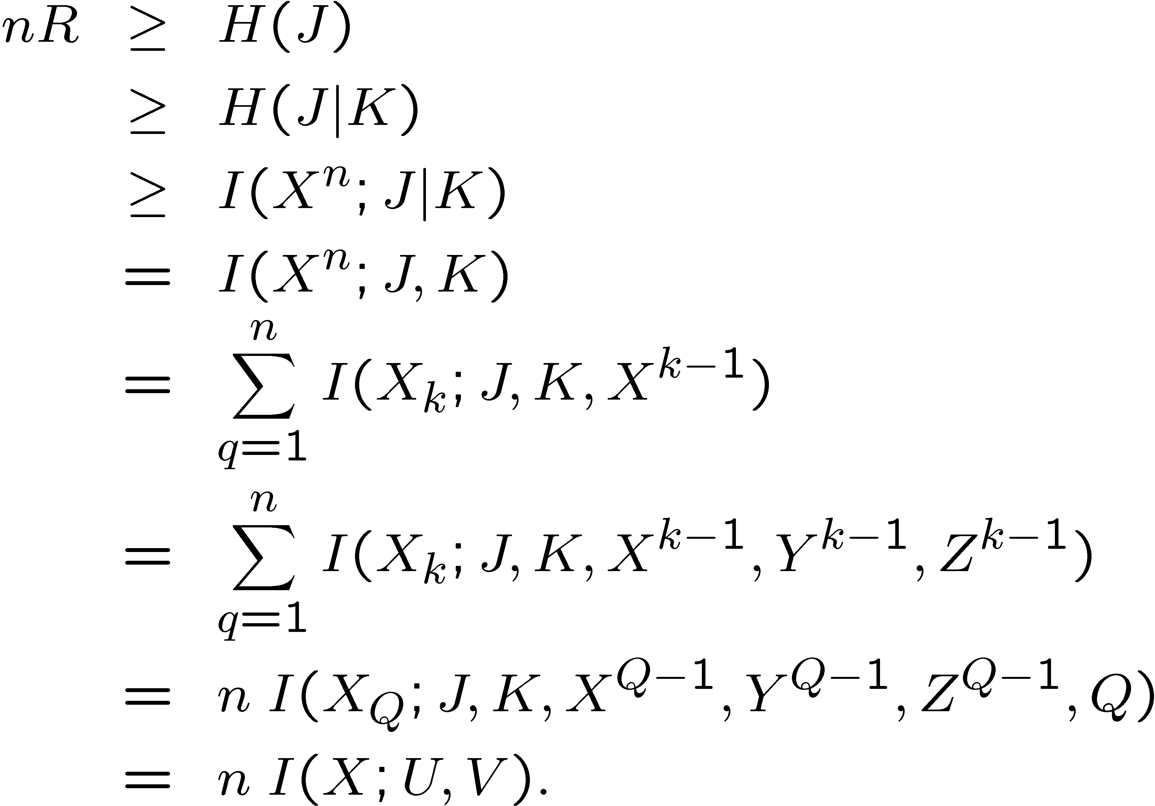
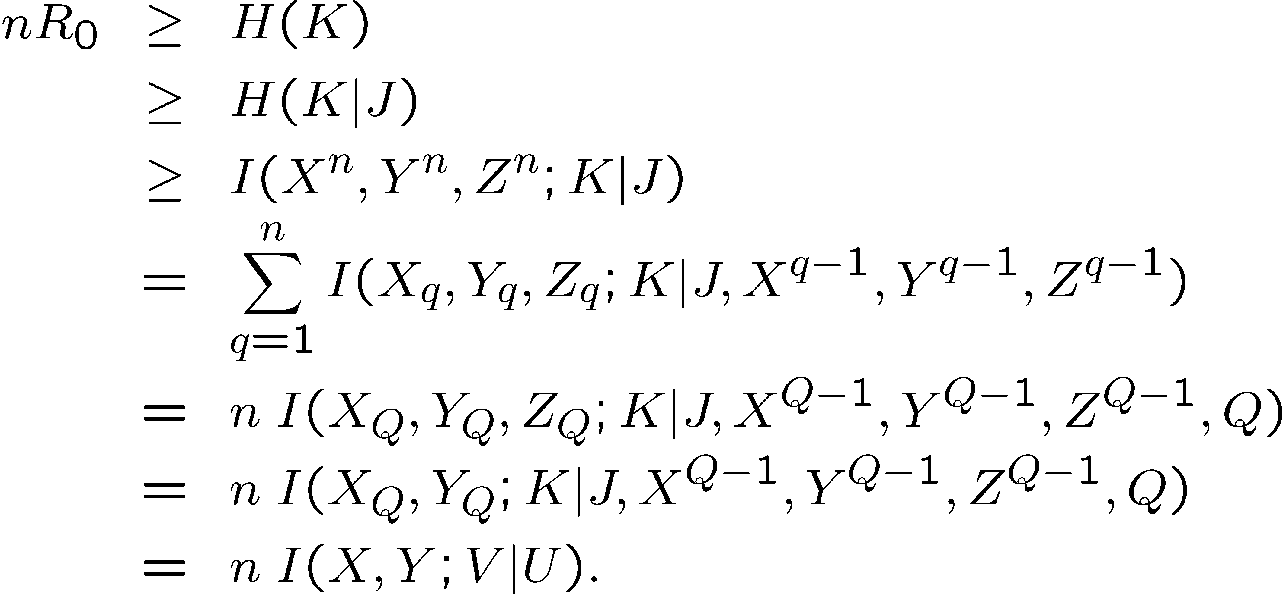
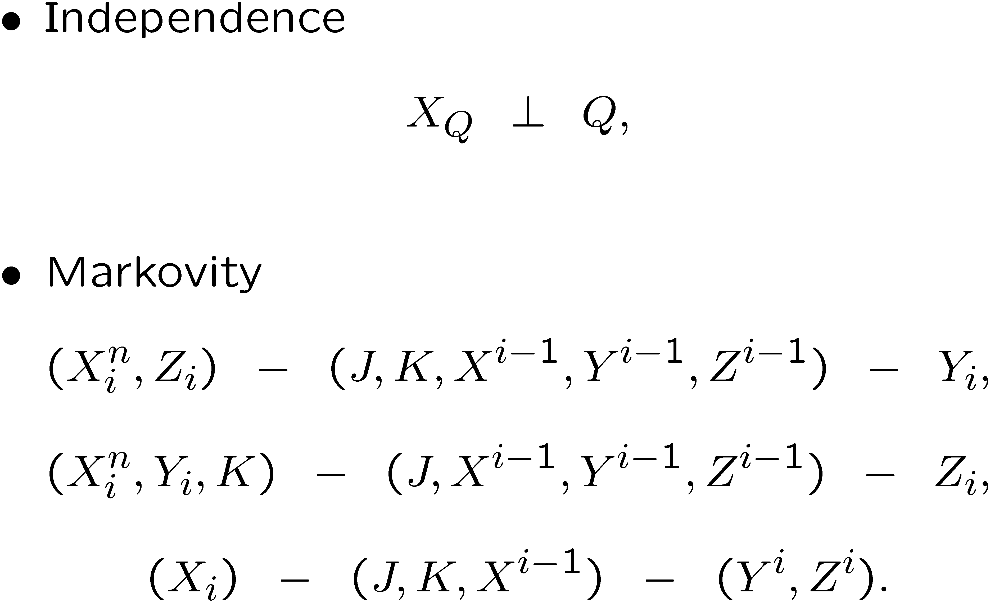
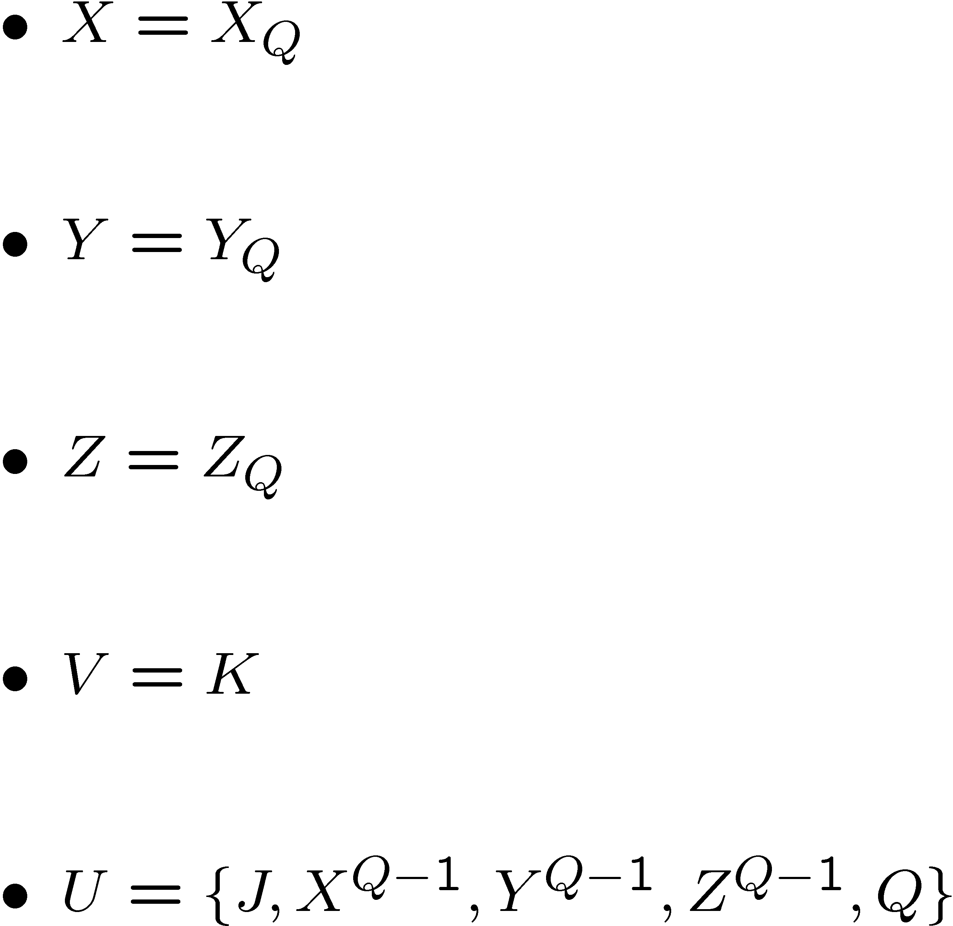
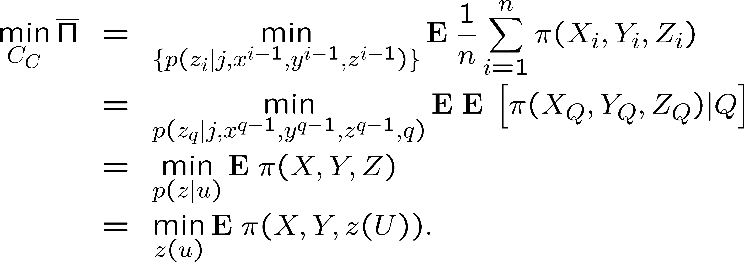
Converse

Slide 37
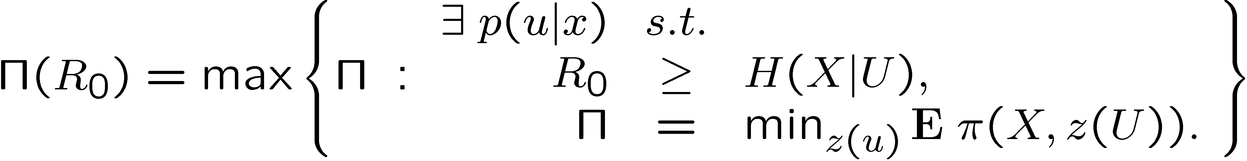
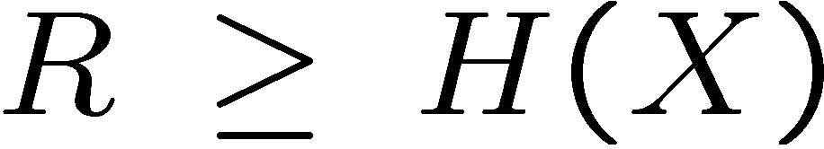
Lossless Case
Require Y=X
Assume a payoff function
Related to Yamamoto’s work [97]
Difference: Adversary is more capable with more information
Theorem:
[Cuff 10]
Also required:

Slide 38
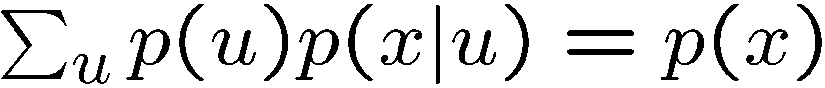
Linear Program on the Simplex
Constraint:
Minimize:
Maximize:
U will only have mass at a small subset of points (extreme points)

Slide 39
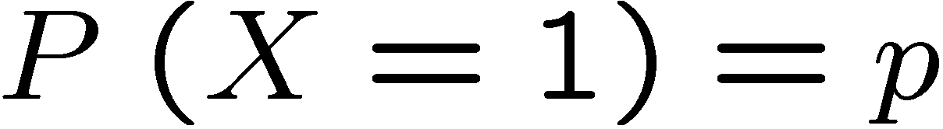
Binary-Hamming Case
Binary Source:
Hamming Distortion
Optimal approach
Reveal excess 0’s or 1’s to condition the hidden bits
Source
0 | 1 | 0 | 0 | 1 | 0 | 0 | 0 | 0 | 1
* | * | 0 | 0 | * | * | 0 | * | 0 | *
Public message

Slide 40
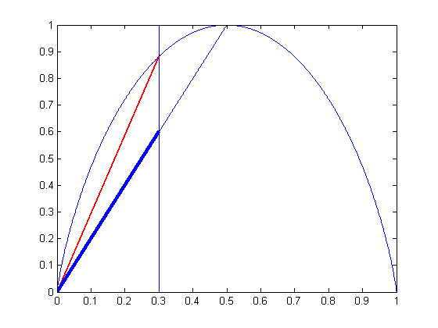
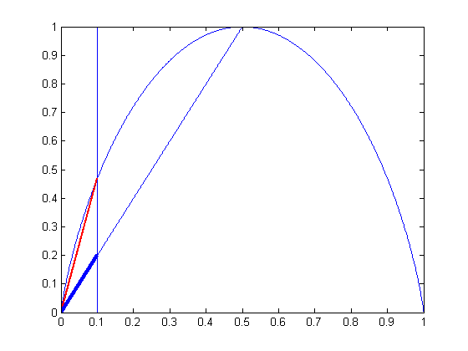
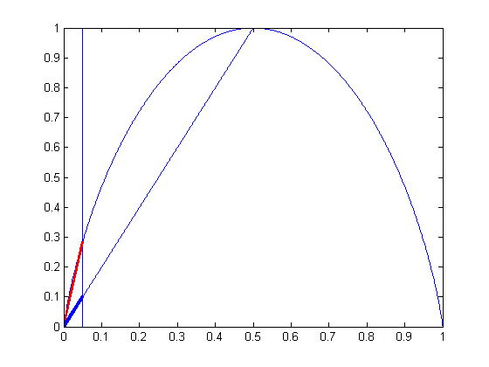
Binary Source (Example)
Information source is Bern(p)
Usually zero (p < 0.5)
Hamming payoff
Secret key rate R₀ required to guarantee eavesdropper error
p
R₀
Eavesdropper Error

Slide 41
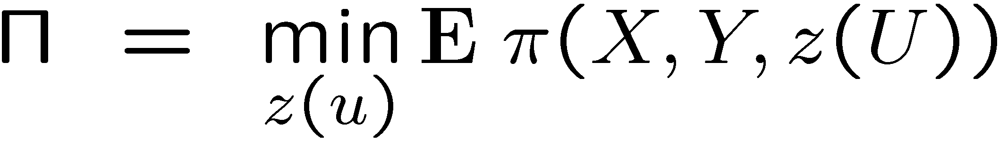
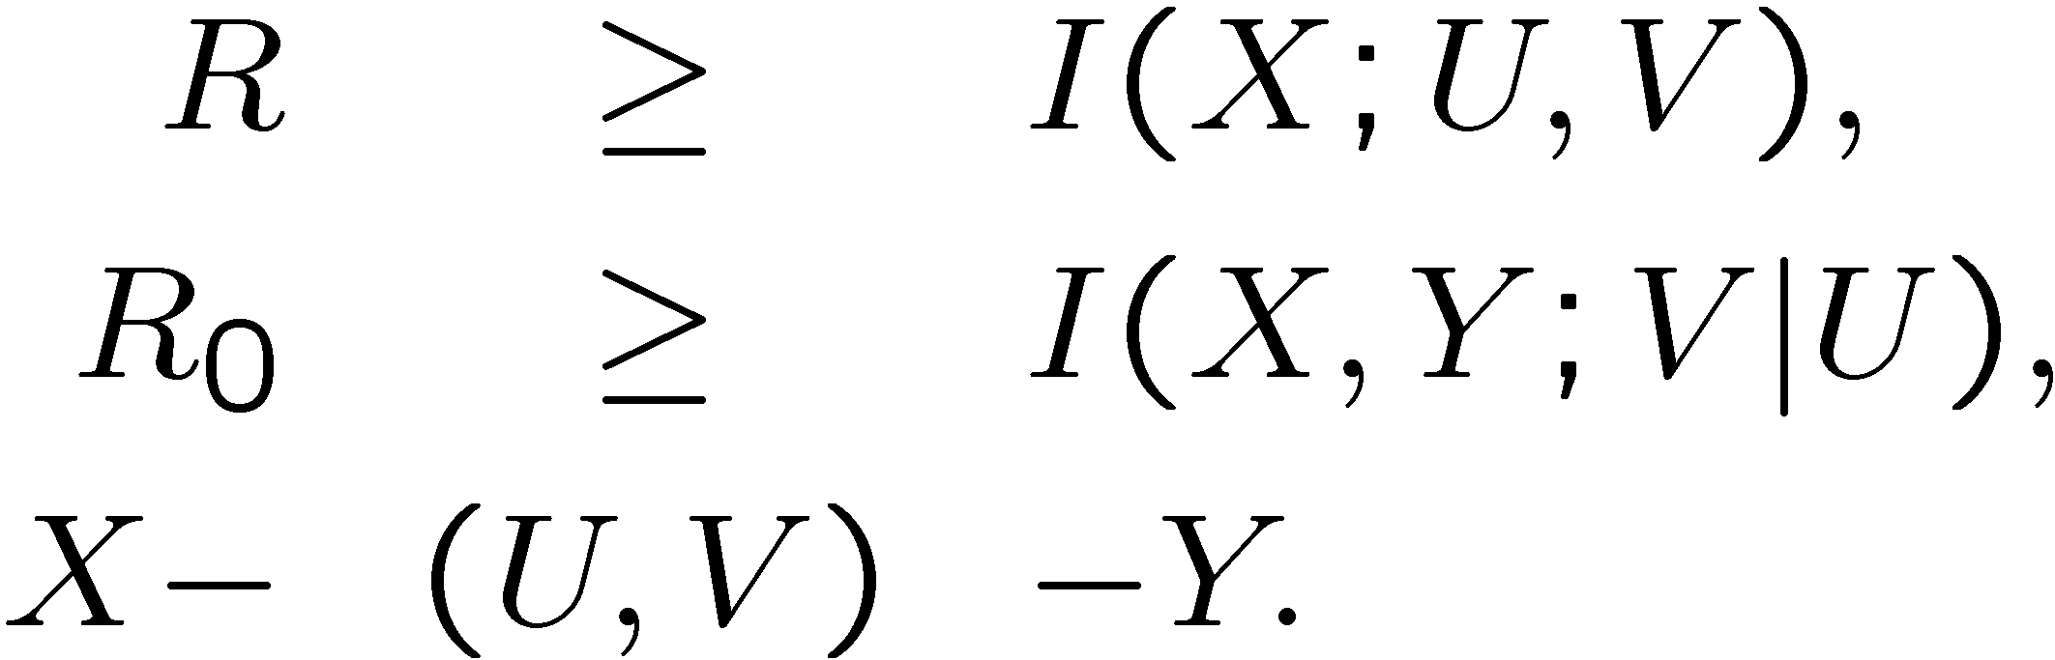








What the Adversary doesn’t know can hurt him.
Knowledge of Adversary:
[Yamamoto 97]
[Yamamoto 88]:

Slide 42



Proposed View of Encryption
Information obscured
Images from albo.co.uk

