Slide 1
Scientific Visualization
Tools & Techniques
Eliot Feibush
October 20, 2016
APC 524

Slide 2
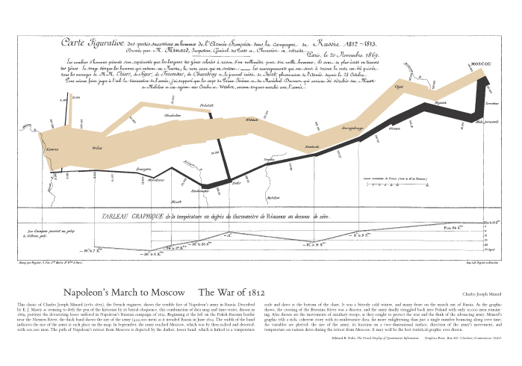
Early Multivariate Data Vis
Not so good for Napoleon in 1812
Credit: Edward Tufte via Charles Minard 1869
Notes:
Tufte – statistics professor at Yale, vis evangelist, nice books on information presentation

Slide 3
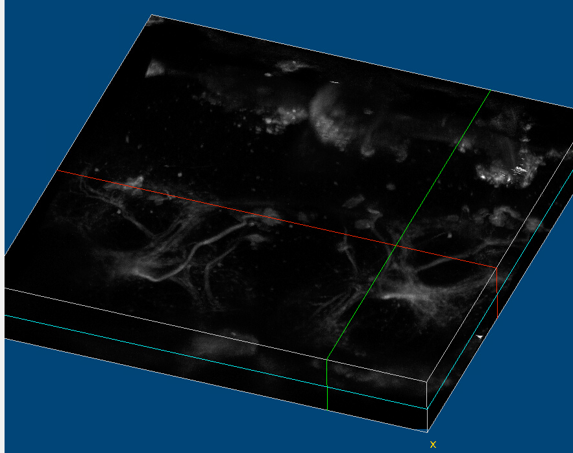
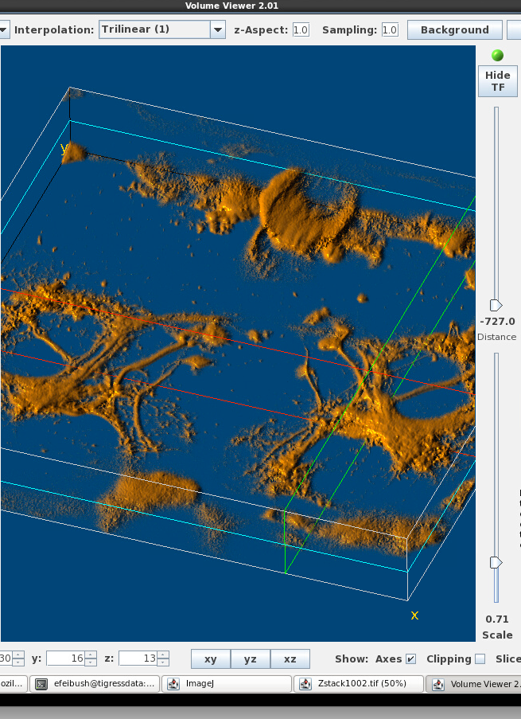

Scientific Visualization
1. Acquire data from experiments.
2. Generate data in simulations.
Explore, Communicate
Based on computer graphics:
points
lines
polygons, surface mesh
3D transformations
hidden surface removal
shading
lighting
ImageJ
Analyse Visualize
Notes:
Stack of images, typically for medical applications. Now in geosciences for analyzing fossils & molecular biology for looking at bacteria & viruses.

Slide 4
Designing a Visualization
I want a visualization of my climate model.
Map your data to a plot type.
Application Scientist
Vis Guy
1D / 2D / 3D Compute grids:
scalar or vector
per point, per cell
Selection + Operators
Notes:
OK, stop me if you’ve heard this one. A scientist walks into a bar up and goes up to the vis guy and says: Make a visualization of my simulation run.
X guy walks into a bar and goes up to 3 Y guys: Wanna hear a Y joke? You sure ...?, my buddy ...; X guy thinks about, nah, don’t want to have to explain it 3 times.

Slide 5
Getting to Know Your Data
Geometric range
Numerical domain (min, max)
Histogram
Outliers
Features
Local / Global (steps)
Presentation
Notes:
Understanding complexity!

Slide 6
Dimensions of Data
f(x)
f(x, time) f(x,i)
f(x, y)
f(x, y, time)
f(x, y, z)
f(x, y ,z ,time)
Time dependent data is a good candidate for animation.

Slide 7
Python
Very convenient for converting data to vis formats.
Analyze & extract.
Good economy for programmer/user.
matplotlib
Examples: f(x), f(x,y), f(x,y,t)
numpy, scipy, PIL
tkinter
Notes:
Spellcheck numpy = bumpy, lumpy, dumpy, grumpy ~ 7 dwarves

Slide 8
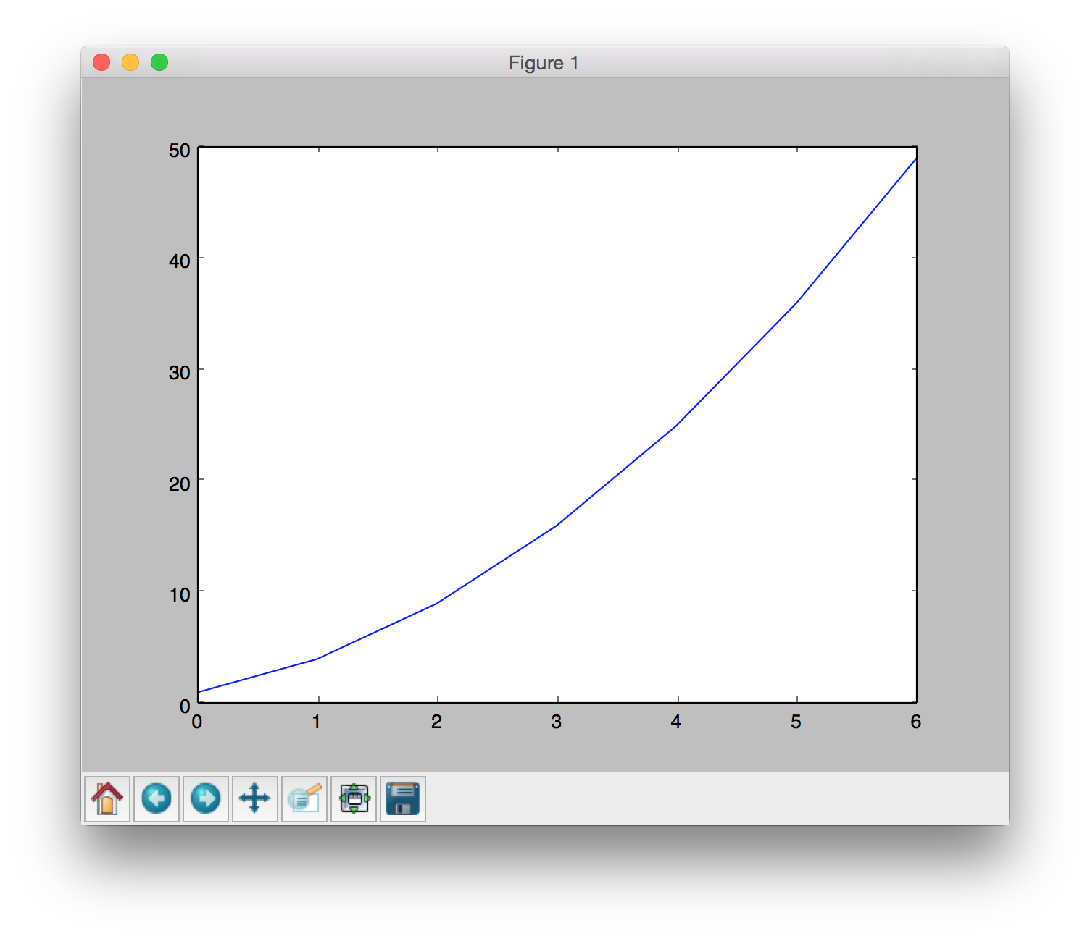
matplotlib f(x)
import matplotlib.pyplot as plt
y = [1, 4, 9, 16, 25, 36, 49]
plt.plot(y)
plt.show()

Slide 9
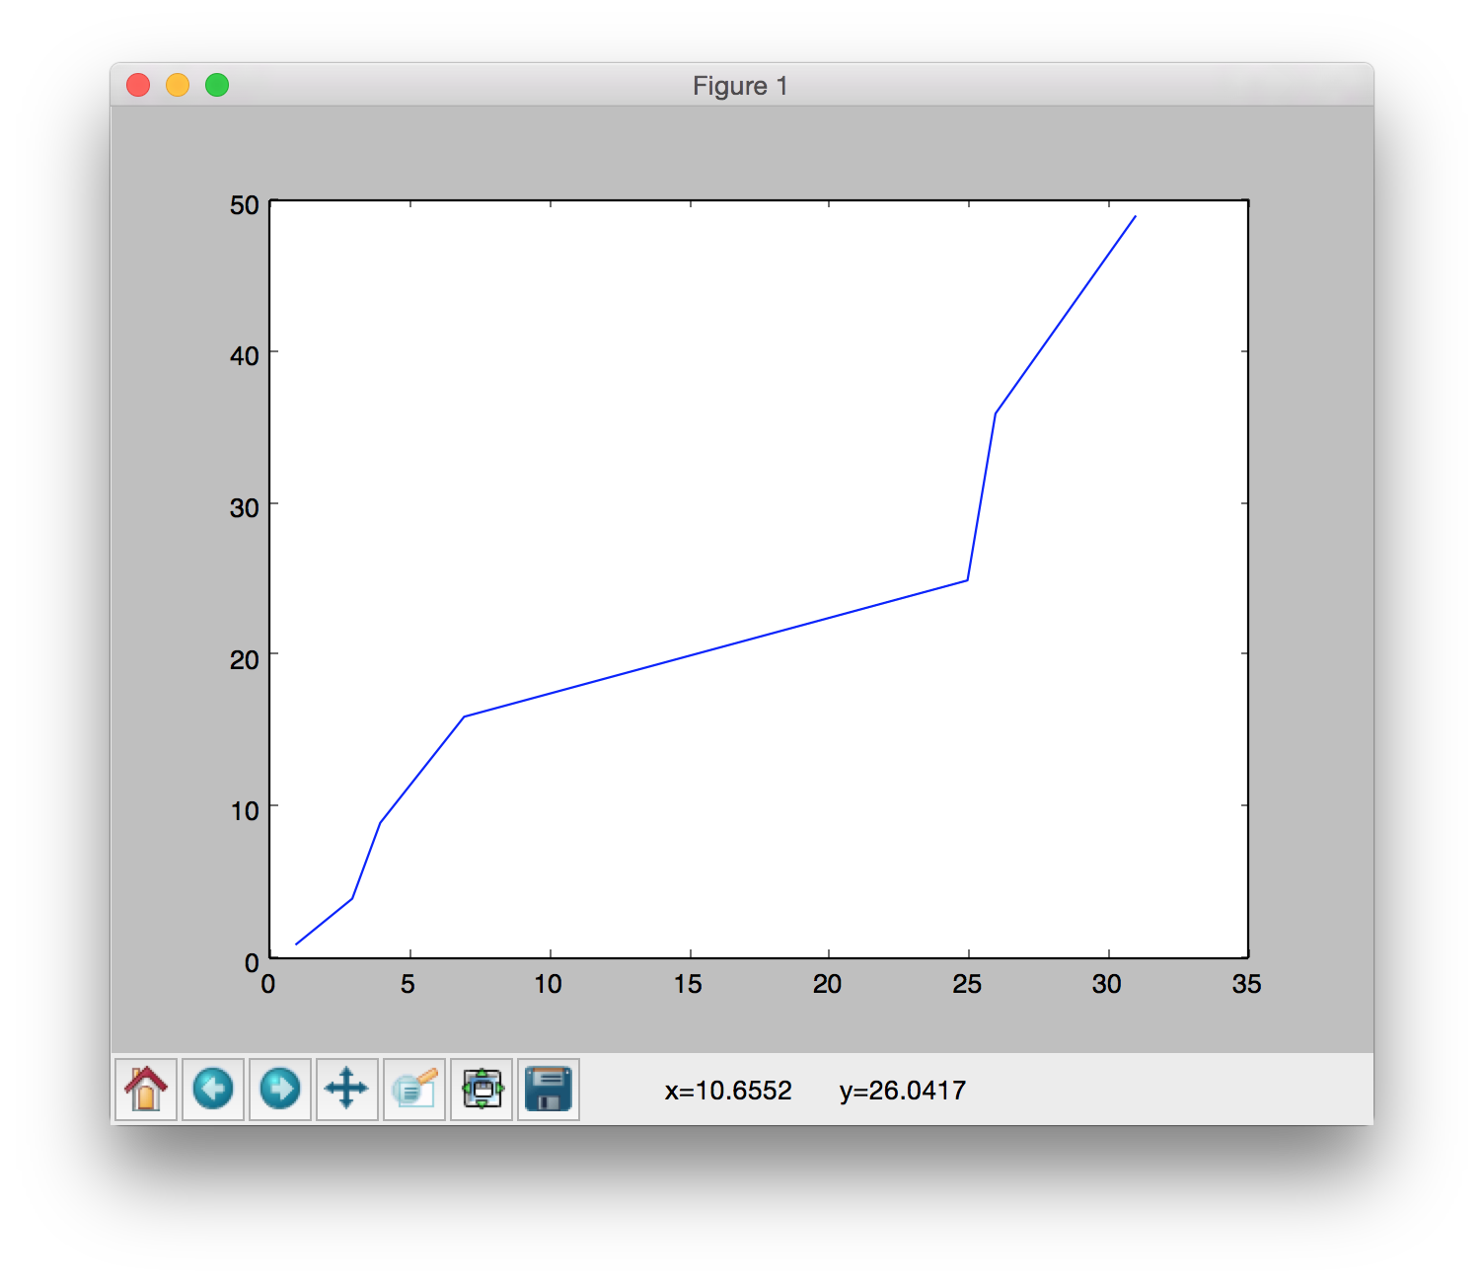
matplotlib f(x)
import matplotlib.pyplot as plt
y = [1, 4, 9, 16, 25, 36, 49]
x = [1, 3, 4, 7, 25, 26, 31]
plt.plot(x,y)
plt.show()

Slide 10
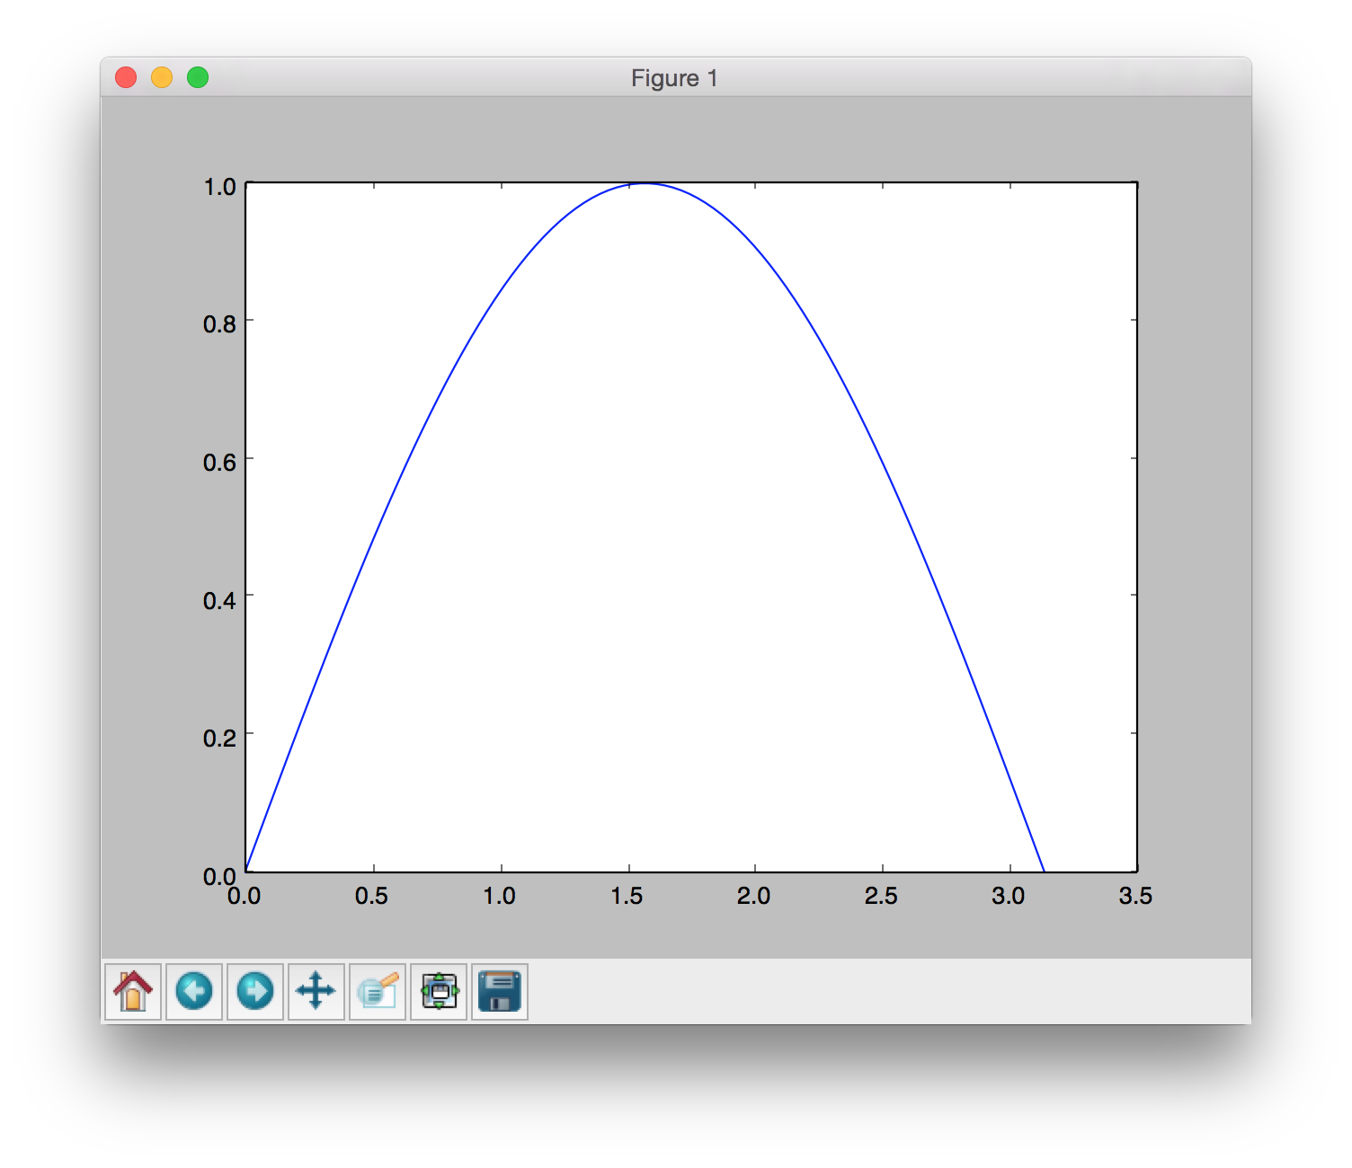
matplotlib, numpy f(x)
import matplotlib.pyplot as plt
import numpy
x = numpy.arange(0., numpy.pi, .01)
y = numpy.sin(x)
plt.plot(x,y)
plt.show()
x and y are 1D
numpy.ndarray
arange takes floats

Slide 11
Latex in Graphs, save to pdf
from matplotlib.backends.backend_pdf import PdfPages
pdfp = PdfPages('multipage.pdf') # starts pdf file, plot per page
# export PATH=$PATH:/usr/local/texlive/2016/bin/universal-darwin
plt.rc(“text”, usetex=True)
plt.plot(x,y)
plt.xlabel(r"\textbf{time} (s)")
# raw string r before quotes escapes tex format instead of tab
plt.title(r"y = " r"$\displaystyle\sin\frac{1} {x^2}$",fontsize=16)
plt.savefig(pdfp, format='pdf') # save before showing
plt.show()
pdfp.close()

Slide 12
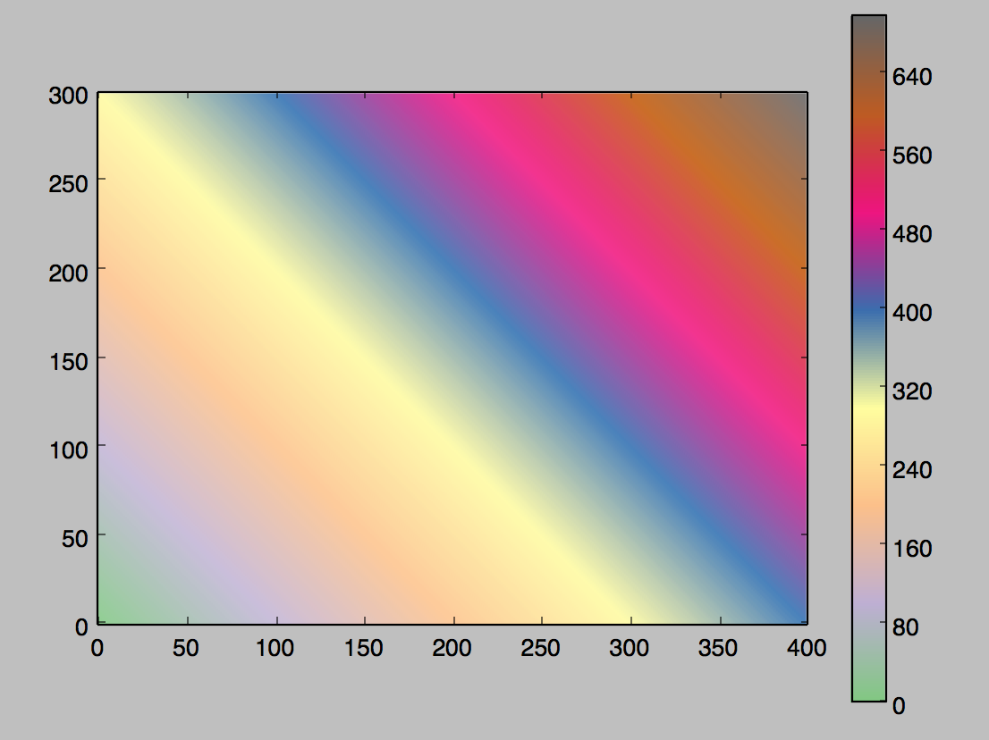
matplotlib, numpy f(x,y)
import matplotlib.pyplot as plt
import numpy
a = numpy.zeros( (300,400) ) # 2D ndarray
for i in range(300):
for j in range(400):
a[i,j] = i + j
plt.imshow(a, origin=“lower”, cmap=plt.cm.Accent)
plt.colorbar()
plt.show()
# show names of colormaps
dir(plt.cm)
Accent is “sequential”

Slide 13
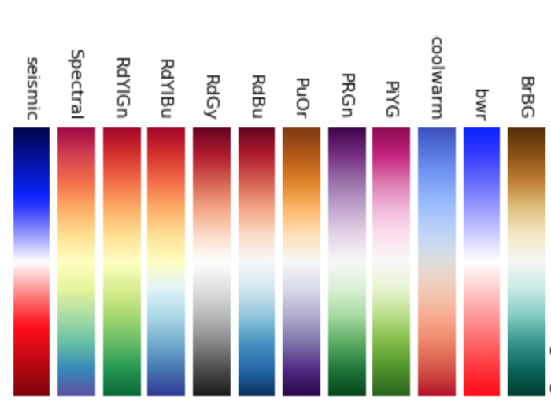
Color Maps
http://matplotlib.org/users/colormaps.html
Divergent color maps
+100.
0.
-100.
See also: Sequential & Qualitative colormaps
Notes:
google books: Python data visualization cookbook

Slide 14
matplotlib, numpy f(x,y,t)
import matplotlib.pyplot as plt
from scipy.io import netcdf
f = netcdf.netcdf_file(“psiRZ.cdf”, “r”)
for v in f.variables: # f.variables is a dictionary
print v # print keys, name of variable
rz = f.variables[“pout_psiRZ”].data # get the data
shape = rz.shape # (84, 65, 65) 84 steps, 65 x 65 magnetic field (tuple)
for i in range(shape[0]): # for each time step
rzt = rz[i][:][:] # get the time slice
plt.contour(rzt) # make a contour plot
plt.draw() # draw on screen for .1 second
plt.pause(.1)
fname = “figs/” + str(i).zfill(3) + “.png”
plt.savefig(fname) # save each plot to a png file

Slide 15
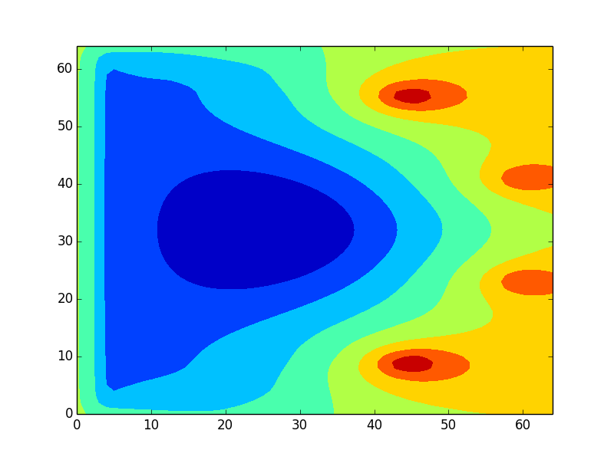
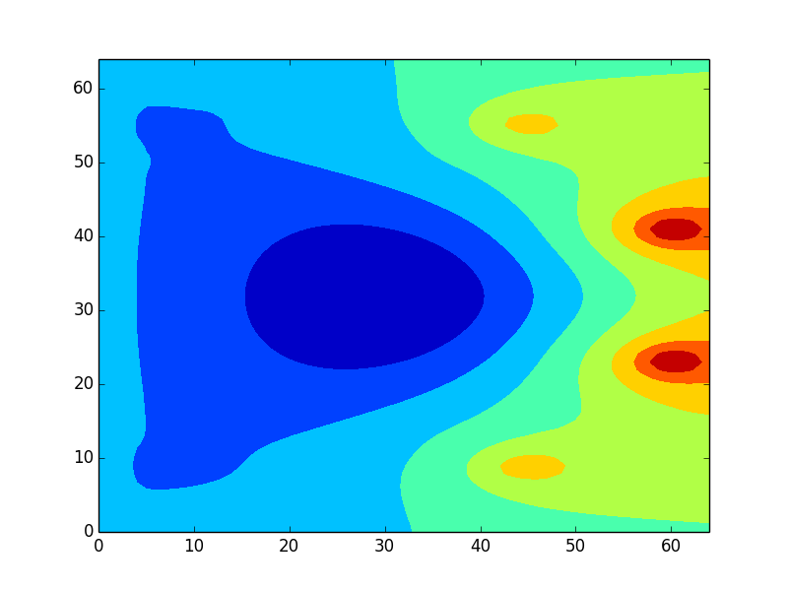
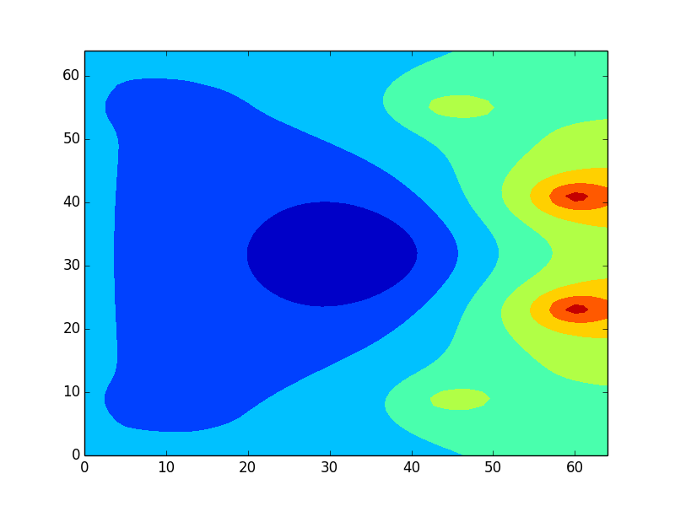
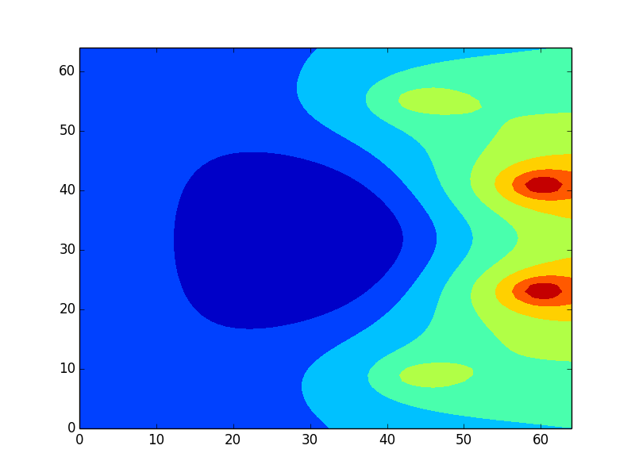
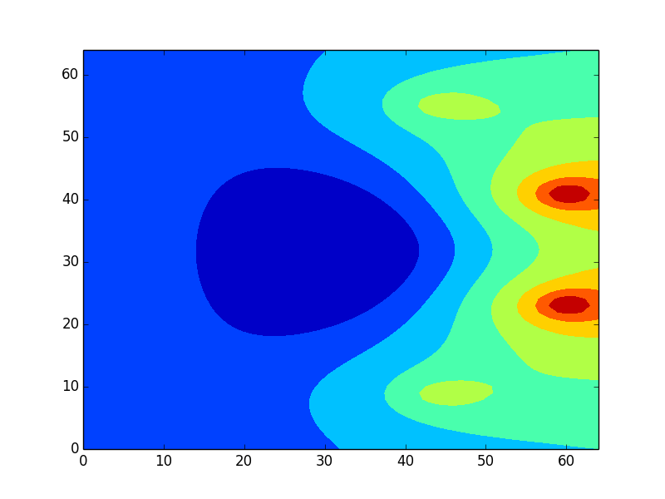
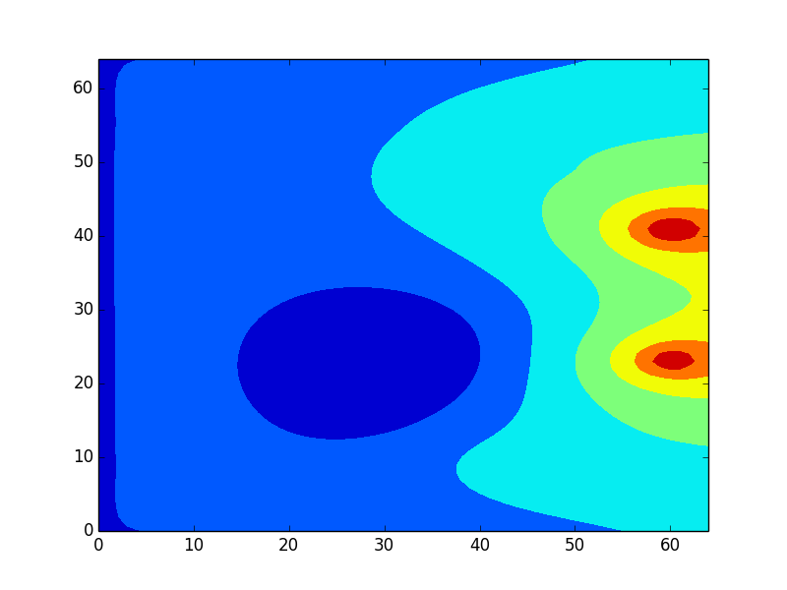
PNG Image Files
...

Slide 16
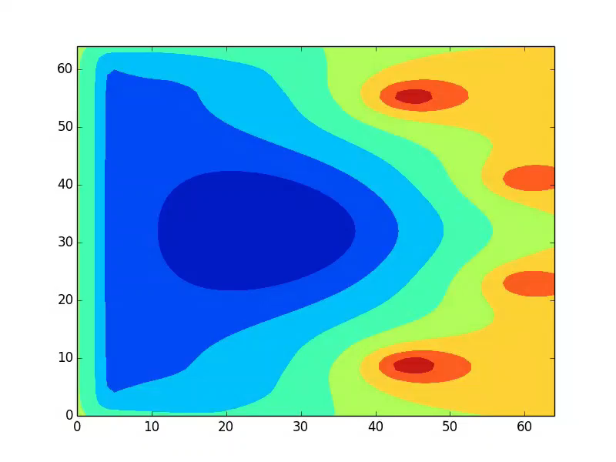

Slide 17
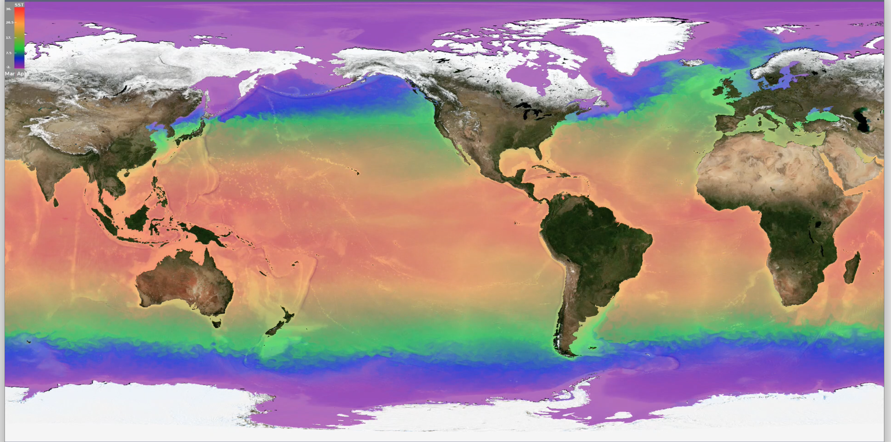
GFDL Sea Surface Temperature: f(x, y, time)
http://w3.pppl.gov/~efeibush/cm sssRDay2.mp4
Notes:
climate data historically stored in netcdf files

Slide 18
Implementation of Vis Programs
vispy
(GPU, OpenGL)
ImageJ
ncview
yt + exts
python
java
Graphics Primitives (in a window)
netcdf
Pixels
Notes:
Light up the pixels
Free, open source, Mac, Windows, Linux
VisIt – displays existing data
ParaView – can create some data: spheres, box, plane, arrow, line, etc.; texture mapping

Slide 19
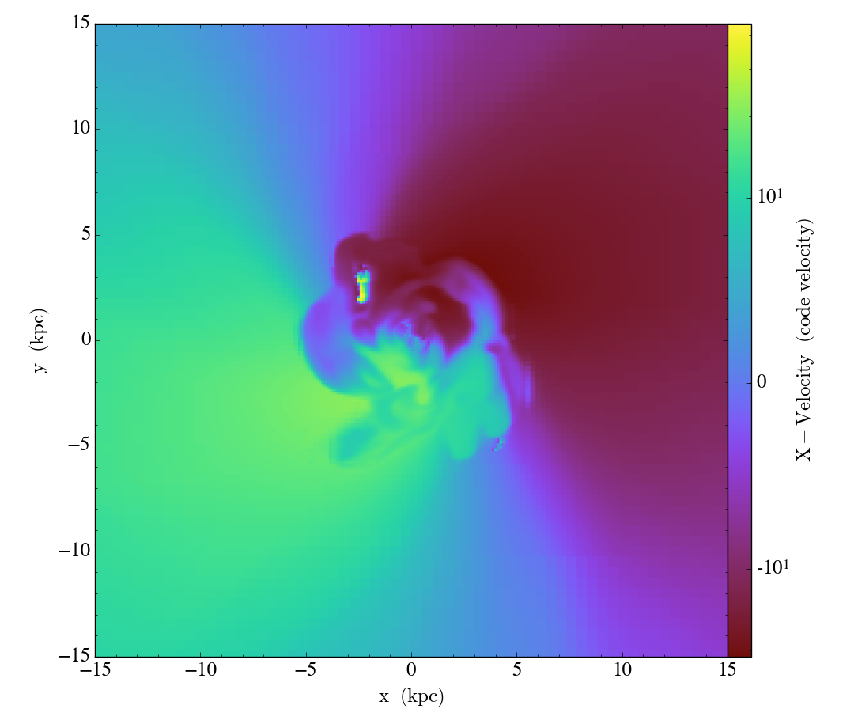
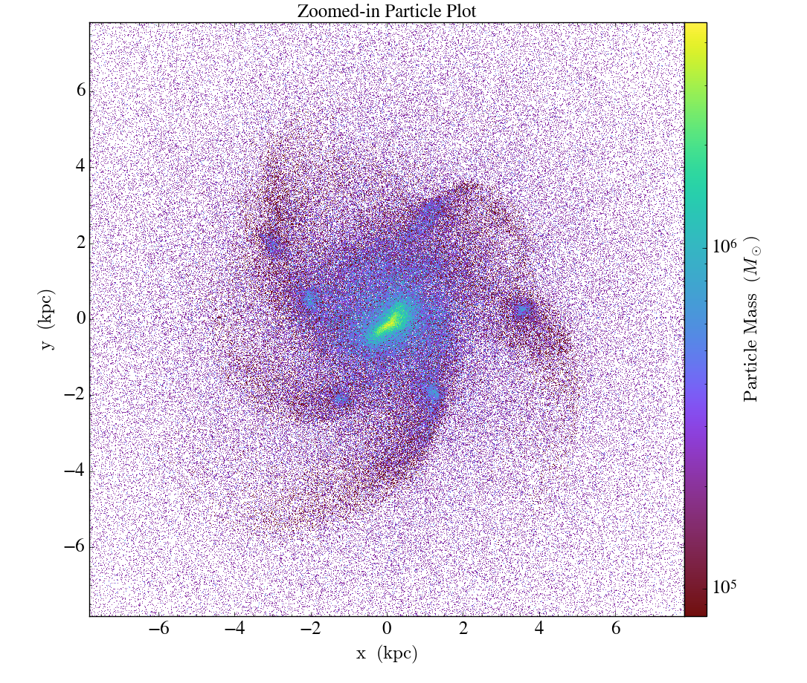
yt-project.org
Volumetric data (astrophysics simulations)
Python implementation, Anaconda install
Think numpy, matplotlib API + annotation
Slices, Projections Particles
Notes:
projections: integrated (weighted by another variable or unweighted), maximum intensity projection (MIP), sum

Slide 20
Implementation of VTK
Vis Programs
Vis GUI – VisIt, ParaView
VTK – Visualization ToolKit
Graphics Primitives (in a window)
Pixels
Notes:
Light up the pixels
Graphics started with just putpixel(x,y,v) and getpixel(x,y) - affectionately nicknamed peek & poke
I had one computer account in 1976. Now I have 47 passwords & 5 secureID tokens.
Free, open source, Mac, Windows, Linux
VisIt – displays existing data
ParaView – can create some data: spheres, box, plane, arrow, line, etc.; texture mapping

Slide 21
Read Data Files
  Silo
  Chombo
  GTC
  M3D-C1
  H5Nimrod
  SAMRAI
  S3D
  Point3D x y z scalar
  XMDV x y z scalar1 scalar2 scalar3 …
  XDMF
  Exodus
  FLASH
  EnSight
  VTK
  NetCDF
  CGNS
  NASTRAN
  TecPlot
  Protein Databank (PDB)
  Plot3D
  GIS (ESRI Shapefile, DEM, many more)
  Image formats
Database reader plug-ins can be developed for new formats**
Variable types
  Scalar
  Vector
  Tensor
VTK is Internal Format for VisIt & ParaView

Slide 22
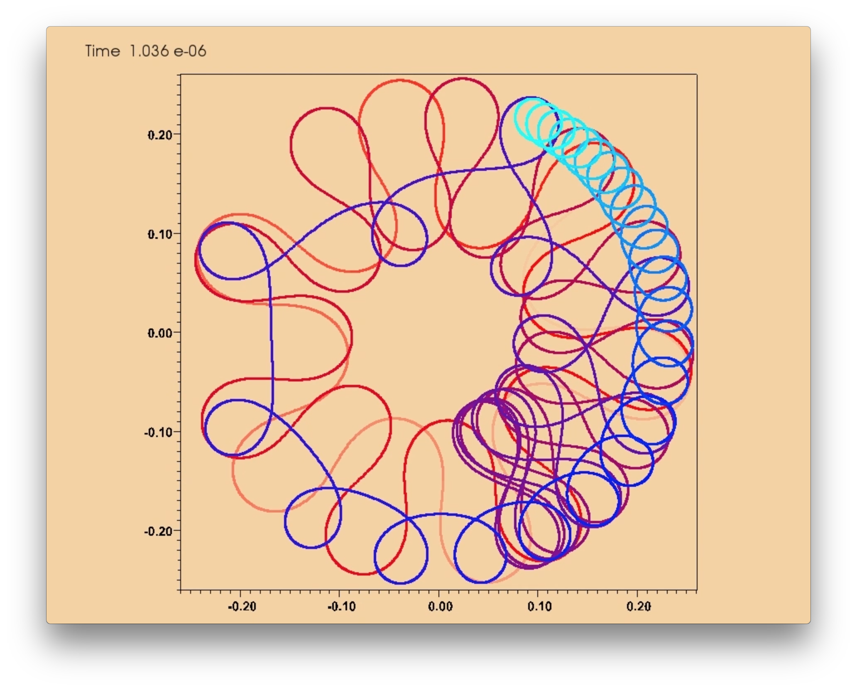
Visualization of 1 Particle Can Be Interesting:
Simulation of Ion Path as Energy Decreases
Trajectory starts as betatron.
Transitions to Figure 8.
Finally becomes cyclotron.
Color is a history trace of the
particle. Cyan = most recent.
http://w3.pppl.gov/~efeibush/movies
m3_720.mov
Notes:
Make Safari the default browser so right click gives option to open with QuickTime player.

Slide 23
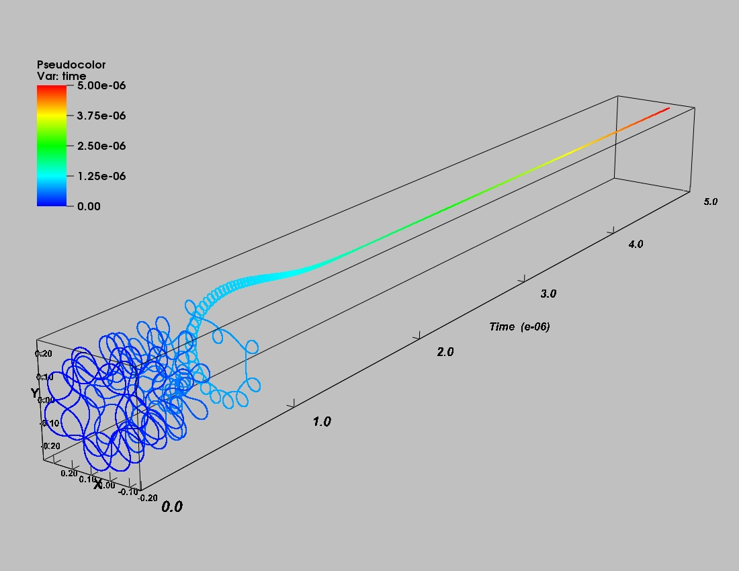
Visualization of 1 Particle
f(x, y, time) in one picture
Color = time index
Vis of time axis in 3D
Notes:
Different run than movie, different time scale.

Slide 24
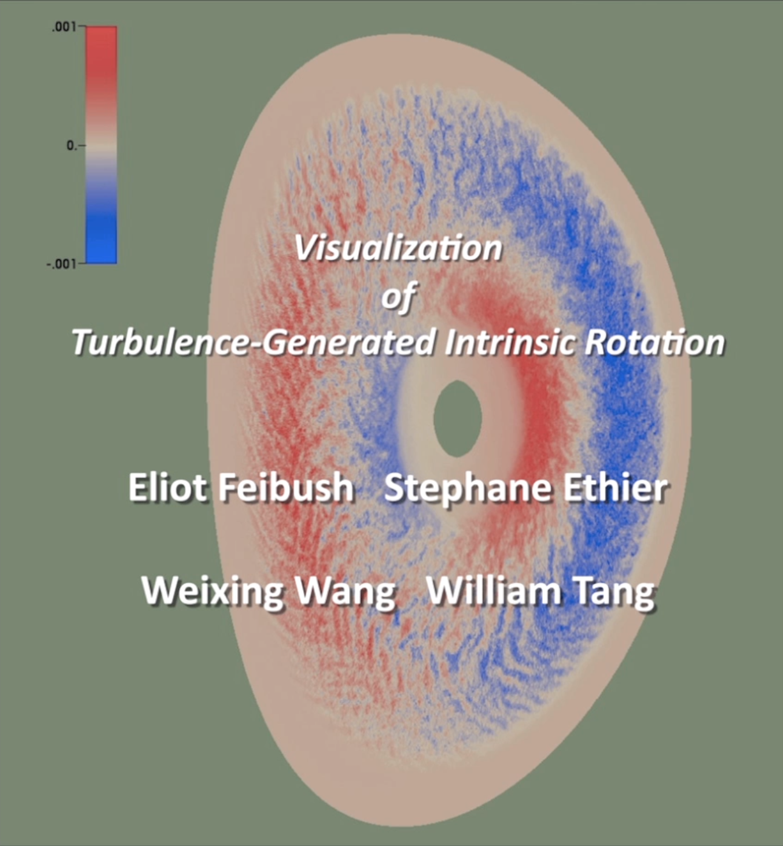
Time Step Simulation
Many particles
Render each time step to a PNG image.
Combine images to create animation.
http://w3.pppl.gov/~efeibush/movies tfden.mov
Notes:
Make Safari the default browser so right click gives option to open with QuickTime player.
Iphone version

Slide 25
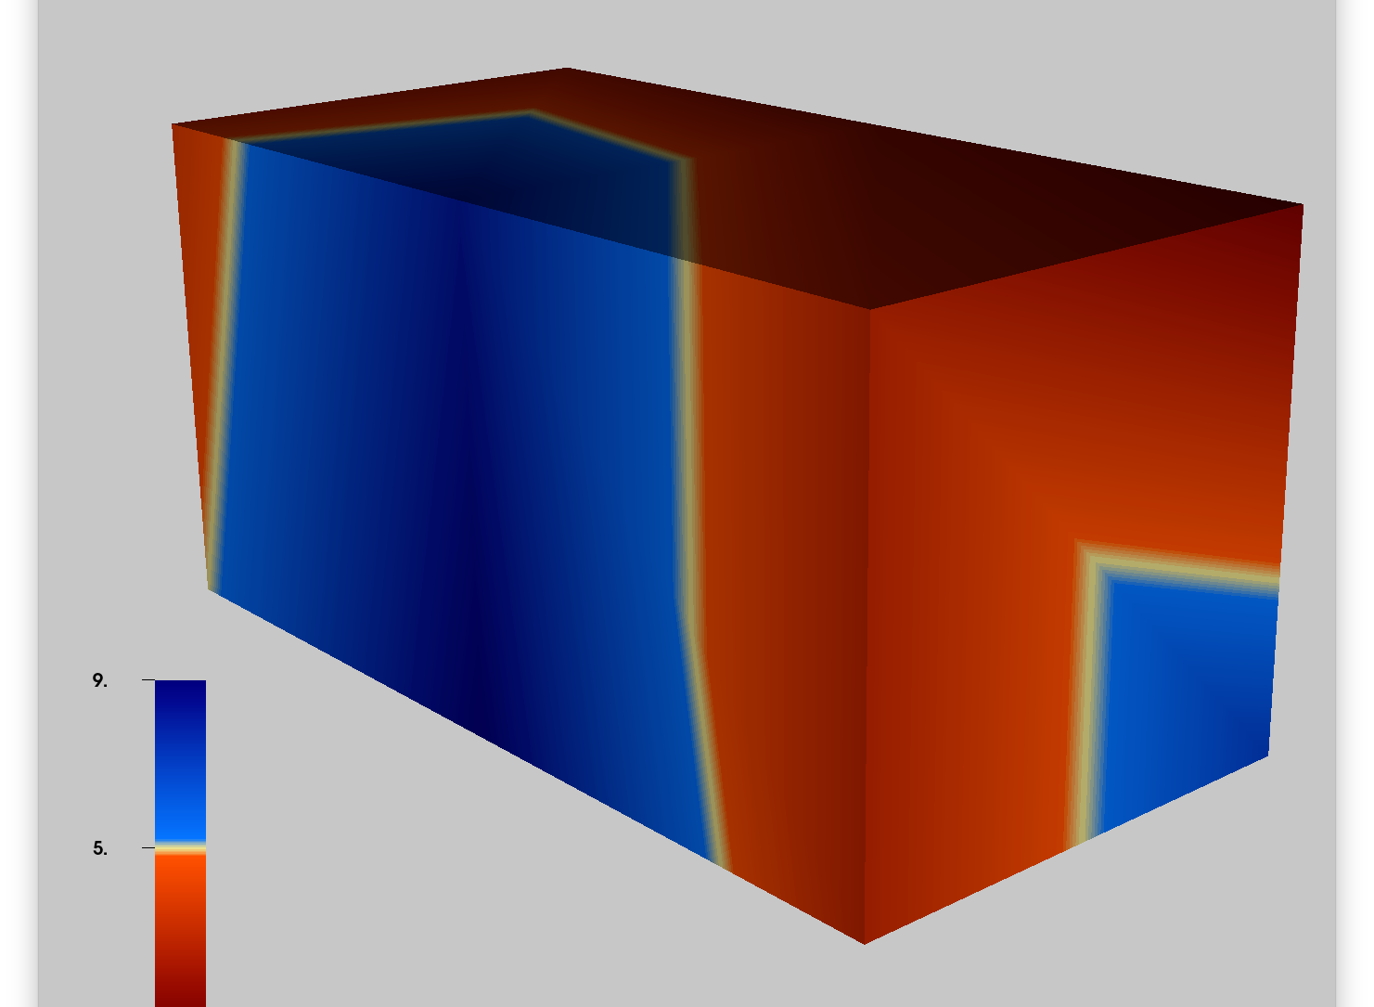
Continuous 3D Grids
3D volume of data
f(x,y,z)
Specify data at grid locations.
VisIt interpolates among grid points in all 3 directions.
Apply Operators to explore & examine data.

Slide 26
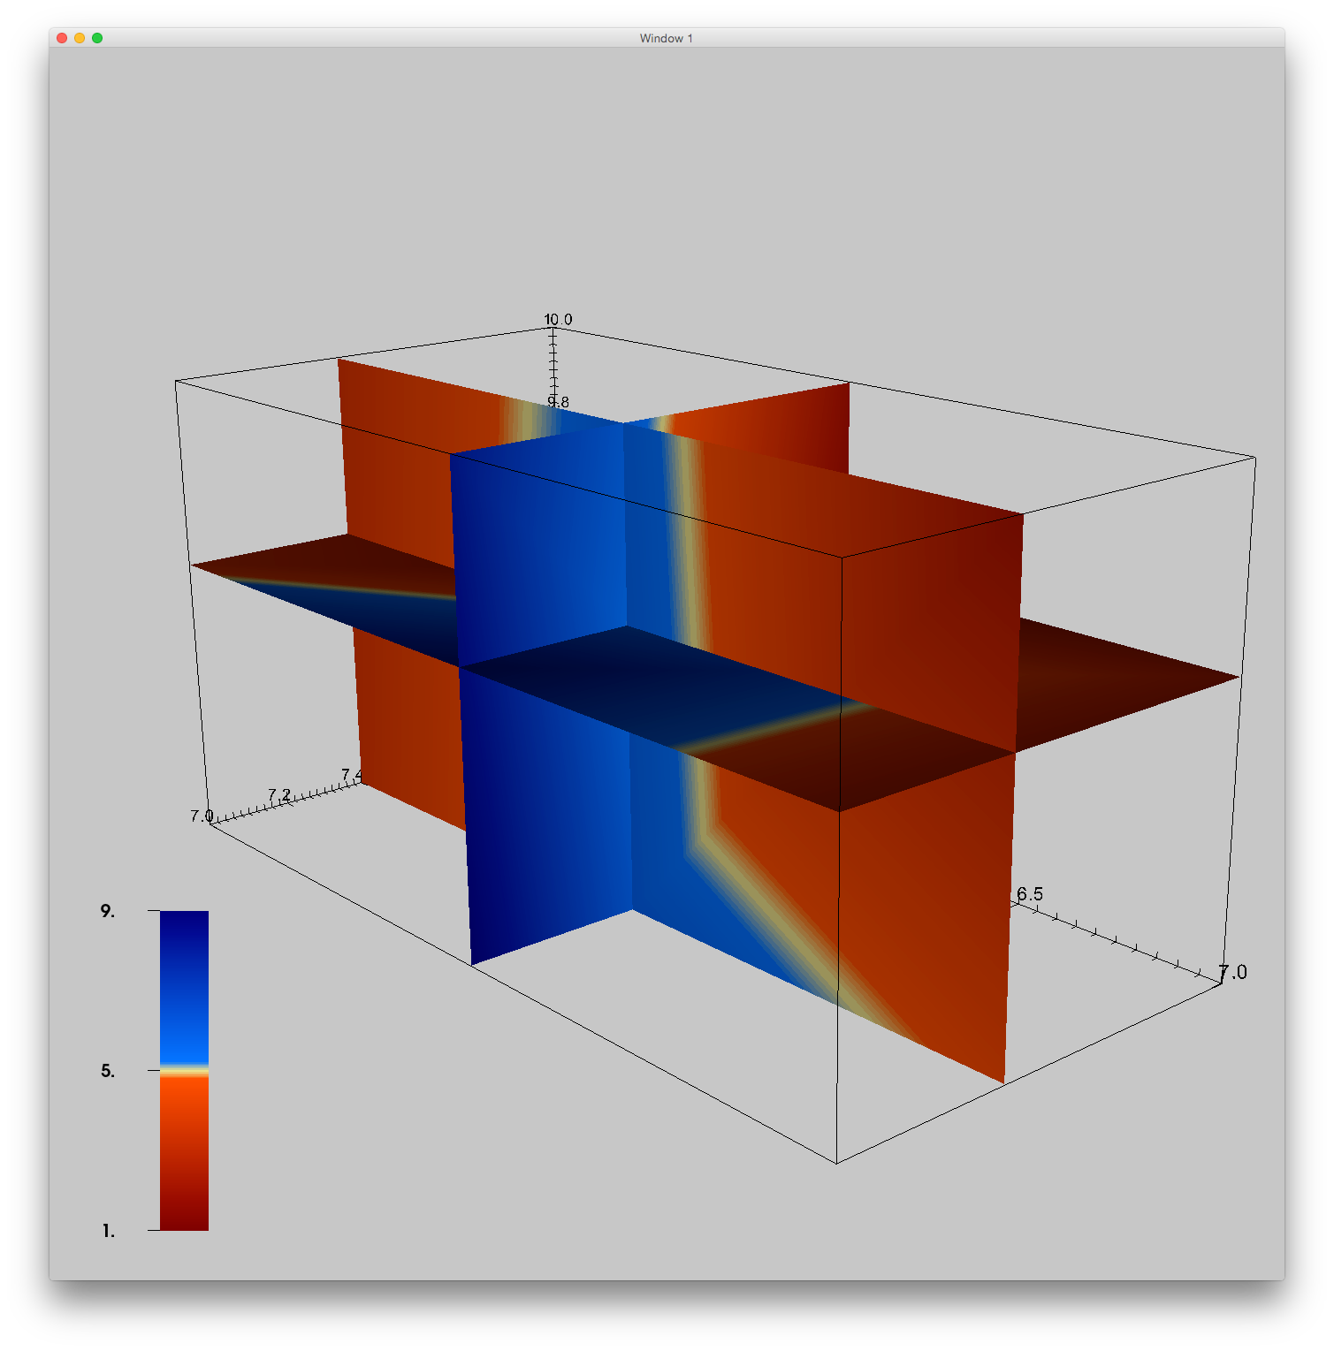
Continuous volume of data: Sliceable
Notes:
Nubeam neutral densities from TRANSP run

Slide 27
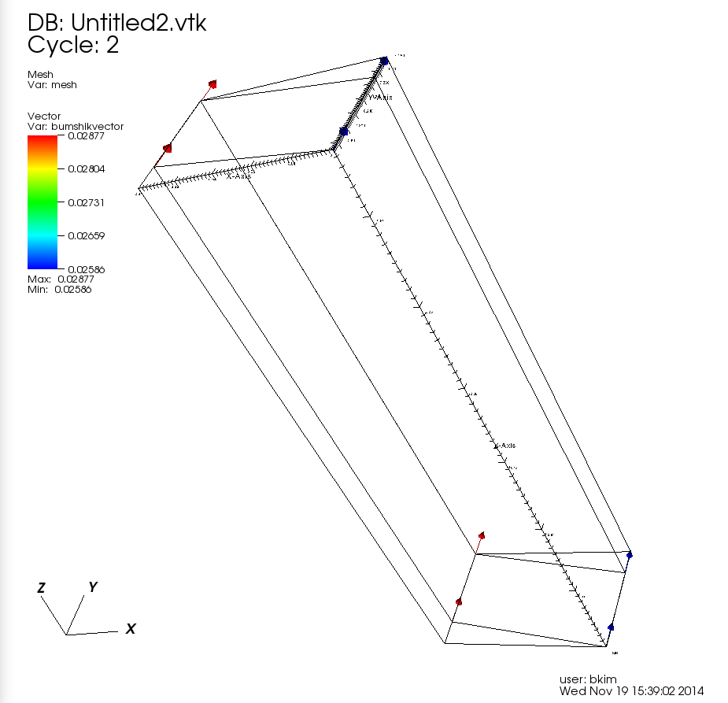
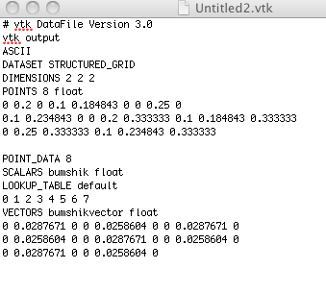
Structured Grids + Vectors

Slide 28
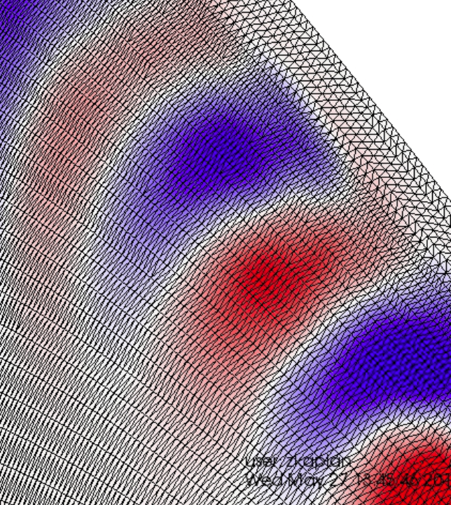
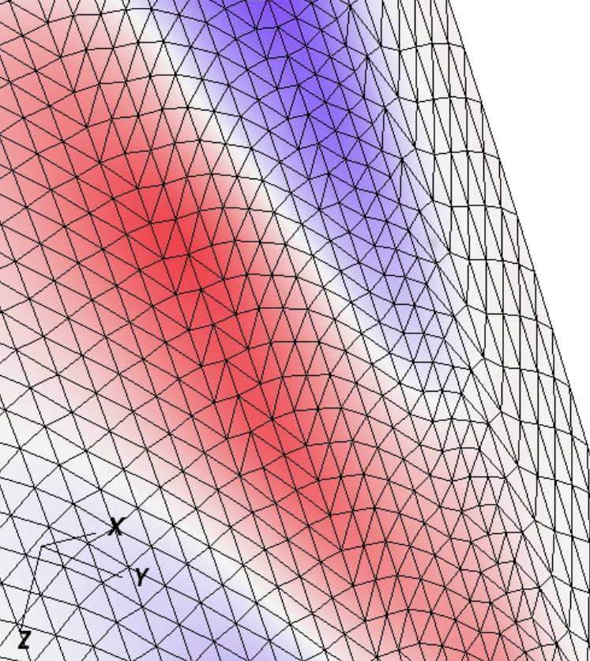
GTS Complex Grid – Poloidal Rings

Slide 29
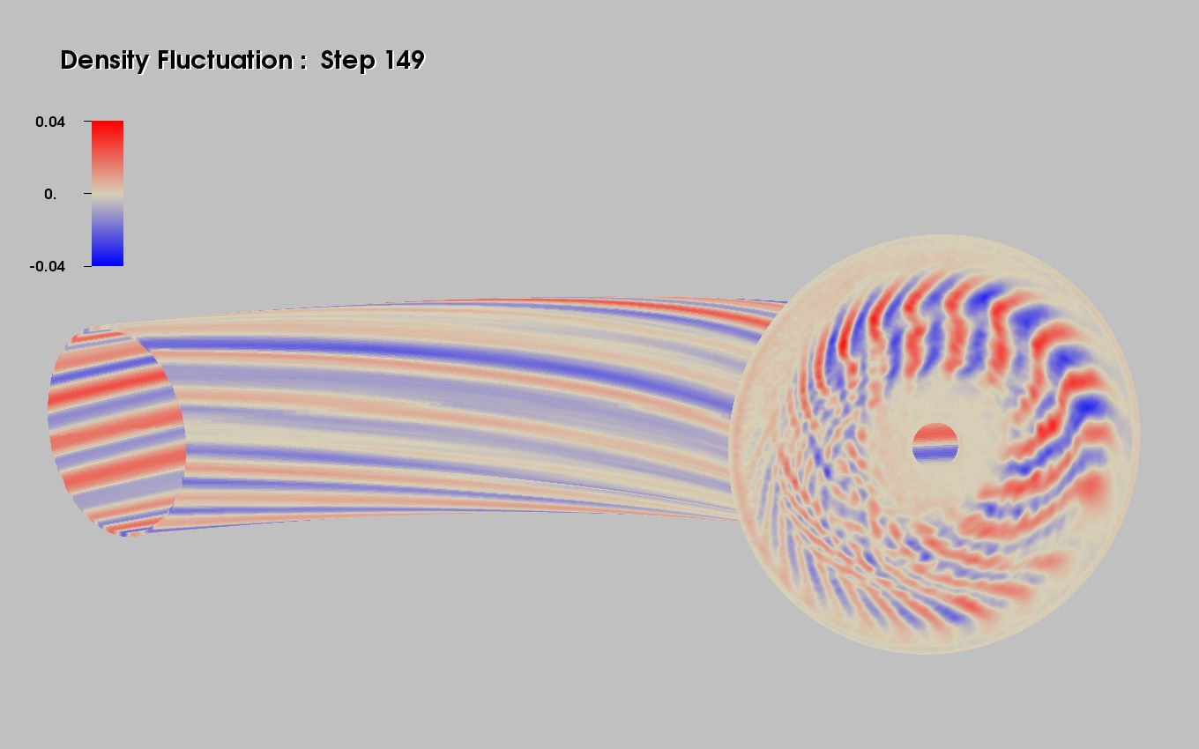
GTCP Simulation
Notes:
Divergent color map – neutral around 0, 2 colors diverge + -

Slide 30
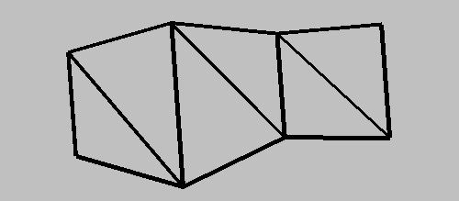
Grid Summary
Structured Points – uniform spacing
Rectilinear Grid – non-uniform spacing
Structured Grid – non-orthogonal
Unstructured Grid – any combination of polygons
Triangle Strip
__________________
Paraview wiki Users Guide VTK_Data_Model

Slide 31
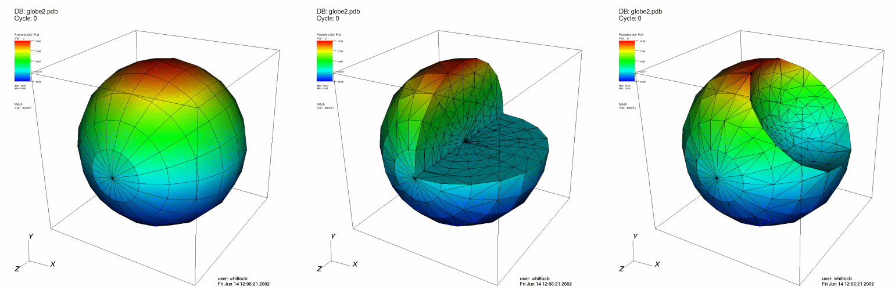
Clip operator – Geometric selection
The Clip operator clips 2D or 3D plots against planes or a sphere to remove sections of the plots
Use this operator when you want to see a cross section of a 3D plot, while still leaving the plot in 3D
Original plots
Plots clipped by 2 planes
Plots clipped by a sphere
Notes:
Select → Box

Slide 32
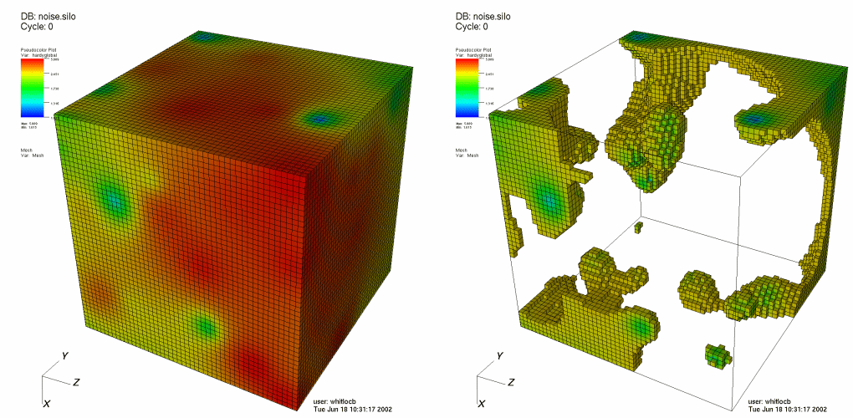
Threshold operator – Data value selection
Removes cells whose value is not in the specified range.
Use this operator to look at cells that have values within a numerical range.
Notes:
similar to isosurface, more like isorange

Slide 33
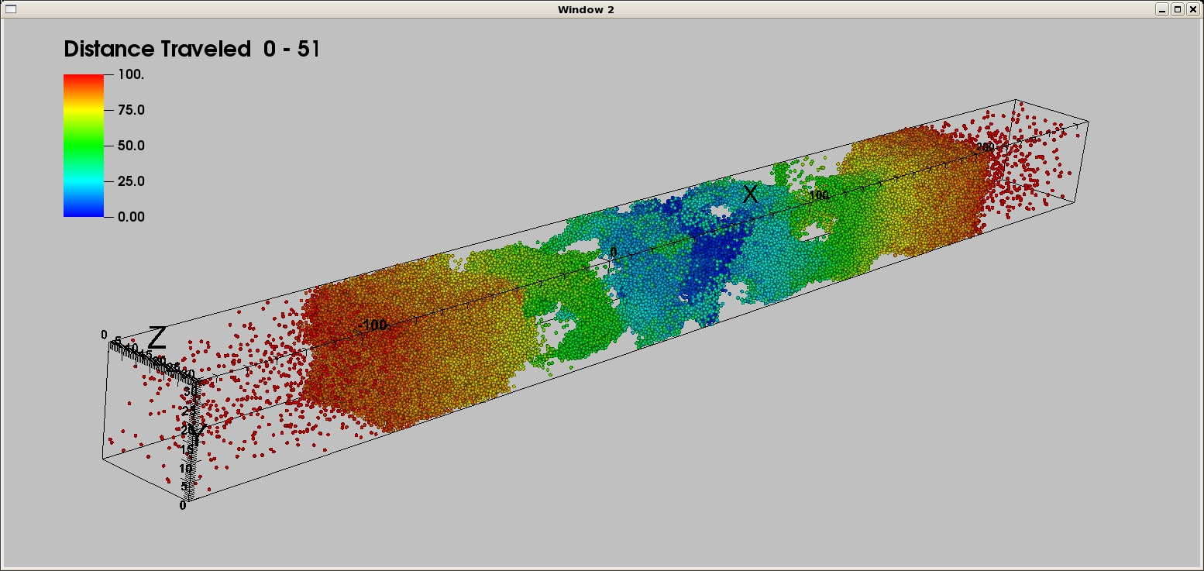
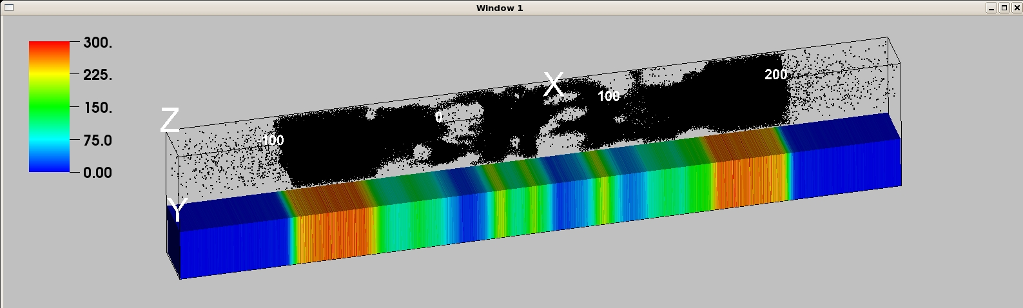
Molecular Dynamics Example
Draw points as spheres
Data Binning Operator quantifies particle density
Notes:
Operators→Analysis→DataBinning
1200 bins in X direction
Uses .Point3D file as input data

Slide 34
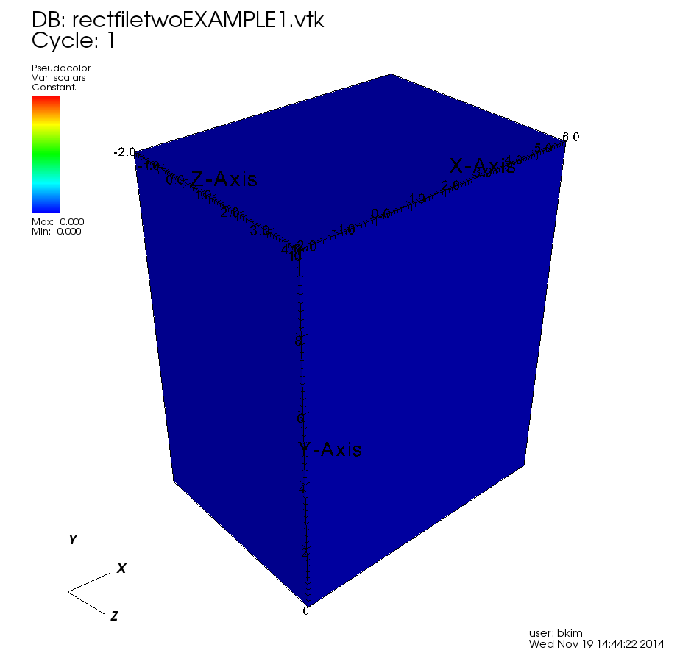
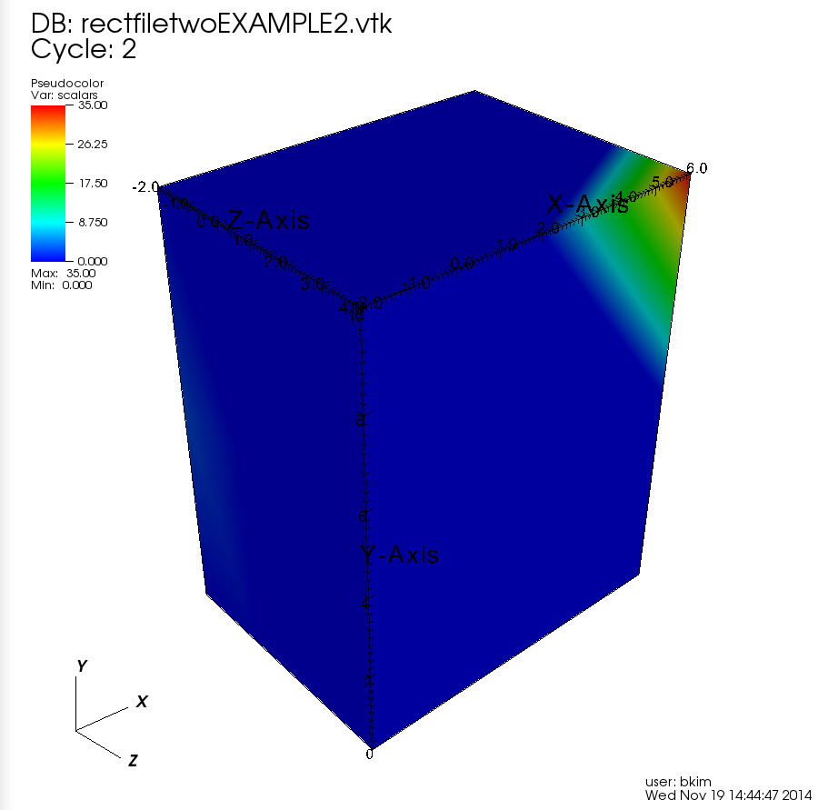
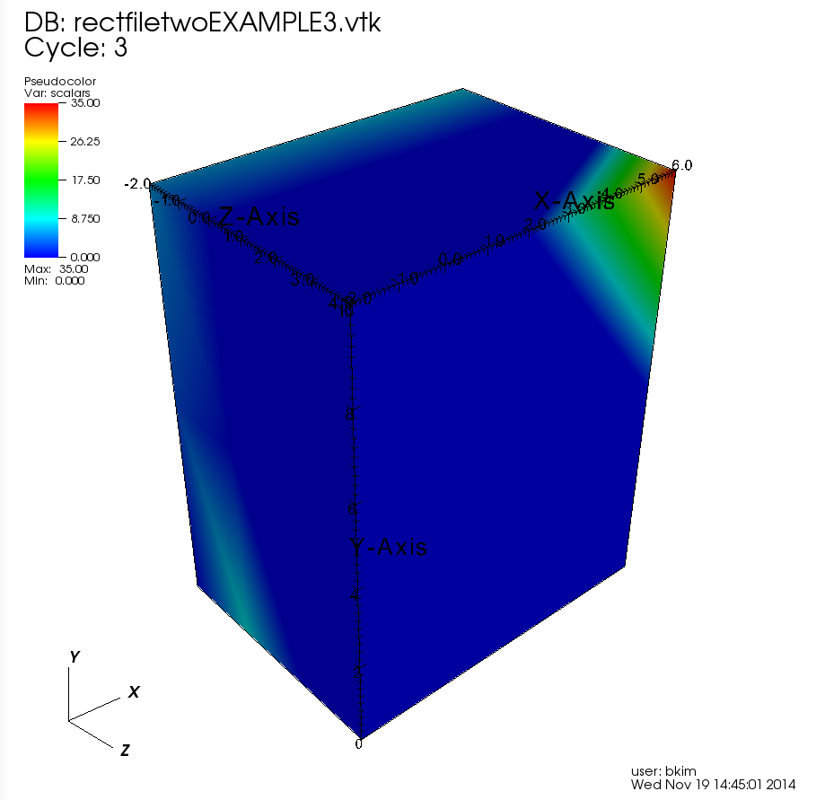
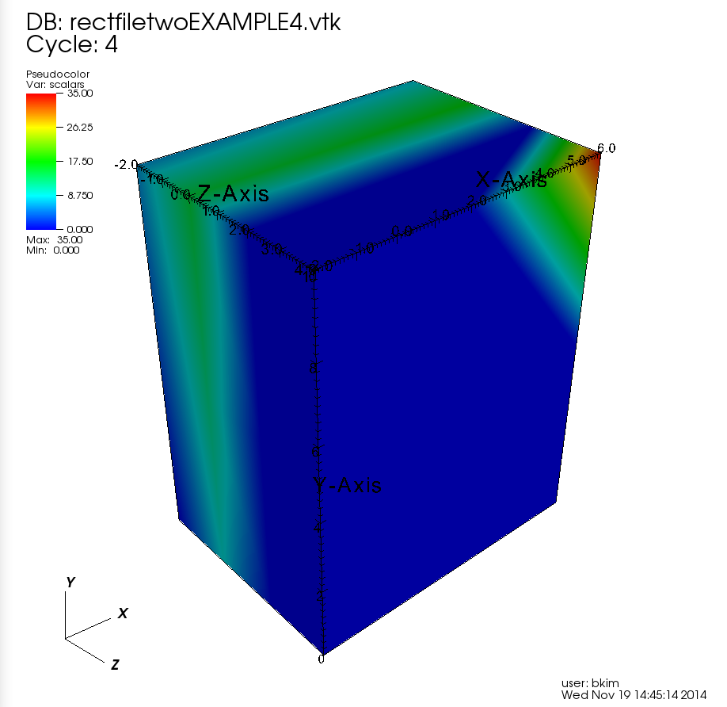
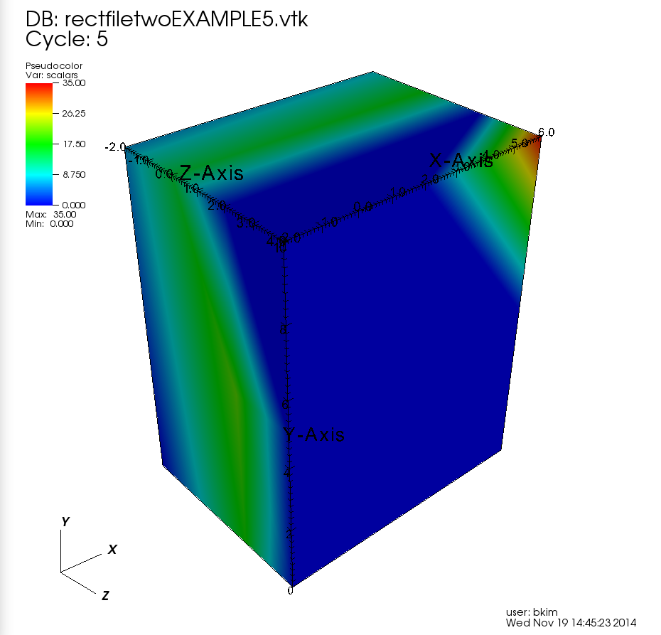
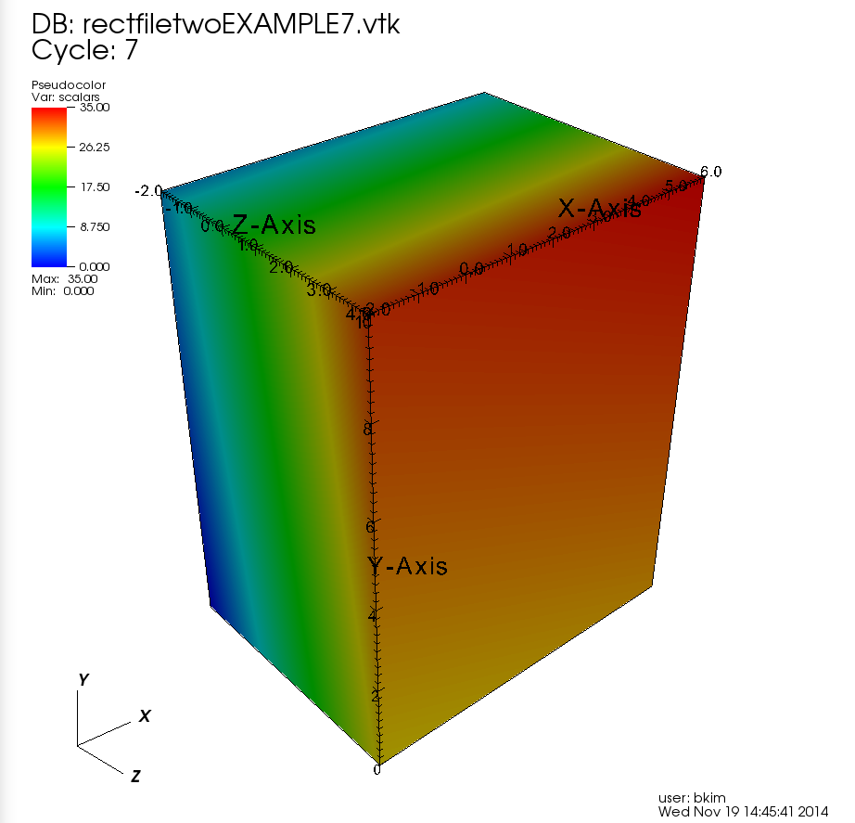
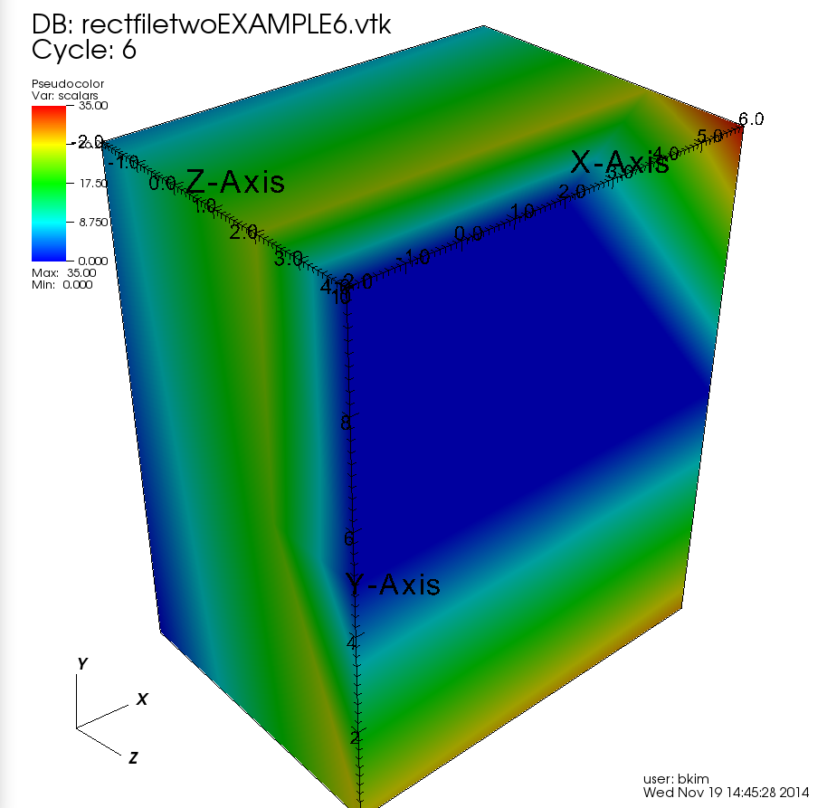
Time Steps f(x,y,z,t)
VisIt automatically reads files named in numerical order for time step visualization.
Notes:
File Grouping: on / off
Block of data changing over time. Cycle 1 : 7

Slide 35
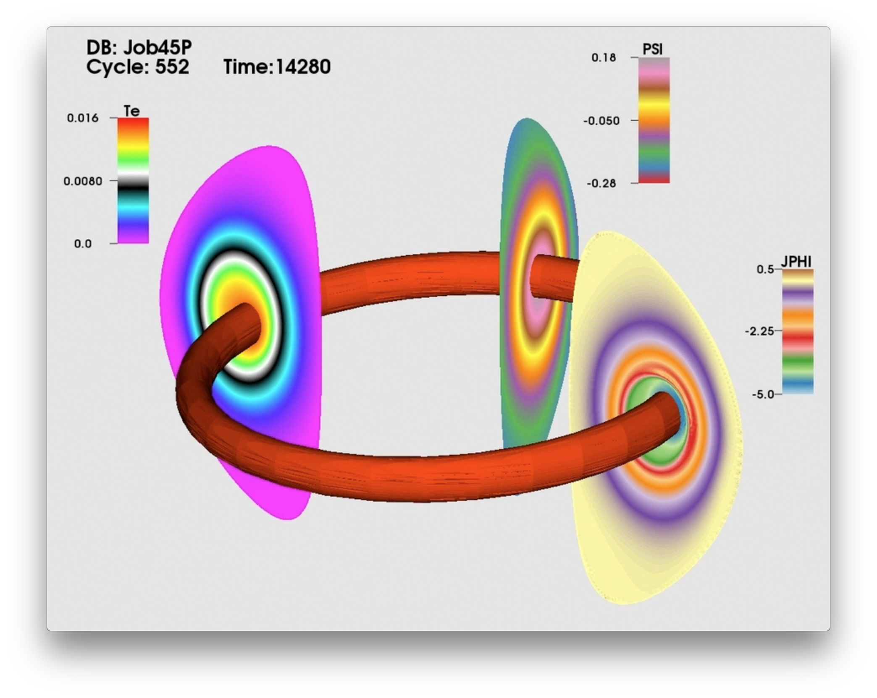
Isosurface of Te = .015 at each time step.
Shows 3 variables concurrently.
http://w3.pppl.gov/~efeibush/movies teiso015.mov

Slide 36
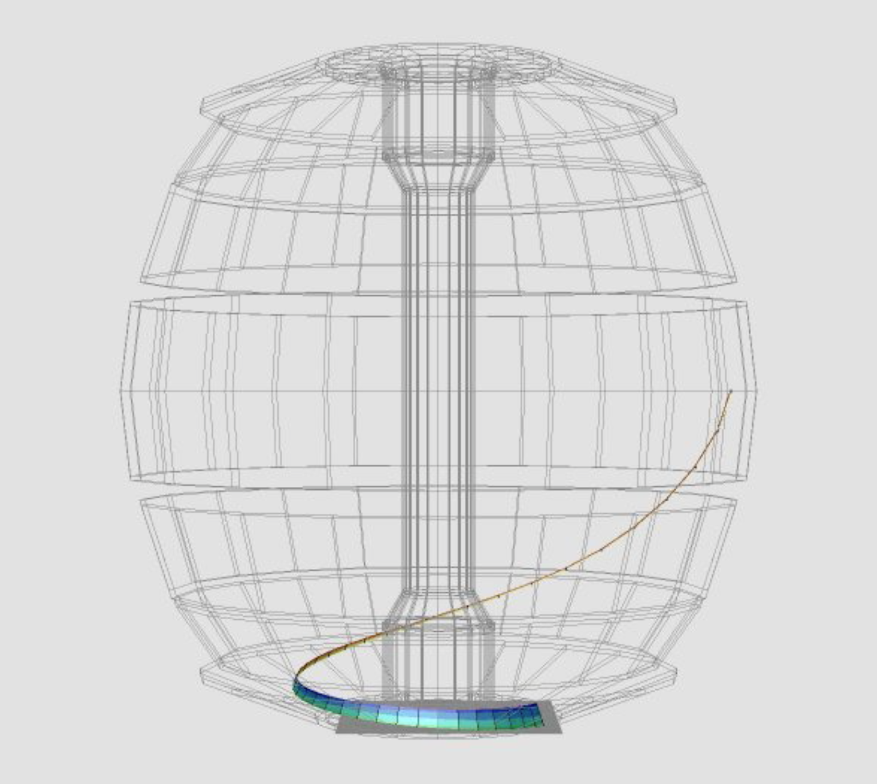
NSTX Magnetic Field Lines
http://w3.pppl.gov/~efeibush/movies
nstx_fl.mov

Slide 37
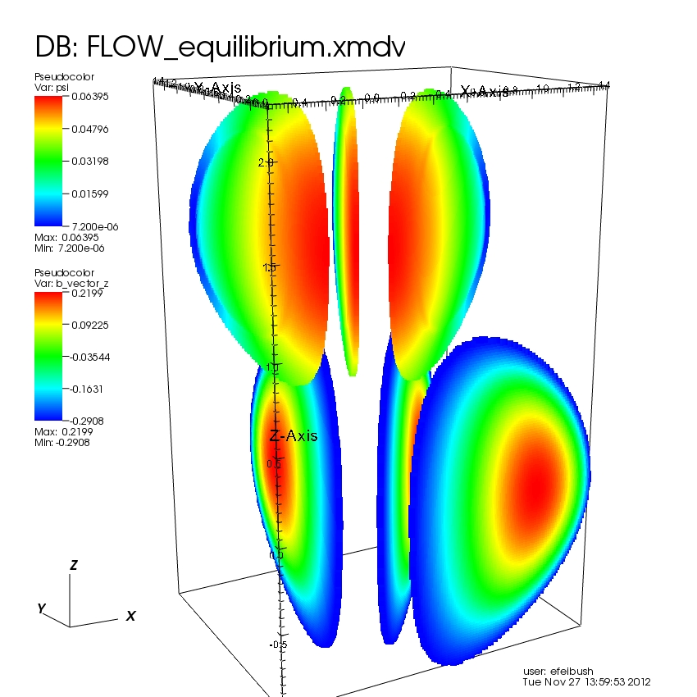
Transforms
Relocate geometry
Translate
Rotate
Scale

Slide 38
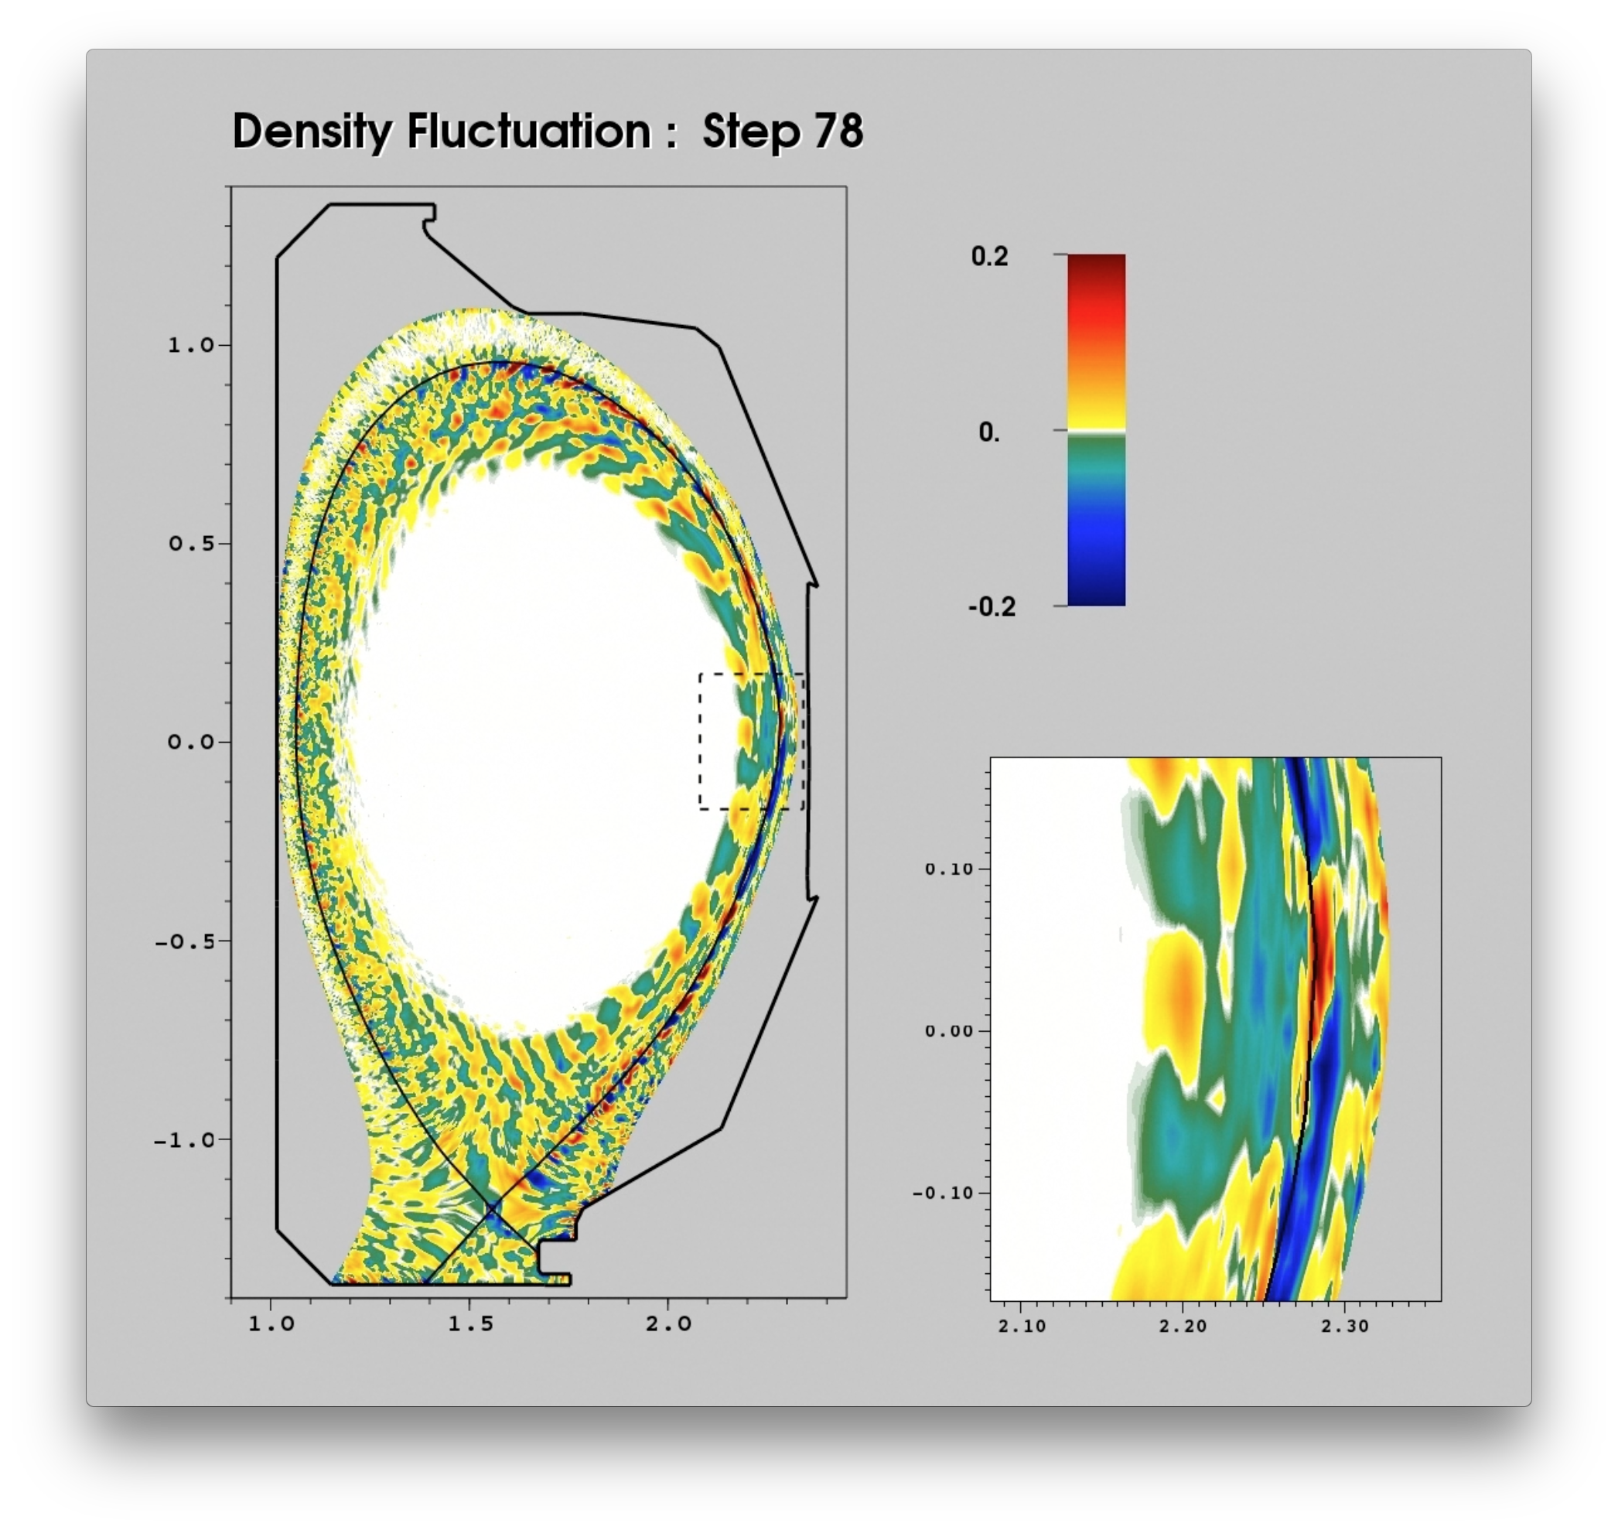
Time Step Simulation
Render overview
+
Region of Interest
Combine images for movie.
Bifurcated colormap.
http://w3.pppl.gov/~efeibush/movies deninsetb1080.mov

Slide 39
Animation
Time step
Variable index
Geometry change
View
Operators (slice, clip, etc.)
Simple VTK time steps
or jpeg files → QuickTime .mov
Complex python scripting
Python interpreter -
import myscript
[ edit, retry ]
reload(myscript)

Slide 40
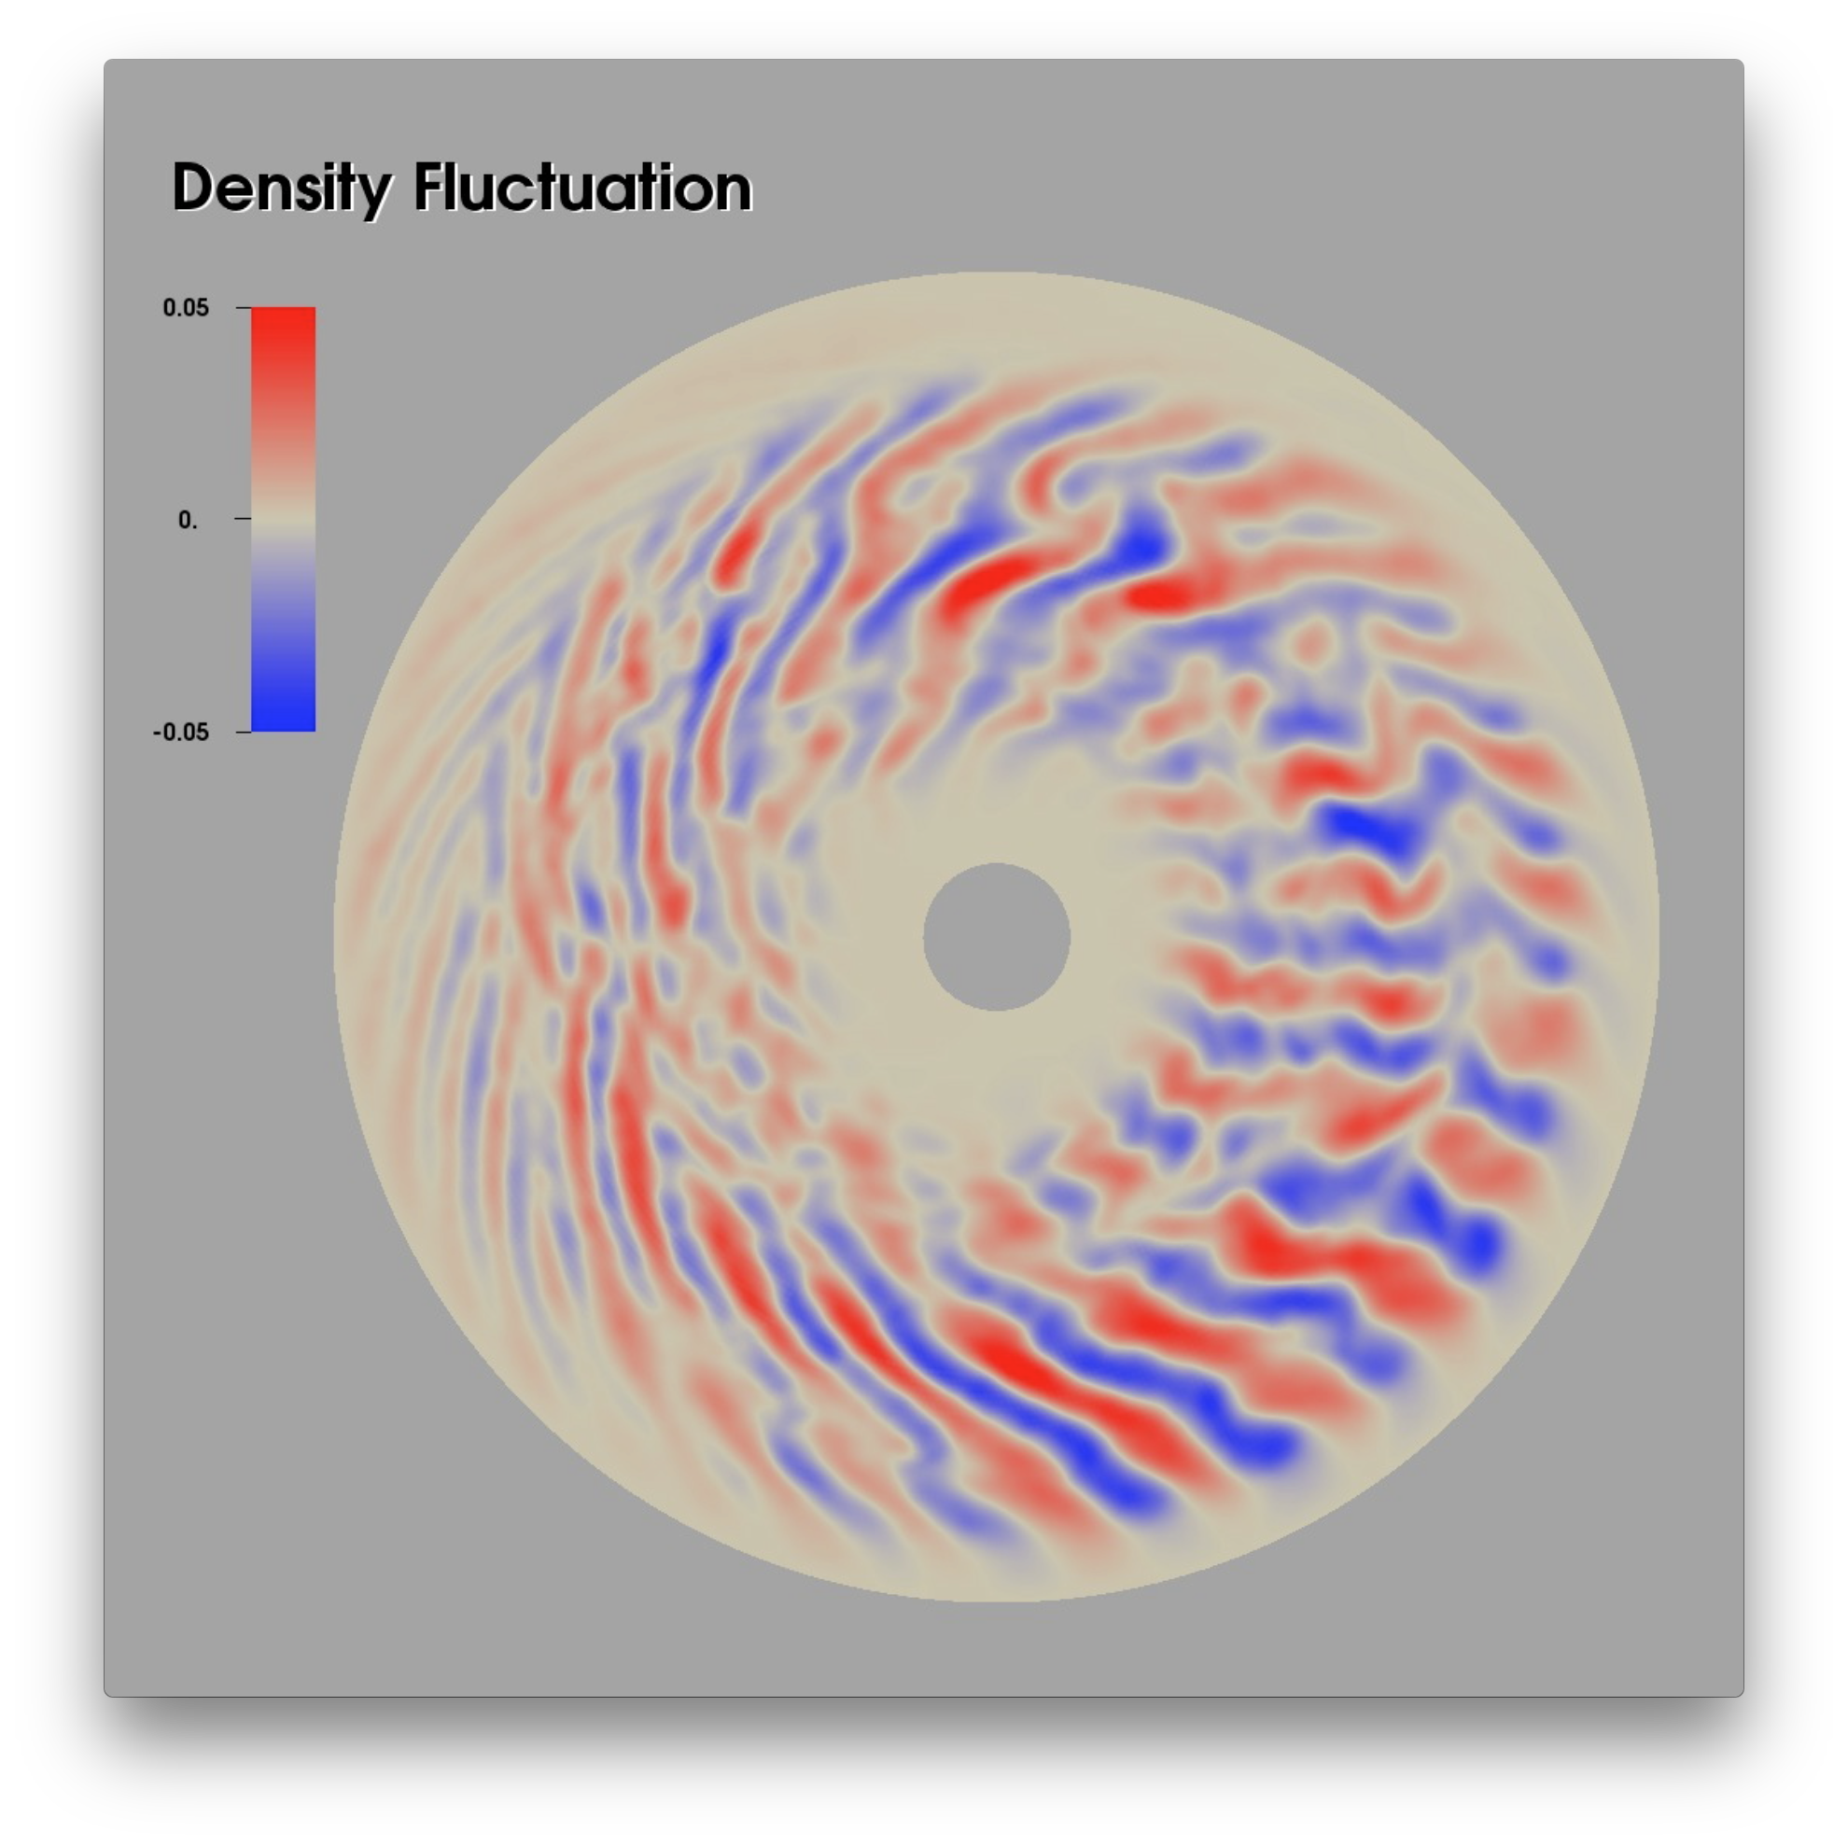
Short Time Steps Avoid Temporal Aliasing
Increasing the sim time between vis steps increases chance of missing some movement or behavior.
Render on shorter sim time makes for smoother movies, avoids jumps.
Notes:
ahd10.mov
den50_6.mov

Slide 41
Movie Maker Program (1)
ffmpeg
  Most comprehensive
  Command line Linux
Notes:
Use QuickTime MoviePlayer to compress up to 10x.

Slide 42
Movie Maker Program (2)
Java – portable to Linux, Mac, Windows
  Based on Sun’s old javax.media package.
Reads all images in directory – JPEG, PNG
  ImageMagick: mogrify -resize 100% *.jpeg
Creates QuickTime movie file - .MOV
princeton.edu/~efeibush/makemovie
iJpegImagesToMovie.jar
Notes:
Use QuickTime MoviePlayer to compress up to 10x.

Slide 43
Movie Maker Program (3)
Adobe Premier, iMovie
Titles, Video, Audio
Lewis Science Library:
Digital Learning Library - resources

Slide 44
Summary of Visualization Features
Plots + Attributes
Mesh
Pseudocolor
Points, Lines, Vectors, Polygons, Mesh – Color Tables
Contour
Molecule
Volume
Data files
VTK
Point3D, xmdv
Transform operators
Scale, Rotate, Translate
Selection operators
Clip
Box
Threshold
Slicing operators
Slice, ThreeSlice
Isosurface
Viewing
Lighting, Shadow, Depth-Cue
Annotation
Animation
Simple Time Slider movie
Python scripting
PNGs to QuickTime movie

Slide 45
High-End Vis Workstation
Data & graphics intensive
Dell 7910 $2,000
Nvidia GPU 2,000 – 4,000
2560 x 1600 monitor 1,000
$5,000 - $7,000

Slide 46
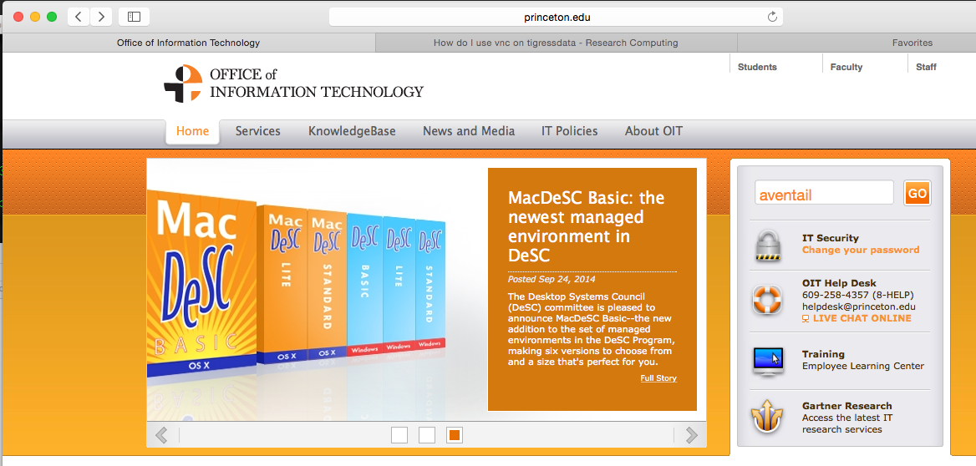

ssh tigressdata
Wireless Considerations
    How to ssh to tigressdata — Aventail — VPN
OIT web page - search for aventail
How do I connect to University online resources from off-campus?

Slide 47


tigressdata.princeton.edu
File System
df command shows:
/tigress
    /hecate/scratch
    /tiger/scratch/gpfs Scratch directories
        /della/scratch/gpfs

Slide 48
tigressdata Remote Vis
TurboVNC remote desktop, Client - Server architecture
3 Step Process
Start vncserver on tigress data
Establish tunnel from your computer to tigress data
Run vncviewer on your computer (client)
            search: turbovnc
            Install from sourceforge.net/projects/turbovnc

Slide 49
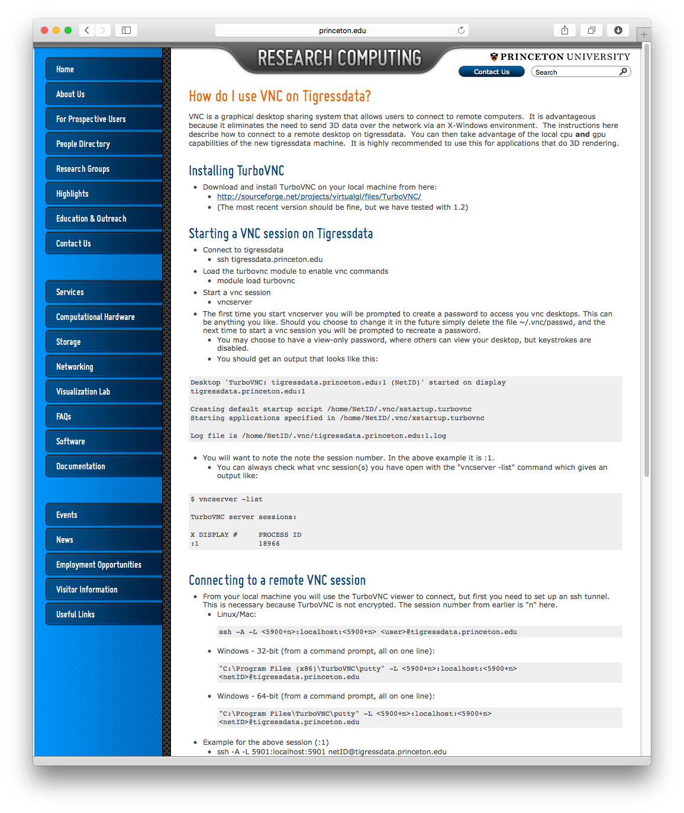
PICSciE FAQ #16
PICSciE FAQ #16

Slide 50
1. Start VNC Server
ssh tigressdata
$ module load turbovnc
$ vncserver
$ vncserver -list
              note X Display # such as :2
              First time: create password, stored in ~/.vnc/passwd (delete file to reset)

Slide 51
2. Establish Tunnel
(because turbovnc is not encrypted)
ssh -A -L 5902:localhost:5902 efeibush@tigressdata
5900 + X Display # (hence step 2 is after step 1)
-A Enables authentication forwarding.
-L Enables client-server port-to-port connection.

Slide 52
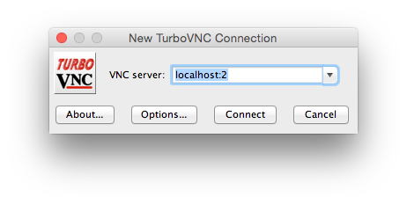
3. Run turbovnc locally
Enter your .vnc/passwd

Slide 53

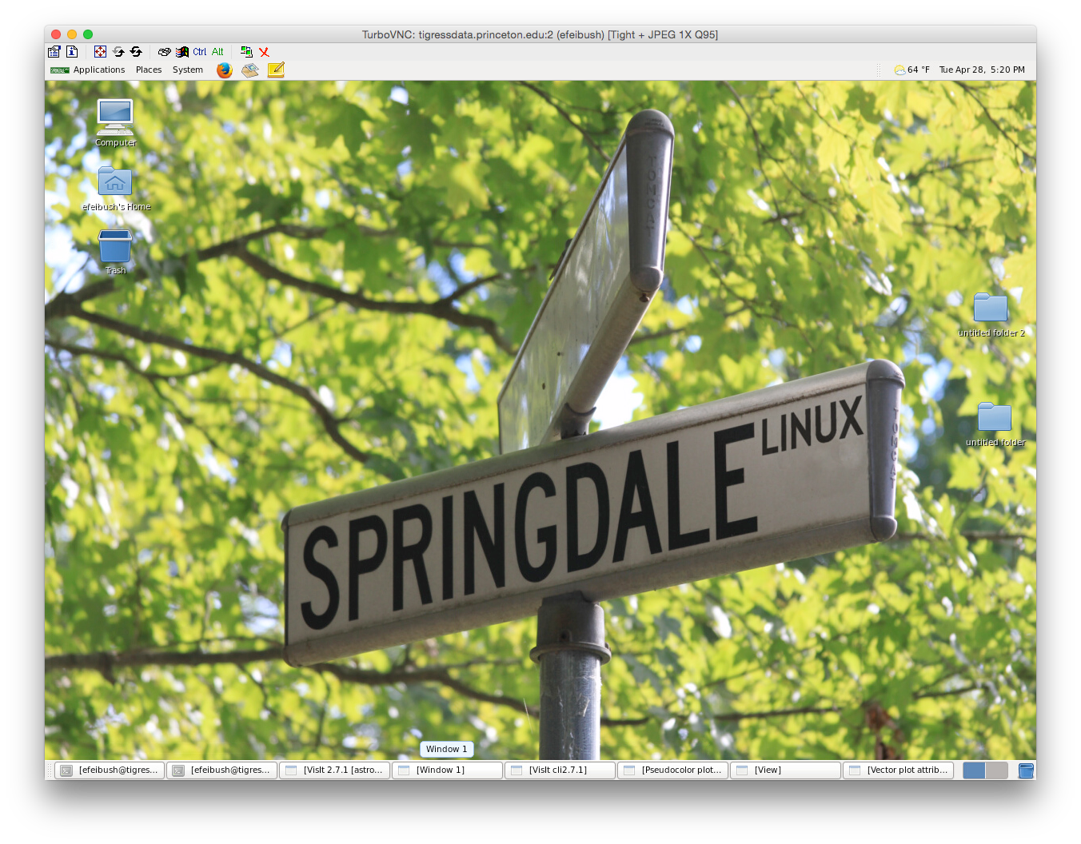
client: turbovnc viewer

Slide 54
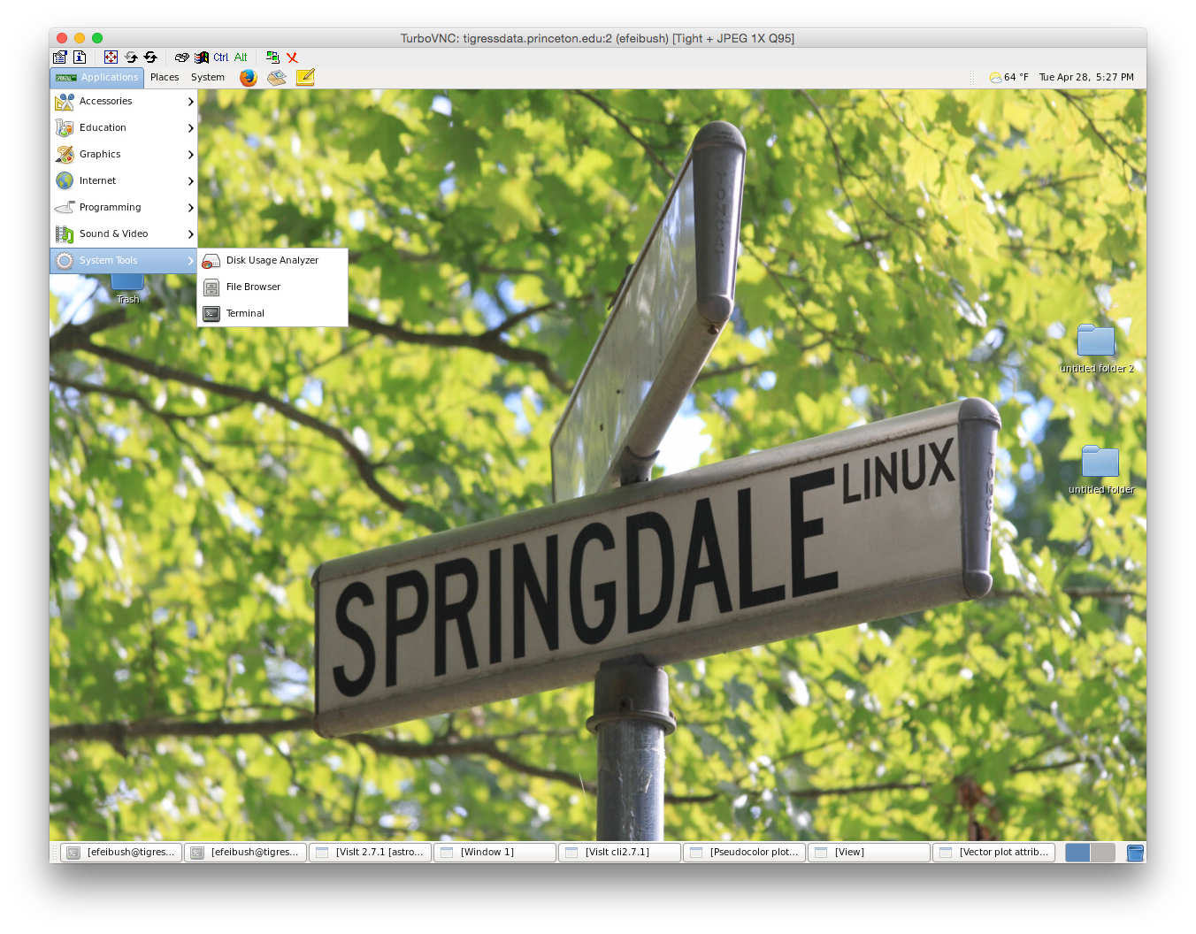
Notes:
module load virtualgl
module load visit or module load paraview
vglrun visit
vglrun paraview

Slide 55



Slide 56
File —> Open
Host: tigressdata.princeton.edu
Path: /della/scratch/gpfs/efeibush/astro
Serial
rt.vtk 1 GB
Add Pseudocolor —> density
Options —> Rendering
12 frames per second

Slide 57
https://wci.llnl.gov/simulation/computer-codes/visit → Downloads
Just search for: “visit visualization”
Resources
Getting Data Into VisIt - document ( & your project )
VTK File Formats - vtk.pdf on my Princeton website:
www.princeton.edu/~efeibush apcvis.pdf
Visualization with Visit mini-course
scivis2016.pdf – step-by-step VisIt 12/7
visitusers.org paraview.org
search ...
Thursday 2 pm PICSciE weekly walk-in help session
Notes:
Don’t be shy about large text data files. I have some that are 30 MB.
Show VTK file document.

Slide 58




Workflow

Slide 60

NCSX Particle Vis
http://w3.pppl.gov/~efeibush/movies
beams3d_ncsx_1080.mov

