Slide 1
Python Numpy Programming Eliot Feibush Zach Kaplan Bum Shik Kim Princeton Plasma Physics Laboratory PICSciE Princeton Institute for Computational Science and Engineering
Notes:
Picscie python programming series

Slide 2
Review
Integers
Floating Point
Dynamic Typing – no declarations
x = 5
y = 6.3
Names start with a letter, cAsE SeNsiTiVe.
Long names OK.

Slide 3
Review Character Strings
Dynamic typing – no declaration
No memory allocation
Immutable
s = “Good Afternoon”
len(s) # length of string

Slide 4
Review String Slicing
s = “Good Afternoon”
s[0] evaluates to “G”
s[5:10] selects “After” # string slicing
s[:10] selects “Good After”
s[5:] selects “Afternoon”
s[-4:] selects “noon” # last 4 characters
Notes:
String slicing is very useful when you start thinking about strings: beginning, end, first character, last character, etc.

Slide 5
String Methods
String is a Class with data & subroutines:
t = s.upper()
pos = s.find(“A”)
_____________________________________
first = “George”
last = “Washington”
name = first + “ “ + last
# string concatenation
Notes:
Can also use single quotes to surround a string

Slide 6
Review Lists
Ordered sequence of items
Can be floats, ints, strings, Lists
a = [16, 25.3, “hello”, 45]
a[0] contains 16
a[-1] contains 45
a[0:2] is a list containing [16, 25.3]
Notes:
Very flexible but not high performance

Slide 7
Create a List
days = [ ]
days.append(“Monday”)
days.append(“Tuesday”)
years = range(2000, 2014)
Notes:
ranges from the number you want to the first number you don’t want
You can define your own irange function to include the last number
You can define your own frange function to return a list containing floating point numbers
7

Slide 8
List Methods
List is a Class with data & subroutines:
d.insert( )
d.remove( )
d.sort( )
Can concatenate lists with +

Slide 9
String split
s = “Princeton Plasma Physics Lab”
myList = s.split() # returns a list of strings
print myList
[ “Princeton”, “Plasma”, “Physics”, “Lab” ]
help(str.split) # delimiters, etc.
Notes:
Now that we have reviewed lists, we can add the string split method
First step in parsing
9

Slide 10
Tuple
Designated by ( ) parenthesis
A List that can not be changed. Immutable.
No append.
Good for returning multiple values from a subroutine function.
Can extract slices.

Slide 11
Review math module
import math
dir(math)
math.sqrt(x)
math.sin(x)
math.cos(x)
from math import *
dir()
sqrt(x)
from math import pi
dir()
print pi
Notes:
A python source code file of classes is a module.
import a module or some classes from a module
11

Slide 12
import a module
import math # knows where to find it
___________________________________
import sys
sys.path.append(“/u/efeibush/python”)
import cubic.py # import your own code
_____________________________________
if task == 3:
import math # imports can be anywhere
Notes:
Something new about imports
It’s not on the test.
12

Slide 13
Review Defining a Function
Block of code separate from main.
Define the function before calling it.
def myAdd(a, b): # define before calling
return a + b
p = 25 # main section of code
q = 30
r = myAdd(p, q)
Notes:
if p = “hello” and q = “goodbye” it will return “hellogoodbye”
13

Slide 14
Keyword Arguments
Provide default values for optional arguments.
def setLineAttributes(color=“black”, style=“solid”, thickness=1):
...
# Call function from main program
setLineAttributes(style=“dotted”)
setLineAttributes(“red”, thickness=2)
Notes:
For methods that have many arguments
Need this technique for graphing later today.

Slide 15
Looping with the range() function
for i in range(10): # i gets 0 - 9
range() is limited to integers
numpy provides a range of floats
Notes:
xrange() – generates number as needed instead of creating all numbers initially
First homework assignment is to write frange that returns a list of floats.
15

Slide 16
Summary
Integer, Float
String
List
Tuple
def function
Keywords: if elif else
while for in
import print
Indenting counts :
Notes:
An indent always starts after a colon.
Outdent does not have a specific character or symbol.

Slide 17
Run python as Interpreter
type()
dir()
help()

Slide 18
numpy module
ndarray class
Items are all the same type.
Contiguous data storage in memory of items.
Considerably faster than lists.
Class with data and methods (subroutines).
Notes:
Guess what nd stands for? N-dimensional
spell checker on numpy: bumpy, dumpy, & lumpy. Just need Grumpy and you have the 7 Dwarves.
18

Slide 19
numpy module
ndarray class
import numpy
dir()
dir(numpy)
help(numpy)
help(numpy.ndarray) # class
help(numpy.array) # built-in function
Notes:
Guess what nd stands for? N-dimensional module can be referred to as a package site-packages directory
spell checker on numpy: bumpy, dumpy, & lumpy. Just need Grumpy and you have the 7 Dwarves.
19

Slide 20
numpy module
import numpy
dir(numpy)
help(numpy.zeros) tuple
a = numpy.zeros( (3,5) )
# create 3 rows, 5 columns
[ [ 0., 0., 0., 0., 0. ],
[ 0., 0., 0., 0., 0. ],
[ 0., 0., 0., 0., 0. ] ]
# default type is float64
Notes:
Store in memory as C or Fortran ordering
Try to match your accessing order
20

Slide 21
numpy Array Access
Access order corresponding to printed order:
[row] [column] index starts with 0
a[0][2] = 5
[ [ 0., 0., 5., 0., 0. ],
[ 0., 0., 0., 0., 0. ],
[ 0., 0., 0., 0., 0. ] ]
Notes:
Store in memory as C or Fortran ordering
Try to match your accessing order
21

Slide 22
idle
Integrated Development Environment (IDE)
Color-coded syntax
statement completion
debugger
Written in Python using tkinter GUI module
Notes:
OK for getting started
Use Eclipse for big project

Slide 23
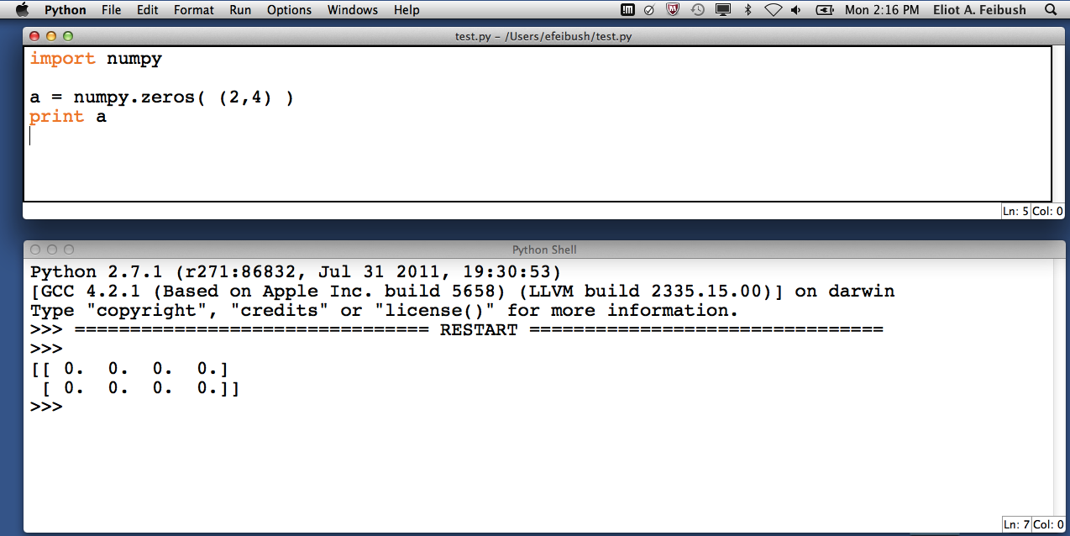
idle IDE
Can save text in interpreter window to a file.
control-p control-n to recall commands
Notes:
File-→ Save

Slide 24
Programming Exercise Prep
Mac: Editing source code
Textedit
Preferences
Format: Plain text
Open and Save
Uncheck: Add .txt extension
Save: File Format – Plain Text
Notes:
Mac; textedit, vi, emacs, nano, word exdeg.py
Windows: notepad, notepad++; idle

Slide 25
Programming Exercise Prep
Mac: Run python from command line
Spotlight terminal
$ python myprogram.py
Notes:
Mac; textedit, vi, emacs, nano, word exdeg.py
Windows: notepad, notepad++; idle

Slide 26
Array Index Exercise
Write a python program:
Create an array (6, 3)
Set each element to rowIndex + columnIndex
print the array
edit index.py
python index.py
[ [ 0. 1. 2. ]
[ 1. 2. 3. ]
[ 2. 3. 4. ]
[ 3. 4. 5. ]
[ 4. 5. 6. ]
[ 5. 6. 7. ] ]
Notes:
Mac; textedit, vi, emacs, nano, word exdeg.py
Windows: notepad, notepad++; idle

Slide 27
1. Create Array
a = numpy.linspace(start, stop, nPoints, inclusive)
# array of evenly spaced floats
# begins with start
# ends with stop
# can include/exclude stop True/False
example: 0., 2.5, 101
0., 2.5, 100, False
Useful to make “range” of floats
for i in a:
ndarray has __iter__()
Arrays are iterable
Notes:
linspace() has cleaner stopping behavior than arange()
numpy.arange(0., 2.3, .1)
numpy.arange(-2,2, 2.2, .1)
27

Slide 28
1a. Create Array
alog = numpy.logspace(start, maxExp, nSteps)
Example: 0., 10., 11

Slide 29
2. Create Array
b = numpy.array( [ 2., 4., 6. ] ) # 1-D from list
# range(start, end, incr) returns a list so
b = numpy.array( range(10) )
array([0, 1, 2, 3, 4, 5, 6, 7, 8, 9])
b = numpy.array( ( 2., 4., 6. ) ) # 1-D from tuple

Slide 30
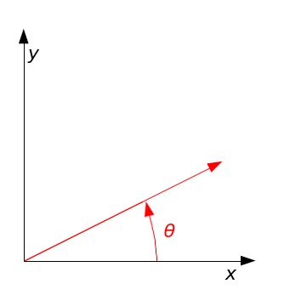
Rotation Matrix Exercise
Write a python program:
Create a 2 x 2 rotation matrix, 30 degrees:
[ cos(30) sin(30)
-sin(30) cos(30) ]
radians = degrees * pi / 180.
Notes:
Mac; textedit, vi, emacs, nano, word rotmat.py
Windows: notepad

Slide 31
Circle Exercise
Add to your python program:
Create 18 xy points around unit circle
(18, 2) array
x = cosine(angle)
y = sine(angle)
print a.round(3)
Notes:
Mac; textedit, vi, emacs, nano, word exdeg.py been using numpy methods; arrays have methods also.
Windows: notepad
Create circle using cosine for x, sin for y

Slide 32
Pointer vs. Deep Copy
a = numpy.zeros( (3, 3) )
b = a # b is a pointer to a
c = a.copy() # c is a new array
b is a # True
c is a # False
Views
base

Slide 33
Array Arithmetic
a = numpy.array( range(10, 20) )
a + 5
a – 3
a * 5
a / 3.14
a.sum()
a > 15
(a > 15).sum()

Slide 34
Array Arithmetic by Index
a = numpy.array( range(10) )
b = numpy.array( range(0, 1000, 100) )
a + b # a[0] + b[0], a[1] + b[1] ...
a – b
a * b # not row, column matrix product
a / b
The 2 arrays must be the same shape.
Notes:
If a and b are not the same shape:
operands could not be broadcast together with shapes ...

Slide 35
Row, Column Matrix Product
c = numpy.dot(a, b)
Dot product of 2 arrays.
Matrix multiplication for 2D arrays.

Slide 36
Transform Exercise
Add to your python program:
Transform 18 points by the rotation matrix.
Save in new array.
Scale up by factor of 2.
[18x2] [18x2]
. [ 2 x 2 ]
[ 2 x 2 ] .
Notes:
Do what’s easy. It may be right.
points . matrix is OK matrix . points → alignment error see help(numpy.dot)

Slide 37
Cross Product
zA = numpy.cross(xA, yA)
Note: we have been using numpy. functions

Slide 38
Array Shape
a = numpy.linspace(2, 32, 16)
a = a.reshape(4, 4) # ndarray . method
a.shape # ndarray attribute tuple (4, 4)
a = numpy.linspace(2,32,16).reshape(8,2)
Notes:
Python golf
len(a) or a.size

Slide 39
Array Diagonals
a = numpy.linspace(1, 64, 64)
a = a.reshape(8, 8)
numpy.triu(a) # upper triangle
numpy.tril(a) # lower triangle
numpy.diag(a) # main diagonal
numpy.diag(a, 1) # 1 above
numpy.diag(a, -1) # 1 below

Slide 40
numpy.array Order [row] [column]
vs.
Internal Storage Order
C is default, Fortran can be specified [contiguous] []
c = numpy.zeros( (2,4), dtype=numpy.int8)
f = numpy.zeros( (2,4), dtype=numpy.int8, order=”F”)
# show c.flags f.flags
c[0][1] = 5 # show c.data[:]
f[0][1] = 5 # show f.data[:]
numpy.array [][] access is the same regardless of internal storage order
Notes:
access order can affect speed: better to access in contiguous dimension
python golf
c = numpy.array(range(8), dtype=numpy.int8).reshape(2,4)
f = numpy.array(c, order=“F”)

Slide 41
ndarray.flags
Interpreter
Look at array flags
dir(a.flags)
Program
status = a.flags.c_contiguous
status = a.flags.f_contiguous
# boolean True or False
ndarray.flatten() # ‘F’ or ‘C’ (default)

Slide 42
Array Data Types
numpy.float64 is the default type
float32
int8, int16, int32, int64, uint8, uint16, uint32, uint64
complex64, complex128
bool - True or False
a.dtype shows type of data in array
>>> help(numpy.ndarray) # Parameters Attributes
Notes:
int8 is a byte
signed or unsigned ints
Correspond to C language implementation
42

Slide 43
Multi-Dimensional Indexing
a = numpy.array( range(12) )
a = a.reshape(2,6) # 2 rows, 6 columns
a[1][5] contains 11
a[1, 5] is equivalent, more efficient

Slide 44
1. Array Slicing
a = numpy.array(range(0, 100, 10))
Array([ 0, 10, 20, 30, 40, 50, 60, 70, 80, 90])
a[2:4] contains 20, 30
a[-4 : -1] contains 60, 70, 80
Slicing returns ndarray

Slide 45
2. Array Slicing
a = numpy.array(range(64)).reshape(8,8)
a[3, 4] contains 28
asub = a[3:5, 4:6]
Very useful for looking at data & debugging.
a[:,2] # all rows, column 2
a[3, 2:5] # row 3, columns 2 and 3 and 4
Notes:
Python was written by people who have done a lot of programming & debugging

Slide 46
Array Stuff
a.T
a.min()
a.max()
a.round()
a.var()
a.std()

Slide 47
Organize Arrays
Make a list of arrays named a, b, and c:
w = [ a, b, c]
len(w) # length of list is 3
w[1].max() # use array method

Slide 48
numpy Tutorial
wiki.scipy.org/Tentative_Numpy_Tutorial
docs.scipy.org/doc/numpy/reference/routines.html
numpy for Matlab Users
wiki.scipy.org/NumPy_for_Matlab_Users

Slide 49
1. Plotting
matplotlib – designed to look like MATLAB plot
200 subroutines for various plots.
Generally available with Python
matplotlib.org
gallery

Slide 50
Plotting on nobel.princeton.edu
> ipython27 -pylab
Bring up plot windows as separate threads, no blocking.
Draw commands are displayed sequentially.
import myplot
reload(myplot)
dir(myplot)
ipython27 –-pylab –-classic –-logfile mytype.txt
dash dash pylab
python interpreter
Notes:
ipython –pylab -classic –noconfirm_exit -nobanner ; exits without prompting for confirmation # set up an alias for this command.
Python/2.7.2: ipython –pylab=tk –classic ; edit ~/.ipython/profile_default/python_config.py and comment out the line with kernmagic

Slide 51
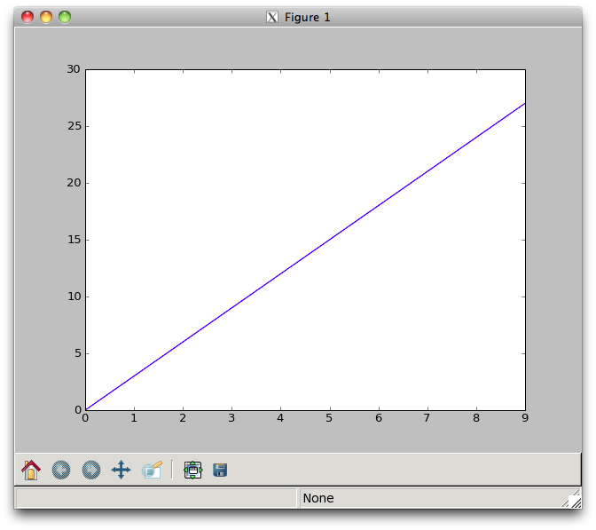
Plot Exercise
New python program:
Create a numpy array
of ten X values.
Create a numpy array
of ten Y values.
import matplotlib.pyplot as g
g.plot(x, y)
g.show()
Notes:
plot.py

Slide 52
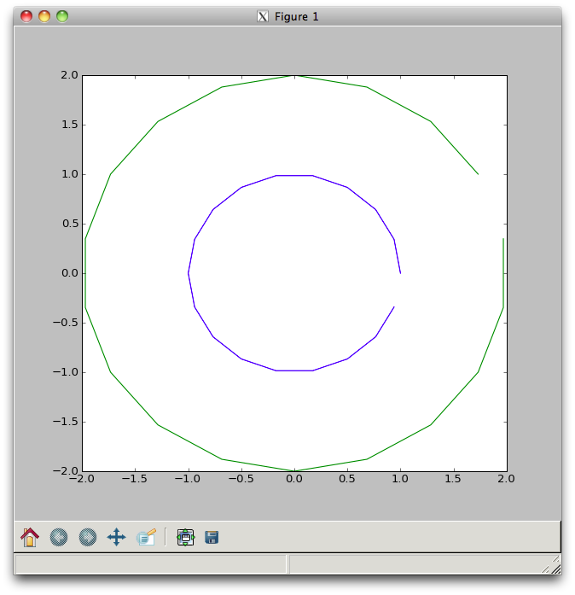
Plot Circles Exercise
Add to your python program:
Slice both (18, 2) arrays into:
x array
y array
g.plot(ax, ay)
g.plot(bx, by)
Notes:
rotmatcirtrnplt.py

Slide 53
matplotlib Contour Plot
r = numpy.random.rand(10,10)
g.contour(r) # contour line plot
fig2 = g.figure() # start new window
fig2.canvas.manager.window.Move((648,20))
g.contourf(r) # filled contour plot
Notes:
numpy/contourplot.py

Slide 54
matplotlib LaTeX
import matplotlib.pyplot as plt
plt.rc(“text”, usetex=True)
plt.xlabel( r”\textbf{Time}” )
# plt.xlabel(“Time”)
latex.py example
Notes:
Nice for showing equations

Slide 55
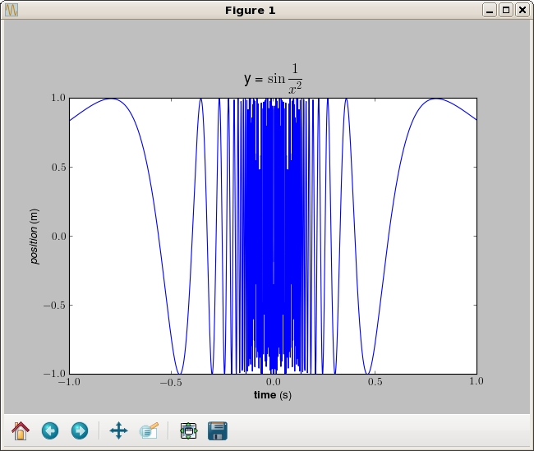

Slide 56
Python at princeton.edu
ssh nobel.princeton.edu
compton% which python
/usr/bin/python
version 2.6.6
/usr/bin/python2.7
version 2.7.3
idle
idle27
Notes:
della /usr/bin/python = 2.4.3
/usr/bin/python2.6 = 2.6.8

Slide 57
More Info & Resources
docs.scipy.org
princeton.edu/~efeibush/python/numpy
Princeton University Python Community
princetonpy.com

Slide 59
Where to?
Graphing & visualization
Writing new classes
scipy – algorithms & math tools
Image Processing
Visualization toolkit – python scripting
Eclipse IDE
Multiprocessing
Python → GPU, CUDA

Slide 60
Reading a netCDF File
Popular file format for scientific data
Multi-dimensional arrays
scipy – netcdf_file class for read/write
numpy – n-dimensional data arrays

Slide 61
Read a Text File
gFile = open("myfile.txt”, “r”)
for j in gFile: # python magic: text file iterates on lines
print j # print each line
gFile.close()
Notes:
iter()

Slide 62
Write a Text File
f = open("myfile.txt", "w")
a = 1
b = 2
f.write("Here is line " + str(a) + "\n");
f.write("Next is line " + str(b) + "\n");
f.close()
Notes:
cast number to string because f.write() expects a string argument
62

Slide 63
Command Line Arguments
import sys
print sys.argv
sys.argv is a list
sys.argv[0] has the name of the python file
Subsequent locations have command line args
>>> help(sys)
Notes:
Write a 2 line program
Interpreter: look at help(sys)
63

Slide 64
Command Line Scripts
Upgrade to csh or bash shell scripts
shell agnostic
Much better text handling
Process control - popen()

Slide 65
Shell Scripting
#!/bin/csh
foreach file (*.py)
echo $file
end
import os
fileL = [] # set up a list
for f in os.listdir("."):
if f.endswith(".py"):
print f
fileL.append(f)
fileL.sort()# list function, sort in place
print fileL
Notes:
os.listdir(dirname) returns a list of strings filenames, not necessarily sorted alphabetically foreachfile.py
iterate on items in list
65

Slide 66
Python + GUI
tkinter
pyqt
wxpython

