Slide 1

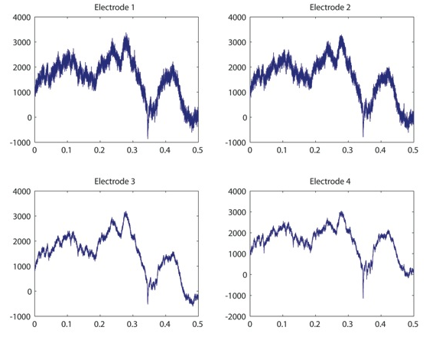
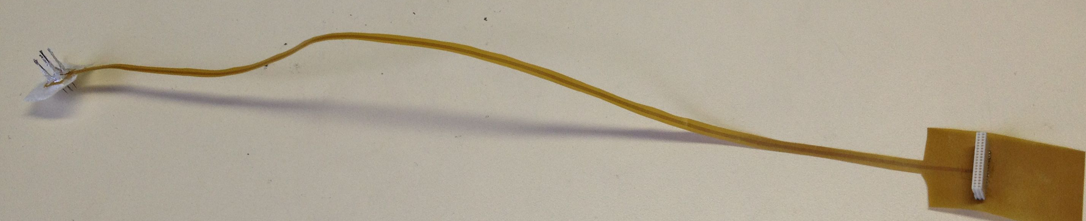
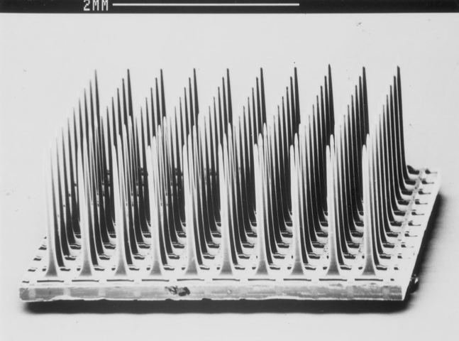
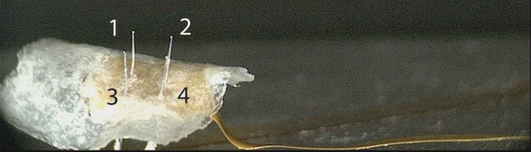
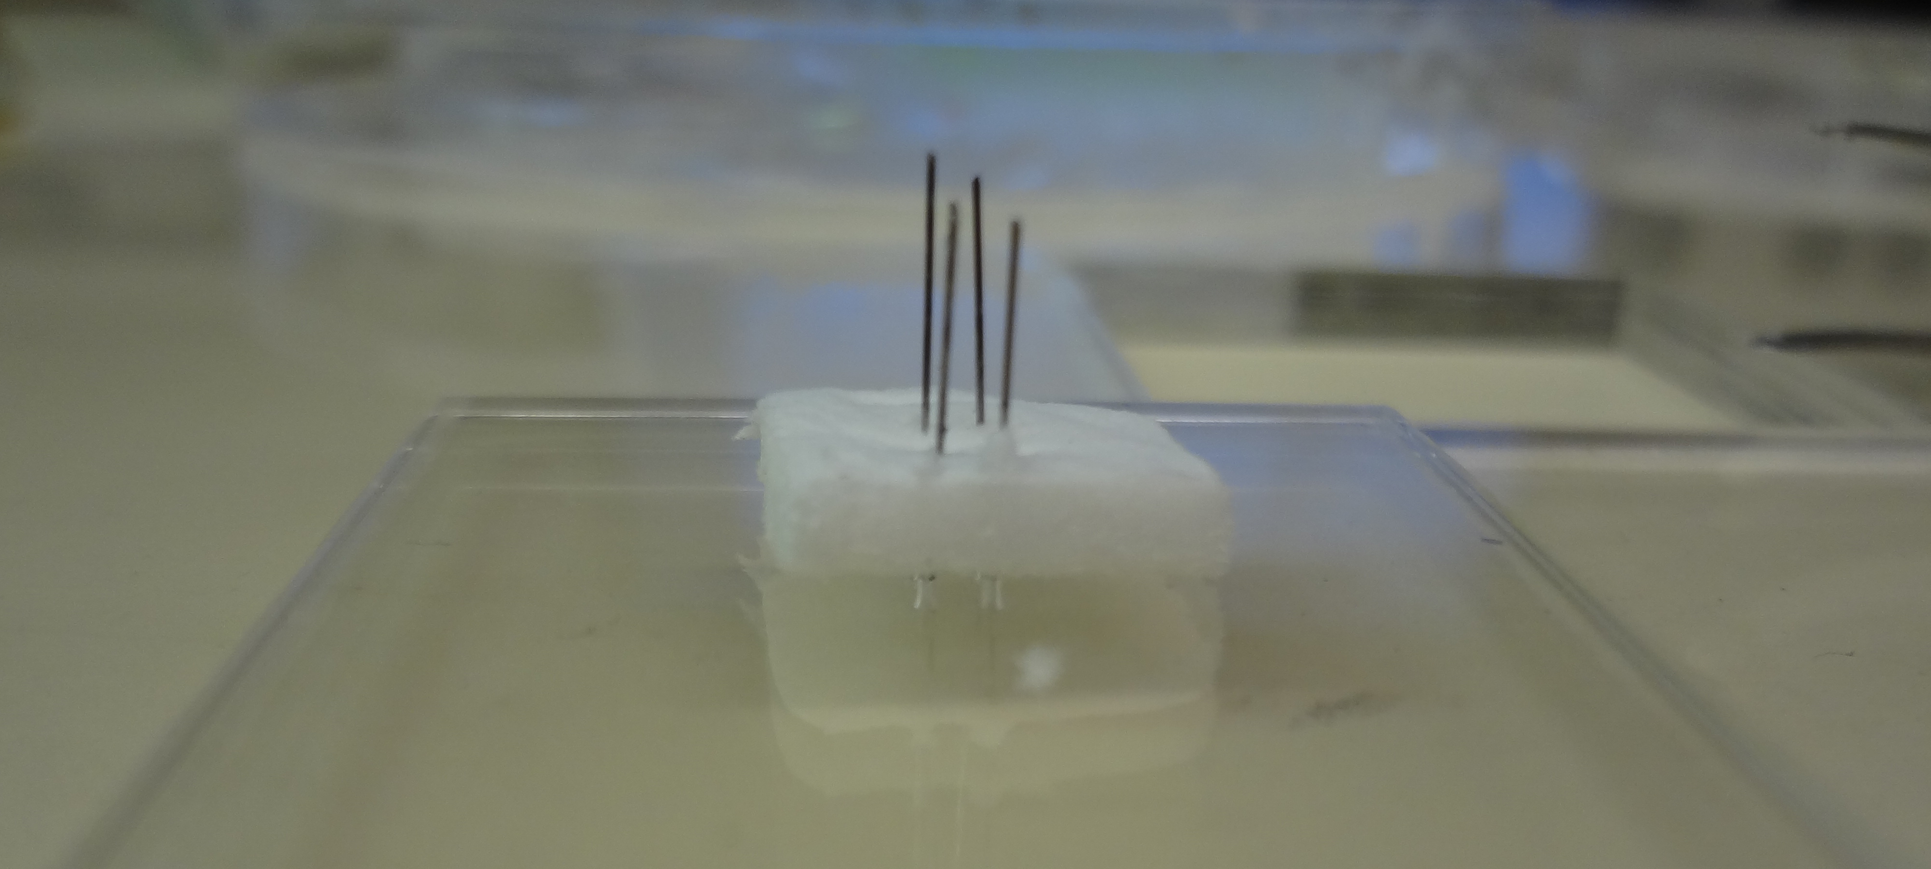
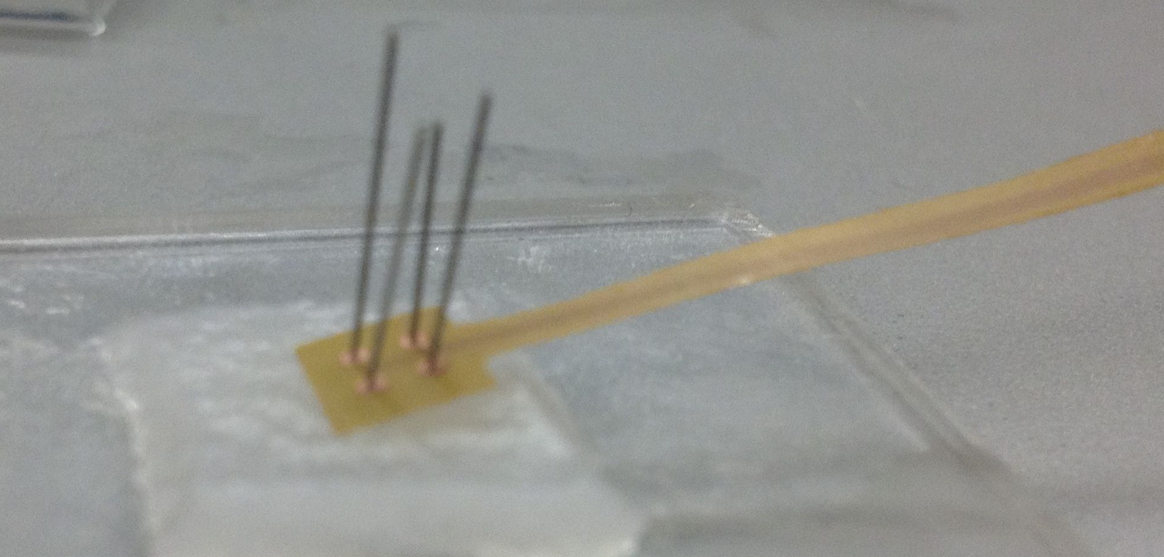
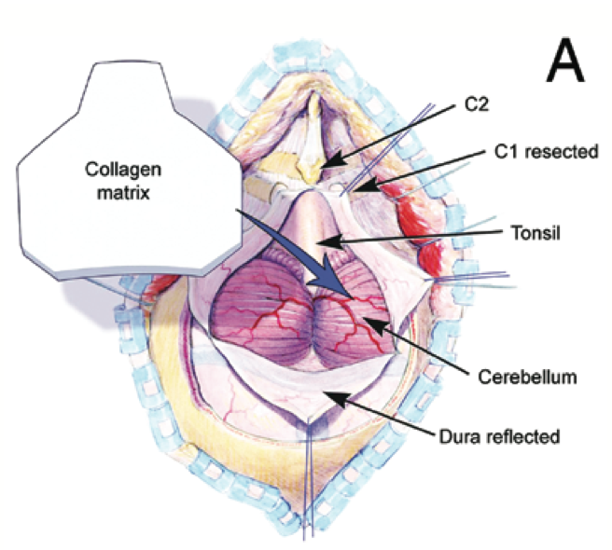
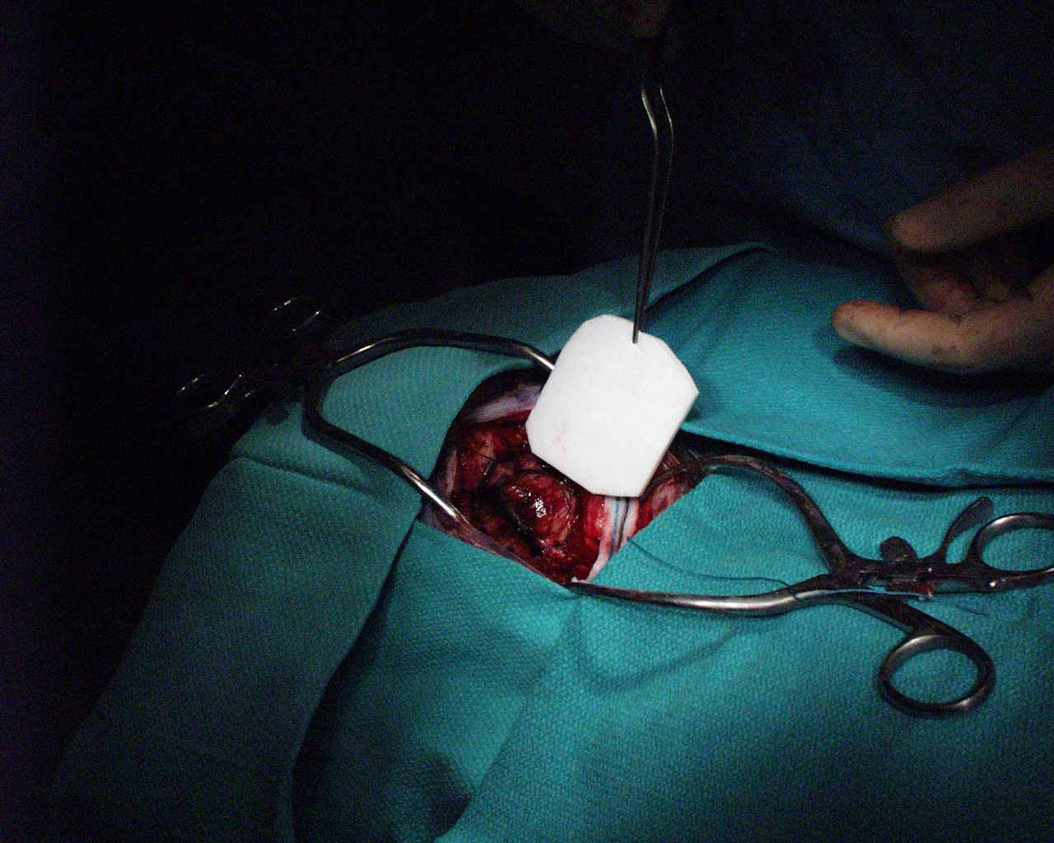
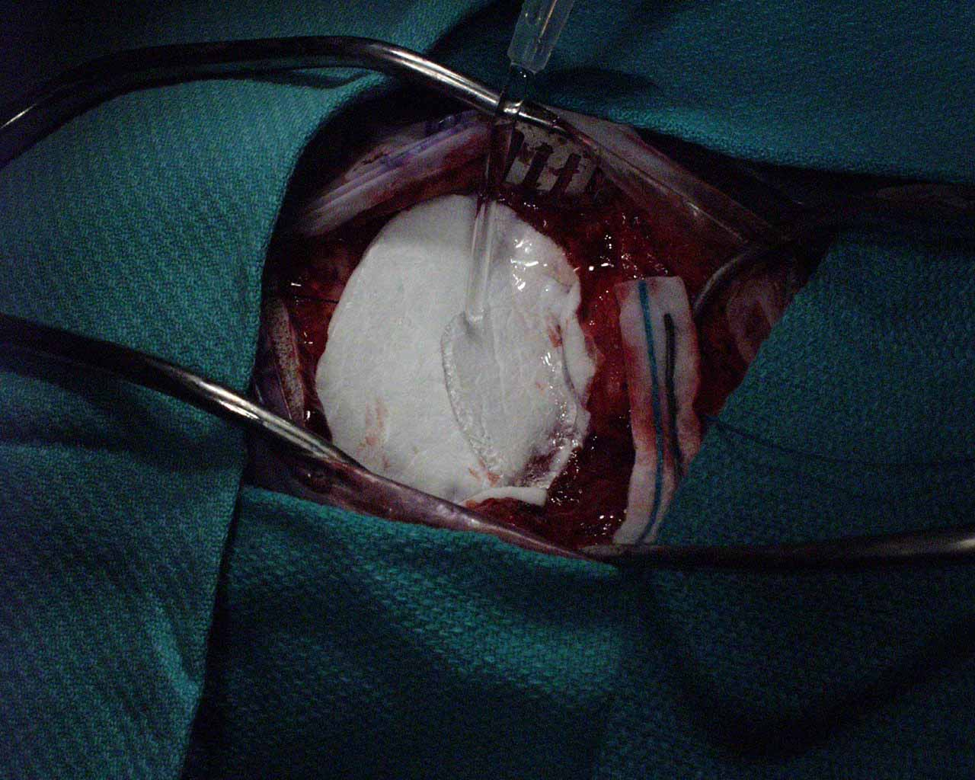
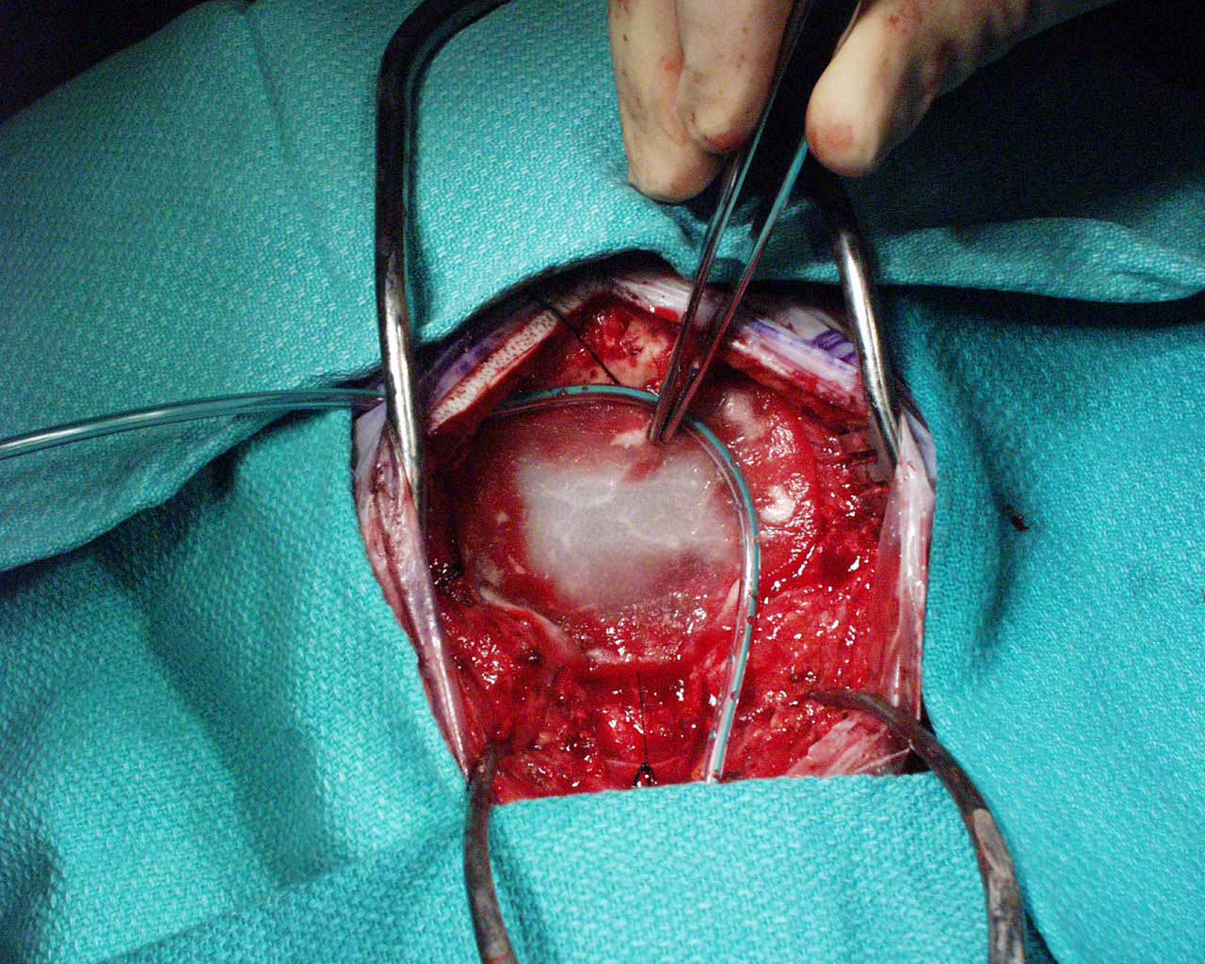
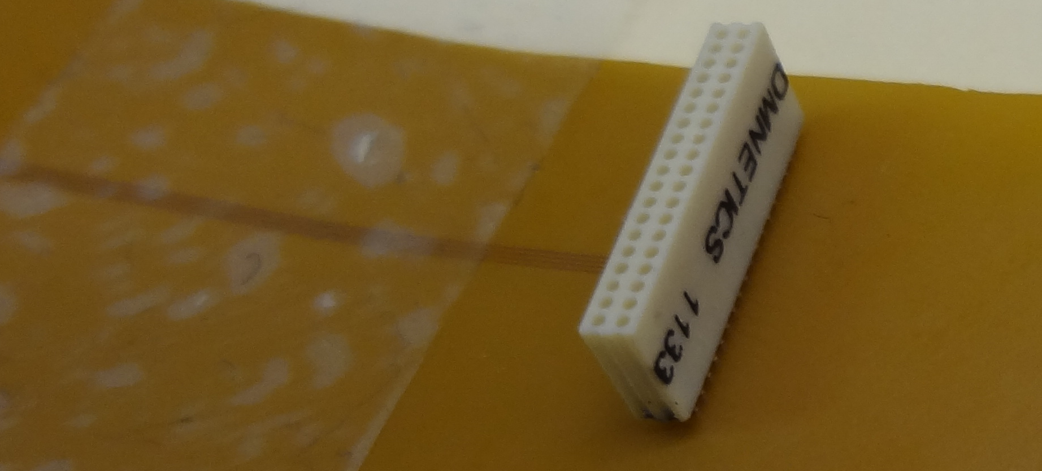
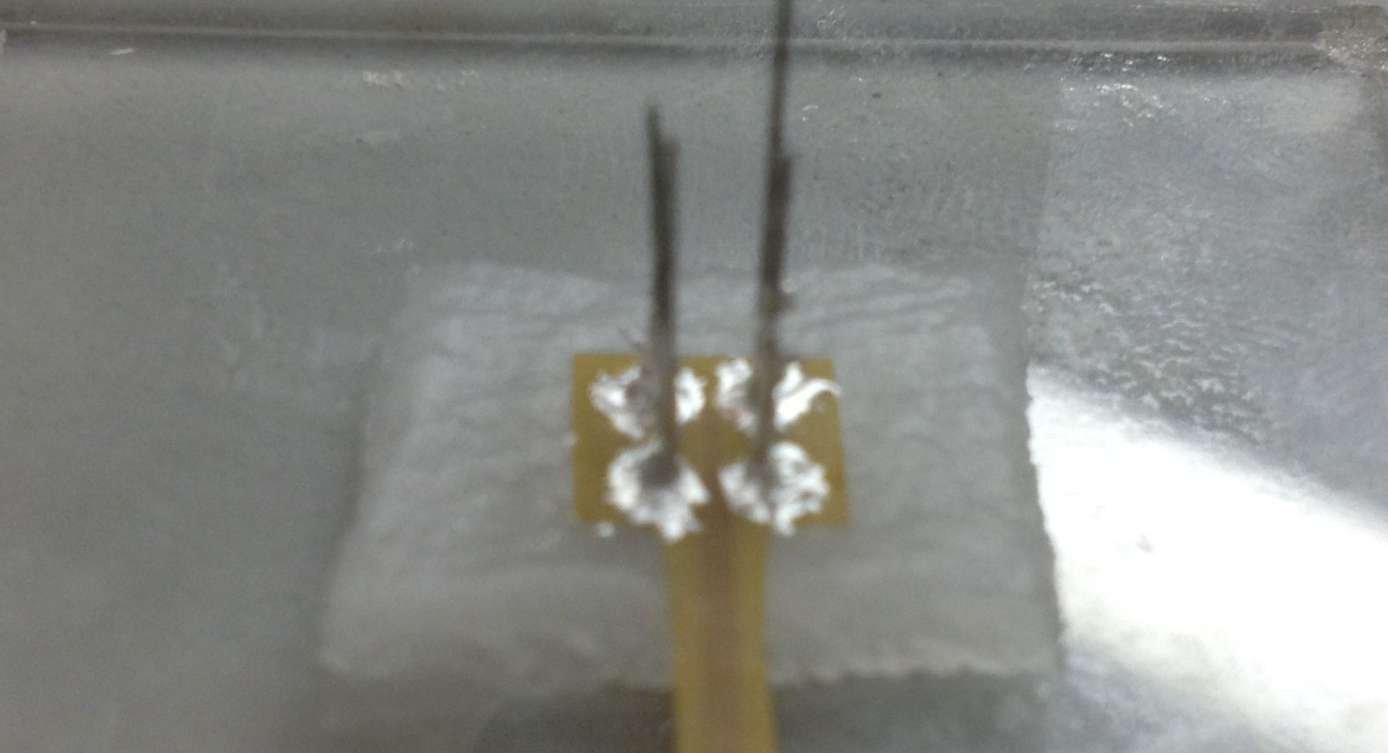
Flexible Microelectrode Arrays with Dural Regeneration for Chronic Neural Recording
Tiffany Moy^{1*}, Yan Wong², Chiraag Galaiya¹, Simon Archibald³, Bijan Pesaran², Naveen Verma¹, and Sigurd Wagner¹
¹Electrical Engineering, Princeton University, Engineering Quadrangle, Olden Street, Princeton, NJ 08544
²Center for Neural Science, New York University, 4 Washington Place, New York, NY 10003
³Integra LifeSciences Corporation, 103 Morgan Lane, Plainsboro, NJ 08536
Motivation
Why Polyimide?
Results
For eventual clinical applications of cortex-penetrating brain-machine interfaces, neural stimulation and recordings must be performed over an extended period of time.
However, current penetrating interfaces are critically limited by reliability concerns. Microelectrode arrays, for example, have been observed to exhibit diminishing performance over time, leading to eventual failure, making them ill-suited for chronic recording of neural signals.
This project aims to improve the quality of neural recordings for in vivo microelectrode arrays by combining materials and technologies used in flexible electronics with collagen, a material used extensively in the field of regenerative medicine.
Current penetrating arrays incorporating hard, planar backplanes have a large mechanical mismatch with the soft, curvilinear tissue of the brain, leading to strain and actual damage on the surrounding neurons. Focusing on matching mechanical properties (ie Young’s Modulus) of tissue and device materials, we use polyimide to construct our backplane.
Electrophysiological testing was performed with in vivo implantation into rat subjects at the Center for Neural Science at NYU.
Biological tissues
Muscle.......................................................280,000Pa (280kPa)
Spinal cord....................................................89,000Pa (89kPa)
Brain.................................................................1,000Pa (1kPa)
Substrate materials
Silicon........................................200,000,000,000Pa (200GPa)
Polyimide........................................2,500,000,000Pa (2.5GPa)
Our Microelectrode Array
Our device consists of 3 main components: a flexible backplane made of copper conductors on polyimide; tungsten electrodes, coated with Parylene-C; and a collagen layer introduced over and around the electrodes.
This Utah Intracortical Electrode Array has been used extensively in acute neural recording and stimulation experiments but is believed to not provide reliable long-term recording for chronic systems.
Collagen Matrix
Fabrication
Implantation of the microelectrode arrays requires an invasive surgery where skull bone and dura mater are removed. This disrupts the homeostatic processes regulated by the implant-affected tissue layers, which may lead to increased neuronal death and dendritic loss within this critical region.
The collagen matrix is a substrate seen in many connective tissues, promoting dural repair and re-growth of neurons. It has been successfully used in posterior fossa duraplasty procedures, where it is applied as an onlay graft.
By incorporating a collagen matrix into the microelectrode array, it is hoped that the health of the tissue surrounding the electrode implant will improve, making it suitable for chronic neural recordings.
To fabricate the device, first, an acrylic jig is used to hold the electrodes with the tips facing downward. The collagen layer is introduced over the back of the electrodes. After wetting the collagen, the backplane is threaded through the back of the electrodes.
Neural signals were recorded as a function of time. While local field potentials were recorded, we did not manage to record isolate units.
Conclusions
The backplane is attached to the collagen using non-conductive epoxy. Silver conductive epoxy is used to bond the electrodes to the side of the backplane not touching the collagen layer.
Finally, a connector is connected to the bottom of the backplane using soldering paste. The Omnetics connector attaches to a complimentary connector employed by our collaborators at NYU, providing a means to read the neural signals off of the device.
The device seems to be able to record neural signals above noise.
The signals across all four electrodes look very similar. Though not unusual, it might be due to coupling between the leads which carry the signals from the electrodes to the connector.
Future Work
Try and record isolate active cells
Modify array design to eliminate any possible capacitive coupling between leads
Scale array to fit in larger animals
Observe recording performance of device over an extended period of time.

