Slide 1
Credit Expansion and Neglected Crash Risk
Matt Baron and Wei Xiong
Princeton University
Princeton Initiative
September 6, 2014

Slide 2
Consequences of credit expansion
Credit expansion may lead to financial instability
  Recent global financial crisis
  The Great Depression in the U.S.
  Mishkin (1978), Bernanke (1983), Eichengreen and Mitchener (2003)
  International financial crises
    Demirgüç-Kunt and Detragiache (1998), Kaminsky and Reinhart (1999)
    Borio and Lowe (2002), Taylor and Schularick (2012), Reinhart and Rogoff (2009)
Credit frictions have significant and persistent effects on the economy
    Bernanke and Gertler (1989), Kashyap, Stein and Wilcox (1993)
    Kiyotaki and Moore (1997), Holmstrom and Tirole (1997)
Theoretical effort to integrate the financial sector with macro models
    Brunnermeier & Sannikov (2013), Gertler and Kiyotaki (2012), He and Krishnamurthy (2012)

Slide 3
What causes credit expansions?
Agency problems
  Misaligned incentives with shareholders
    Allen and Gale (2000) and Bebchuk, Cohen, and Spamann (2010)
  Implicit guarantees provided by the government
    Rajan (2006, 2010) and Acharya, et al. (2010)
Elevated risk appetite
  Danielsson, Shin and Zigrand (2012)
  Adrian, Moench and Shin (2013)
Over-optimism
  Minsky (1977) and Kindleberger (1978)
  Behavioral frictions:
    Neglected risk (Gennaioli, Shleifer and Vishny, 2012, 2013)
    Group think (Benabou, 2013), extrapolative expectations (Barberis, 2012), this-time-is-different thinking (Reinhart and Rogoff, 2009)
  Agency frictions and elevated risk appetite may also be present: Bankers are likely to seek risk to cater or take advantage of optimism of shareholders.
    Stein (1998) and Bolton, Scheinkman and Xiong (2006), Cheng, Hong and Scheinkman (2012)

Slide 4
Our approach
We examine causes and consequences of
credit expansion through stock prices
  Stock prices aggregate shareholders’ expectations and preferences regarding credit expansion
  A simple measure of credit expansion:
    3-year change of bank credit to GDP
  Data available in panel of 24 developed countries 1920-2012
Notes:
Effects should be magnified for banking sector

Slide 5
What’s in this paper?
Credit expansion predicts a higher probability of crash risk in bank equity index and equity market index in a sample of 24 developed countries, 1920-2012.
But despite the elevated crash risk, the equity premium is lower rather than higher during credit expansions.
  Presents a challenge to a narrowly-focused agency view of credit expansion
  Suggests that shareholders do not recognize imminent tail risk during credit expansions
Returns subsequent to large credit expansions are substantially negative.
  Difficult to reconcile with elevated risk appetite / intermediary asset pricing view
  More likely, reflects the over-optimism of shareholders during credit expansions.

Slide 6
Related research
Predictability of crises:
  Borio and Lowe (2002) and Schularick and Taylor (2012): credit expansion predicts banking crises
Broker-dealer leverage explains time-varying risk premia
  Adrian, Moench, and Shin (2013), Adrian, Etula, and Muir (2013), Muir (2013)
  Our analysis highlights the substantially negative equity returns during credit expansions rather than the largely increased equity premium after crises.
Optimism in the recent housing crisis
  Cheng, Raina, and Xiong (2013)
Debate on increasing required bank capital
  Cost of bank equity is not constant but dramatically time-varying over the credit cycle
  And is rather cheap during credit expansion

Slide 7
Related research
Pricing of tail risk
  Reitz (1988), Barro (2006): disaster risks as an explanation for the equity premium puzzle
  Time-varying disaster risk
    Gabaix (2012) and Wachter (2013)
    Gourio (2012): disaster risk and credit risk
  Bank equity premium and tail risk:
    Gandhi (2011) and Gandhi and Lustig (2014)
    Explain time-varying equity premium of bank stocks in terms of disaster risk but in the opposite direction of what we find
  Gennaioli, Shleifer and Vishny (2012, 2013): tail risk might be neglected
  Weitzman (2007): subjective expectations of crash risk
    Important to account for investors’ subjective beliefs in tail risk, which may or may not be fully consistent with the actual tail risk
  Chen, Dou and Kogan (2013)
    Not to treat tail risk as dark matters in finance

Slide 8
Data
24 developed countries: 1920-2012
Variables:
  Credit expansion
    From merging Schularick-Taylor (2012) & BIS data
    3-year change in bank credit to GDP of households and private non-financial corporations
  Equity index log excess returns (including dividends)
    Banking sector
    Broad market
  Controls:
    D/P, term spread, book/market, Inflation , i/k
    corporate spread, consumption to wealth

Slide 9
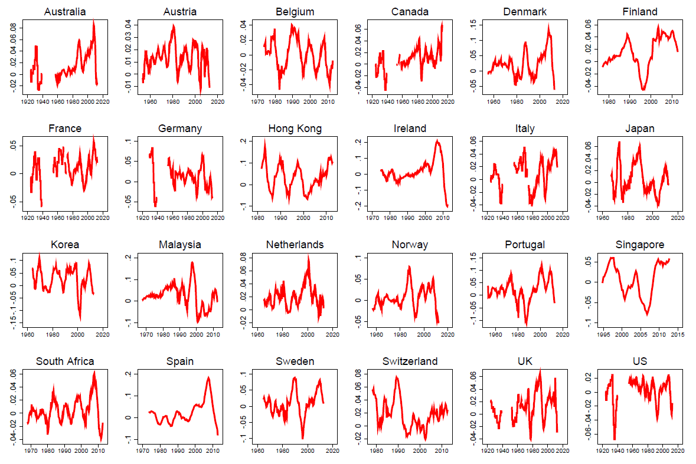
Credit expansion

Slide 10
Credit and equity prices before and after banking crises
Bank credit / GDP
Broad market
Bank stocks

Slide 11
Summary statistics
Bank credit expansion tends to follow:
  Higher GDP growth
  Lower stock market volatility, corporate spread, sovereign spread.
Highly correlated with other credit variables
  Various other credit aggregates
  Leverage: household, corporate, and banking sectors
  International credit flows

Slide 12
Regressions
Hypothesis 1: Credit expansion → higher crash risk
    Probit: use credit expansion to predict crash events
      K-quarters ahead (K=1,4,8)
      Crashes in both bank stock index and market equity index
2. Hypothesis 2: Credit expansion → higher equity premium
    OLS with fixed effects: use credit expansion to predict future mean excess returns
3. Hypot. 3: Large credit expansion → large negative returns
  Regression on indicator 1_{credit expansion>x} to predict future returns

Slide 13
Regressions
Hypothesis 1: Credit expansion → higher crash risk
    Probit: use credit expansion to predict crash events
2. Hypothesis 2: Credit expansion → higher equity premium
    OLS with fixed effects: use credit expansion to predict future mean excess returns
3. Hypot. 3: Large credit expansion → large negative returns
  Regression on indicator 1_{credit expansion>x} to predict future returns

Slide 14
Standard errors
  Panel regressions (OLS, probit) with fixed effects
  Residuals are correlated:
    across countries (due to common global shocks)
    over time (due to persistent shocks within countries)
  Need for dually-clustered standard errors
    For OLS: implemented with exact formulas from Thompson (2011)
    For probit and quantile: block bootstrapping
Non-overlapping returns
  delete intervening observations to eliminate autocorrelation
  overly conservative approach

Slide 15
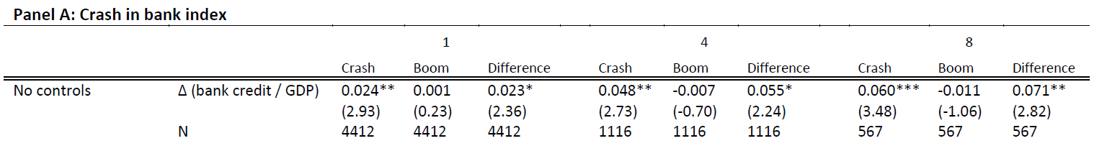
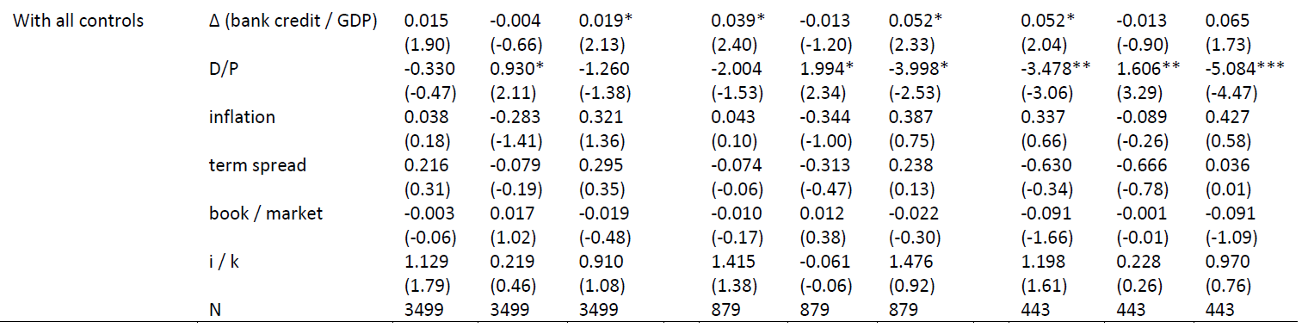
Predictive probit regressions using crash indicators
Marginal effects reported
∆(bank credit/GDP) in standard deviations (within country)

Slide 16
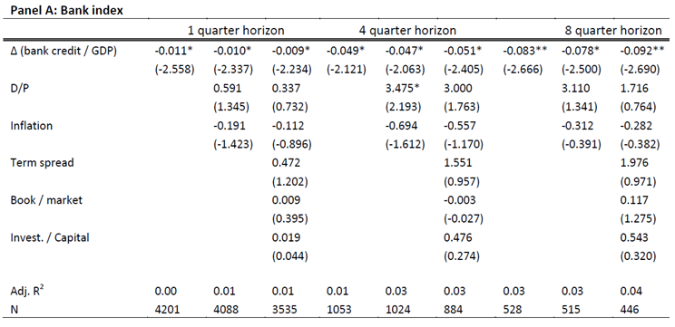
Predicting the equity premium
∆(bank credit/GDP) is in standard deviations (within country)

Slide 17
Optimism or elevated risk appetite?
Evaluate magnitude of equity premium predicted by credit expansion
Compare equity premium after credit expansions and contractions

Slide 18
Predicted excess returns after credit expansion and contraction
95% confidence intervals from dually-clustered S.E.s (Thompson, 2011)

Slide 20
Alternative crash risk measures
Two alternative measures of crash risk / negative skewness in future returns using quantile regressions
  Negative skewness, conditional on credit expansion
  2. Median minus mean
Wald test for linear restrictions
  H₀: β_{negative skew} = (β_{q=50} - β_{q=5}) - (β_{q=95} - β_{q=50}) = 0
  H₀: β_{mean} - β_{median} = 0
  Standard errors of coefficients in linear restrictions are simultaneously bootstrapped for testing restrictions

Slide 21
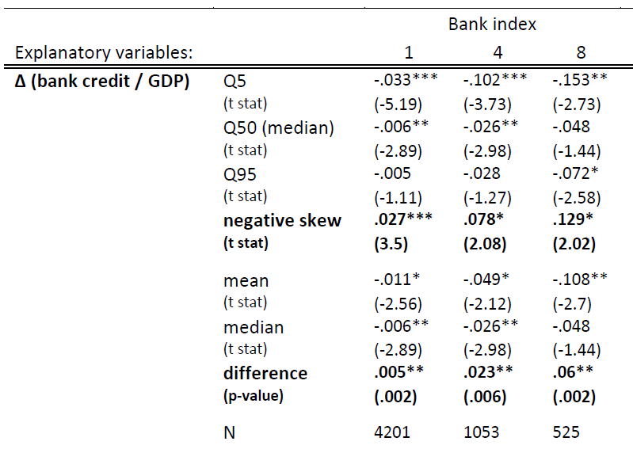
Quantile regressions and negative skewness
∆(bank credit/GDP) is in standard deviations (within country)

Slide 22
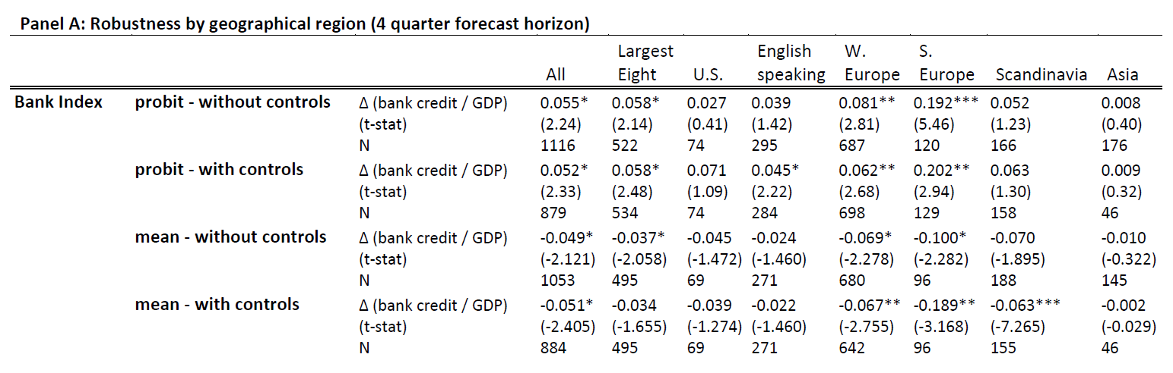
Robustness in geographical regions

Slide 23
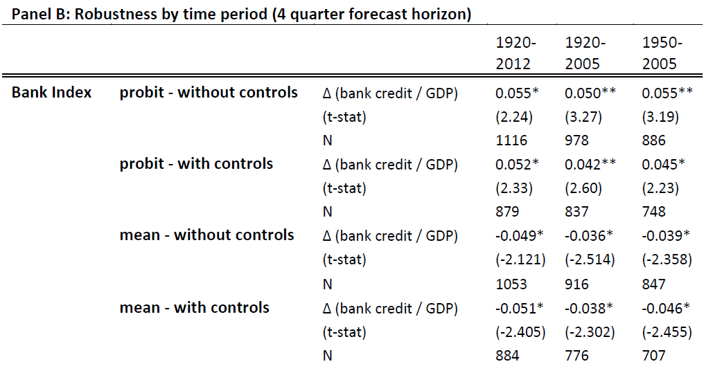
Robustness in sub-periods

Slide 24
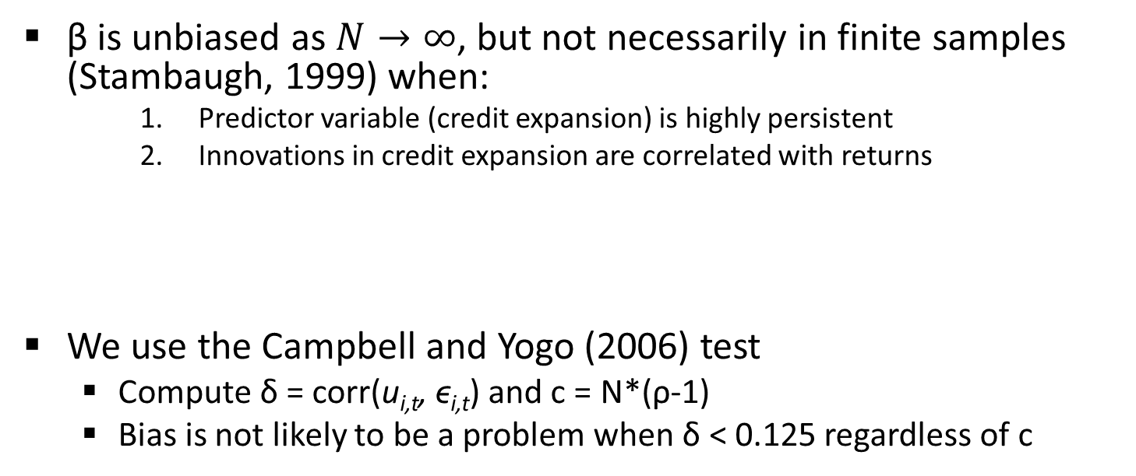
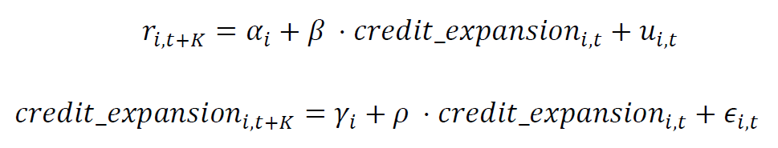
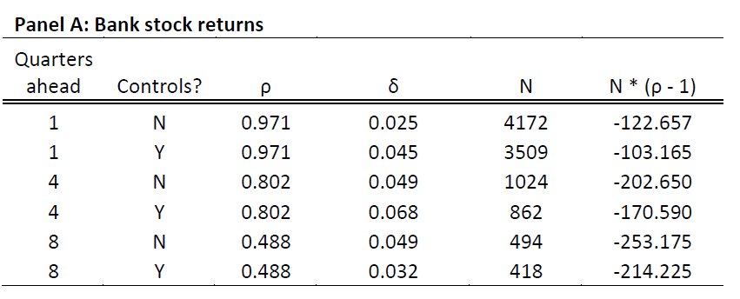
Test for small-sample bias

Slide 25
Conclusions
Credit expansion predicts a higher probability of crash risk in equities in a sample of 24 developed countries, 1920-2012.
But despite the elevated crash risk, the equity premium is lower rather than higher during credit expansions.
  Presents a challenge to a narrowly-focused agency view of credit expansion
Returns subsequent to large credit expansions are substantially negative.
  Difficult to reconcile with elevated risk appetite / intermediary asset pricing view
Key implications
Over-optimism is likely present in driving credit expansions
Important to account for investors’ subjective beliefs of tail risk, which may or may not be fully consistent with the actual tail risk
Belief dynamics are as important as capital constraints in understanding roles of financial intermediaries

Slide 26
Thank you!

