Slide 1

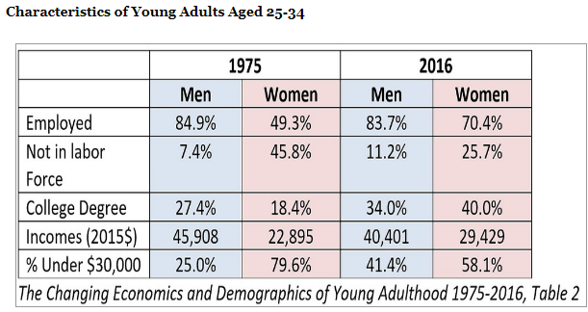
Current News 9/18/17
Chips Off the Old Block: Computers Are Taking Design Cues From Human Brains
New technologies are testing the limits of computer semiconductors. To deal with that, researchers have gone looking for ideas from nature.
Funding Talks at Uber and Lyft Complicate Ride-Hailing Allegiances
The only thing changing faster than who is winning the race in the cutthroat world of ride hailing are the shifting behind-the-scenes allegiances between those companies and investors.
At the moment, Uber, the ride-hailing behemoth, is nearing a deal to receive billions of dollars in funding from SoftBank, the Japanese conglomerate, according to three people with knowledge of the matter, who asked not to be identified because the talks are confidential.
MILLENNIALS YESTERDAY AND TODAY
• More young adults today, 18 to 34, are living with parents than with a spouse.
Updated federal driverless policy continues, and expands, hands-off approach

