Slide 1
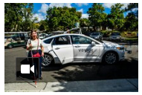
Current News 10/04/17
Where Driverless Cars Brake for Golf Carts
https://nyti.ms/2xTcgZG

