Slide 1
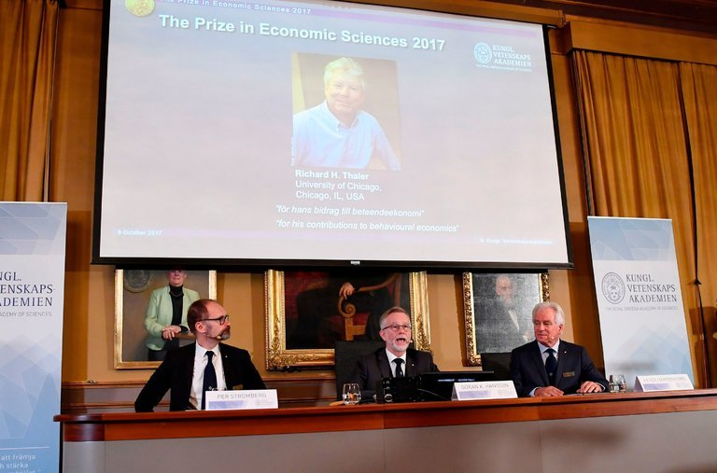
Current News 10/09/17
Nobel in Economics Is Awarded to Richard Thaler
Professor Thaler is an expert in behavioral economics and a professor at the University of Chicago’s Booth School of Business.
Walmart Puts Its Eggs in a Time-Saving Basket: Grocery Pickup
Seeking an edge against Amazon, the retail giant is pushing a service that delivers your order to your car. Customers never have to step inside the store.
By MICHAEL CORKERY
G.M. Acquires Strobe, Start-Up Focused on Driverless Technology
https://www.strobeinc.com/
The Panama Canal’s Big Bet Is Paying Off

