Slide 1
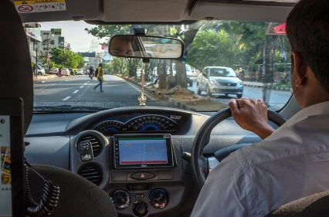

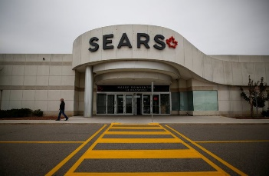
Current News 10/11/17
Ola, India’s Ride-Hailing Leader, Raises $1.1 Billion to Fight Uber
Why Big Cities Thrive, and Smaller Ones Are Being Left Behind
Sears Canada to Shut Down, Leaving 12,000 Out of Work
https://www.dmv.ca.gov/portal/dmv/detail/about/lad/regactions

