Slide 1
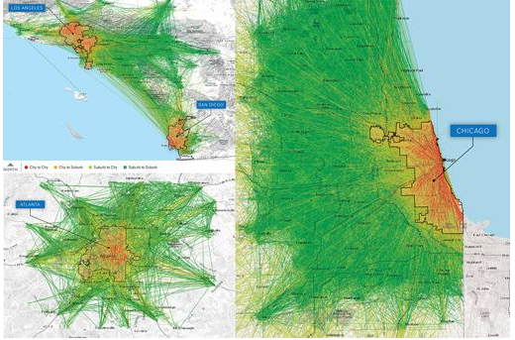
Current News 12/4/17
Why Uber wont kill Transit
Driverless car bill hits speed bump
Personal Sedan Sales in Jeopardy as U.S. Auto Market Transitions to “Islands” of Autonomous Mobility: KPMG Research

