Slide 1
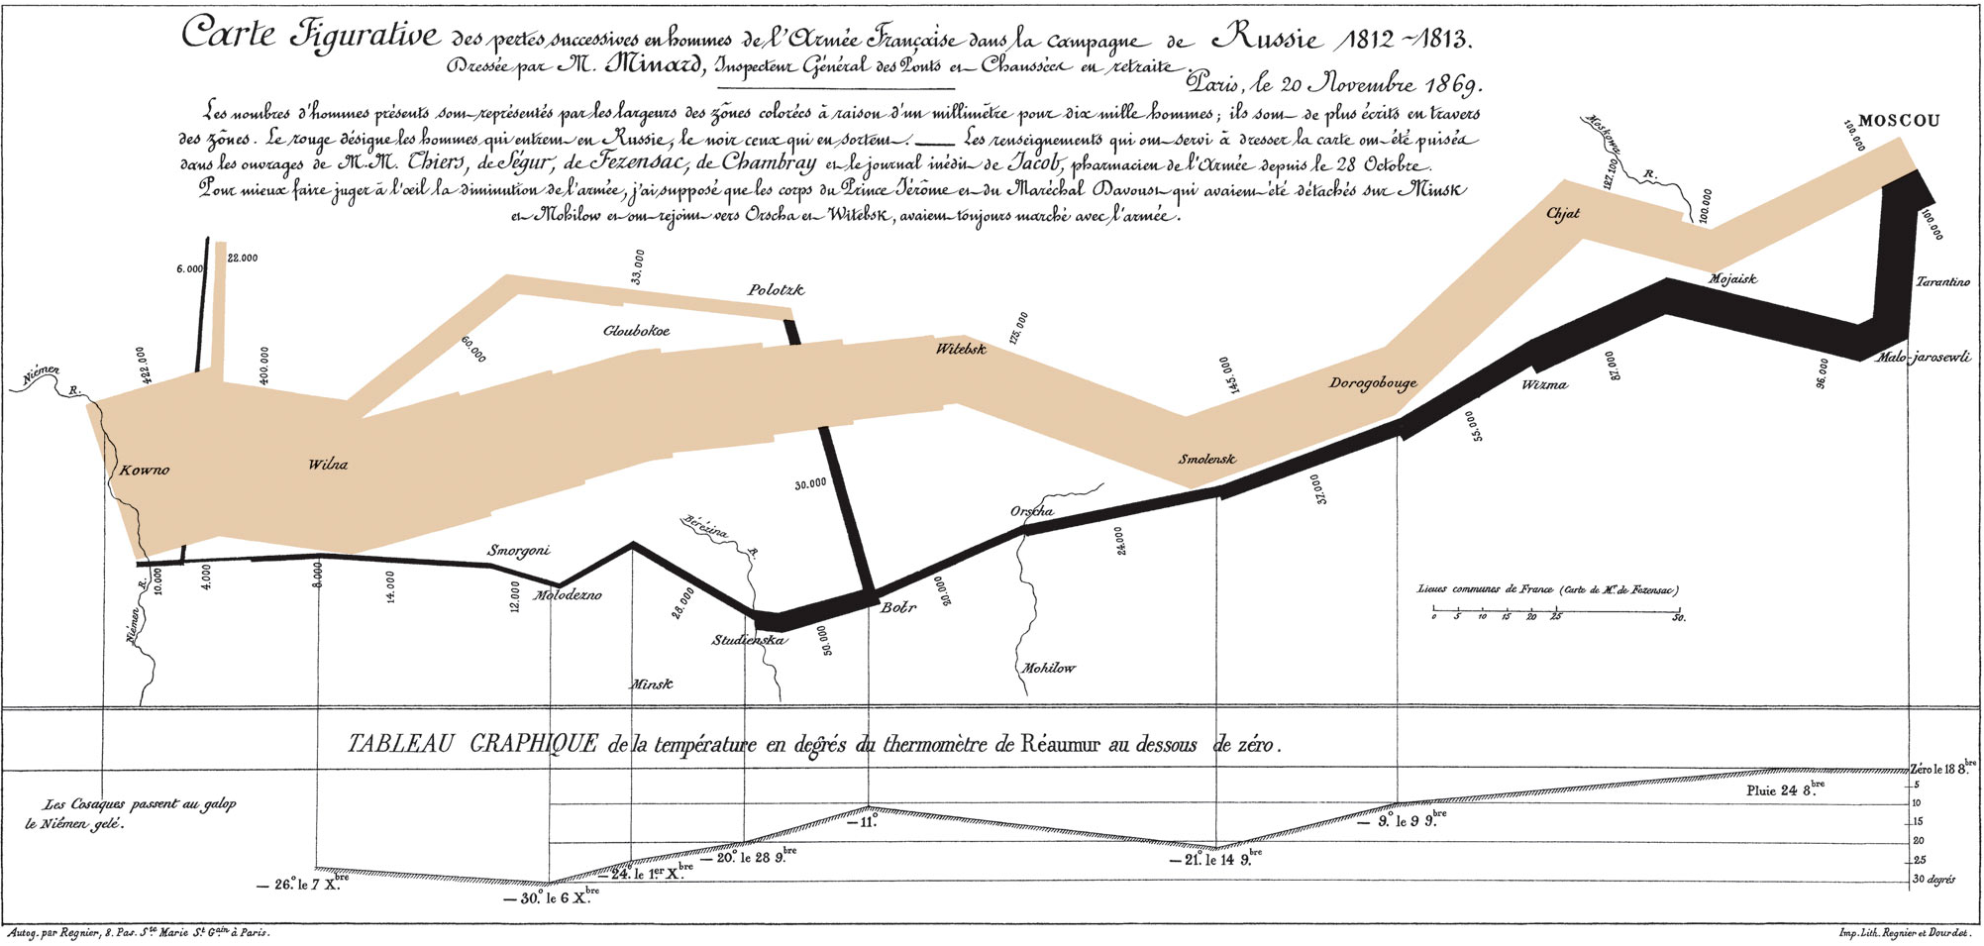

Slide 2
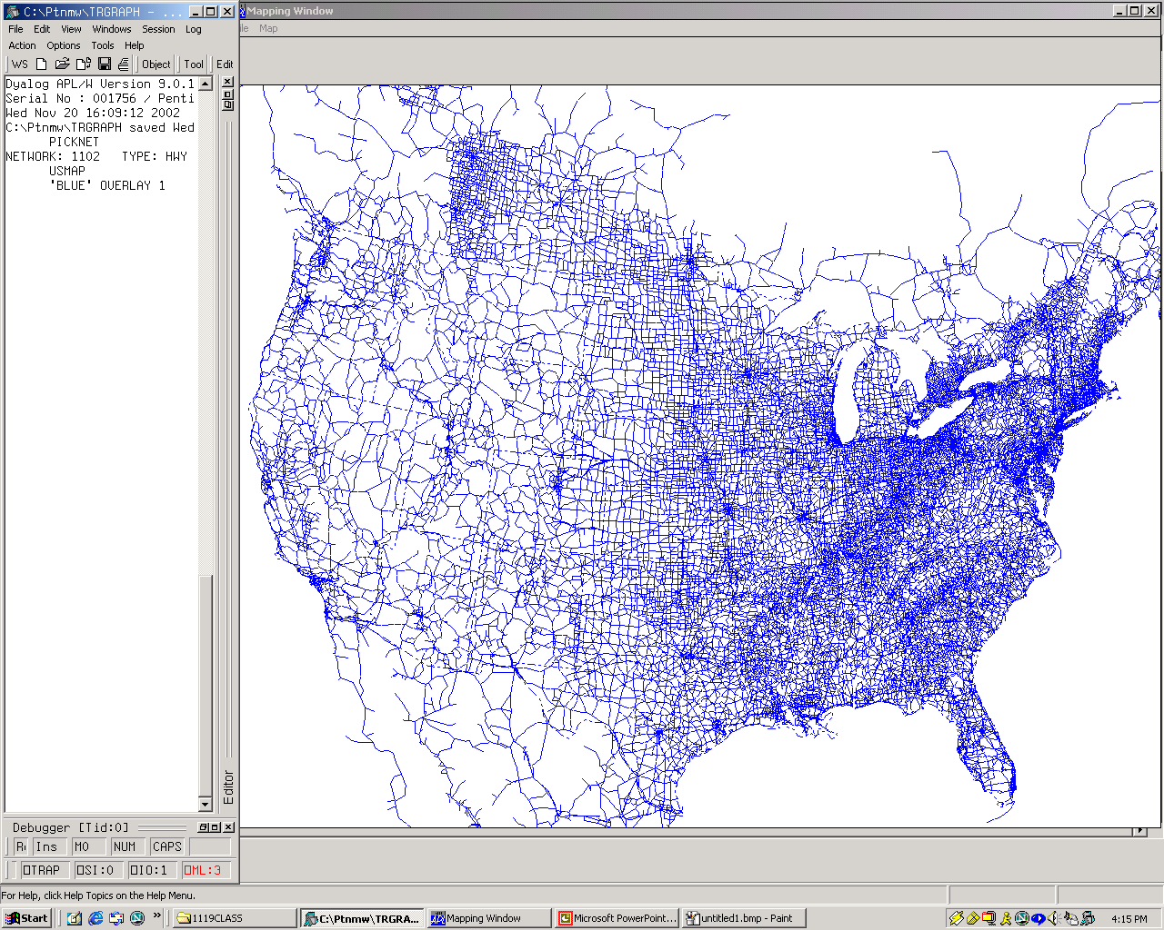
NationWideNetwork: Links, Nodes, Readme
NationwideSythesizedPersonTrips

Slide 3
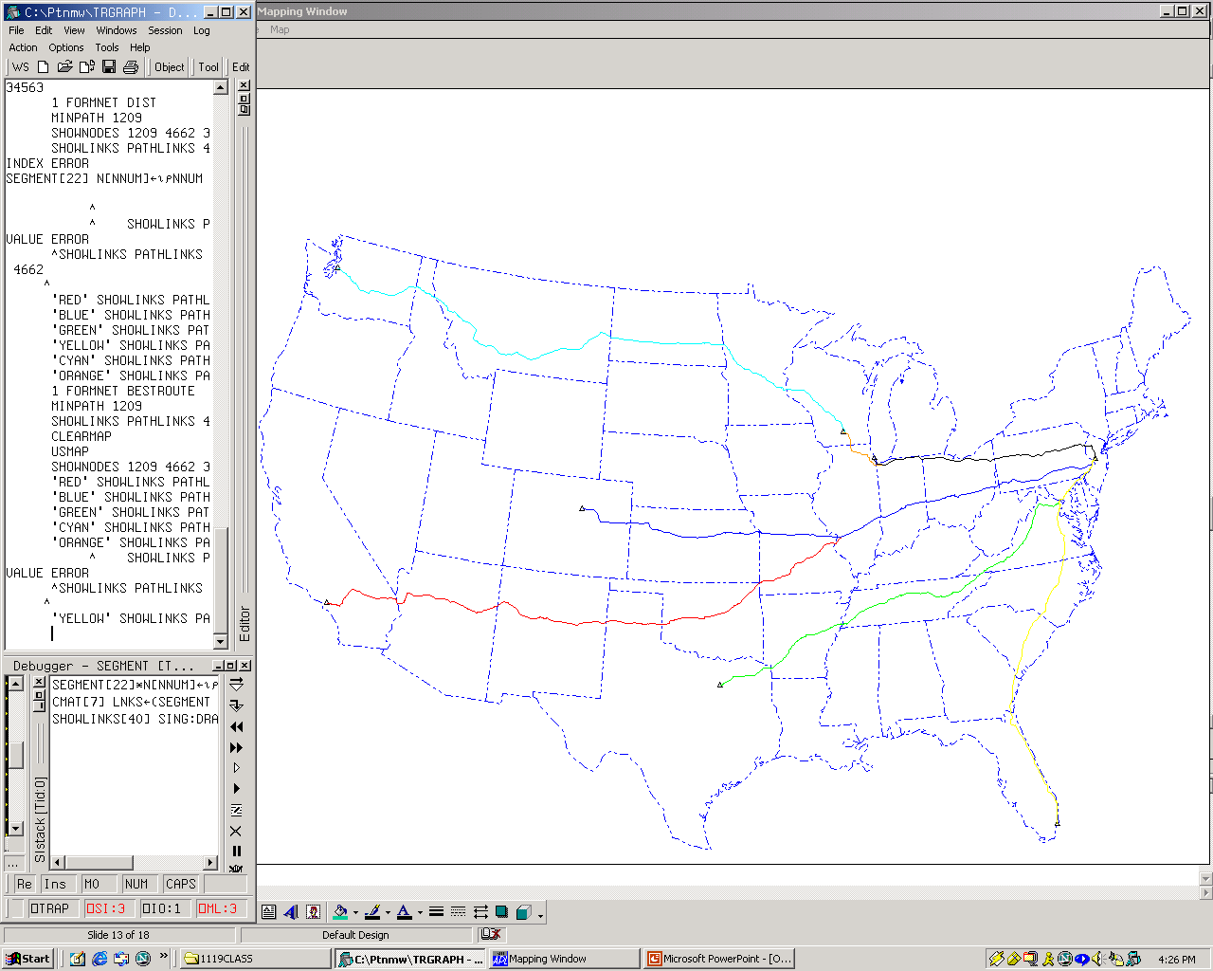

Slide 4
Visual Display of Traffic Volume
C
destination
A
B
C
D
origin
A
150
B
100
C
250
B
D
50
a
b
A
Link a-b
150 + 50 = 200
Link b-a
100 + 250 = 350
D

Slide 5
Flow Map Examples
Simply Files:
 | CMD1 |  | CMD2
Link # | Vol A->B | Vol B->A | Vol A->B | Vol B->A
236.0 | 324.5 | 56.7 | 5,634.2 | 734.6
243.0 | 546.4 | 902.1 | 1,456.0 | 45.6

Slide 6
Corporate Upheavals
Merger of Pennsylvania RR and NY Central RR Feb 1, 1968
Survived for only one year, bankrupt in 1969
by 1975:
7 bankrupt RRs in NE, (PC, Reading, LV, New Haven, Boston & Main, Central of NJ, Grand Trunk)
In summer of 1975, geocoded 1st digital map database of the Northeast RRs as part of a Congressional Study on “The Final System Plan”
“… More downside risk than upside potential…”
“… cost $7B not $1B…”
“…no other reasonable alternative than to create ConRail…”
Spent the next 25 years rationalizing the freight RRs system (unwinding the system from potential government ownership)
Privatization and eventual private sale of Conrail

Slide 7
To help the Freight RR Industry
We built PTNM/GIS
Princeton Transportation Network Model & Graphical Information System

Slide 8
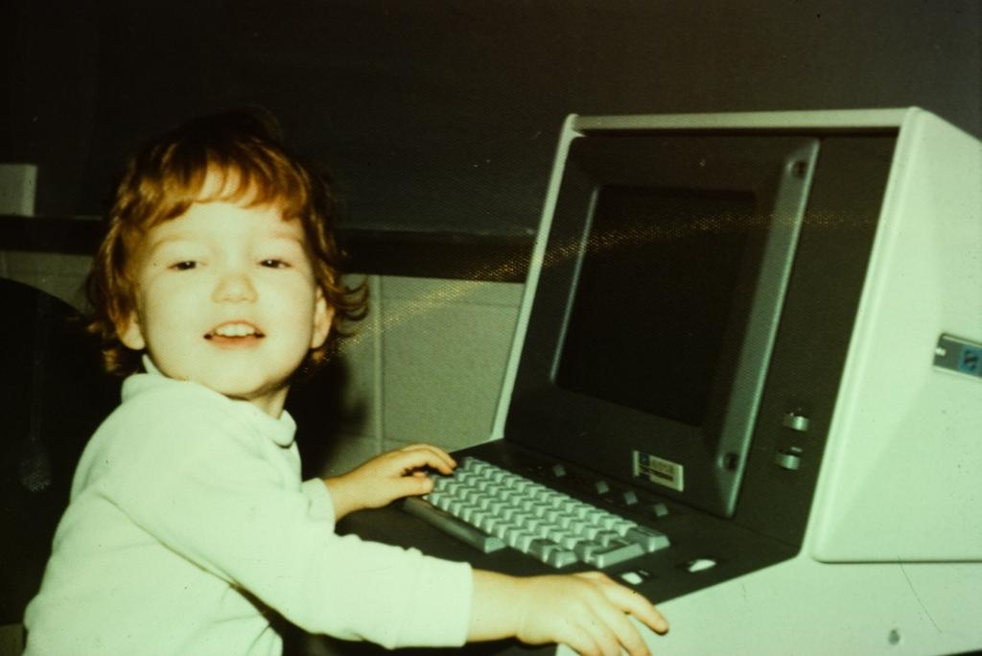
Tektronix 4013 Monochrome Graphics Terminal to IBM 370 Mainframe

Slide 9
To help the Freight RR Industry
We built PTNM/GIS
Princeton Transportation Network Model & Graphical Information System
We realized that a major competitor to RRs were trucks
So we built a digital map data base of the North American highway system and extended it across the world.

Slide 10
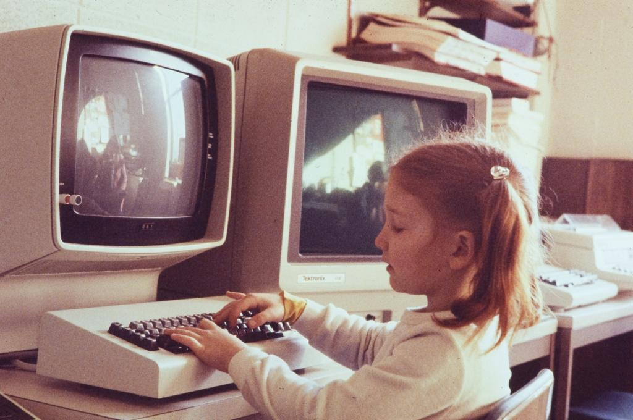
Tektronix 4015 Dual headed Mono Graphics Terminal to IBM 4300 Mainframe

Slide 11
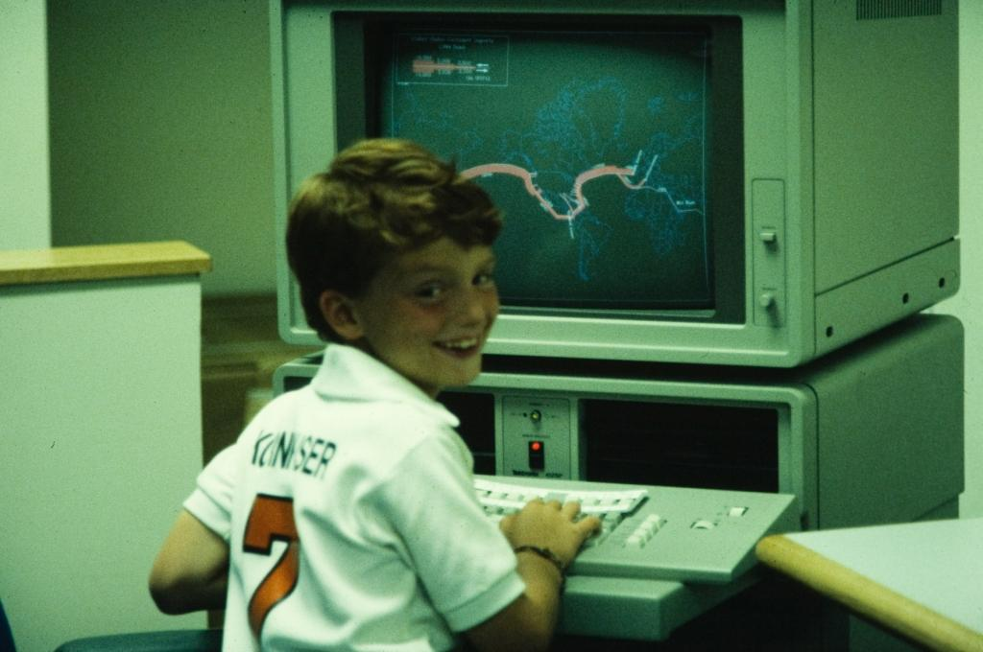
Tektronix 4025 Color Graphics Terminal to IBM 4300 Mainframe

Slide 12
To help the Freight RR Industry
We built PTNM/GIS
Princeton Transportation Network Model & Graphical Information System
We realized that a major competitor to RRs were trucks
So we built a digital map data base of the North American highway system and extended it across the world.
Motor carrier deregulation required/deserved a rating system that was based on actual routes & real miles not government tariff routes & imaginary “HouseHoldMoversGuide” miles
so PC*Miler was born

Slide 13
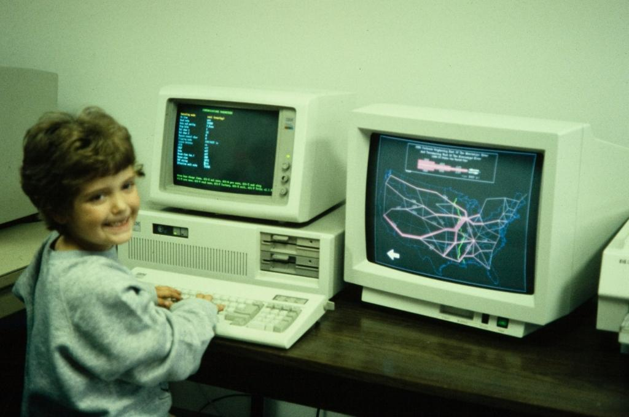
IBM PC-AT w 19” Tektronix Color Monitor

Slide 14
As Computer Power & Memory Grew
About 15 years ago we started looking at Door-to-Door routing
Launched RoadTrips Door-to-Door in 1997
Added GPS
launched Laptop version of CoPilot in Aug 1998
Ported CoPilot to Casio’s Cassiopeia
launched 1st PDA version of turn-by-turn navigation in 2000
Ported CoPilot to Msft Mobile
launched 1st Copilot|Live focuses of communications in 2003
Ported CoPilot to iPhone and Android
in the process of launching CoPilot on those platforms
Our Future view continues to be committed to limiting the exposure and capturing the value of a dynamic transportation environment we call:

Slide 15
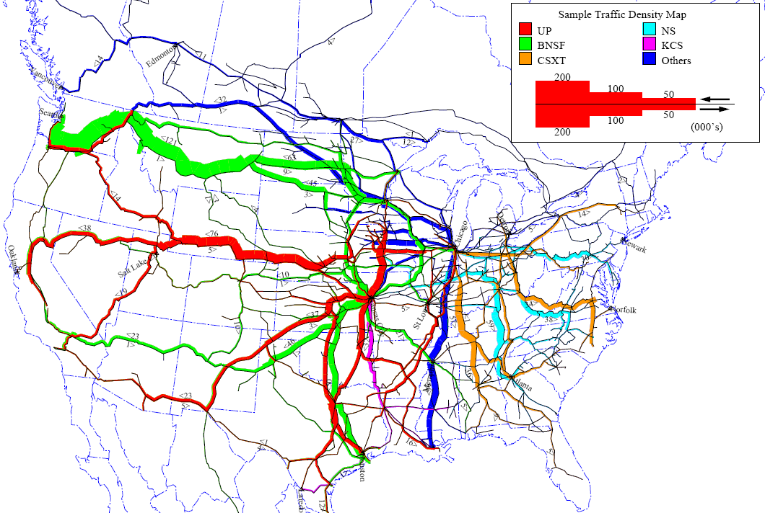

Slide 16
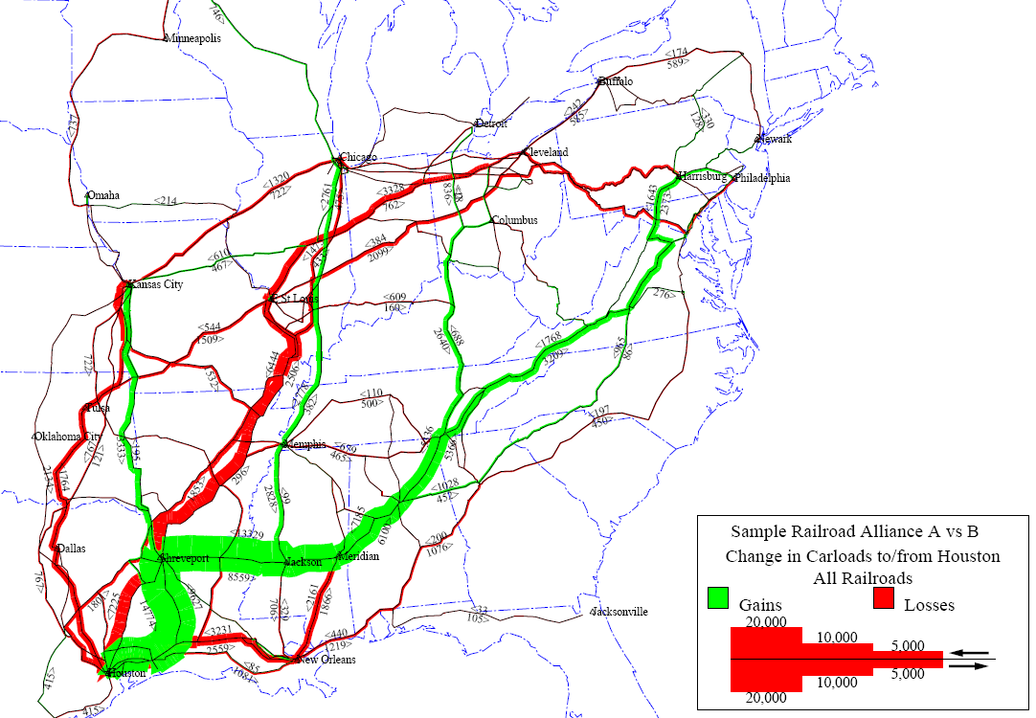

Slide 17
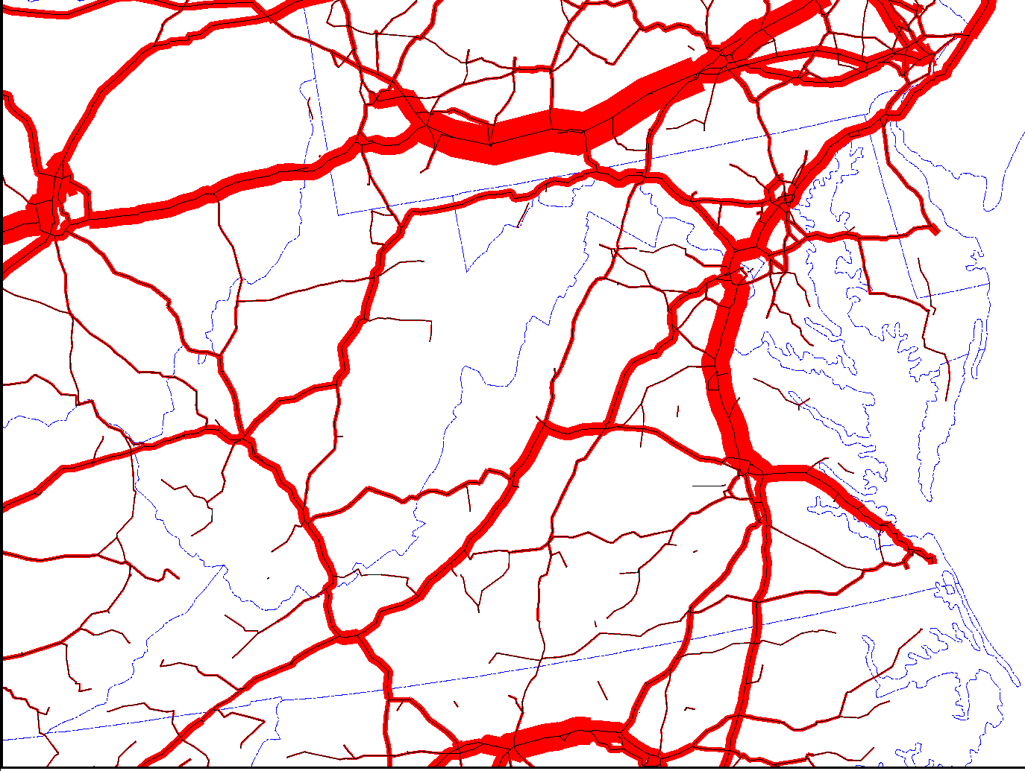
I-81
Truck Flows After a $.20/mile toll on I-81

Slide 18
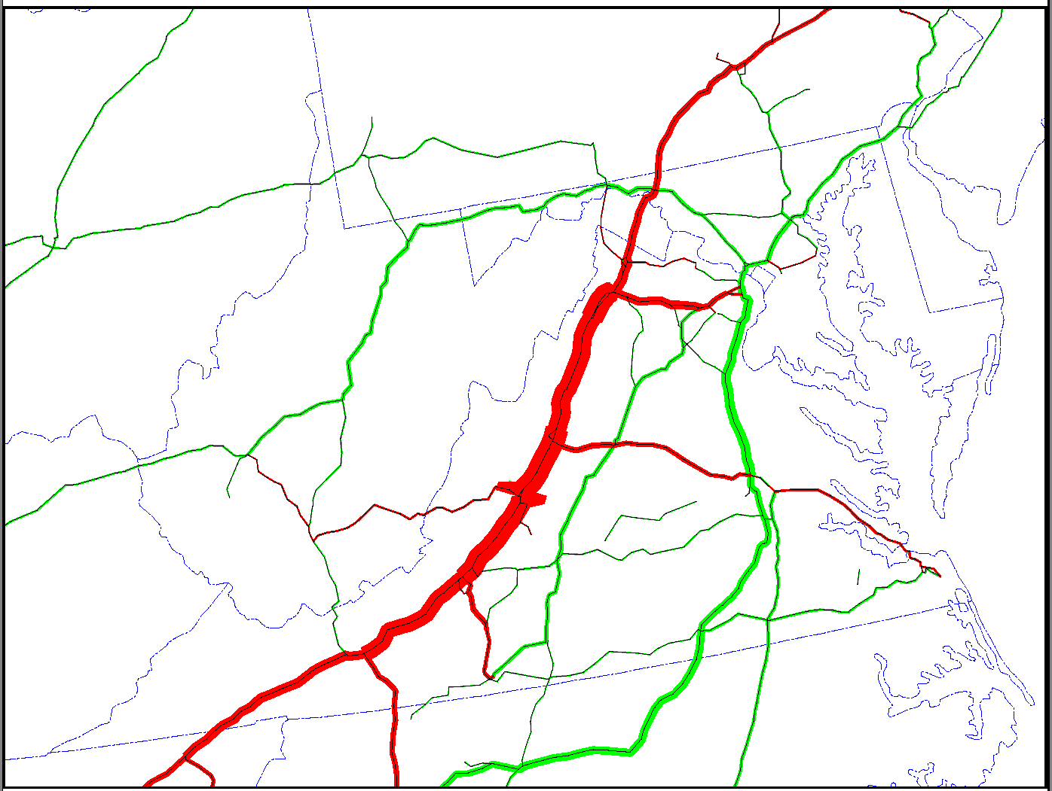
Change in Truck Flows Due to a $.10/mile toll on I-81
Green: Increase
Red: Decrease
I-81

Slide 19
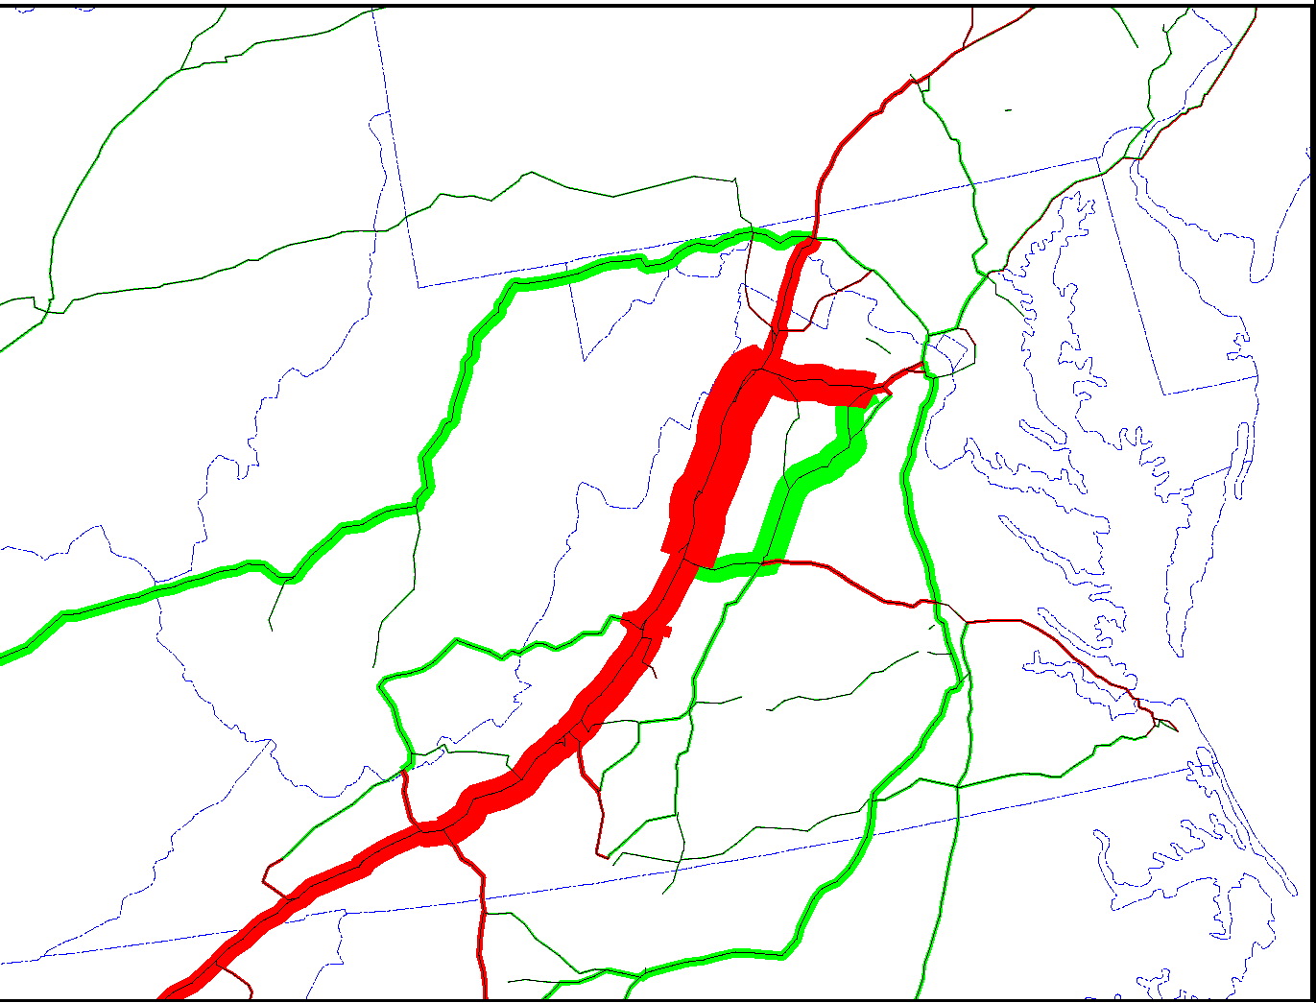
Change in Truck Flows Due to a $.20/mile toll on I-81
Green: Increase
Red: Decrease
I-81
15

