Slide 1
Midwest analysis
emily kallfelz, jordan argue, cole bransford, adam kelly, hunter johnson

Slide 2
** note this is not population – instead it is number of people starting a trip from each county
we will have population in the final project report

Slide 3
total number of trips per county

Slide 4
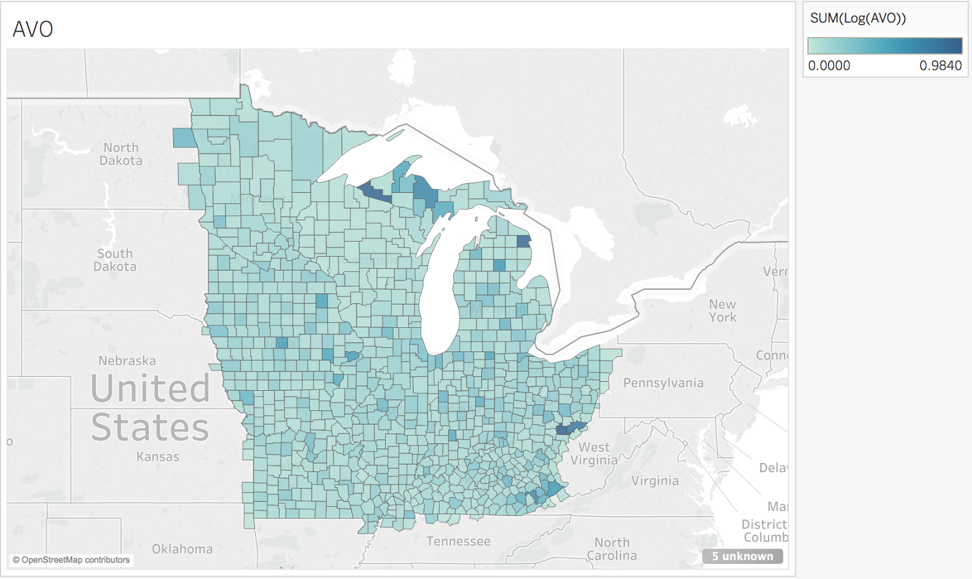
AVO by county

Slide 5
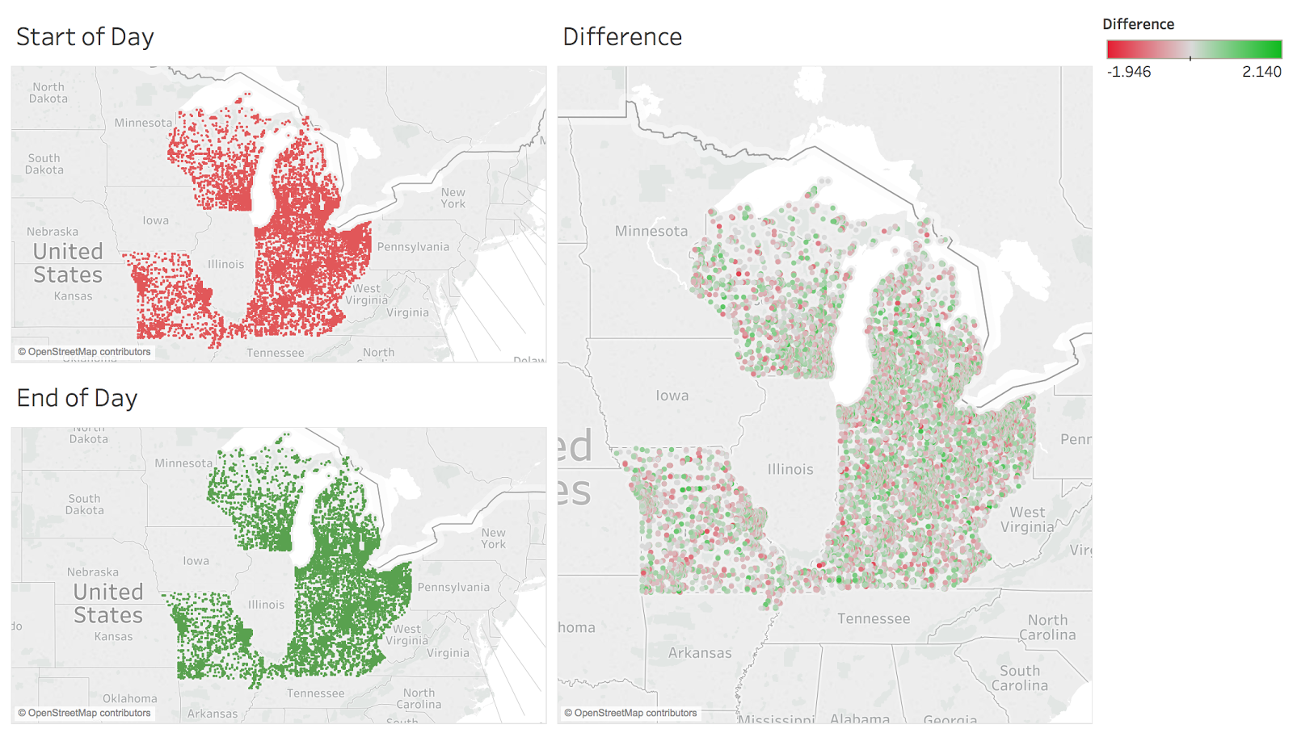
red represents demand for aTaxis at the start of the dat
green represents where aTaxis end up at the end of the day
we will have actual amounts of aTaxis for the final report

Slide 6
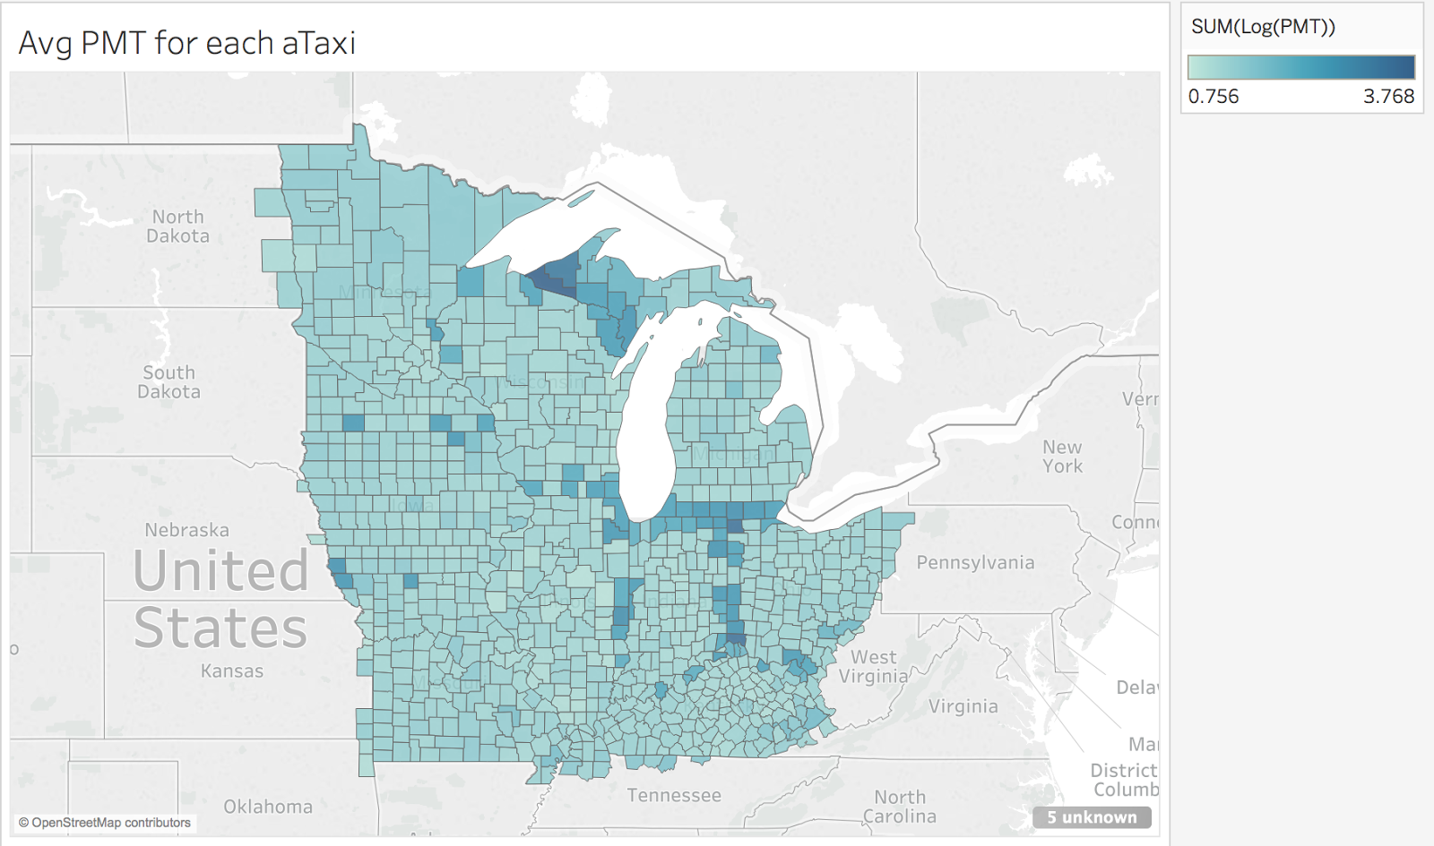
average PersonMilesTraveled per aTaxi in county

Slide 7
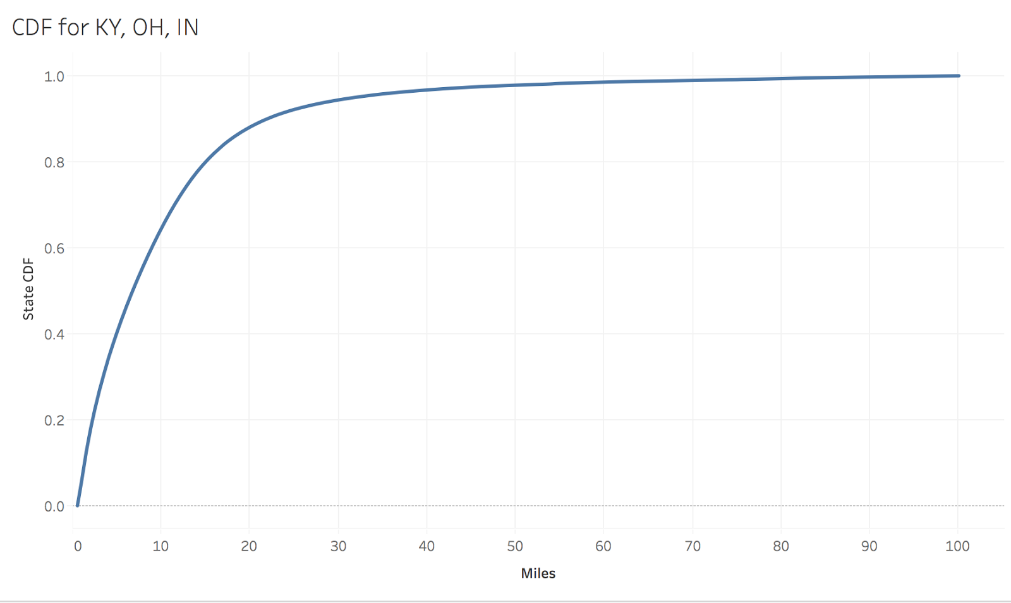
CDF for 3 states – will include all states in region in final report

Slide 8
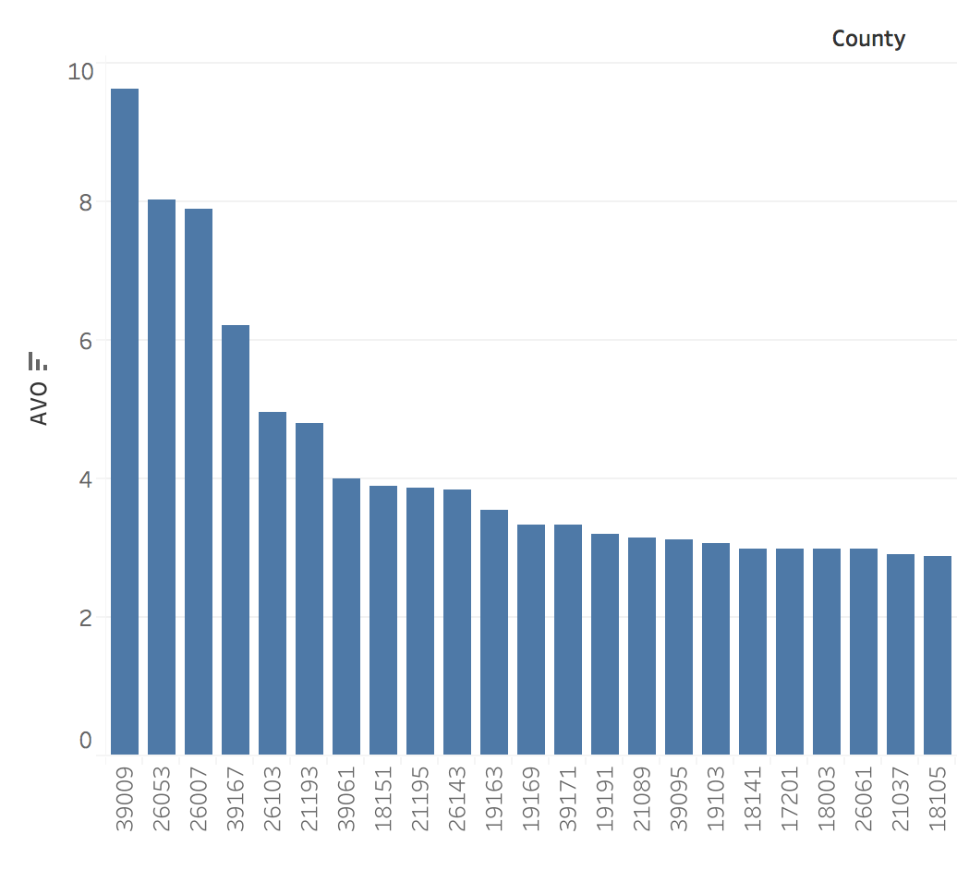
counties with top AVO’s in region

Slide 9
Summary of data
actual distance traveled – 1.85 billion miles
average persontrip length – 17,000
number of trips beginning in the region – 83.53 million
total AVO for entire region – 1.522
total distance traveled – 2.8 billion miles
number of trips within region – 181 million

