Slide 1
ORF 467 Final Project
Assessment of RideSharing, ‘Last-Mile” and Optimal Empty Vehicle Management of Large Regional aTaxi Operation: South Region
Yowan Ramchoreeter, Yun Teng, Albert Wang
Professor Alain L. Kornhauser

Slide 2
Overview of Southern Region
States: North Carolina, South Carolina, Georgia, Florida, Alabama, Mississippi, Tennessee, Arkansas, and Louisiana
Population: ~124 million (US Census 2017)
Passenger miles/day: 3.4 billion mi
Vehicle miles/day 2.4 billion mi
AVO: 1.38
143,523,956 total person trips

Slide 3
Part 1
Analysis of NN files

Slide 4
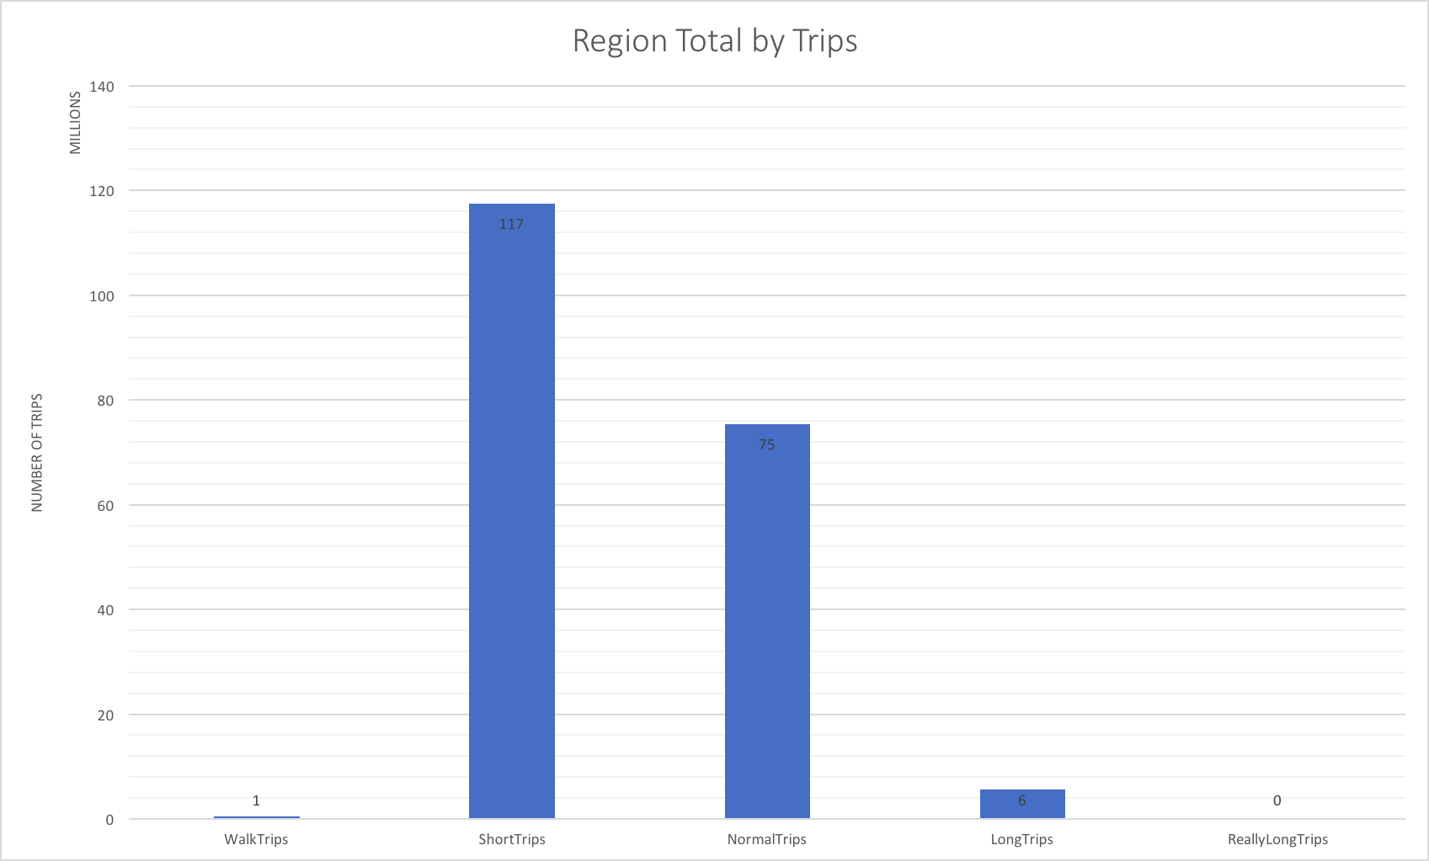
Population total & Geographic Distribution

Slide 5
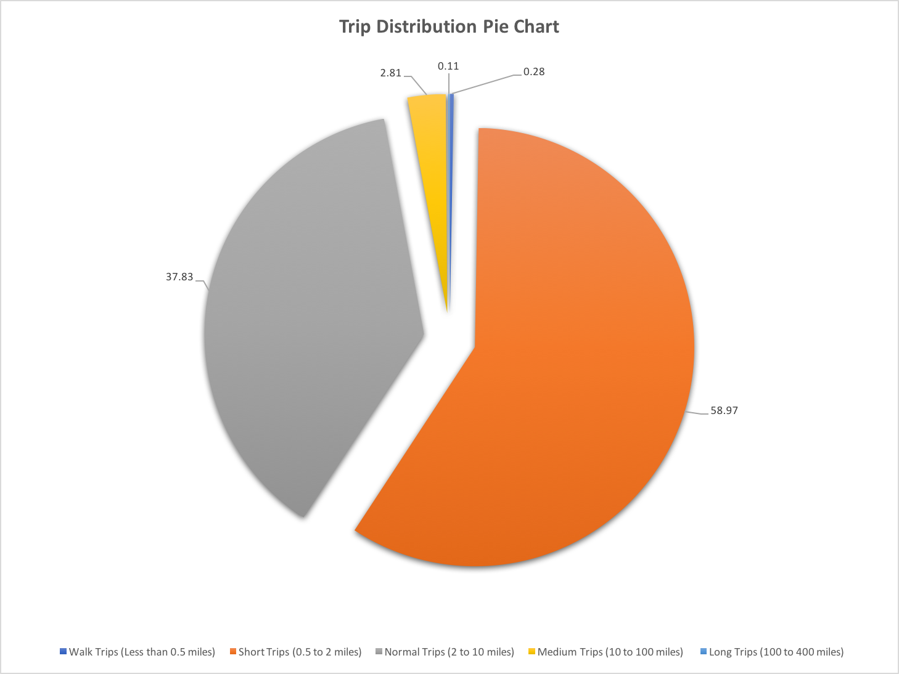
Population total & Geographic Distribution

Slide 6
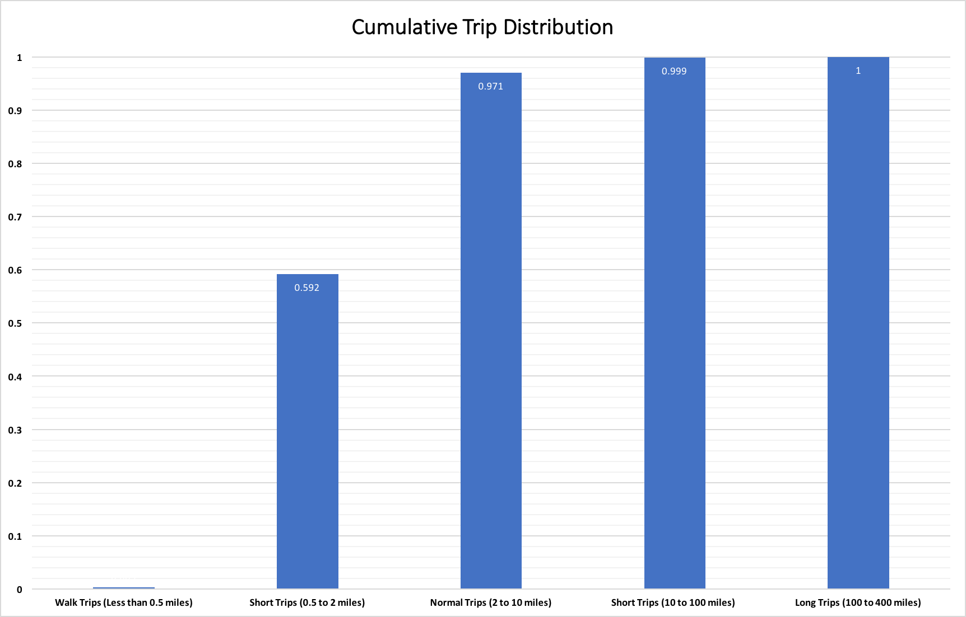

Slide 8
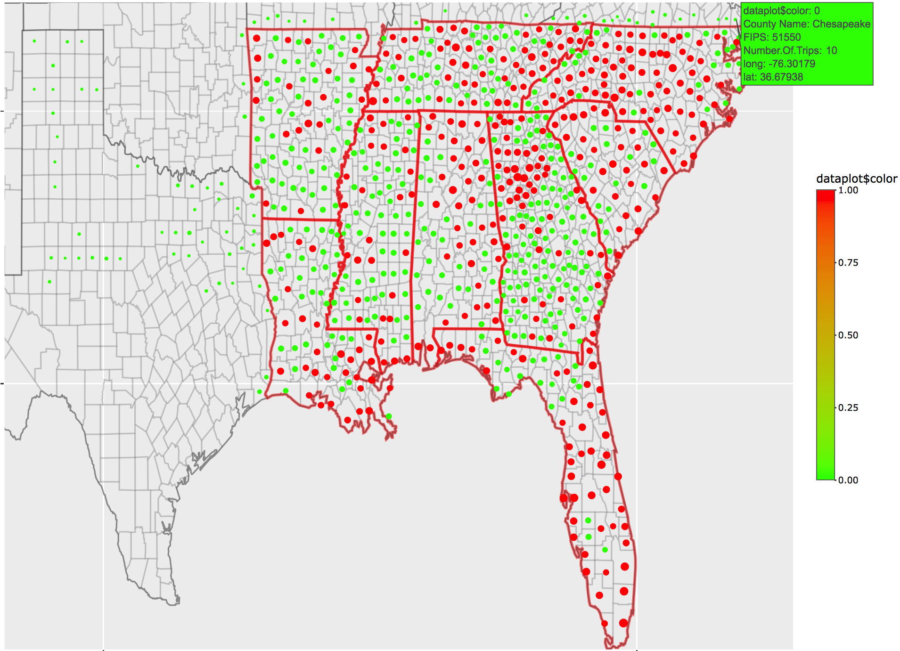
Population Distribution Per County
Counties with population above 100k in red - about 39.8%

Slide 9
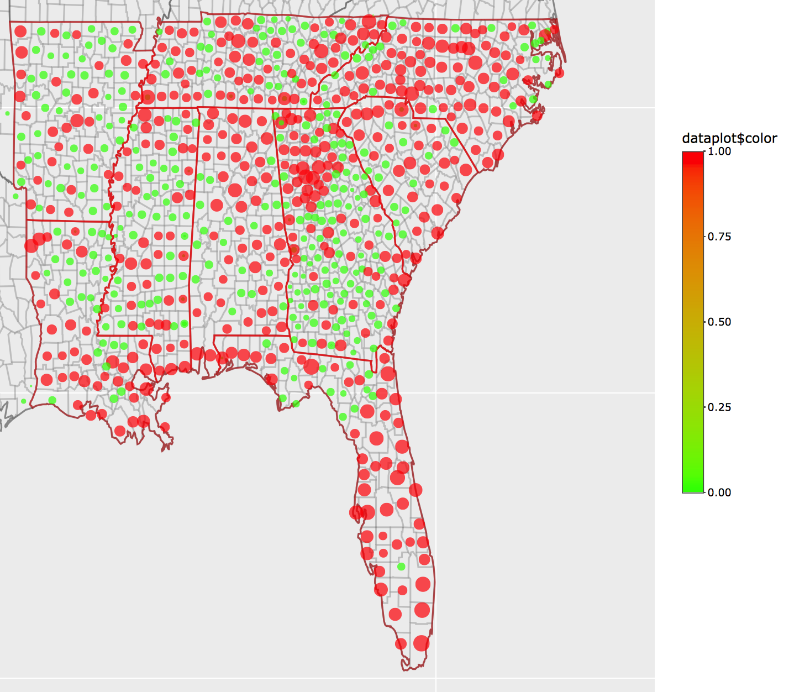
Number of Person Trip Per County
Counties above 1 Million Trips in red
They account for 77% of all counties

Slide 10
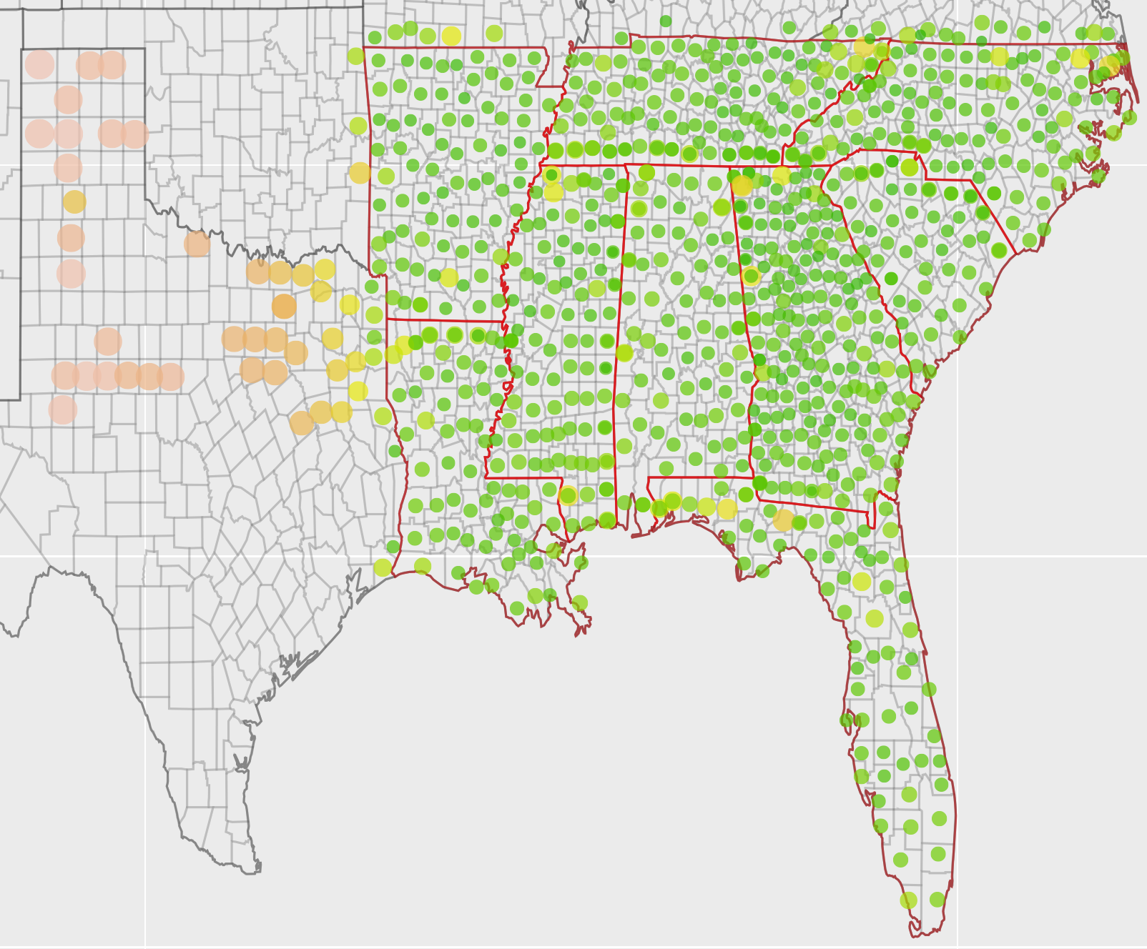
Average Person Trip Miles Per County

Slide 11
Part 2
Analysis of NationWide modal files - aTaxis

Slide 12
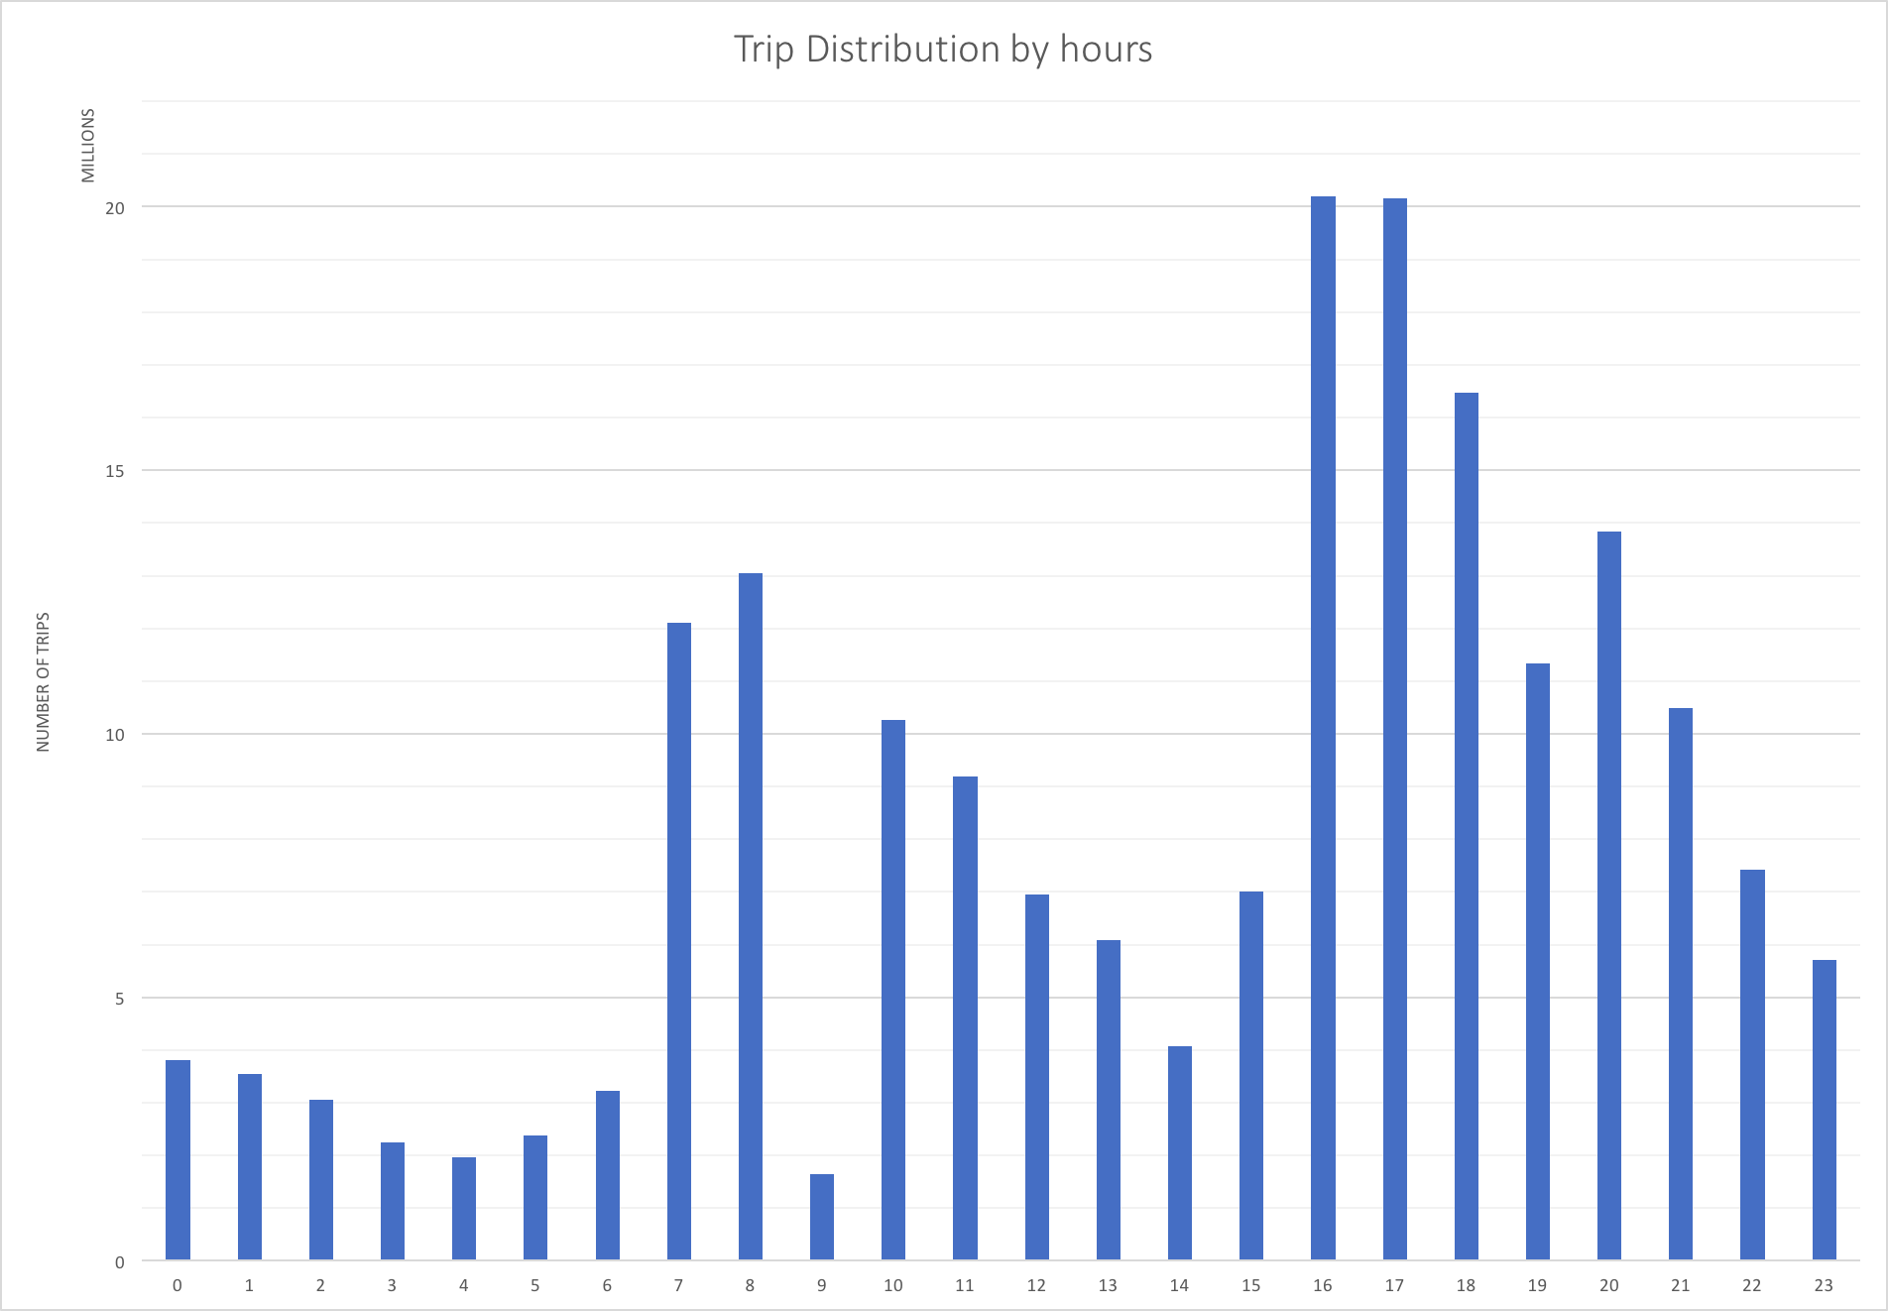

Slide 13
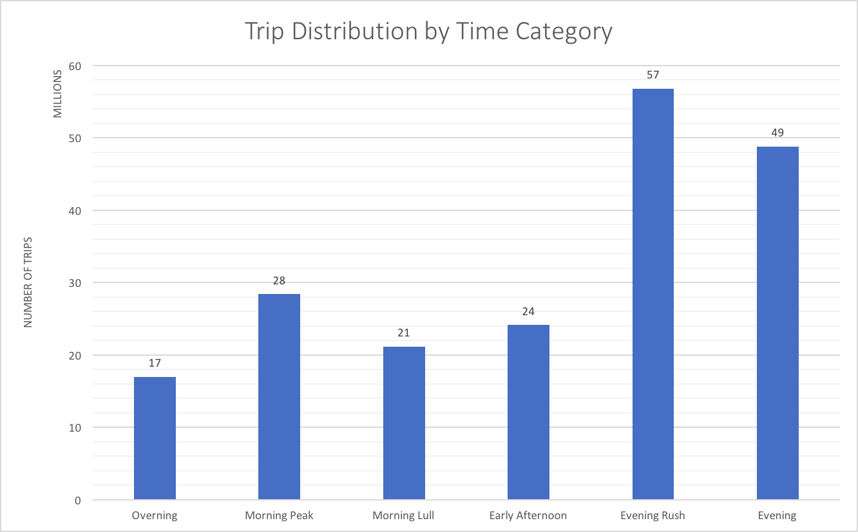

Slide 14
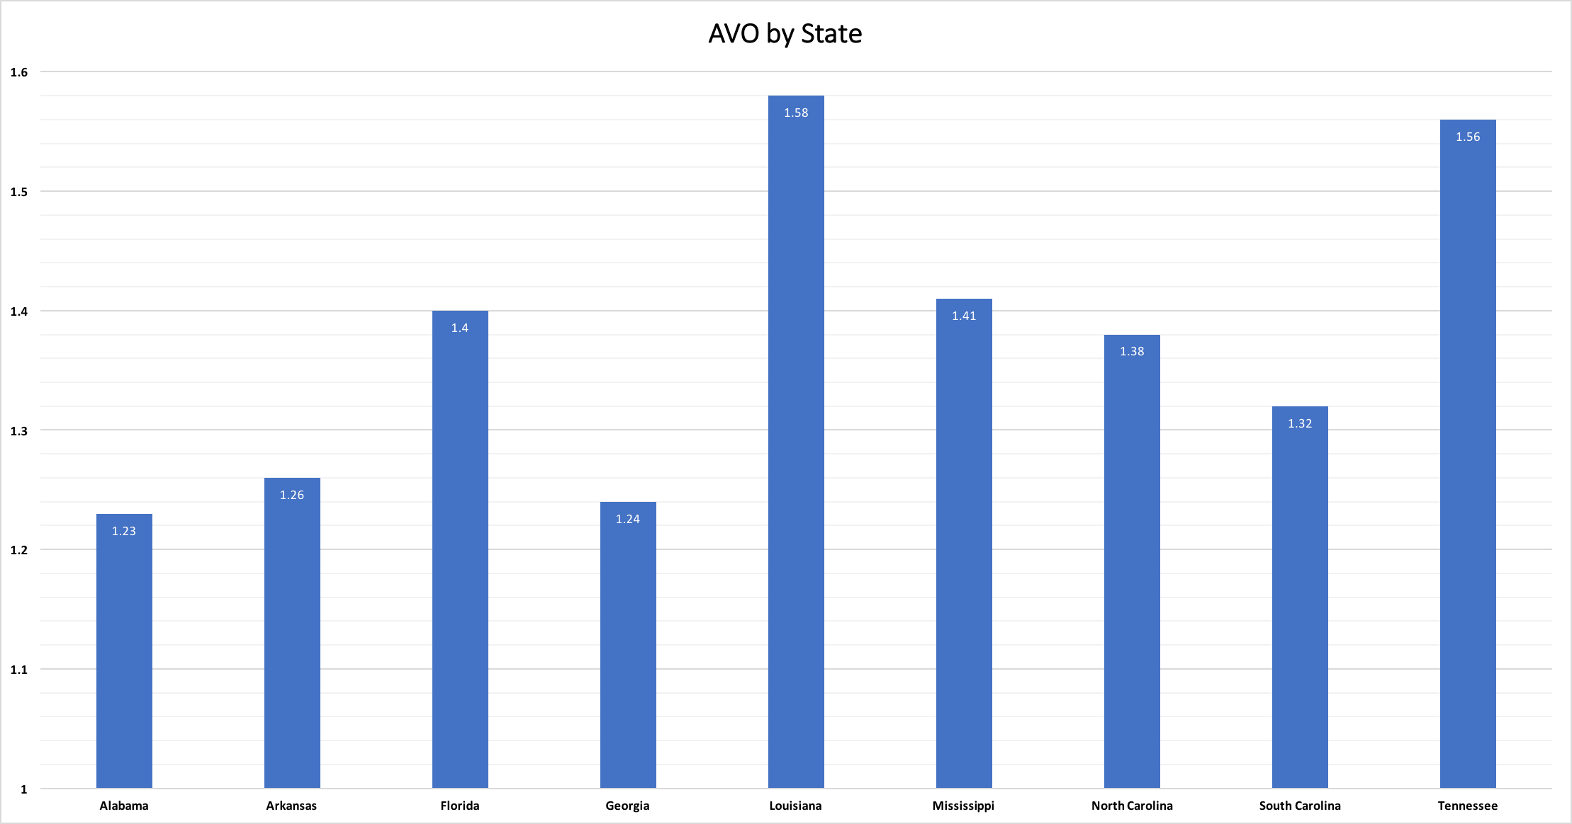

Slide 15
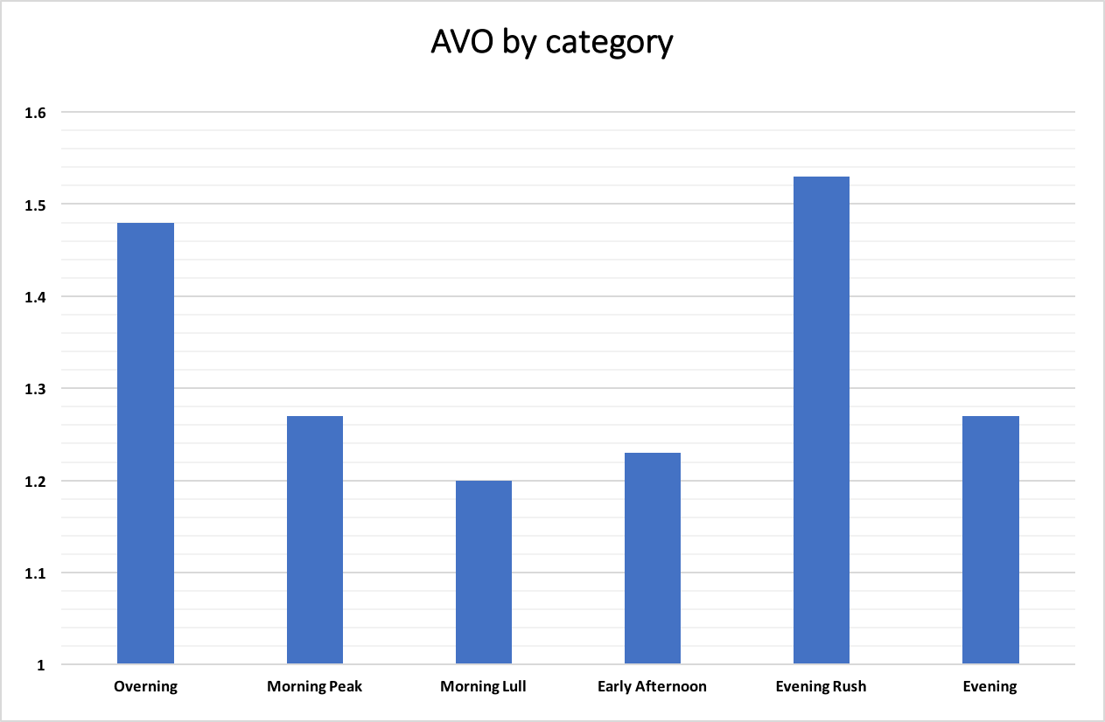

Slide 16
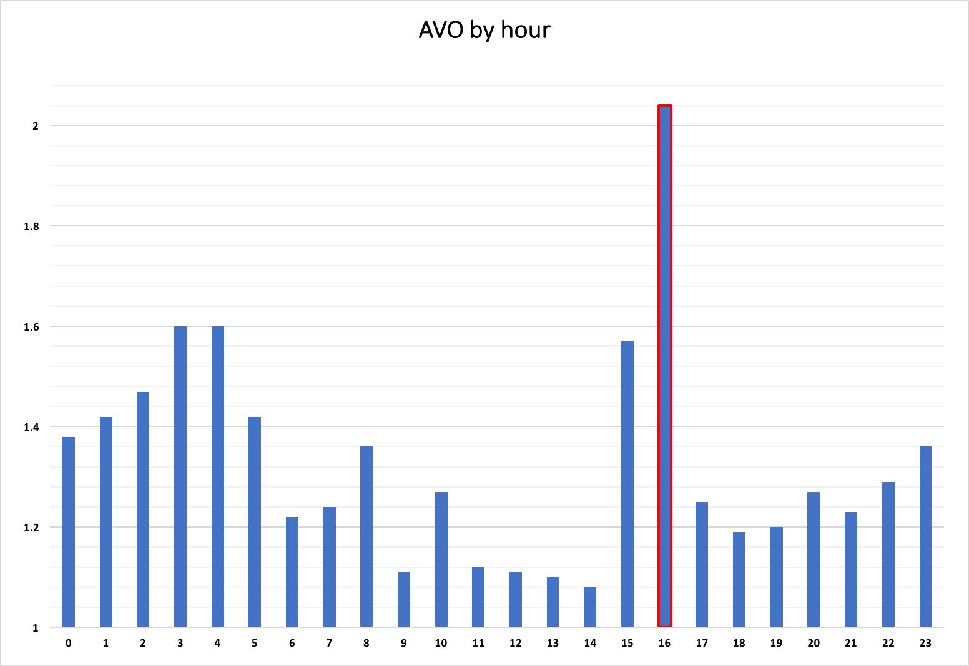

Slide 17
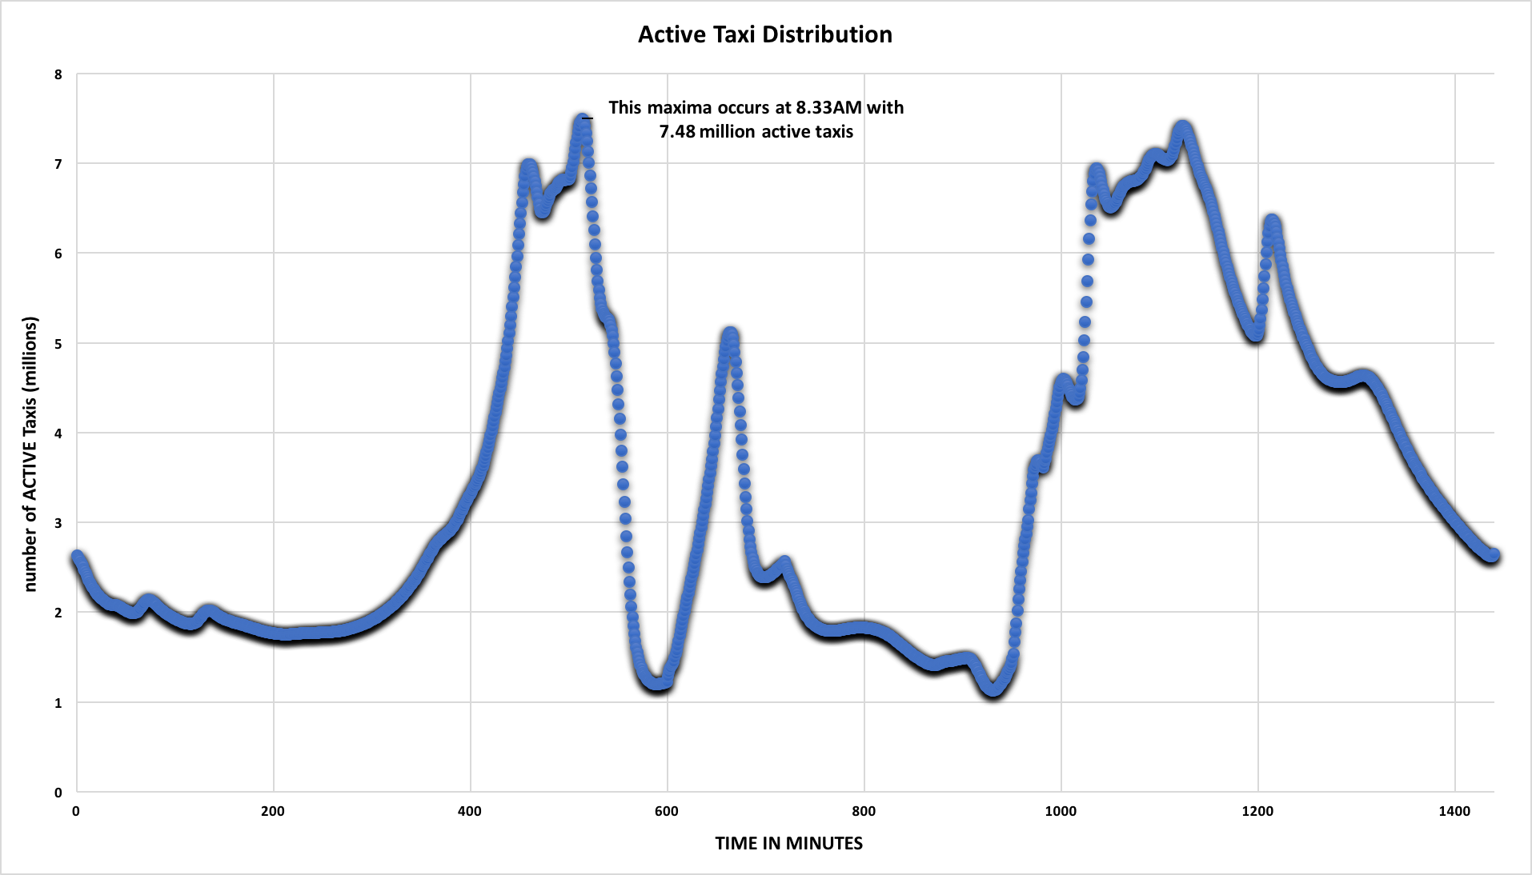

Slide 18
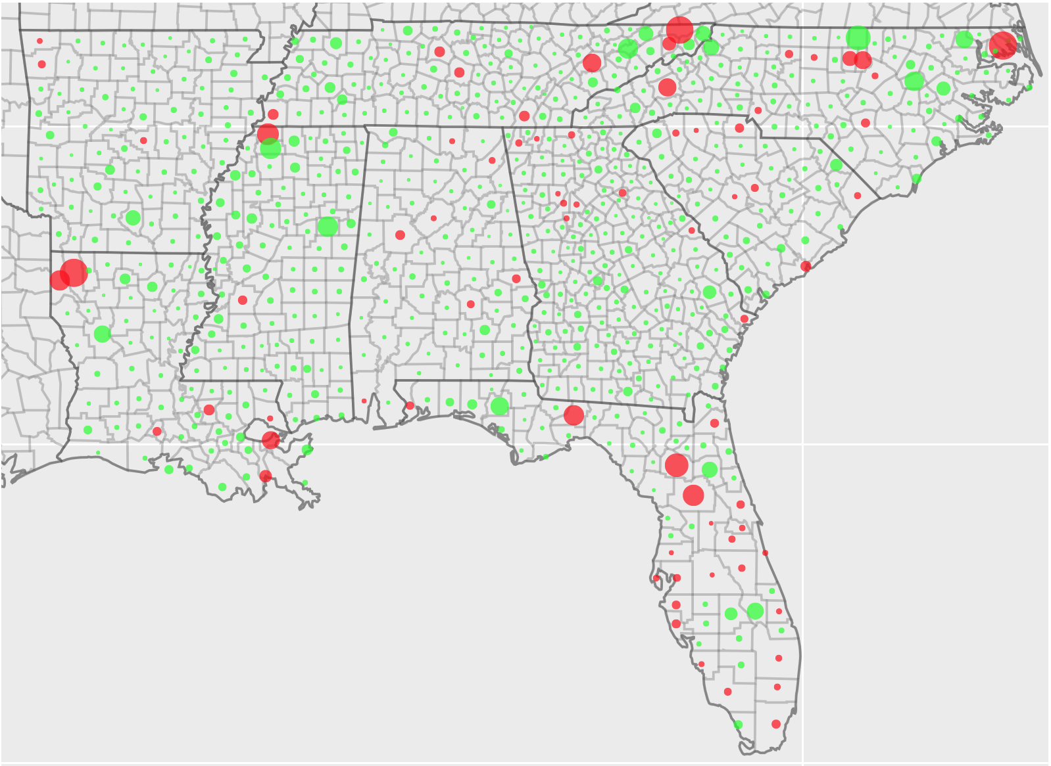
AVO per County (Region AVO: 1.38)
Bossier Parish, LA
2.73
Atlanta, GA
1.31
Area: AVO
Color: PMT
(red > 10 million)
63.5% are red

Slide 19
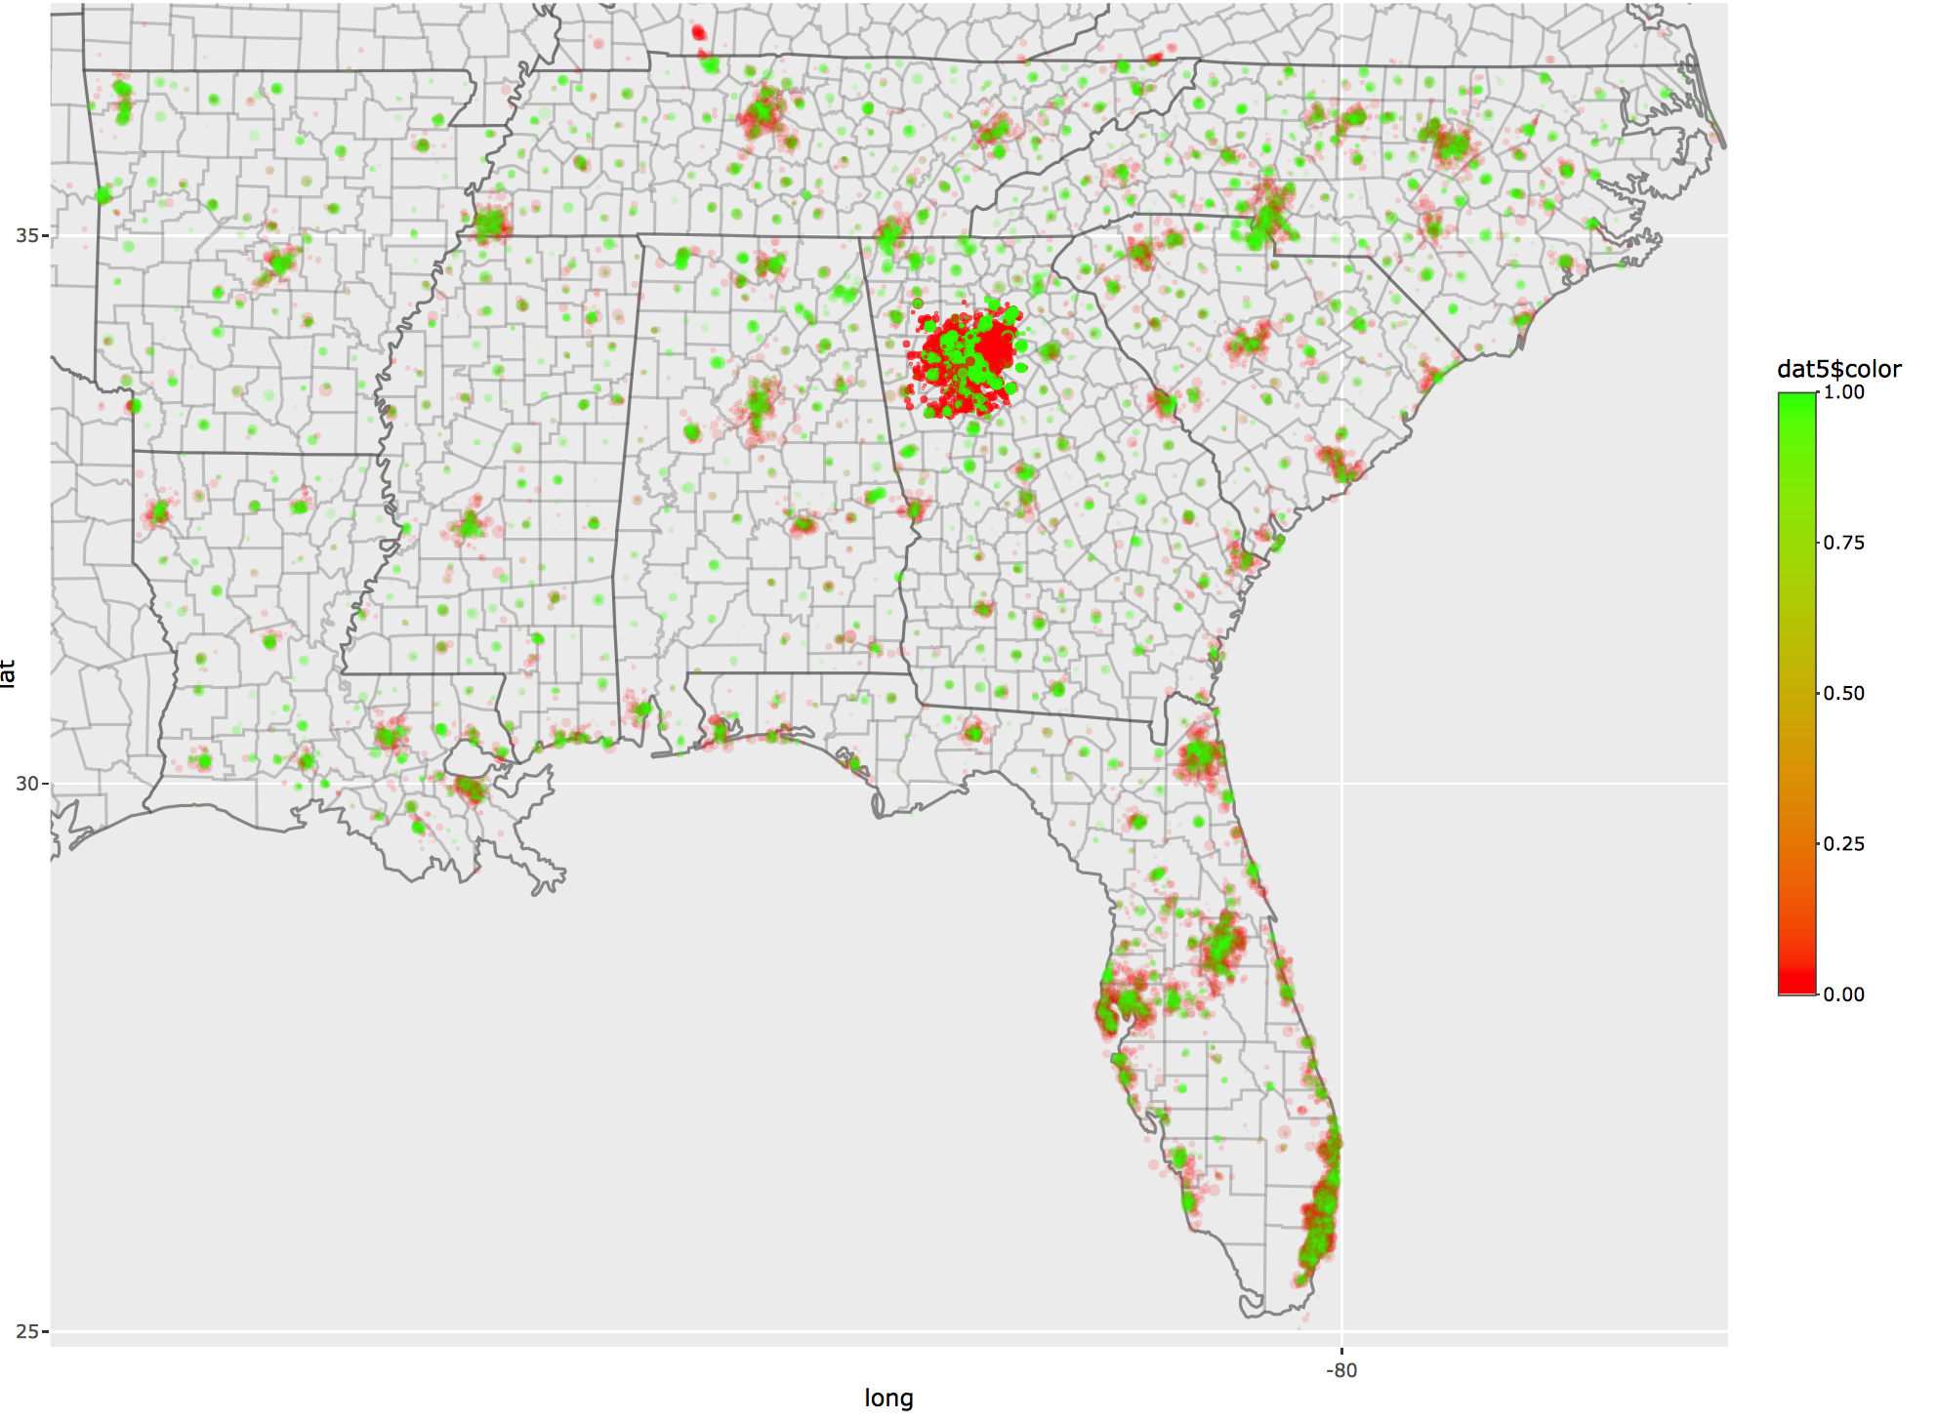
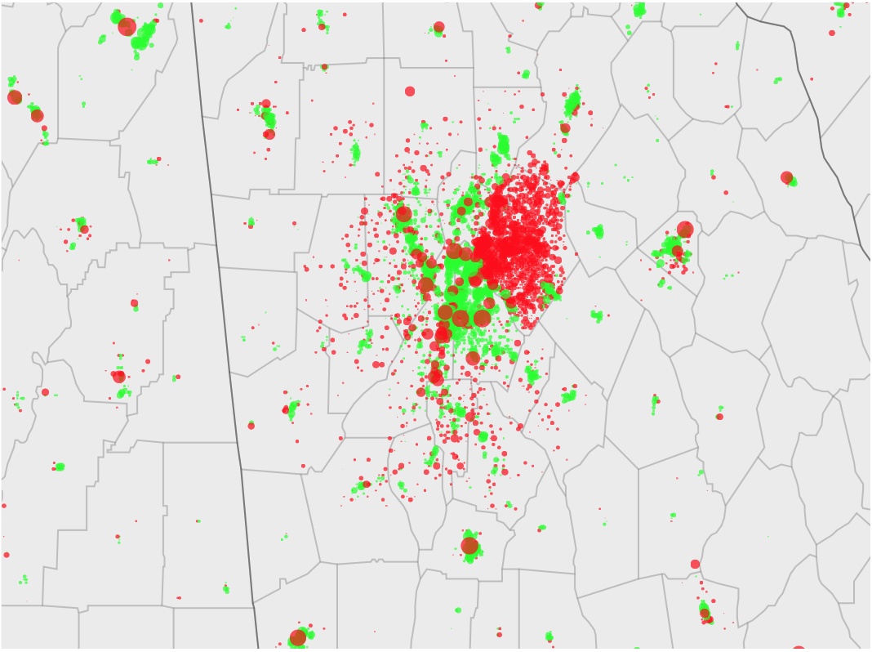
Atlanta, GA
Atlanta metropolitan area population:
5.7 million

Slide 20
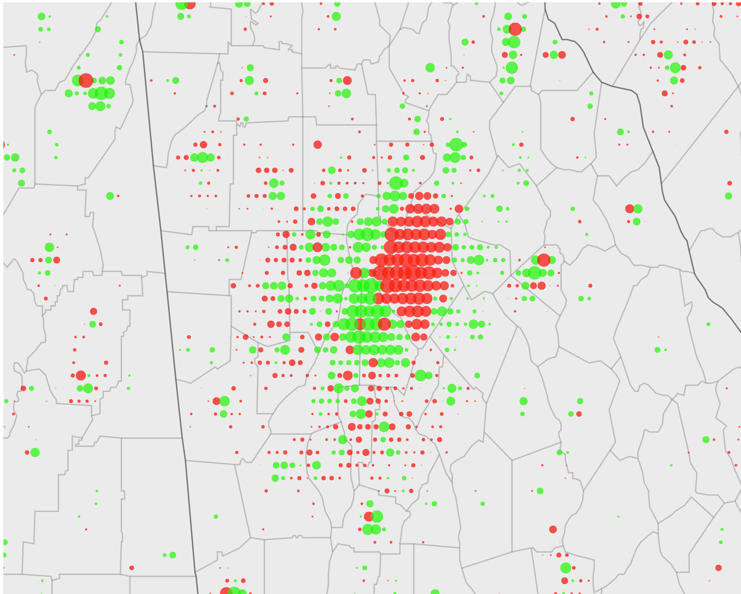
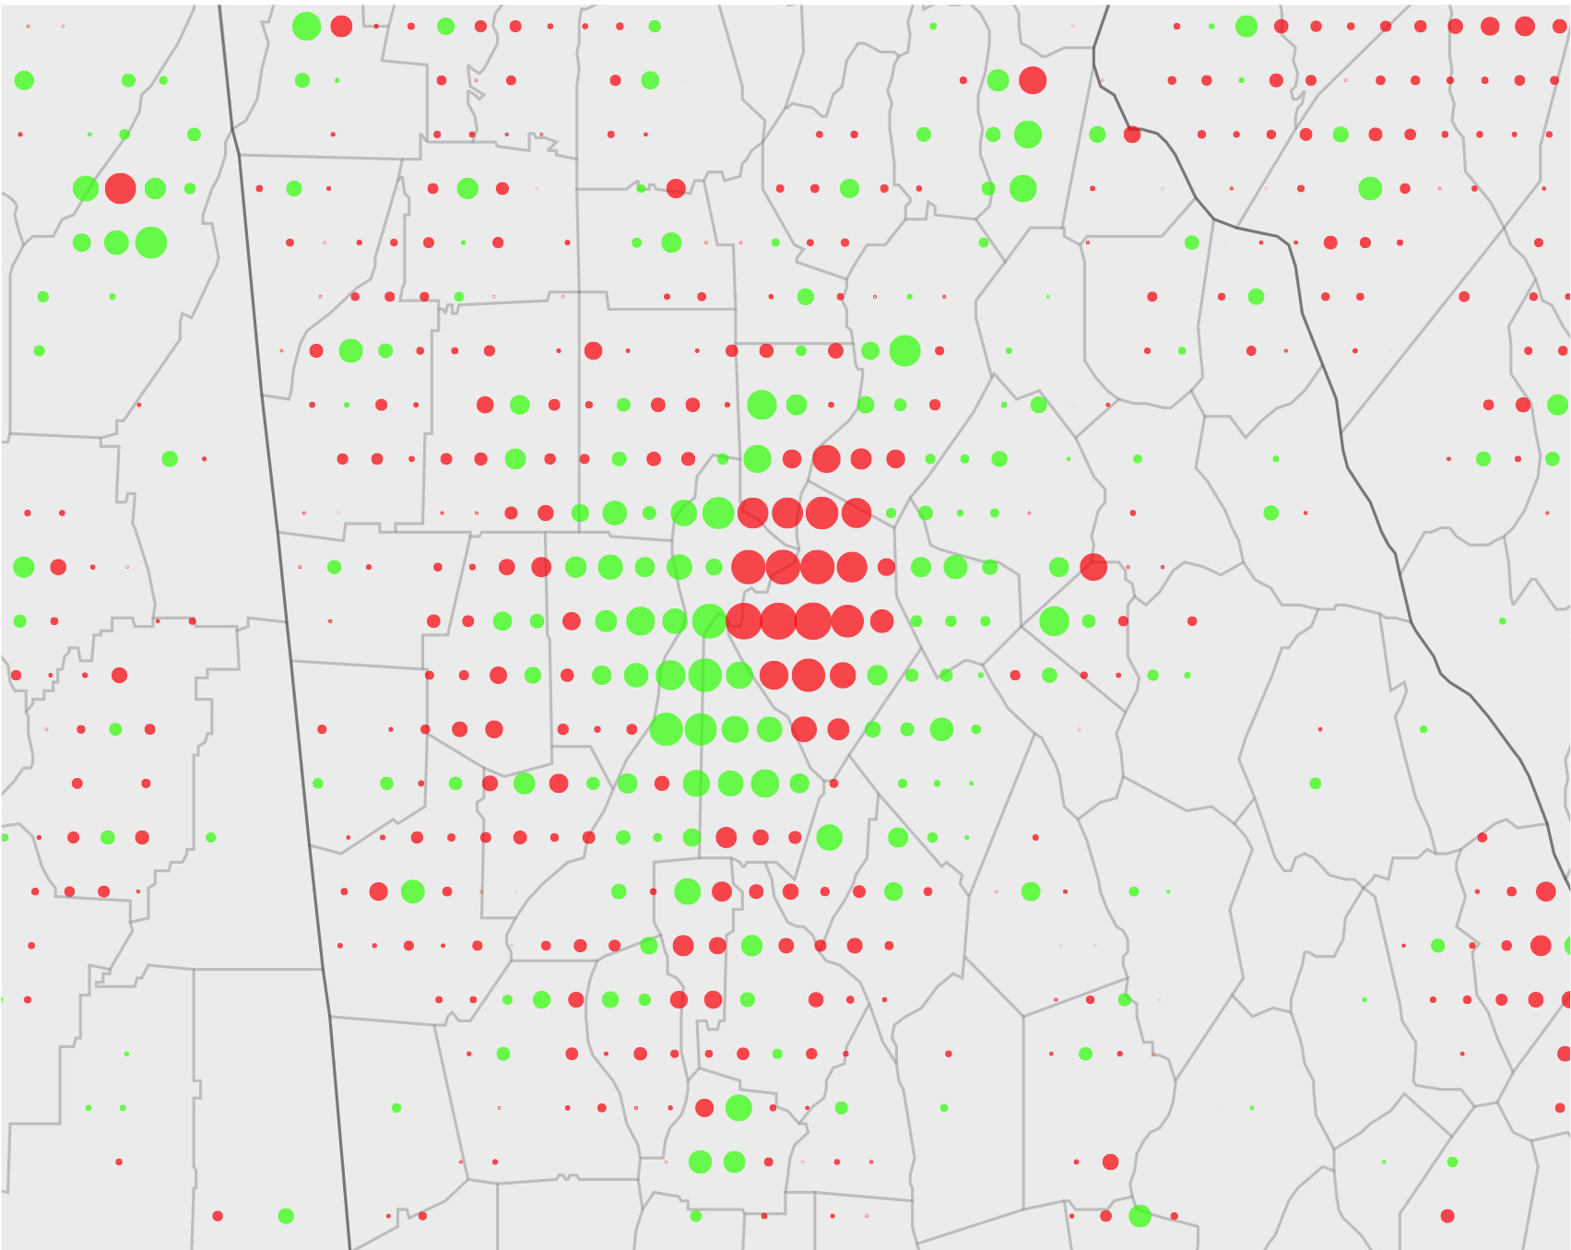
Superpixel comparison for Atlanta, Georgia
1x1
5x5
10x10
Notes:
For a 10x10 superpixels, we actually have to allocate only about 2.7 Million Taxis per day
For a 5x5 superpixels, we actually have to allocate only about 3.4 Million Taxis per day
For a 1x1 pixels, we have to allocate only about 5.5 Million Taxis per day

Slide 21
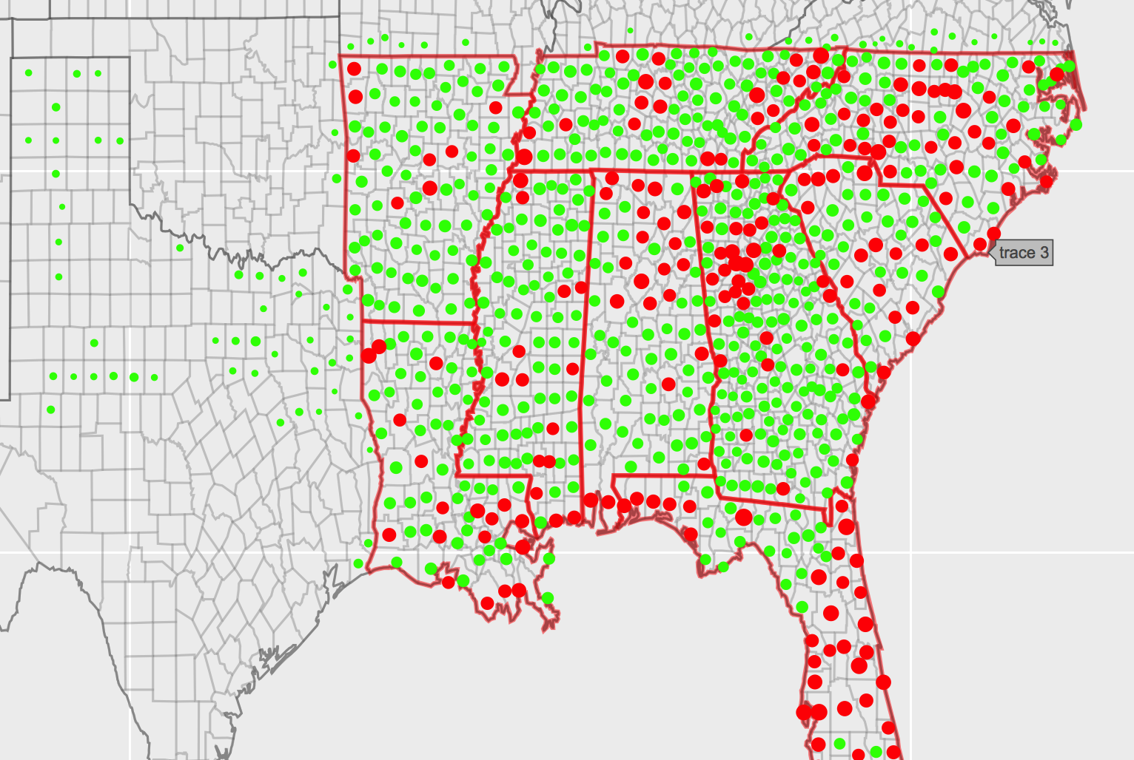
Ratio of aTaxis outside our region to aTaxis inside our region
Notice that there are a decent amount of green dots outside our region.
We have about 6435 aTaxis (out of 7.48 Million) leaving our region, resulting in a ratio of about 0.000921.

Slide 22
Part 3
Business Model

Slide 23
Business Case: Operating Expenditures
Vehicle Acquisition
7.5 million minimum fleet size,, 8.625 million fleet (1.15x), $60,000 per vehicle
Vehicle Maintenance
$1400 maintenance, 134,000 miles driven a year, 5 times a year (every 27,000 miles, 115,000 mile lifetime)
Solar Power Generation
Considered as a fixed cost spanning 20 years, 3 miles per kWh
12.2 cents per kWh after installation
Parking Land Rental
Approximated $1500 per acre of parking, ~242 vehicles per acre

Slide 24
Business Case: Revenue Pricing Model
The average American hourly wage in the Southeast region of the United States is ~$22.30.
Cars average 30 miles per hour, we charge customers $.65 per mile traveled, customers receive a net $2.80 per hour of value through our service.
Since there are ~1.2 trillion miles traveled per year, at $0.65/mi our annual revenue is projected to be ~$798 billion.

Slide 25
Business Case: pro forma balance sheet for the business
Assets
Ride-Sharing Revenue (@$0.65/mi): | $798 billion
Total Assets: | $798 billion
Liabilities
Annualized Vehicle Acquisition Costs: | $461 billion
Annual Vehicle Maintenance Fees: | $60 billion
Annual Solar Installation Fees (taken as a 20 year loan): | $195 billion
Annual Energy Generation Costs: | $95 million
Annual Parking Land Rental: | $53 million
Total Liabilities: | $716 billion
Net Profit: | $82 billion

Slide 26
Questions?
Thank you!

