Slide 1
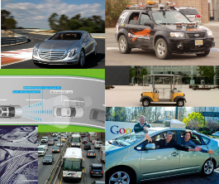
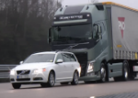
Management of Empty
aTaxis
by
Alain L. Kornhauser, PhD Professor, Operations Research & Financial Engineering Director, Program in Transportation
Faculty Chair, PAVE
(Princeton Autonomous Vehicle Engineering)
Princeton University
November 29, 2017

Slide 2
Key References
S. Zhu’16 “Making Transportation Great Again” 2016 Senior Thesis
S. Zhu’16 & A. Kornhauser*71 Interplay_Between_Fleet-size,_LoS and_EmptyRepositioning

Slide 3
Basic Problem:
Demand for aTaxis is NOT Symmetric (even in the long run)
Thus empty aTaxis end up where no one else wants to get in.
Thus they need to be repositioned
If you have a big enough fleet, you may be able to wait a long time, but eventually, you’ll need to reposition them.

Slide 4
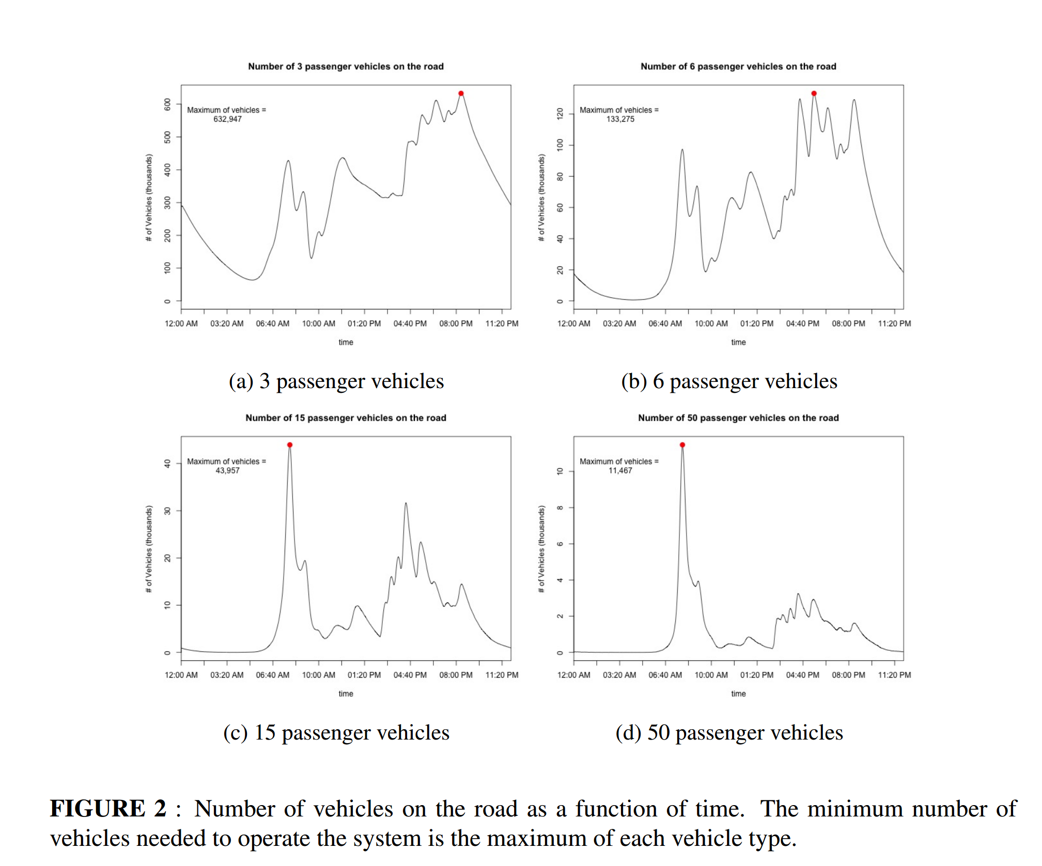

Slide 5
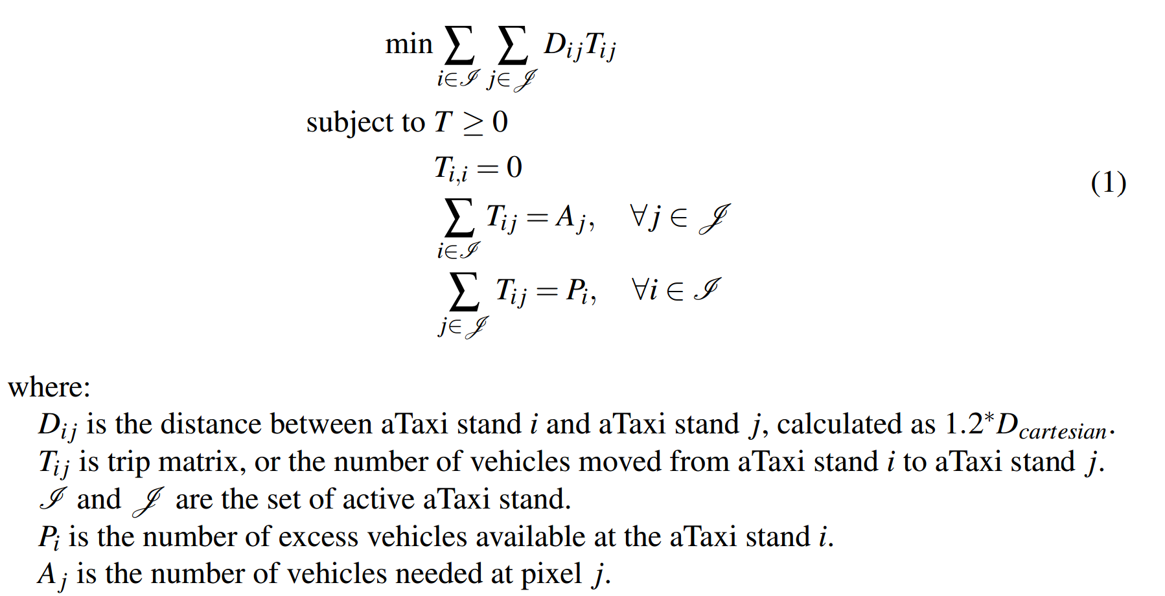
Early Morning Repositioning Costs

Slide 6
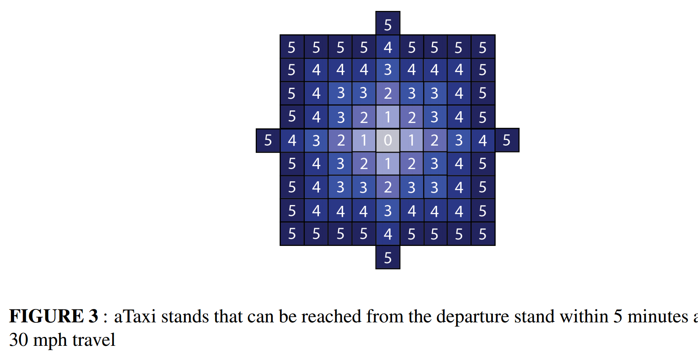
Near-by Repositioning

Slide 7
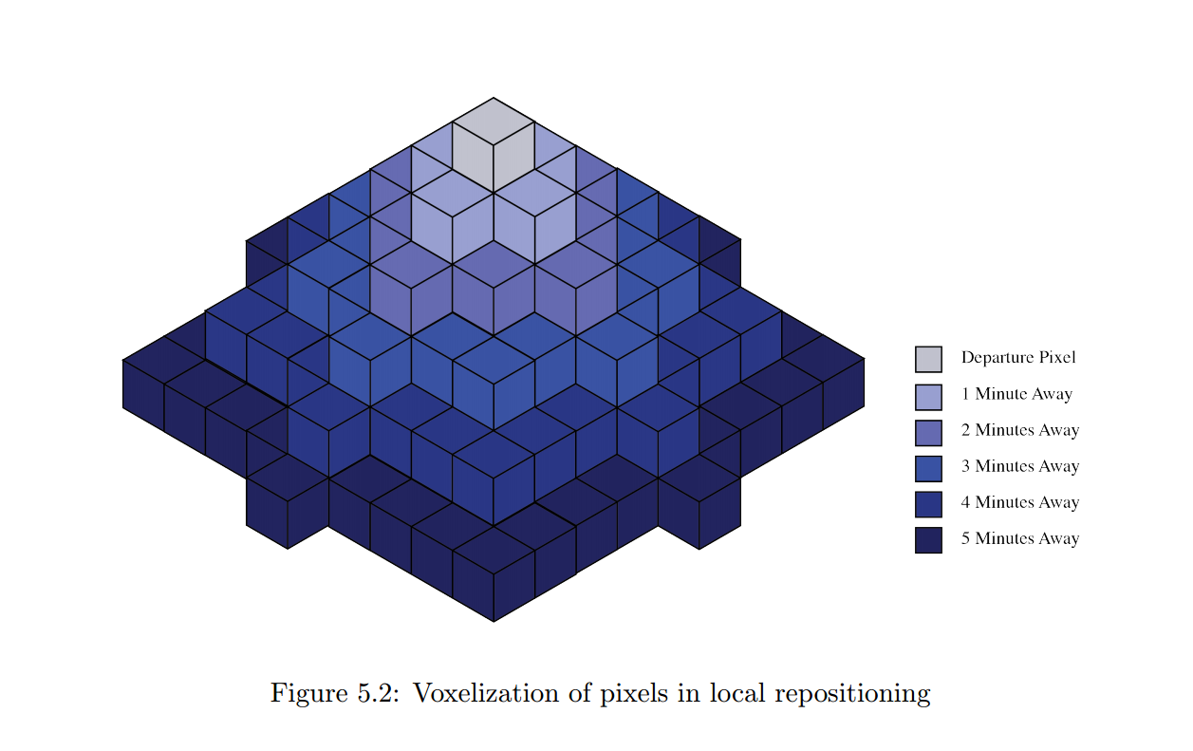
Near-by Repositioning

Slide 8
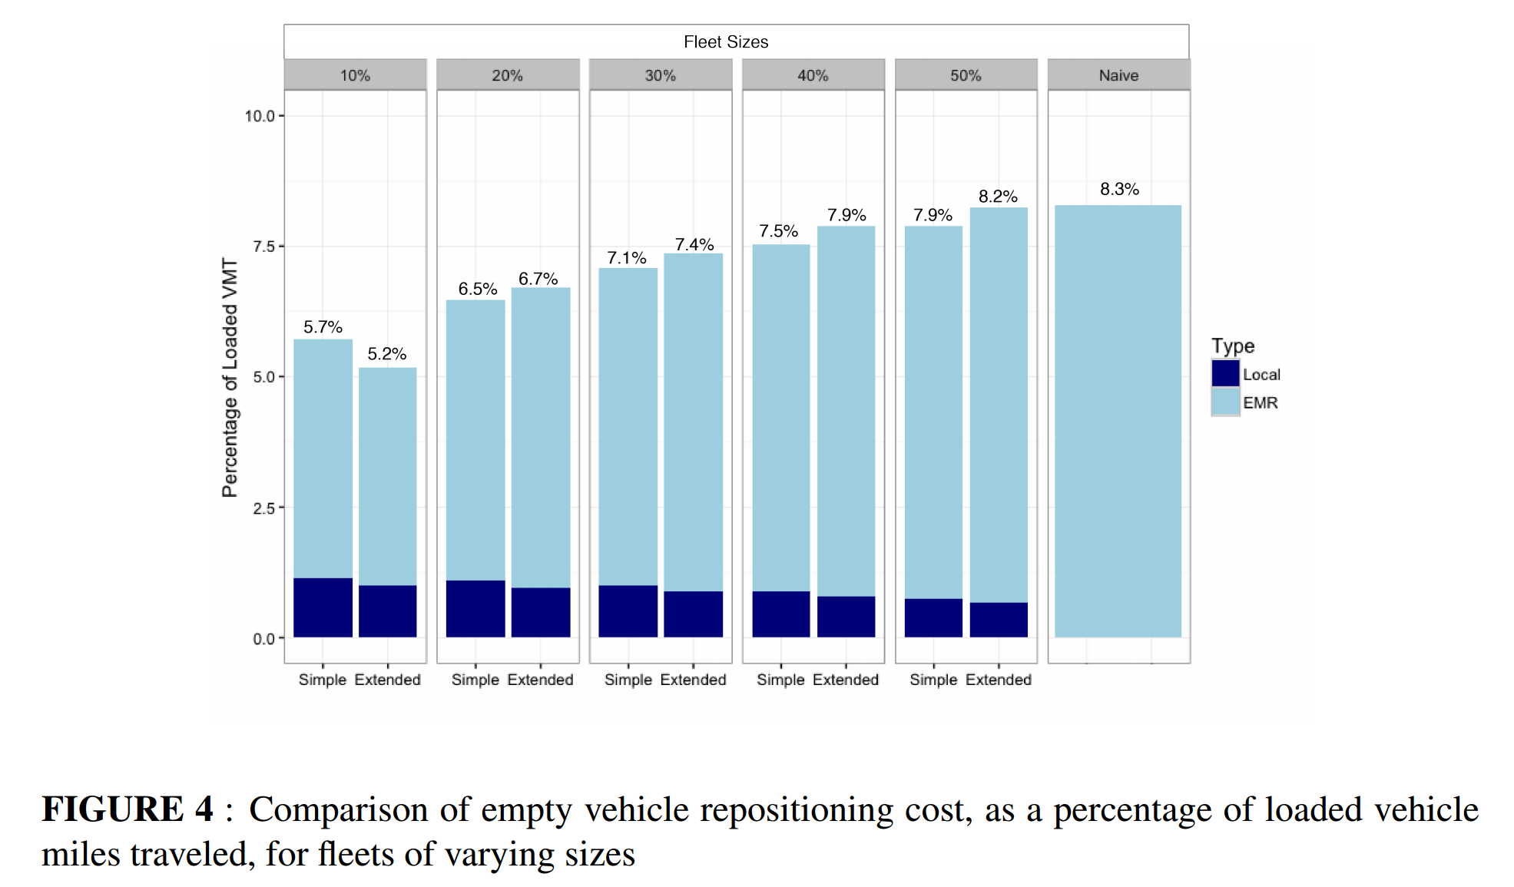
Repositioning v Fleet Size: NJ

Slide 9
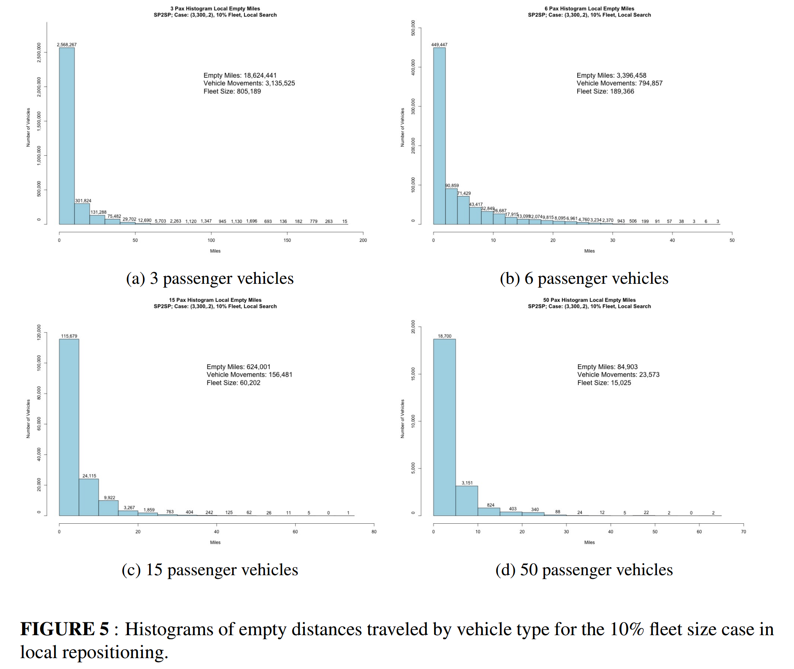
Empty Miles: NJ

Slide 10
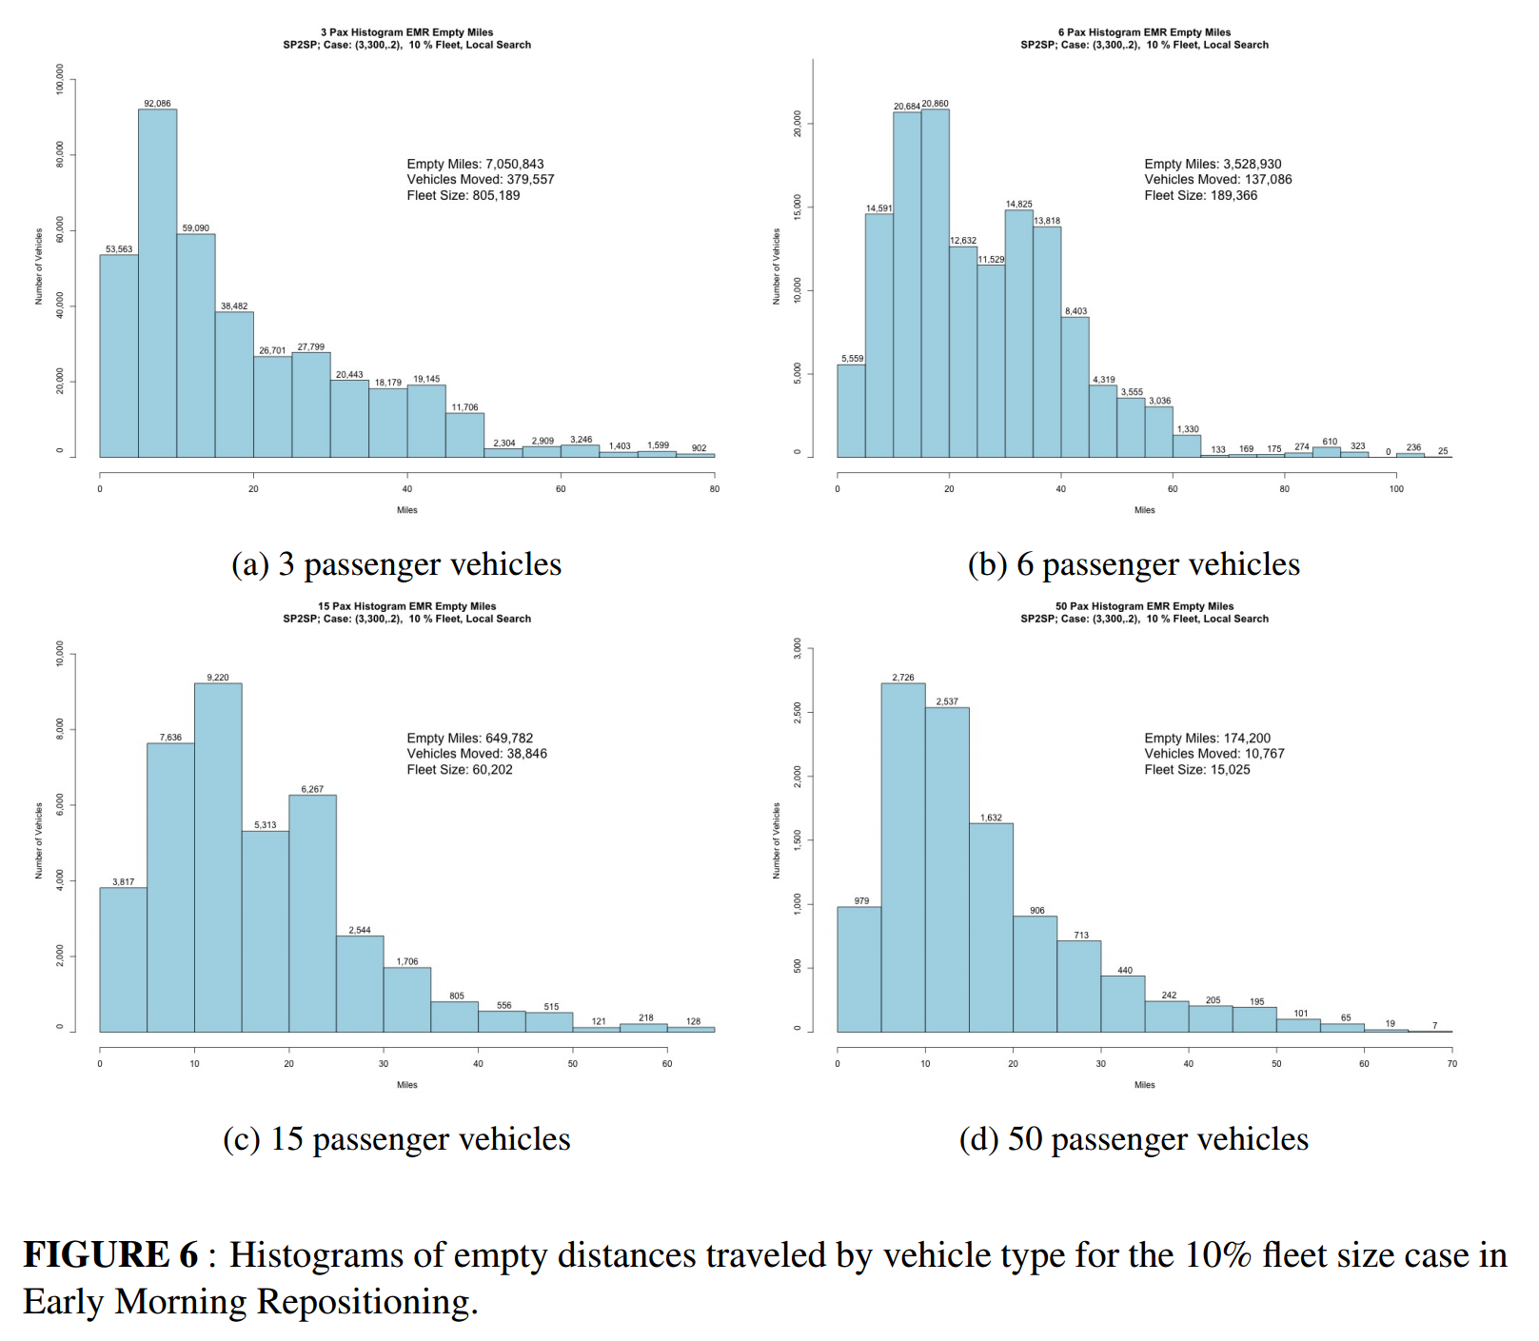
Empty Miles: 10% Fleet Size case

Slide 11
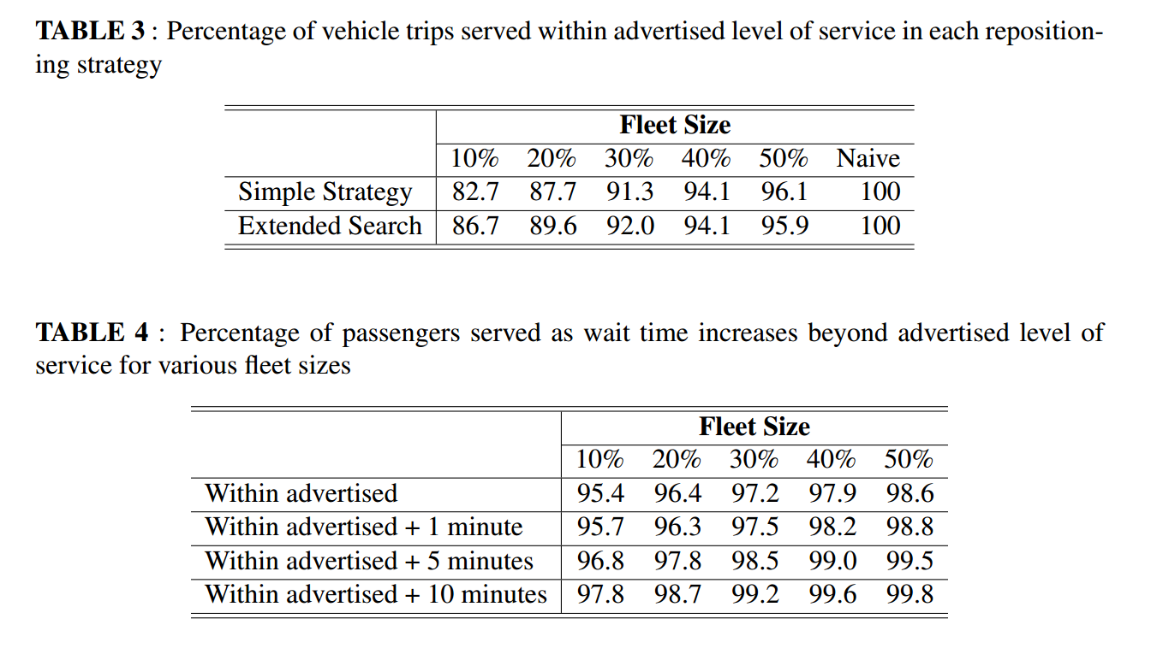
Summary

Slide 12
Discussion!
Thank You
alaink@princeton.edu
www.SmartDrivingCar.com

