Slide 1
Elements of the Transportation Sector of the Economy: the players, the technologies
Orf 467 Fall 2017 Syllabus (pdf)
Transportation Defined
Transportation is an intermediate good. It is a derived demand (demand a bi-product of another demand)
Transportation is the creation of place and time utility while incurring a cost.
Purchaser of transportation acquires a bundle of services
place, time, comfort (l&d) , convenience (information)
utility of goods = f( 1 / landed costs, time, …)
Place Utility: Lardner’s Law: law of squares in transportation:
For a system that has ubiquitous accessibility, then Trans$ = f(Dist) therefore 1-Dimensional:
Let MarketArea (π R² ) be that area for which Fixed$ + Trans$ < Demand$
Let Trans$ = C * D , C = Const(technology, management, policy), D = distance
Then R = (Demand$ -Fixed$)/C
So.. MarketArea = (π (Demand$ -Fixed$)²)/C² = K /C² ; where K = (π (Demand$ -Fixed$)²), a const.
So… If, say, technology causes C_{new} = ½ Cold ,then MarketArea_{new} = 4 * MarketArea_{old}
Demand for transportation:
Elasticities: % change quantity / % change in attribute
Attributes: price, travel time, reliability, accessibility, security, l&d, information, comfort, etc

Slide 2
“Modes” of transportation: Major Categorization, by what it carries, by function, by what is carrying (supporting) it
• Carries:
• People
• Non-people (freight)
Regulation split this way
• Function (purpose)
• Intra-urban
• Inter-urban
• by “way” (the support of the transportation or other physical characteristic or function)
• highway, airway, railway, waterway, pipeway,
• intermodal
• by “technologies”
bus, car, light rail, heavy rail, Metro, truck, LTL, TL, overnight, Automated People Mover (APM), Personal Rapid Transit (PRT), Automated Transit Networks (ATN), dial-a-ride, jitney, autonomousTaxis (aTaxis), …
Externalities:
Safety, Environment, Environment, Economy,
The End of Traffic and the Future of Transport. Slide Summary
Basic background on Transportation in the US (Pocket Guide 2017)

Slide 3
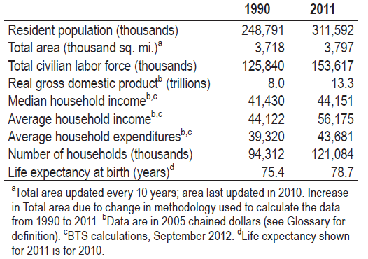
Macro-economic Aspects of the US economy
2017 Population
According to the U.S. Census Bureau’s, the United States entered 2015 with 320,090,857 people while the planet Earth overall will had more than 7.2 billion living souls on it.
Overall the U.S. is the third most populous country in the world, behind China (nearly 1.4 billion) and India (nearly 1.3 billion) and ahead of Indonesia (nearly 256 million). The U.S. population was 2,334,187 people larger than the start of 2014,

Slide 4
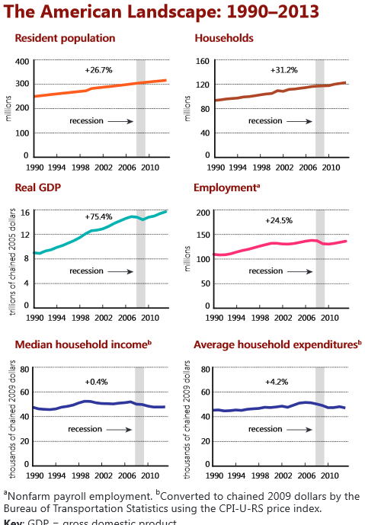

Slide 5
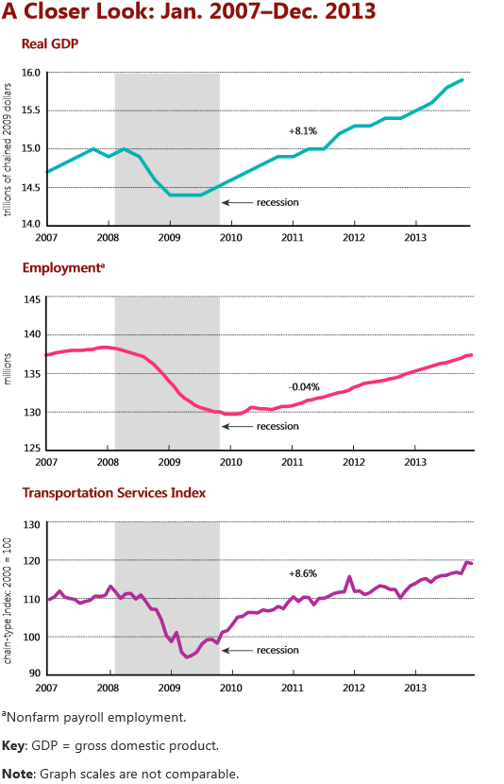

Slide 6
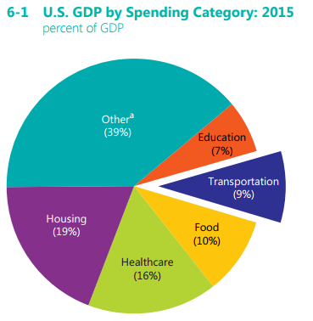
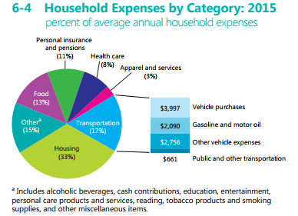
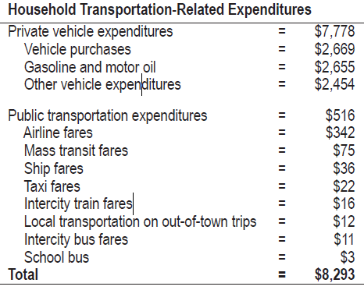
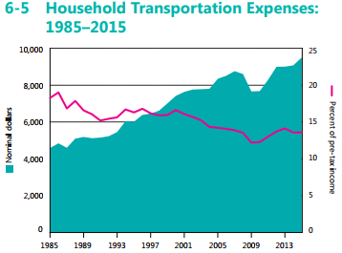
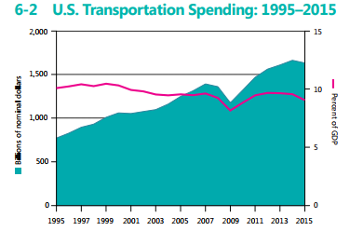
Macro-economic Aspects of Transportation

Slide 7
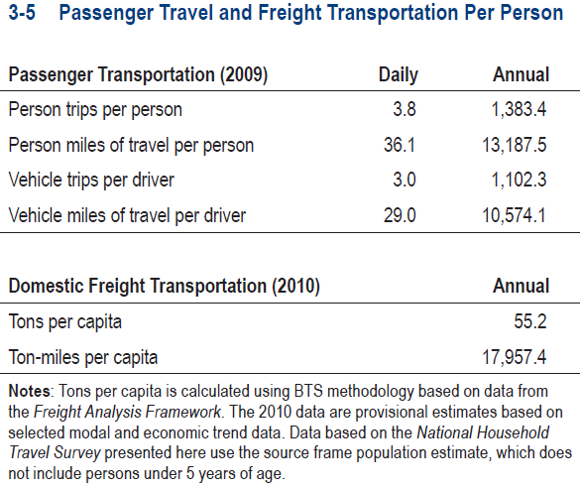
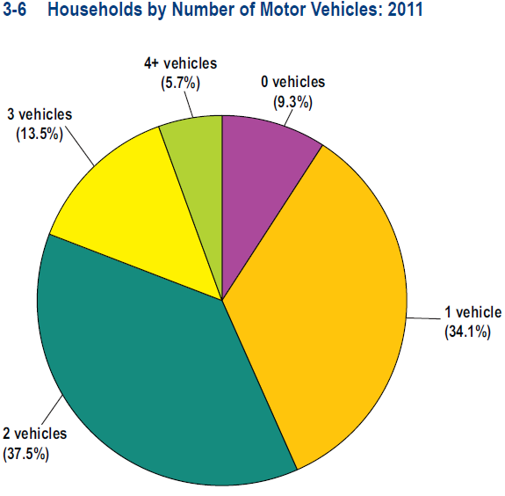
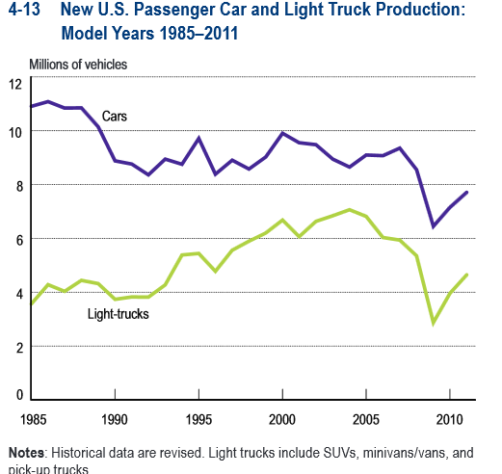
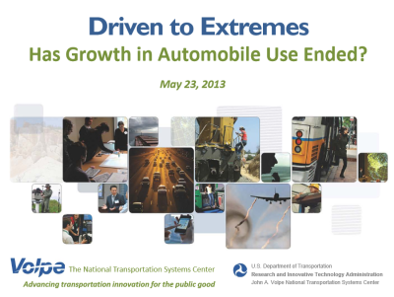
Note: Data cover the household populations and excludes the population living in institutions, college dorms and other group quarters
http://www.princeton.edu/~alaink/Orf467F13/HasGrowthInAutomobileUseEnded_Pace-Pickrel.pdf

Slide 8
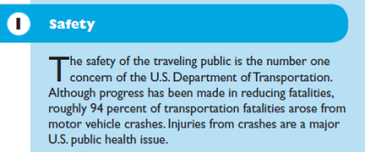
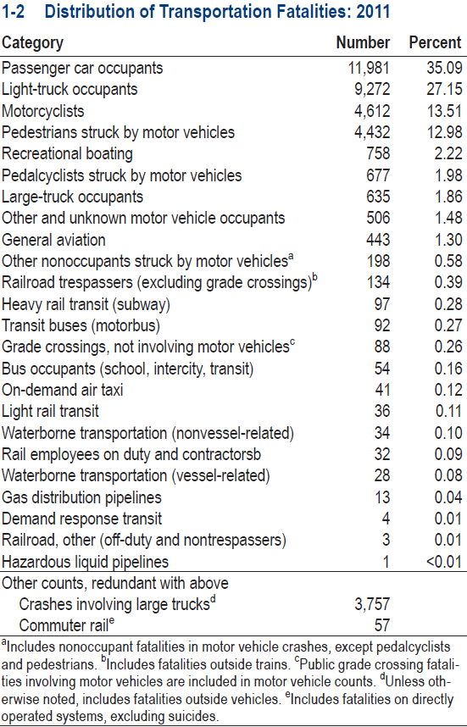
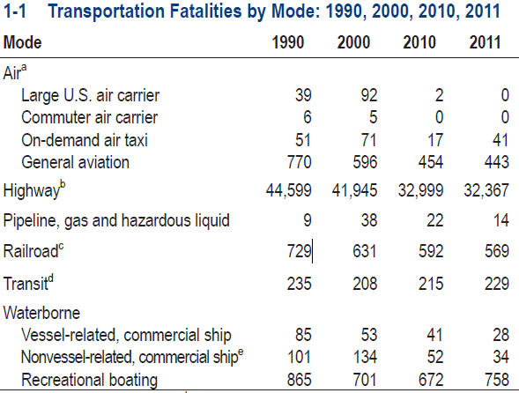
Fatalities

Slide 9
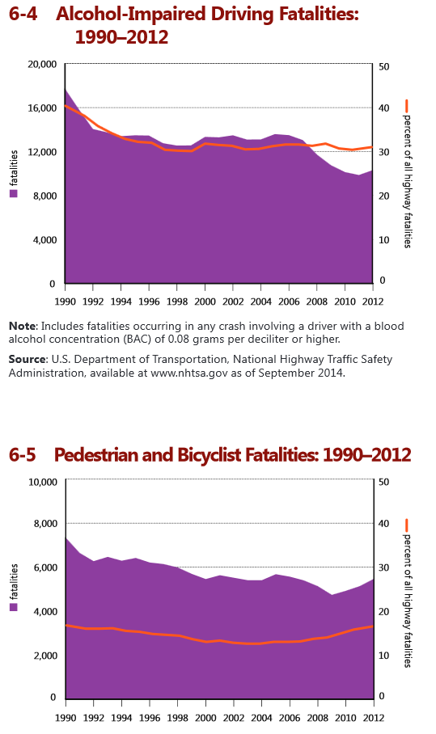
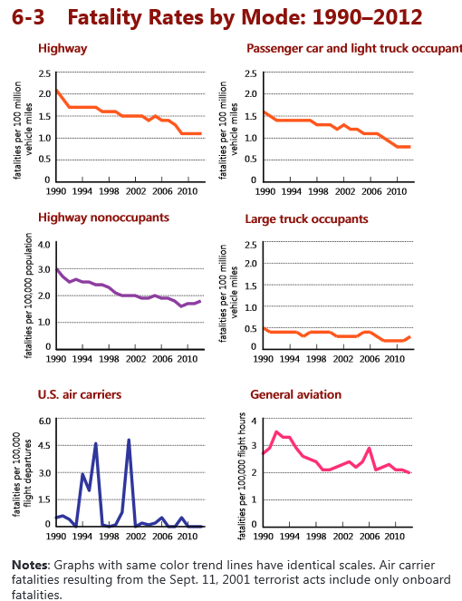
Fatalities

Slide 10
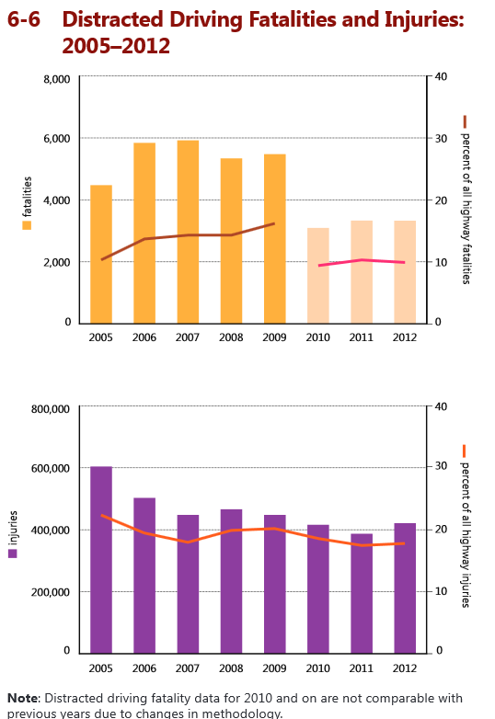
Fatalities

Slide 11
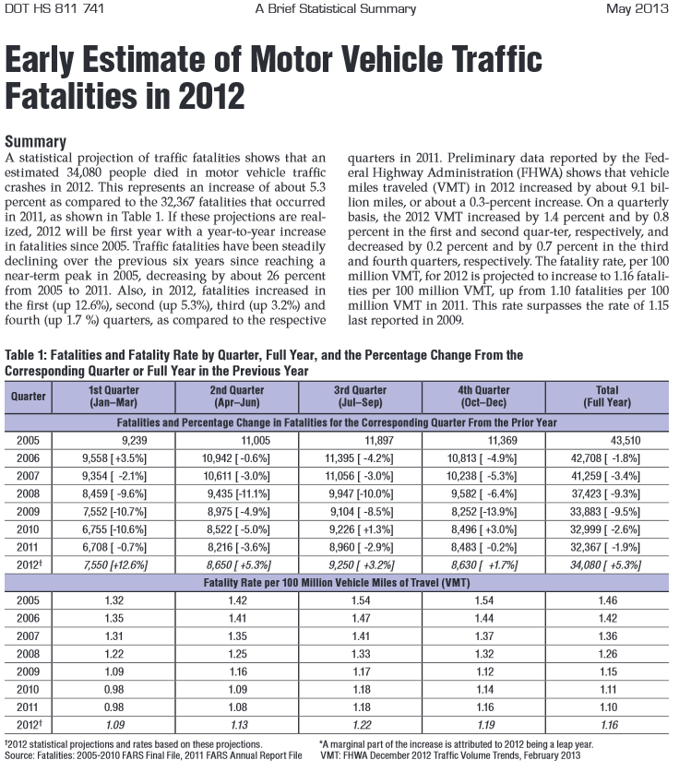
Fatalities
Link

Slide 12
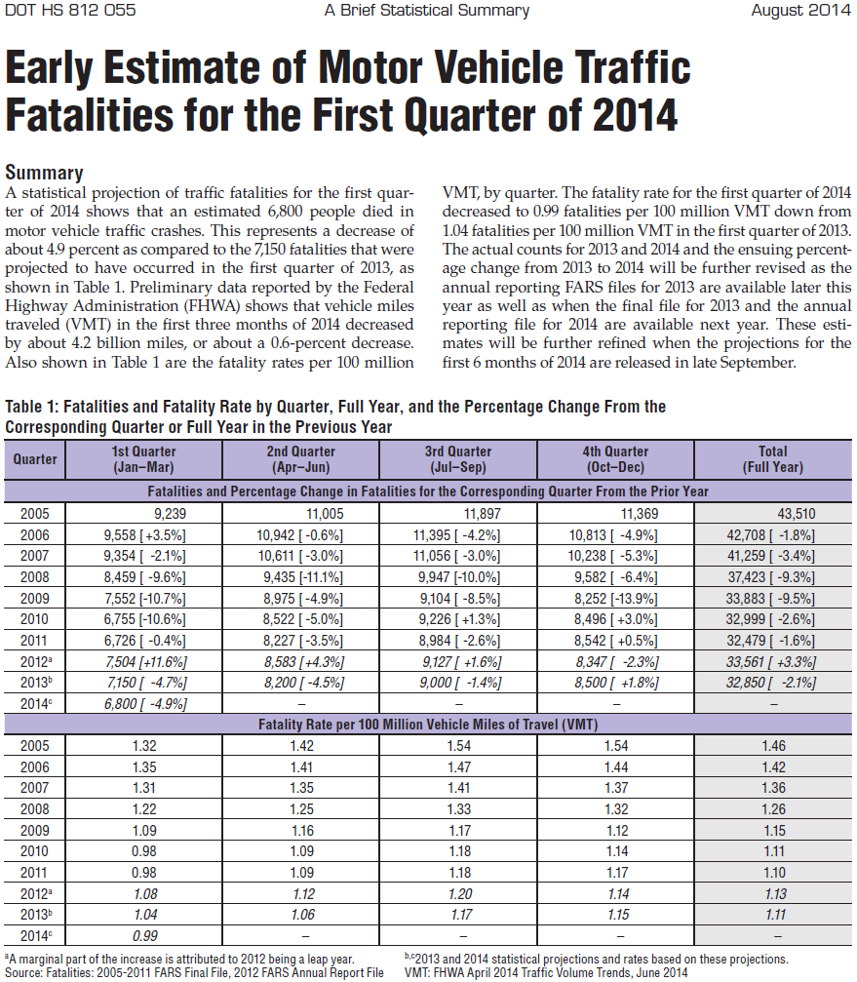

Slide 13

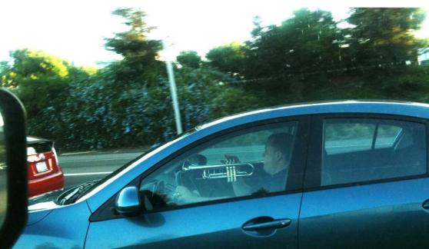

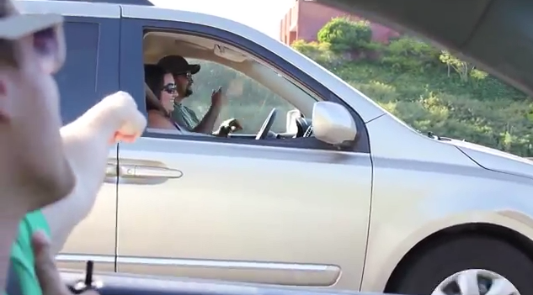

We Love the Freedom & Mobility
But…Continuous Vigilance is an unrealistic requirement for drivers

Slide 14

Highway Sign-A-Long Buttercup Edition http://orfe.princeton.edu/~alaink/SmartDrivingCars/Videos/HIGHWAY_SING-A-LONG_%20BuildMeUpButtercup.mp4

Slide 15
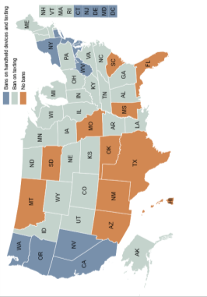
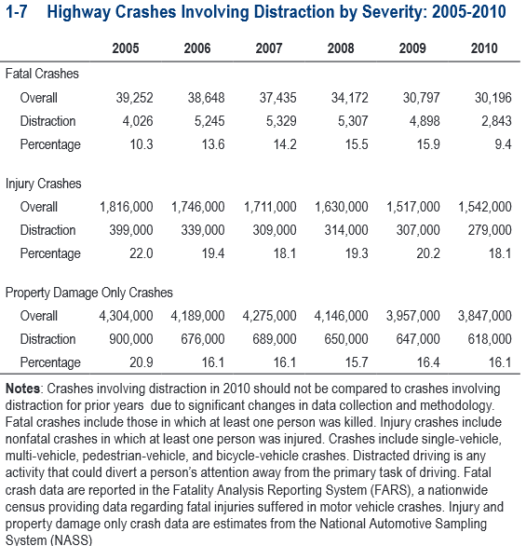


Slide 16
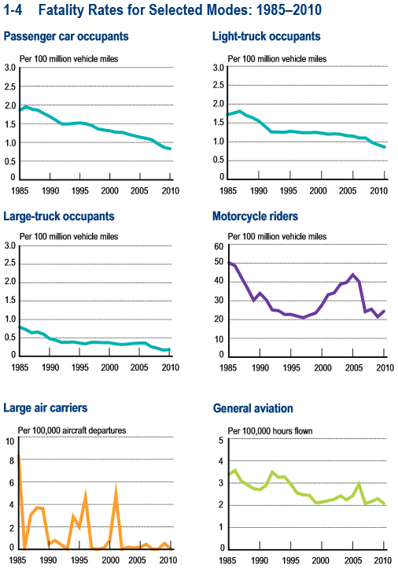
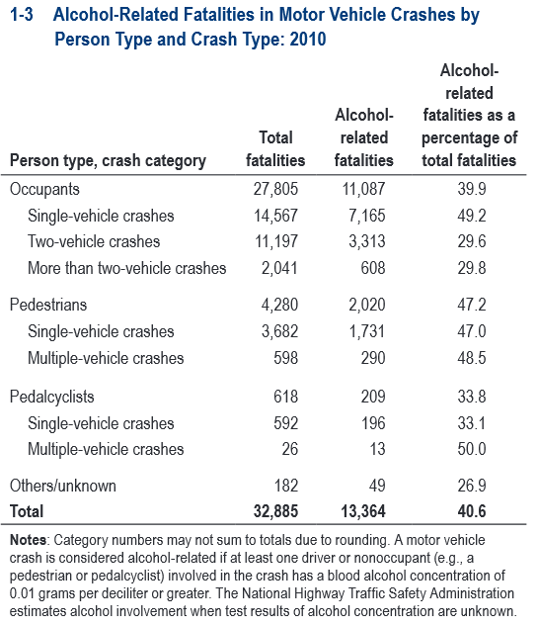

Slide 17
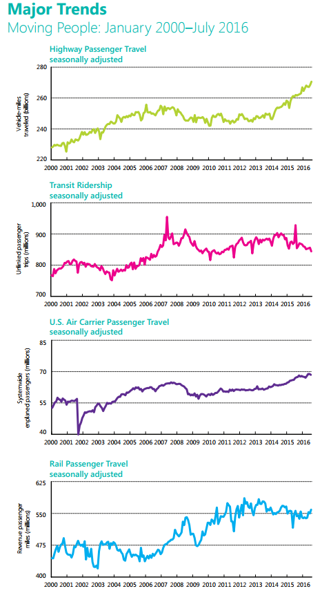
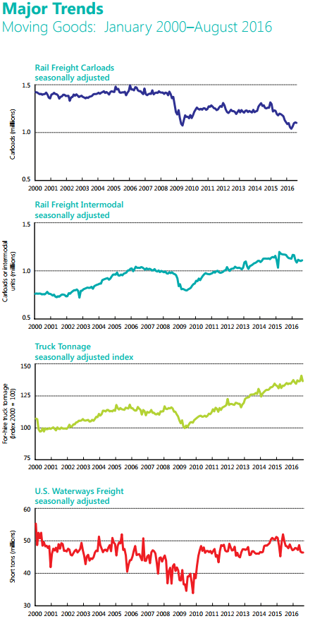

Slide 18
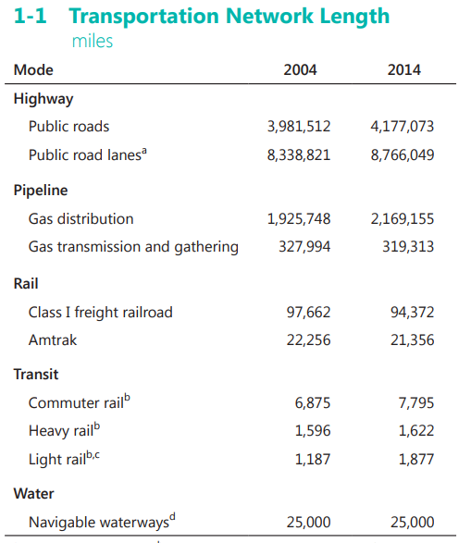
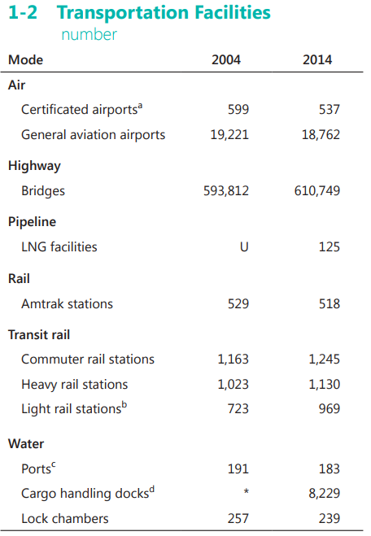
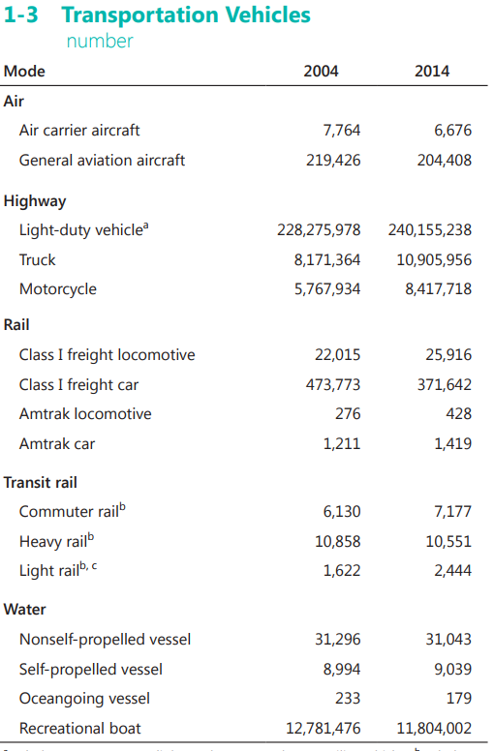

Slide 19
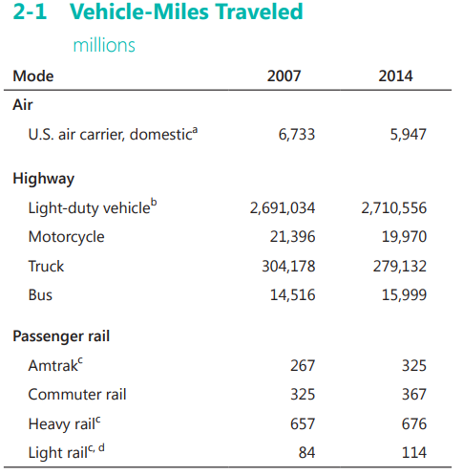
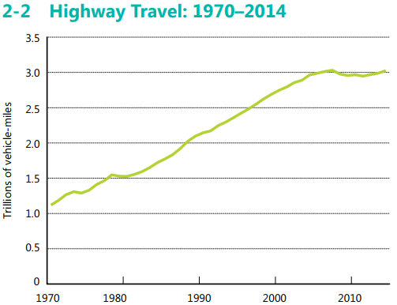

Slide 20
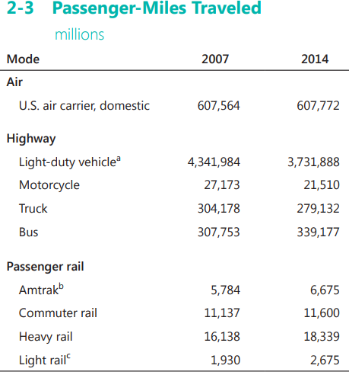
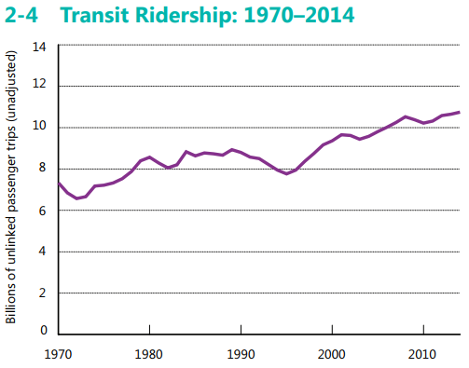

Slide 21
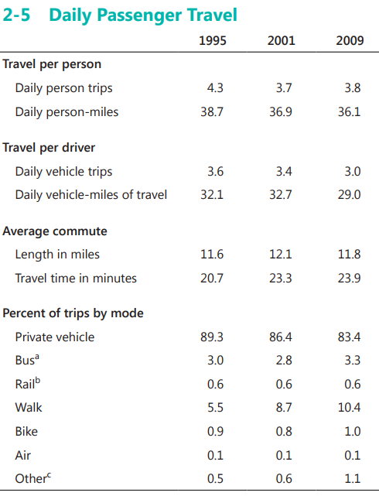
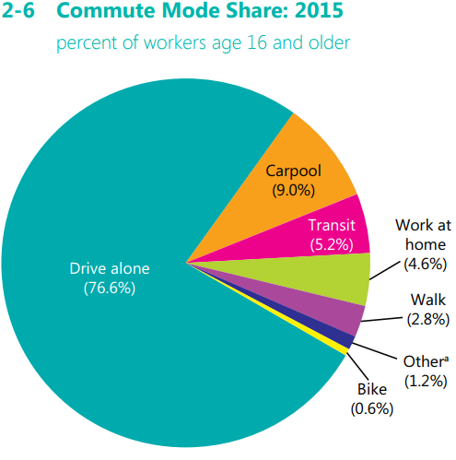

Slide 22
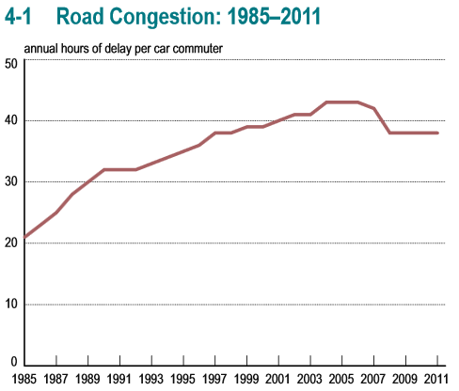
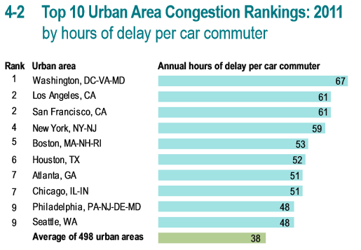

Slide 23
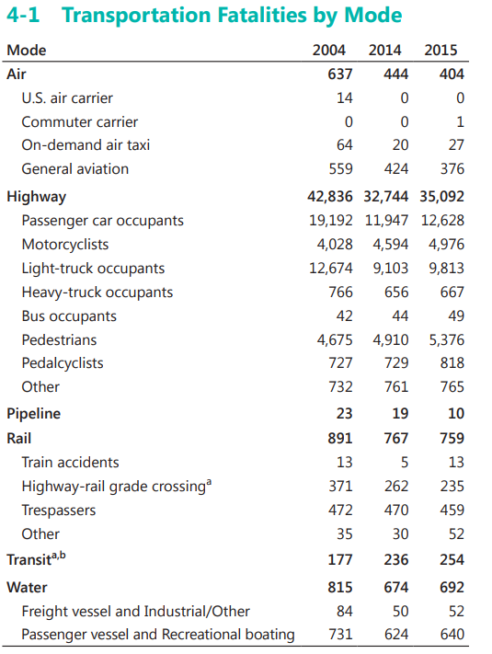
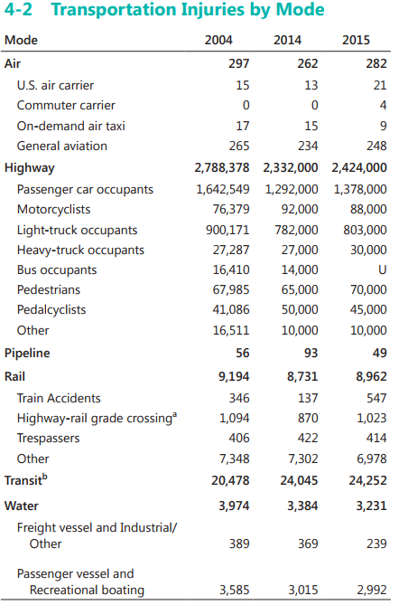

Slide 24
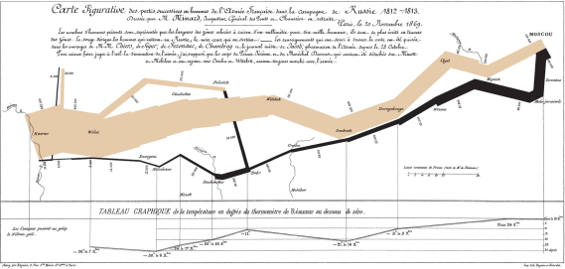
What is this?:
A Flow map! I like Flow maps!
(I may have drawn or have caused to be drawn more flow maps than anyone else in the world, but who’s counting. ☺ )

Slide 25
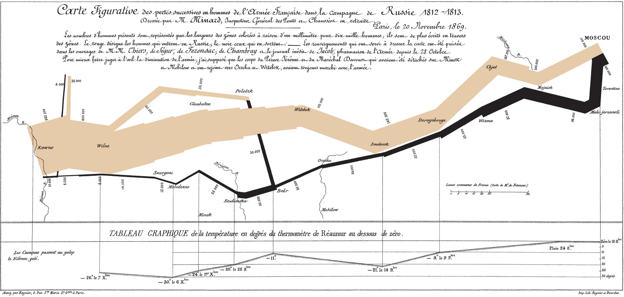
http://www.princeton.edu/~alaink/Orf467F13/FreightFacts&Figures2012.pdf

Slide 26
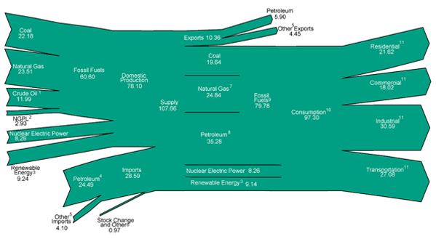
Energy Flow 2011
Implies chart can be read as %

Slide 27
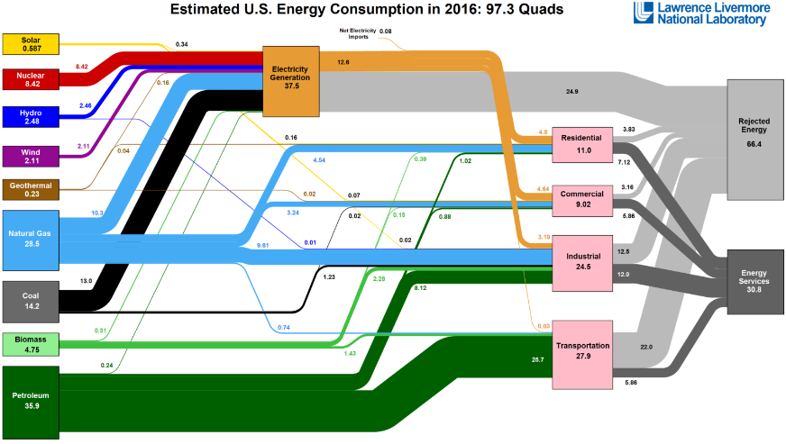
Energy Flow 2016

Slide 28
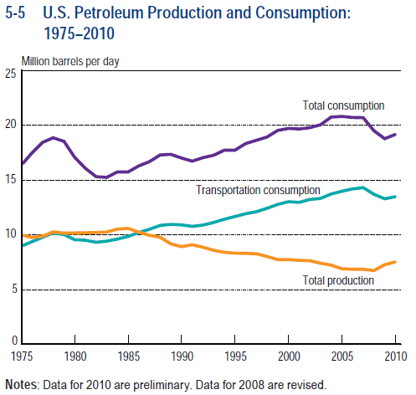
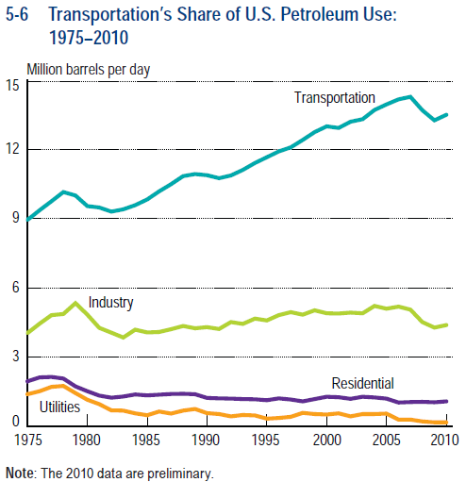
Petroleum Consumption

Slide 29
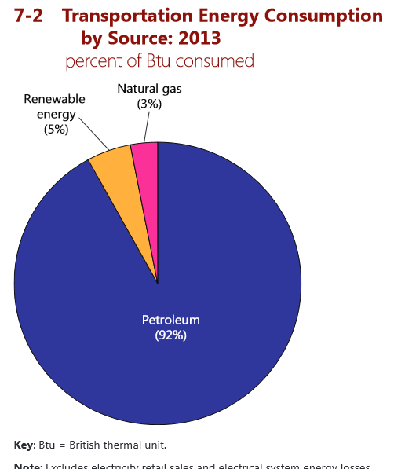
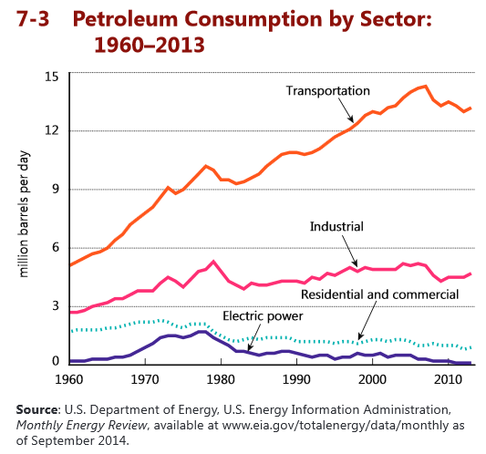

Slide 30
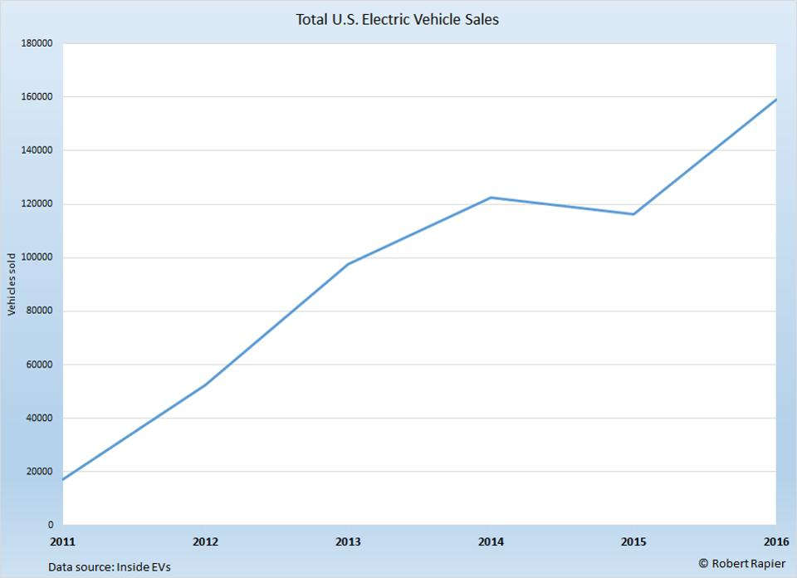



http://www.hybridcars.com/may-2017-dashboard/

Slide 31



Transportation and
Air Quality

Slide 32


Petroleum Source

Slide 33






Slide 34


Slide 35



Slide 36



Slide 37




Slide 38


International Trade

Slide 39


Government & Transportation

Slide 40
Societal oversight on transportation.
Transportation is a derived good
an industry that impacts public interests; a “business affected with the public interest”
Government Involvement / Influence:
Why?
To create or replace the attributes of: competition and free markets
Products are justified only by the willingness of people to produce them and buy them
People are Utility maximizers (do things that make them better off)
Product should not be sold at price less than marginal cost of last unit.
Issues of Externalities, Equity
Is it a Utility, Is it a Ubiquitous Public Good (Should it be nationalize) ?

Slide 41
• What?
Control externalities: Safety, Environment
Maintain competition ( Courts enforce anti-trust)
Invest, assume ownership
Regulation has involved: Regulation of entry and exit (Granting of charters); Pricing (filed rate doctrine), Employee relations, Operations, Safety
• How?
Controlled by the legal system based on Common law (judicial precedent; principles of law developed from former court decisions) augmented by Statutory law enacted by legislative bodies.
Concept of “business affected with the public interest”
Concept of common carriage: serve all shippers on a similar basis, at reasonable rates and without discrimination.
Who’s involved:
Legislature, courts, administrative bodies
• Started with states, moved to the federal Gov in 1887 with the ICC,
• ICC was an administrative layer that provides continuity to regulation that the legislature and the judiciary don’t provide. (Surface Transportation Board replaced ICC)
added “executive decisions” to legislative and judicial actions.

Slide 42
Evolution of Regulation:
• Granger laws: problem- high rates where competition didn’t exist
• Wabash case 1886: Supreme court ruled that states could not control rates on interstate commerce.
• ICC 1887 regulate interstate commerce (RR): promulgate common carriage concepts
• 1935 Motor Carrier Act:
• Control of Entry
• CAB Act 1938; purpose:
• promote aviation by establishing and establishing an airport airways system
• safety (regulate entry)
• Transport Act 1940 national policy statement
• Regulation of all modes of transportation
• Need a unified perspective
• Reed - Bulwinkle Act of 1948: Joint rate-making anti-trust protection.
• 1956 ND & IH Act
• 1966 Creation of Exec branch Department of Transportation
• 3R, 4R, ‘78 Air Dereg. Act, Motor carrier Dereg. Act, Staggers,
• 1994 Sunset of ICC, Transportation Board
Current Federal Laws: U.S. Code
Title 23 Highways; Title 45 Railroads; Title 49 Transportation

