Slide 1
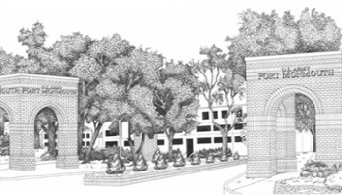
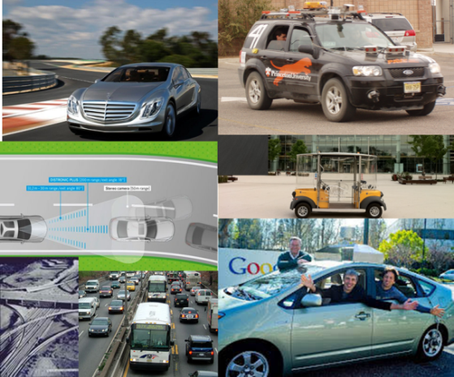
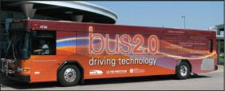
Daily Person Trips in New Jersey & the Whole USA: A Synthesis
by
Alain L. Kornhauser, PhD Professor, Operations Research & Financial Engineering Director, Program in Transportation
Faculty Chair, PAVE (Princeton Autonomous Vehicle Engineering)
Princeton University
See also:
A National Hybrid Activity/Agent-Based Demand Model to
Characterize the Mobility of the United States,
K. Marocchini, Jan 2017
Mufti: TripSynthesizer
HillWyrough’14SeniorThesis
Presented at
Orf 467’F17
Oct. 23, 2017

Slide 2
Most every day…
Almost 9 Million NJ residents
0.25 Million of out of state commuters
Make 30+ Million trips
Throughout the 8,700 sq miles of NJ
Where/when do they start?
Where do they go?
Does anyone know???
I certainly don’t
Not to sufficient precision for credible analysis

Slide 3
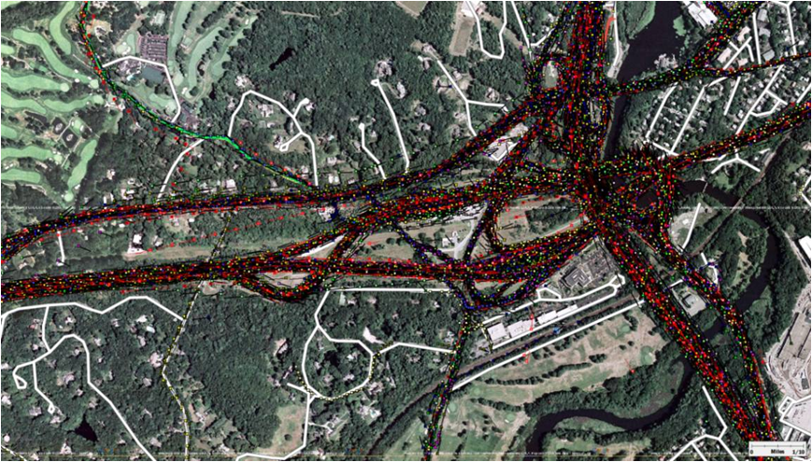
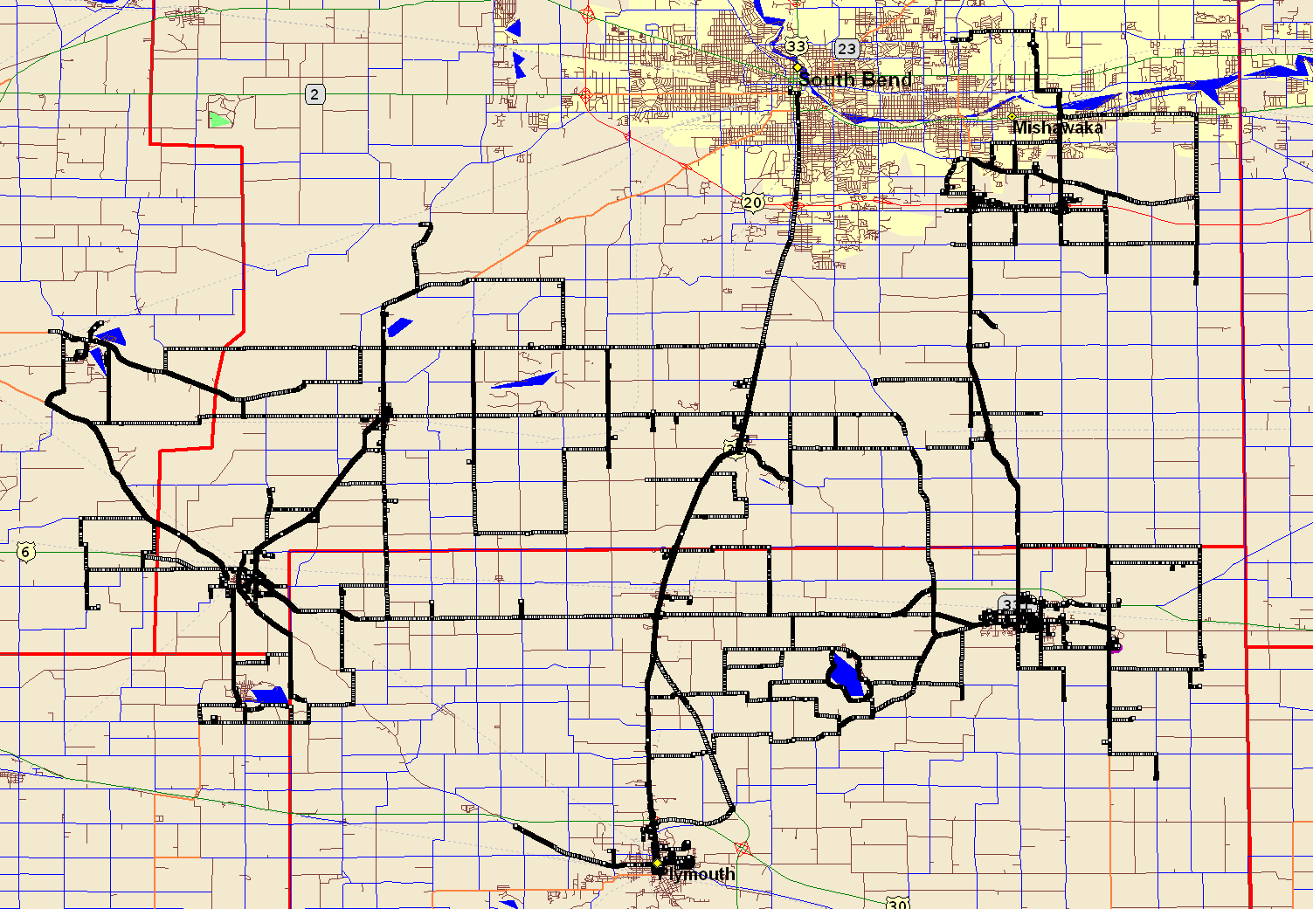
I’ve Tried…
I’ve harvested one of the largest troves of GPS tracks
Literally billions of individual trips,
Unfortunately, they are spread throughout the western world, throughout the last decade.
Consequently, I have only a very small ad hoc sample of what happens in NJ on a typical day.

Slide 4
Why do I want to know every trip?
Academic Curiosity
If offered an alternative, which ones would likely “buy it” and what are the implications.
More specifically:
If an alternative transport system were available, which trips would be diverted to it and what operational requirements would those trip impose on the new system?
In the end…
a transport system serves individual decision makers. It’s patronage is an ensemble of individuals,
I would prefer analyzing each individual trip patronage opportunity.

Slide 5
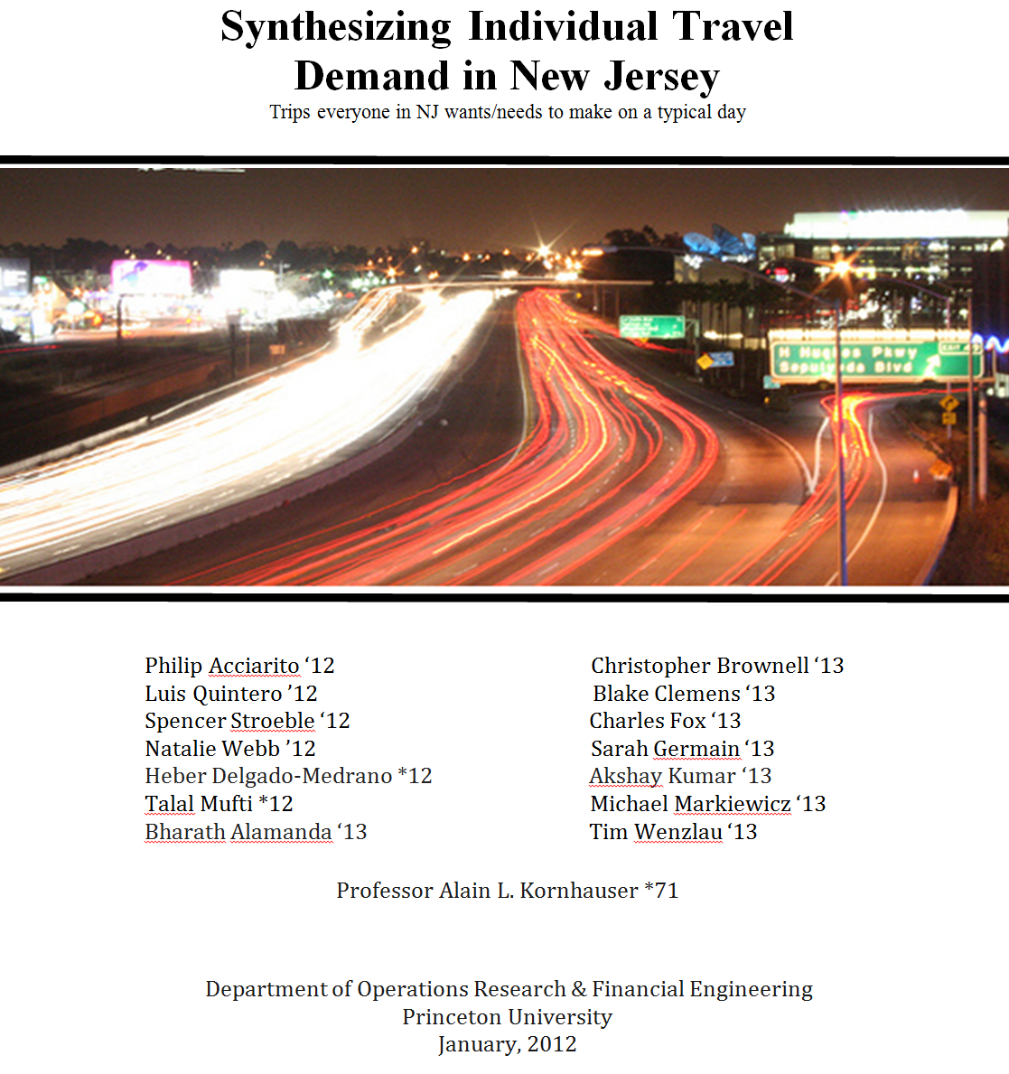

Slide 6
Synthesize from publically available data:
“every” NJ Traveler on a typical day NJ_Resident file
Containing appropriate demographic and spatial characteristics that reflect trip making
“every” trip that each Traveler is likely to make on a typical day. NJ_PersonTrip file
Containing appropriate spatial and temporal characteristics for each trip

Slide 7
Creating the NJ_Resident file
for “every” NJ Traveler on a typical day
NJ_Resident file
Start with Publically available data:

Slide 8
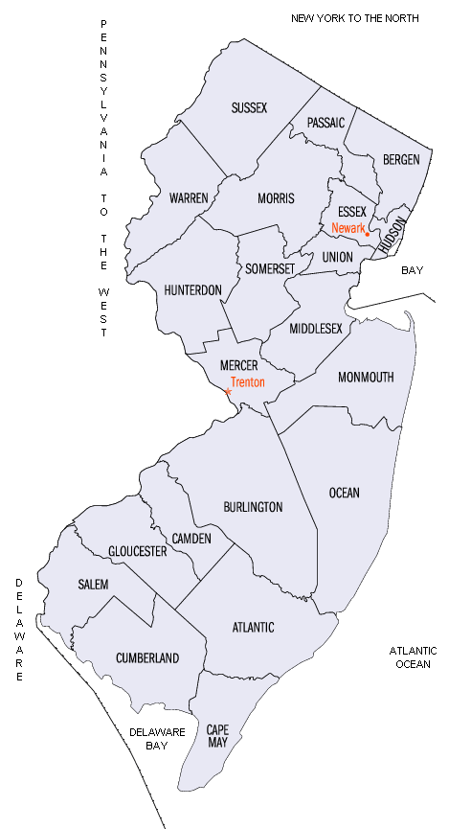
2010 Population census @Block Level
8,791,894 individuals distributed 118,654 Blocks.
County | Population | Census Blocks | Median Pop/ Block | Average Pop/Block
ATL | 274,549 | 5,941 | 26 | 46
BER | 905,116 | 11,171 | 58 | 81
BUR | 448,734 | 7,097 | 41 | 63
CAM | 513,657 | 7,707 | 47 | 67
CAP | 97,265 | 3,610 | 15 | 27
CUM | 156,898 | 2,733 | 34 | 57
ESS | 783,969 | 6,820 | 77 | 115
GLO | 288,288 | 4,567 | 40 | 63
HUD | 634,266 | 3,031 | 176 | 209
HUN | 128,349 | 2,277 | 31 | 56
MER | 366,513 | 4,611 | 51 | 79
MID | 809,858 | 9,845 | 50 | 82
MON | 630,380 | 10,067 | 39 | 63
MOR | 492,276 | 6,543 | 45 | 75
OCE | 576,567 | 10,457 | 31 | 55
PAS | 501,226 | 4,966 | 65 | 101
SAL | 66,083 | 1,665 | 26 | 40
SOM | 323,444 | 3,836 | 51 | 84
SUS | 149,265 | 2,998 | 28 | 50
UNI | 536,499 | 6,139 | 61 | 87
WAR | 108,692 | 2,573 | 23 | 42
Total | 8,791,894 | 118,654 |  | 74.1

Slide 9
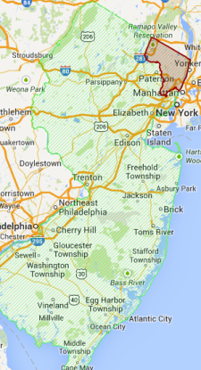
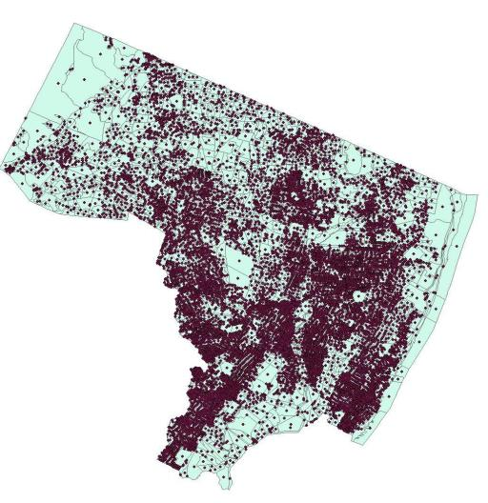
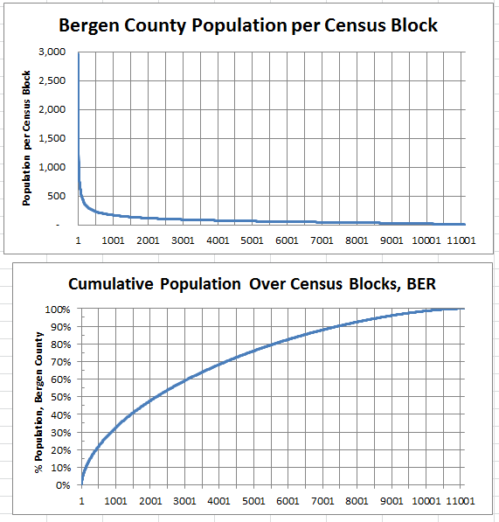
Bergen County @ Block Level
County | Population | Census Blocks | Median Pop/ Block | Average Pop/Block
BER | 907,128 | 11,116 | 58 | 81.6

Slide 10
Publically available data:
Distributions of Demographic Characteristics
Age
Gender
Household size
Name (Last, First)
Ages (varying linearly over interval): | input: | output:
[0,49] | 67.5% | 67.5%
[50,64] | 18.0% | 17.9%
[65,79] | 12.0% | 12.1%
[80,100] | 2.5% | 2.5%
Household: | Size: | Probability: | cdf: | Expectation:
couple | 2 | 0.30 | 0.300 | 0.6
couple + 1 | 3 | 0.08 | 0.380 | 0.24
couple + 2 | 4 | 0.06 | 0.440 | 0.24
couple + 3 | 5 | 0.04 | 0.480 | 0.2
couple + 4 | 6 | 0.04 | 0.520 | 0.24
couple + grandparent: | 3 | 0.01 | 0.525 | 0.015
single woman | 1 | 0.16 | 0.685 | 0.16
single mom + 1 | 2 | 0.07 | 0.755 | 0.14
single mom + 2 | 3 | 0.05 | 0.805 | 0.15
single mom + 3 | 4 | 0.03 | 0.835 | 0.12
single mom + 4 | 5 | 0.03 | 0.865 | 0.15
single man | 1 | 0.12 | 0.985 | 0.12
single dad + 1 | 2 | 0.01 | 0.990 | 0.01
single dad + 2 | 3 | 0.005 | 0.995 | 0.015
single dad + 3 | 4 | 0.005 | 1.000 | 0.02
 |  |  |  | 2.42
Gender: | Input: | Output:
female | 51.3% | 51.3%

Slide 11
Beginnings of NJ_Resident file
County | Person Index | Household Index | Last Name | First Name | Middle Initial | Age | Gender | Worker Index | Worker Type | Home Latitude | Home Longitude
0 | 1 | 1 | PREVILLE | RICHARD | G. | 24 | FALSE | 5 | worker | 39.43937 | -74.495087
0 | 2 | 1 | PREVILLE | JACK | J. | 7 | FALSE | 0 | grade School | 39.43937 | -74.495087
0 | 3 | 1 | PREVILLE | CHARLES | X. | 1 | FALSE | 7 | under 5 | 39.43937 | -74.495087
0 | 4 | 2 | DEVEREUX | SUE | B. | 24 | TRUE | 6 | at-home-worker | 39.43937 | -74.495087
0 | 5 | 2 | DEVEREUX | ANTON | P. | 2 | FALSE | 7 | under 5 | 39.43937 | -74.495087
0 | 6 | 2 | DEVEREUX | KATIE | S. | 6 | TRUE | 0 | grade School | 39.43937 | -74.495087
0 | 7 | 3 | WHEDBEE | LINDA | C. | 26 | TRUE | 6 | at-home-worker | 39.43937 | -74.495087
0 | 8 | 4 | CARVER | ROBERT | Z. | 24 | FALSE | 5 | worker | 39.43937 | -74.495087
0 | 9 | 4 | CARVER | JENNIFER | P. | 25 | TRUE | 6 | at-home-worker | 39.43937 | -74.495087
0 | 10 | 5 | TINSLEY | ELLEN | U. | 23 | TRUE | 4 | college on campus: | 40.85646 | -74.197833
County
Task 1
2010 Census
# People,
Lat, Lon,
WorkerType Index | WorkerType String: | Distribution:
0 | grade school | 100% ages [6,10]
1 | middle school | 100% ages [11,14]
2 | high school | 100% ages [15,18]
3 | college: commute | Sate-wide distribution
4 | college: on campus | Sate-wide distribution
5 | worker | Drawn to match J2W Stats by County
6 | at-home worker and retired | Remainder + 100% ages [65,79]
7 | nursing home and under 5 | 100% ages [0,5] and 100% ages [80,100]
For each person
Vital Stats
RandomDraw:
Age, M/F, WorkerType,

Slide 12
Using Census Journey-to-Work (J2W) Tabulations to assign Employer County
Home
County
Task 2
C2C
Journey2Work
WorkCounty Destination RandomDraw:
Journey2Work
Home State | Home County | County Name | Work State | Work County | County Name | Workers
34 | 1 | Atlantic Co. NJ | 6 | 59 | Orange Co. CA | 12
34 | 1 | Atlantic Co. NJ | 6 | 85 | Santa Clara Co. CA | 9
34 | 1 | Atlantic Co. NJ | 10 | 3 | New Castle Co. DE | 175
34 | 1 | Atlantic Co. NJ | 10 | 5 | Sussex Co. DE | 9
6 | 37 | L. A. Co. CA | 34 | 1 | Atlantic Co. NJ | 33
6 | 65 | Riverside Co. CA | 34 | 1 | Atlantic Co. NJ | 7
9 | 3 | Hartford Co. CT | 34 | 1 | Atlantic Co. NJ | 5
9 | 5 | Litchfield Co. CT | 34 | 1 | Atlantic Co. NJ | 4
Work
County
http://www.census.gov/population/www/cen2000/commuting/files/2KRESCO_NJ.xls
http://www.census.gov/population/www/cen2000/commuting/files/2KWRKCO_NJ.xls
County | Person Index | Household Index | Last Name | First Name | Middle Initial | Age | Gender | Worker Index | Worker Type | Home Latitude | Home Longitude | Employer County
0 | 1 | 1 | PREVILLE | RICHARD | G. | 24 | FALSE | 5 | worker | 39.43937 | -74.495087 | 22
0 | 2 | 1 | PREVILLE | JACK | J. | 7 | FALSE | 0 | grade School | 39.43937 | -74.495087
0 | 3 | 1 | PREVILLE | CHARLES | X. | 1 | FALSE | 7 | under 5 | 39.43937 | -74.495087
0 | 4 | 2 | DEVEREUX | SUE | B. | 24 | TRUE | 6 | at-home-worker | 39.43937 | -74.495087
0 | 5 | 2 | DEVEREUX | ANTON | P. | 2 | FALSE | 7 | under 5 | 39.43937 | -74.495087
0 | 6 | 2 | DEVEREUX | KATIE | S. | 6 | TRUE | 0 | grade School | 39.43937 | -74.495087
0 | 7 | 3 | WHEDBEE | LINDA | C. | 26 | TRUE | 6 | at-home-worker | 39.43937 | -74.495087
0 | 8 | 4 | CARVER | ROBERT | Z. | 24 | FALSE | 5 | worker | 39.43937 | -74.495087 | 0
0 | 9 | 4 | CARVER | JENNIFER | P. | 25 | TRUE | 6 | at-home-worker | 39.43937 | -74.495087
0 | 10 | 5 | TINSLEY | ELLEN | U. | 23 | TRUE | 4 | college on c ampus: | 40.85646 | -74.197833

Slide 13
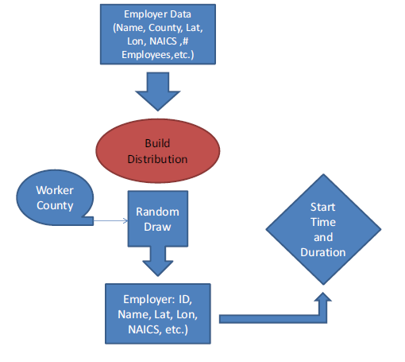
Using Employer Data to assign a Workplace Characteristics
Name | County | NAICS Code | NAICS Description | Employment | Latitude | Longitude
1 VIP SKINDEEP | Atlantic | 81219915 | Other Personal Care | 2 | 39.401104 | -74.514228
10 Acres Motel | Atlantic | 72111002 | Hotels & Motels Ex Casino | 2 | 39.437305 | -74.485488
1001 Grand Street Investors | Atlantic | 52399903 | Misc Financial Inves | 3 | 39.619732 | -74.786654
1006 S Main St LLC | Atlantic | 53111004 | Lessors Of Res Buildg | 5 | 39.382399 | -74.530785
11th Floor Creative Group | Atlantic | 51211008 | Motion Picture Prod | 2 | 39.359014 | -74.430151
123 Cab Co | Atlantic | 48531002 | Taxi Svc | 2 | 39.391600 | -74.521715
123 Junk Car Removal | Atlantic | 45331021 | Used Merch Stores | 2 | 39.361705 | -74.435779
1400 Bar | Atlantic | 72241001 | Drinking Places | 4 | 39.411266 | -74.570083
1-800-Got-Junk? | Atlantic | 56221910 | Other Non-Haz Waste Disp | 4 | 39.423954 | -74.557892
Employment-Weighted
Random Draw

Slide 14
Using School Data to Assign School Characteristics

Slide 15
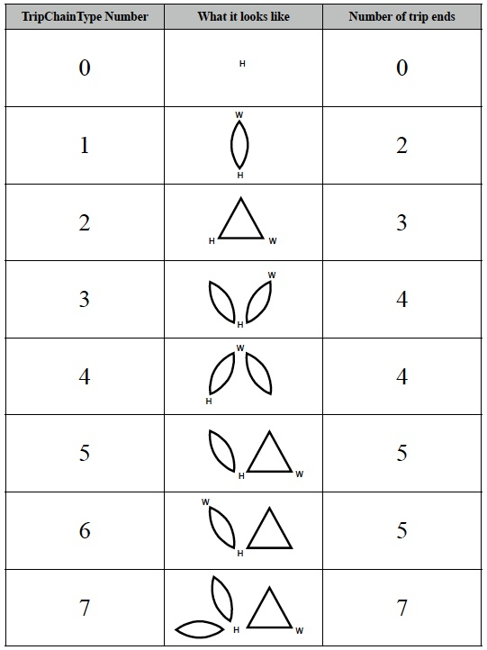
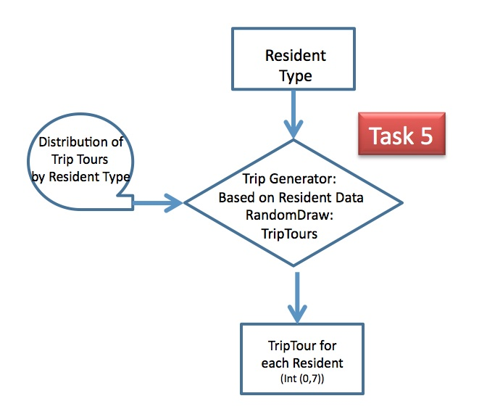
Assigning a Daily Activity (Trip) Tour to Each Person

Slide 16
Final NJ_Resident file
Home County
Person Index
Household Index
Full Name
Age
Gender
Worker Type Index
Worker Type String
Home lat, lon
Work or School lat,lon
Work County
Work or School Index
NAICS code
Work or School start/end time
ATL | 274,549
BER | 905,116
BUR | 448,734
CAM | 513,657
CAP | 97,265
CUM | 156,898
ESS | 783,969
GLO | 288,288
HUD | 634,266
HUN | 128,349
MER | 366,513
MID | 809,858
MON | 630,380
MOR | 492,276
OCE | 576,567
PAS | 501,226
SAL | 66,083
SOM | 323,444
SUS | 149,265
UNI | 536,499
WAR | 108,692
NYC | 86,418
PHL | 18,586
BUC | 99,865
SOU | 13,772
NOR | 5,046
WES | 6,531
ROC | 32,737
Total: | 9,054,849

Slide 17
Creating the NJ_PersonTrip file
“every” trip that each Traveler is likely to make on a typical day. NJ_PersonTrip file
Containing appropriate spatial and temporal characteristics for each trip
Start with
NJ_ResidentTrip file
NJ_Employment file
Readily assign trips between Home and Work/School
Trip Activity -> Stop Sequence
Home, Work, School characteristics synthesized in NJ_Resident file

Slide 18
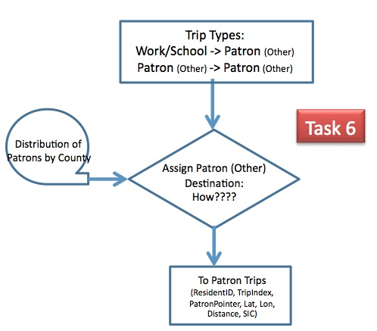
Assigning “Other” Locations
1. Select Other County Using:
Attractiveness-Weighted
Random Draw
Attractiveness (i)= (Patrons (I)/AllPatrons)/{D(i,j)² + D(j,k)²};
Where i is destination county; j is current county; k is home county
2. Select “Other” Business using:
Patronage-Weighted Random Draw within selected county

Slide 19
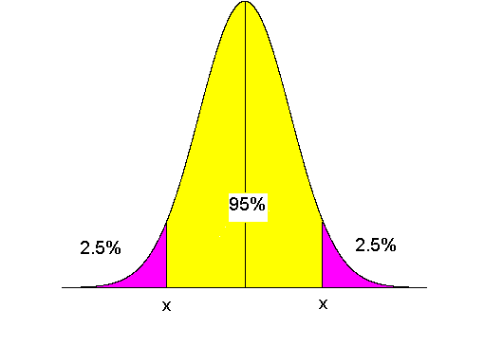
Assigning Trip Departure Times
Task 8
Trip Type; SIC
Distribution of
Arrival/Departure
Times
Time Generator:
RandomDraw:
Time Distribution
Trip Departure time
(SeconsFromMidnight)
For: H->W; H->School; W->Other
Work backwards from Desired Arrival Time using
Distance and normally distributed Speed distribution, and
Non-symmetric early late probabilities
Else, Use Stop Duration with non-symmetric early late probabilities based on SIC Cod

Slide 20
NJ_PersonTrip file
 | All Trips
Home County | Trips | TripMiles | AverageTM
 | # | Miles | Miles
ATL | 936,585 | 27,723,931 | 29.6
BER | 3,075,434 | 40,006,145 | 13.0
BUC | 250,006 | 9,725,080 | 38.9
BUR | 1,525,713 | 37,274,682 | 24.4
CAM | 1,746,906 | 27,523,679 | 15.8
CAP | 333,690 | 11,026,874 | 33.0
CUM | 532,897 | 18,766,986 | 35.2
ESS | 2,663,517 | 29,307,439 | 11.0
GLO | 980,302 | 23,790,798 | 24.3
HUD | 2,153,677 | 18,580,585 | 8.6
HUN | 437,598 | 13,044,440 | 29.8
MER | 1,248,183 | 22,410,297 | 18.0
MID | 2,753,142 | 47,579,551 | 17.3
MON | 2,144,477 | 50,862,651 | 23.7
MOR | 1,677,161 | 33,746,360 | 20.1
NOR | 12,534 | 900,434 | 71.8
NYC | 215,915 | 4,131,764 | 19.1
OCE | 1,964,014 | 63,174,466 | 32.2
PAS | 1,704,184 | 22,641,201 | 13.3
PHL | 46,468 | 1,367,405 | 29.4
ROC | 81,740 | 2,163,311 | 26.5
SAL | 225,725 | 8,239,593 | 36.5
SOM | 1,099,927 | 21,799,647 | 19.8
SOU | 34,493 | 2,468,016 | 71.6
SUS | 508,674 | 16,572,792 | 32.6
UNI | 1,824,093 | 21,860,031 | 12.0
WAR | 371,169 | 13,012,489 | 35.1
WES | 16,304 | 477,950 | 29.3
Total | 32,862,668 | 590,178,597 | 19.3
9,054,849 records
One for each person in NJ_Resident file
Specifying 32,862,668 Daily Person Trips
Each characterized by a precise
{oLat, oLon, oTime, dLat, dLon, Est_dTime}

Slide 21
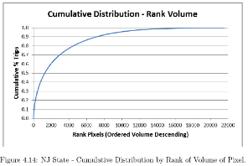
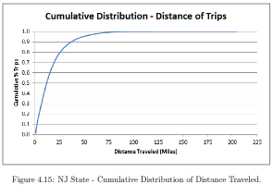
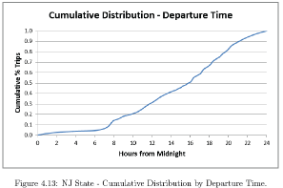
New Jersey Summary Data
Item | Value
Area (mi²) | 8,061
# of Pixels Generating at Least One O_Trip | 21,643
Area of Pixels (mi²) | 5,411
% of Open Space | 32.9%
# of Pixels Generating 95% of O_Trips | 9,519
# of Pixels Generating 50% of O_Trips | 1,310
# of Intra-Pixel Trips | 447,102
# of O_Walk Trips | 1,943,803
# of All O_Trips | 32,862,668
Avg. All O_TripLength (miles) | 19.6
# of O_aTaxi Trips | 30,471,763
Avg. O_aTaxiTripLength (miles) | 20.7
Median O_aTaxiTripLength (miles) | 12.5
95% O_aTaxiTripLength (miles) | 38.0

Slide 22
Analysis of aTaxi Demand in Mercer County CD=3p; DD=300sec; MaxCircuity=20%
469,020 aTaxi Departures throughout typical “October weekday”
935 “50-passenger” aTaxi Departures
8,127 “15-passenger” aTaxi Departures
283,779 “6-passenger” aTaxi Departures
176,179 “2-passenger” aTaxi Departures
527,724 aTaxi Arrivals throughout typical “October weekday”
1,089 “50-passenger” aTaxi Arrivals
8,472 “15-passenger” aTaxi Arrivals
272,653 “6-passenger” aTaxi Arrivals
245,510 “2-passenger” aTaxi Arrivals
~58,704 aTaxis will need to be repositioned outside of Mercer County overnight.
~154 “50-passenger” aTaxis will need to be repositioned out of Mercer County overnight
~345 “15-passenger” aTaxis will need to be repositioned out of Mercer County overnight
~11,126 “6-passenger” aTaxis will need to be repositioned into Mercer County overnight.
~69,331 “2-passenger” aTaxis will need to be repositioned out of Mercer County overnight.

Slide 23
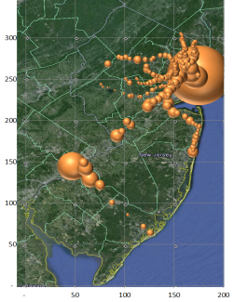
Spatial Aggregation
By walking to a station/aTaxiStand
A what point does a walk distance makes the aTaxi trip unattractive relative to one’s personal car?
¼ mile ( 5 minute) max
By using the rail system for some trips
Trips with at least one trip-end within a short walk to a train station.
Trips to/from NYC or PHL

Slide 24
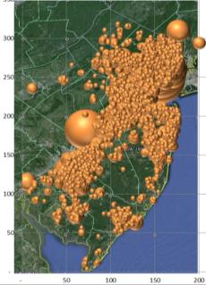
Spatial Aggregation
By walking to a station/aTaxiStand
A what point does a walk distance makes the aTaxi trip unattractive relative to one’s personal car?
¼ mile ( 5 minute) max
By using the rail system for some trips
Trips with at least one trip end within a short walk to a train station.
Trips to/from NYC or PHL
By sharing rides with others that are basically going in my direction
No trip has more than 20% circuity added to its trip time.

Slide 25
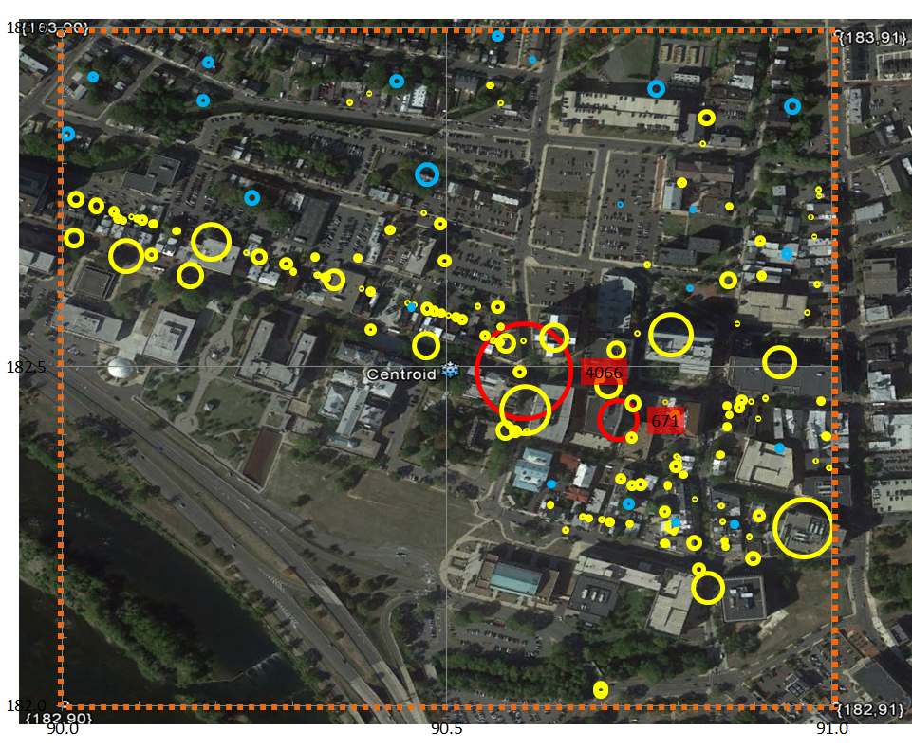
Mercer County Pixel {182,90} Trenton
Item | Value
Activity Locations | 135
Employment | 8,654
Population | 707
School Enrollment | 4,737
Work
Home
(Block Centroid)
School
Pixel Centroid

Slide 26
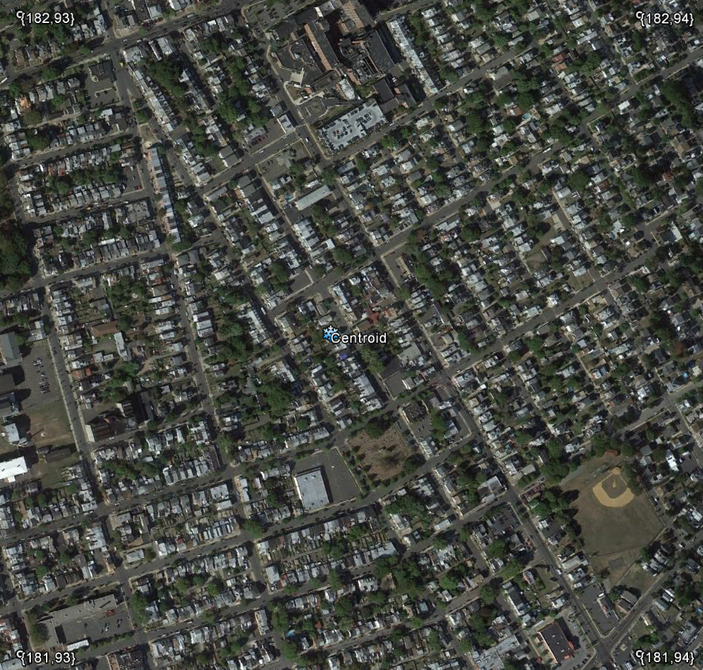
Mercer County Pixel {181,93} Chambersburg
Item | Value
Activity Locations | 113
Employment | 2,295
Population | 5,622
School Enrollment | 594
Work
Home
(Block Centroid)
School
Pixel Centroid

Slide 27
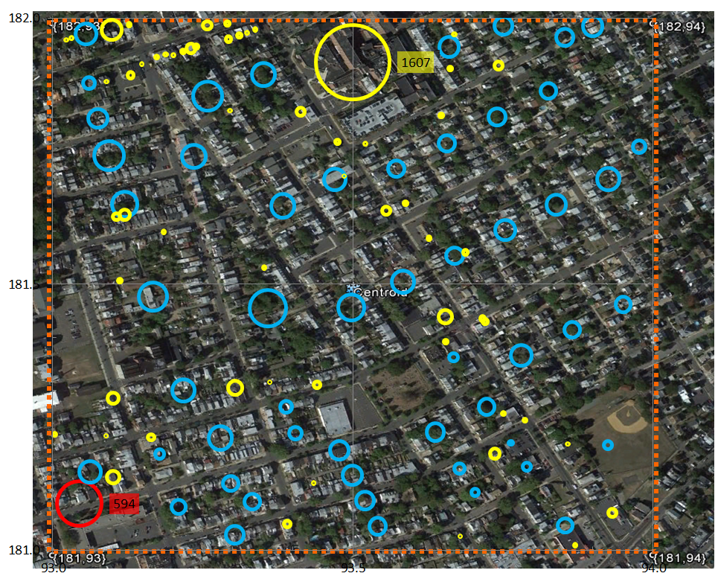
Mercer County Pixel {181,93} Chambersburg
Item | Value
Activity Locations | 113
Employment | 2,295
Population | 5,622
School Enrollment | 594
Work
Home
(Block Centroid)
School
Pixel Centroid

Slide 28
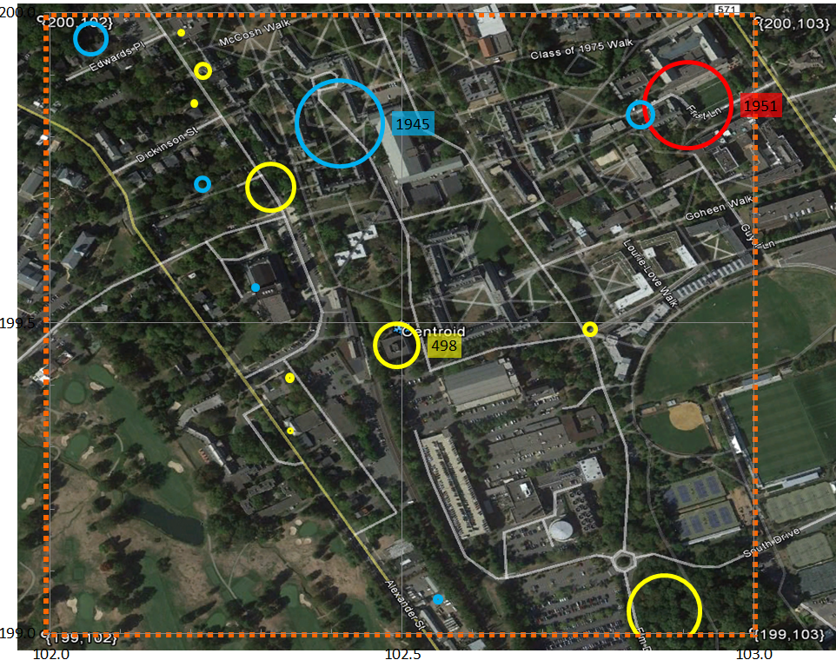
Mercer County Pixel {199,102} Princeton
Item | Value
Activity Locations | 16
Employment | 2,490
Population | 2,430
School Enrollment | 1,951
Work
Home
(Block Centroid)
School
Pixel Centroid

Slide 29
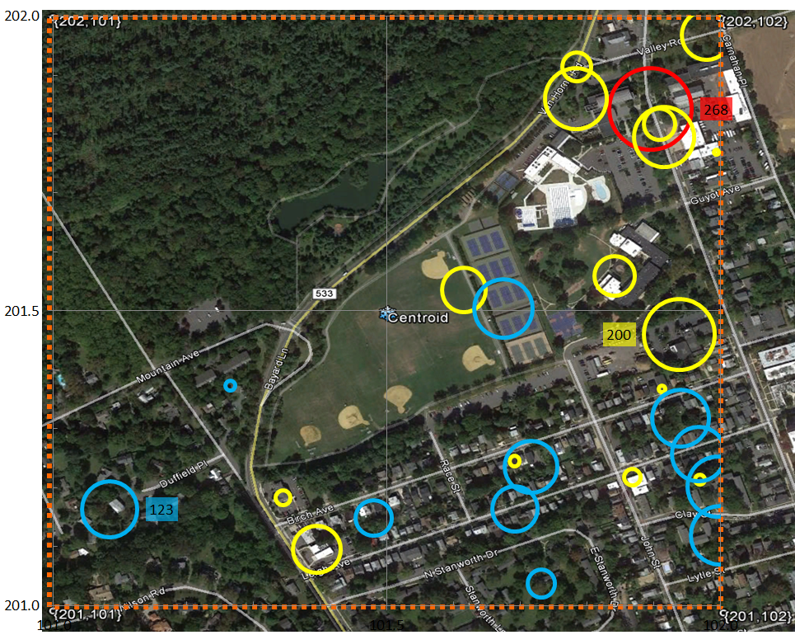
Mercer County Pixel {201,101} Princeton
Item | Value
Activity Locations | 27
Employment | 925
Population | 1,056
School Enrollment | 268
Work
Home
(Block Centroid)
School
Pixel Centroid

Slide 30
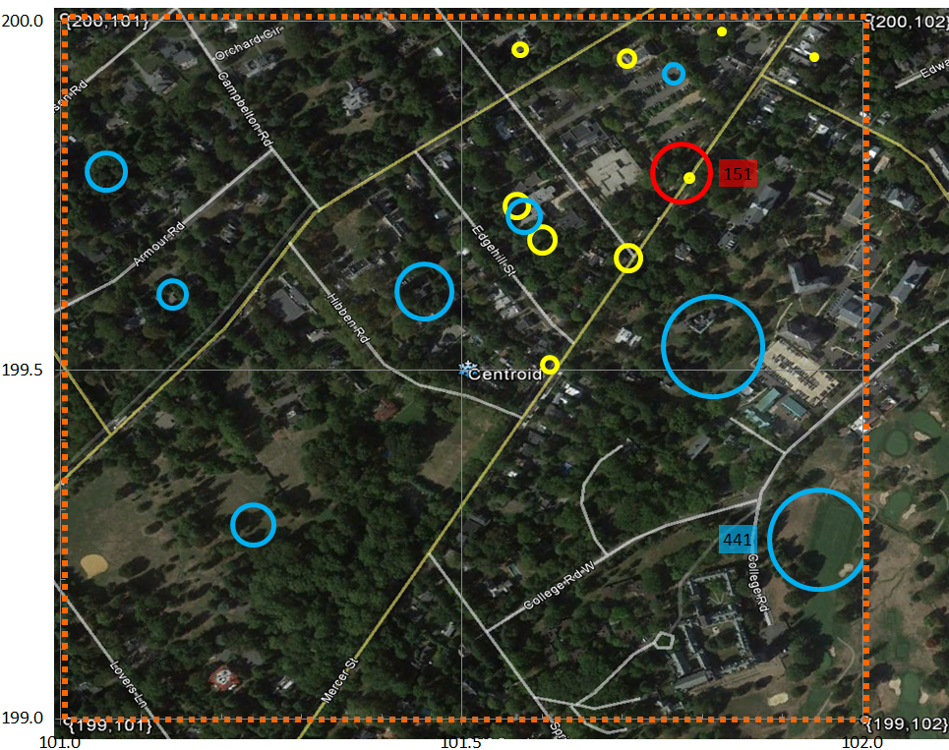
Mercer County Pixel {199,101} Princeton
Item | Value
Activity Locations | 18
Employment | 116
Population | 1,268
School Enrollment | 151
Work
Home
(Block Centroid)
School
Pixel Centroid

Slide 31
Mercer County Pixel {199,102} Princeton
Item | Value
Activity Locations | 16
Employment | 2,490
Population | 2,430
School Enrollment | 1,951
Work
Home
(Block Centroid)
School
Pixel Centroid

Slide 32
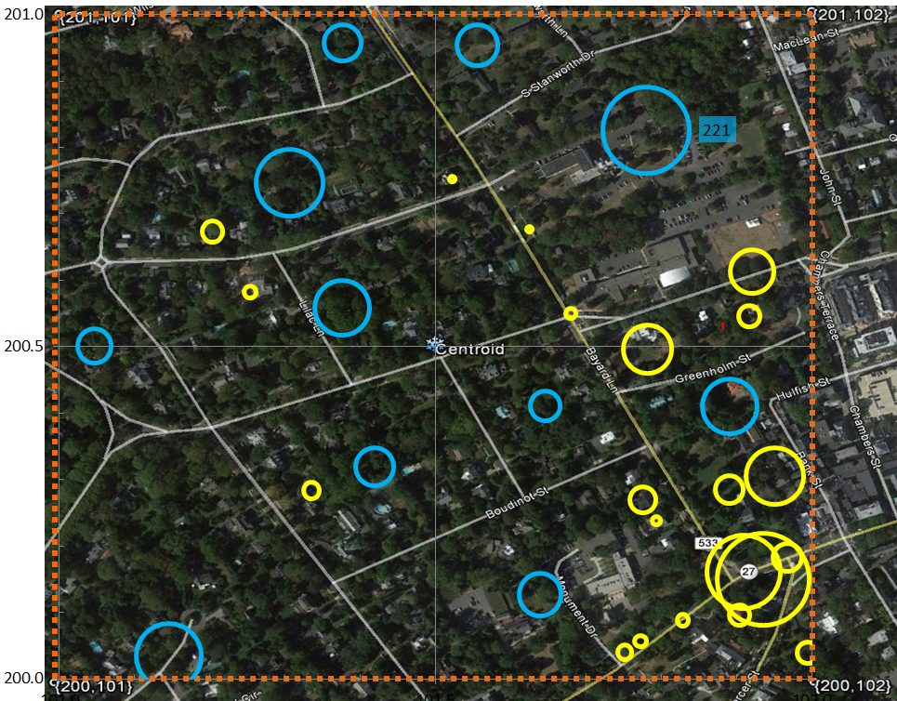
Mercer County Pixel {200,101} Princeton
Item | Value
Activity Locations | 32
Employment | 789
Population | 906
School Enrollment | 0
Work
Home
(Block Centroid)
School
Pixel Centroid

Slide 33
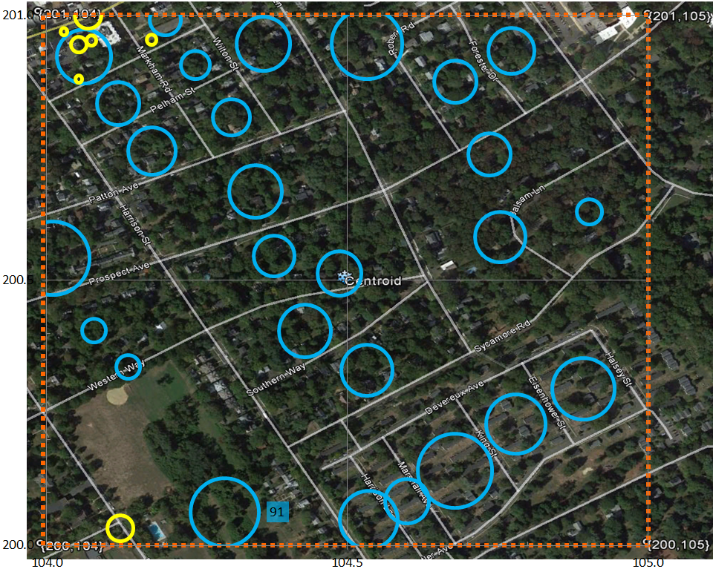
Mercer County Pixel {200,104} Princeton
Item | Value
Activity Locations | 34
Employment | 38
Population | 1,332
School Enrollment | 0
Work
Home
(Block Centroid)
School
Pixel Centroid

Slide 34
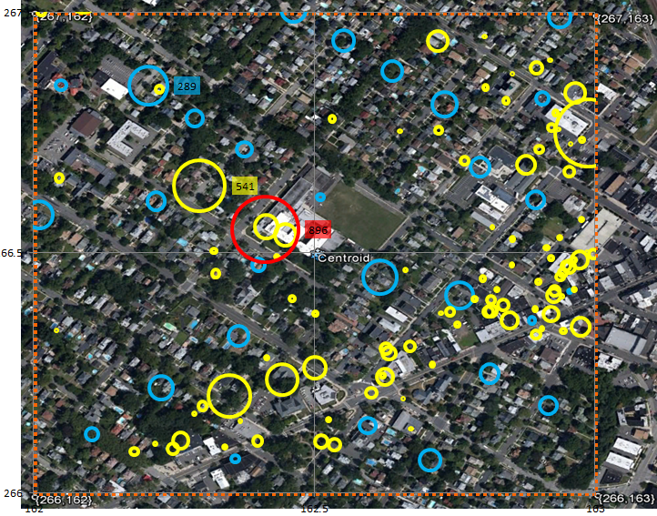
Bergen County Pixel {266,162} Rutherford
Item | Value
Activity Locations | 131
Employment | 3,809
Population | 2,352
School Enrollment | 896
Work
Home
(Block Centroid)
School
Pixel Centroid

Slide 35
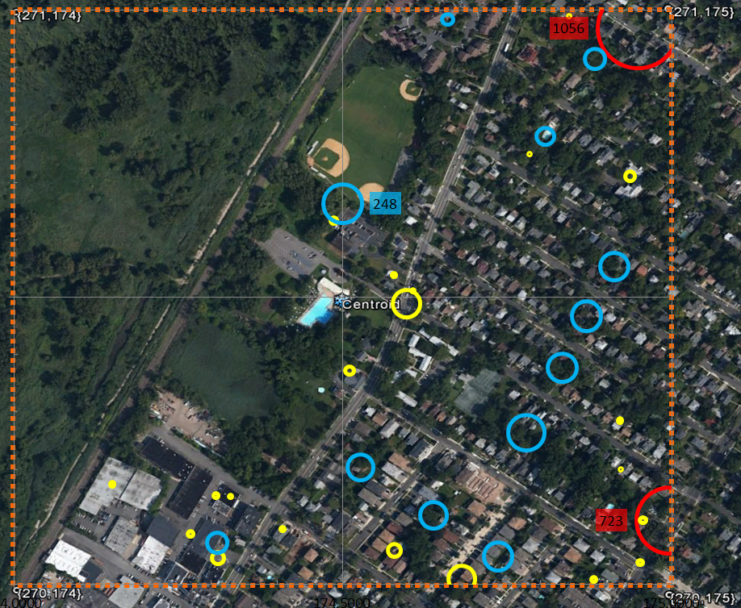
Bergen County Pixel {270,174} Leonia
Item | Value
Activity Locations | 35
Employment | 364
Population | 1,428
School Enrollment | 1,779
Work
Home
(Block Centroid)
School
Pixel Centroid

Slide 36
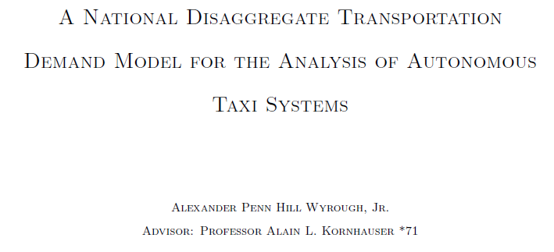
What about the whole country?

Slide 37
Trip Files are Available If You want to Play

Slide 38
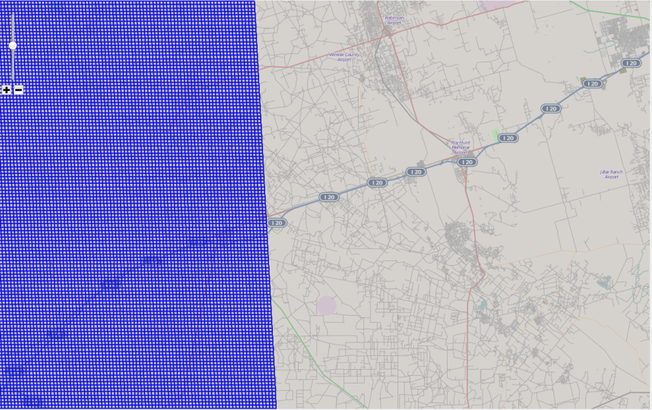
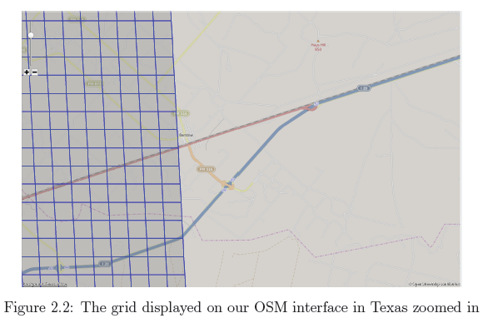
The North American Grid
18 million pixel
0.5mi. x 0.5 mi.
Centered @
37º N Latitude, -97.50º W Longitude

Slide 39
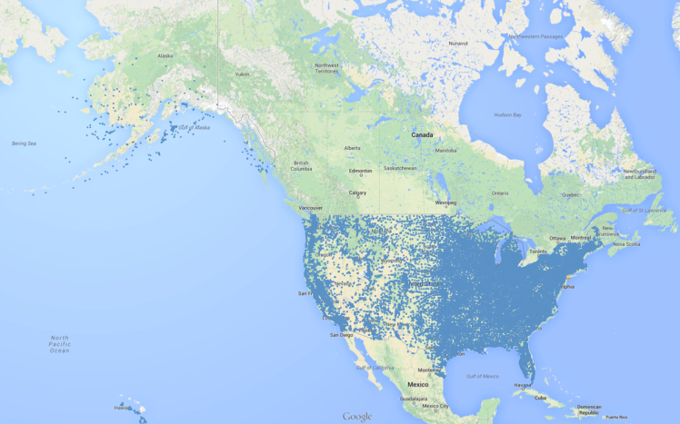
Public Schools in the US

Slide 40
Nation-Wide Businesses
Rank | State | Sales Volume | No. Businesses
1 | California | $1,889 | 1,579,342
2 | Texas | $2,115 | 999,331
3 | Florida | $1,702 | 895,586
4 | New York | $1,822 | 837,773
5 | Pennsylvania | $2,134 | 550,678
9 | New Jersey | $1,919 | 428,596
45 | Washington DC | $1,317 | 49,488
47 | Rhode Island | $1,814 | 46,503
48 | North Dakota | $1,978 | 44,518
49 | Delaware | $2,108 | 41,296
50 | Vermont | $1,554 | 39,230
51 | Wyoming | $1,679 | 35,881
13.6 Million Businesses {Name, address, Sales, #employees}
Notes:
US Businesses: 13.6Million
US Employees: 240 Million (with Luke's 50M students, 12% Unemployment)
US Patrons: 330 Million (!!!)
US Sales Volume: 30Billion

Slide 41
US_PersonTrip file will have..
308,745,538 records
One for each person in US_Resident file
Specifying 1,009,332,835 Daily Person Trips
Each characterized by a precise
{oLat, oLon, oTime, dLat, dLon, Est_dTime}
Will Perform Nationwide aTaxi AVO analysis
Results

Slide 42
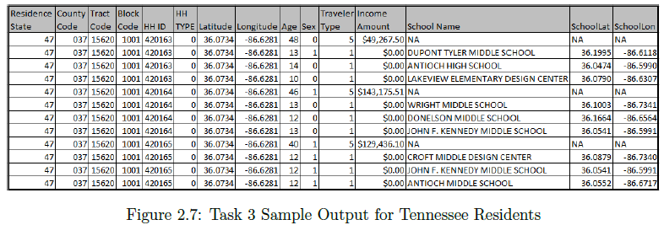

Slide 43
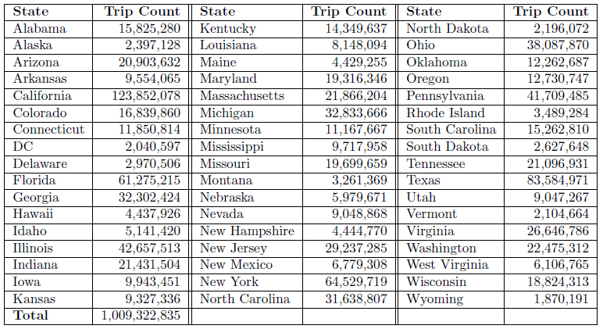

Slide 44
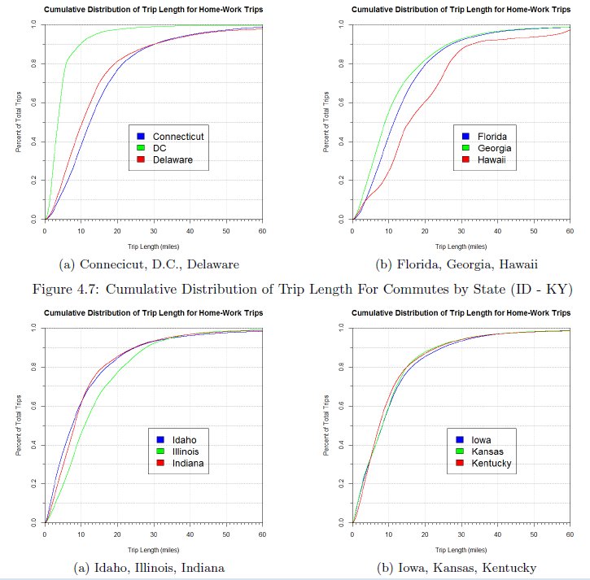

Slide 45
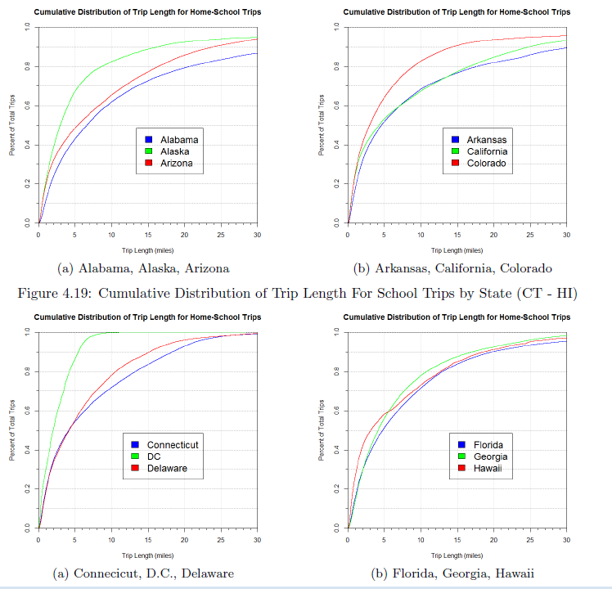

Slide 46
Manhattan (New York County)
Simulated population of 1,585,873 residents
8,085,055 trips originate within Manhattan
52,759,156 person-trip miles for Manhattan oTrips
3,010,666 unique travelers (1,424,793 non-resident travelers – Commuters)
Mean Trip Length = 6.53 miles; Median Trip Length = 3.31 miles
Interesting differences between commuter and resident population traveling through Manhattan

Slide 47
Manhattan (New York County)

Slide 48
Manhattan (New York County)

Slide 49
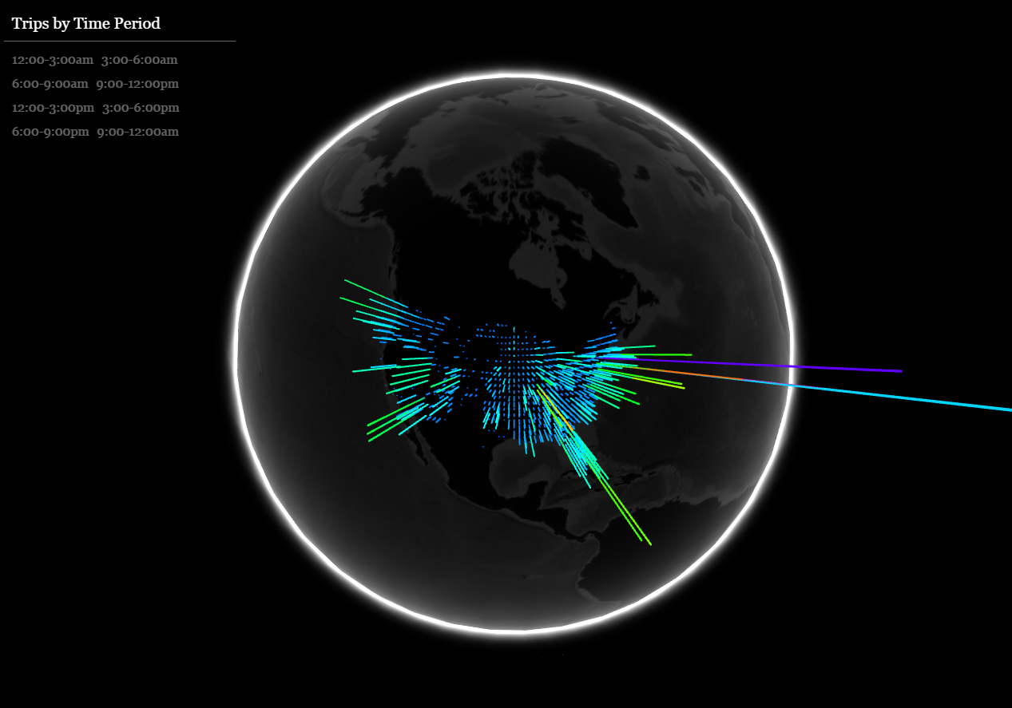
Visualizing Synthesized Individual Person Trips on a Typical Day Throughout the Lower 48
http://162.209.99.128/globe/ (Use Chrome; wait for it to load)

Slide 50
Outline
Background on Smart Driving Cars (Where we are today)
What is Today’s Demand for Mobility (Synthesizing Individual Person trips for new Jersey and the Nation)
How Might Those Trips be Served by aTaxis

Slide 51
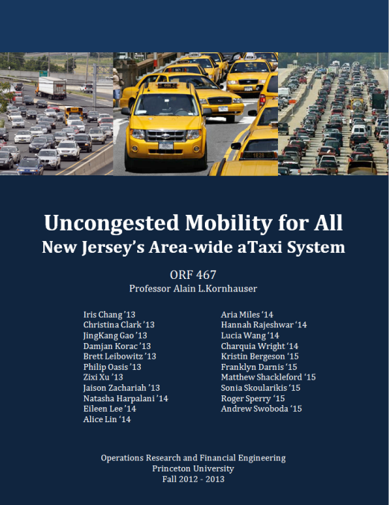

Slide 52
aTaxis and RideSharing
“AVO < 1” RideSharing
Eliminate the “Empty Back-haul”; AVO Plus
“Organized” RideSharing
Diverted to aTaxis
“Tag-along” RideSharing
Only Primary trip maker modeled, “Tag-alongs” are assumed same after as before.
“Casual” RideSharing
This is the opportunity of aTaxis
How much spatial and temporal aggregation is required to create significant casual ride-sharing opportunities.

Slide 53
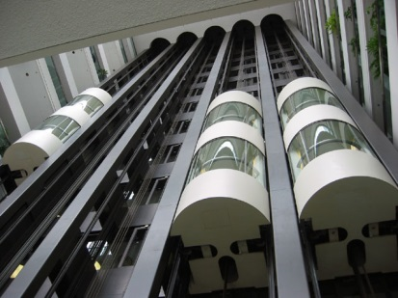
Spatial Aggregation
By walking to a station/aTaxiStand
At what point does a walk distance makes the aTaxi trip unattractive relative to one’s personal car?
¼ mile ( 5 minute) max
Like using an Elevator!
Elevator

Slide 54
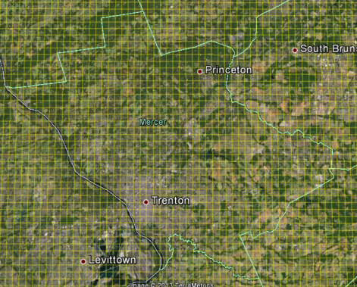
Pixelation of New Jersey
Zoomed-In Grid of Mercer
NJ State Grid

Slide 55
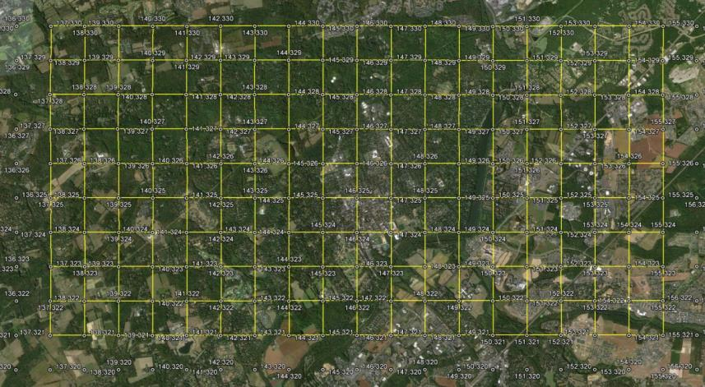
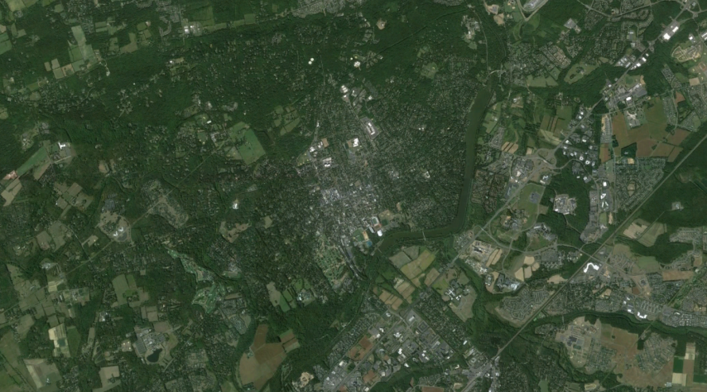
Pixelating the State
with half-mile Pixels
xPixel = floor{108.907 * (longitude + 75.6)}
yPixel = floor{138.2 * (latitude – 38.9))

Slide 56
An aTaxiTrip
{oYpixel, oXpixel, oTime (Hr:Min:Sec) , }
An aTaxiTrip
{oYpixel, oXpixel, oTime (Hr:Min:Sec) ,dYpixel, dXpixel, Exected: dTime}
a PersonTrip
{oLat, oLon, oTime (Hr:Min:Sec) ,dLat, dLon, Exected: dTime}
P₁
D
O
O

Slide 57
Common Destination (CD)
CD=1p: Pixel -> Pixel (p->p) Ride-sharing
P₁
O
TripMiles = L
TripMiles = 2L
TripMiles = 3L

Slide 58
P₁
O
PersonMiles = 3L
PersonMiles = 3L
aTaxiMiles = L
AVO = PersonMiles/aTaxiMiles = 3

Slide 59
CD= 3p: Pixel ->3Pixels Ride-sharing
P₁
O
P₂

Slide 60
CD= 3p: Pixel ->3Pixels Ride-sharing
P₃
P₁
O
P₂

Slide 61
CD= 3p: Pixel ->3Pixels Ride-sharing
P₅
P₁
O
P₃

Slide 62
CD= 3p: Pixel ->3Pixels Ride-sharing; P₃ New
P₃
P₁
P₂
O
Scenario: L_{0->1} < L_{0->2} < L_{0->3} ; P₃ new
Service Constraint:
{L_{0->1->2} / L_{0->2}} -1 < MaxCircuity
{L_{0->1->2->3} / L_{0->3}} -1 < MaxCircuity
MaxCircuity is a service parameter; (say 0.2 or 0.3)
Improve Ride-Share constraint:
(AVO_{Rideshare 1,2} > AVO_{Alone} )
{L_{0->1} + L_{0->2}} > L_{0->1->2}
(AVO_{Rideshare 1,2,3} > AVO_{Rideshare 1,2} + AVO_{3 Alone} );
{N_{0->1} * L_{0->1} + N_{0->2} * L_{0 ->2} + N_{0->3} * L_{0 ->3}} / {L_{0->1->2->3} }
> {N_{0->1} * L_{0->1} + N_{0->2} * L_{0 ->2} + N_{0->3} * L_{0 ->3}} / {L_{0->1->2} + L_{0->3}}
Numerators are identical; Therefore:
{L_{0->1->2} + L_{0->3}} > L_{0->1->2->3}

Slide 63
CD= 3p: Pixel ->3Pixels Ride-sharing; P₂ New
P₃
P₁
P₂
O
Scenario: L_{0->1} < L_{0->2} < L_{0->3} ; P₂ new
Service Constraint:
{L_{0->1->3} / L_{0->3}} -1 < MaxCircuity
{L_{0->1->2} / L_{0->2}} -1 < MaxCircuity
{L_{0->1->2->3} / L_{0->3}} -1 < MaxCircuity
MaxCircuity is a service parameter; (say 0.2 or 0.3)
Improve Ride-Share constraint:
(AVO_{Rideshare 1,3} > AVO_{Alone} )
{L_{0->1} + L_{0->3}} > L_{0->1->3}
(AVO_{Rideshare 1,2,3} > AVO_{Rideshare 1,3} + AVO_{2 Alone} );
{N_{0->1} * L_{0->1} + N_{0->2} * L_{0 ->2} + N_{0->3} * L_{0 ->3}} / {L_{0->1->2->3} }
> {N_{0->1} * L_{0->1} + N_{0->2} * L_{0 ->2} + N_{0->3} * L_{0 ->3}} / {L_{0->1->3} + L_{0->2}}
Numerators are identical; Therefore:
{L_{0->1->3} + L_{0->2}} > L_{0->1->2->3}

Slide 64
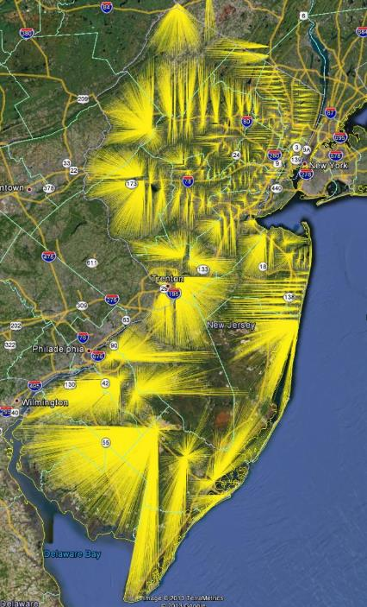
NJ Transit
Train Station
“Consumer-shed”

Slide 65
a PersonTrip from NYC
(or PHL or any Pixel containing a Train station)
An aTaxiTrip
{oYpixel, oXpixel, TrainArrivalTime, dYpixel, dXpixel, Exected: dTime}
NYC
NJ Transit Rail Line to NYC, next Departure
D
O
aTaxiTrip
Princeton Train Station

Slide 66
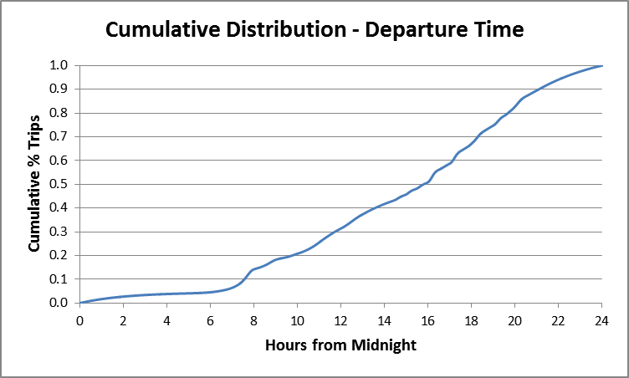
NJ_PersonTrip file

Slide 67
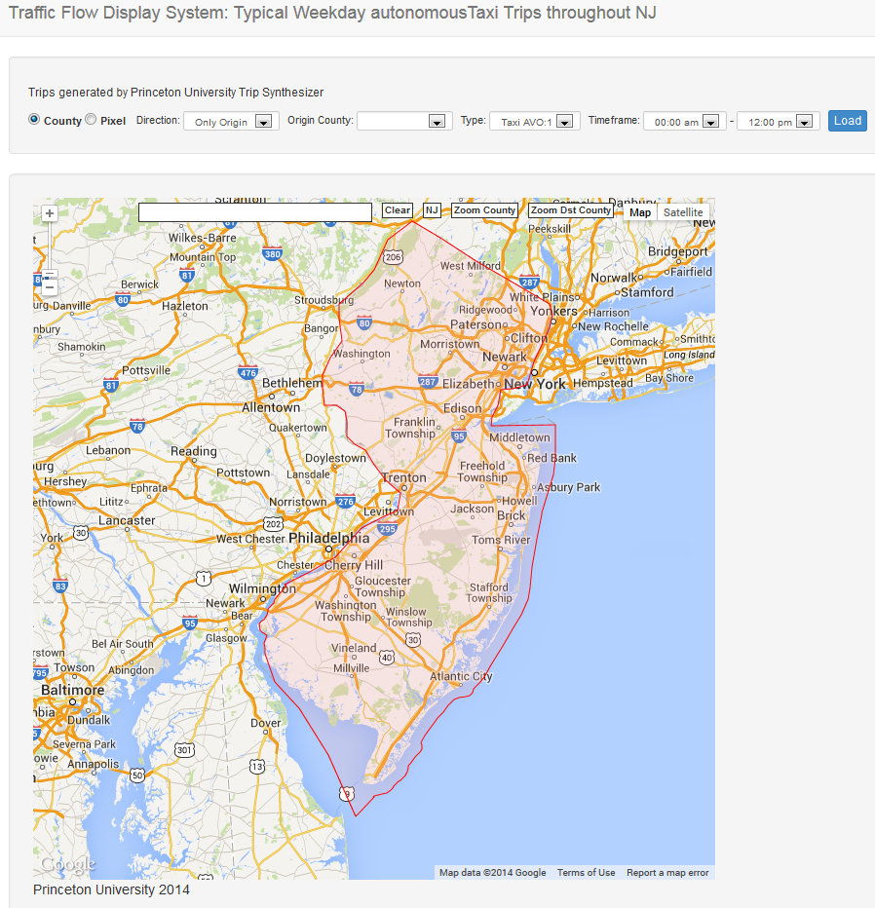
http://depler.no/route/#/

Slide 68
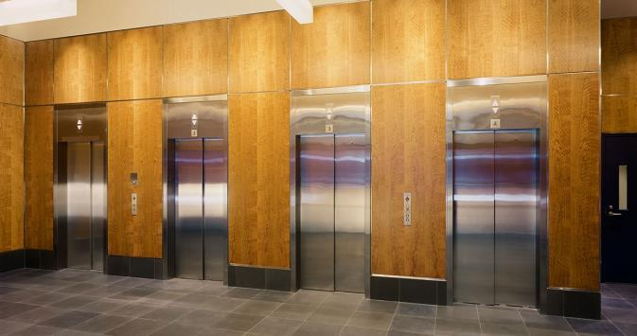
Elevator Analogy of an aTaxi Stand
Temporal Aggregation
Departure Delay: DD = 300 Seconds
Kornhauser
Obrien
Johnson
40 sec
Henderson
Lin
1:34
Popkin
3:47

Slide 69
Elevator Analogy of an aTaxi Stand
60 seconds later
Henderson
Lin
Young
0:34
Christie
Maddow
4:12
Samuels
4:50
Popkin
2:17

Slide 70
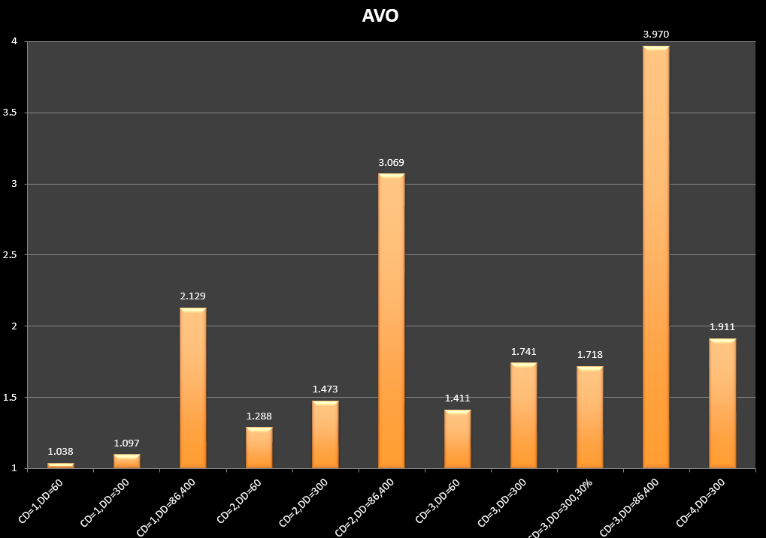
Typical Daily NJ-wide AVO
CD: Common Destinations; DD: Departure Delay (in Seconds)

Slide 71
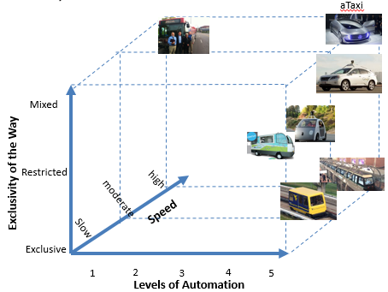
“Last Mile” Impact on NJ Transit Rail
(Today: 281,576, +537% ! )

Slide 72
Results

Slide 73
http://depler.no/route/#/

Slide 76
2013 NY TLC Stats
168,779,842 TLC Trips during 2013 calendar year
66% 35 or under; 35% 21<->35
42,821 drivers and 13,741 unique taxicabs.
1,155,367 unique taxicab pickups @ Penn Station

Slide 79
Concentration of departure “areas

Slide 80
Pixel = 0.01 Sq. Mile

Slide 81
Common Destination

Slide 85
Take-away…
Except for from a few locations, the spatial and temporal distribution of 2013 taxi trips is VERY DIFFUSE!
In order to achieve a 25% reduction in occupied taxi miles, service would have to substantially degrade making users wait up to 5 minutes before departure and traveling as much as 20% father/longer to drop off ride sharers in as many as 2 intermediate locations.
Opening up ride-sharing to all other trips would certainly increase ridesharing without increasing VMT; HOWEVER, these trips would be take away from walking or reduce existing ride-sharing on conventional buses an subways.

Slide 86
Outline
Background on Smart Driving Cars (Where we are today)
What is Today’s Demand for Mobility (Synthesizing Individual Person trips for new Jersey and the Nation)
How Might Those Trips be Served by aTaxis
How Large of a Fleet Will One Need to Serve These Trips (How would one approach the empty aTaxi management problem)

Slide 87
Empty aTaxi Repositioning Problem
If demand is CONSTANT in time

Slide 88
Persons moving from a2b by time of day

Slide 89
aTaxis_{(DD=300, CD=3)} moving from a2b by time of day

Slide 90
Instantaneous AVO by time of day

Slide 91
Mercer County Cumulative Departures & Arrivals
50 passenger aTaxis
CD=3p; DD=300Sec.; MaxCircuity= 20%
935 daily departures
935 Departures
1,089 Arrivals

Slide 92
Mercer County Cumulative Departures & Arrivals
15 passenger aTaxis
CD=3p; DD=300Sec.; MaxCircuity= 20%
8,127 Departures
8,472 Arrivals

Slide 93
Mercer County Cumulative Departures & Arrivals
2 passenger & 6 passenger aTaxis
CD=3p; DD=300Sec.; MaxCircuity= 20%
6 Passenger aTaxis
283,779 Departures
272,653 Arrivals
2 Passenger aTaxis
176,179 Departures
245,510 Arrivals

Slide 94
Mercer County Pixel {200,103} Princeton
Item | Value
Activity Locations | 57
Employment | 1,336
Population | 1,062
School Enrollment | 0
Work
Home
(Block Centroid)
School
Pixel Centroid

Slide 95
Mercer County Pixel {y=200,x=103} Princeton
 | vehicle Miles | tripMiles | AVO
Departures | 82,140 | 141,111 | 1.718
Arrivals | 81,363 | 126,995 | 1.561

Slide 96
2-pax aTaxis
15-pax aTaxis
6-pax aTaxis

Slide 97
Mercer County Pixel {200,102} Princeton
Item | Value
Activity Locations | 165
Employment | 6,617
Population | 1,325
School Enrollment | 0
Work
Home
(Block Centroid)
School
Pixel Centroid

Slide 99
Discussion!
Thank You
alaink@princeton.edu
www.SmartDrivingCar.com

