Slide 1
West Region
Cakmak, Erkalova, Wu, Wagner

Slide 2
Progress
Part 1: Assessment of Population - Completed (not including item 5)
Part 2: Assessment of Trips Originating in the Region - Partially Completed (see following slides)
Part 3: Assessment of Business Case – Not started
Part 4: Assessment of Last-Mile Access – Not started

Slide 3
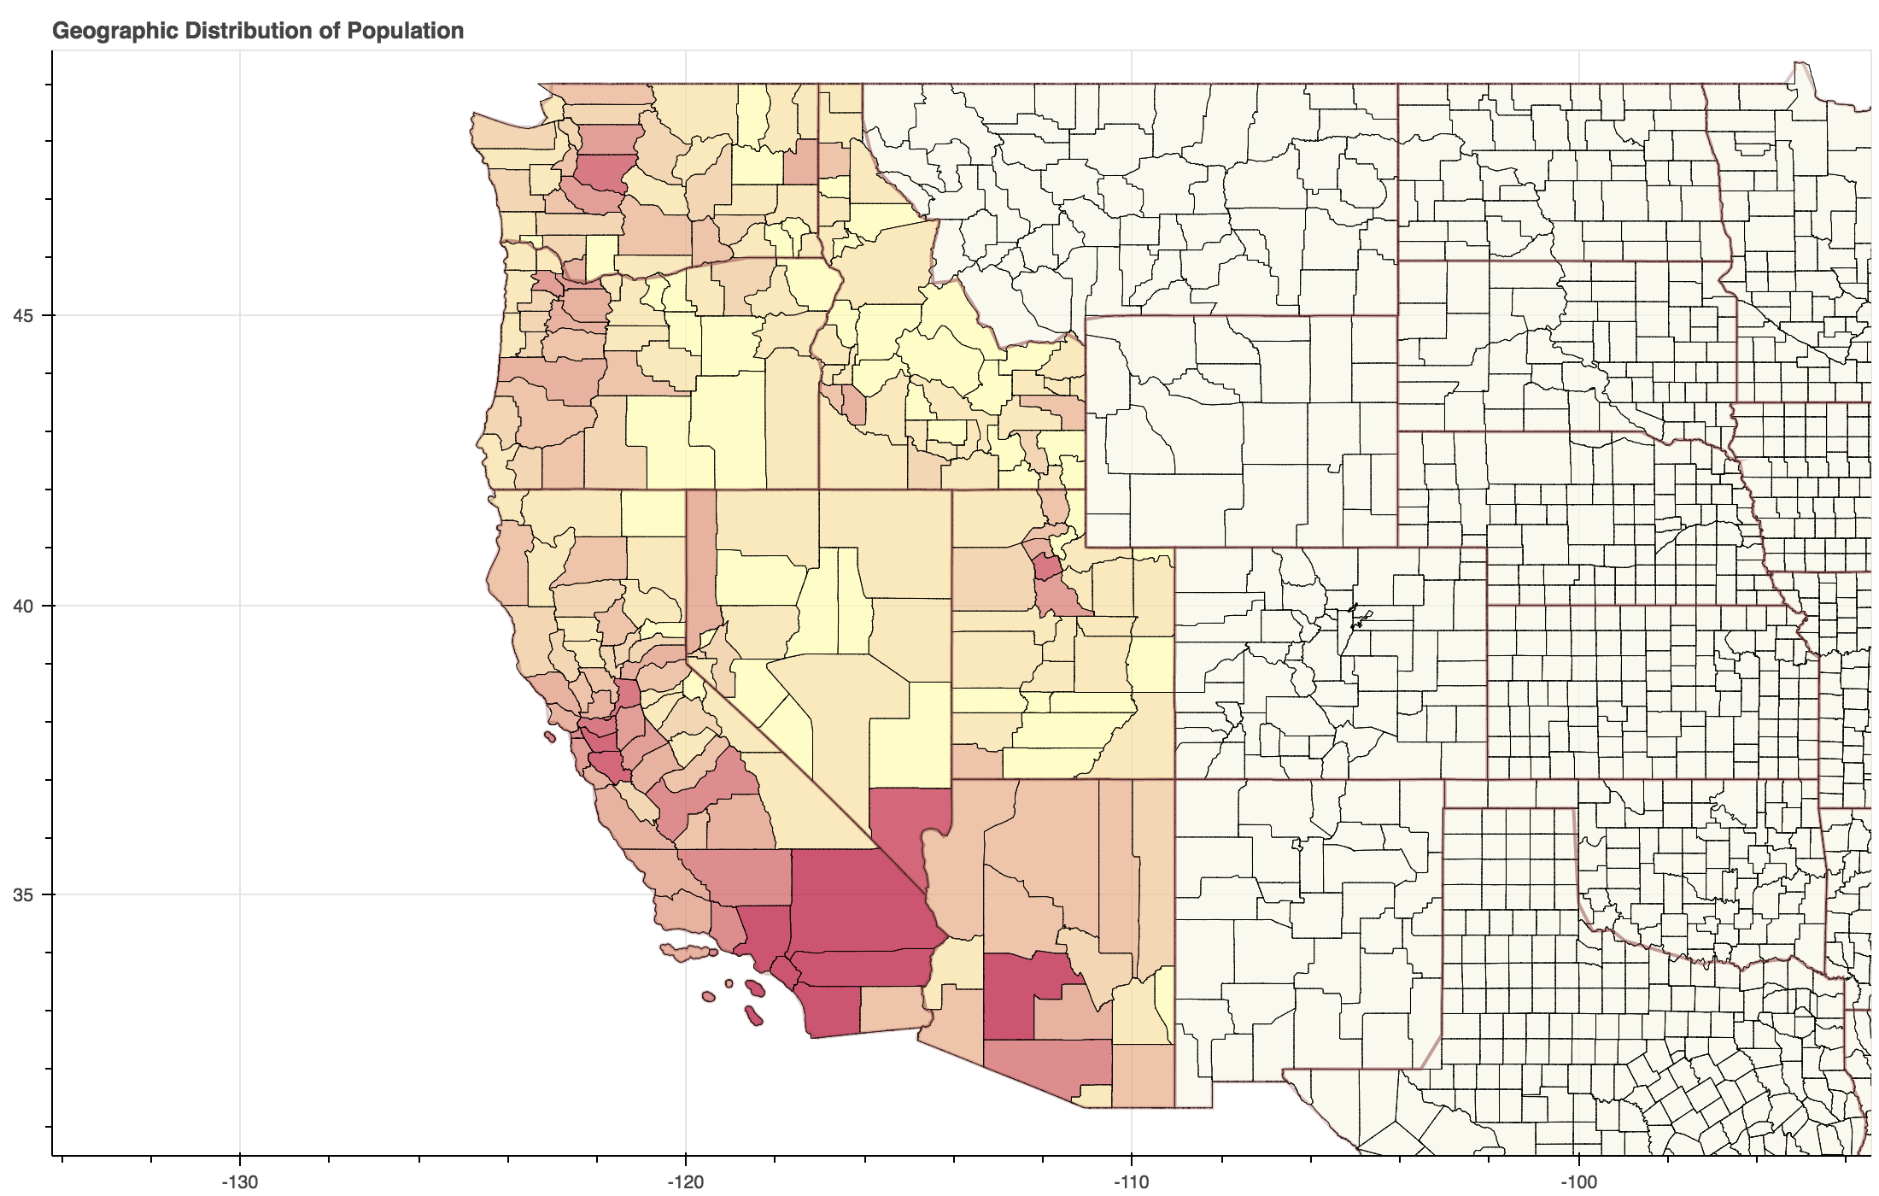
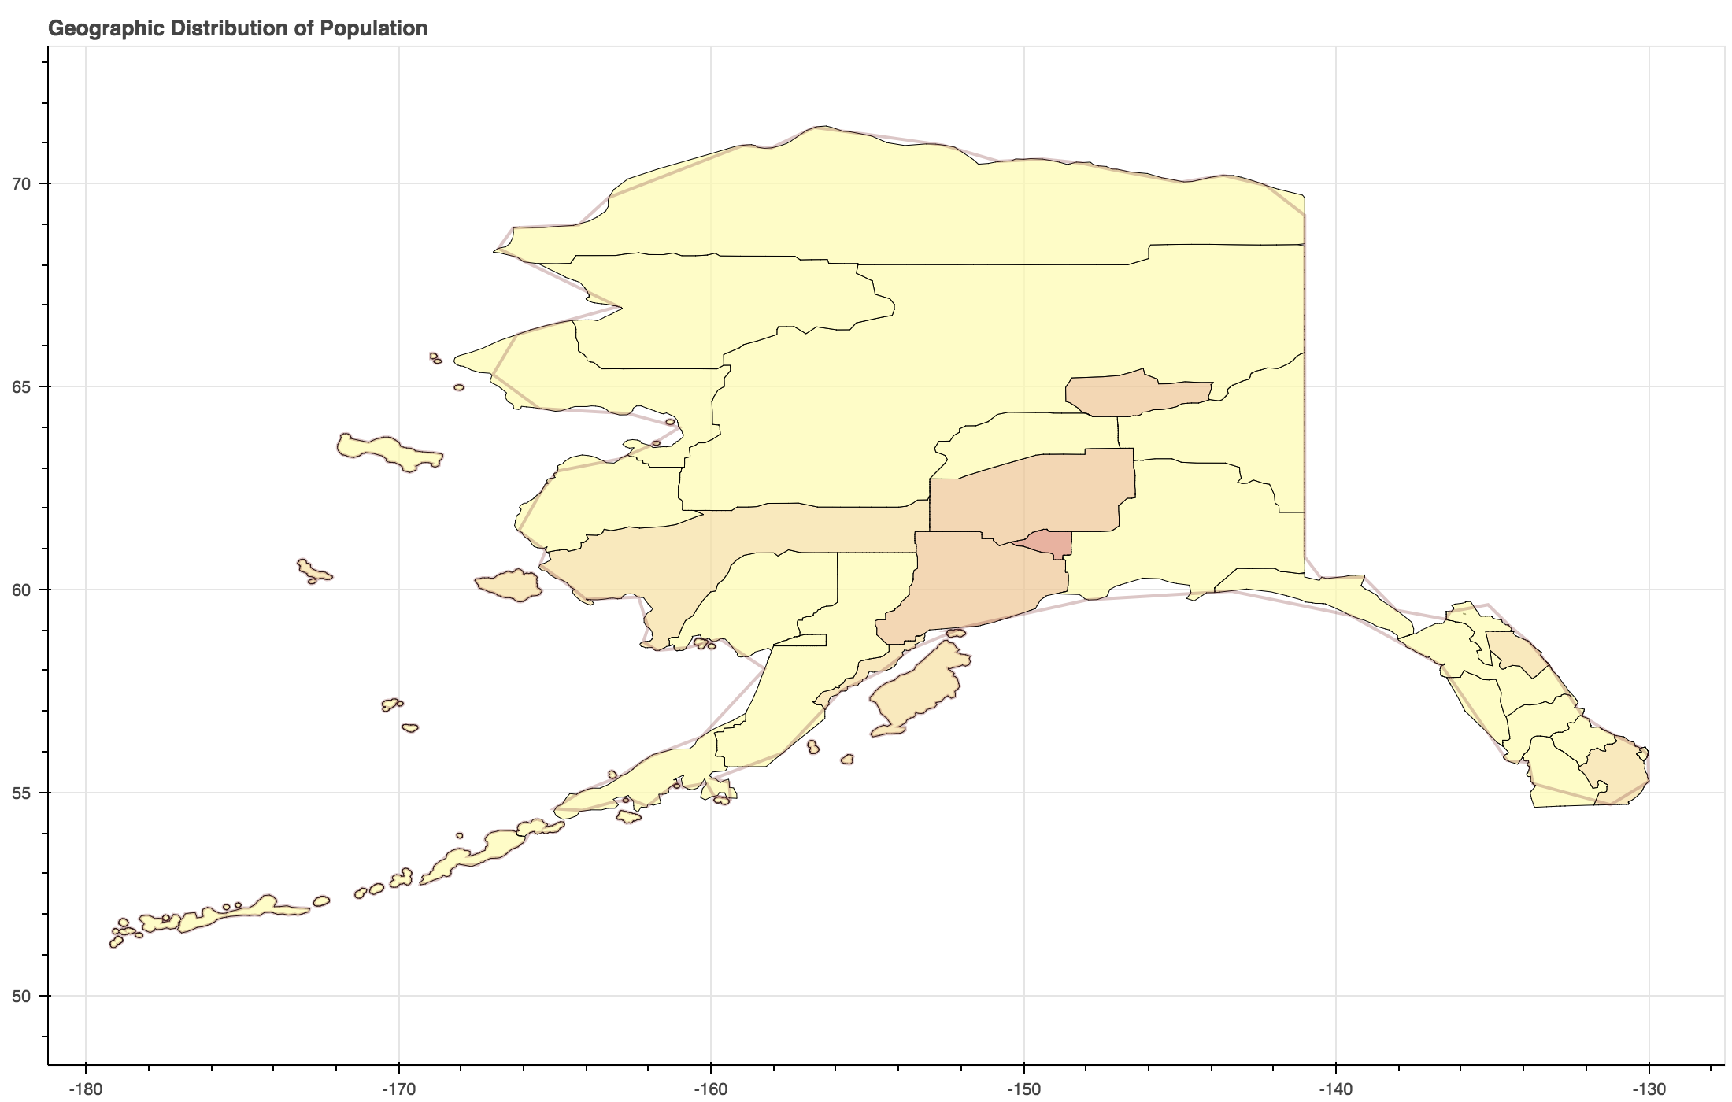
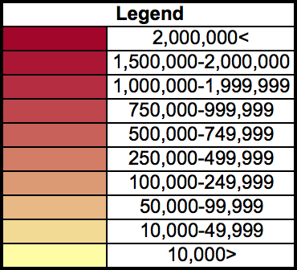
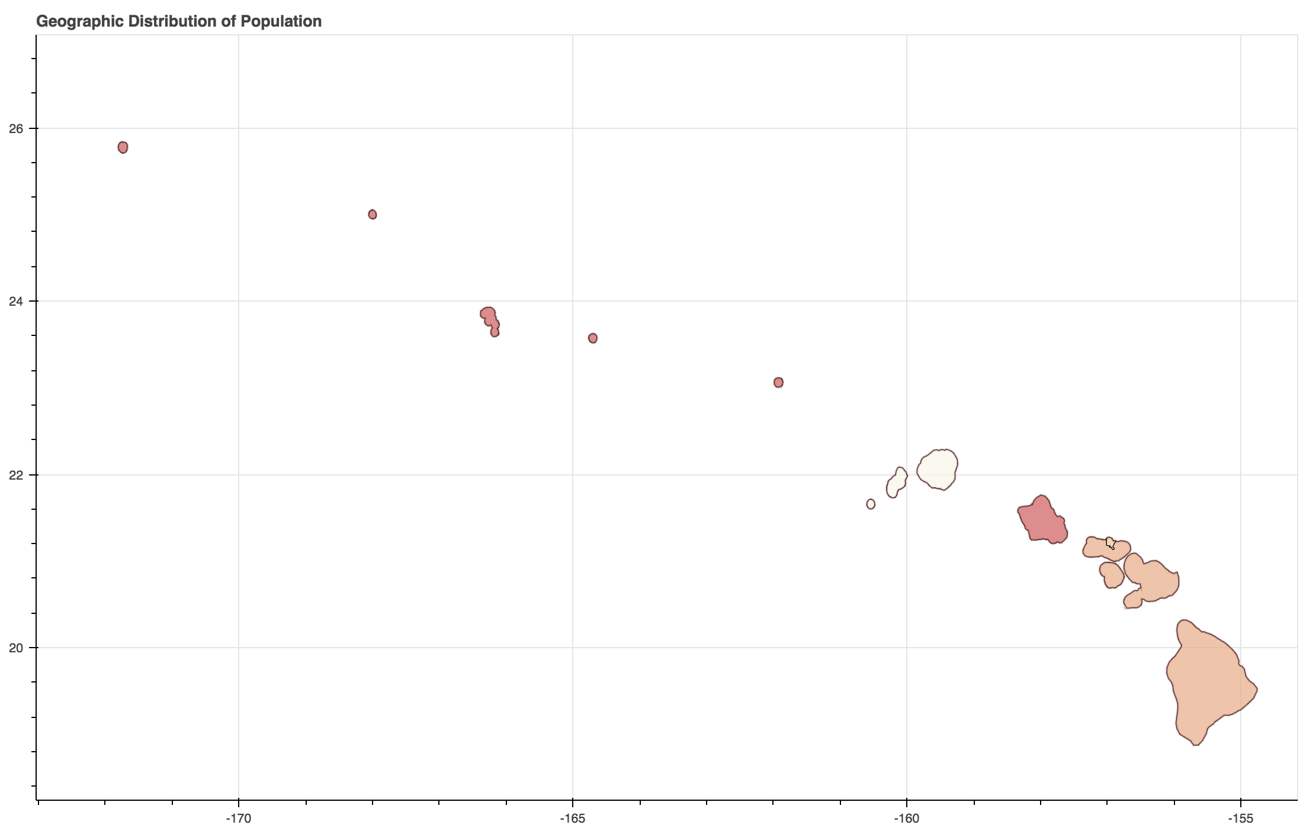
Geographic Distribution of Population

Slide 4
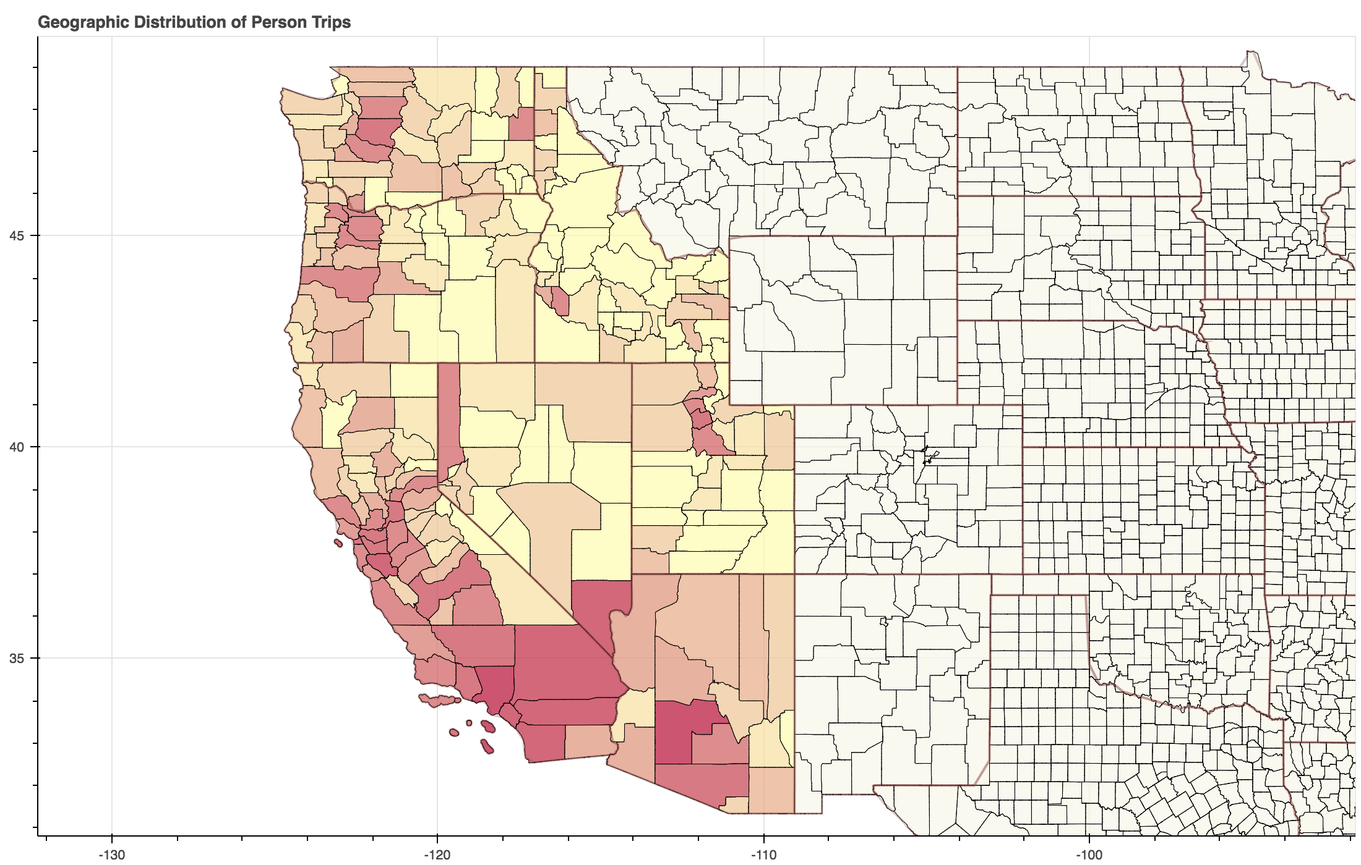
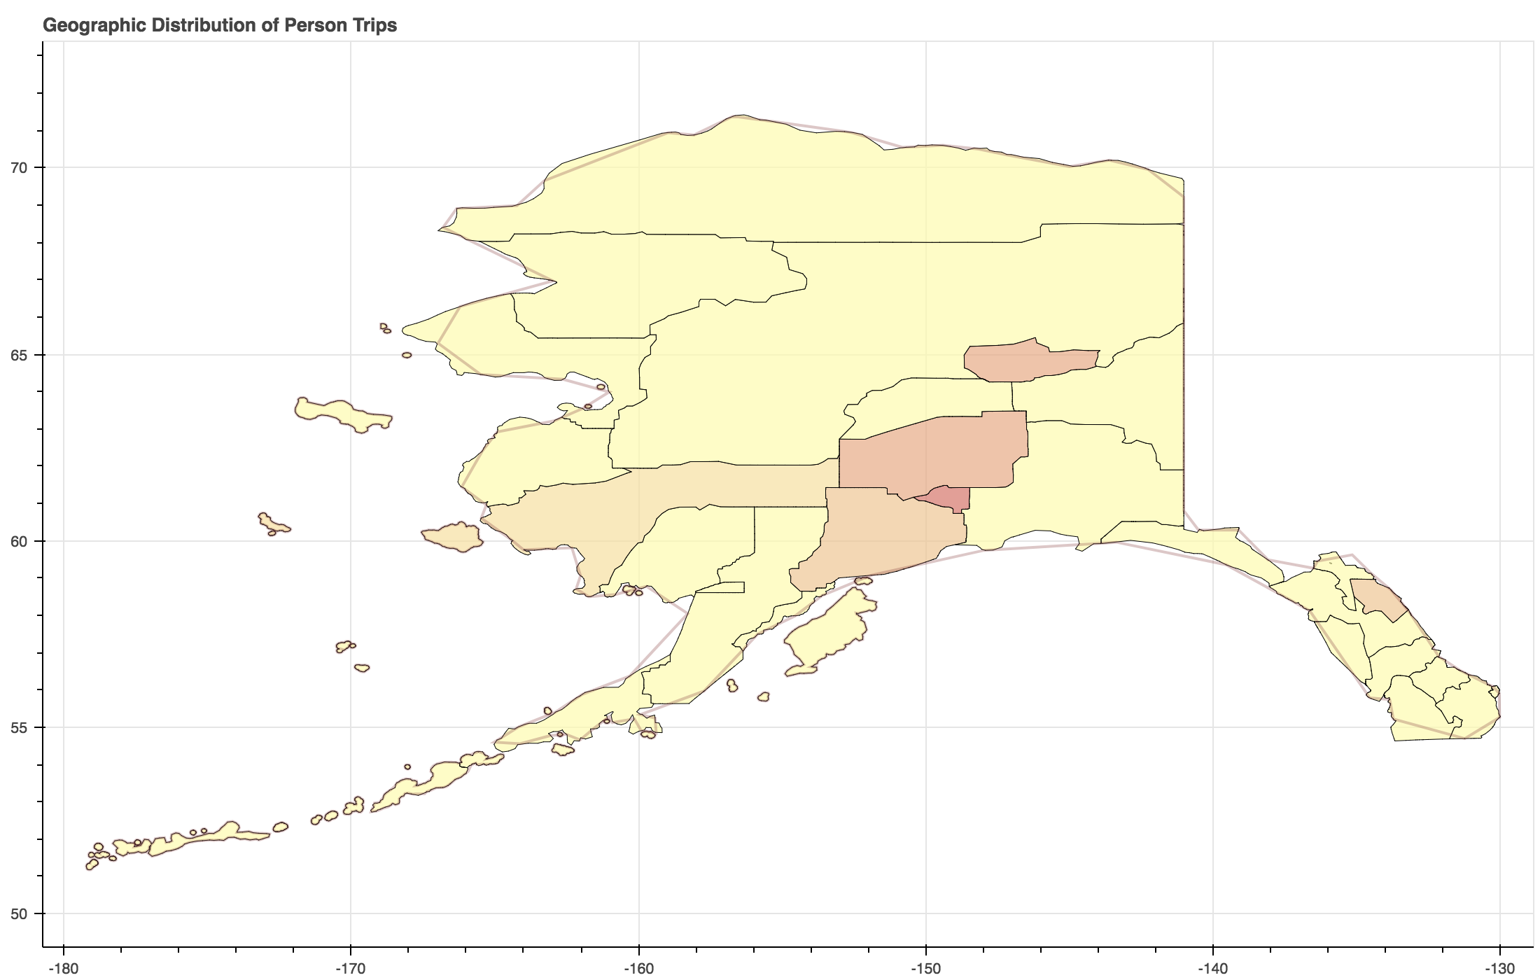
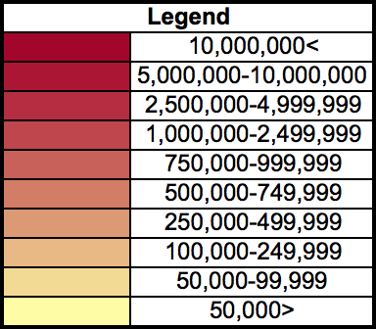
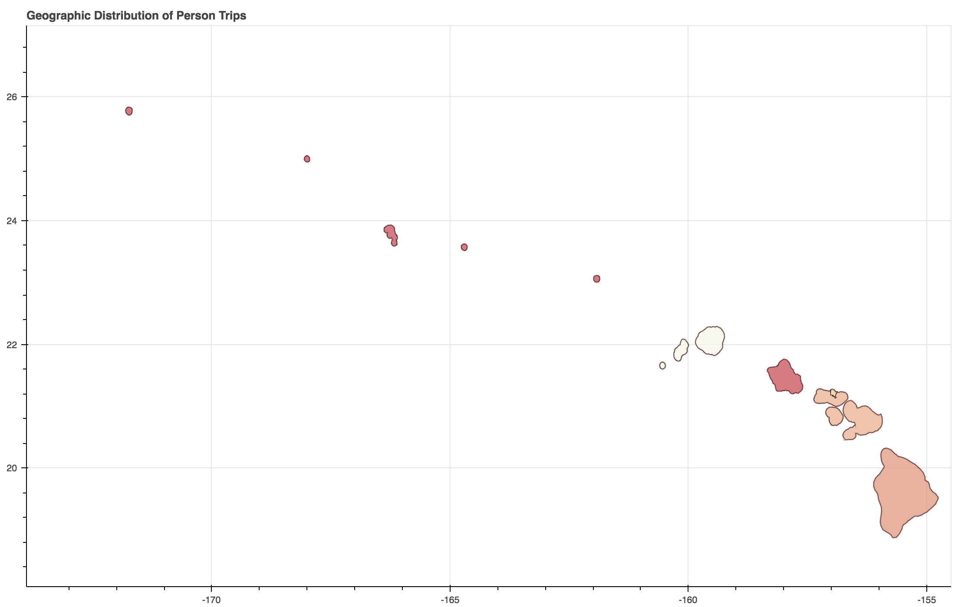
Geographic Distribution of Person Trips

Slide 5
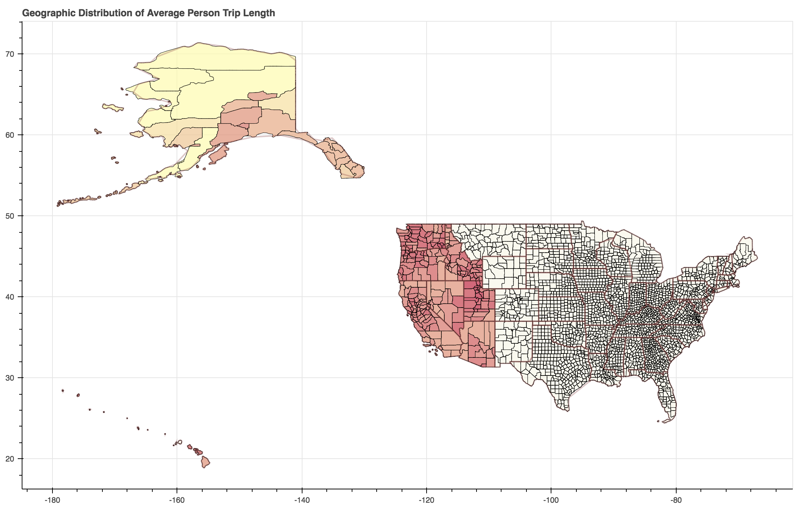
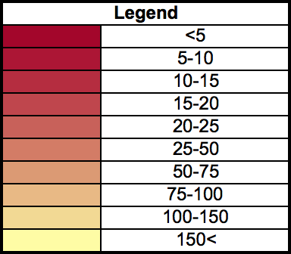
Geographic Distribution of Average Person Trip Length

Slide 6
Cumulative Distributions of Trip Lengths

Slide 7
Trips and AVO Breakdown by State and Time

Slide 8
Cumulative Distance and Active Fleet

Slide 9
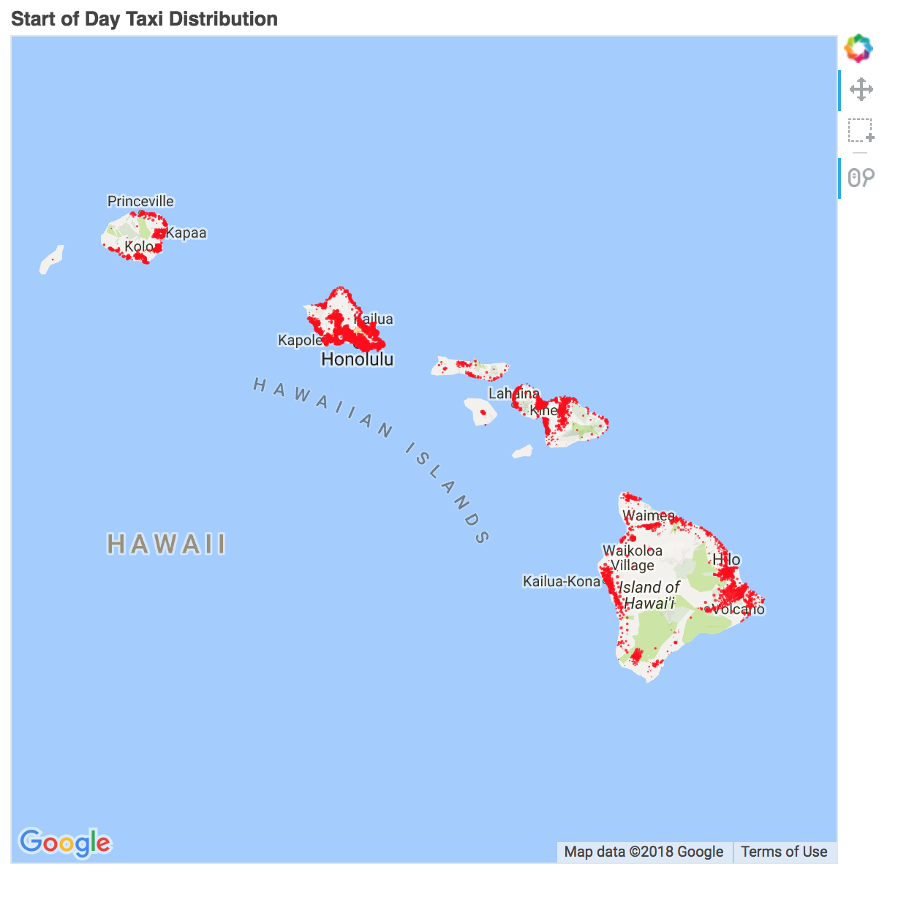
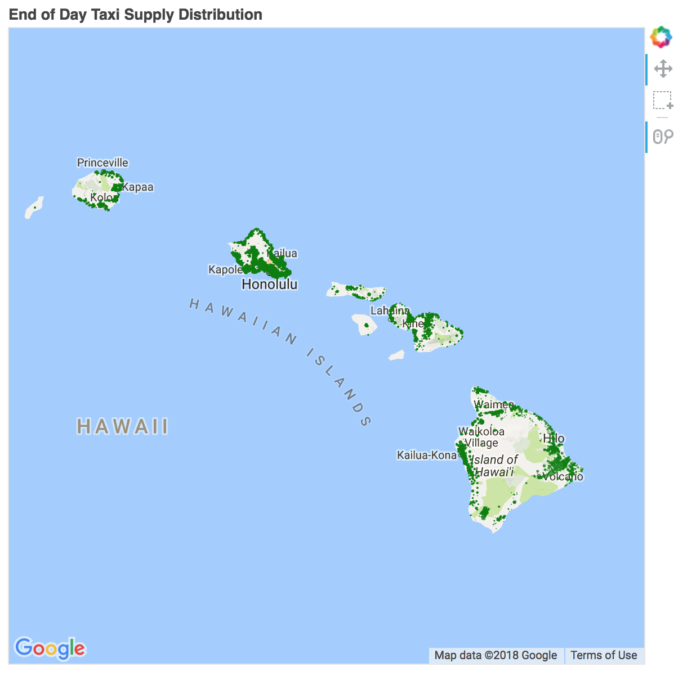
aTaxi Distribution
Start of Day
End of Day

Slide 10
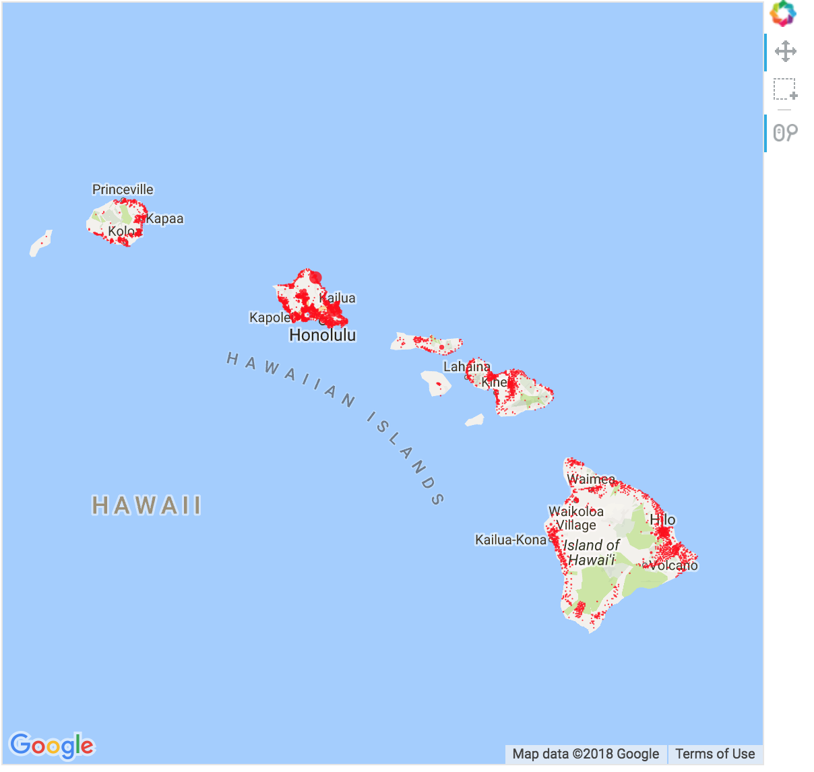
AVO

