Slide 1
Requirements for Fair and Robust Voting Systems
Mark Wang
John Sturm
Sanjeev Kulkarni
Paul Cuff

Slide 2
Outline
Basic Background – What is the problem?
Condorcet = IIA
Survey Data
Pairwise Boundaries = No strategic voting

Slide 3
Democracy
How to make group decisions when you must.
Corporations
Organizations
Academic Departments
Politics

Slide 4
Only Two Choices
Majority Decision
No real controversy
Three candidates or more --- not so obvious

Slide 5
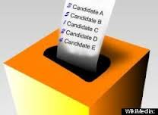
Preferential Voting
Voters express preferences as a list

Slide 6
Voting Example
Vote Profile (entire preferences of population)
Overly simplified for illustration

Slide 7
Plurality
Vote Profile
Each voter submits only one name on ballot
The candidate named the most wins
Ann wins with 37% of the vote.*
Notes:
* This assumes that each voter votes for the first choice. There may be a strategic reason not to do so.

Slide 8
Instant Run-off
Vote Profile
Rounds of plurality voting, eliminating one loser each round.
Betty loses first, then Carl wins with 63%.

Slide 9
Borda
Vote Profile
Score given for place on ballot
Ann = .74, Betty = 1.3, Carl = .96
Betty wins

Slide 10
Item 2, A Perfect Voting System
Voting systems can give different outcomes
Do they really?
Is there a best system?
How do we arrive at it?

Slide 11
Assumptions
Natural Assumptions:
(Anonymous) Each voter is treated equally
(Neutral) Each candidate is treated equally
(Majority) Two candidates = majority
(Scale invariant – to be defined)
Notes:
Most of these properties will not be needed in this talk. Only Property 3 is needed for our discussion of IIA and Condorcet. Properties 1 and 4 are assumed for our graphical representations. Property 2 is never used.

Slide 12
Golden Properties
Robust to Candidate adjustments
Independence of Irrelevant Alternatives (IIA)
Robust to Voter adjustments
Immunity to Strategic Voting

Slide 13
Our Definition of IIA
The voting outcome would not be different if any of the non-winning candidates had not run in the race.
Notes:
Change to “not been an option at voting time.”

Slide 14
Condorcet = IIA
One assumption:
Given someone’s honest preference order, we can assume they would vote for the higher ranked candidate in a two-candidate election.
IIA => Winner must win in any subset
=> winner must win pairwise against everyone
=> Condorcet winner must exist and win election

Slide 15
Problem – IIA is impossible!
Arrow’s Impossibility Theorem
Condorcet winner may not exist
Notes:
Arrow’s impossibility theorem is actually more complex than this statement. It doesn’t assume, for example, that pairs are decided by majority. But this is really the big take away from the theorem.

Slide 16
Graphical Representation
Anonymous:
Outcome only depends on number of voters who cast each possible ballot.
i.e. ( #(A,B,C), #(A,C,B), … )
Equivalent: ( #(A,B,C)/n, #(A,C,B)/n, … ) and n.
Scale Invariant:
Only depends on ( #(A,B,C)/n, #(A,C,B)/n, … )
i.e. Empirical distribution of votes

Slide 17
Simplex Representation
(A > B > C)
Vote Profile
(A > C > B)
(B > C > A)
(B > A > C)
Notes:
Unfortunately, even for three candidates this would be a five dimensional simplex (6! - 1).

Slide 18
Simplex
Notes:
A voting system is a partition of the simplex. Some regions of the simplex have a Condorcet winner. These correspond precisely to the vote profiles where IIA is possible.

Slide 19
Projections of the Simplex
Some 3-candidate voting systems can be visualized through projections of the simplex
Example: Three dimensional space of pair-wise comparisons
Condorcet Regions
Many Condorcet Methods
Borda

Slide 20
Condorcet Regions

Slide 21
Condorcet Regions

Slide 22
Condorcet Regions

Slide 23
Borda

Slide 24
Black Method

Slide 25
Baldwin Method

Slide 26
Kemeny-Young Method
Notes:
Minimax, Kemeny-Young, Nanson’s, Dodgson’s, and Schultze’s are all equivalent for three candidates.

Slide 27
Item 3, Data
What really happens?
In real life, does a Condorcet winner exist or not?

Slide 28
Sources of Data
Tideman Data (1987, supported by NSF grant)
UK Labour Party Leader
Ice Skating
American Psychology Association Elections
Debian Leader Election (2001-2007)
Various City Elections
Our collection: Survey responses from 2012 US Presidential Election
Notes:
Tideman data: only 1 of 87 did not have a Condorcet winner. 2/3 had complete order. Only 0.25% of 3-way matches with more than 30 voters didn’t have Condorcet winners. Condorcet and IRV agree most often (>98%).
APA data studied by Popov, Popova, and Regenwetter among others. All have Condorcet winners.
Debian elections (3-9 candidates) all have complete Condorcet orders

Slide 29
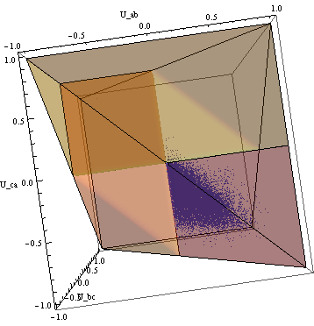
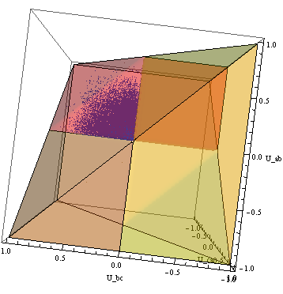
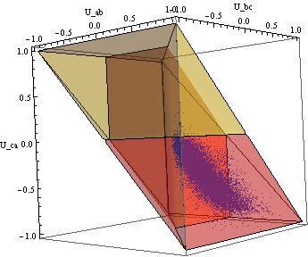
Visualization of Tideman Data
Sets of 3 candidates
Top View
Side View

Slide 30
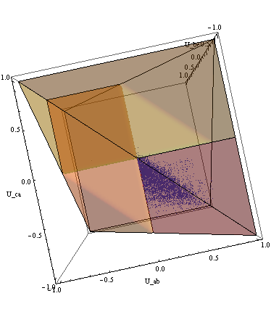
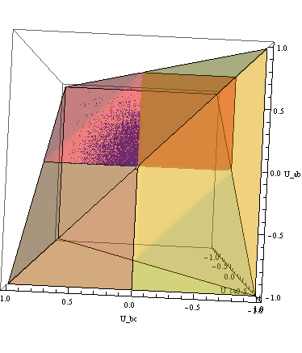
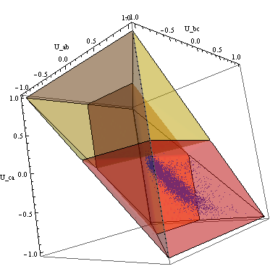
Visualization of Tideman Data
Sets of 3 candidates with enough voters
Top View
Side View

Slide 31
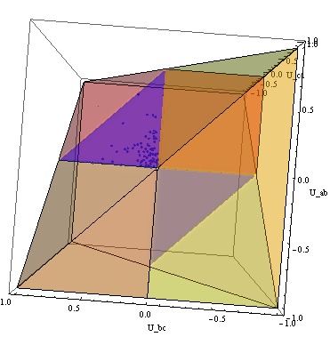
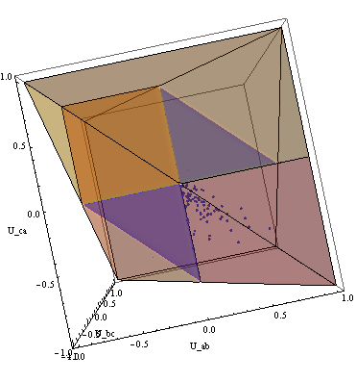
Visualization of Tideman Data
Sets of top 3 candidates
Top View
Side View

Slide 32
Strategic Voting
Do voters have an incentive to vote strategically?
A strategic vote is a vote other than the true preferences. Does this ever benefit the voter?
Gibbard-Satterthwaite Theorem
Yes

Slide 33
Boundary Property
Immunity to Strategic Voting is a property of the shape of the boundaries.
Some boundaries may not give incentive for strategic voting.

Slide 34
Borda
All boundaries incentivize strategic voting
Notes:
Not just Borda, but all other voting systems that aren’t Condorcet methods that we tried.

Slide 35
Kemeny-Young Method
Notes:
Minimax, Kemeny-Young, Nanson’s, Dodgson’s, and Schultze’s are all equivalent for three candidates.

Slide 36
Requirement for Robust Boundary
Consider a planar boundary
B
A

Slide 37
Robust Boundaries
Robust boundaries are based only on pairwise comparisons

Slide 38
Geometric Proof of G-S Theorem
Assume anonymity
(more than G-S assumes)
Assume at least 3 candidates can win
Not possible to partition using only non-strategic boundaries.

Slide 39
Condorcet Regions
In some sense, this is uniquely non-strategic.
Notes:
Any Condorcet method will have non-strategic boundaries in the areas that matter most.

Slide 40
Dynamic Setting
Voters are allowed to modify their vote based on feedback
The population is sampled
One random voter is allowed to change his vote
Update the feedback… pick another random voter

Slide 41
US Presidential Election Survey Results
2012 Poll

Slide 42
All Results

Slide 43
Google Poll
Notes:
All year. Over 550 completed surveys.

Slide 44
Mercer County Results
Notes:
Feb. 2012. 288 completed surveys

Slide 45
Mercer County

Slide 46
Mechanical Turk Poll
Notes:
February, 2012. 472 completed surveys.

Slide 47
Mechanical Turk

Slide 48
NYT Blog Poll
Notes:
Jan. 13 and 14, 2012. 188 completed surveys. fivethirtyeight.com

Slide 49
Google – Condorcet

Slide 50
Google – Plurality

Slide 51
Google – Plurality

Slide 52
Google – Instant Run-off

Slide 53
Google – Borda

Slide 54
Google – Condorcet (Democrat voters)

Slide 55
Google – Condorcet (Republican voters)

Slide 56
Google – Borda (Republican voters)

Slide 57
Google – Range Voting (Republican voters)

Slide 58
Google – Condorcet (Independent voters)
Notes:
Clinton has a moment as Condorcet winner, but she never leads in any other voting methods except range voting.

Slide 59
Google – Borda (Independent voters)
Notes:
Clinton has a moment as Condorcet winner, but she never leads in any other voting methods except range voting.

Slide 60
Summary
Condorcet winner is uniquely:
IIA
Whenever possible
Robust to Strategic Voting
Within the Condorcet regions
Upon strategy, some methods become Condorcet
Disagreement among voting systems is non-negligible.

