Slide 1

Rate-distortion Theory for Secrecy Systems
Paul Cuff
Electrical Engineering
Princeton University

Slide 3
Information Theory
Channel Coding
Source Coding
Secrecy
Secrecy
Channel
Source

Slide 4
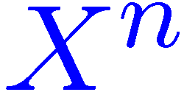
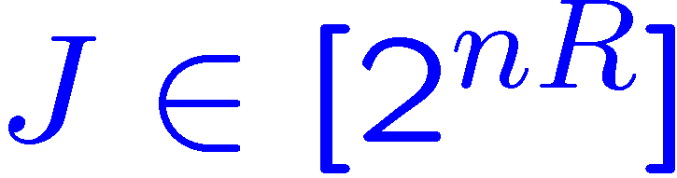
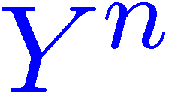
Source Coding
Describe an information signal (source) with a message.
Information
Encoder
Message
Decoder
Reconstruction

Slide 5
Entropy
If X^{n} is i.i.d. according to p_{X}
R > H(X) is necessary and sufficient for lossless reconstruction
Space of X^{n} sequences
Enumerate the typical set

Slide 6
Many Methods
For lossless source coding, the encoding method is not so important
  It should simply use the full entropy of the bits

Slide 7
Single Letter Encoding (method 1)
Encode each X_{i} separately
  Under the constraints of decodability, Huffman codes are optimal
  Expected length is within one bit of entropy
  Encode tuples of symbols to get closer to the entropy limit

Slide 8
Random Binning
(method 2)
Assign to each X^{n} sequence a random bit sequence (hash function)
0100110101011
Space of X^{n} sequences
0110100010010
1101011000100

Slide 9
Linear Transformation
(method 3)
Source
Message
Random Matrix
J
X^{n}

Slide 10
Summary
For lossless source coding, structure of communication doesn’t matter much
Information
Gathered
H(X^{n})
Message Bits Received

Slide 11
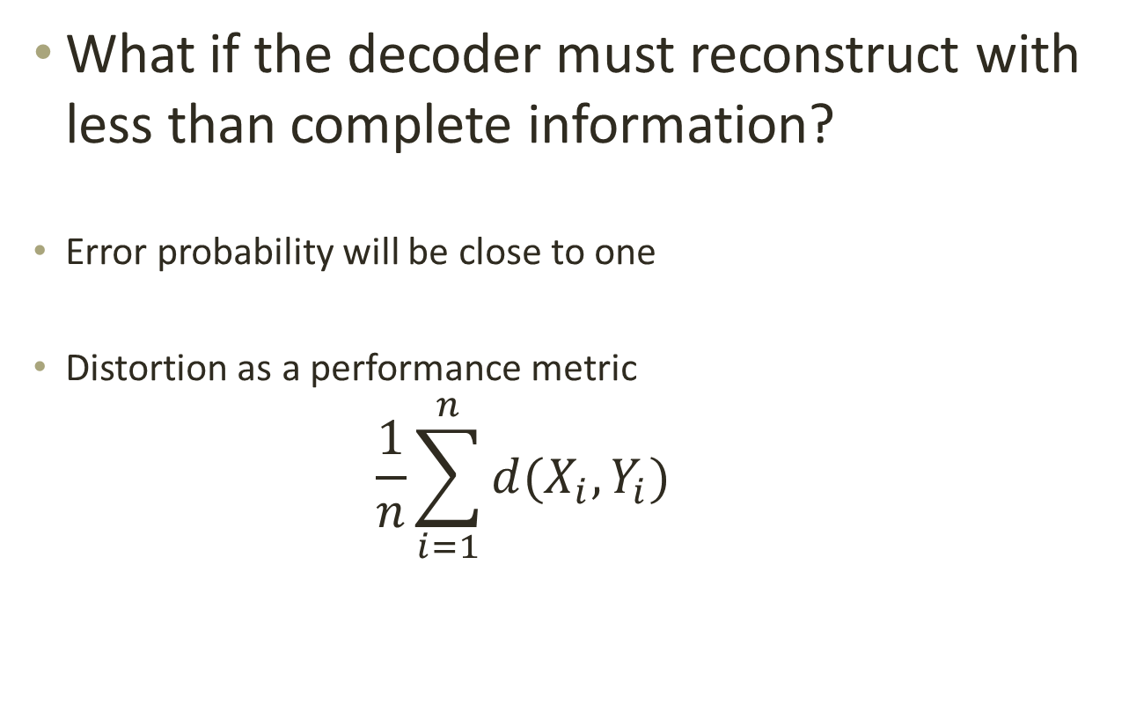
Lossy Source Coding
What if the decoder must reconstruct with less than complete information?
Error probability will be close to one
Distortion as a performance metric
  $$\frac{1}{n}\sum_{i=1}^{n}{d(X_{i},Y_{i})}$$

Slide 12

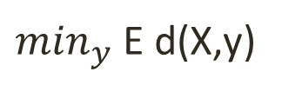
Poor Performance
Random Binning and Random Linear Transformations are useless!
Distortion
$\min_{y}$ E d(X,y)
Time Sharing
Massey Conjecture:
Optimal for linear codes
$$H(X^{n})$$
Message Bits Received

Slide 13
Puzzle
Describe an n-bit random sequence
Allow 1 bit of distortion
Send only 1 bit

Slide 14
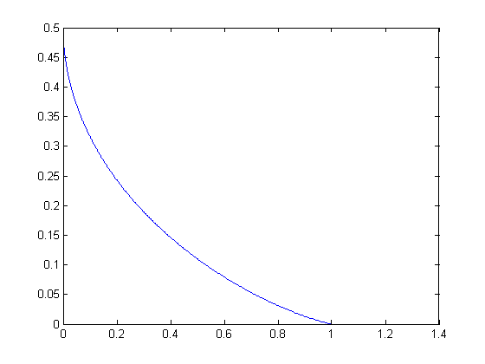

Rate Distortion Theorem
[Shannon]
Choose p(y|x):
$$R>I\left(X;Y\right)$$
$$D>E d(X,Y)$$

Slide 15

Structure of Useful Partial Information
Coordination (Given source P_{X} construct Y^{n} ~ P_{Y|X} )
  Empirical
  $$\frac{1}{n}\sum_{i=1}^{n}{1\left( \left(X_{i},Y_{i}\right)=\left(a,b\right)\right)≈P_{X,Y}}(a,b)$$
  Strong
  $$P_{X^{n}Y^{n}} ≈ {\prod{P_{X,Y}}}_{}$$

Slide 16
Empirical Coordination Codes
Codebook
  Random subset of Y^{n} sequences
Encoder
  Find the codeword that has the right joint first-order statistics with the source

Slide 17
Strong Coordination
P_{Y|X}
Black box acts like a memoryless channel
X and Y are an i.i.d. multisource
Communication Resources
Source
Output

Slide 18
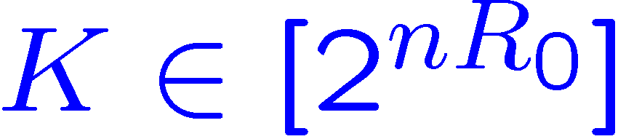
Strong Coordination
Synthetic Channel P_{Y|X}
Related to:
  Reverse Shannon Theorem [Bennett et. al.]
  Quantum Measurements [Winter]
  Communication Complexity [Harsha et. al.]
  Strong Coordination [C.-Permuter-Cover]
  Generating Correlated R.V. [Anantharam, Gohari, et. al.]
Common Randomness
Source
Node A
Message
Node B
Output

Slide 19
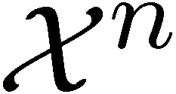
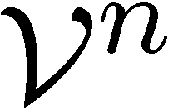
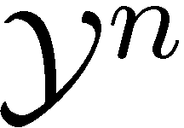
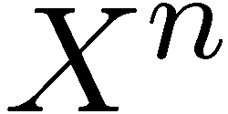
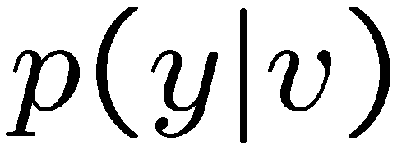
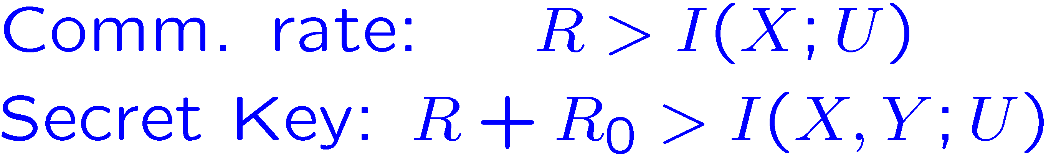
Structure of Strong Coord.
K

Slide 20
Information Theoretic Security

Slide 21
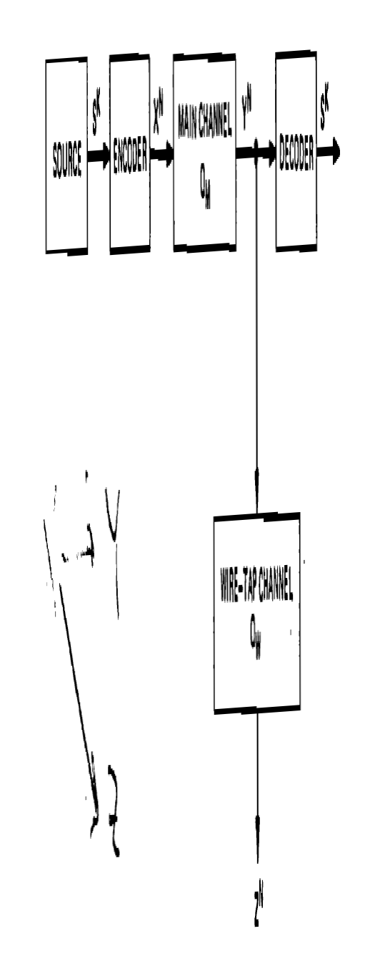
Wiretap Channel
[Wyner 75]

Slide 22
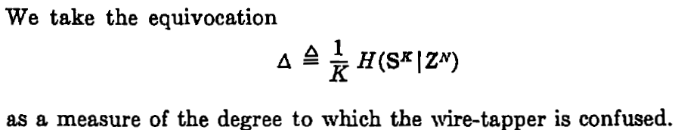
Wiretap Channel
[Wyner 75]

Slide 23
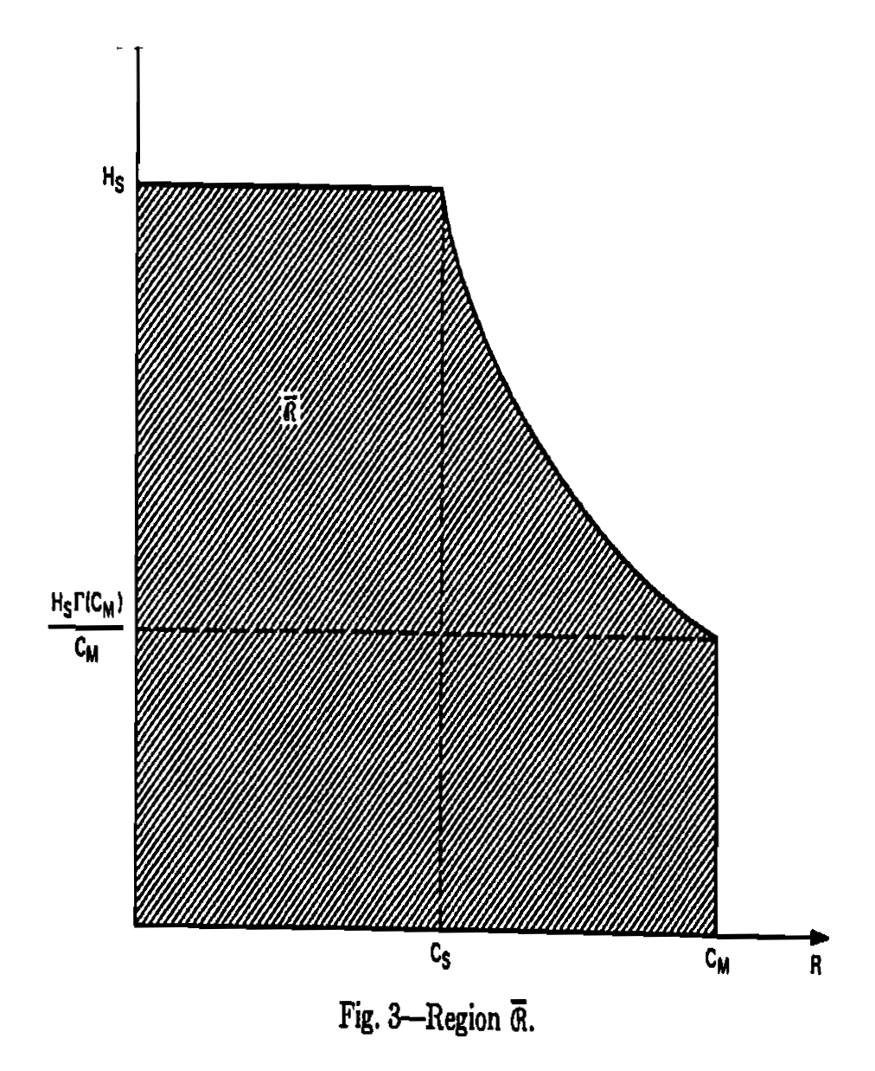
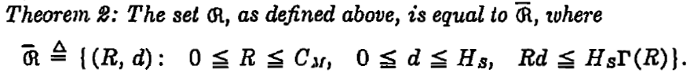
Wiretap Channel
[Wyner 75]

Slide 24
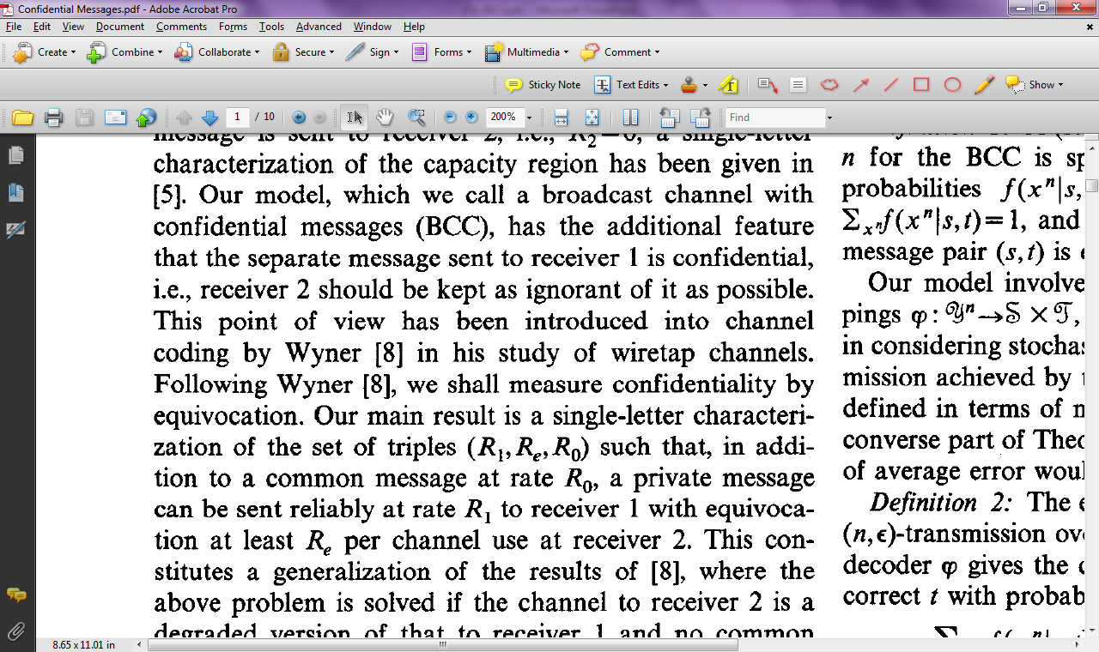
Confidential Messages
[Csiszar, Korner 78]

Slide 25
Confidential Messages
[Csiszar, Korner 78]

Slide 26
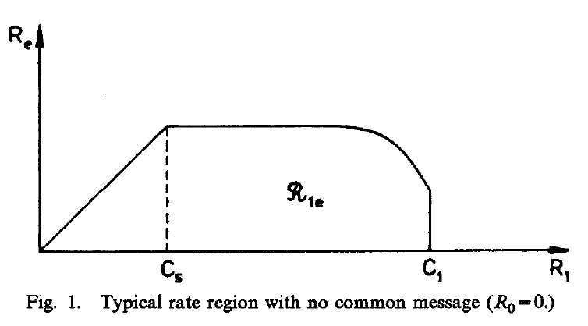
Confidential Messages
[Csiszar, Korner 78]

Slide 27
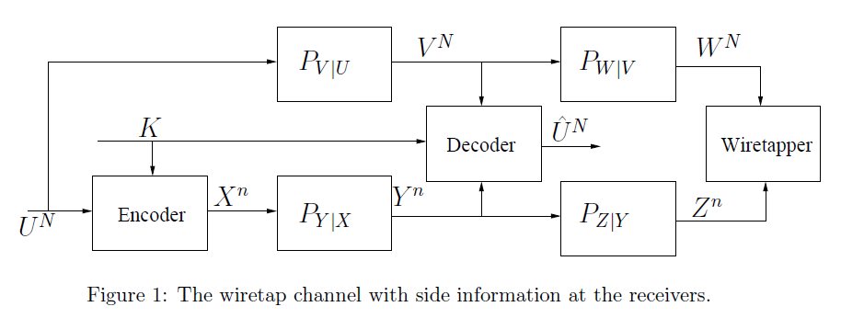
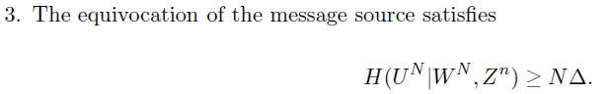
Merhav 2008

Slide 28
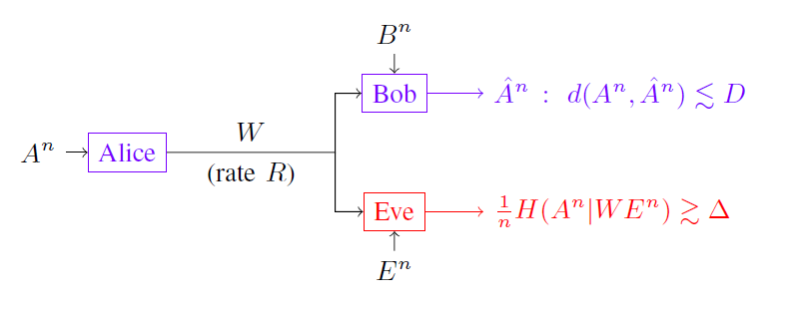
Villard-Piantanida 2010

Slide 29
Other Examples of
“rate-equivocation” theory
Gunduz-Erkip-Poor 2008
Lia-H. El-Gamal 2008
Tandon-Ulukus-Ramchandran 2009
…

Slide 30
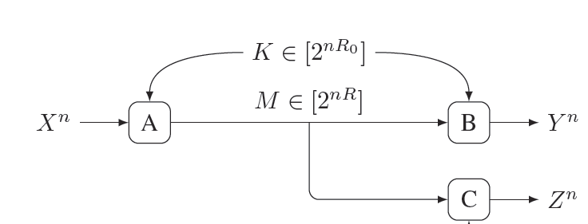
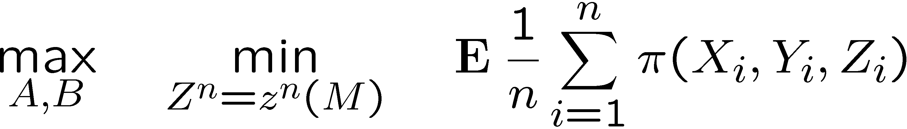
Rate-distortion theory (secrecy)

Slide 31
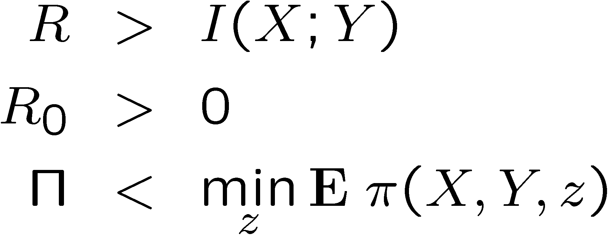
Achievable Rates and Payoff
Given
[Schieler, Cuff 2012 (ISIT)]

Slide 32
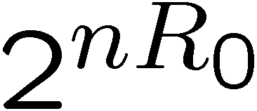
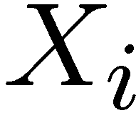
How to Force High Distortion
Randomly assign bins
Size of each bin is
Adversary only knows bin
Adversary has no knowledge of
only knowledge of

Slide 33
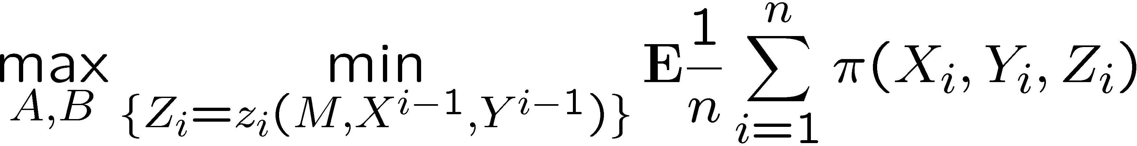
Causal Disclosure

Slide 34
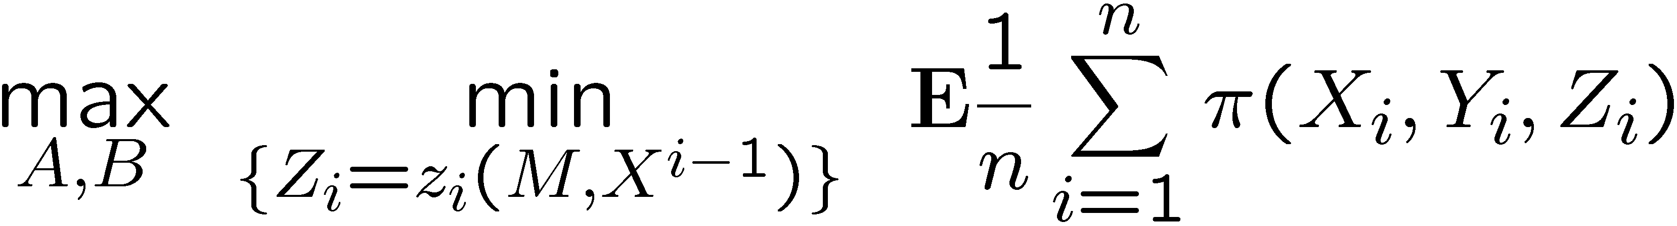
Causal Disclosure (case 1)

Slide 35

Causal Disclosure (case 2)

Slide 36
Example
Source distribution is Bernoulli(1/2).
Payoff: One point if Y=X but Z≠X.

Slide 37
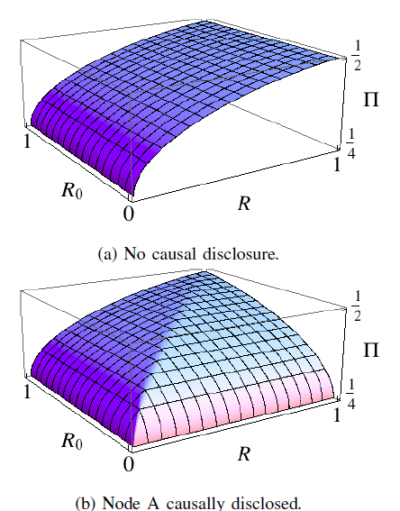
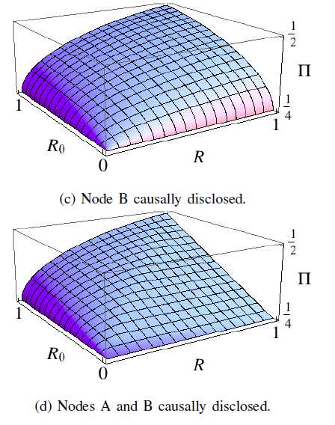
Rate-payoff Regions

Slide 38
General Disclosure
Causal or non-causal

Slide 39
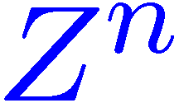
Strong Coord. for Secrecy
Channel Synthesis
Information
Node A
Node B
Action
Adversary
Attack
Not optimal use of resources!

Slide 40
Strong Coord. for Secrecy
Channel Synthesis
Information
Node A
Node B
Action
U^{n}
Adversary
Attack
Reveal auxiliary U^{n} “in the clear”

Slide 41
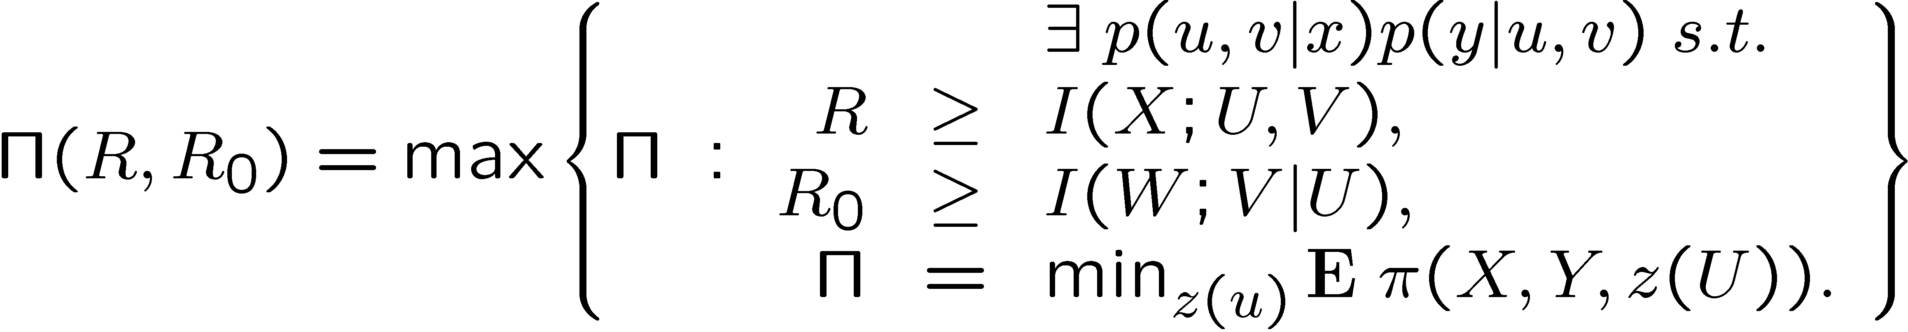
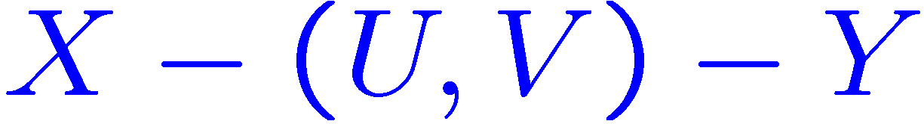
Payoff-Rate Function
Maximum achievable average payoff
Markov relationship:
Theorem:

Slide 42
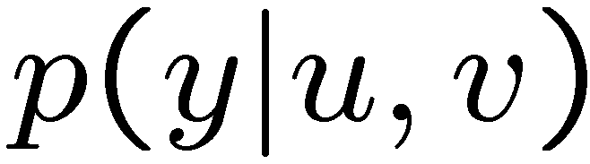
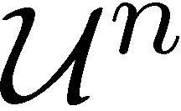
Structure of Secrecy Code
K

Slide 43
Intermission
Equivocation next

Slide 44
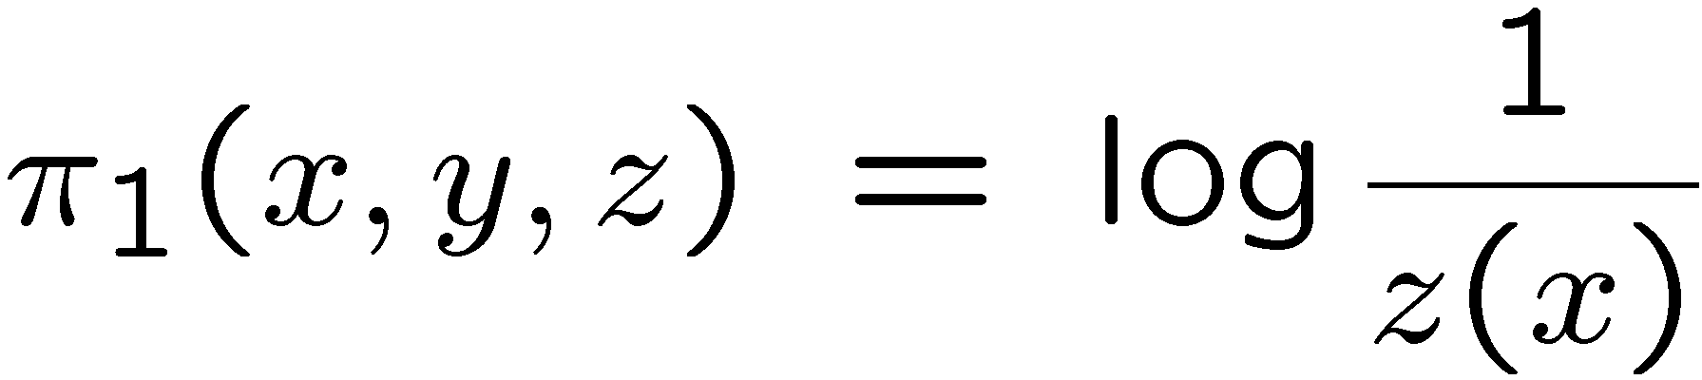
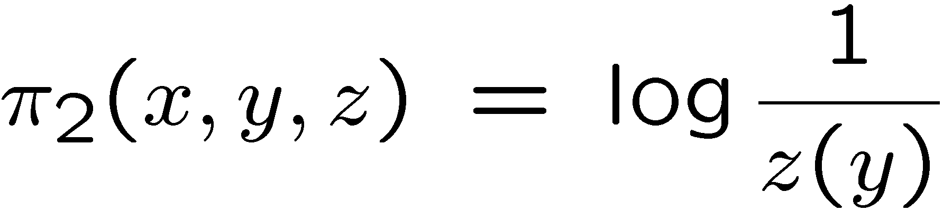
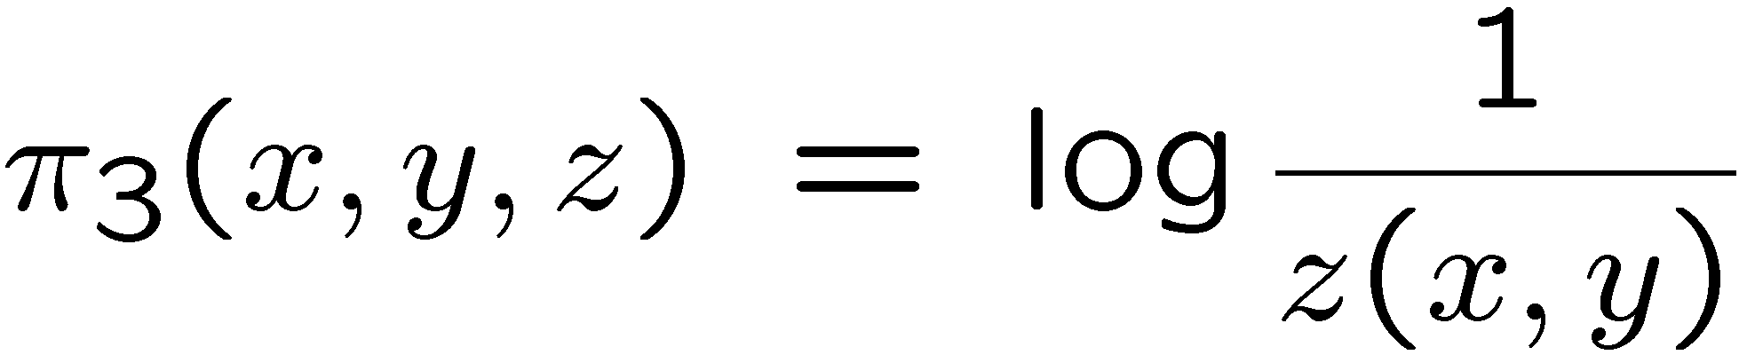
Log-loss Distortion
Reconstruction space of Z is the set of distributions.

Slide 45
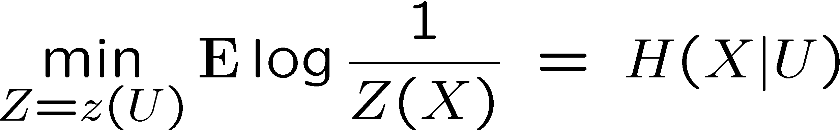
Best Reconstruction Yields Entropy

Slide 46
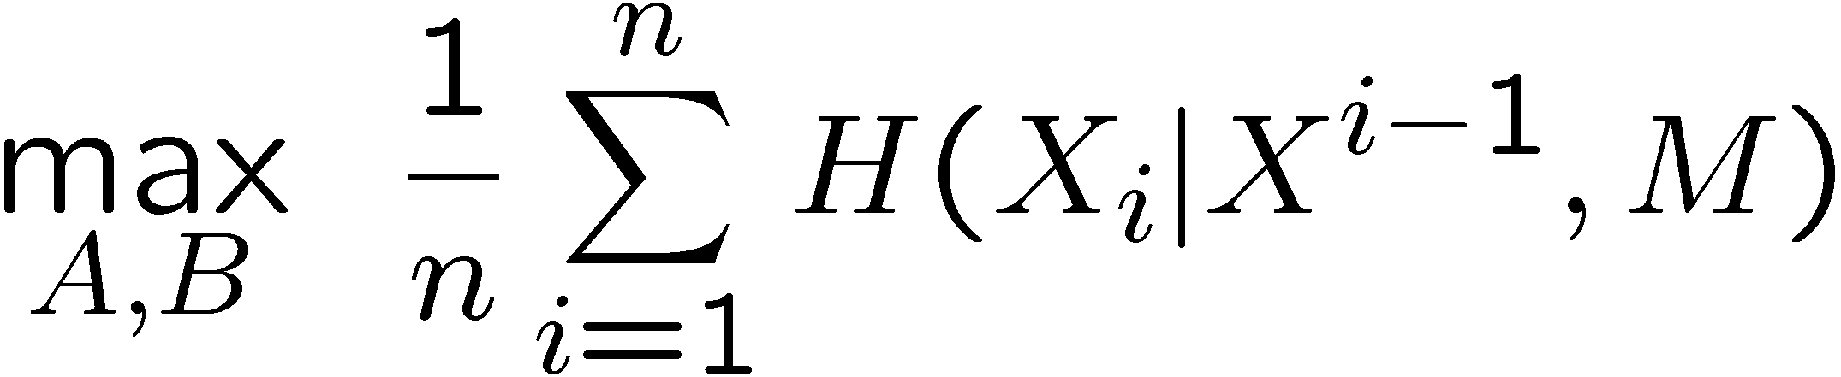
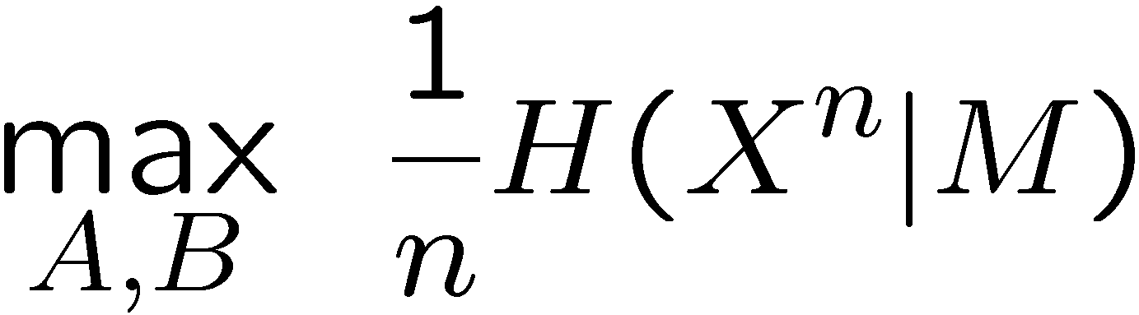
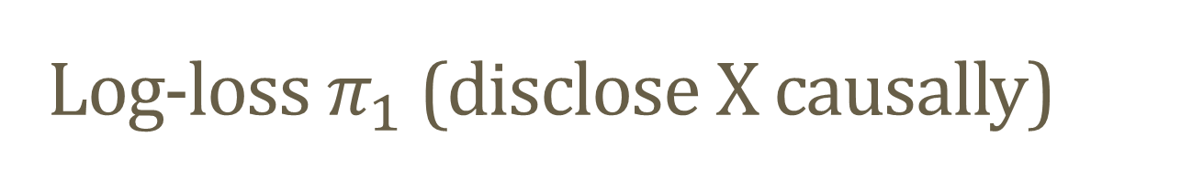
Log-loss $π_{1}$ (disclose X causally)

Slide 47
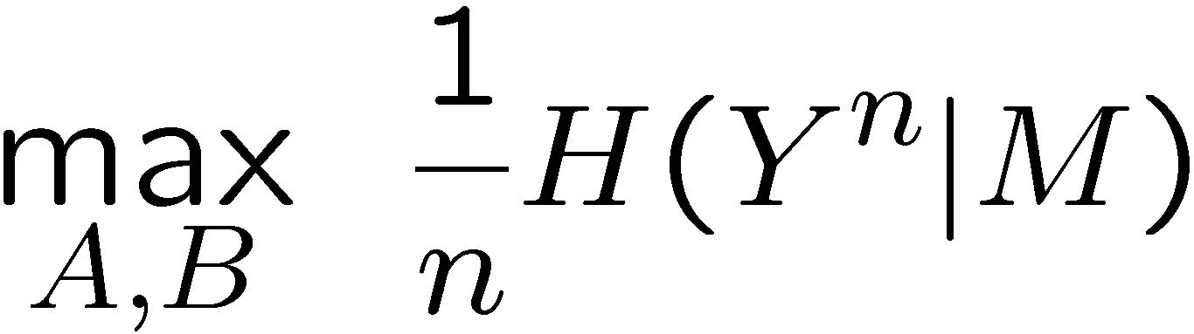
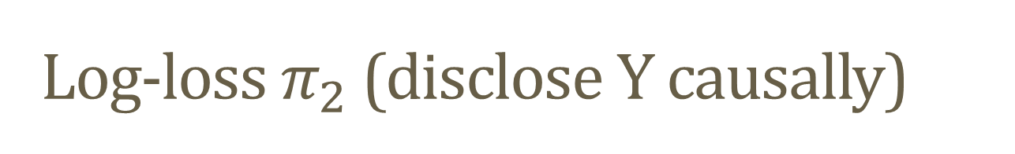
Log-loss $π_{2}$ (disclose Y causally)

Slide 48
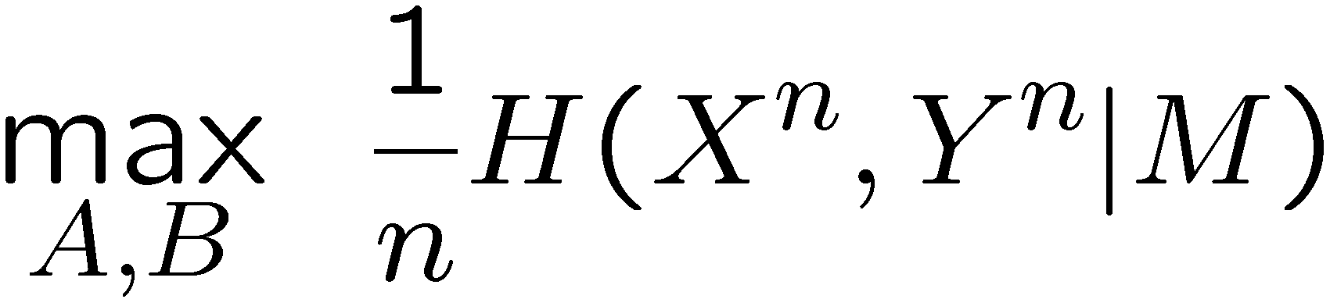
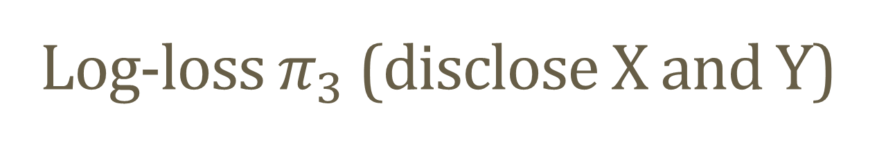
Log-loss $π_{3}$ (disclose X and Y)

Slide 49
Result 1 from Secrecy R-D Theory

Slide 50
Result 2 from Secrecy R-D Theory

Slide 51
Result 3 from Secrecy R-D Theory

Slide 52
Some Difficulties
In point-to-point, optimal communication produces a stationary performance.
The following scenarios lend themselves to time varying performance.

Slide 53
Secure Channel
Adversary does not observe the message
  Only access to causal disclosure
Problem: Not able to isolate strong and empirical coordination.
  Empirical coordination provides short-duration strong coordination.
  Hard to prove optimality.

Slide 54
Side Information at the intended receiver
Again, even a communication scheme built only on empirical coordination (covering) provides a short duration of strong coordination
  Performance reduces in stages throughout the block.

Slide 55
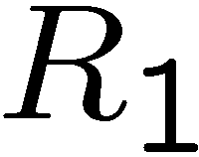



Cascade Network

Slide 56


Inner and Outer Bounds

Slide 57
Summary
To assist an intended receiver with partial information while hindering an adversary with partial secrecy, a new encoding method is needed.
Equivocation is characterized by this rate-distortion theory
Main new encoding feature:
  Strong Coordination superpositioned over revealed information
    (a.k.a. Reverse Shannon Theorem or Distributed Channel Synthesis)
  In many cases (e.g. side information; secure communication channel; cascade network), this distinct layering may not be possible.

Slide 58





Restate Problem---Example 1 (RD Theory)
Existence of Distributions
Can we design:
such that
Does there exists a distribution:
Standard
f
g

Slide 59








Restate Problem---Example 2 (Secrecy)
Existence of Distributions
Can we design:
such that
Does there exists a distribution:
Standard
Score
f
g
Eve
[Cuff 10]

Slide 60
Tricks with Total Variation
Technique
  Find a distribution p₁ that is easy to analyze and satisfies the relaxed constraints.
  Construct p₂ to satisfy the hard constraints while maintaining small total variation distance to p₁.
How?
Property 1:

Slide 61

Tricks with Total Variation
Technique
  Find a distribution p₁ that is easy to analyze and satisfies the relaxed constraints.
  Construct p₂ to satisfy the hard constraints while maintaining small total variation distance to p₁.
Why?
Property 2 (bounded functions):

Slide 62

Summary
Achievability Proof Techniques:
  Pose problems in terms of existence of joint distributions
  Relax Requirements to “close in total variation”
  Main Tool --- Reverse Channel Encoder
  Easy Analysis of Optimal Adversary
Secrecy Example: For arbitrary ², does there exist a distribution satisfying:

Slide 63





Cloud Overlap Lemma
Previous Encounters
  Wyner, 75 --- used divergence
  Han-Verdú, 93 --- general channels, used total variation
  Cuff 08, 09, 10, 11 --- provide simple proof and utilize for secrecy encoding
Memoryless Channel
P_{X|U}(x|u)

Slide 64


Reverse Channel Encoder
For simplicity, ignore the key K, and consider J_{a} to be the part of the message that the adversary obtains. (i.e. J = (J_{a}, J_{s}), and ignore J_{s} for now)
Construct a joint distribution between the source X^{n} and the information J_{a} (revealed to the Adversary) using a memoryless channel.
Memoryless Channel
P_{X|U}(x|u)

Slide 65

Simple Analysis
This encoder yields a very simple analysis and convenient properties
  If |J_{a}| is large enough, then X^{n} will be nearly i.i.d. in total variation
  Performance:
Memoryless Channel
P_{X|U}(x|u)
Notes:
Notice that this simplifies to a single letter expression.

Slide 66
Summary
Achievability Proof Techniques:
  Pose problems in terms of existence of joint distributions
  Relax Requirements to “close in total variation”
  Main Tool --- Reverse Channel Encoder
  Easy Analysis of Optimal Adversary
Notes:
I’ve outlines tools and techniques for designing optimal encoders for source coding for game theoretic secrecy. The main ideas were to pose the operational question in terms of existence of a joint distribution. Then we show that most hard constraints can be relaxed. This was important for removing the causal nature of the problem statement. Then we constructed a joint distribution using a memoryless channel and the cloud overlap lemma which was very easy to analyze for the worst-case adversary. The resulting “reverse channel encoder” behaves somewhat like a rate-distortion encoder but is random.

