Slide 1
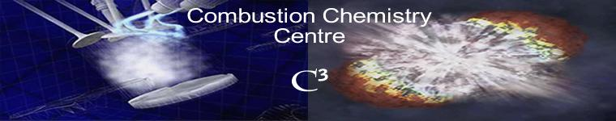
Kinetic Mechanism Development for Hydrocarbons and Oxygenated Fuels
Dr. Henry Curran and Dr. Philippe Dagaut
Combustion Chemistry Centre, NUI Galway, Ireland
CNRS Orleans, France
Lecture
1st Workshop on Flame Chemistry
July 28th, 2012

Slide 2
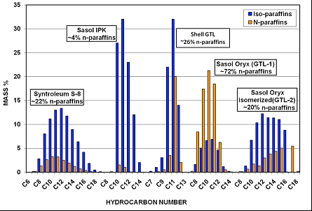
Future HC fuels - many sources
Some petroleum will still be available
Oil sands, oil shale
Coal-to-liquids
Fischer – Tropsch
Natural gas
Hydrogen
Bio-derived fuels
Ethanol, butanol, algae
Biodiesel from vegetable and animal oils
Chemical kinetics to understand and simulate
complex behaviour (ignition, NTC, cool flames…)
reactivity (extent of conversion, heat release)
product / pollutant formation
2

Slide 3

How well an oxygenated fuel works depends on its molecular structure
Reference fuel mixed with:
Miyamoto et al. Paper No. SAE 980506 (1998).
Westbrook et al. J. Phys. Chem. A (2006) 110: 6912–6922.
3

Slide 4
Oxygenated fuels
Alcohols (methanol, ethanol, propanol, butanol)
Ethers (DME, DEE, EME, MTBE, ETBE)
Esters (methyl and ethyl esters)
Ketones (acetone, EMK, DEK)
Furans (methyl furan, di-methyl furan)
4

Slide 5
General reaction scheme
High temperature
Fuel
decomposition
β-scission
+ O₂
∙
smaller molecules
Ṙ
RO₂
+ O₂
Low temperature
olefins,
cyclic ethers,
β-scission
chain branching
∙
+ O₂
QOOH
Intermediate temperature
5

Slide 6
Fuel decomposition reactions

Slide 7
Propanol isomers: Comparison of reactivity
0.5% fuel, 2.25% O_{2,} φ = 1.0, P = 1 atm
Johnson et al. Energy & Fuels (2009) 23 5886–5898.
7

Slide 8
Alcohol molecular elimination
k = 3.52 x 10¹³ 0. 67300. s⁻¹
k = 2.11 x 10¹⁴ 0. 67300. s⁻¹
Tsang, W. Int. J. Chem. Kinet. (1976) 8: 173–192.
8

Slide 9
Water elimination is much more important for iso-propanol
0.5% n-propanol
φ = 1.0, T = 1600 K
30% fuel consumed
0.5% iso-propanol
= 1.0, T = 1600 K
30% fuel consumed
Johnson et al. Energy & Fuels (2009) 23: 5886–5898.
9

Slide 10
General reaction scheme
High temperature
Fuel
decomposition
β-scission
+ O₂
∙
smaller molecules
Ṙ
RO₂
+ O₂
Low temperature
olefins,
cyclic ethers,
β-scission
chain branching
∙
+ O₂
QOOH
Intermediate temperature
10

Slide 11
Sub-mechanism

Slide 12
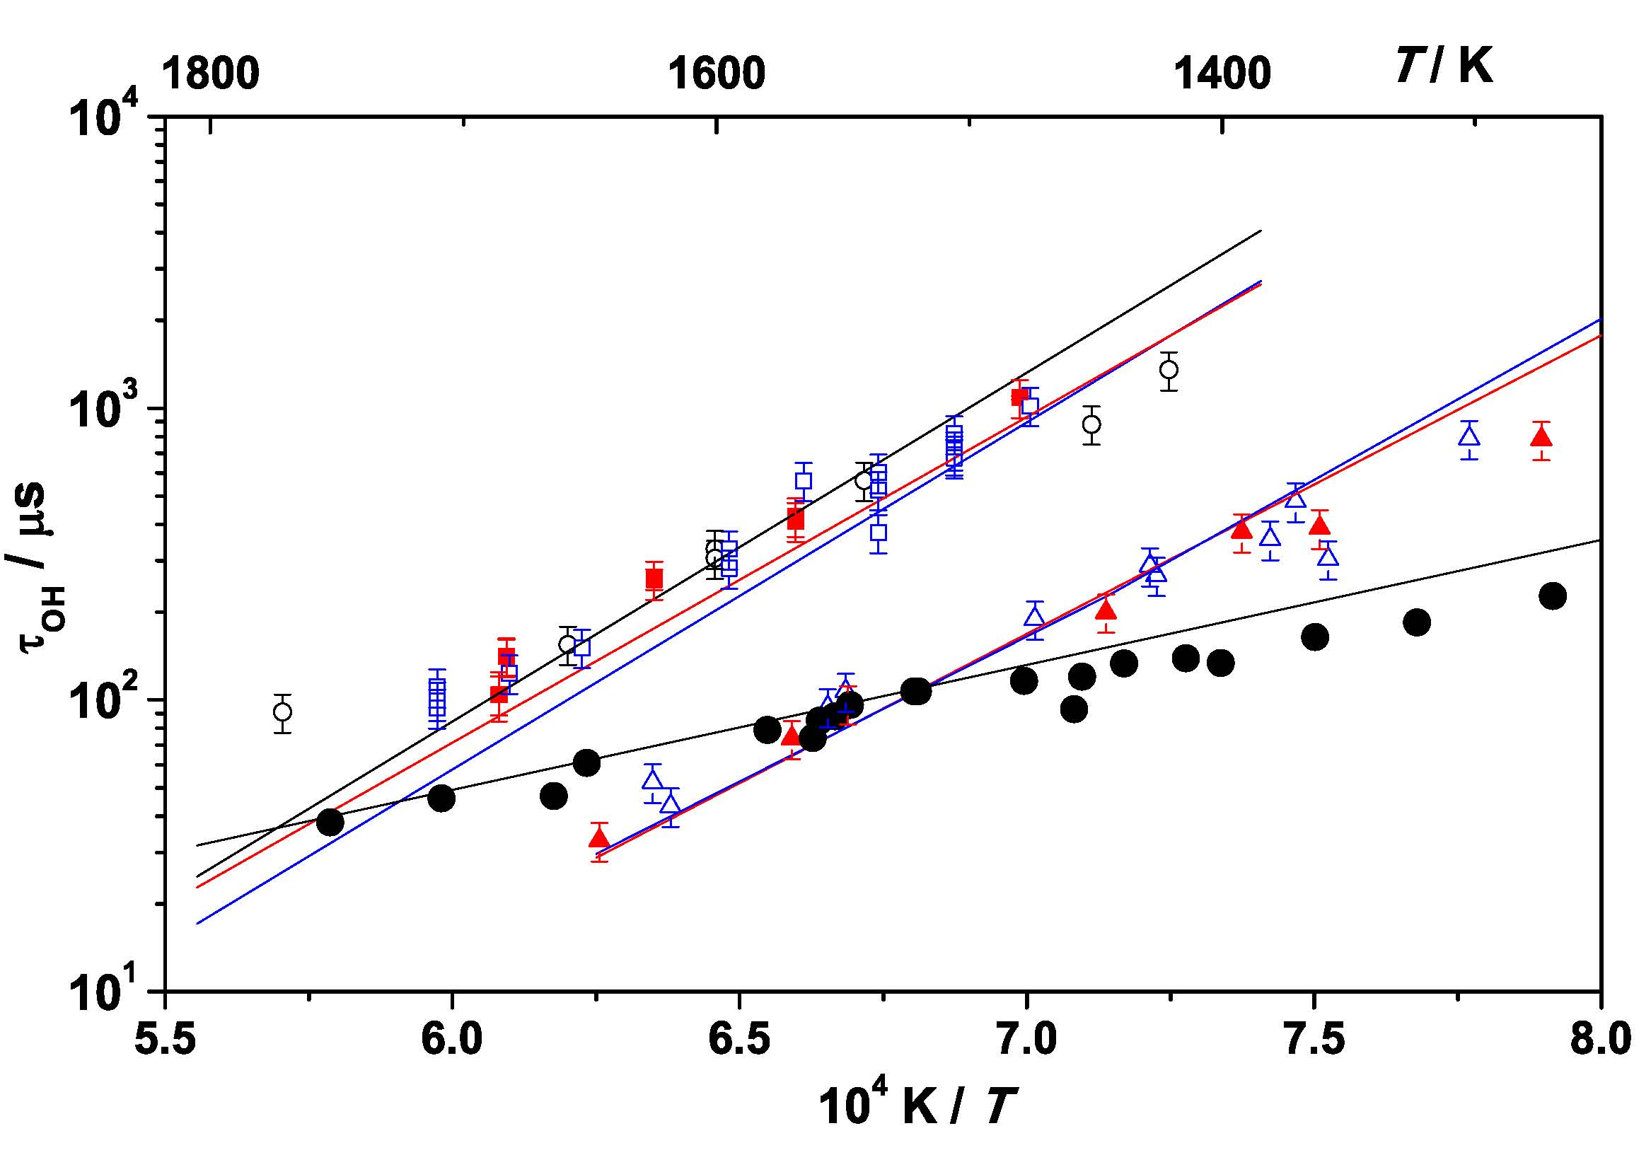
Reactivity of ethers
● 1% H₂, 1% O₂ in Ar, p₅ = 1.4–2.6 atm
○ 0.1% iso-C₄H₈
■ 0.1% MTBE
□ 0.1% ETBE
▲ 0.1% DEE
△ 0.1% EME
Yasunaga et al. Comb. Flame (2011) 158: 1032–1036.
12

Slide 13
Ether molecular elimination
k = 1.70 x 10¹⁴ 0. 60800. s⁻¹
k = 1.70 x 10¹⁴ 0. 60600. s⁻¹
Yasunaga et al. Comb. Flame (2011) 158: 1032–1036.
MP4/cc-pVTZ//MP2/cc-pVTZ level of theory with zero point corrections
13

Slide 14
Ether molecular elimination
k = 5.0 x 10¹³ 0. 63400. s⁻¹
k = 5.0 x 10¹³ 0. 65200. s⁻¹
Yasunaga et al. Comb. Flame (2011) 158: 1032–1036.
MP4/cc-pVTZ//MP2/cc-pVTZ level of theory with zero point corrections
14

Slide 15
Ethylene is very fast to ignite
1.0% fuel, φ = 1.0
15

Slide 16
General reaction scheme
High temperature
Fuel
decomposition
H-atom abstraction
β-scission
+ O₂
∙
smaller molecules
Ṙ
RO₂
+ O₂
Low temperature
olefins,
cyclic ethers,
β-scission
chain branching
∙
+ O₂
QOOH
Intermediate temperature
16

Slide 17
H-atom abstraction reactions

Slide 18
Acetone: Low p, High T
1.25% fuel, 22% fuel conversion, T = 1400 K, p = 1 atm
18

Slide 19
CH₃COCH₃ + OH = CH₃COCH₂ + H₂O
19

Slide 20
CH₃OCH₃ + OH = CH₃OCH₂ + H₂O
20

Slide 21
CH₃OCH₃ + OH = CH₃OCH₂ + H₂O
21

Slide 22
H-atom Abstraction
n-Butanol + OH/HO₂
C-W. Zhou, J. M. Simmie, H. J. Curran. Combust. & Flame, 2011 158 726−731.
C-W. Zhou, J. M. Simmie, H. J. Curran. Int. J. Chem. Kinet., 2012 44 155−164.
n-Butanol + ĊH₃ (Imperial College London: Prof. Alex Taylor )
Ethers + OH
D. Katsikadakos, C-W. Zhou, J. M. Simmie, H. J. Curran, P.A. Hunt,
Y. Hardalupas, A.M.K.P. Taylor. Proc. Comb. Inst., 2012. Paper 4D03 Thursday 2nd August.
DME
EME
iPME
C-W. Zhou, J.M. Simmie, H.J. Curran
Phys. Chem. Chem. Phys. 2010 12 7221−7233.
22

Slide 23
H-atom Abstraction
Ketones + OH
DMK
EMK
iPMK
C-W. Zhou, J. M. Simmie, H. J. Curran. Phys. Chem. Chem. Phys. 2011 13 11175−11192.
iso-Butanol decomposition and related (CH₃)₂ĊH + ĊH₂OH reaction (Argonne National Laboratory: Dr. Stephen Klippenstein)
C-W. Zhou, S. J. Klippenstein, J. M. Simmie, H. J. Curran
Proc. Comb. Inst., 2012 in press
Paper : 4D05 Thursday 2nd August
23

Slide 24
 | A | n | E
Zhou | 6.24E-05 | 4.89 | 1.05E+04
Klippenstein | 2.28E-05 | 5.06 | 1.02E+04
Curran | 1.08E+04 | 2.55 | 1.05E+04
Li | 3.98E+13 | 0.00 | 1.94E+04
--- in cm³, mol, s, cal units
Klippenstein, S J.; Harding, L B.; Davis, M J. et al. Proc. Comb. Inst. 2011 33 351−358.
Li, J.; Zhao, Z.; Kazakov, A.; Chaos, M.; Dryer, F L. et al. Int. J. Chem. Kinet. 2007 39 109−136.
24

Slide 25
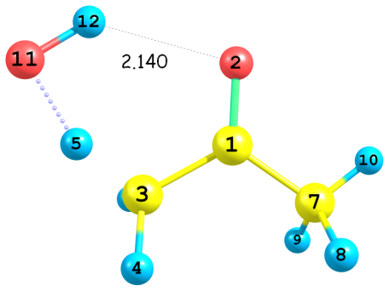
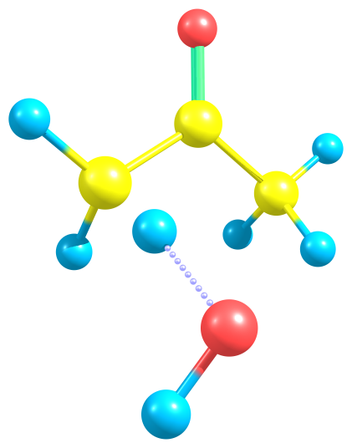
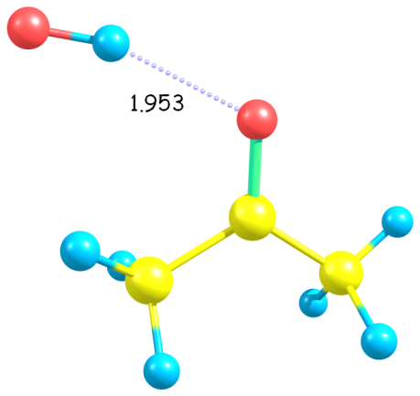
Acetone: α' hydrogen reactivity
TS1a
TS2a
RC1a
25

Slide 26
Acetone: α' hydrogen reactivity
Electron delocalization from π(CO) to σ*(CH_{in}) and σ*(CH_{out}) is different
∆E_{CT} = 2.0 kcal/mol
∆E_{CT} = 0.0 kcal/mol
26

Slide 27
α' hydrogen reactivity in DME
Electron delocalization from oxygen lone pairs to σ*(CH_{out}) weaken the BDE of out-of-plane CH bond by 5.0 kcal/mol.
∆E_{CT} = 4.9 kcal/mol
∆E_{CT} = 1.7 kcal/mol
27

Slide 28
α' Reactivity Compared to Alkanes
Ethers
Oxygen lone pairs accelerate reactivity of α’ hydrogen compared to alkane
Growing size of the α-side has no influence on reactivity of α’ hydrogen atoms
Ketones
α’ H-atom is less reactive than primary H-atom in alkanes
Growing size of the α-side will accelerate reactivity of α’ H-atoms
28

Slide 29
Comparative Reactivity
29

Slide 30
General reaction scheme
High temperature
Fuel
decomposition
H-atom abstraction
Smaller molecules
β-scission
+ O₂
∙
Ṙ
RO₂
+ O₂
Low temperature
olefins,
cyclic ethers,
β-scission
∙
+ O₂
QOOH
Intermediate temperature
30

Slide 31
Low-temperature chemistry

Slide 32
Alcohol Oxidation
Aldehyde formation from α-radical + O₂
32

Slide 33
Alcohol Oxidation
Waddington mechanism (β-radical + O₂)
33

Slide 34
Comparison: Alcohol/Alkane Oxidation
34

Slide 35
Effect of chain length

Slide 36
Alcohol Oxidation
Effect of chain length on influence of functional group
n-Butanol vs n-Butane
n-Pentanol vs n-Pentane
Heufer et al. Proc. Comb. Inst. (2012) in press.
Paper 4D06, Thursday 2nd August
36

Slide 37
Soybean and rapeseed derived biodiesels have only 5 principal components
Fatty acid methyl esters (FAMEs):
Methyl Palmitate (C16:0)
Methyl Stearate (C18:0)
Methyl Oleate (C18:1)
Methyl Linoleate (C18:2)
Methyl Linolenate (C18:3)
Westbrook et al. Proc. Comb. Inst. (2012) in press.
Paper 3D03 Wednesday 1st August
37

Slide 38
Biodiesel components ignite in order of number of double bonds
Engine-like conditions:
13.5 bar
Stoichiometric fuel/air mixtures
Westbrook et al. Proc. Comb. Inst. (2012) in press.
Paper 3D03 Wednesday 1st August
38

Slide 39
C = C double bonds reduce low T reactivity
s s a v v a s s
- C – C – C – C = C – C – C – C -
s s a a s s
Inserting one C=C double bonds changes the reactivity of 4 carbons atoms in the C chain
Allylic C – H bond sites are weaker than most others
Therefore they are preferentially abstracted by radicals
O₂ is also very weakly bound at allylic sites and falls off rapidly, inhibiting low T reactivity
Westbrook et al. Proc. Comb. Inst. (2012) in press.
Paper 3D03 Wednesday 1st August
39

Slide 40
Observed same effect in hydrocarbon fuels: hexenes
Ignition delay times in a rapid compression machine of hexene isomers
(0.86-1.09 MPa, Φ=1):
C = C - C - C - C - C 1-hexene
C - C = C - C - C - C 2-hexene
C - C - C = C - C - C 3-hexene
RO₂ isomerization initiates
low temperature reactivity
Moving the double bond towards the center
of the molecule “inhibits” RO₂ kinetics
Experimental data: Vanhove et al. PCI 2005
Simulations: Mehl, Vanhove, Pitz, Ranzi Combustion and Flame 155 (2008) 756—772.
40

Slide 41
Novel fuels

Slide 42
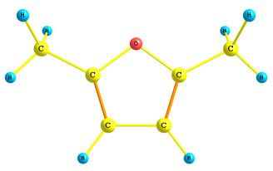
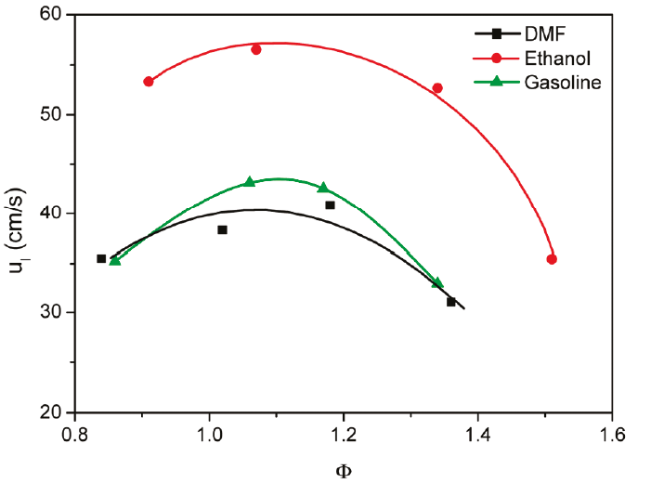
Furans vs bio-ethanol
Promising Next Generation Biofuels
Roman-Leshkov et al., Nature (2007) 447: 982-985. (2nd generation)
Novel renewable production process
Biomass (lignocellulosic) feedstock not destined for human/animal consumption
Highly efficient
Large scale and low cost
Desirable physicochemical properties
Higher energy density (40%)
Direct combustion in unmodified engine
RON = 119
Lower aqueous solubility and less volatile
Laminar Flame Speed Measurements of DMF, Ethanol and Gasoline, Tian et al., Energy Fuels, 2010
Energy Densities:
Gasoline: 35 MJ/L
2,5-DMF: 31 MJ/L
Bio-Ethanol: 23 MJ/L
Session 1: Monday morning: “Kinetics of Cyclic Ethers”
42

Slide 43
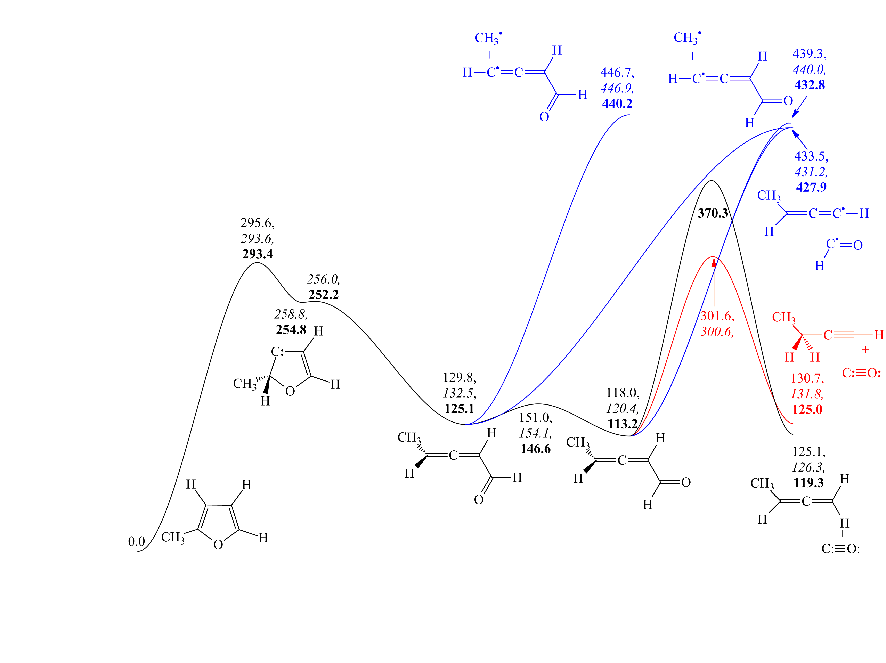
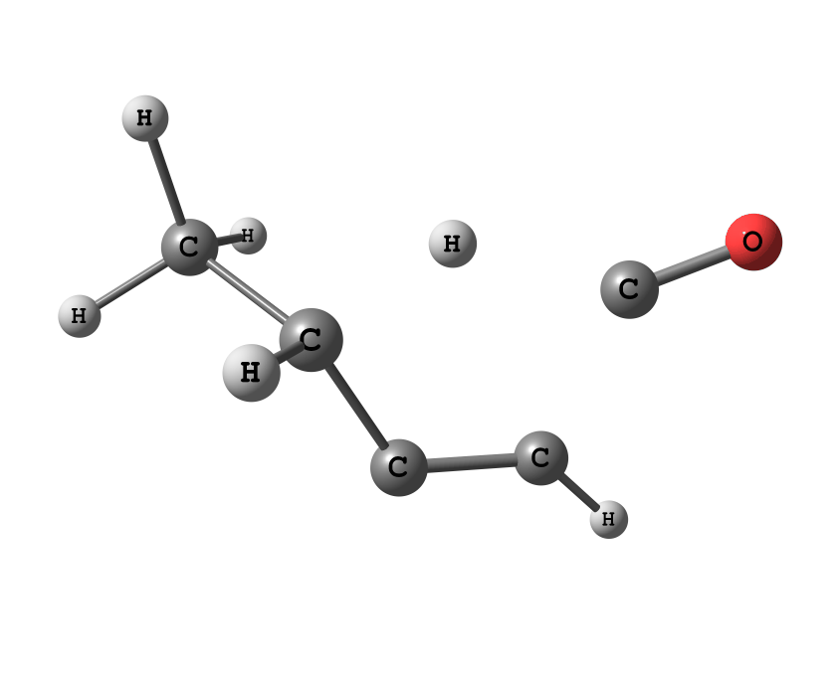
2MF: Unimolecular Decomposition
Energies (0 K, kJ / mol) CBS-QB3, CBS-APNO, G3
Somers et al. Comb. Inst. (2012) in press. Paper1D01 Monday 30th July
43

Slide 44
Conclusions
General chemical reaction schemes of HCs can be applied to oxygenated fuels
Details of oxygenated fuel combustion are quite different!
44

